Slide 1
DevOps Transformation Solution Recommendation
Meeting
Attendees
Business Leaders
Finance
DevOps Sponsor
DevOps Initiator
DevOps Expert
© EngineeringDevOps 2019 This template is available in PowerPoint format on www.EngineeringDevOps.com

Slide 2
Agenda
DevOps Transformation Goals
Summary of Current State
Summary of Solution Requirements
Future-State Value-Stream Map
DevOps Transformation RoadMap
Return-On-Investment
Solution Recommendation Summary
Next Steps

Slide 3
Strategic Goals for the DevOps Transformation
Our product organization shall be the market leader, measured by volume of sales, within three years, through increasing new product release velocity ten times while reducing non-value added costs in the delivery pipeline two times.
WHY? The market for this product category is maturing. Only the top three competitors are expected to survive the next 5 years. Industry trends show the winning companies will the ones with the fastest, most innovative value-stream and lowest price.
At this level the goals are expressed as visionary and qualifiable, but not necessary quantifiable objectives which will have a major impact on the purpose of the organization. These are not technical goals as much as they are business goals. For example, statements about improvements to competitiveness, innovation, customer satisfaction, employee satisfaction would qualify as visionary strategic goals. Technologies expected to accomplish these goals may be included but the emphasis of these goals are on strategic outcomes instead of the means to accomplish them. Usually there are no more than one or two strategic goals because the intent is to have a simply stated, clear, common visionary goal that the entire organization can understand and rally around. Strategic goals do not substitute for tactical goals. It is important to explain WHY this goal was chosen over alternatives considered.
An example strategic goal is shown above:

Slide 4
Definition of DevOps
DevOps is the application of lean practices Continuous Flow, Continuous Feedback and Continuous Improvement to people, process and technology for the benefit of agility, stability, efficiency, quality, security and satisfaction.
DevOps_The_Gray
There is no industry standard definition of DevOps yet it is important for each organization to have a definition the team can accept and rally around. The above definition is suggested. Alternative definitions are also acceptable provided the DevOps Transformation Team accepts a definition for use in the organization.

Slide 5
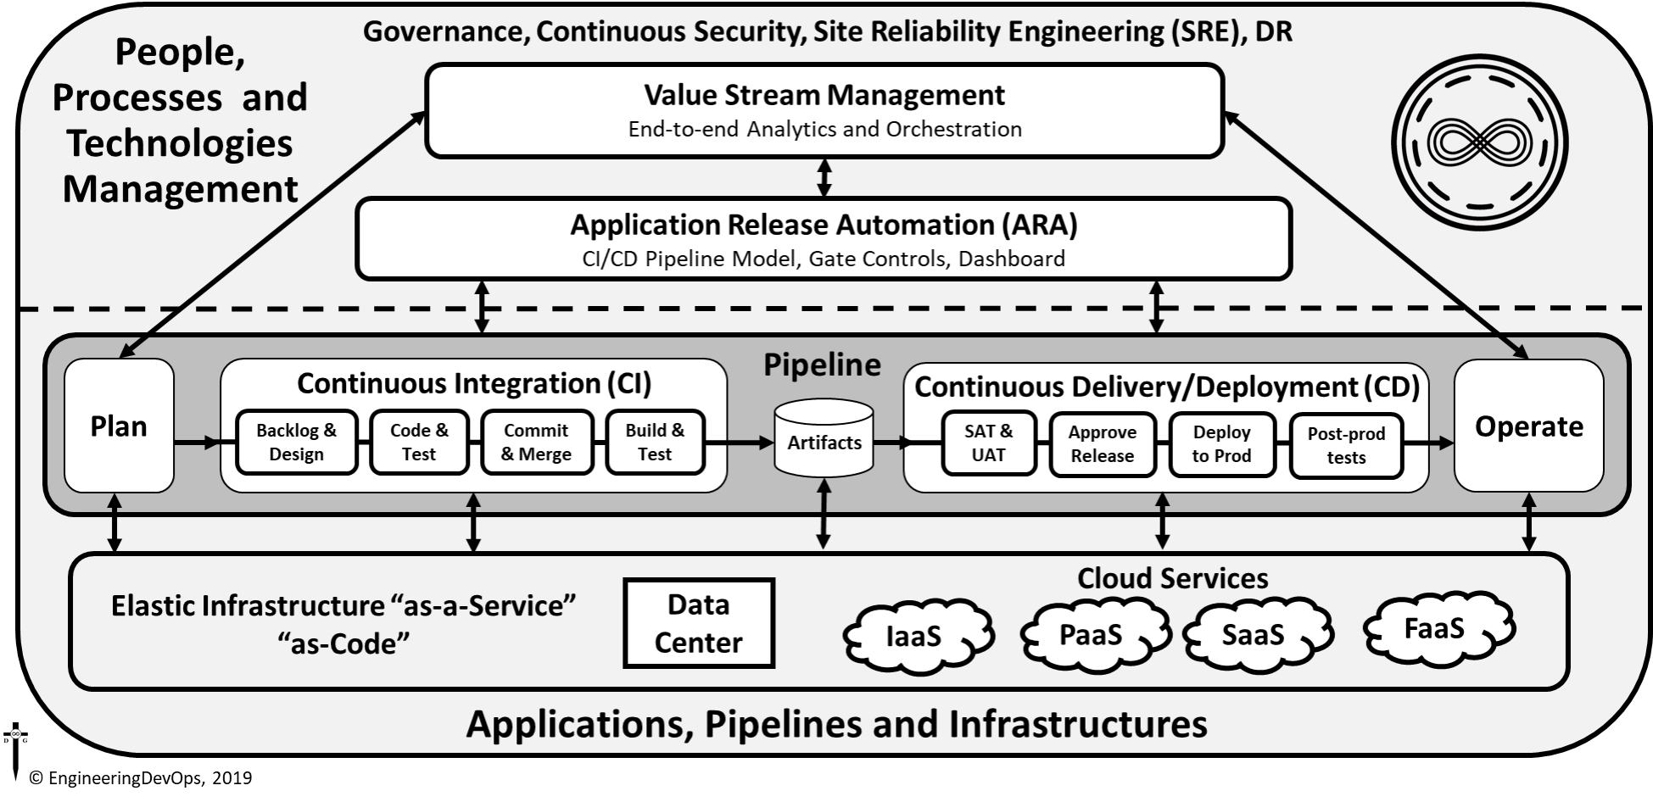


Slide 6
DevOps Transformation Application Selection
The DevOps transformation will apply to the following applications: <name of application(s)>
The <name> application will be used as a model for kicking-off and evaluating changes needed to people, process and technology for the DevOps transformation.
WHY? A DevOps Application Selection Scorecard indicates these application(s) will most likely benefit from the DevOps transformation.

Slide 7
DevOps Transformation Goals Workshop
Calculate
Enter
For each goal enter Unit, Importance (I), Current State, Desired State.
Once all goal data is entered calculate % Improvement, Score and Rank to determine the top goals.
20 goals in six categories: Agility, Stability, Efficiency, Quality, Security, and Satisfaction
© EngineeringDevOps 2019 This template is available in Excel format on www.EngineeringDevOps.com

Slide 8
DevOps Transformation Practices Score Workshop
Enter
Calculate
For each Practice Category enter Importance and Current Level of Practice Score
Once all data is entered calculate a score and rank to determine the top priority practices.
Nine Pillars and 11 Deep-Dive Topics
© EngineeringDevOps 2019 This template is available in Excel format on www.EngineeringDevOps.com

Slide 9
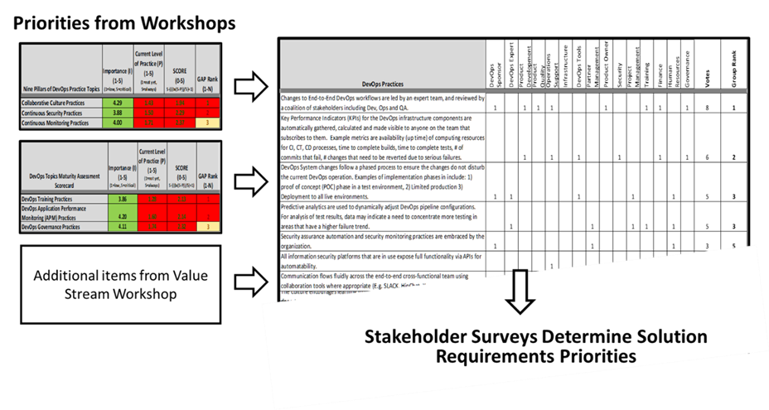
DevOps Solution Requirements

Slide 10
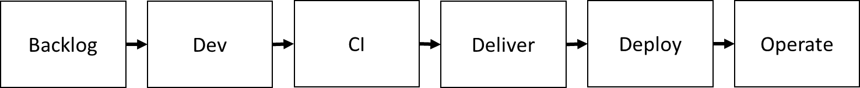

Value Stream Map Future State Example
Automate unit test and use TDD for functional test creation
Automate CI builds, smoke and regression
Automate release acceptance tests
Automate CAB approvals using ARA
Ops stage tests, monitor,
Rework
3h
14h
4h
4h
4h
20h
4h/1h
-10
62h/48h
-10
10h/6h
-10
10h/6h
8h/4h
80h/60h
80%
75%
80%
80%
70%
3h
-14
2h
-6
2h
-14
2h
-6
6h
Wait for code and test resources
Orchestrate CI build and test infra
Orchestrate
Staging infra and use containers
Orchestrate deployment infra and containers
Orchestrate deployments with containers
© EngineeringDevOps, 2019
Notes:
Key concepts:
This chart simply provides hints. Again there are many possible answers. Some may be better than others but may be hard to judge given the assumptions.

Slide 11
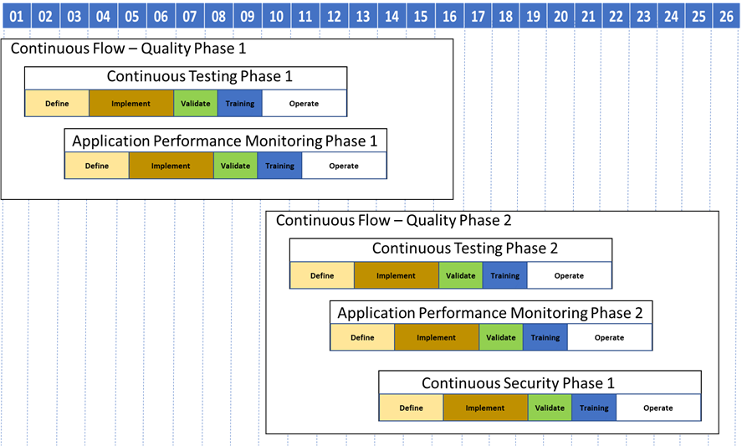
DevOps Transformation Roadmap

Slide 12
DevOps Transformation Return On Investment
Theme | Epic | Costs $K 3 years | Savings $K 3 years | ROI Ratio | Payback Months
DevOps Phase 1 | Continuous Testing 1 | 500 | 7,500 | 15 | 7
 | Monitoring 1 | 350 | 6,300 | 18 | 7
DevOps Phase 2 | Continuous Testing 2 | 300 | 6,000 | 20 | 5
 | Monitoring 2 | 250 | 3,750 | 15 | 7
 | Security 1 | 400 | 8,800 | 22 | 8
TOTAL | ALL | 1,800 | 32,350 | 18 | 7
Assumptions:
3 Years amortization
8 Applications
Primary source of Savings:
1) Automation of test phases
2) Bottlenecks removed in the value stream provided by improved visibility
3) Reduction of Non-Value-Added work
Risks if not approved:
1) 18 releases will be delayed.
2) Security risks

Slide 13
DevOps Solution Recommendation Summary
The DevOps Solution recommended meets the strategic goals
ROI and payback period is sufficient to justify the projects
Approval is requested for the DevOps Solution Recommendation

Slide 14
Next Step Actions towards Realizing the DevOps Transformation
Action | Date | Responsible
Schedule date to reply to actions | MM/DD/YYYY | Initiator
Schedule dates for approvals of Epics | MM/DD/YYYY | Initiator
Assign Backlog | MM/DD/YYYY | Initiator
Set dates for follow-up with business leaders | MM/DD/YYYY | Initiator

