Slide 1
DevOps Transformation Visioning Meeting
Attendees
DevOps Sponsor
DevOps Initiator
DevOps Expert
© EngineeringDevOps 2019 This template is available in PowerPoint format on www.EngineeringDevops.com

Slide 2
Strategic Goals for the DevOps Transformation
At this level the goals are expressed as visionary and qualifiable, but not necessary quantifiable objectives which will have a major impact on the purpose of the organization. These are not technical goals as much as they are business goals. For example, statements about improvements to competitiveness, innovation, customer satisfaction, employee satisfaction would qualify as visionary strategic goals. Technologies expected to accomplish these goals may be included but the emphasis of these goals are on strategic outcomes instead of the means to accomplish them. Usually there are no more than one or two strategic goals because the intent is to have a simply stated, clear, common visionary goal that the entire organization can understand and rally around. Strategic goals do not substitute for tactical goals. It is important to explain WHY this goal was chosen over alternatives considered.
An example strategic goal is shown below:
Our product organization shall be the market leader, measured by volume of sales, within three years, through increasing new product release velocity ten times while reducing non-value added costs in the delivery pipeline two times.
WHY? The market for this product category is maturing. Only the top three competitors are expected to survive the next 5 years. Industry trends show the winning companies will the ones with the fastest, most innovative value-stream and lowest price.

Slide 3
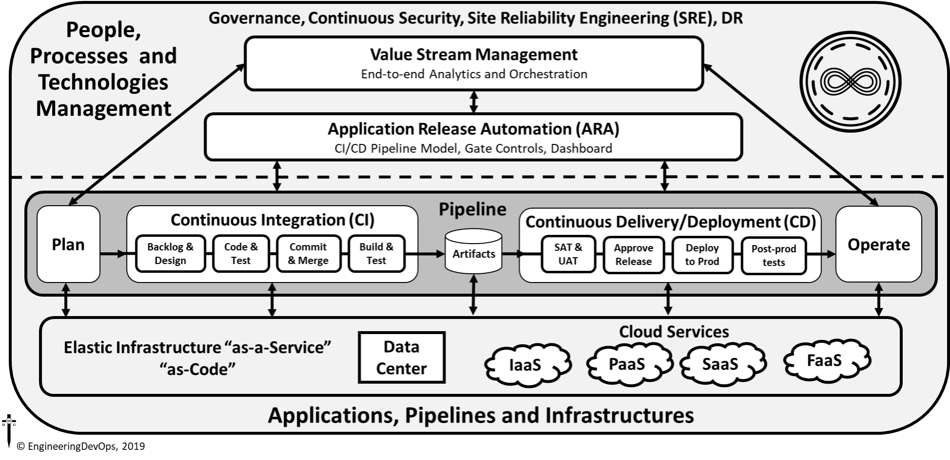

Slide 4
DevOps Transformation Application Selection
The DevOps transformation will apply to the following applications: <name of application(s)>
The <name> application will be used as a model for kicking-off and evaluating changes needed to people, process and technology for the DevOps transformation.
WHY? A DevOps Application Selection Scorecard indicates these application(s) will most likely benefit from the DevOps transformation.

Slide 5
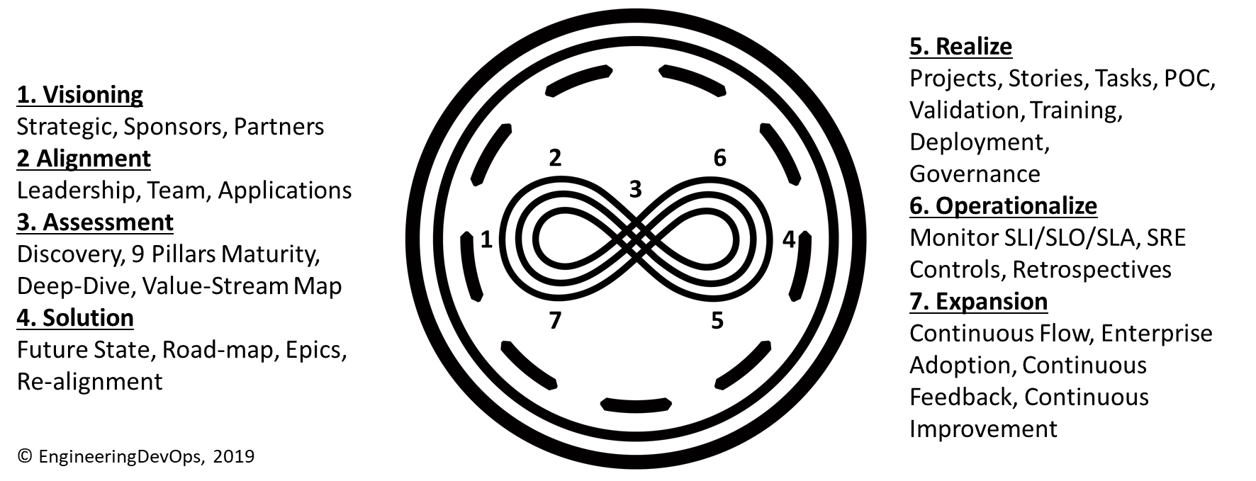
DevOps Seven-Step Transformation Engineering Blueprint

Slide 6
DevOps Transformation Team Leaders
Name | Role/Responsibility
 | DevOps Transformation Sponsor
 | DevOps Expert
 | Product Development
 | Product Quality Assurance
 | Operations Support
 | Infrastructure
 | DevOps Tools
 | Partner Management
 | Product Owner
 | Security
 | Project Management
 | Training
 | Finance
 | Human Resources
 | Governance
Identify strategic level leaders and partners that cover the cross-section of organization functions that are most relevant to the DevOps transformation. For example, strategic leaders with responsibility over roles from Development, Quality Assurance, Operations, Infrastructure, DevOps Tools, 3rd party suppliers, Product Owners, Security, Project Management, Training, Finance, Human Resources and Governance should be considered, depending on the extent to which each of the roles are likely to be affected by the transformation.

Slide 7
Next Step Actions towards Alignment
Action | Date | Responsible
Engage DevOps Expert | MM/DD/YYYY | DevOps Sponsor
Communicate membership, strategic goals and kick-off meeting schedule to the DevOps Transformation Team | MM/DD/YYYY | DevOps Sponsor
Prepare DevOps Transformation Alignment Kick-off Meeting | MM/DD/YYYY | DevOps Initiator

