Slide 1
DevOps Engineering Blueprint
Governance, Continuous Security, Site Reliability Engineering (SRE)
DevOps
Engineering
Blueprint
Value Stream Management
End-to-end Analytics and Orchestration
Application Release Automation (ARA)
CI/CD Pipeline Model, Gate Controls, Dashboard
Pipeline
Plan
Continuous Integration (CI)
Continuous Delivery/Deployment (CD)
Operate
Backlog & Design
Code & Test
Commit & Merge
Build & Test
Artifacts
SAT & UAT
Approve Release
Deploy to Prod
Post-prod tests
Cloud Services
Elastic Infrastructure “as-a-Service”
“as-Code”
Data Center
FaaS
IaaS
PaaS
SaaS

Slide 2
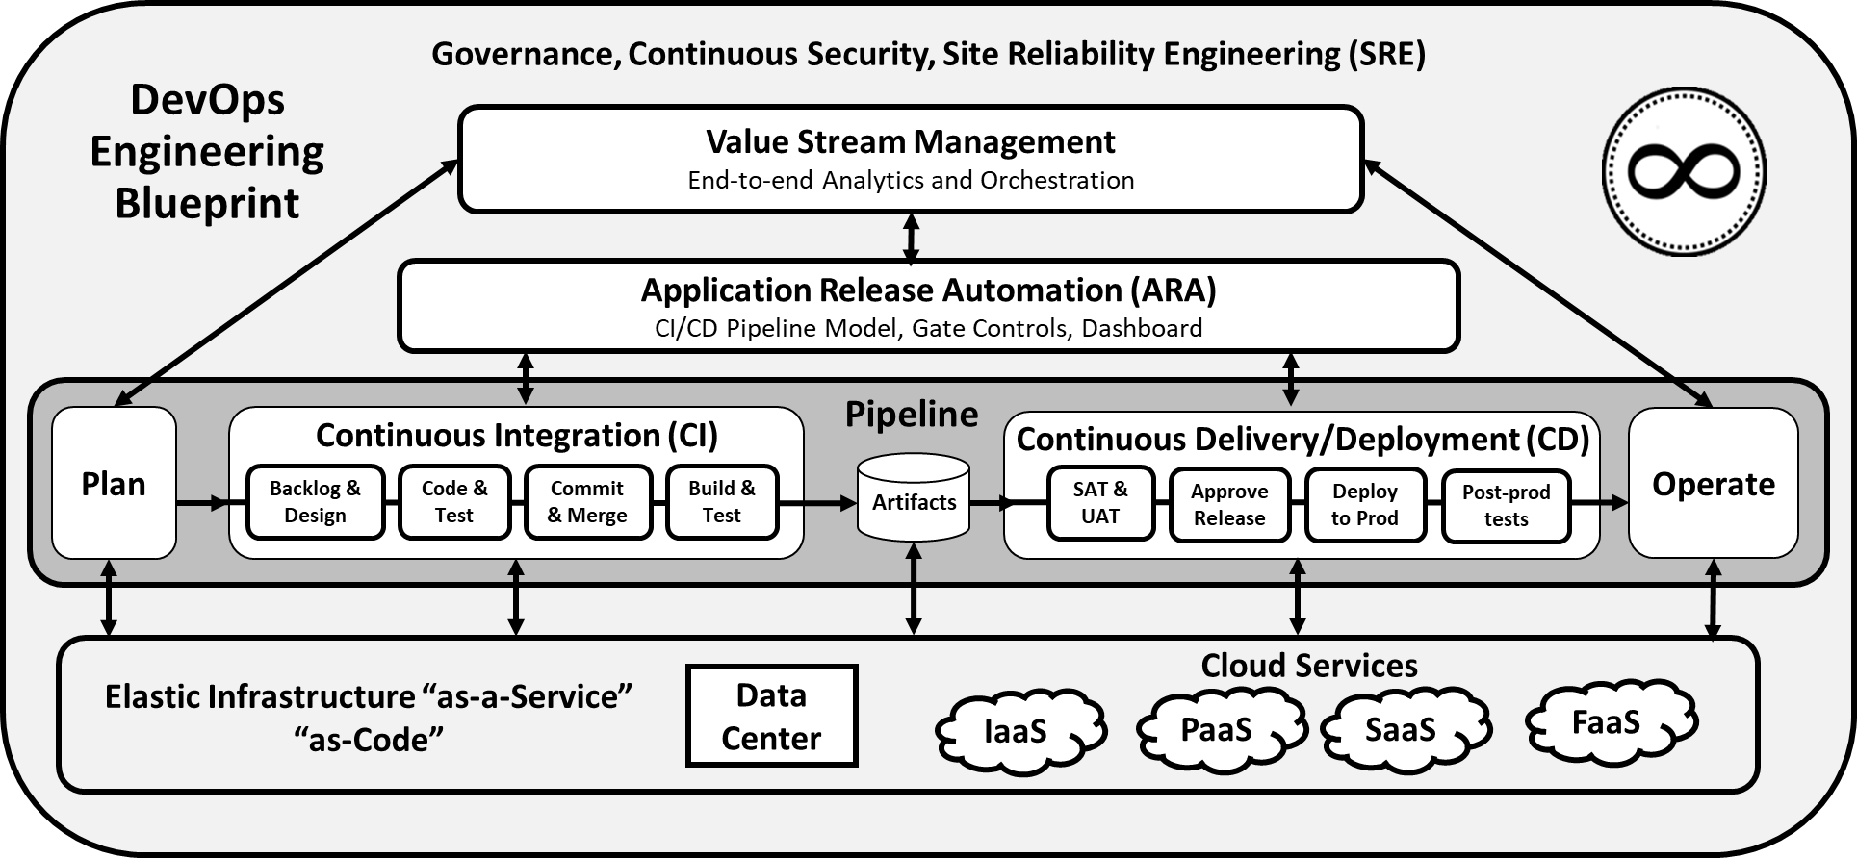
© Confinity Consulting, 2019

