Slide 1
Engineering DevOps Blueprints
These blueprints in this PowerPoint may be reproduced, and used or modified by anyone, however it is required that when they are the following statement appears on the page:
* Used by permission of EngineeringDevOps.com *
www.EngineeringDevOps.com

Slide 2
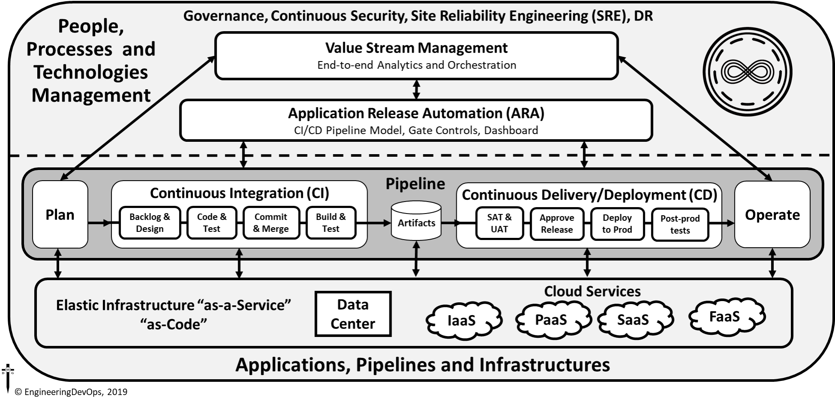
DevOps Engineering Blueprint

Slide 3
DevOps CI/CD Pipeline
Value Stream Management and Application Release Automation
Pipeline
Plan
Continuous Integration (CI)
Continuous Delivery/Deployment (CD)
Operate
Backlog & Design
Code & Test
Commit & Merge
Build & Test
Artifacts
SAT & UAT
Approve Release
Deploy to Prod
Post-prod tests
© EngineeringDevOps, 2019
Elastic Infrastructure

Slide 4
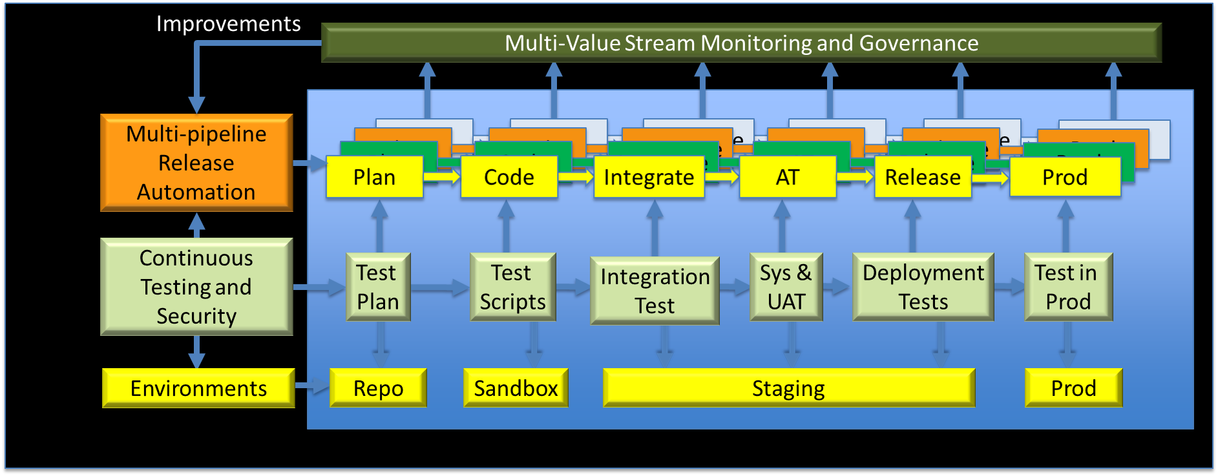
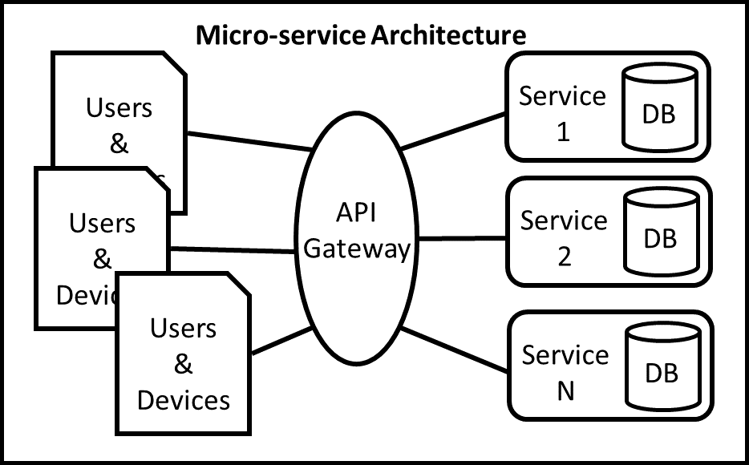
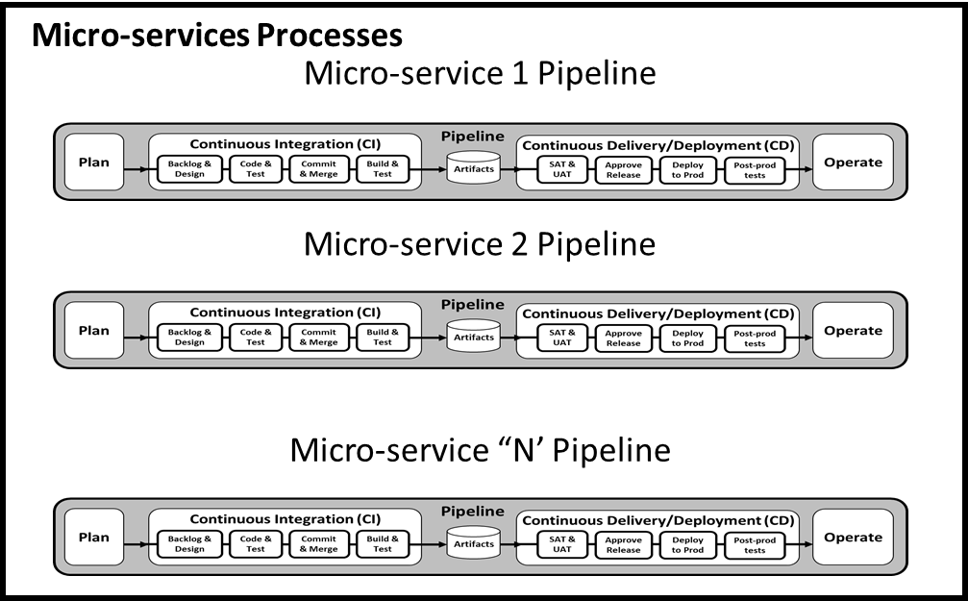
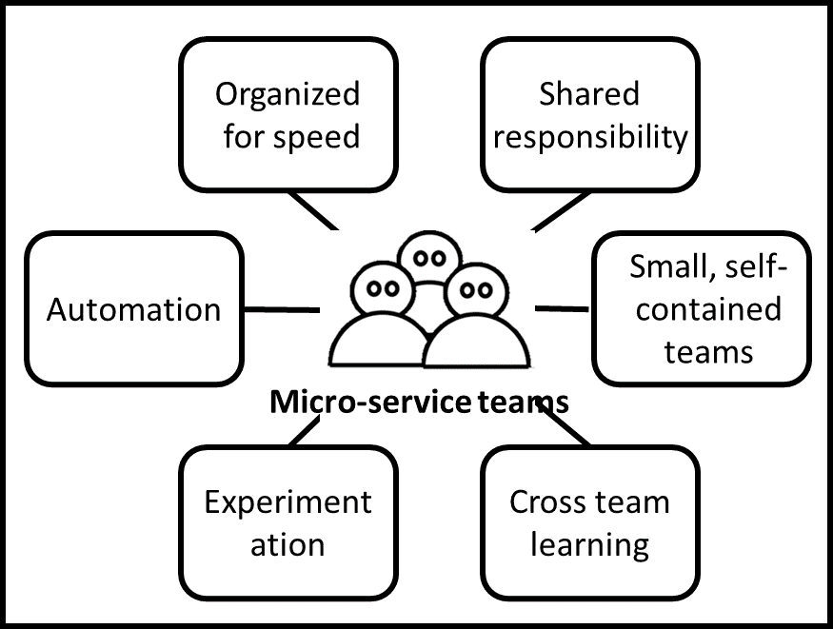
CI/CD for Microservices Pipelines
© EngineeringDevOps, 2019

Slide 5
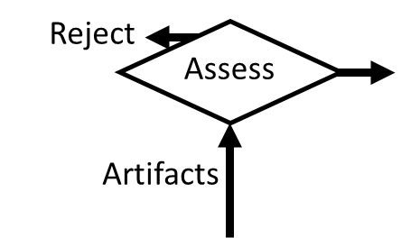
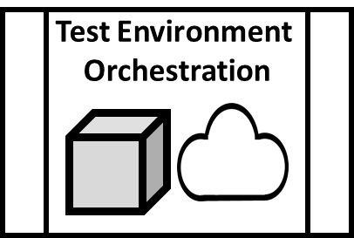
Continuous Testing Blueprint
Dev
Stage
Integration
Stage
Pre-Prod
Stage
Production
Stage
© EngineeringDevOps, 2019

Slide 6
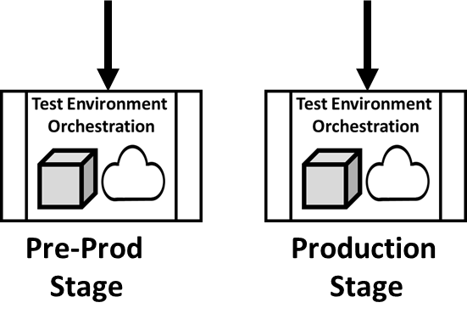
Continuous Delivery and Deployment Engineering Blueprint
Acceptance Testing
System Acceptance
User Acceptance
Release Approval
CAB automation
Policy-as-code
Deploy to Prod
Green/Blue
Dark Launch
Post-Prod Tests
A/B
Canary
Continuous Delivery/Deployment (CD)
Artifacts
SAT & UAT
Approve Release
Deploy to Prod
Post-prod tests
Operate
© EngineeringDevOps, 2019

Slide 7
Continuous Monitoring Engineering Blueprint
Intelligence
Synthetics
Analytics
Dashboards
Alerts
Continuous Monitoring
Decision Layer
© EngineeringDevOps, 2019
Continuous
Monitoring
Aggregation Layer
People
Applications
Pipeline
Infrastructure
Continuous
Monitoring
Data Layer

Slide 8
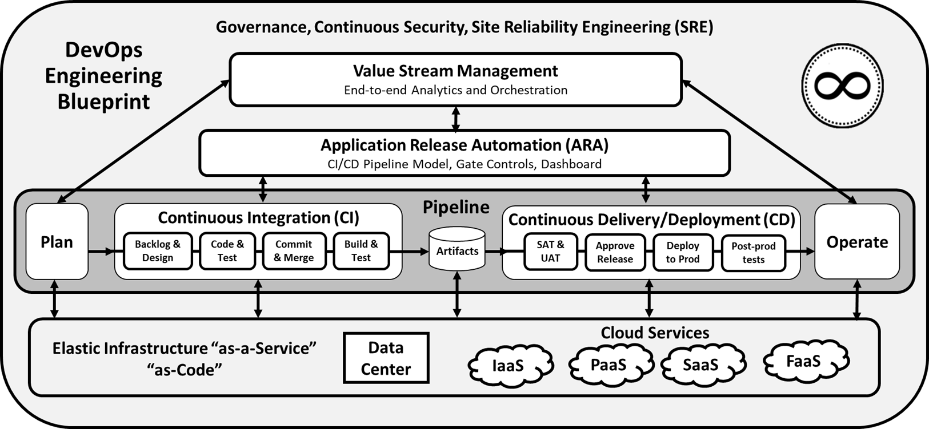
Continuous Security Blueprint
Planning
Security requirements from business functionality, Security user stories in backlog
Tools: Cyberplanner, Service Now, Jira
VSM
End-to-end value stream security governance-policies-as-code, analytics
Tools: Plutora
ARA
Pipeline entry/exit gate policies as code, release dashboard
Tools: CloudBees & ElectricFlow
Infrastructure
Infrastructure-as-Code, network security, access security
Tools: F5, Nagios, ZenMap, CyberArk, Vault, Identity Finder
Post-prod tests
Secrets Management, Authorization and logging, Repeatable Execution
Tools: CyberArk, Vault,
Design
Threat Modeling, Secure by Default Designs (security services, frameworks), Opensource scanning
Tools: Continuum Security, ThreatModeler, Blackduck
Operate
Chaos Engineering, Social engineering attacks, in-operation vulnerability scans
Tools: Chaos Monkey, F5, Immunio, Retina, SET
Code & Test
Development Standards, Peer Review, Static Code Analysis, Unit Tests, Software supply chain, Data masking, Web code scanning
Tools: Veracode, MSSQL Data Mask, Probely, Blackduck
Deploy to Prod
Secrets Management, Dark launches, Penetration testing, SQL discovery, DB encryption
Tools: LaunchDarkly, SQLRECON, DbDefence, CyberArk, Vault, Metasploit
Commit & Merge
Version management role-based access, Validate pre-flight security results were done in pipeline prior to code commit
Tools: Git, Datical, DBMaestro, AppDetectivePRO
Build & Test
Dynamic Security Testing, Containers security , SQL Fault injection, dependencies
Tools: Contrast, Veracode, Aqua Security, BSQL Hacker, Dependency-check, Twistlock
Artifacts
Deliverable image scanning, white lists and black lists
Tools: XRay
SAT & UAT
Test automation, Web vulnerability testing
Tools: Gauntlt, Acunetix
Approve Release
Validate release meets all security policies
Tools: CloudBees & ElectricFlow
© EngineeringDevOps, 2019

Slide 9
Nine Pillars of
DevOps
© EngineeringDevOps, 2019
Value Stream Management
Application Release Automation
Continuous Delivery CI/CD Pipeline
Leadership
Collaborative Culture
Design for DevOps
Continuous Integration
Continuous Testing
Elastic Infrastructure
Continuous Monitoring
Continuous Security
Continuous Delivery
Orchestration and Automation
Governance

Slide 10
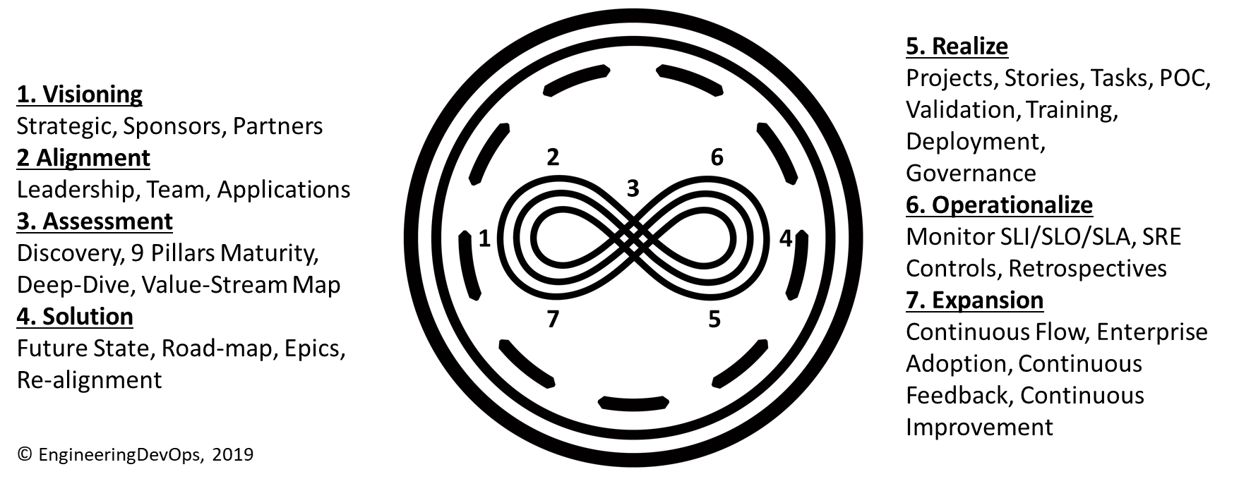
DevOps Seven-Step Transformation Engineering Blueprint

Slide 11
Site Reliability Engineering (SRE) Blueprint
SRE
Response automation
Post mortems
Monitor events, alerts
Capacity Planning
Focus: Reliability
Use Cases
Report on issues
System Diagnostics
Track SLA/SLOs
Identify optimizations
Ensure reliable releases
SLAs/SLOs
End-user availability
Latency
Error rate
End-user response time
Correctness
Dev
Release automation
Environment builds
Config Management
Infra—as-code
Focus: Delivery Speed
SLIs
Number of incidents
MTTR
MTBF
Deploy frequency
Revenue
© EngineeringDevOps, 2019

Slide 12
Application Release Automation (ARA) Engineering Blueprint
Value Stream Management, Governance, Security
Application Release Automation (ARA)
CI/CD Pipeline Model, CI/CD Gate Controls, CI/CD Metrics Dashboard
Stories
-
Tasks
-
Docs
Static Analysis
-
Unit tests
-
Test cases
Build results
-
Test Results
Release candidate
-
Image scans
System & User Test Results
Quality metrics
-
Deploy scripts
Deploy test results
© EngineeringDevOps, 2019
Gate criterion examples

Slide 13
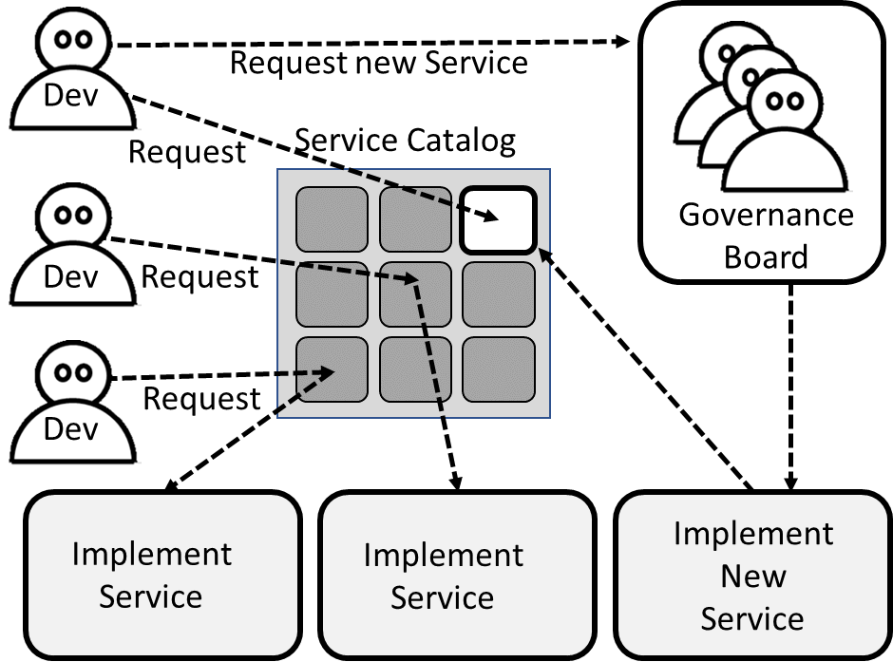
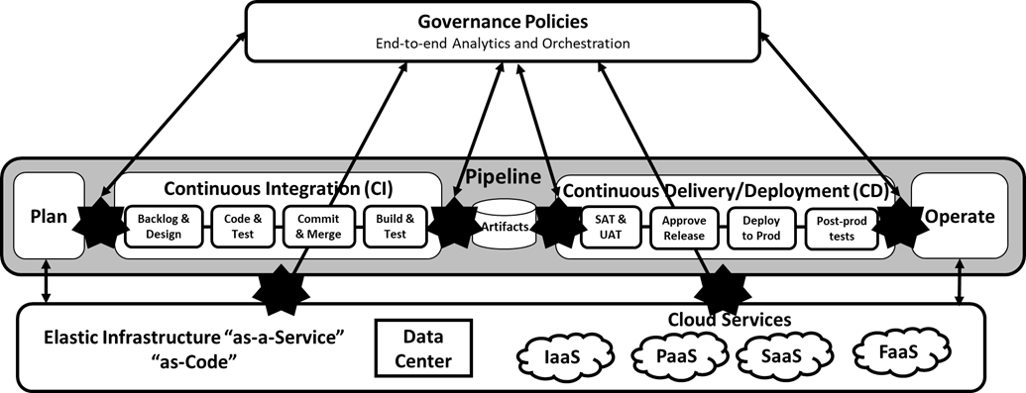
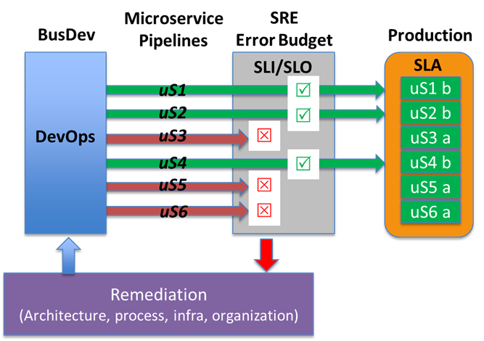
DevOps Governance Engineering Blueprint
Team Governance
Pipeline Governance
Site Governance
+
+
Continuous Flow
(DevOps First Way)
Continuous Feedback
(DevOps 2nd Way)
Continuous Improvement
(DevOps 3rd Way)
© EngineeringDevOps, 2019

Slide 14
DevOps VSM Engineering Blueprint
© EngineeringDevOps, 2019
Governance, Continuous Security, Site Reliability Engineering (SRE)
Value Stream Management
End-to-end Analytics and Orchestration

Slide 15
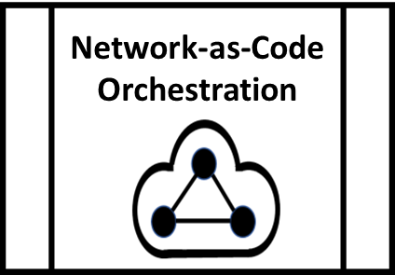
NetDevOps Blueprint
Network Planning
Network Code, Build, Test, & Commit
Network Images
Pre-Prod (in-Lab) testing
Deploy to Live Network
Live NetOps
Dev
Stage
Integration
Stage
Pre-Prod
Stage
Live Production
Stage
© EngineeringDevOps, 2019

Slide 16
Value Stream Map Template
Process Steps (5 to 15 steps ideal)
LT/PT
LT/PT
LT/PT
LT/PT
LT/PT
LT/PT
%C/A
%C/A
%C/A
%C/A
%C/A
NVT
NVT
NVT
NVT
NVT
LT/PT: Value Added Time (Lead Time/Process Time)
NVT: Non-Value Added Time (e.g. Wait time)
%C/A: % of time process can use results of prior stage without rework
© EngineeringDevOps, 2019
Notes:
Key concepts
Value stream mapping is not the only method for analyzing tool chains, but it is most recommended because it is a well proven method derives from successful lean manufacturing.
A CDA is advised to become familiar with, and promote the use of, value stream mapping.

