Slide 1
DevOps Engineering Value Stream Mapping Workshop (Current-State)
© Engineering DevOps 2019 This template is available in PowerPoint format on www.EngineeringDevOps.com

Slide 2
DevOps Engineering Value Stream Mapping Workshop
(Current State)
This interactive workshop creates a current state value-stream map for the Application.
The value selected for analysis in this workshop is determined by the DevOps Leadership Team .
Factors affecting the selection of value stream:
Application selected by the DevOps Transformation Leadership Team
DevOps Goal priorities
DevOps Practices Gap Rank
The output of this workshop is a key input to the Solution stage of the DevOps Transformation Blueprint.

Slide 3
DevOps Engineering Value Stream Mapping Workshop
Step 1 – Select the Value and the Measurements
The DevOps Transformation Leadership team selects the Value or Values to be analyzed by Value-Stream Analysis, and the measurement to be used for the analysis of the selected Value Streams for the Application
Example:
Value 1: Lead time: measured as the duration from the time a task is assigned in the backlog until the code is delivered, assuming not errors that require remediation.
Value 2: Quality: measured as the % of changes integrated into trunk that do not require rework at the deployment stage.

Slide 4
DevOps Engineering Value Stream Mapping Workshop
Step 2: Determine the Pipeline Stages relevant to the Values Selected for Analysis
To qualify as a stage:
Activities is relevant to the affecting the value being analyzed
Quantifiable input criterion can be defined
Quantifiable output criterion can be defined

Slide 5
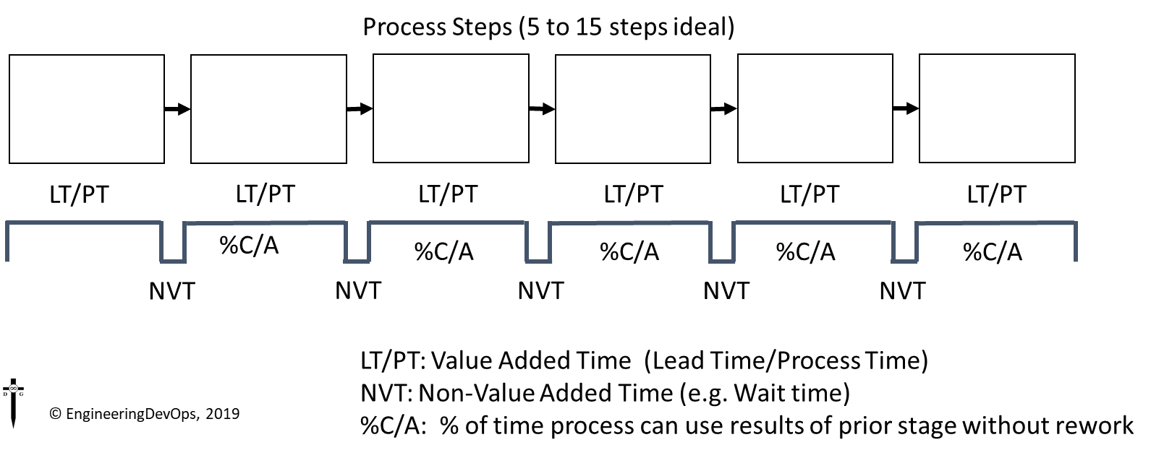
DevOps Engineering Value Stream Mapping Workshop
Step 3: Determine the measurements that will be used.
Example measurements:
Lead Time and Process time for each stage
NVT wait time between stages
% of time next stage can use inputs without requesting rework

Slide 6
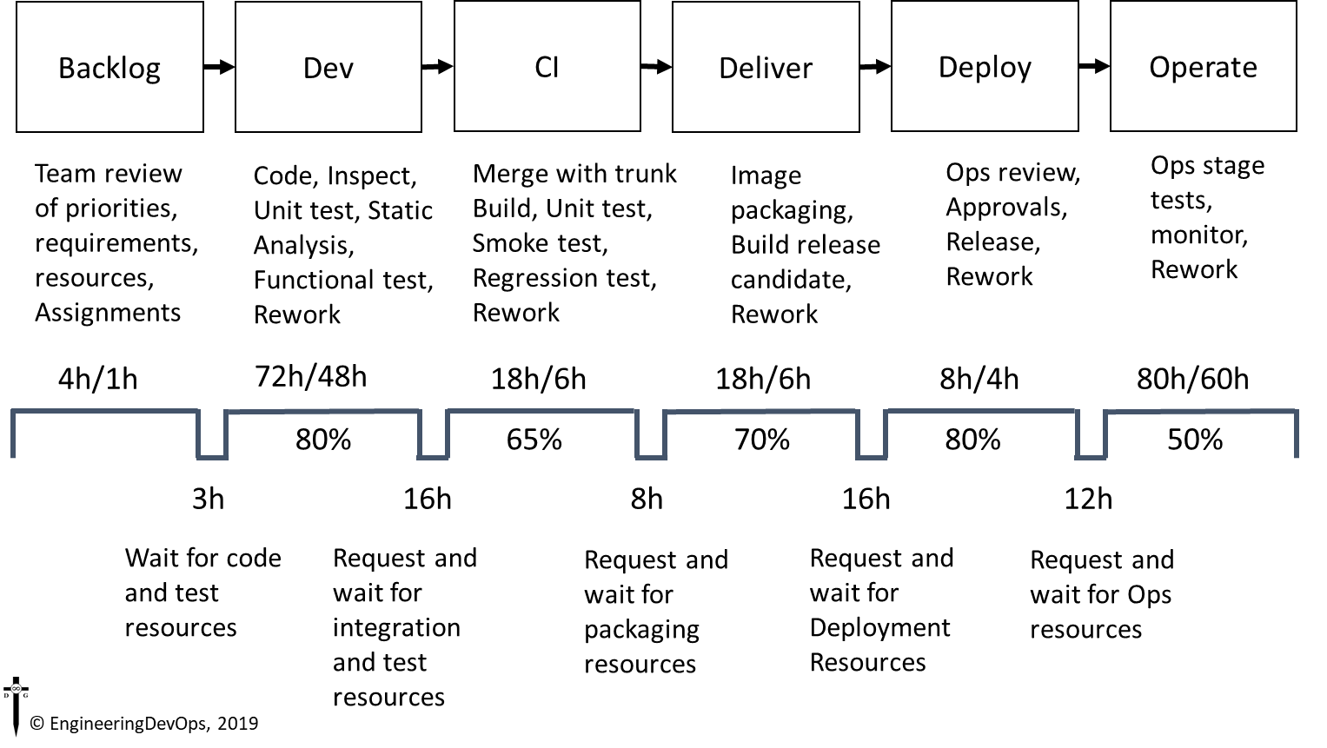
DevOps Engineering Value Stream Mapping Workshop
Step 4: Enter Activities and Values

