Slide 1
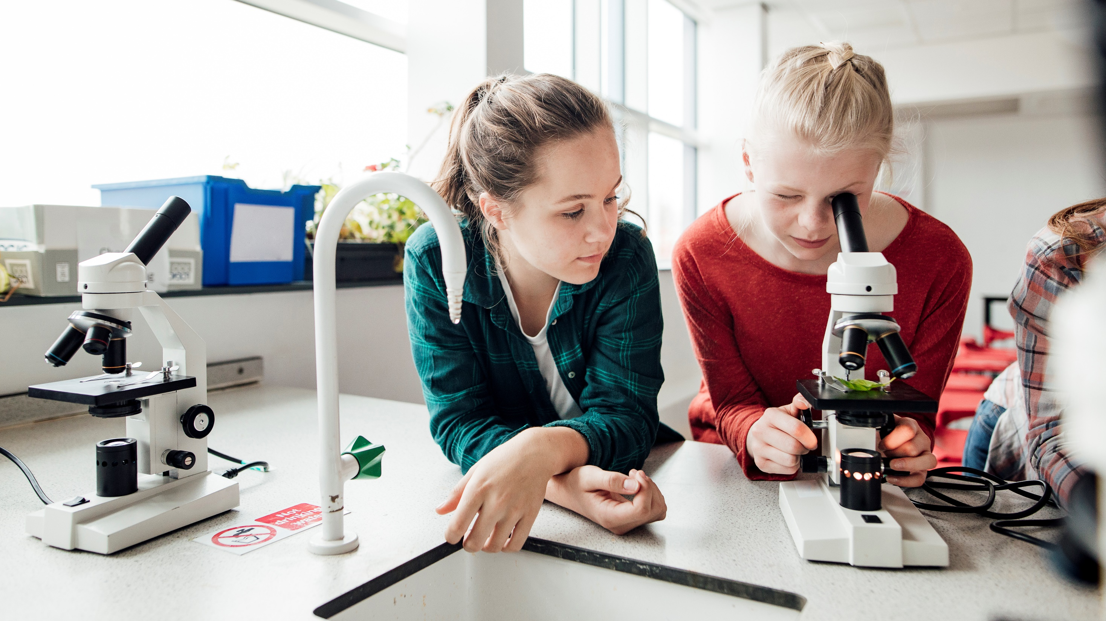
Eagles KINDERGARTEN Level Program – The alternate path to first grade

Slide 2
Introduction

Slide 3
agenda
Why Enroll your Child in the Eagles Program
Our program director/teacher
Program Eligibility
Program Goals
Curriculum Overview
Conferences and Assessments
Daily Schedule
Policies and guidelines

Slide 4
Why Enroll your child in the eagles program?
Low Ratio with maximum of 16 children enrolled
Because of the low ratio, children get significant one on one time
Curriculum and class structure based on best practices and not administrative dictate
Taught by a highly experienced, professional teacher with over 20 years of kindergarten experience
Students receive a full lunch and 2 recess periods every day
All class days are full days (instead of multiple early release days in public schools). Also, our calendar has more learning days than the public schools
Extended care available from 6:30 am to 5:30 pm at a minimal cost
DES Childcare subsidies are accepted with minimal additional payments

Slide 5
Ann Zammit, Kindergarten program director/teacher
Certified teacher that has been teaching for over 30 years
Over 20 years of teaching kindergarten
Masters Degree in curriculum development; bachelors in elementary education and associates in early childhood education
Developed this program based on what works and not by administrative dictate
Always available for the children and parents (all parents have her cell phone with daily availability to discuss their child)

Slide 6
Program goals
Provide families with another choice for child's first formal education experience
Smaller class sizes conducive to a superior learning environment with more one-on-one attention given to the children
Lessons will be flexible in order to adapt to each child’s unique learning style – assuring readiness to achieve first grade standards upon completion of their Eagles experience

Slide 7
Eligibility
Children who are 5 years old as of 10/01/22 are eligible to attend our program. In addition, Children who turn 5 between 10/1/22-10/31/22 may be evaluated by our program director to determine readiness/eligibility

Slide 8
Curriculum Overview
All curriculum for this program is aligned in accordance to Arizona state standards for Kindergarten, and inclusive of First Grade standards in the areas of Language arts and math
At Mind and Body Kids each child will be met at their own level both academically and socially. Lessons will be flexible in order to adapt to fit each child’s unique learning style assuring readiness to meet or exceed first grade state standards upon completion of the program.

Slide 9
Curriculum Overview
Math: Saxon Math
Material is introduced in easily understandable pieces, allowing students to grasp one facet of a concept before the next one is introduced. Both facets are then practiced together until another one is introduced. This feature is combined with continual review in every lesson throughout the year. Topics are never dropped but are increased in complexity and practiced every day, providing the time required for concepts to become totally familiar.
Phonic and Reading: Primary Phonics
Systematic, phonics-based early reading program. Primary Phonics facilitates individualized instruction through flexible, skills-based workbooks and storybooks that correspond to students’ ability levels. Students are able to work at their own pace and progress from simple to complex phonic elements to become successful readers. Students apply phonic knowledge from the workbooks to read decodable storybooks and then demonstrate comprehension using the Comprehension Workbooks.
Handwriting /Writing: Spectrum K and HMH
Consists of Writing upper and lower case manuscript letters to communicate ideas. Separating simple words into their syllables, writing frequently used words. Using a combination of drawing, and writing to craft texts with different purposes.

Slide 10
Curriculum Overview
Grammar: Scholastic
Learn about the different sentence types, parts of speech, common and proper nouns, contractions, tenses, subject and verb agreement, capitalization and punctuation.
Spelling: Evan-Moor Spelling Skills Grade 1
Building Spelling Skills series, students conquer weekly grade appropriate spelling lists through practice exercises that incorporate all the spelling essentials. Through puzzles, mixed up words, sorting and fill-in activities, students will master the word lists. Weekly spelling test and dictation sentences will start in January

Slide 11
Curriculum Overview
Science: Kinder Science
Kinder Science encourages a daily routine, each lesson the students will partake in a quick lesson opener, skill lesson, and each day the students will take part in an experiment or experiment follow-up. There are five units all correlated to Arizona State standards.
Unit one: Life Science
Unit two: Earth Science
Unit Three: Physical Science
Unit Four: Space and Simple Machines
Unit Five: Five Senses

Slide 12
Curriculum Overview
Social Studies
Students will be introduced to civics, geography, economics, and history. They also will understand their roles and responsibilities as citizens within their own community. Students will learn about their own culture and how it impacts the understanding of oneself and others and be introduced to aspects of our national culture.
Importance of rules and responsibilities
Individual roles in a community
Personal decision-making
Familiarity with geographic models
Culture in the home, school, and community
American symbols, holidays, and traditions
Character Education

Slide 13
Curriculum Overview
Other areas covered
In addition to the general curriculum, your children will also be exposed to:
Health and Hygiene
Art
Conflict Resolution

Slide 14
Conferences and assessments
Conferences
Two Times per year
November: Parent/Teacher Conference
March: Student/Teacher guided Conference

Slide 15
Conferences and assessments
Assessments
Starfall
Areas of Assessment
Math
Phonics
Reading Fluency
Reading Comprehension

Slide 16
Conferences and assessments
Assessment Milestones
Entry Assessment
Establishes a baseline for each child, and will be administered during the first two weeks of the school year.
Students will be periodically reassessed in any area not mastered on the entry assessment before administering the mid-year assessment.
Students who master all areas of the entry assessment will be given the mid- year assessment at the beginning of the school year
Mid-Year Assessment
The mid-year assessment is extremely valuable. It allows the teacher to determine which children are on or above grade level, and which children need academic interventions. For children needing review and reinforcement, small groups and one-on-one instruction will be given.
Exit Assessment
The end of the year assessment completes the Starfall assessment year. This assessment helps to evaluate my instruction, and provides data regarding the students understanding of the curriculum

Slide 17
Conferences and assessments
Assessment Types
Summative Assessments
Summative Assessments are conducted each week during Learning Centers each Friday. These assessments provide ongoing evaluations of the skills and concepts presented during the unit. The Summative Assessments are directly related to the standards.
Formative Assessments
Formative assessments are included at the end of each lesson. The goal of the formative assessment is to monitor children’s learning and to provide ongoing feedback. More specifically, formative assessments target areas that need additional practice, and help the teacher recognize areas in which children are struggling, and address those areas immediately

Slide 18
Daily Schedule
Daily Schedule 2022-23 School year Eagles Room | Monday | Tuesday | Wednesday | Thursday | Friday
8:00-8:30 | Breakfast Student Choice Activity Pledge | Breakfast Student Choice Activity Pledge | Breakfast Student Choice Activity Pledge | Breakfast Student Choice Activity Pledge | Breakfast Student Choice Activity Pledge
8:30- 9:00 | Phonic/Spelling | Phonic/Spelling | Phonic/Spelling | Phonic/Spelling | Phonic/Spelling
9:00-10:00 | *Penmanship *Grammar *Reading (Whole Group) | *Penmanship *Grammar *Reading (Whole Group) | *Penmanship *Grammar *Reading (Whole Group) | *Penmanship *Grammar *Reading (Whole Group) | *Penmanship *Grammar *Reading (Whole Group)
10:00-10:30 | Snack/Recess | Snack/Recess | Snack/Recess | Snack/Recess | Snack/Recess
10:30-11:30 | *Writing (Whole Class) *Reading/Groups *Center Practice Phonic/ spelling, Grammar/ Writing. | *Writing (Whole Class) *Reading/Groups *Center Practice Phonic/ spelling, Grammar/Writing. | *Writing (Whole Class) *Reading/Groups *Center Practice Phonic/ spelling, Grammar/Writing | . *Writing (Whole Class) *Reading/Groups *Center Practice Phonic/ spelling, Grammar/Writing | Writing (Whole Class) *Reading/Groups *Center Practice Phonic/ spelling, Grammar/Writing
11:30-12:00 | Group meeting Morning review | Group meeting Morning review | Group meeting Morning review | Group meeting Morning review | Group meeting Morning review
12:00-12:15 | Ready for lunch hand washing | Ready for lunch hand washing | Ready for lunch hand washing | Ready for lunch hand washing | Ready for lunch hand washing
12:15-1:00 | Lunch/Recess | Lunch/Recess | Lunch/Recess | Lunch/Recess | Lunch/Recess
1:00-2:00 | Math meeting Saxon math (Whole Group) & (small Group) | Math meeting Saxon math (Whole Group) & (small Group) | Math meeting Saxon math (Whole Group) & (small Group) | Math meeting Saxon math (Whole Group) & (small Group) | Math meeting Saxon math (Whole Group) & (small Group)
2:00-2:30 | Social Studies | Music | Social Studies | Art/Culinary | Social Studies
2:30-3:00 | Science | Health | Science | Science | Art
3:15-3:30 | *Pack up! *Homework Folders. *End of day song | *Pack up! *Homework Folders. *End of day song. | *Pack up! *Homework Folders. *End of day song. | *Pack up! *Homework Folders. *End of day song. | *Pack up! *Homework Folders. *End of day song

Slide 19
Policies and Guidelines

Slide 20
Attendance
All Children must be in attendance no later than 8:30 am
Children that come late disrupt the flow of the classroom and take away from the education teacher is providing.
Children that come after 8:30 may not be accepted unless prior arrangements have been made (we understand doctors appointments, etc.)
IF YOUR CHILD IS COMING FOR BREAKFAST, PLEASE ARRIVE NOT LATER THAN 8:10 AM TO AVOID DELAY IN START OF CLASSROOM SCHEDULE.

Slide 21
Homework
the children will have Math and Language Arts homework Monday-Thursday nights.
The homework is designed to reinforce concepts learned in school.
The homework should not take the children more then approximately 15 minutes to complete.
Students should complete their homework independently.
Parents can clarify directions and re-explain concept or idea if the child is having trouble.
In addition to homework, please make sure children are reading every night.
If your child can not read yet, please read to them. This is the best way to help your child develop into a fluent reader.

Slide 22
Classroom Rules
Be respectful
Be responsible
Be safe
Be kind
Be helpful

Slide 23
Classroom Behaviors
We use positive discipline in our school.
It is an extremely effective way of maintaining an effective classroom environment of learners and communicating to our students that we value them.
With positive discipline, we recognize the child for doing the “right thing” by providing genuine feedback about what they have done and why it is appreciated.
This simple action communicates a great deal to all students. They learn that they are recognized for positive behaviors, helping others and doing their best in their school work.
While we use positive and encouraging words with our students, they are also providing an excellent role model for other children when they work effectively with others.
We expect all of our students to display these behaviors while following classroom and school rules. Most importantly, we expect all students to not interfere with the learning of other students.
STUDENTS WILL DEVELOP A “GROWTH MINDSET” THINKING THAT CREATES A GOOD ENVIRONMENT FOR LEARNING WITHIN OUR BRAINS.

Slide 24
Questions?

Slide 25
Thank You
Ann@mindandbodykids.com

