Slide 1
SafeStaff
Foodhandler Certificate Program

Slide 2
What is SafeStaff?
Through this foodhandler safety course, you will not only be provided with essential food safety information, but you will have a better understanding of the professional standards set by the food service industry.
Your certification will be valid for 3 years.
Training and certification for foodhandlers is required in the state of Florida.

Slide 3
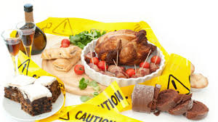
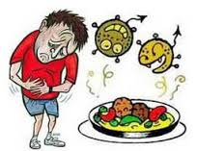
Chapter 1: Food Contamination

Slide 4
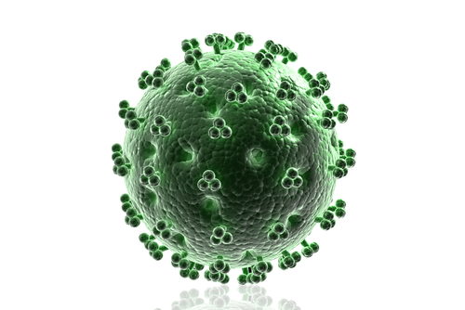
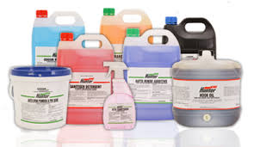
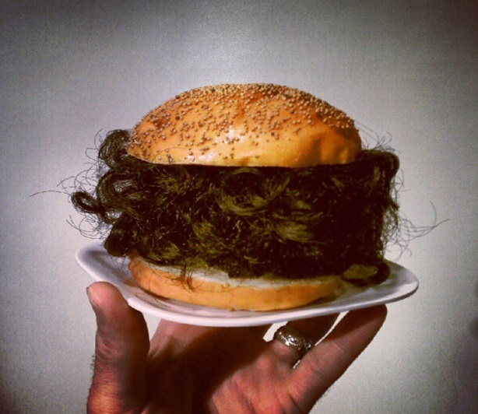
3 types of food contamination:
Biological: Microorganisms such as viruses, bacteria, parasites, and toxins | Chemical: Cleaning products, toxic metal residue, and pesticides | Physical: Hair, band aids, dirt, metal items, artificial fingernails, pest droppings

Slide 5
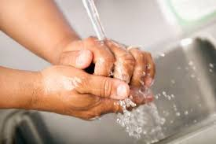
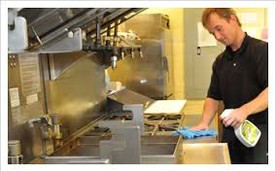
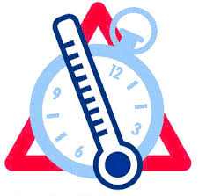
What causes food contamination?
Poor personal hygiene
Time and Temperature control factors
Improper cleaning and sanitizing

Slide 6
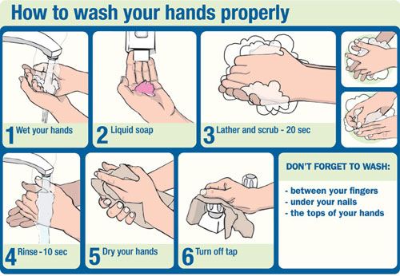
Poor personal hygiene
Research as shown that it is the leading cause of spread of foodborne illnesses
Frequent and proper handwashing is important in preventing contamination when serving and preparing food.

Slide 7
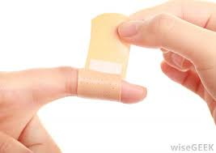
Examples of practicing good hygiene:
Having clean work clothes
Avoid touching hair, skin, nose or mouth
Maintaining health
Reporting illness
Not working while ill
Leaving jewelry at home
Covering exposed cuts, burns, and sores

Slide 8
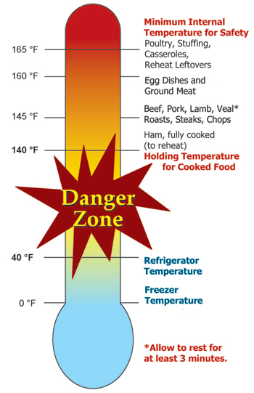
Time and Temperature Control
The “Danger Zone”
Between 41-135 degrees Fahrenheit
In this temperature range, harmful microorganisms grow most rapidly
Potentially hazardous foods are know as Temperature Control for Safety or TCS Foods
TCS foods may not remain in this Danger Zone for more than 4 hours. Anything left in in this zone for more than 4 hours must be thrown out

Slide 9
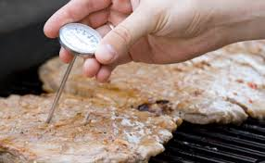
Safe Temperatures
For food to remain safe, it must remain at the following temperatures:
Frozen- 0° F or lower
Cold- 41° F or lower
Hot- 135° F or higher
When preparing food, work quickly and in small batches to minimize exposure to the danger zone.

Slide 10
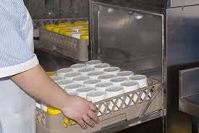
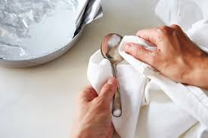
Cleaning and Sanitizing
A critical area in preventing food contamination is proper cleaning and sanitizing of equipment, utensils, dishware and silverware.
Even when food workers properly prepare food and have good hygiene, food can become contaminated if it comes in contact with unclean work surfaces or cookware

Slide 11
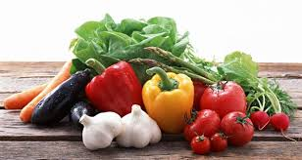
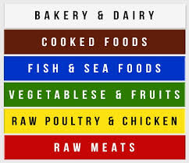
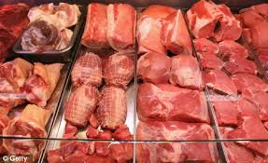
Cross Contamination
Employees must constantly be aware of potential cross-contamination.
It is best to prepare raw meats and seafood on a separate surface as far as physically possible away from fresh produce and ready-to-eat food prep areas.
For best results, use color coded cutting boards

Slide 12
Chapter 1 Quiz-
1-True
2-True
3-False
4-True
1-Four
2-Discarded/Thrown Out
3-Biological, Chemical, Physical
4-Hygiene
1-B, microorganisms
2-A, Cross-contamination
3-C, small; minimalize
4-D, Proper Handwashing

Slide 13
Chapter 2: Foodborne Illness
Foodborne illness is described as “illness caused by infectious or toxic substances that enter the body through ingestion of food”.
Every person is at risk for foodborne illness, and this risk can easily be reduced by becoming a knowledgeable and careful food service employee

Slide 14
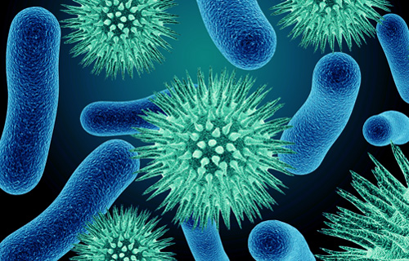
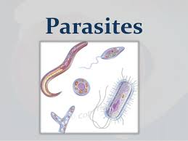
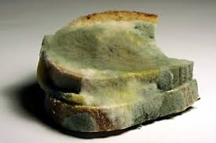
Types of Microorganisms
There are 4 types of microorganisms that cause biological contamination:
Bacteria
Viruses
Parasites
Fungi

Slide 15
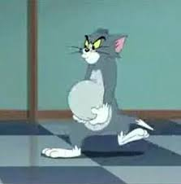
How do microorganisms grow?
Using the acronym “FAT TOM” it is easy to remember the conditions that provide a favorable environment for microorganisms to grow
F-Food-Potentially hazardous/TCS Foods
A-Acidity-Food with slight acidic or neutral pH allows growth
T-Temperature-Danger Zone temp between 41°-135°
T-Time-Foods in the Danger Zone for more than 4 hours
O-Oxygen-Most microorganisms require oxygen
M-Moisture-Moisture allows microorganisms to grow

Slide 16
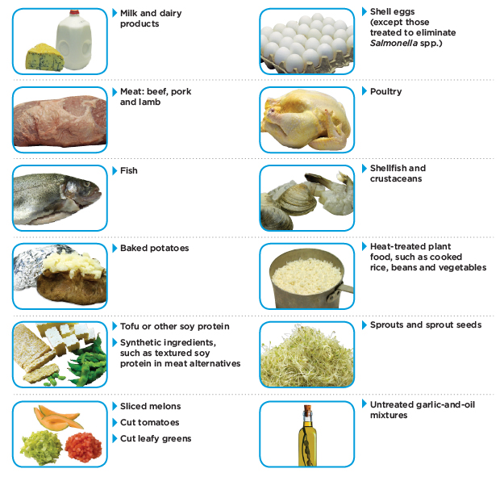
Potentially Hazardous/TCs Foods
A potentially hazardous/TCS food is any food neutral or synthetic, that is capable of supporting rapid and progressive growth of harmful microorganisms.
Examples include:
Milk and Milk products
Fish, shellfish, and crustaceans
Shell eggs
Sprouts and raw seeds
Meat-beef, pork and lamb
Soy-protein foods
Poultry
Cooked rice and beans
Chopped Tomatoes
Garlic in oil
Sliced melon

Slide 17
Foodborne Illnesses
These are the most common foodborne illnesses, and what TCS foods they stem from:
Salmonellosis-Poultry, raw eggs, milk
Campylobacterosis-Raw poultry
Gastroenteritis-Seafood and shellfish, oysters
Hemorrhagic colitis- Undercooked ground beef, produce, unpasteurized dairy products
Botulism-Home canned goods, garlic and oil
Listeriosis-Unpasteurized milk, cheeses, deli meats
Bacillus cereus Gastroenteritis-Rice, potato's, pasta
Shigellosis-salads, raw vegetables, dirty water
Hepatitis A-Shellfish, water, ice, lettuce, salads
Norovirus-ready to eat foods, contaminated water

Slide 18
Exclusion from work
It is extremely important that food service employees pay close attention to their health and report any illnesses or symptoms to management.
Employees diagnosed with any of the following illnesses must be excluded from work:
Hepatitis A
Shigellosis
Salmonellosis
Hemorrhagic (E.coli)
Norovirus

Slide 19
Restriction from work
Employees must be restricted from food handling duties if the following symptoms are present:
Sore throat with fever
Running nose
Diarrhea
Vomiting
Jaundice(yellowing of the skin)
Lesions containing pus, such as boils or infected wounds
Any of the following symptoms must be reported to a manger

Slide 20
Chapter 2 Quiz
1-True
2-True
3-False
4-True
1-TCS
2-Foodborne
3-Manager
4-Bacteria
1-D
2-D
3-D
4-B

Slide 21
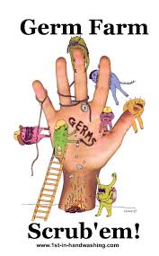
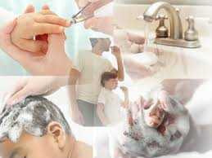
Chapter 3: Importance of personal hygiene
Working in the food service industry requires employees to maintain good personal hygiene.

Slide 22
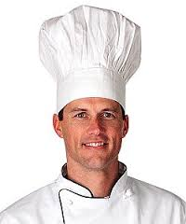
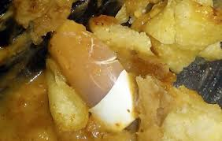
Good basics for personal hygiene
Good personal grooming is essential to preventing foodborne illnesses and must be part of every food service employees regular routine
Bathing daily and wearing clean clothes to work is mandatory. Other examples include:
Aprons not being used to wipe hands
Hair must be clean and effectively restrained
No jewelry of any kind except a single plain band
Fingernails must be neatly trimmed and clean. Artificial nails and nail polish are prohibited while preparing food

Slide 23
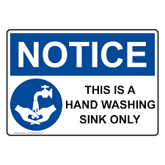
Proper handwashing is a must
Always wash hands or change gloves after:
Toughing skin or bare body
Using the bathroom
Coughing, sneezing, using tissue
Tobacco use, eating, or drinking
Handling soiled equipment
Preparing raw foods or meats
Clearing a table or cleaning dishes
Disposing of trash
Use of any chemical
Changing tasks during food prep
Designated hand washing stations must be convenient, accessible, and properly stocked with soap, sanitizer, and paper towels
At no time may hands be washed at a food prep or dishwashing sink
Expensive food inspection violations can result if hand sinks are blocked, inaccessible, inoperable, or improperly supplied

Slide 24
Techniques for proper handwashing
Wet hands and exposed portions of arms with running hot water of at LEAST 100° F
Apply an adequate amount of soap
Scrub vigorously for 10-15 seconds ensuring soap covers and cleans every part of hands and wrists
Clean between fingers and under nails
Rinse thoroughly with warm water
Vigorously dry hands using paper towel or hand dryer
Use paper towel to turn off faucet
Sanitize using FDA approved sanitizer
Use paper towel to open any doors
Wash hands frequently throughout work shift every times tasks are changed

Slide 25
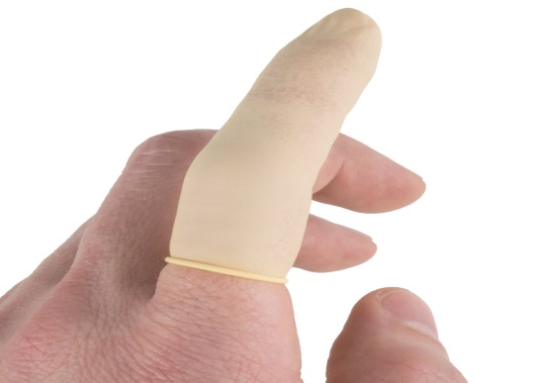
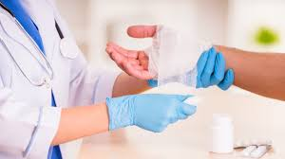
Proper treatment of cuts, burns, sores, and infections
To ensure employee health and safety, and to minimize foodborne illnesses, all cuts, burns, sores, infected wounds, or skin infections must be immediately reported to a manger
Each of these should be covered by a DRY and CLEAN bandage, and protective moisture proof barrier
Employees may also be reassigned to duties that do not involve food preparation to minimize risk.
Hands must be washed before and after attending to a wound.

Slide 26
Chapter 3 Quiz
1-False
2-False
3-True
4-True
1-Bandage
2-Stocked
3-Wash
4-Hands
1-D
2-D
3-C
4-D

Slide 27
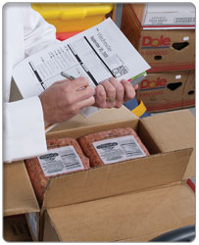
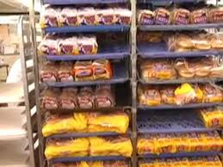
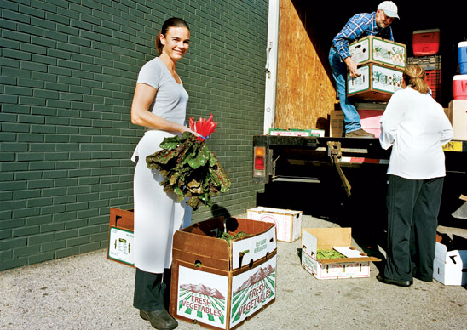
Chapter 4: Safe food handling chain
Receiving food deliveries is the first step in the chain of food safety critical control points
To ensure the highest food safety and quality, all deliveries must be immediately and thoroughly inspected

Slide 28
Inspecting and accepting deliveries
When accepting deliveries, using your senses is as important as getting the job done quickly. Smell, sight and touch are reliable resources to use when judging food items for acceptance
You should reject foods when:
Signs of pests are present
Ice crystals are in packaging
Containers are torn
Goods are expired
Dry good packages are wet

Slide 29
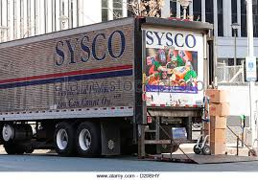
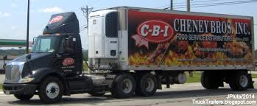
Receiving Temperatures:
See chart in book pg. 24
Almost no uncooked food should be accepted with a temperature that is in the danger zone, as there is no way of knowing how long the product has been at that temperature

Slide 30
Safe Food storage
Protect-all food while it is being transported and/or stored
FIFO-First In First Out products should be used in the order they are accepted
Containers-clearly separated and labeled for protection
Separate-Keeping specific raw food separate from ready to eat foods is crucial in preventing cross contamination
Stocking-be careful not to overload areas for storage to ensure temperatures will be consistent. All food products must be a minimum of 6 inches off the floor and with space off the wall and between food items

Slide 31
Chapter 4 Quiz
1-False
2-False
3-False
4-False
1-Torn, broken or damaged
2-First in, first out
3-above
4-frozen
1-C
2-D
3-C
4-B

Slide 32
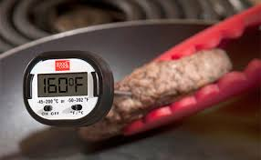
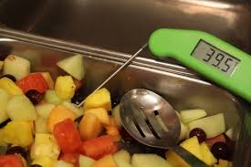
Chapter 5: Controlling the Temperature Danger Zone
Learning safe methods to prepare, cook, store, and serve food requires that employees take food safety seriously.
Knowing, using, and closely monitoring proper time and temperature controls ensures safe thawing, cooking, cooling, and holding food.

Slide 33
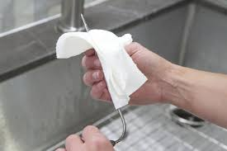
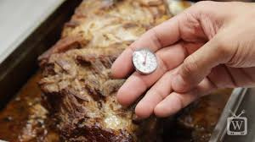
Using food thermometers
The typical range of a common food thermometer is between 0° and 220°
The proper use of a food thermometer includes knowing techniques to:
Calibrate the thermometer
Accurately measure the internal temperature of food
Correctly sanitize the thermometer
Keep accurate records of food temperature

Slide 34
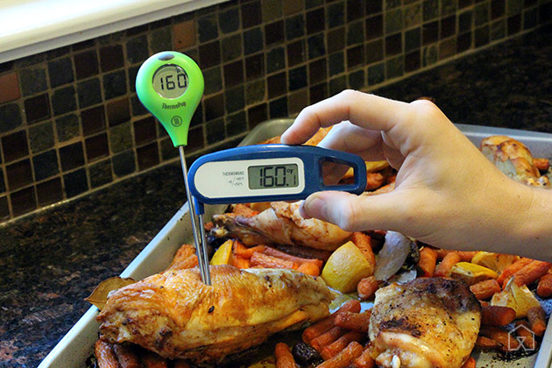
Measuring
Completely insert the thermometer stem into the center of the thickest part of the food item, and away from bones or gristle
Soups, sauces, and other liquids should fist be thoroughly stirred to ensure even temp
Allow thermometer to reach maximum or minimum temperature and read the measurement

Slide 35
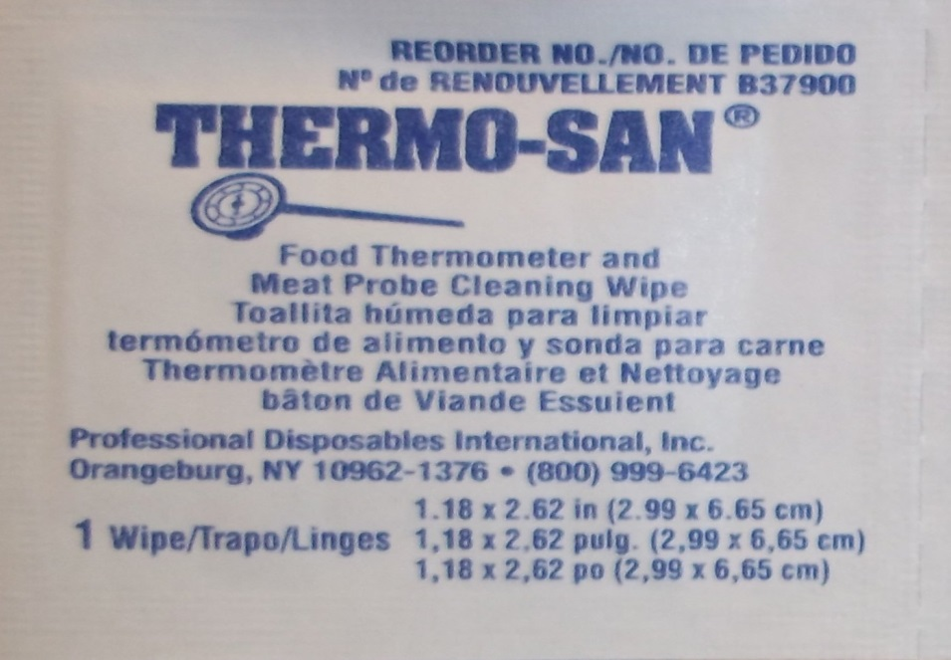
Sanitizing
Wash, rinse, and sanitize the thermometer after each use.
Sanitize the thermometer by immersing it in a common bleach sanitizing solution, ammonia solution, or swab with a alcohol wipe

Slide 36
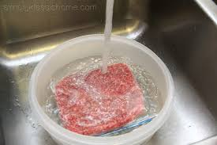
Thawing food
There are four acceptable ways of thawing food:
Refrigeration
Cold water
Microwaving
Cooking
Thawing is a critical step in food preparation and when done improperly, increases foodborne illness risk

Slide 37
Acceptable thawing
Refrigeration
The safest method for thawing. Placing food in a temperature that is below 41 ° or lower. Food must be placed in a container sufficient enough to capture any liquid the food may purge
Cold Water
Placing food under constantly running potable water of 70° or lower until thawed. Prep sink must be sanitized properly after use
Microwave
Place frozen food in a microwave, and cook on thawing setting. This method may only be used if food is to be cooked immediately after thawing
Cooking
Using a frozen food item in regular food item in the regular cooking procedure until completely cooked for service.

Slide 38
Safe minimum internal cooking temperatures
Cooking food to its proper internal cooking temperature will destroy most harmful microorganisms
The required temperature differs according to the type of food
Each item must be cooked until reaching the required internal temperature for 15 seconds in the thickest part of the item
See chart on Pg. 29 for all major food types

Slide 39
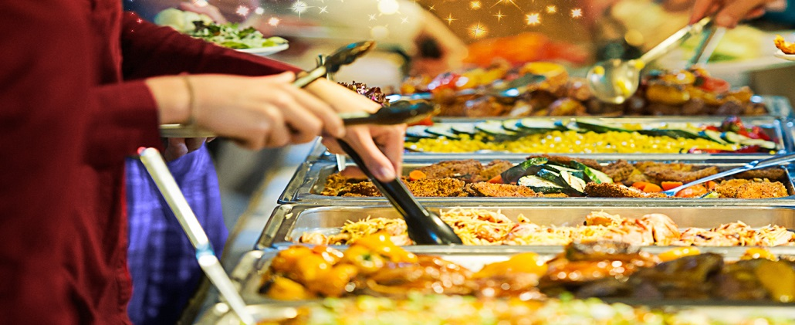
Correct food temperatures for hot and cold holding
For maximum safety and minimum foodborne illness risk, food must be held at temperatures out of the danger zone
Hot Foods must be kept above 135°
Cold Food must be kept under 41°
Food may not be in the danger zone for more than 4 hours.

Slide 40
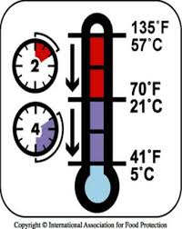
Cooling requirements
Two-stage cooling is the process of cooling food to safe storage temperatures
Stage 1 requires hot food items be cooled from 135° to 70° within 2 hours
Stage 2 requires the food items be cooled from 70° to 42° within 2 hours
If the food is not cooled properly within each stage, it must be reheated to its 165° for 15 seconds within 2 hours, or be thrown away
The worst part of the danger zone lies between 125° and 70°, which allows the fastest microorganism growth

Slide 41
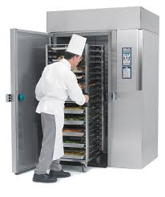
Safe cooling techniques
There are several techniques for cooling food properly, but there are 4 that are most efficient
Ice bath
Placing hot food in a container that can be surrounded by a mixture of ice and water
Small batch cooling
Dividing food into shallow metal pans and placing in the refrigerator for cooling
Chill sticks or ice paddles
Hollow container made of plastic are filled with ice and frozen. They can be inserted into bulk foods such as soups to lower the temperature rapidly
A blast chiller
Fastest and safest method for cooling food.

Slide 42
Chapter 5 Quiz
1-True
2-True
3-True
4-True
1-Thermometer
2-Blast
3-Never
4-Temperature
1-D
2-C
3-A
4-C

Slide 43
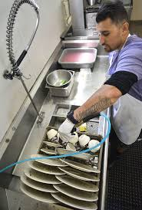
Chapter 6: Cleaning and Sanitizing
Cleaning and sanitizing are also steps that are critical control points for food service establishments
Cleaning and sanitizing have different roles and knowing the difference will result in quality and safe food for customers
Cleaning-removes food residues, dirt, and grease. Cleaning is the important fist step in ensuring utensils, plates, and food services are safe
Sanitizing-reduces harmful microorganisms to safe levels. This is done through the use of a chemical sanitizing solution

Slide 44
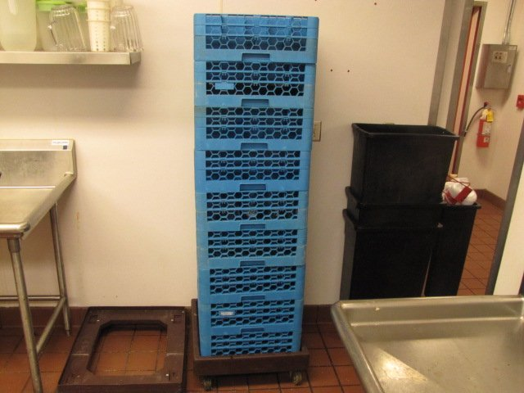
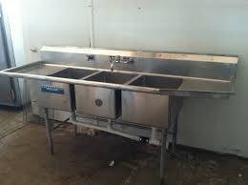
Cleaning and sanitizing techniques
Manual/3 compartment sinks: cleaning and sanitizing can be done without a machine.
The order for a 3 compartment sink is: Wash, rinse, sanitize, air dry

Slide 45
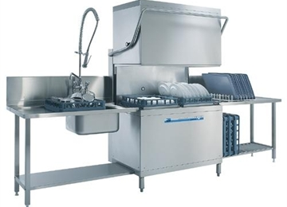
Hot water vs. Chemical sanitizing
Hot water sanitizing requires items be completely immersed in water of at least 171°F for at least 30 seconds. Water temperature must be continuously checked, items must be allowed to air dry
Chemical sanitizing involves using solutions made with chlorine, iodine, or quaternary ammonium are approved for use in sanitizing, when used in the correct, prescribed concentration. Always use test kits to ensure correct concentration of chemicals, allow items to air dry.

Slide 46
Chapter 6 Quiz
1-False
2-True
3-False
4-True
1-Cleaning
2-Sanitizing
3-Heat, Chemical
4-Cross-contamination
1-D
2-C
3-B
4-A

Slide 47
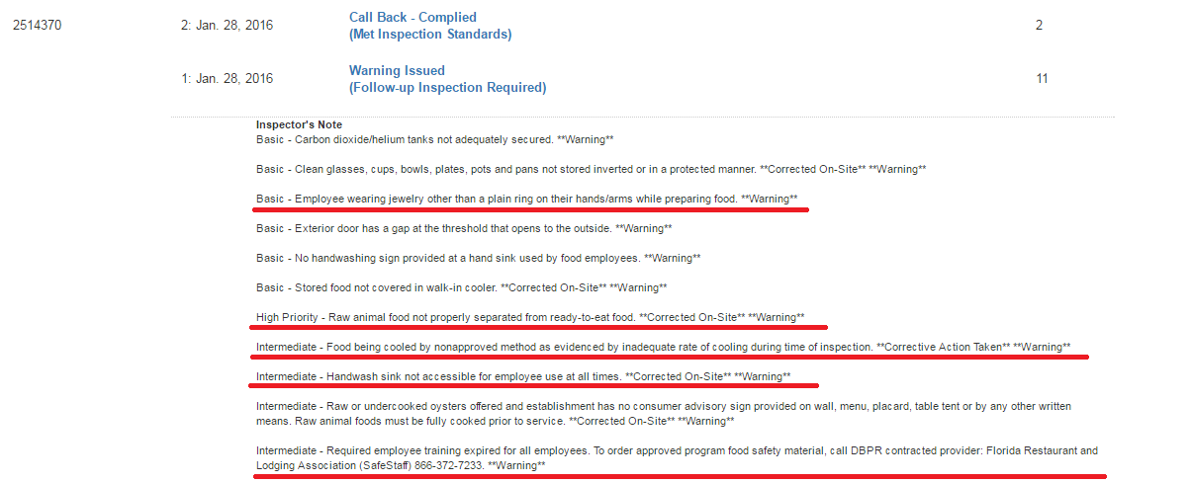

Slide 48
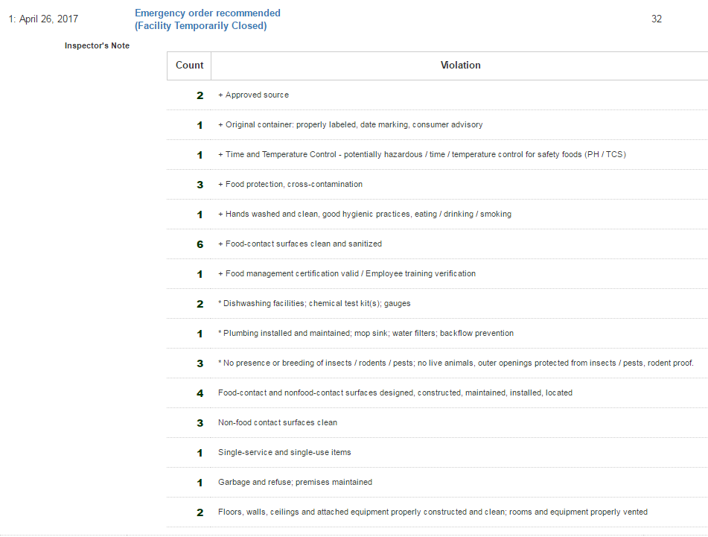

Slide 49
Chapter 7: Controlling Pests
Pests and insects spread microorganisms and can easily contaminate food. Pest control is a top priority in food service establishments.
Common insects and pests, aka vermin that are attracted to foo include:
Rodents-rats, mice, squirrels
Insects-flies, wasps, cockroaches, weevils, ants
Birds-Pigeons, sparrows, nesting birds

Slide 50
Inspecting for pests
When inspecting the premises of a food establishment, look for these signs:
Live or dead rodents, including insects, eggs, or larvae
Rodent or insect droppings
Damage to food packaging, wood, plaster, boxes
Food spills in dry storage
Unusual odors, associated with mice or cockroaches
Tracks or trail marks in dust or powder
Black greasy smears on walls, pipes, or counters

Slide 51
Preventing pests
Pest control can be done easily with careful attention and common sense sanitation
Follow these steps to ensure pests do not become an issue at your establishment
Inspect all deliveries for signs of pests
Refuse deliveries with signs
Dispose of trash properly and quickly
Keep trash an dumpster areas clean and free of debris
Ensure all trash goes into dumpster with lid
Never prop exterior doors open
Cover all holes that can invite pests in
Seal wall and floor cracks
Use professional pest control service
Keep restrooms clean
Sanitize and clean frequently throughout the shift

Slide 52
Chapter 7 Quiz
1-True
2-False
3-True
4-True
1-Inspections
2-Signs
3-Pest
4-Garbage
1-C
2-B
3-C
4-A

Slide 53
Self Test:
You have 10 mins to complete the self test. Please close your book when you are done.

Slide 54
Self Test Review
1-A
2-D
3-C
4-B
5-D
6-C
7-B
8-D
9-C
10-B
11-B
12-B
13-B
14-D
15-B

Slide 55
Congratulations!!!
You are now a certified Foodhandler!!!

