Slide 1
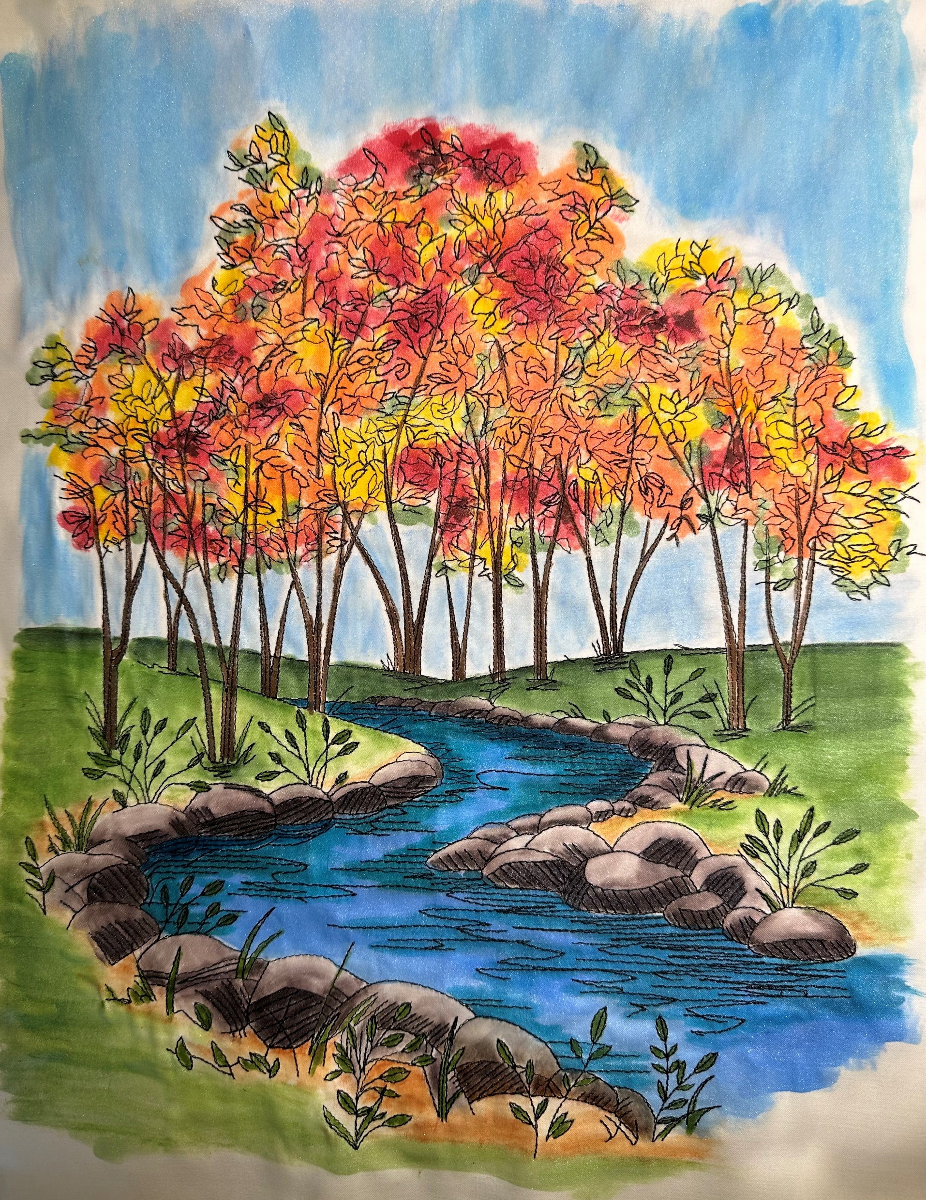
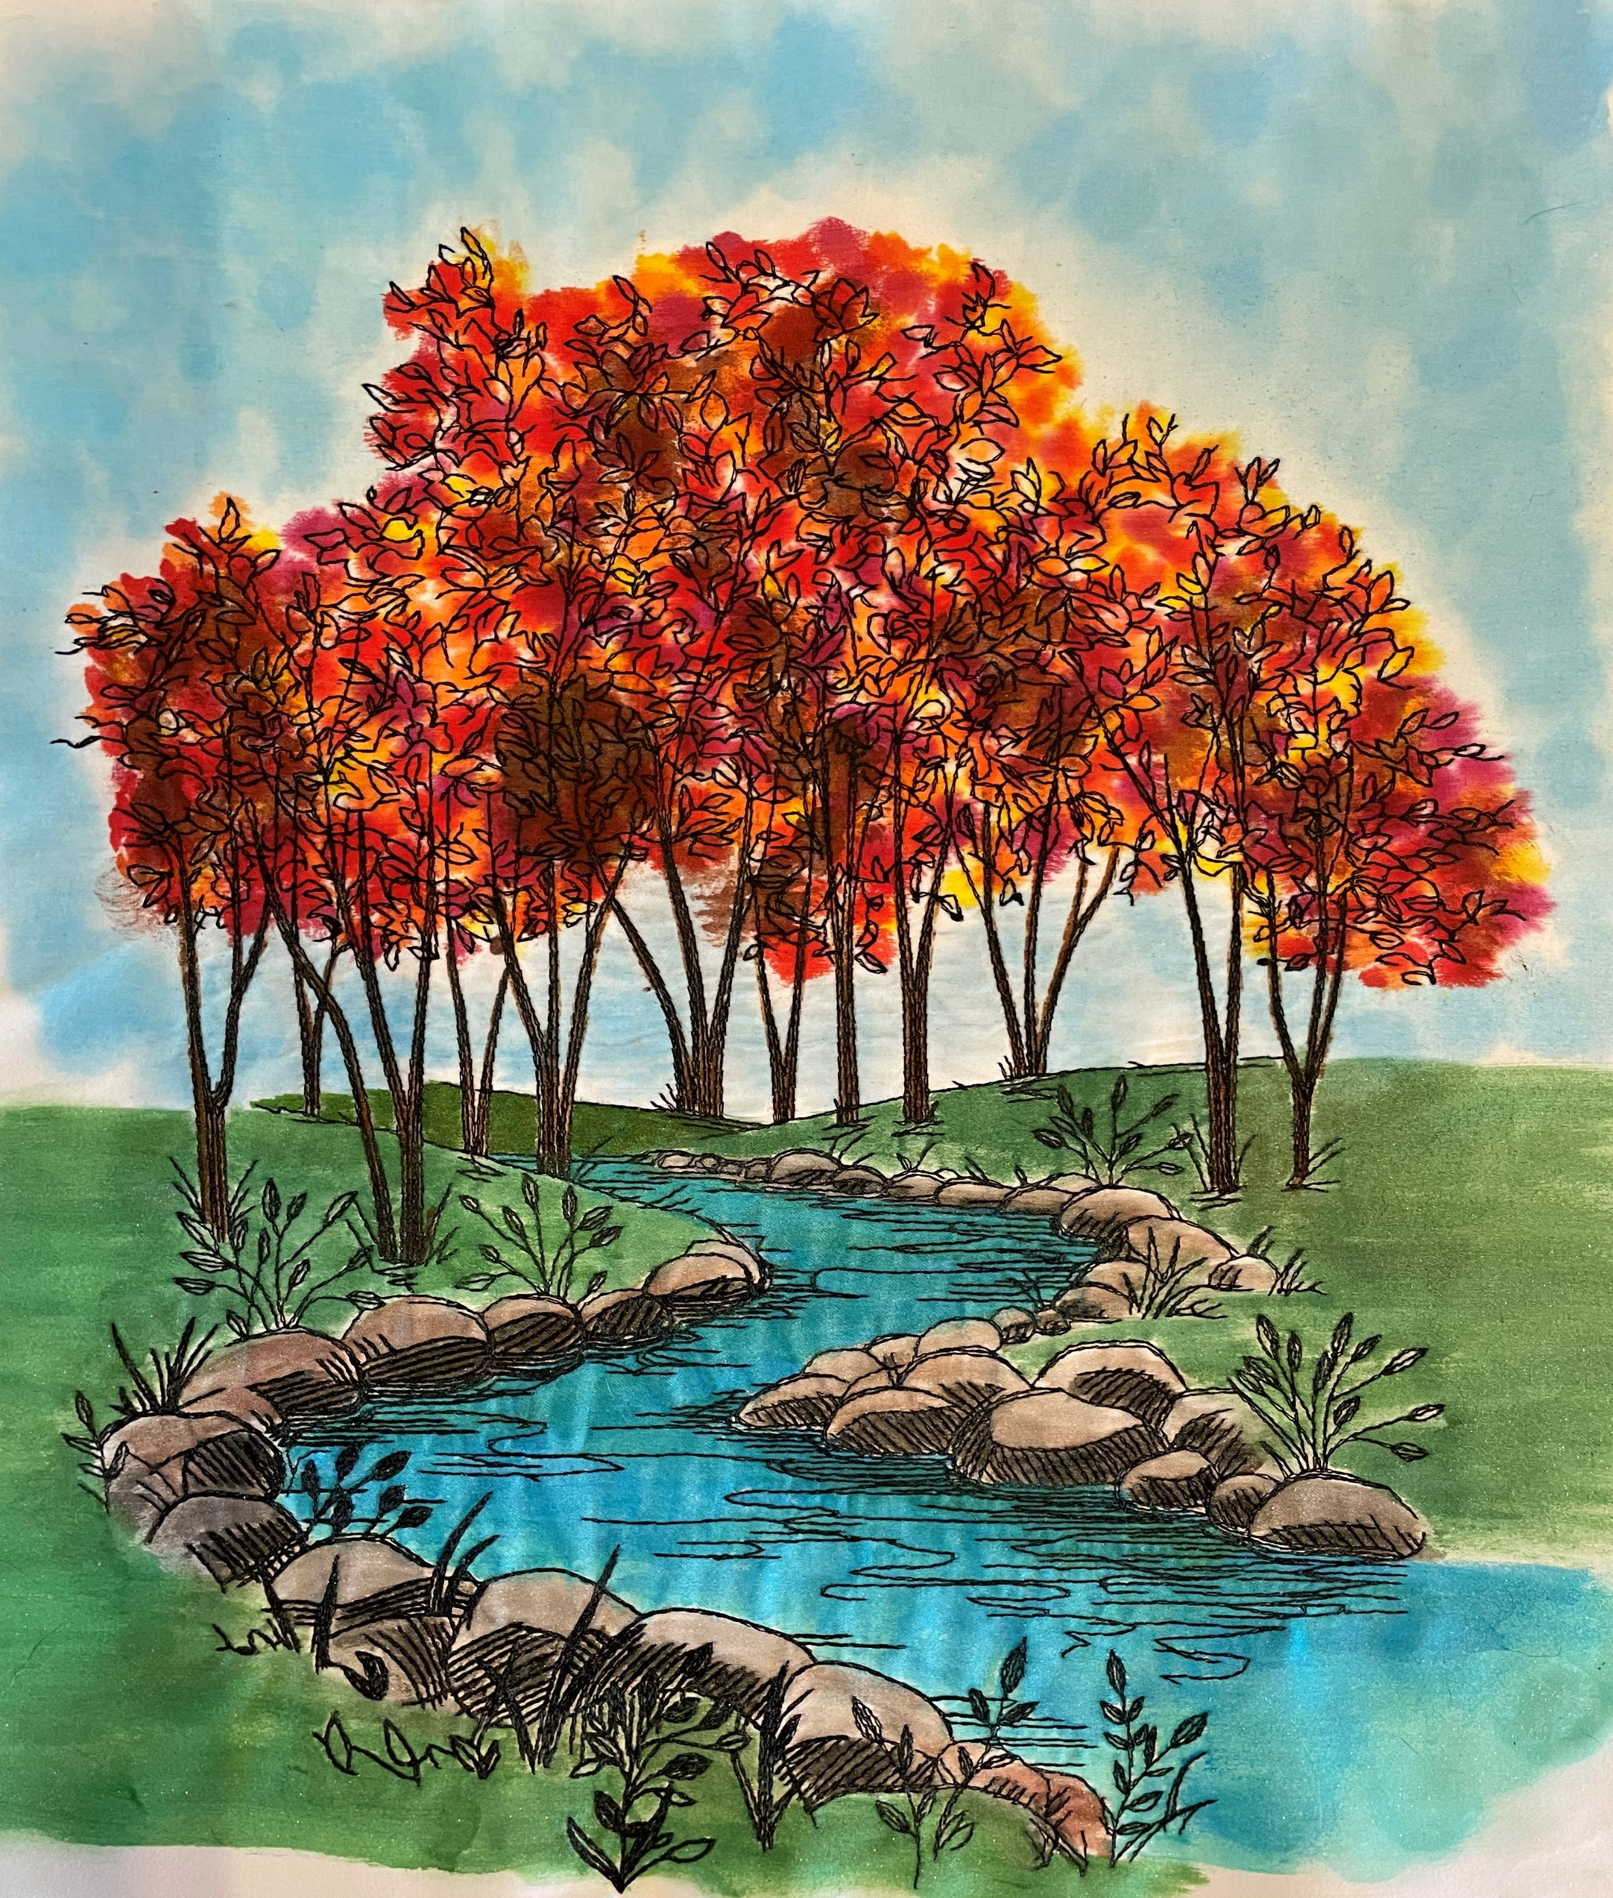
Fall Reflections Class – November 2, 2024 Houston Quilt Festival

Slide 2
Order of Painting this Block
1. Leaves: start by applying a light coat of fabric medium to the stitched area of leaves. Try not to get too far away from stitching. Using a small makeup sponge or a small brush head, dip your tool into the Golden yellow paint and dab in a random pattern over the wet leaves area. Try not to make perfect little circles but random blotches of color. Repeat with the Orange blend and then the Red blend. If you want your leaves to look darker, use a small amount of the Burnt Umber in a similar random fashion. If you want your leaves to look like they are just turning add some Olive green instead of the Burnt Umber.
2. Grass and land: In order to define this picture a little better, I use the Ionian Green pencil to carry the horizon line beyond either side of the trees. Ionian green should also be used in the stitching area around the base of the trees to give a sense of a shadow at the base of each tree. Pour a small bit of the Olive green paint in a palette pot as well as some fabric medium in a separate pot. Apply the paint along the back horizon line and come down into the trees a bit. Then apply some fabric medium to the land area about ½ way down the land, then paint over that area with the Olive Green paint. The key is to get a seamless look from dark green to medium green to a light green at the bottom of the block. Leave space around the rocks to apply Baked Earth pencil for dirt. Blend the Baked Earth up to the stitch line of the rocks and slightly into the green area.
3. By this time, the leaves area should be dry. Using your Fabrico marker Truffle, outline the branches and trunks of the trees. Don’t worry about getting slightly outside the lines. Use the small tip for the small branches within the leaves.
4. Water: I have colored the water with several different methods. The one I prefer is using the Dy-Na-Flow Turquoise as the base color of the water and the Dy-Na-Flow Teal along the sides of the stream and in the ripples. Despite the tiny amount of color in each bottle, Dy-Na-Flow is a very concentrated paint/ink. To make the base color, pour a generous amount of fabric medium in a palette pot and drop a couple of drops of Dy-Na-Flow Turquoise into the fabric medium. Blend with a brush. Test the color on the fabric scrap to see if you like the color. Add more color if necessary. Coat the entire stream with the Turquoise. Mix a bit of fabric medium and the Teal. Paint the Teal all along the shore line and the stitched ripples of water. Use the Dark Aquamarine Inktense pencil to add depth in the back of the stream and along the shoreline.
5. Rocks: Use the Bark Inktense pencil starting at the base of each rock (the areas that have multiple lines of stitching). Color heavily. Dip your brush into the fabric medium and coat the colored area and then drag the color to the tops of the rocks. The color should look lighter than the base of the rocks. If the tops of the rocks are too dark, let the area dry first, then color the tops with the White Caran D’ache crayon to lighten the area up then blend with fabric medium.
6. Sky: Two methods for coloring:
a. Easy method: Use the Light Blue Caran D’ache crayon and color the areas beneath and above the leaves using a “light hand”. (I usually do the areas in between the trees first). Dip your brush into the fabric medium and blend using a gentle scrubbing motion to blend out any streaks.
b. Paint method: Mix a generous amount of fabric medium with the Dy-na-Flow Azure Blue (mix a drop at a time to get the light color of the sky). Test color on fabric scrap before painting on block. To achieve a “mottled” sky look, you can use either the cotton balls or the round makeup sponge and dab in overlapping patterns.
7. Plants: To highlight plant leaves and some of the stems, using the Fabrico Pine marker (small tip works best).
Congratulations! You are done!

Slide 3
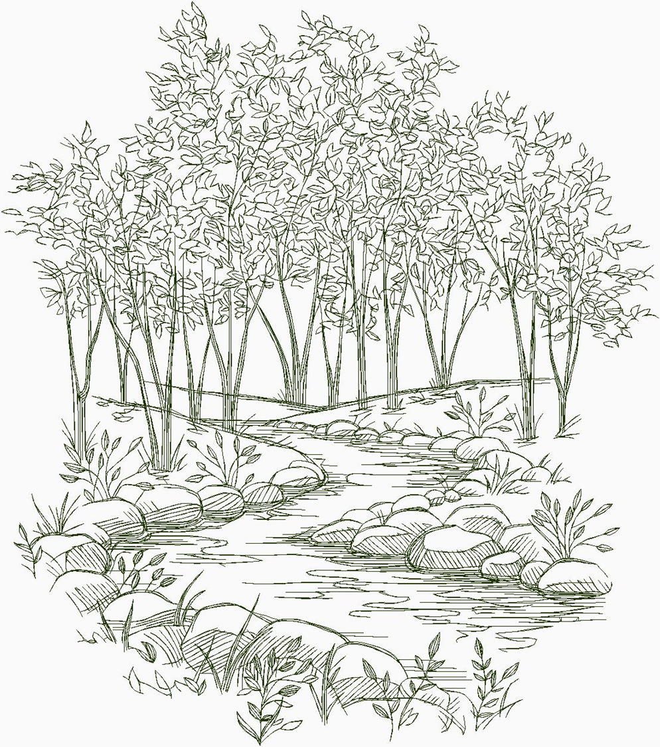
Practice Coloring Page

Slide 4

1
1
3
2
2
2
2
1
1
3
3
1
3
1
1
3
2
3
1
2
2
1
2
1
2
3
2
2
2
3
1
1
3
3
1
3
1
1
2
1
1
3
2
2
1
3
3
3
2
2
2
2
1
1
2
1
3
1
3
3
3
1
2
2
1
1
Leaves: start by applying a light coat of fabric medium to the stitched area of leaves. Try not to get too far away from stitching. Using a small makeup sponge or a small brush head, dip your tool into the Golden yellow paint and dab in a random pattern over the wet leaves area. Try not to make perfect little circles but random blotches of color. Repeat with the Orange blend and then the Red blend. If you want your leaves to look darker, use a small amount of the Burnt Umber in a similar random fashion. If you want your leaves to look like they are just turning add some Olive green instead of the Burnt Umber.

Slide 5
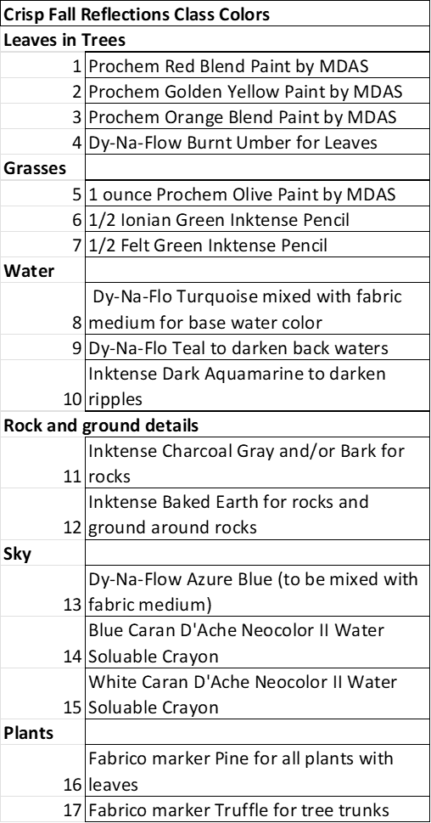
6
6
6
6
6
6
6
6
6
Dark 5
6
6
6
6
Dark 5
Dark 5
Dark 5
Dark 5
Dark 5
6
6
Dark 5
Dark 5
Dark 5
Dark 5
Dark 5
Med 5
Med 5
Med 5
Med 5
7
Med 5
7
7
7
12
7
12
7
Grass and land: In order to define this picture a little better, I use the Ionian Green pencil to carry the horizon line beyond either side of the trees. Ionian green should also be used in the stitching area around the base of the trees to give a sense of a shadow at the base of each tree. Pour a small bit of the Olive green paint in a palette pot as well as some fabric medium in a separate pot. Apply the paint along the back horizon line and come down into the trees a bit. Then apply some fabric medium to the land area about ½ way down the land, then paint over that area with the Olive Green paint. Use Felt Green for the remainder of the grass area. The key is to get a seamless look from dark green to medium green to a light green at the bottom of the block. Leave space around the rocks to apply Baked Earth pencil for dirt. Blend the Baked Earth up to the stitch line of the rocks and slightly into the green area.

Slide 6
17
17
17
17
17
17
17
17
17
17
17
17
17
16
9
9
10
9
11
11
16
8
9
10
9
9
11
11
16
8
10
10
11
16
16
9
11
11
10
8
9
10
11
11
10
9
11
11
16
11
9
8
11
16
16
16
16
11
9
10
12
11
8
11
11
10
9
9
11
11
10
16
10
11
11
9
11
11
12
11
10
9
8
10
11
11
8
9
10
11
11
9
10
7
12
8
9
10
10
11
8
9
9
11
11
11
11
7
12
11
8
8
10
16
11
9
8
7
16
11
10
12
11
7
16
16
7
12

