Slide 1

Treasurer
Club Officer Training

Slide 2
Why are you here?

Slide 3
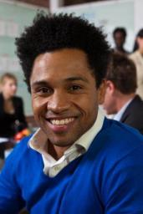


Agenda
Treasurer
Role
Treasurer
Responsibilities
Treasurer Resources

Slide 4

During Club Meetings
Collect membership dues. (Send out reminders)
Report on club finances.

Slide 5
Trouble collecting dues?
Scenarios discussion
The treasurer sent dues statements to all club members and all members have paid except one.
The treasurer reminds the delinquent member to pay dues at each meeting, but the member still doesn’t produce a payment. How should the treasurer handle the situation?

Slide 6
Possible Responses
Collecting Dues
Let them know that World Headquarters will remove their names from the club’s membership roster
Notes:
If the club did not vote a member in, the club cannot vote a member out. If a member was not voted in, they can still be removed by the club including a disruptive member from the club.

Slide 7
Possible Responses
Collecting Dues
Let them know that World Headquarters will remove their names from the club’s membership roster
They will no longer have any rights within the club
Notes:
Members of a club have voting privileges. They may be elected as an officer of your club, they may be counted towards a quorum of the club membership, may participate in speech contests, and have a place on the regular speaker's program.

Slide 8
Possible Responses
Collecting Dues
Let them know that World Headquarters will remove their names from the club’s membership roster
they will no longer have any rights within the club
No longer receive the magazine or any other materials.
Notes:
The Toastmaster magazine is published monthly by Toastmasters International, Inc. Articles promote the ideas and goals of Toastmasters International, your nonprofit educational organization with clubs throughout the world dedicated to teaching skills in public speaking and leadership. Members’ subscriptions are included in the $45 semi-annual dues.
The official publication of Toastmasters International carries authorized notices and articles regarding the activities and interests of the organization,

Slide 9
Possible Responses
Collecting Dues
Let them know that World Headquarters will remove their names from the club’s membership roster
they will no longer have any rights within the club
No longer receive the magazine or any other materials
Will be ineligible for contests.

Slide 10
Possible Responses
Collecting Dues
Let them know that World Headquarters will remove their names from the club’s membership roster
they will no longer have any rights within the club
No longer receive the magazine or any other materials
will be ineligible for contests.
If a member has not paid and still shows up at meetings, the club can vote that person out and disallow further participation in club activities. This process is the Club President’s responsibility.

Slide 11

Before Club Meetings
Prepare a financial report.
Notes:
Most clubs have a treasury in which they keep funds for club use. The Toastmasters program is designed to be supported by members through club dues. Clubs may also raise funds on a limited basis.
Each club should prepare a budget at the beginning of the year to designate income and expenses. A majority of the club members should approve the budget, as well as any unanticipated expenses throughout the year.
Authorized uses include:

Slide 12
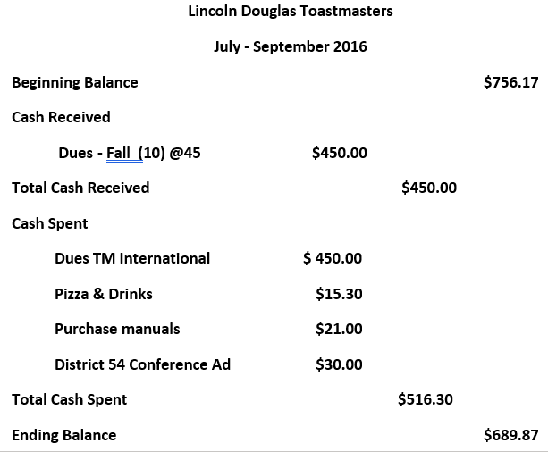
Sample Quarterly Financial Report

Slide 13

Outside the Club Meeting
Add New Pres and Treas to Club acct
Pay dues to TI
Notes:
Membership dues are collected for semiannual terms of April 1 – September 30 and October 1 – March 31.
Submit new member applications
Issue checks (or debit card) for club expenses
Keep financial records
Prepare a budget

Slide 14
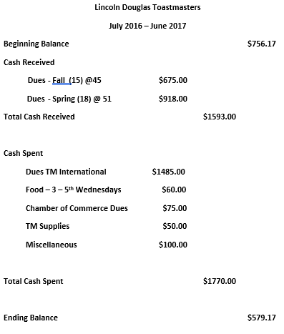
Sample Budget

Slide 15
Outside the Club Meeting
Submit club accounts for audit.
  Audit committee – 3 impartial members
  At TM Year end
Attend executive committee meetings.
Reconcile deposits, expenditures and cash on hand regularly
Notes:
Financial Records: 7 years
(Includes internal audit reports, bank statements, cancelled checks, receipts and disbursements, etc.)

Slide 16

The Executive Committee
Work with executive committee on Club Success Plan.
www.toastmasters.org/1111

Slide 17
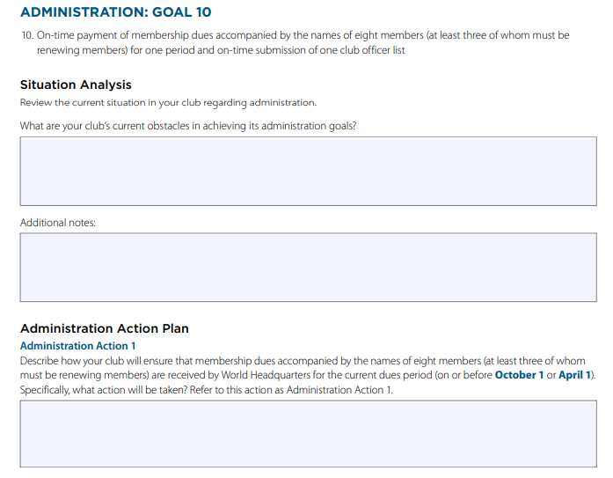
Your Club Success Plan Participation
Notes:
The Club Success Plan is a planning document for defining the goals of a club. Club officers should create a Club Success Plan for their club in order to help them focus their efforts and the efforts of the club as a whole during their term in office. In particular, the Club Success Plan represents the club's stated criteria in defining success for the club in the Distinguished Club Program.
After the Club Success Plan is completed, the club's executive committee is encouraged to share the plan with all of the club's members and keep a copy of the plan in the club's records. Note that participation in the preparation of a Club Success Plan satisfies one of the requirements for Advanced Leader Bronze recognition.

Slide 18
Getting Started
Attend club-officer training
Read Club Leadership Handbook
Meet with outgoing executive committee.
Meet with current executive committee.
Review Policies and Protocol.
Start working on a budget. Review records, financial reports and audit committee’s report.
Be added to club bank account
Create or learn the record-keeping system

Slide 19
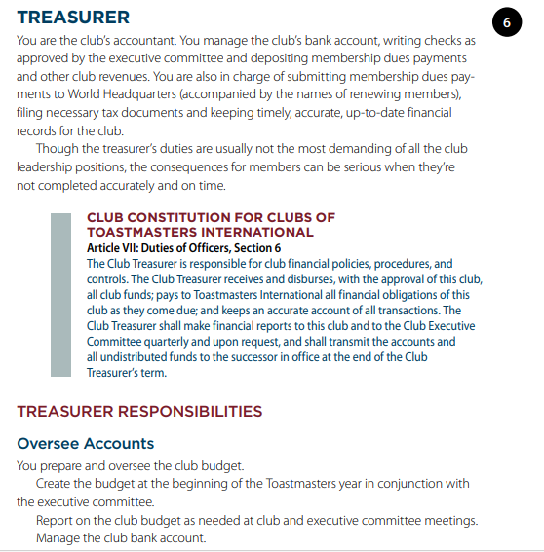
Club Leadership Handbook

Slide 20
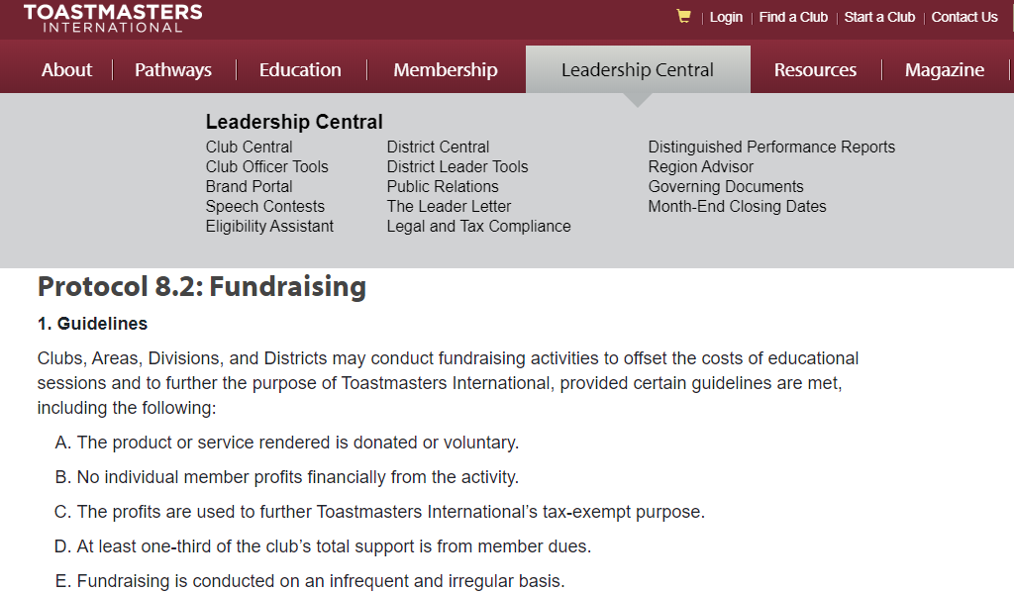
Policies and Protocols etc.

