Slide 1
Navigating Base Camp
Maryann Reichelt
after October 23, 2024 launch

Slide 2
Agenda Items
Pathways Overview
              Welcome
              Base Camp Videos
              Choose a Path – LMS and Legacy
              Pathways Updates and FAQ
              Base Camp
              Go To Base Camp
              Learning Management System Paths
              Legacy System Paths
              Base Camp Manager
              Approvals
              Member Overview
              Paths in Progress
              Member Profile
              Resources

Slide 3
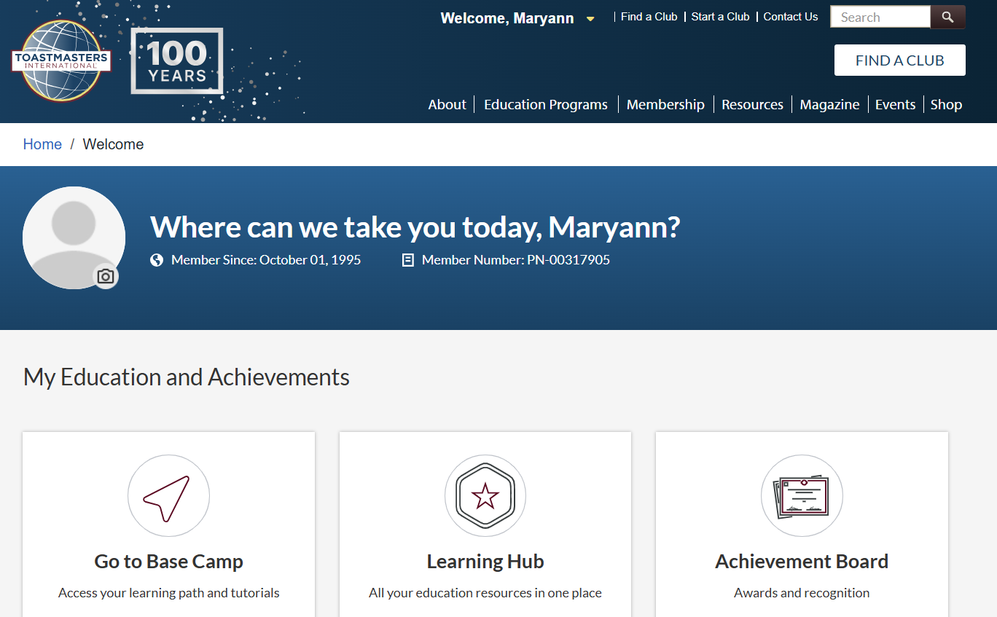


Notes:
To choose a Path you cannot Go to Base Camp directly.
When you log in to the Toastmasters International website you will see the My Home page.
Choose Education Programs to be taken to the Information page

Slide 4
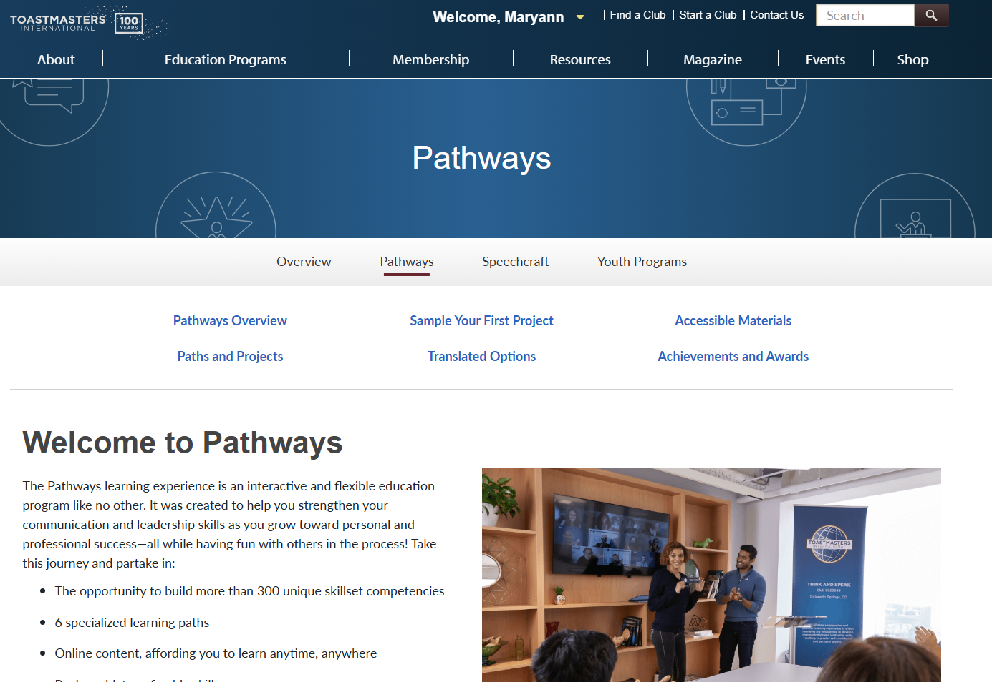


Notes:
Entering Pathways via this route gives you the introduction to Pathways, the link to the Ice Breaker (Sample Your First Project), Accessible Materials, and an overview of the LMS Paths and the Legacy Paths (no longer available for purchase).
The Achievements and Awards let you know what you can attain in Pathways as well as an explanation of what the Distinguished Toastmaster award is and the steps to achieve this highest individual award in Toastmasters.
Continue scrolling to the bottom of the page for purchasing a Path, Pathways Updates and FAQ.

Slide 5
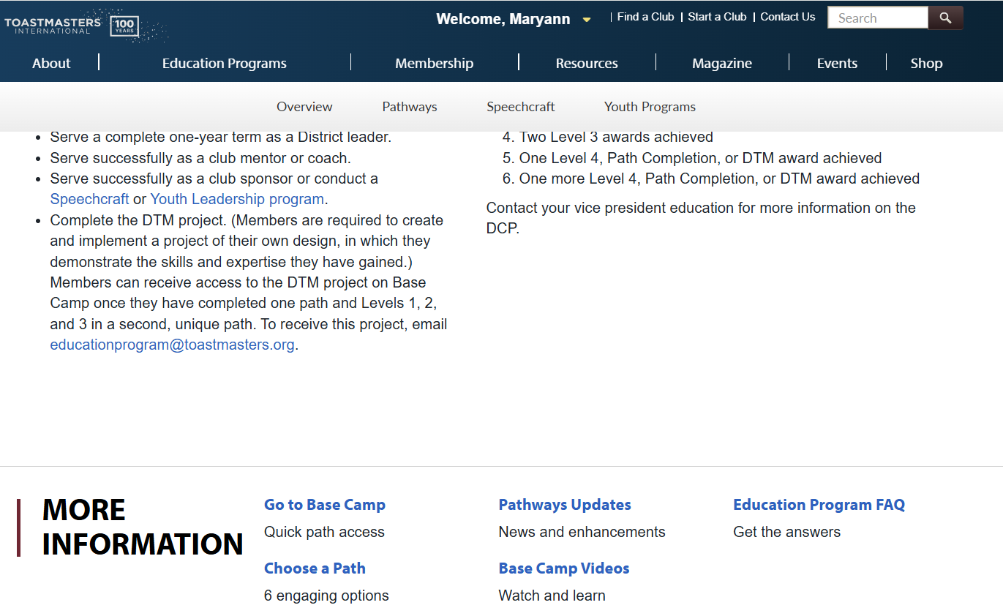


Notes:
This is the bottom of the previous webpage.
From here you can:
View the Base Camp Videos
Choose a Path – next two slides will show the LMS Pathways Paths and the Legacy Paths
Get the latest Pathways Update and Education Program FAQ
Go To Base Camp … one of many routes to get there

Slide 6
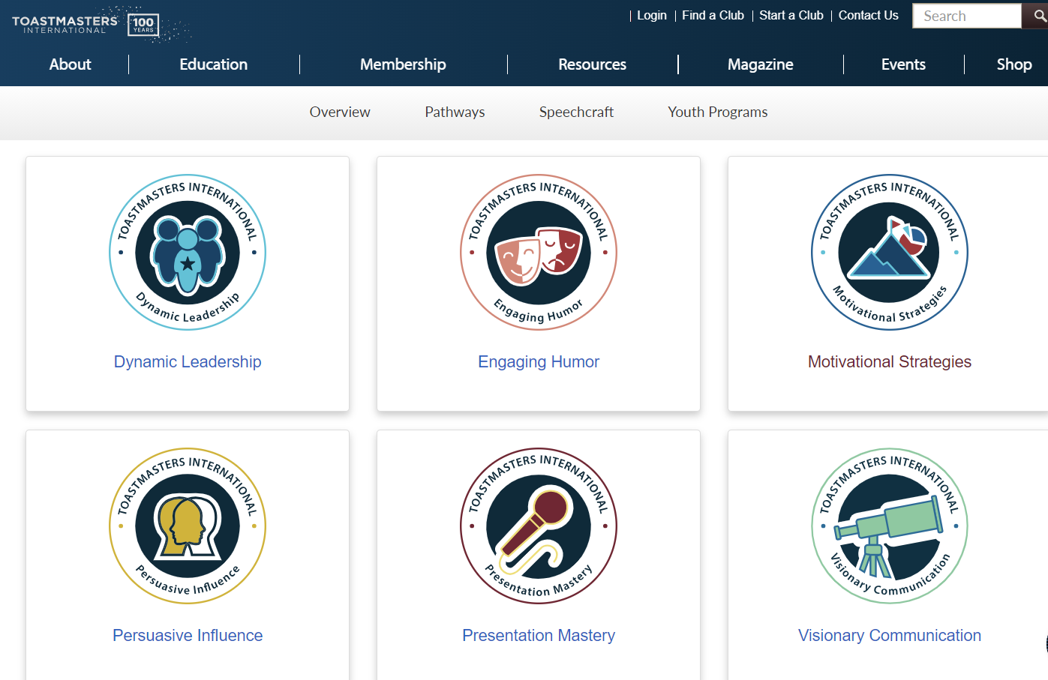

Pfrom PATHS AND PROJECTS selection on previous slide
Notes:
These are the LMS Paths.

Slide 7
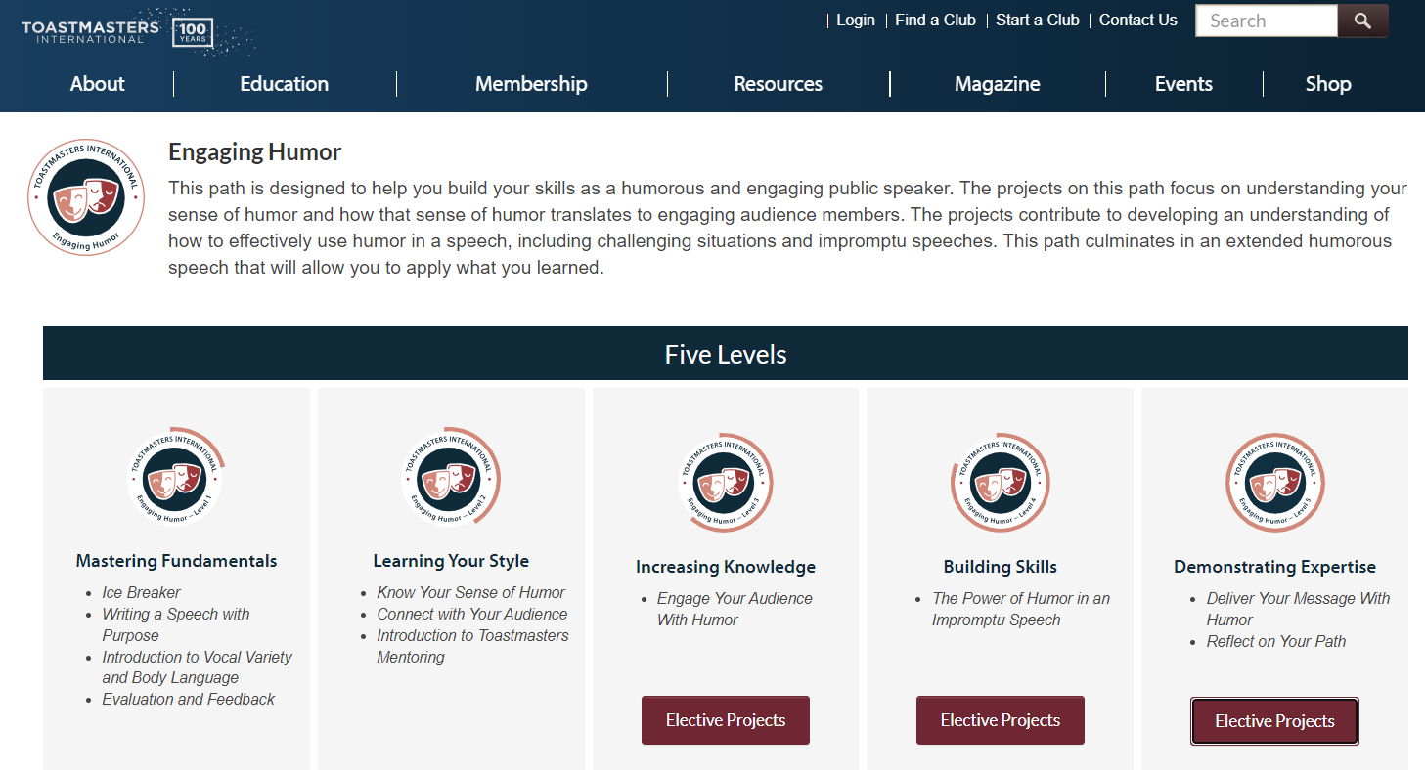
Notes:
This is what you will see as you hover over the Engaging Humor icon. All the elective projects for a level will be shown when you click on the Elective Projects tab.

Slide 8
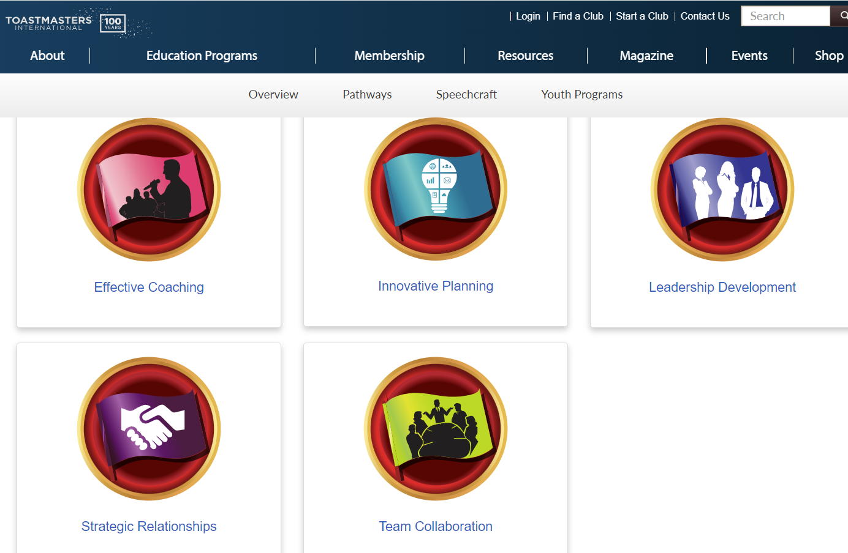

LEGACY PATHS
Notes:
These are the badges for the Legacy Paths.

Slide 9
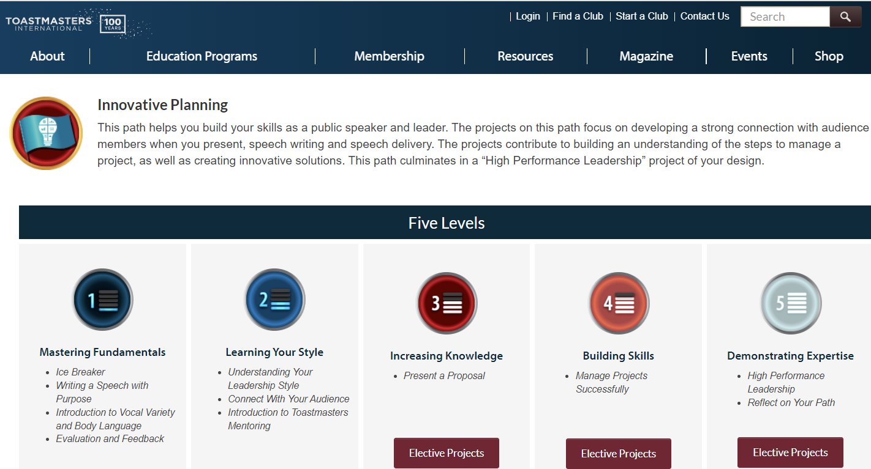
Notes:
This is what is shown when you choose a Legacy Path icon. All electives for a Level will be shown when the Elective Projects tab is chosen.

Slide 10
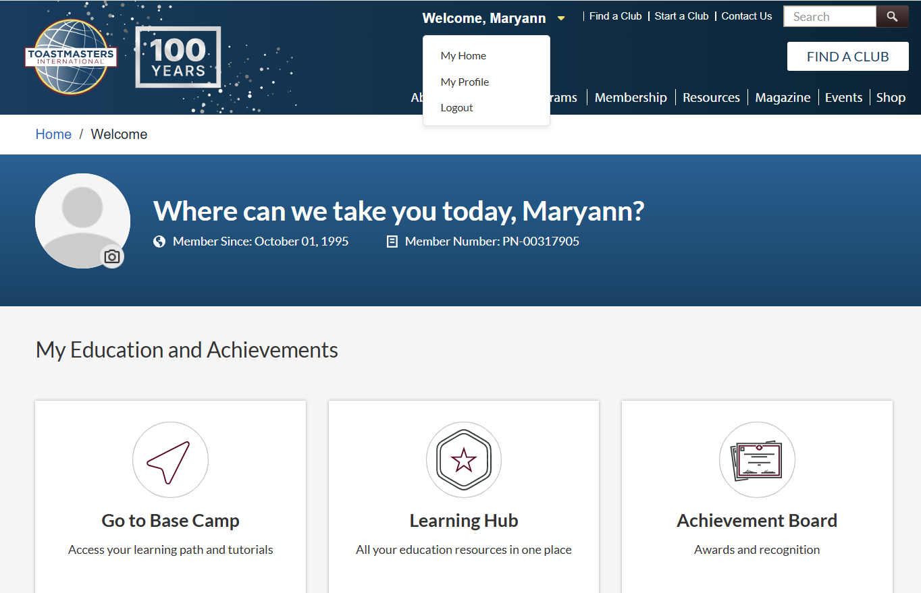



Notes:
When you log onto the Toastmasters International webpage and do not see this page click the down arrow next to your name and select My Home.
From this screen you select Go To Base Camp

Slide 11
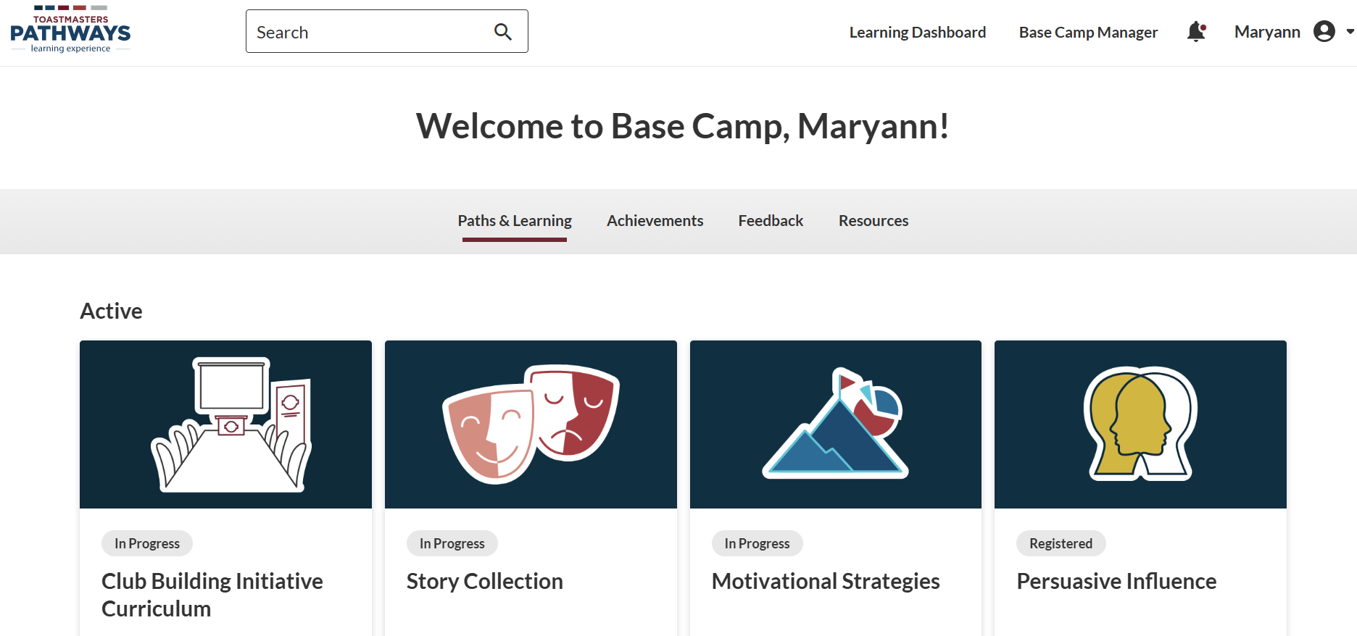
Notes:
If you are working a printed Path they did not get moved to LMS Base Camp. You will still have to ask your Base Camp Manager to send your completed form 8950 to Toastmasters International for completion.
If you have NOT yet received all five of the printed Path manuals, contact supplyorders@toastmasters.org and request the remaining levels that you need.
This is the Base Camp landing page that shows your active Paths, Suggested Learning, and Completed Paths.
I chose Persuasive Influence as what you will see as you START your Path.

Slide 12
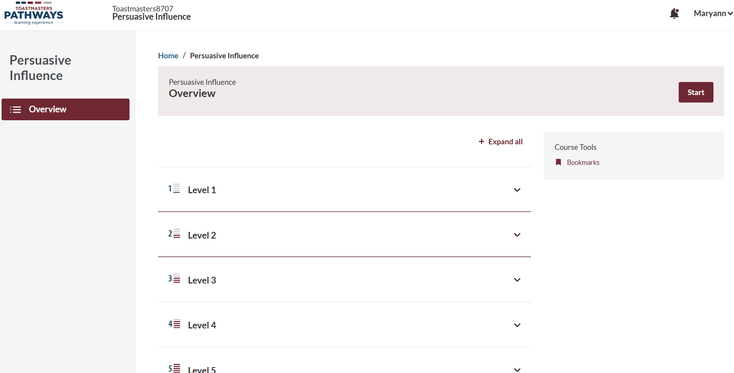

Notes:
If this is your initial activity for this Path click the START tab. If it isn’t your initial activity, RESUME will be shown instead.

Slide 13
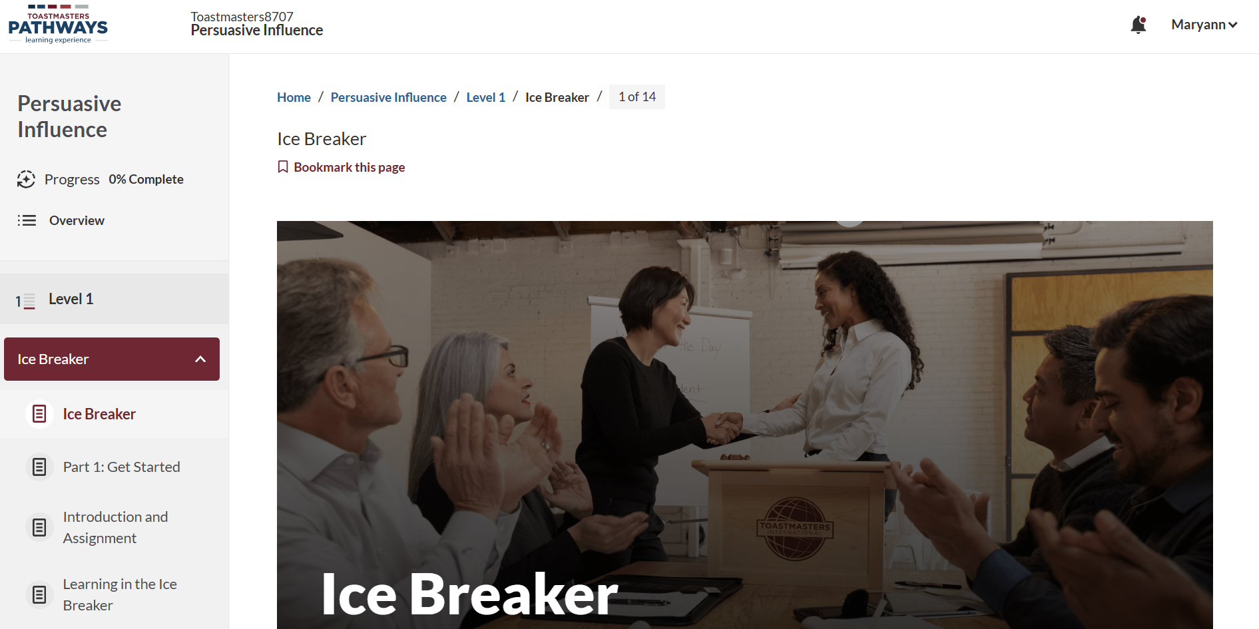
Notes:
When you select START you are taken to Level 1, Project 1, the Ice Breaker.
The left panel drop down list is the same as what was on the bottom, center section, of a Legacy Project.
To get back to the Project cover page, you can select OVERVIEW at any time to return to the initial screen selection for the Path.
If you scroll down the page you will see the resources page that is where you can download the Project PDF if you choose.

Slide 14
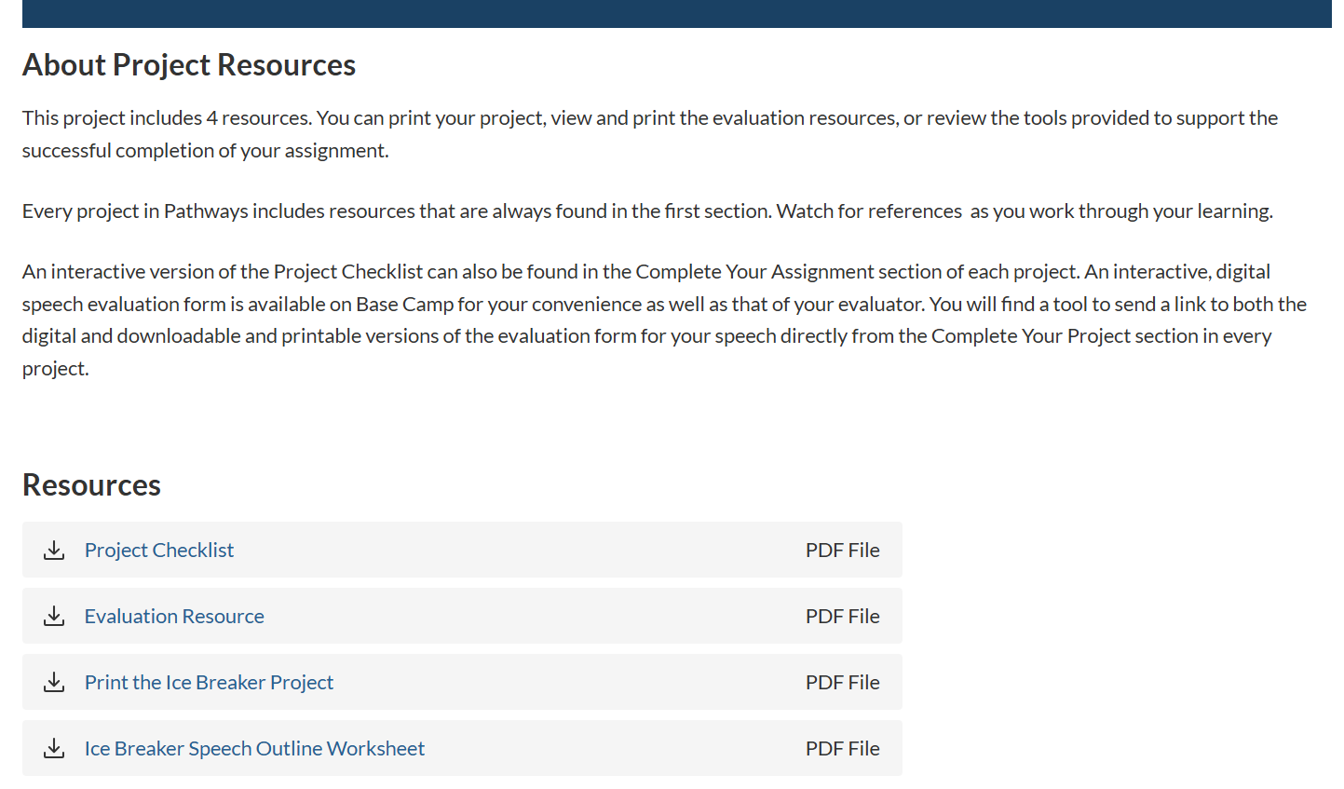




Notes:
The Resources are the same as in the Legacy Paths and is always on this page of any Project.

Slide 15
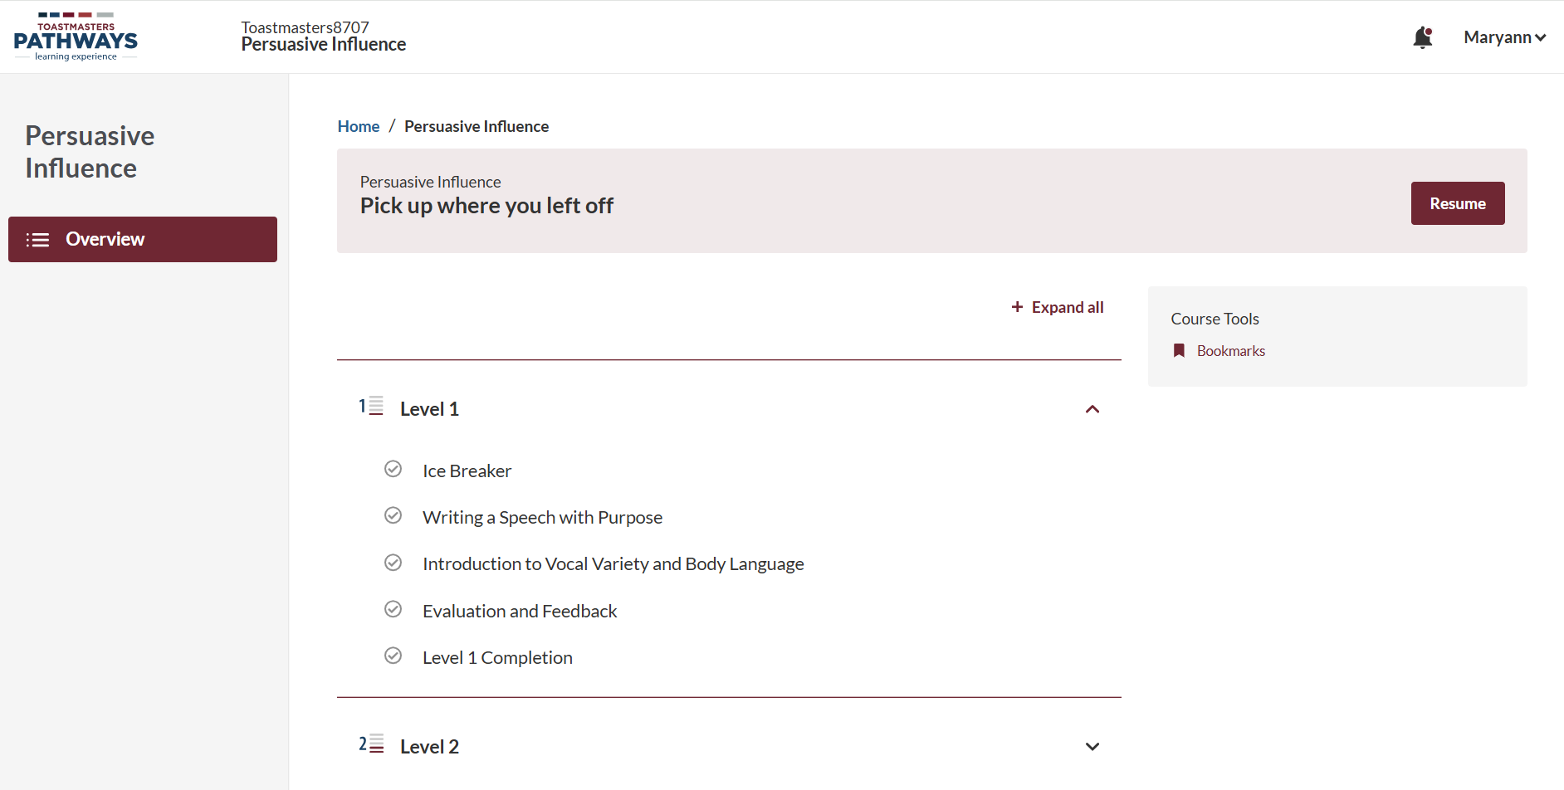

Notes:
This is an example of what your second foray into this Path will look like. Note all the Level 1 Projects are the same as in the Legacy Project.

Slide 16
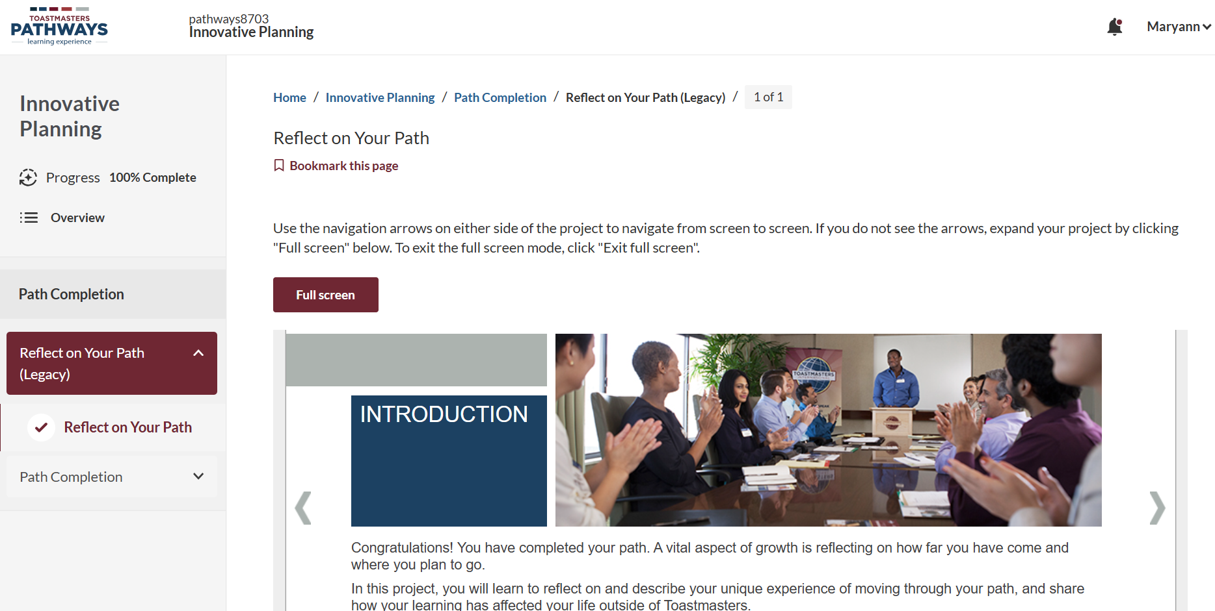
Notes:
This is an example of what a Legacy Project would look like. There is, at this time, no time limit for completion of a Legacy Path.

Slide 17
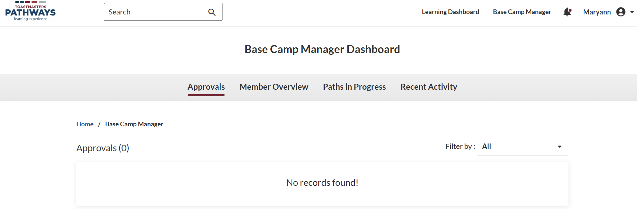
Landing page when Base Camp Manager tab is selected

Slide 18
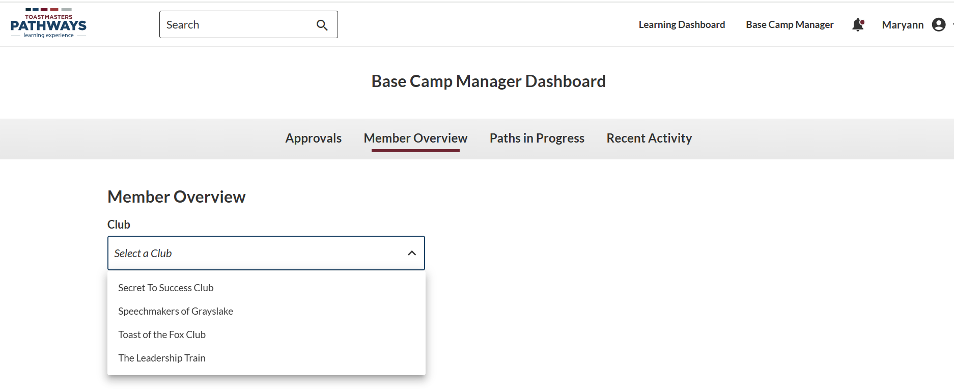
Notes:
If you are a member of more than one club the drop down list will appear for you to select which club you wish to review.

Slide 19
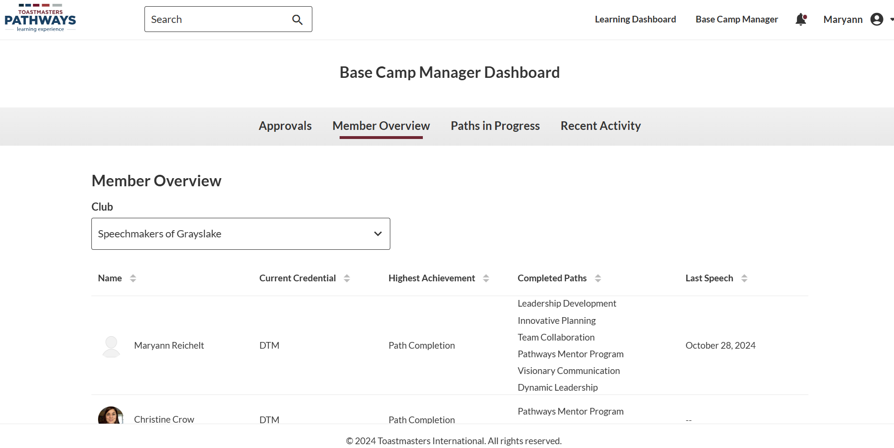

Slide 20
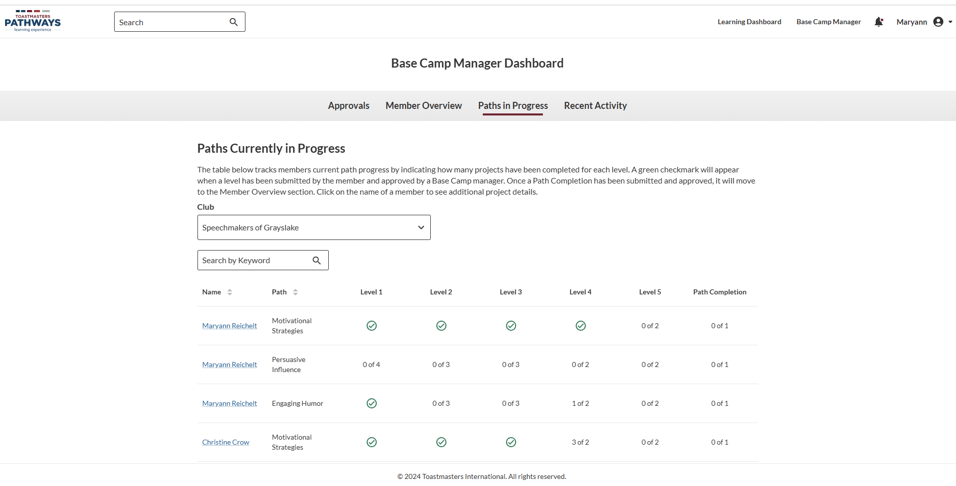

Slide 21
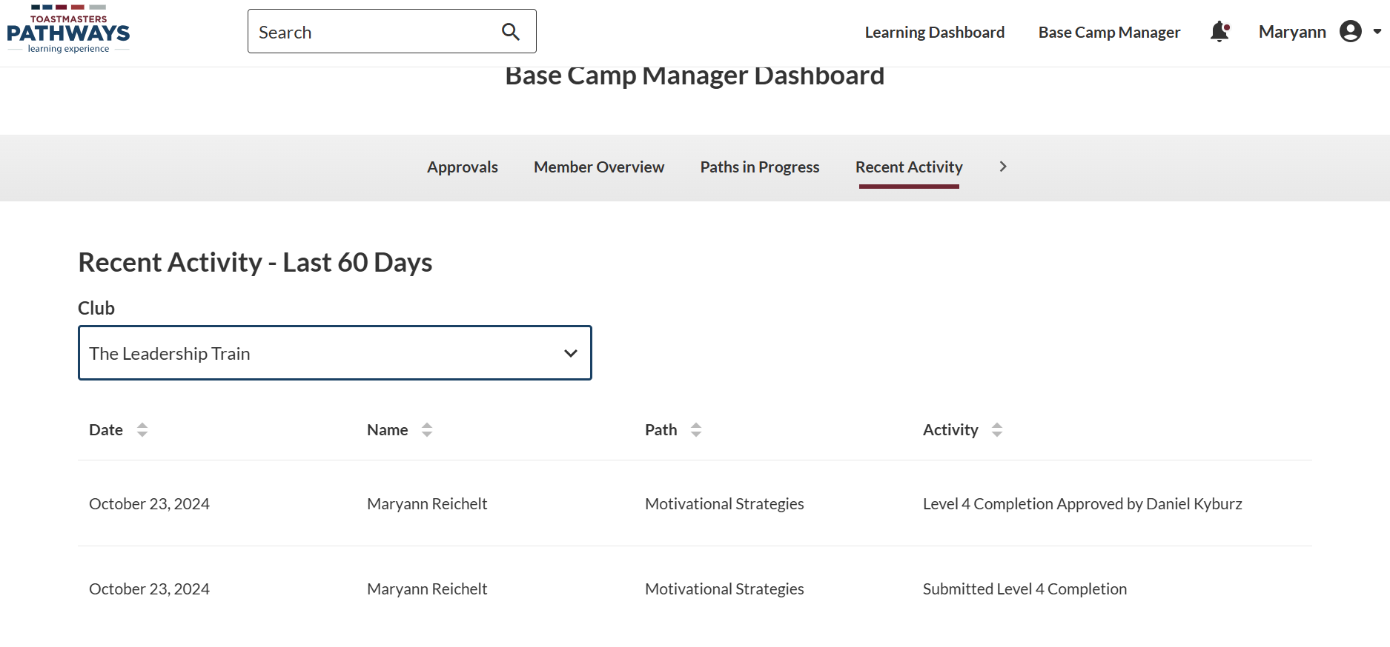

Slide 22
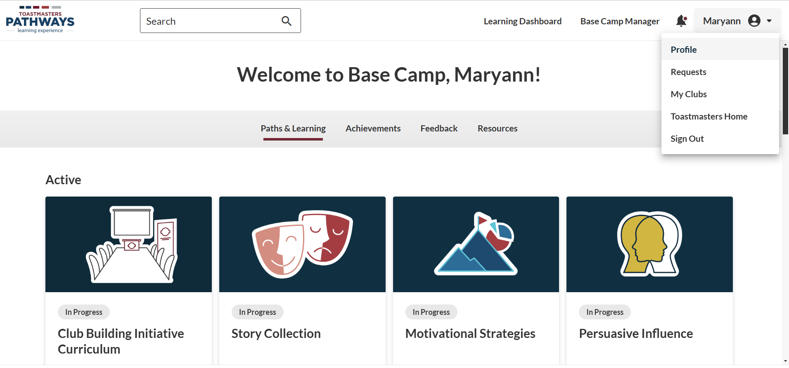

Notes:
This is where you can see all the members of your club, see their profile, send them feedback, and print or save a PDF version of their certificates.

Slide 23
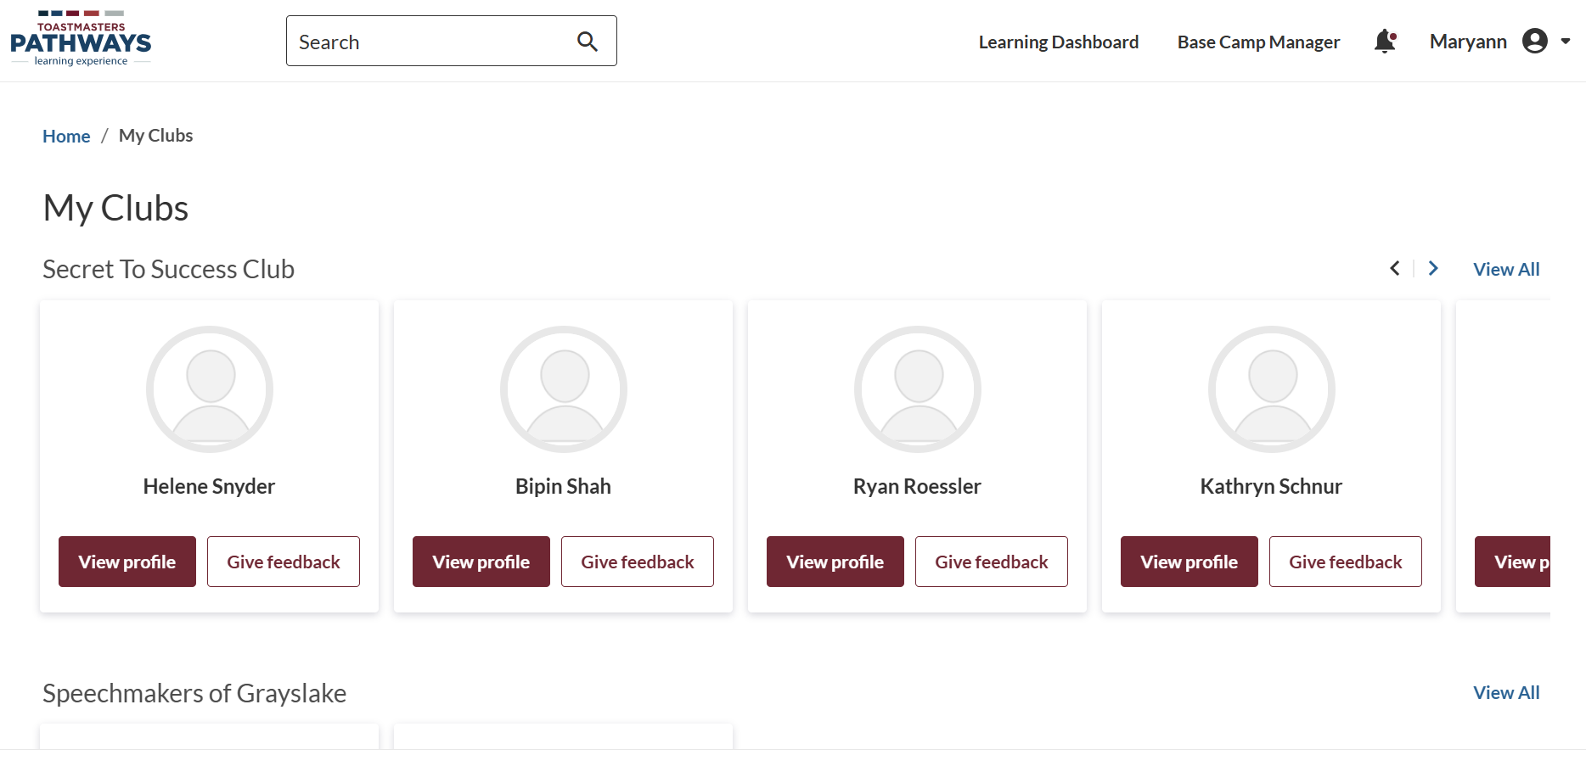
Notes:
These are my D30 clubs. My D54 clubs are listed below on this website.

Slide 24
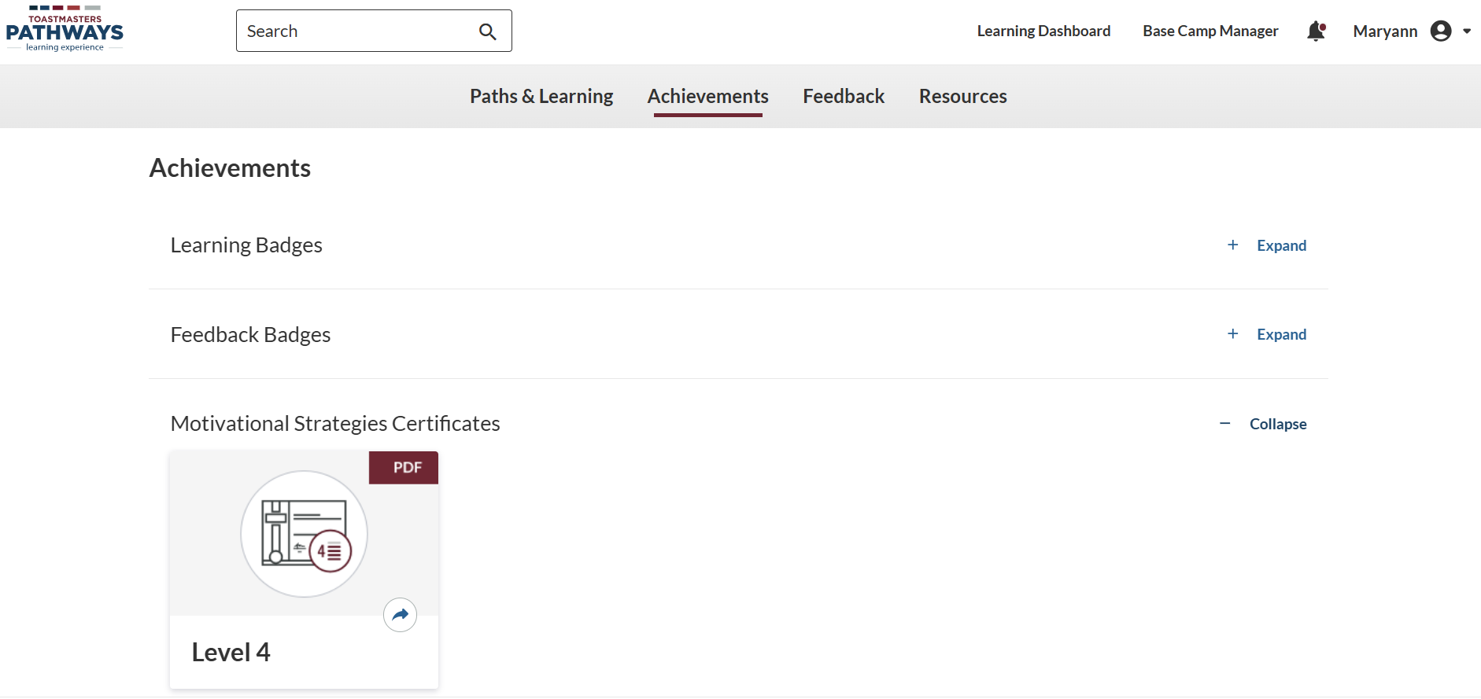


Certificates
Notes:
You can click on the icon OR choose to click on the backwards arrow to get a webpage version.

Slide 25
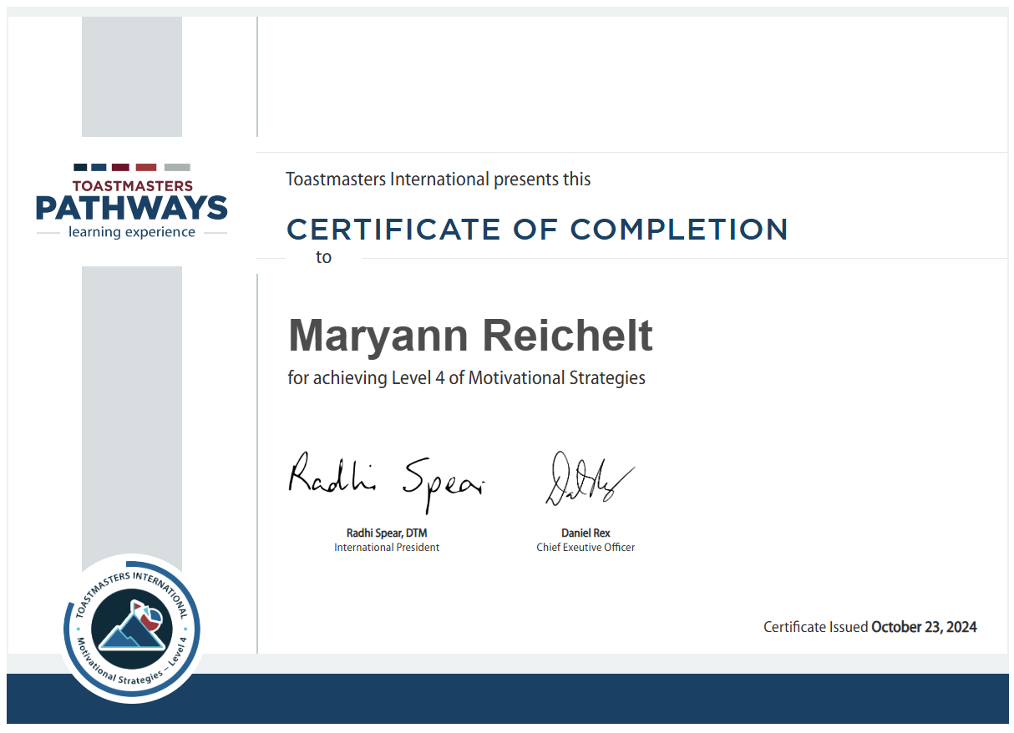

Slide 26
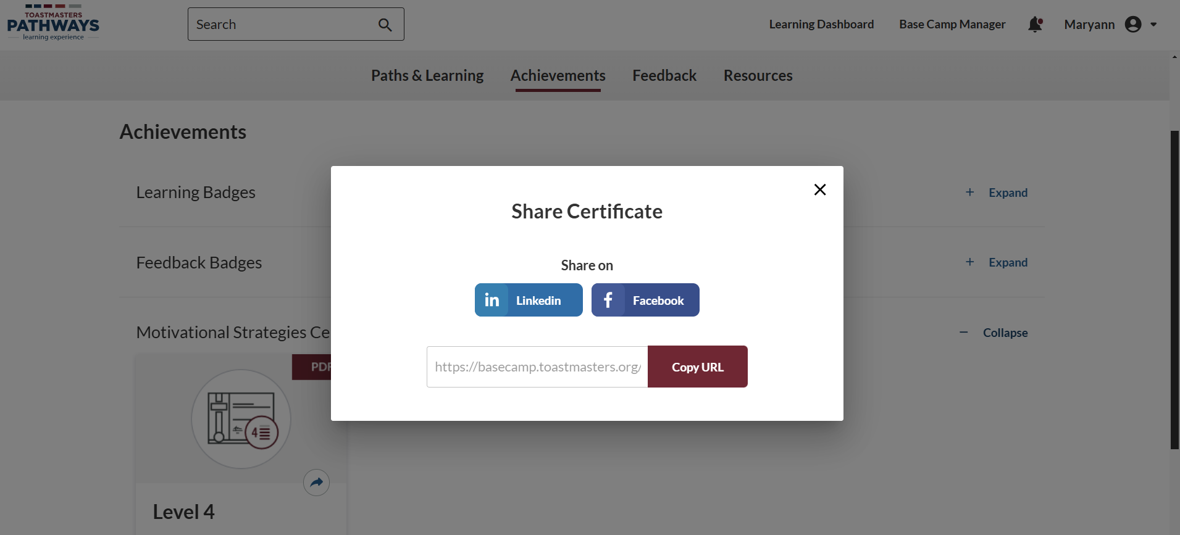
Notes:
This is how you can share awards on social media.

Slide 27
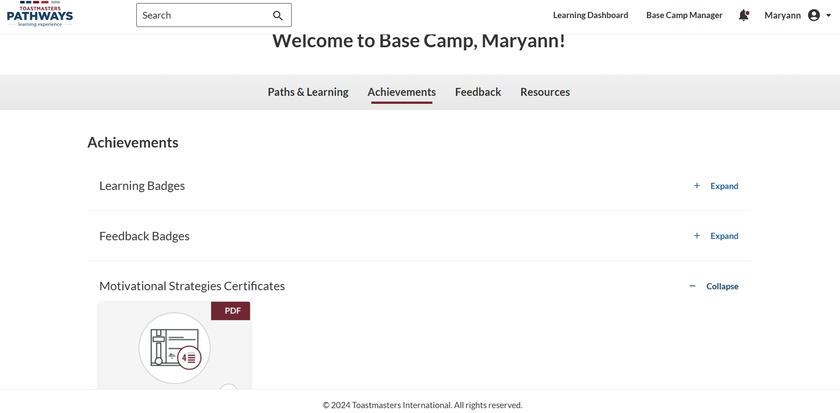

Notes:
This is how you can print or save your certificate as a PDF.
Click on the certificate image … next slide for further details.

Slide 28
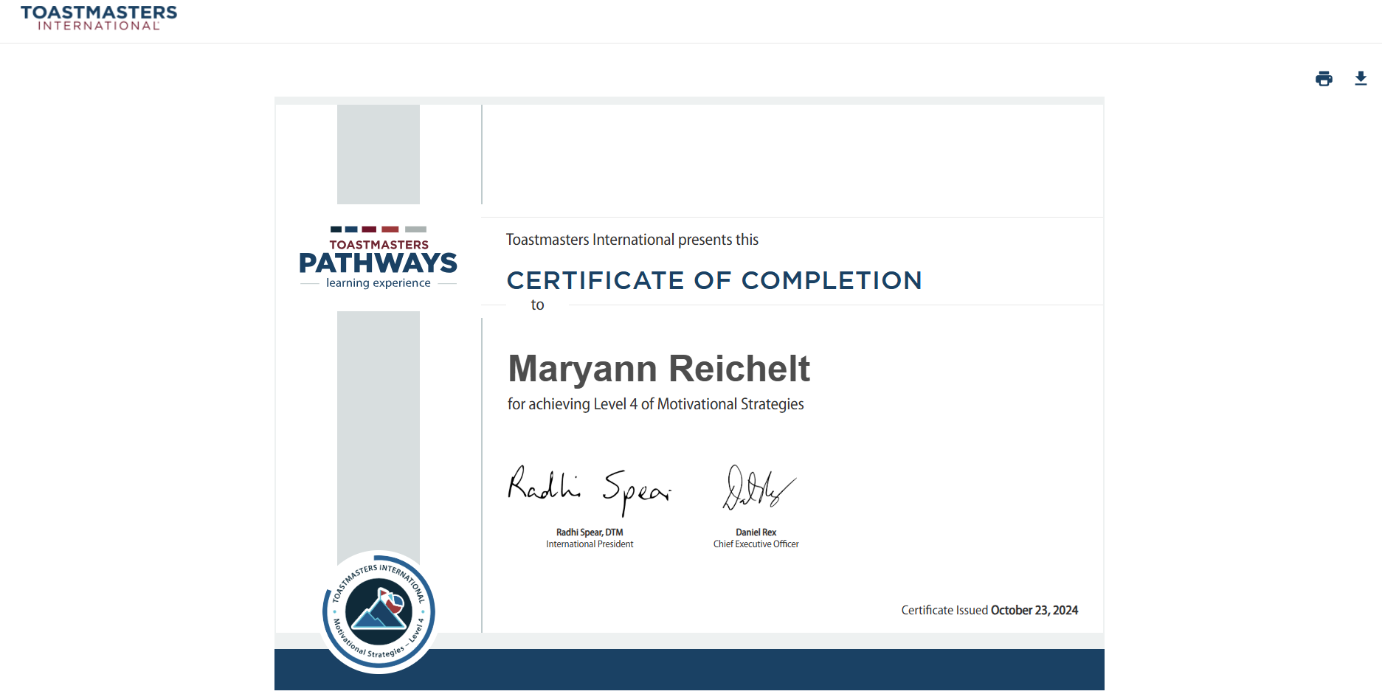



Notes:
Click on the Print or Download icon to print or save a PDF copy of the certificate.

Slide 29
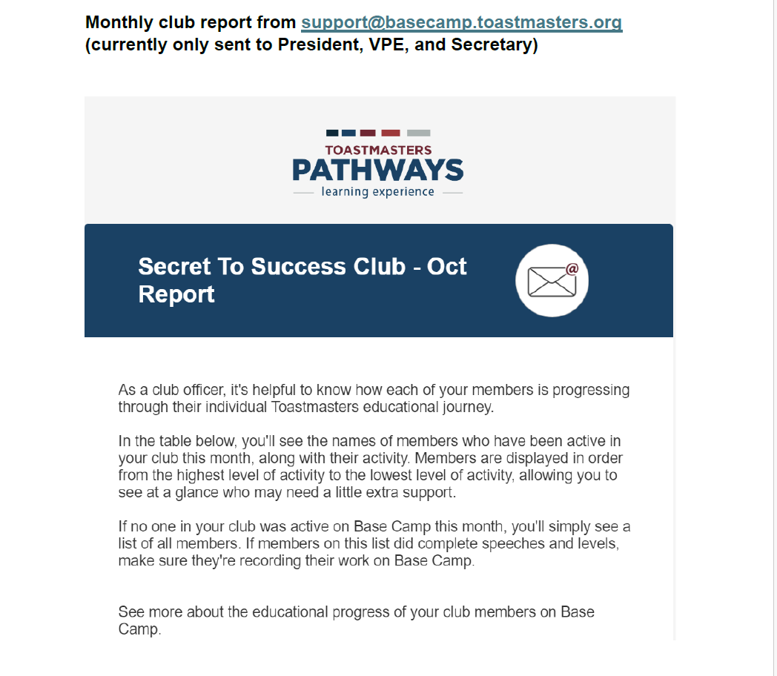
Monthly report sent to club officers
Notes:
The President, V P Education, and Secretary will receive this monthly report of the club’s Pathways activity.

Slide 30
Resources
Base Camp User Guide
Base Camp Manager User Guide
Both can be found in the Resources tab

Slide 31
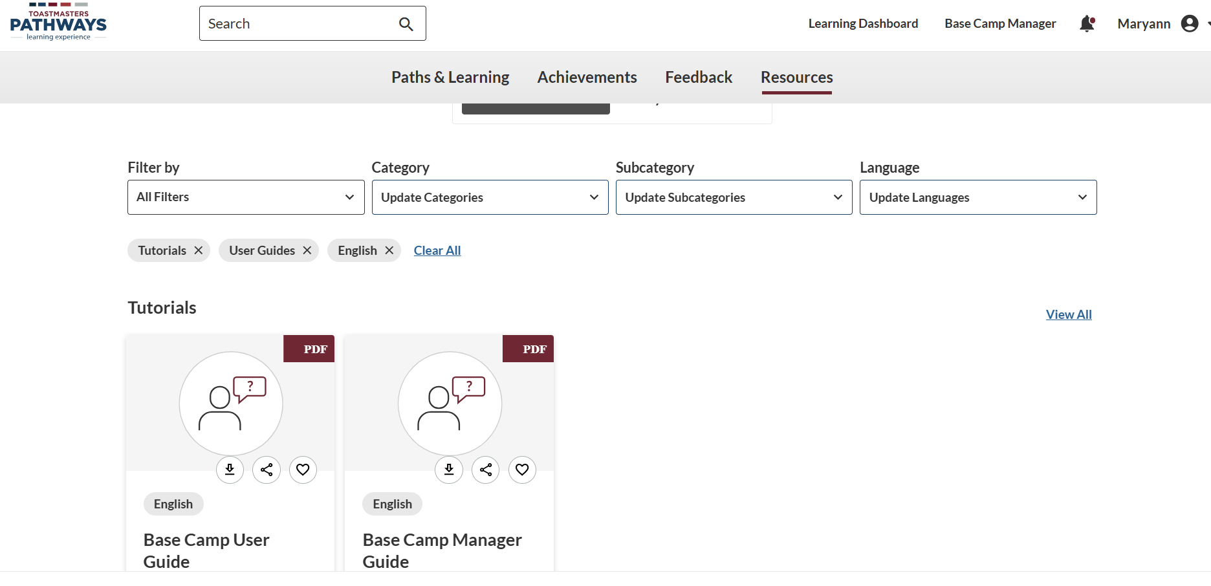



Notes:
Be sure to use the Pathways Resources tab!
Pathways videos are also available.

Slide 32

Questions?

