Slide 1
Creating a Quality Club
Club Officer Training
Jon Greiner, Dick Poirier

Slide 2

Session Objectives
Identify the elements that satisfy & engage club members.
Understand relationships among Moments of Truth, Club Success Plan and Distinguished Club Program
Identify your leadership role
Understand District support & Communication

Slide 3

Member Engagement
How do we engage our members?

Slide 4
Toastmasters’ Club Mission
We provide a supportive and positive learning experience in which members are empowered to develop communication and leadership skills, resulting in greater self-confidence and personal growth.

Slide 5
Toastmasters’ Club Mission
We provide a supportive and positive learning experience in which members are empowered to develop communication and leadership skills, resulting in greater self-confidence and personal growth.

Slide 6
Toastmasters’ Values
Integrity
Respect
Service
Excellence

Slide 7
Building Club Quality
The Quality Club
DCP/Club Success Plan
DCP/Club Success Plan
Moments of Truth
Moments of Truth
Mentoring
Peer feedback
Guiding
Principles
Experiential Learning
Self-paced program
Values
Club Mission

Slide 8
The Path to Success
Where are we? (Moments of Truth)
Where do we want to be? (DCP)
How will we get there? (Club Success Plan)
DCP (Goals)
Club Success Plan (The Path)
Moments of Truth (Assessment)

Slide 9
Moments of Truth
First Impressions
Membership Orientation
Fellowship, Variety and Communication
Program Planning and Meeting Organization
Membership Strength
Achievement Recognition

Slide 10
Distinguished Club Program (DCP)
Education
  Members, who have the opportunity to earn education awards, are reaching their goals
Membership
  With enough members, everyone’s experience is enhanced because leadership is provided and meeting and committee assignments are filled
Training
  Trained club officers are better able to serve and support your club
Administration
  Fulfilling administrative duties helps your club run more smoothly, which benefits members

Slide 11
DCP Goals
Four members complete Level 1
Two members complete Level 2
Two more members complete Level 2
Two members complete Level 3
One member completes Level 4, Level 5 or DTM
One more member completes Level 4, Level 5 or DTM
Toastmasters Pathways Learning Experience
Must have 20 members or net gain of 5 by 6/30
Four new members
Four more new members
Membership
A minimum of four club officers trained during each
of two training periods
Training
On-time payment of membership dues for at least eight members for one dues period &
On-time submission of one club officer list (by 6/30 of previous year)
Administration

Slide 12
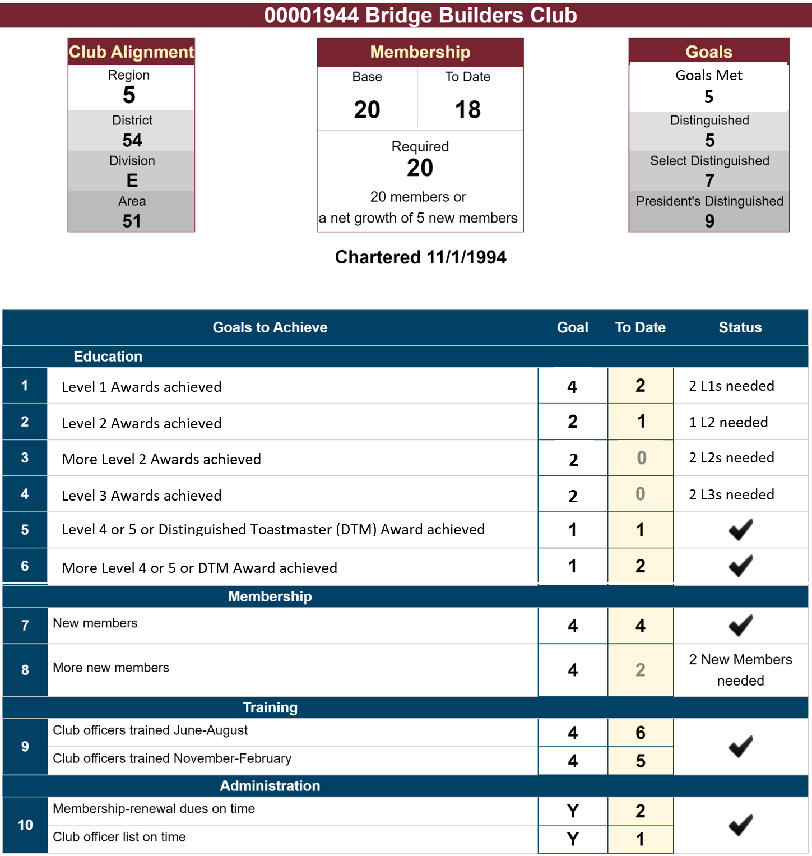

XYZ Toastmasters

Slide 13
Club Success Plan
Education
  Identify members who can reach their goal, resources needed, barriers, support activities, timeframe
Membership
  Methods for gaining & retaining members, resources needed, barriers, support activities, timeframe
Training
  Commitment from club officers to attend training, barriers
Administration
  Ensure club dues and officer list is timely, who and when

Slide 14
The Path to Success
DCP (Goals)
Club Success Plan (The Path)
Moments of Truth (Assessment)
Rework the plan as needed

Slide 15
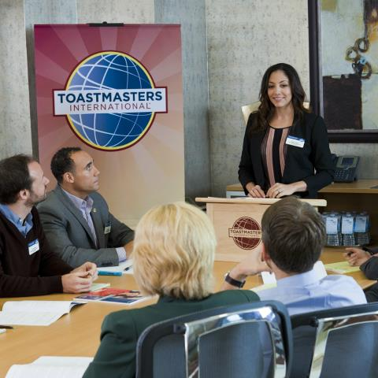
Communication & Teamwork

Slide 16
The Gestalt Approach to Teamwork
The whole is greater than the sum
of its parts.
  Know your role.
  Know the roles of your teammates.
  Communicate your areas of strength.
  Take a proactive approach.
  Be willing to cover for another officer.
Roles may vary based on Club Tools and/or officer expertise

Slide 17
The Executive Committee
President
Vice president education (VPE)
Vice president membership (VPM)
Vice president public relations (VPPR)
Secretary
Treasurer
Sergeant at arms (SAA)
Immediate Past President

Slide 18
Executive Committee Duties
Create a club budget
Strategize for success in the Distinguished Club Program
Develop/implement a Club Success Plan (Item 1111)
Create and oversee other club committees as necessary

Slide 19
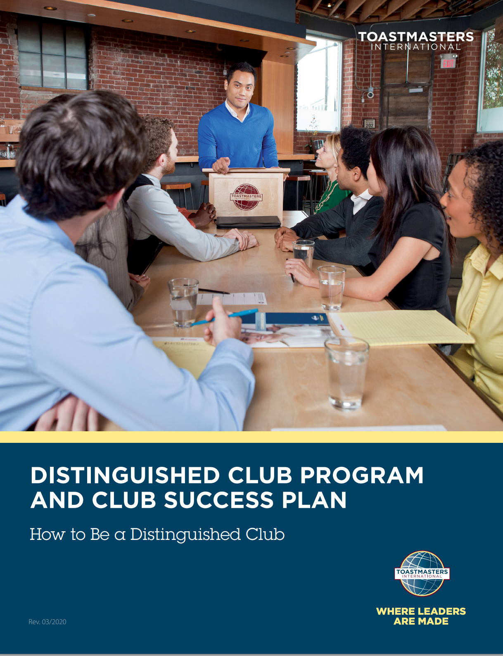
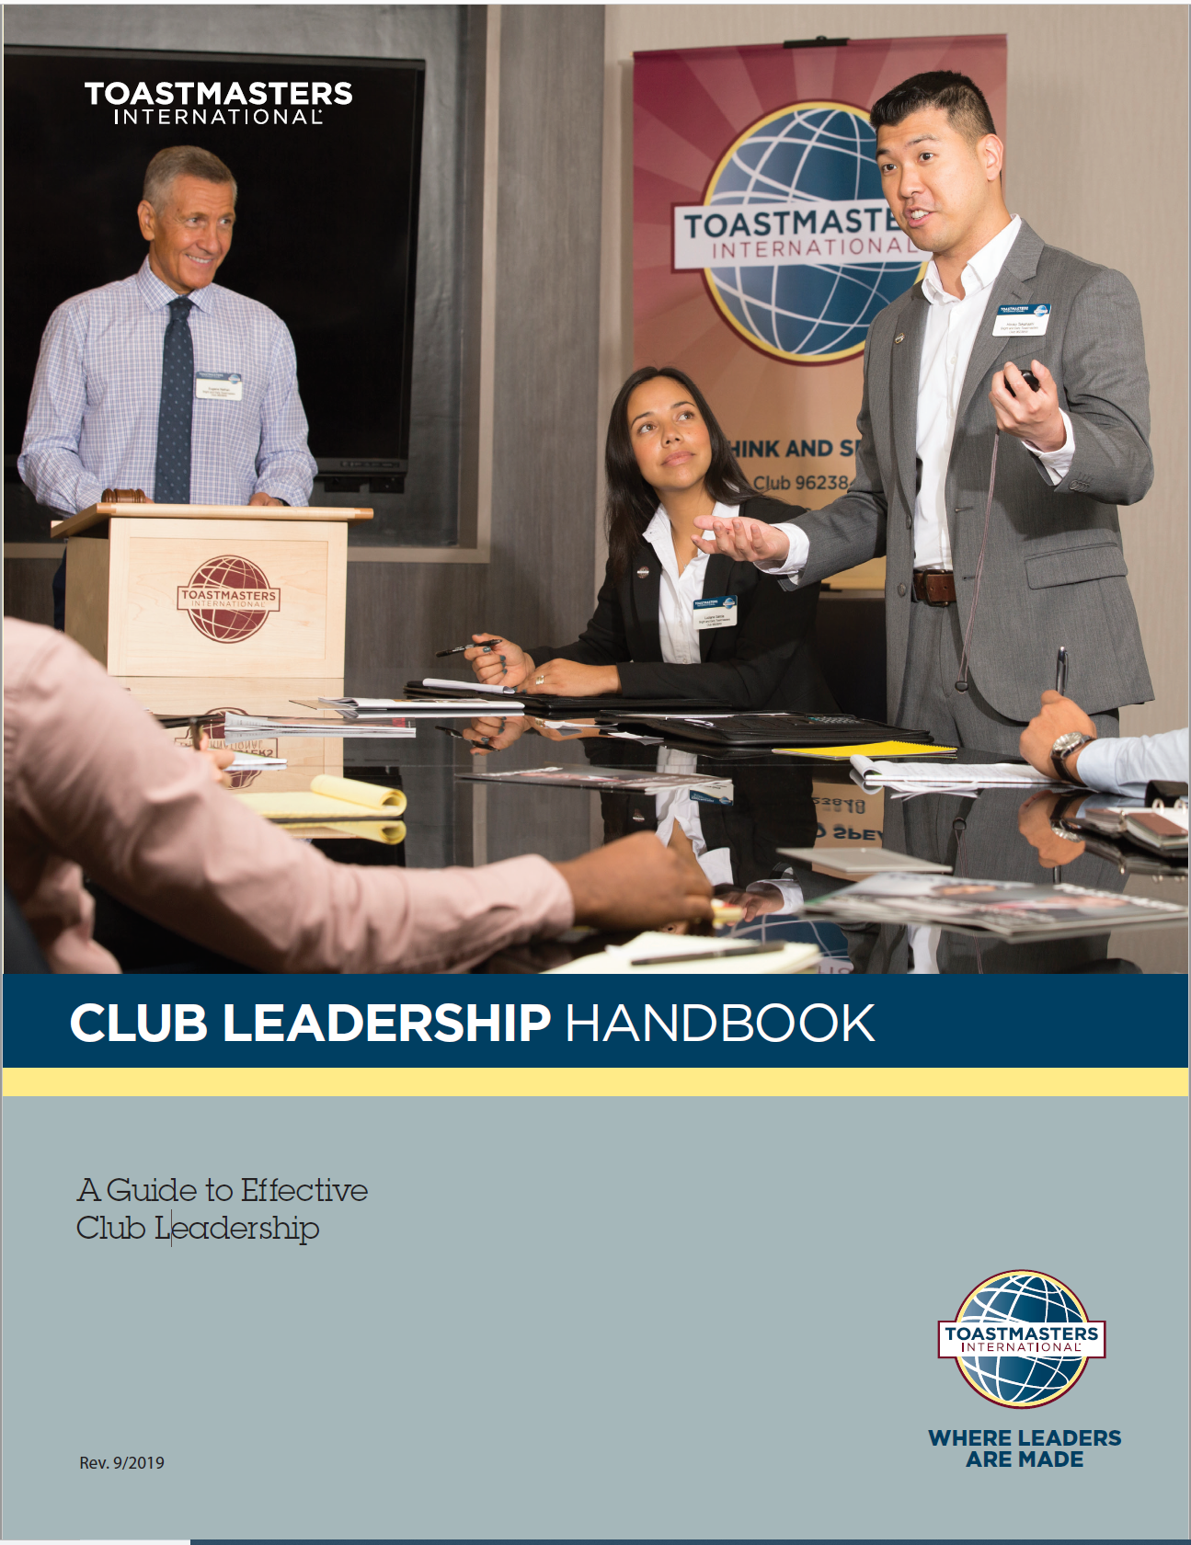
Resources
1111
1310
290A
15

Slide 20
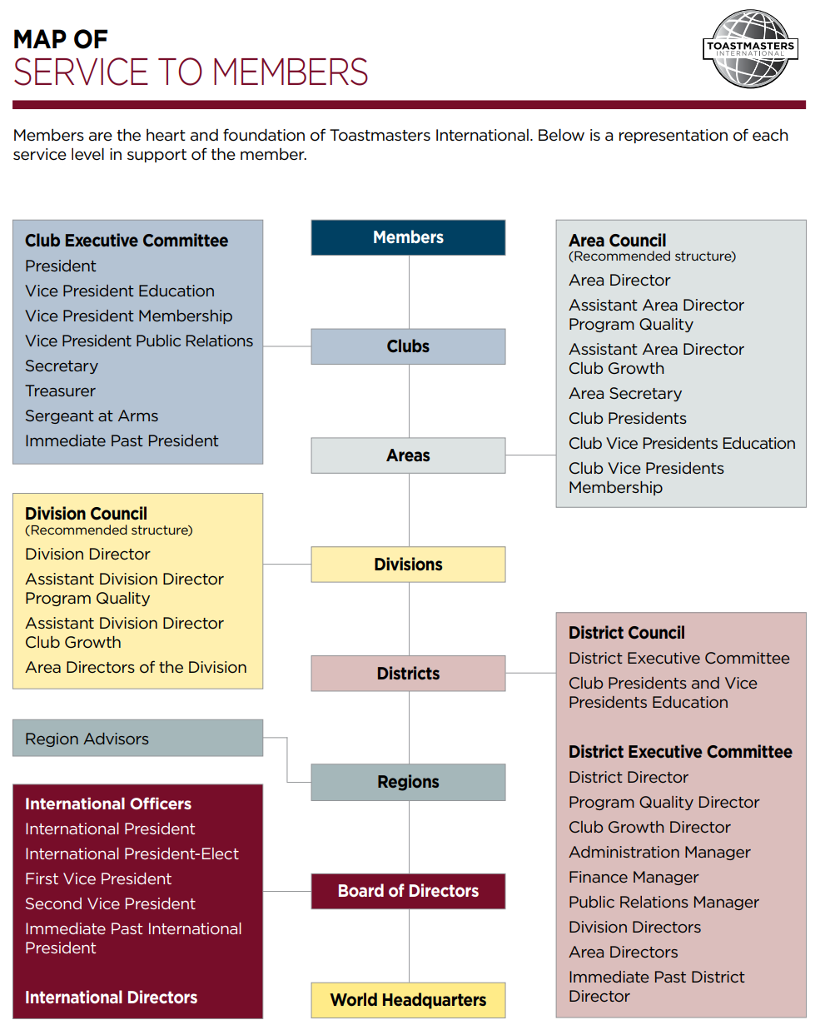
Other Resources
Area Director
Division Director
Other Clubs
District Leadership

Slide 21
Other Resources
Club Coach (for less than 13 members)
Various district support staff positions, e.g.:
  Pathways Support Team
  Leadership Path Coordinator (for HPL Projects)
  Public Relations Manager
International website: www.toastmasters.org
District website: www.d54tm.com

Slide 22
The Next Step(s)
What will you do back at your club?
When will you do it?
Who is responsible?
Success and quality don’t just happen….
…..Let’s plan for it

Slide 23
This concludes
Creating a Quality Club.
Club Officer Training

Slide 24
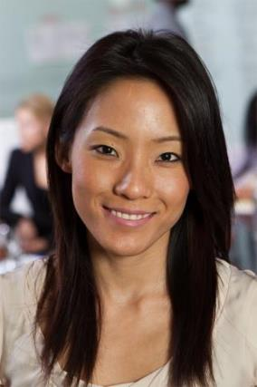
The President
Sets the tone for the club
Provides helpful, supportive leadership
Facilitates communication
Knows membership levels and progress
Serves as Base Camp Manager
Ensures executive officers are functioning well and the club focuses on DCP status and Success Plan
Guides the executive committee and club towards goals

Slide 25
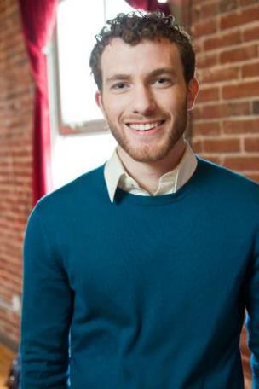
The VPE
Encourages members to complete their communication and leadership goals
Schedules member speeches and projects
Serves as Base Camp Manager
Serves as a resource for questions about education awards, speech contests and mentors
Is a source for Toastmasters knowledge and the education program

Slide 26
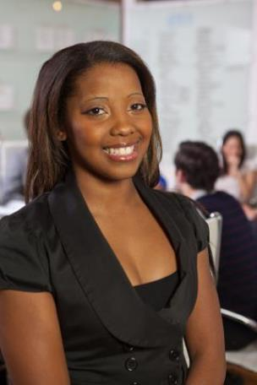
The VPM
Promotes the club and manages the process of bringing in guests and transforming them into members
Initiates contact with guests, makes them feel welcome and provides information to join the club
Works with the VPPR and the treasurer

Slide 27
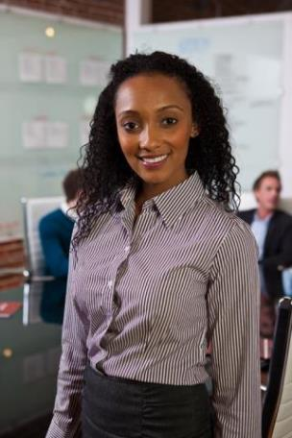
The VPPR
Promotes the club to the community/ corporation through activities that increase membership
Publishes meeting times and locations
Writes a newsletter
Maintains social media sites such as Facebook, Twitter and MeetUp.

Slide 28
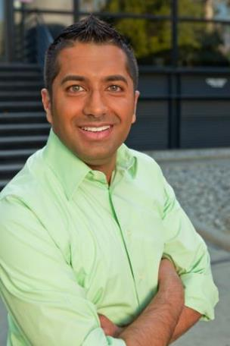
The Secretary
Manages accurate files, all club records and correspondence
Takes the minutes at every meeting
Archives historical records
Records all member and guest attendance
Distributes the club roster of current paid memberships
Maintains a current club officer list
Serves as Base Camp Manager

Slide 29
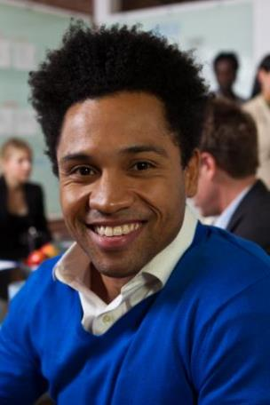
The Treasurer
Is the club’s accountant
Keeps financial records
Manages the club’s bank account
Writes checks as approved by the executive committee
Collects and pays dues on time to World Headquarters
Works with the executive committee to create the budget

Slide 30
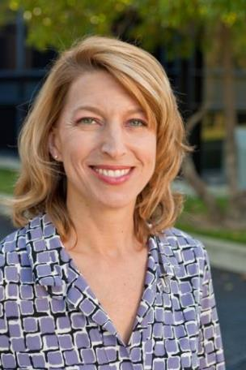
The SAA
Is responsible for the club’s physical property
Arrives early
Sets up the meeting location
Removes club property after the meeting
Creates a good first impression
Sets the tone for the entire meeting.

