Slide 1
DISTRICT 54
DTM Award Ceremony
November 7, 2020

Slide 2
Toastmasters International Statement
By attending this remote event, you agree to the privacy policy of Toastmasters International as well as the unassociated remote hosting service. Some of your personal information, such as name, image, and any shared messages may be shared with other meeting participants and will be recorded by Toastmasters International who may use the recording in the future as it sees fit. Your remote attendance hereby discharges Toastmasters International from all claims, demands, rights, promises, damages and liabilities arising out of or in connection with the use or distribution of said video recordings, including but not limited to any claims for invasion of privacy, appropriation of likeness or defamation.

Slide 3
Virtual Meeting Conventions
MICS & VIDEO
CHAT
Mute ON!
Video OFF!
Check chat for our event program
When open, please heap praise and congratulations, both publically and privately

Slide 4
District 54 Virtual DTM Award Ceremony
Opening Remarks Bala Sreedharan
Honored Guests
Region 5 International Director Mohamad Qayoom
Region 5 Regional Advisor Phil Varona
Past International President Jon Greiner
Immediate Past D54 Director Chris Boyk
Presentation of DTM Awards Maryann Reichelt
Closing Remarks Bala Sreedharan

Slide 5
Michael R. Cummings Esprit De Corps

Slide 6
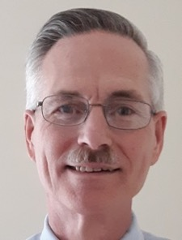
Michael R. Cummings
July 16, 2019

Slide 7
Hariharan Senthilnathan Four Seasons

Slide 8
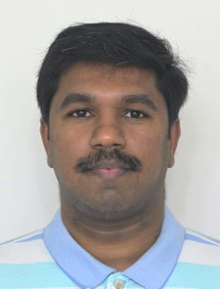
Hariharan Senthilnathan
September 17, 2019

Slide 9
Rakesh Chandra State Farm Talkin' 24/7

Slide 10
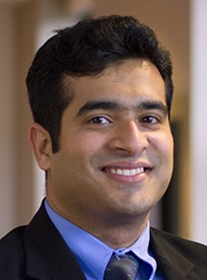
Rakesh Chandra
December 2, 2019

Slide 11
Ray P. Termini Timely Talkers

Slide 12
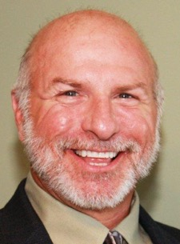
Ray P. Termini
December 24, 2019

Slide 13
William Neuman Listen, Learn, Lead

Slide 14
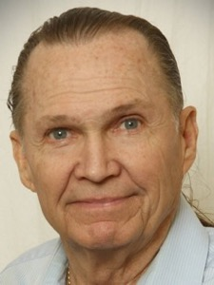
William Neuman
February 13, 2020

Slide 15
Carol A. Loser Logistically Speaking

Slide 16
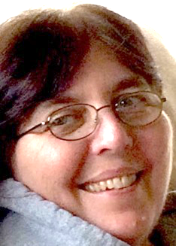
Carol A. Loser
February 15, 2020

Slide 17
Jacqueline Taylor Logistically Speaking

Slide 18
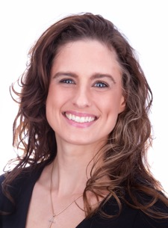
Jacqueline Taylor
April 1, 2020

Slide 19
Daniel J. Kyburz Timely Talkers

Slide 20
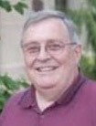
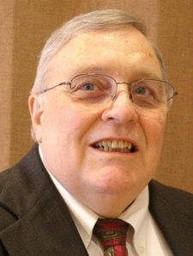
Daniel J. Kyburz
May 5, 2020

Slide 21
Sara Amaravadi State Farm Landmark

Slide 22
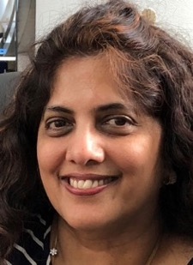
Sara Amaravadi
May 28, 2020

Slide 23
Dwayne E. Mickelson Morris Area

Slide 24
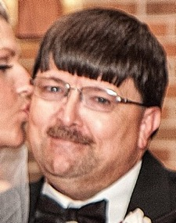
Dwayne E. Mickelson
May 29, 2020

Slide 25
Ronald L. Korte Toast of the Fox

Slide 26
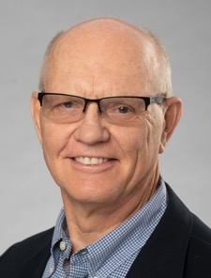
Ronald L. Korte
June 17, 2020

Slide 27
Valerie M. Horton Caterpillar Employees

Slide 28
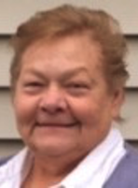
Valerie M. Horton
June 19, 2020

Slide 29
Rudy Segovia Advanced Expressives

Slide 30
Rudy Segovia
June 20, 2020

Slide 31
Helen Haynes College of Business

Slide 32
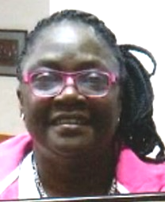
Helen Haynes
June 22, 2020

Slide 33
Mary Lynn Edwards State Farm OAKS

Slide 34
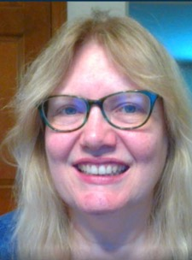
Mary Lynn Edwards
June 22, 2020

Slide 35
Steve Cohen Advanced Expressives

Slide 36
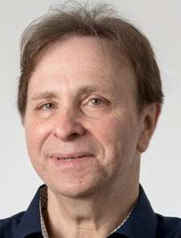
Steve Cohen
June 25, 2020

Slide 37
Heather M. Blasé Progressively Speaking

Slide 38
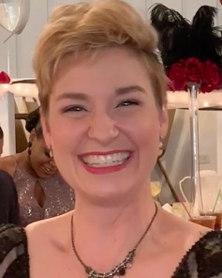
Heather M. Blasé
June 29, 2020

Slide 39
Catrina Eimer State Farm Speakeasy

Slide 40
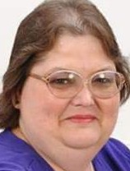
Catrina Eimer
June 29, 2020

Slide 41
Craig Karvala Lincoln-Way

Slide 42
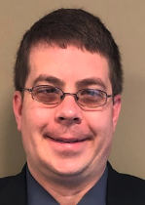
Craig Karvala
July 8, 2020

Slide 43
Jemma Ku McKinley

Slide 44
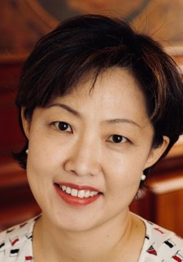
Jemma Ku
August 3, 2020

Slide 45
Congratulations to all our new DTM’s!

