Slide 1

Let's
Have FUN

Slide 2

Happy

Slide 3

HAPPY LOVE-YOU-ARY

Slide 4

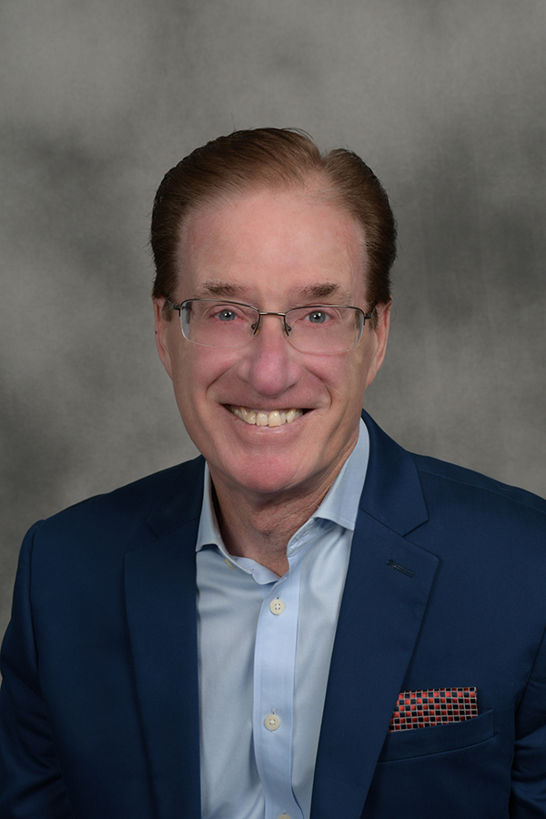
Express Your Best Self: Go for Connection Not Perfection
Jerry Evans, DTM

Slide 5
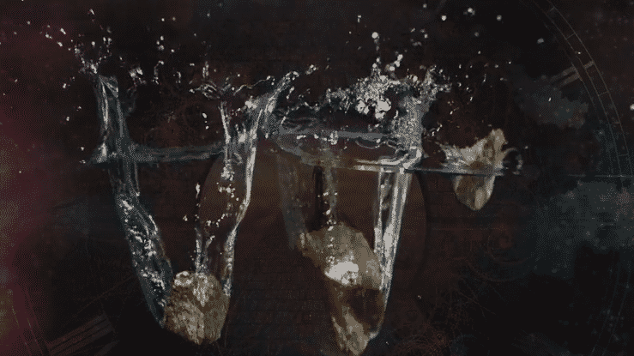

Slide 6

#1. Be Authentic
Authenticity Always Trumps Perfection

Slide 7


Slide 8
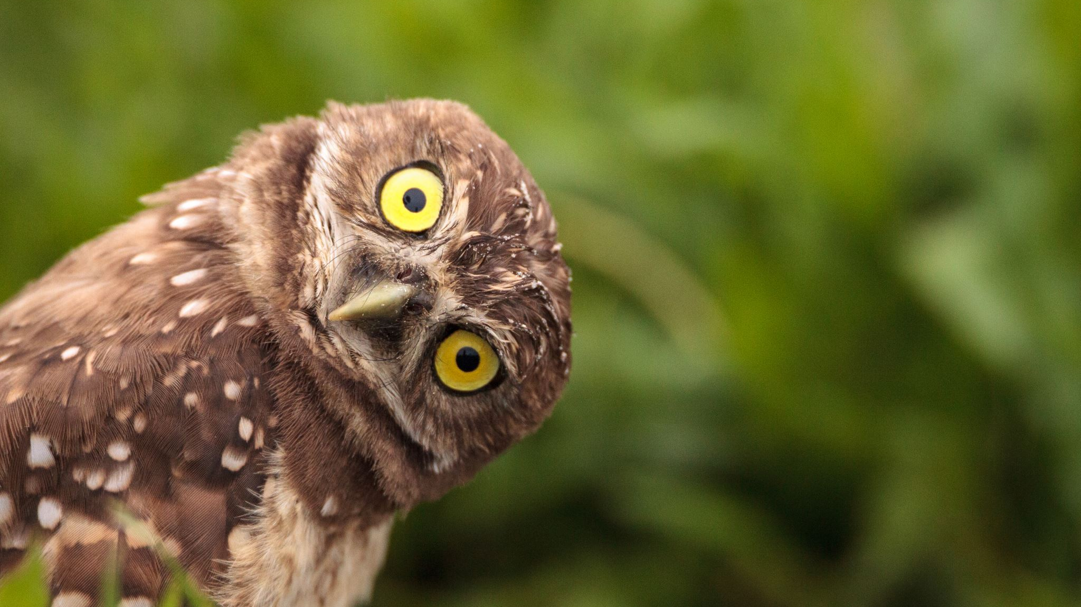
#2. Be Curious

Slide 9

#3. Really Listen

Slide 10


Slide 11
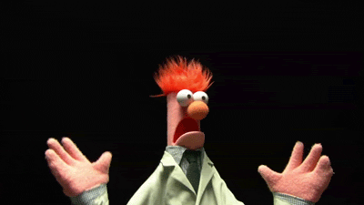
NERVOUS
﻿about Your Upcoming Speech?

Slide 12

#4. Tell Stories

Slide 13

Perfect people aren’t real and
Real people aren’t perfect.

Slide 14
Go for Connection Not Perfection

Slide 15

Contact Information
Jerry Evans, DTM
jerry@theawardscompany.com
Cell: 630-640-9219

