Slide 1
Rebuilding Clubs
Area & Division Director Training
August 2021
Notes:
Duration: 1 hour

Slide 2
Mission
Club
We provide a supportive and positive learning experience in which members are empowered to develop communication and leadership skills, resulting in greater self-confidence and personal growth.
Toastmasters International
District
We empower individuals to become more effective communicators and leaders.
We build new clubs and support all clubs in achieving excellence.
Notes:
We know the Toastmasters International and the District Missions.
(CLICK and ASK:) Who can tell me what the Club mission statement is? (let participants respond)
Club Mission: Clubs are the way to empower more individuals to become better communicators and leaders. The members who make-up the club are the base – the foundation – the reason we do the work we do. Clubs are the way to empower more individuals to become better communicators and leaders.
TI Mission: ASK: How does the Toastmasters mission relate to the district mission?
The district mission is the manner in which the Toastmasters International mission is fulfilled.
District Mission: ASK: How do the Toastmasters and district missions relate to club-building?
Make the District mission a reality by staying focused on the clubs and members you serve. Remember, every club is a group of people seeking the opportunity to grow and develop through the Toastmasters education program.
There is a direct relationship between the club, district and international mission statements. Just as your club members have individual goals they strive to achieve, by achieving those goals they are helping their club be successful – which in turn helps the Area be successful, then the Division, etc. Earning recognition for your Area, Division, or District is not something that you can accomplish by yourself. It takes a team of people who are dedicated to a common goal, have a plan, and execute it well. We have a shared responsibility and must depend on one another to achieve our common goal(s). Teams are the most effective way of meeting your Area, Division, and District goals.

Slide 3
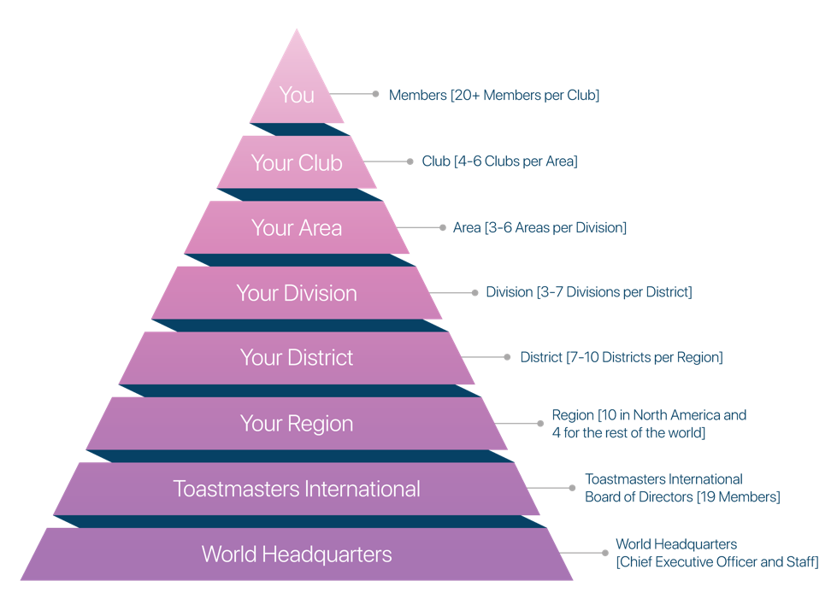
The Toastmasters Hierarchy
Notes:
District leaders put service above self in supporting all clubs in achieving excellence. While most people come to Toastmasters to become a better speaker, members evolve into natural leaders by participating in Toastmasters club meetings.
Looking at the Toastmaster hierarchy pyramid, the top position is held by the most important person, the member. Every other role supports the member’s individual growth. That is Why Toastmasters works!
Alternately, if we don’t have quality clubs, they are weak, faltering, and not meeting member needs, then we aren’t supporting our members – it’s time to rebuild!

Slide 4
Session Objectives
Understand why clubs are rebuilt
Determine when a club needs to be rebuilt
Identify who will do the work
Notes:
Walking into a club-in-need can be a difficult experience, but it’s important to remember that each club is different and has different needs. The members of some clubs desperately want to keep the club going, but don’t know how. Other clubs may not meet any more so you may need to track down the last members of the club and motivate them to continue with the club.
After today you should be able to (at a high level):
Understand why clubs are rebuilt
Determine when a club needs to be rebuilt
Identifying who will do the work

Slide 5
How do you know when a club is doing well?
Notes:
ASK: How do you know when a club is doing well?

Slide 6
How do you know when a club is struggling?
We could use the help of a Club Coach!
Notes:
ASK: How do you know when a club is struggling?
(CLICK for thought bubble): We could use the help of a Club Coach!

Slide 7
Why are clubs rebuilt?
Club existence is in jeopardy:
Lost its leadership base
Natural attrition
Community / Company need no longer exists to support it
Notes:
A Toastmasters club needs to be rebuilt when, for some reason, its existence is in jeopardy. This may occur because
the club has lost its leadership base to natural attrition or other circumstances
Key member leaves and a motivation, organization, a leadership vacuum occur
the need for the community/company club no longer exists
The need probably still exists but perhaps a production site closed, or the population dwindled
ASK participants to share their ideas as to why clubs may need to be rebuilt

Slide 8
Rebuilding: Club Lifecycle
Club’s educational program is expanding and improving
Members are motivated & enthusiastic
1
Notes:
To understand WHY clubs sometimes need to be rebuilt, you must first understand the club lifecycle.
The first phase in a club’s life occurs during and just after it is organized. The club’s educational program is expanding and improving. The members are motivated, and their enthusiasm generally makes up for their lack of experience. As the educational program improves, productivity increases, and the club moves toward the peak of the curve.

Slide 9
Rebuilding: Club Lifecycle
2
Increased productivity with educational program successfully meeting members’ needs
Original members new relatively experienced
New members join & are quickly assimilated into club culture
Notes:
As the club matures into the second phase, the educational program reaches a high level of productivity and successfully meets members’ needs. The original club members are now relatively experienced Toastmasters. New members join the club and quickly become assimilated into the club’s culture. The length of time spent at the top of the curve varies from club to club.

Slide 10
Rebuilding: Club Lifecycle
3
Members content with status quo
New members have a hard time fitting in & don’t stay long
Productivity declines
Notes:
At the beginning of the third phase, members become content with the status quo and resist change and new influences. Guests are greeted, but the club’s internal cliques are sometimes difficult to break into. New members have a hard time fitting in and don’t stay long. Productivity declines, and the club slips from the top of the curve and begins a downward slide.

Slide 11
Rebuilding: Club Lifecycle
Time for a Club Coach!
Attendance drops
Education program falls apart
Guests don’t join the club
4
Notes:
By the time you get to phase four, attendance drops, the educational program falls apart, and guests do not join the club. Members may be more concerned with socializing than learning.
If the club continues its downward slide and nears the bottom of the curve, something must be done to keep the club from dissolving. (CLICK) In many cases a club coach is appointed to help the members revitalize their club. If the effort is successful, the club’s productivity will increase, and a new life cycle will begin.

Slide 12
Rebuilding: Club Qualifications
Club has at least one but not more than 12 members
May have up to 2 coaches appointed
Coach appointment lasts to June 30th of the current club year if the club becomes Distinguished or better by that date

Slide 13
Rebuilding: Club Coach
A Toastmaster who is not a member of the struggling club upon appointment.
Appointed by District Director or Club Growth Director
Appointment lasts to June 30th of current program year if club becomes Distinguished or better*
Earns credit toward DTM after successful completion
Notes:
The club coach is a Toastmaster who is not a member of the club and not (yet) familiar with the club or its members. This perspective allows the coach to objectively view the club.
A club coach may only be assigned by the district director or the club growth director.
A club must have at least one but not more than 12 members when a coach is appointed, and the coach cannot be a member of that club until their appointment request has been processed.
Up to two coaches may be appointed to a club.
The appointment lasts to June 30 of the current program year if the club becomes Distinguished or better. If distinguished club status is not reached in the initial program year, the assignment will be extended to June 30 of the following year.

Slide 14
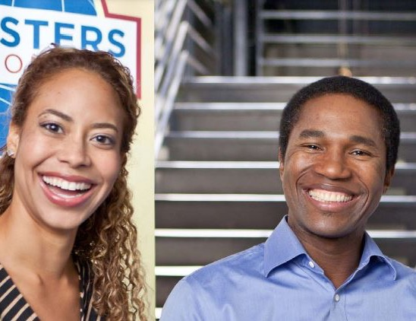
Rebuilding: Club Coach Responsibilities
The coach’s goal is to help the club become a Distinguished Club
Build a rapport with the club’s leaders and members.
Assess the environment – observe, analyze, and recommend solutions
Develop a plan with goals for improvement
Implement the plan & ensure that the changes are performed by the officers and members
Instill enthusiasm, loyalty, and a sense of responsibility for the club’s future
Notes:
The coach is a counselor, a source of knowledge and a fountain of ideas. To be successful as a coach you will need all of your speaking, thinking and listening skills – as well as hard work, determination and patience.
The following is a summary of what a coach must do:
Build a rapport with the club’s leaders and members.
Assess the environment … observe, analyze, and recommend solutions.
Develop a plan with goals for improvement.
Implement the plan and ensure that the changes are performed by the officers and members as much as possible.
Instill enthusiasm, loyalty, and a sense of responsibility for the club’s future.

Slide 15
Rebuilding: Club Coach Responsibilities
1) Build a rapport with the club’s leaders and members
Visit the club & become acquainted with the officers and members
Actively participate in the club
Set a good example
All the individuals on the team have something at stake!
Notes:
Build a personal rapport with the club leadership and members. It is important that you establish this relationship early. Visit the club and become acquainted with the officers and members. Gain their respect and trust by actively participating in the club and setting a good example. Don’t formally join the club until after you have been appointed by your district director or club growth director and the appointment is recognized by World Headquarters.
Arrange for a meeting with the club’s executive committee. During this meeting you should:
Discuss with the officers the purpose of the club coach program, review the role of the coach in their club, offer your assistance as a coach and ask for their support;
Discuss with the club’s leadership their perceptions of the club’s strengths and weaknesses; and
Formulate an action plan, following the guidelines in this manual, and set up a continuous review of the progress being made.
All the individuals on the team have something at stake: the club officers and members have the time and money they have invested in the club, the area director is working to achieve Distinguished Area recognition, and the club coaches are probably motivated to take on this task in order to achieve Distinguished Toastmaster recognition.

Slide 16
Rebuilding: Club Coach Responsibilities
2) Assess the environment – observe, analyze, and recommend solutions
Know the characteristics of a successful club
Use the Club Coach’s Troubleshooting Guide
Observe 2 or 3 meetings to determine club’s true nature before completing assessment
Notes:
As a specific tool, use the Club Coach’s Troubleshooting Guide (available online at www.toastmasters.org/clubcoachguide) to assess the club’s success in meeting the needs of its members. Observe two or three meetings to determine the true nature of the club before you attempt this analysis. As you consider each portion of the assessment, objectively rate the performance on the scale. Don’t be too negative or too positive; just be as realistic as possible.

Slide 17
Rebuilding: Club Coach Responsibilities
3) Develop a plan with goals for improvement
Help develop a well-run, fun, and educational club meeting
Be sure all officers have a copy of the plan which includes:
A statement of goals
Specific actions and programs to be undertaken
Notes:
Membership decline is only a symptom of the problem. What needs improvement is the quality and attractiveness of the meetings so that the people who visit the club as guests will want to join. Help develop a well-run, fun, and educational club meeting. Be sure all officers have a copy of the plan.
The plan should include:
A statement of goals that identify levels of growth and a timetable;
Specific actions and programs to be undertaken, including a timetable, along with persons responsible.

Slide 18
Rebuilding: Club Coach Responsibilities
4) Implement the plan & ensure that the changes are performed by the officers and members
Encourage the use of the Club Leadership Handbook (Item 1310)
Encourage the club officers to use the Distinguished Club Program and Club Success Plan (Item 1111)
Encourage & recognize accomplishment
Notes:
You also can conduct How to Be a Distinguished Club (Item 299), part of The Successful Club Series program for the club. It explains the program and the benefits it offers.
For more information, go to www.toastmasters.org/membershipprograms.

Slide 19
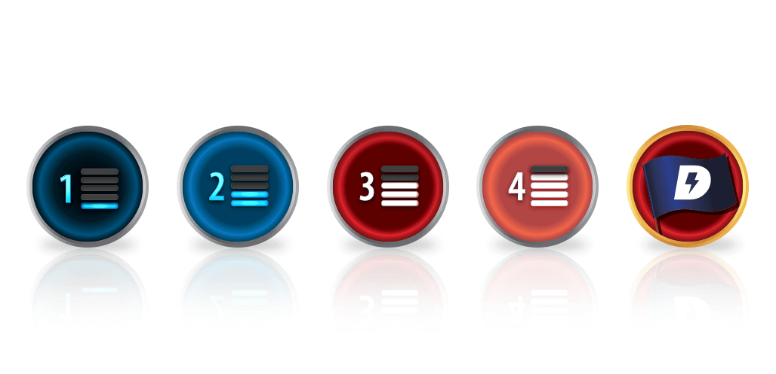
Rebuilding: Club Coach Responsibilities
5) Instill enthusiasm, loyalty, and a sense of responsibility for the club’s future
Make sure meeting location is suitable for a dynamic meeting
Get involved with other local clubs
Invite other clubs to your meetings and attend other clubs.
Encourage a “sister club” type of relationship with a strong club in the area
Today’s guest is tomorrow’s member!
Notes:
Often changing the meeting time, place, and/or location has a major positive impact on the club’s rebuilding efforts .
Consult the Master Your Meetings (Item 1312) handbook. This contains the information needed to conduct a good club meeting. In it, you will find:
How to create the right environment
The elements of a club meeting
The roles of club officers
The roles of program participants
Program ideas

Slide 20
How many of you have been a club coach?
Notes:
ASK: How many of you have been a club coach?
Then ASK: How were you approached?

Slide 21
How would YOU approach someone else to be club coach?
Notes:
ASK: How would you approach someone else to be club coach?

Slide 22
The Toastmasters Hierarchy
Notes:
District leaders put service above self in supporting all clubs in achieving excellence. While most people come to Toastmasters to become a better speaker, members evolve into natural leaders by participating in Toastmasters club meetings.
Looking at the Toastmaster hierarchy pyramid, the top position is held by the most important person, the member. Every other role supports the member’s individual growth. That is Why Toastmasters works!
Alternately, if we don’t have quality clubs, they are weak, faltering, and not meeting member needs, then we aren’t supporting our members – it’s time to rebuild!

Slide 23
Session Review
Understand why clubs are rebuilt
Determine when a club needs to be rebuilt
Identify who will do the work
Notes:
After today you should be able to (at a high level):
Understand why clubs are rebuilt
Determine when a club needs to be rebuilt
Identifying who will do the work

Slide 24
Club Growth Director Challenge
Coaches earn credit* toward DTM!
CALL FOR COACHES!
Identify 2 names of individuals for club coaches by August 30th
Email names to blase_heather_m@cat.com
Club Coach training planned for September
~25 clubs qualify for a coach today
Notes:
If every Area Director (14 Areas = 28 coaches) got 2 people to be a club coach, we would have just enough to cover the current shortage.
Add another 2 coaches from each Division (8 coaches) and that gets us to 36 coaches.

Slide 25
Questions?

