Slide 1

Leveraging Storytelling To Enhance Your Presentations
Wendy Pesavento
District 54, Online TLI #1
6/27/2020

Slide 2

Overview
Benefits of a Story
Inspiration
Writing a Story
Delivery Tips

Slide 3
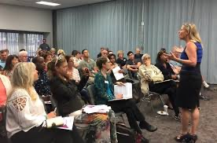
Why Storytelling?

Slide 4
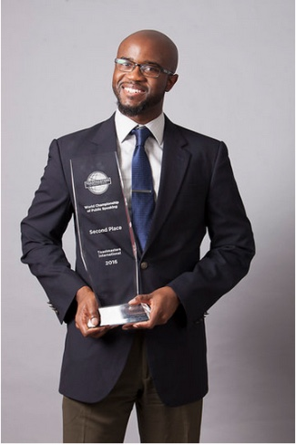
Where Can We Find Inspiration?
Uniquely You
Life lessons learned
Things that inspire you
Difficult experiences
Tough problems Solved
Stories that other people tell you
Stories from strangers
Internet search & social media
Books & magazines

Slide 5
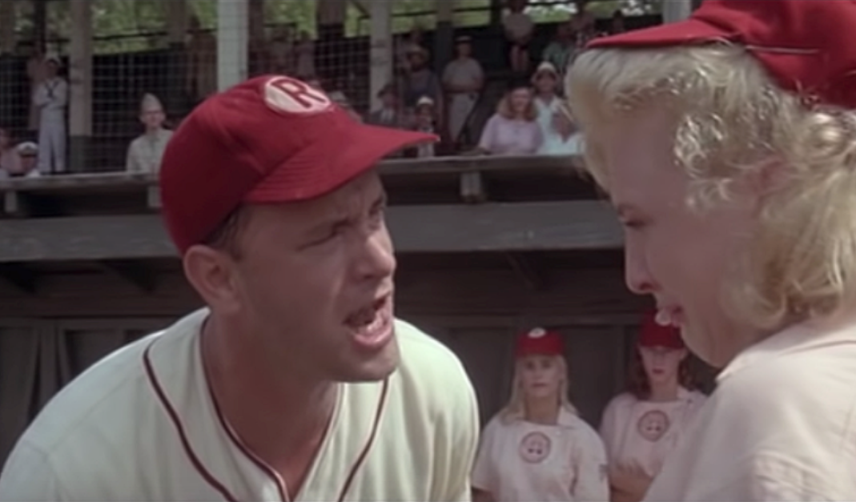
One Story, Many Variations
One central character
Who wants something intensely
Striving to accomplish something
Despite opposition
Who either “wins” or “loses”

Slide 6
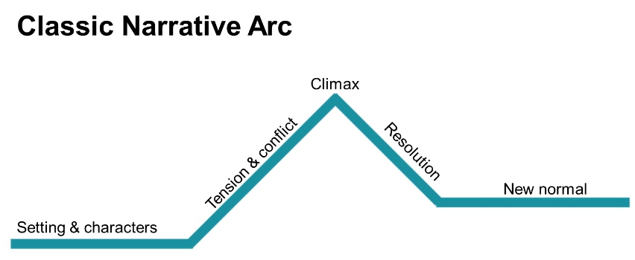
Elements In A Well-Structured Story
Setting
Characters
Conflict
Resolution

Slide 7
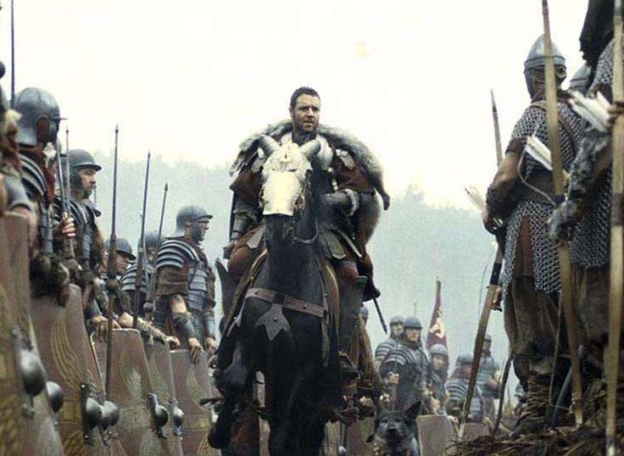

Setting

Slide 8
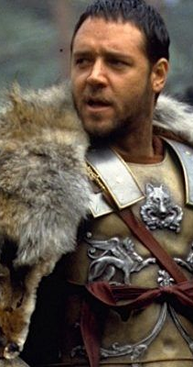
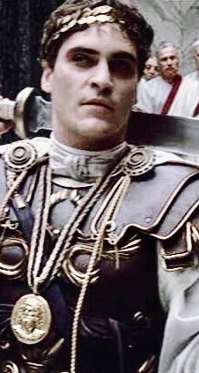
Character Development

Slide 9
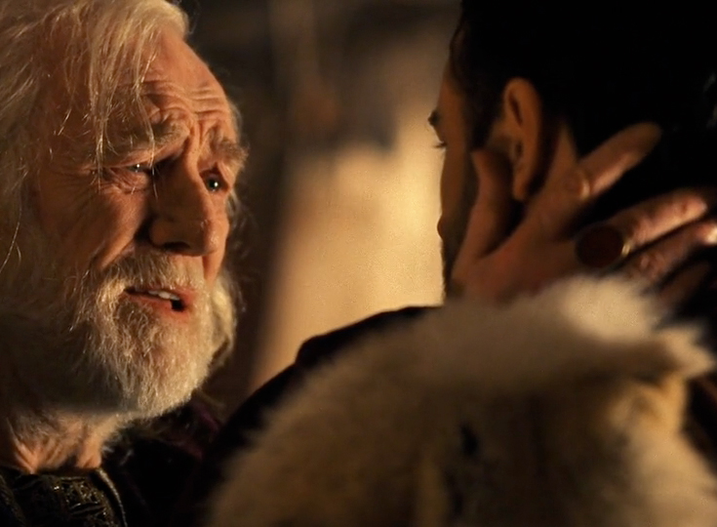
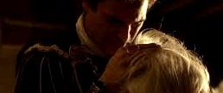
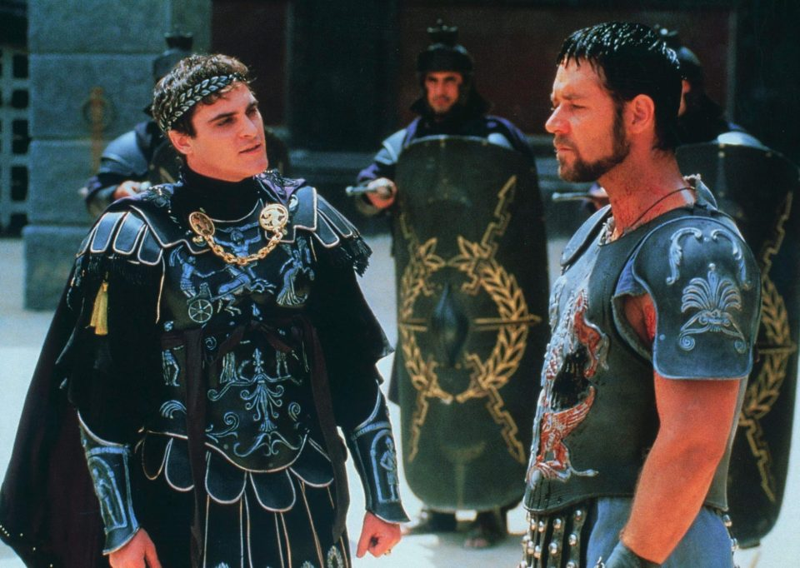
Conflict

Slide 10
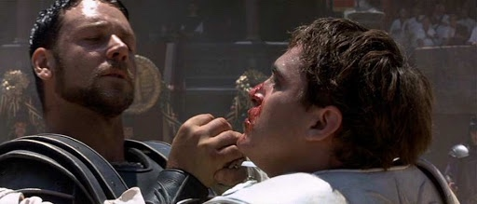
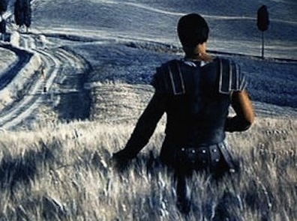
Resolution

Slide 11
Elements In A Well-Structured Story
Setting
Characters
Conflict
Resolution

Slide 12
A box is delivered to your house. Inside the box is a Frog. Open the box.
Next, make a very short story that has a
Setting, Characters, Conflict, and Resolution.
Setting
When does your story take place?
Where does your story take place?
Characters
Who is the main character?
Who is the hero?
What do the characters look like?
What are personality traits of the characters?
What does the hero want?
Does the hero have a passion?
Conflict
Who or what is getting in his or her way?
What is the obstacle?
What happened to the hero?
Resolution
Did the hero win or lose?
What happened at the end?
Is there a moral?

Slide 13
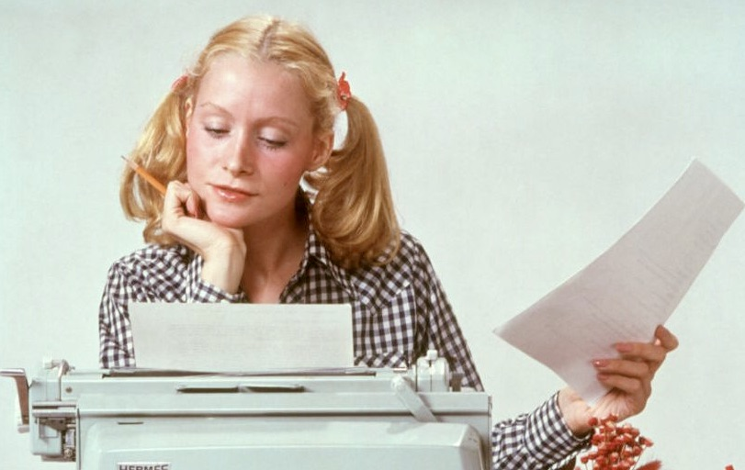
Delivery Tips
Strong opening
Use “we” not “I”
  Engage your audience Emotion
  Empathy
Bring your audience into the story
  Questions
  Analogies & Metaphors

Slide 14
Questions?
Thank you!

