Slide 1
VPM and VPPR Training
Winter TLI 2024
Wendy Pesavento, DTM, CGD
January 30, 2024
Notes:
Important work to do today. Let's get started.
Slides created by Heather Blase (blase_heather_m@cat.com) for the District 54 Toastmasters Leadership Institute (TLI) – Summer 2022

Slide 2

Introduce Yourself
Corporate or Community Club?
VPM or VPPR?
One (brief) suggestion that you would give to the next VPM / VPPR to help them be successful in their new role.

Slide 3
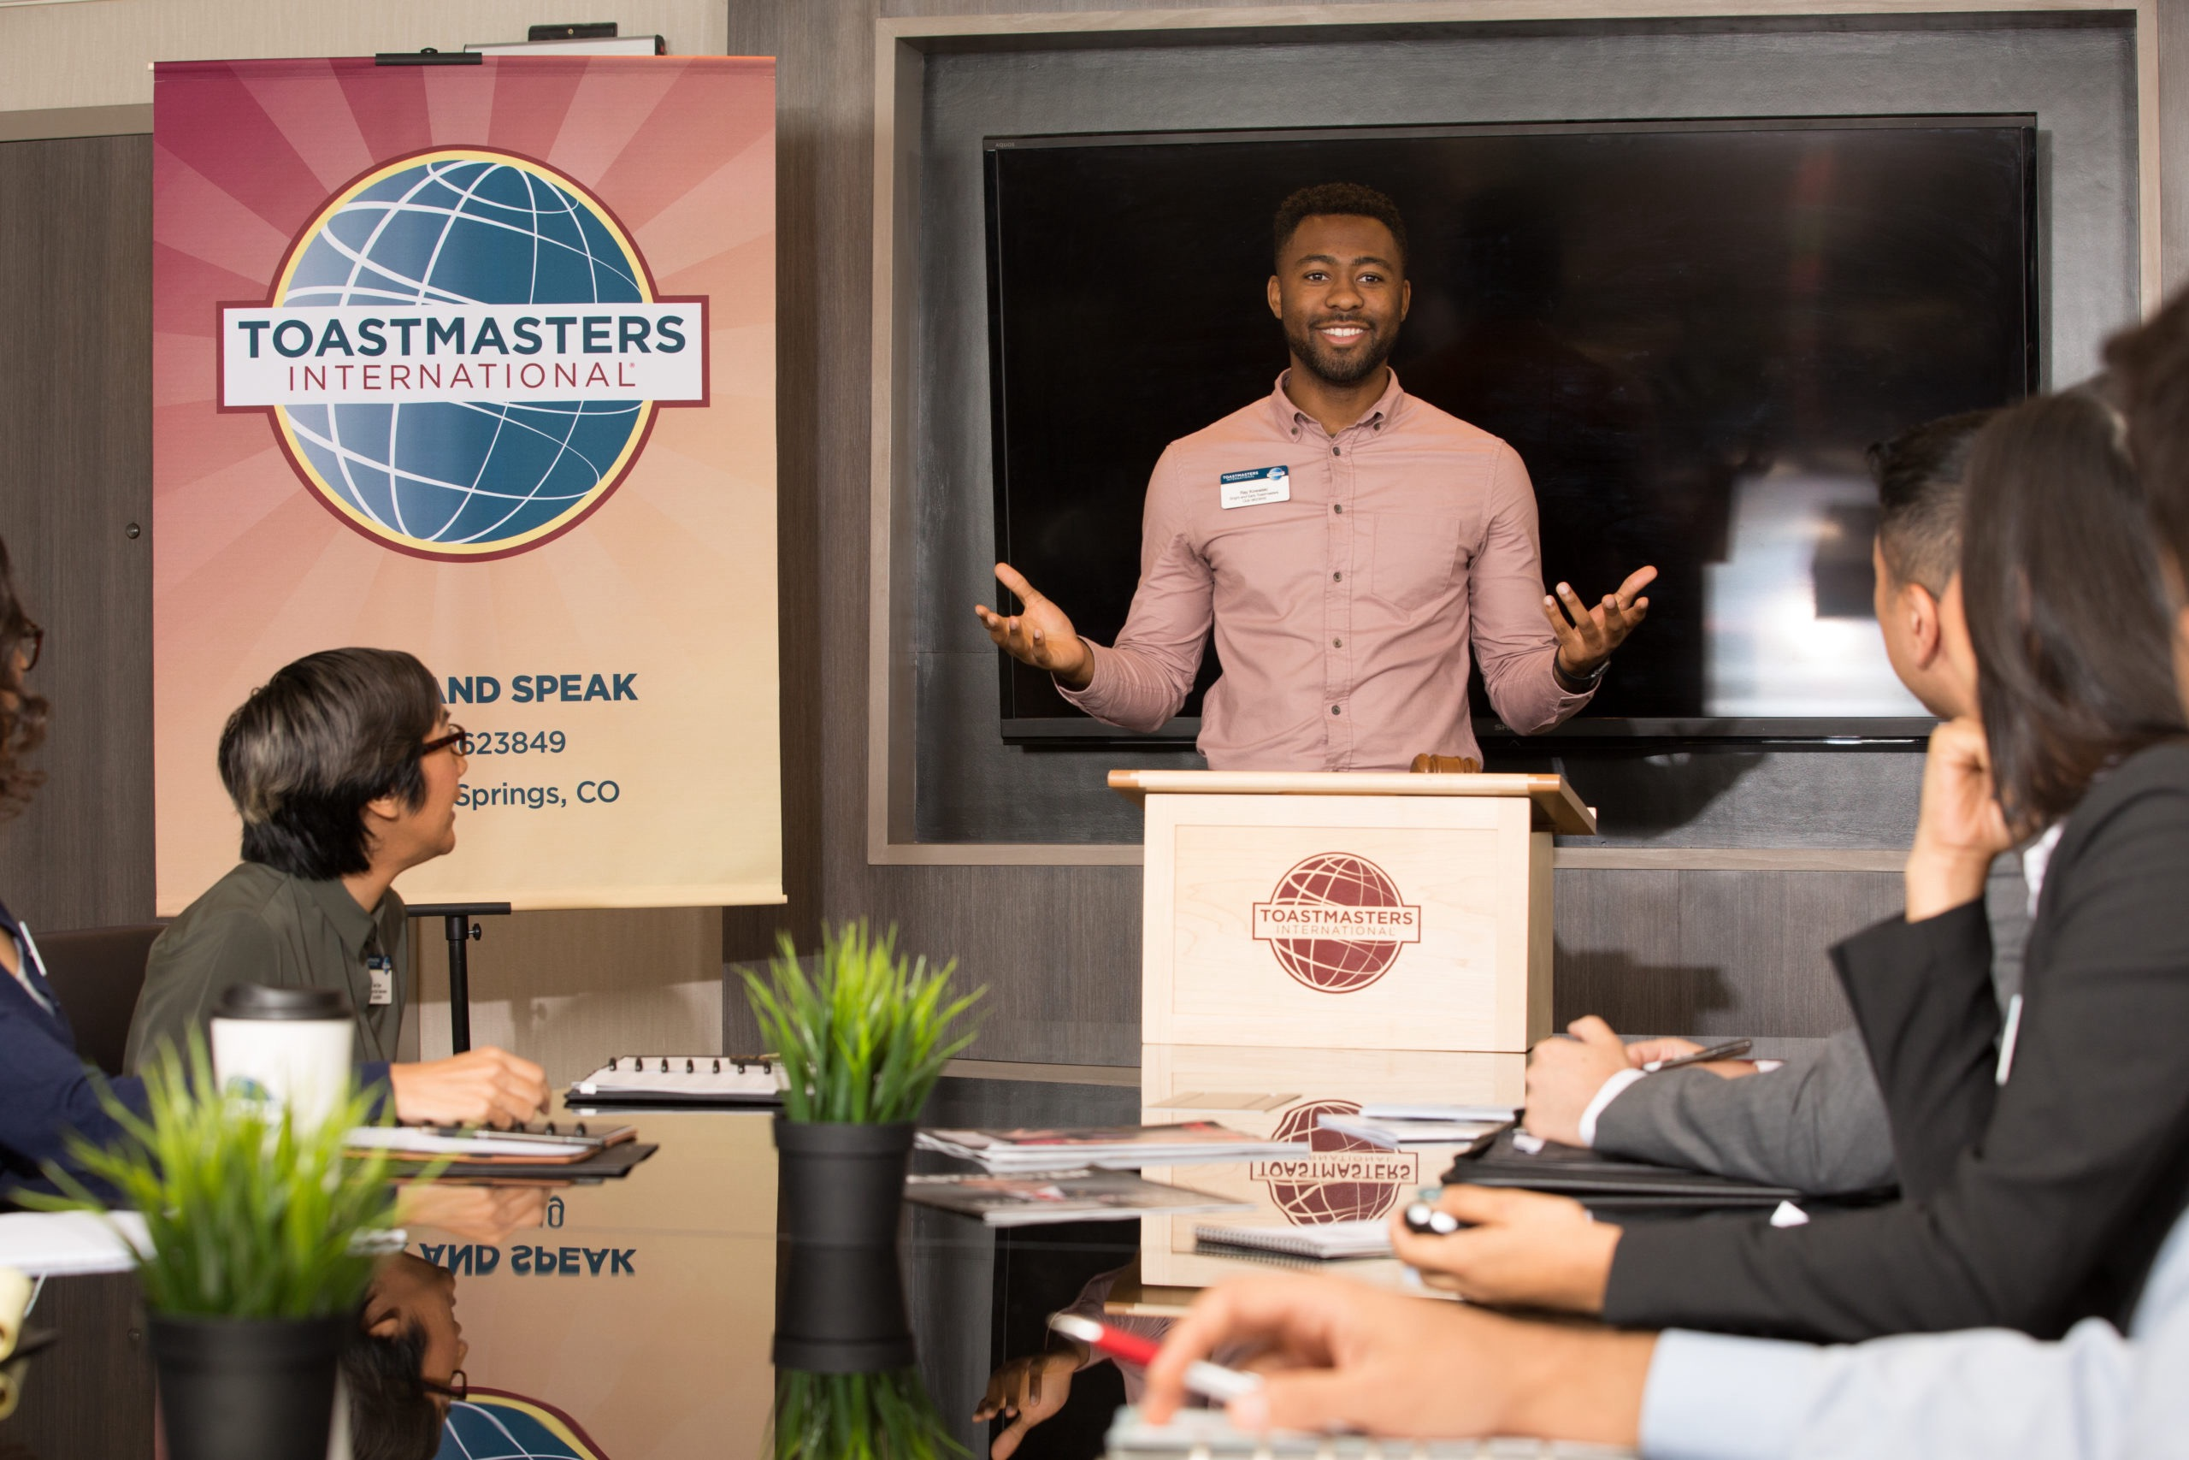
Agenda
Check in
Member Engagement
Executive Committee Tasks

Slide 4
Check in
Notes:
Let's start with the mission of Ti, D54, and the club

Slide 5
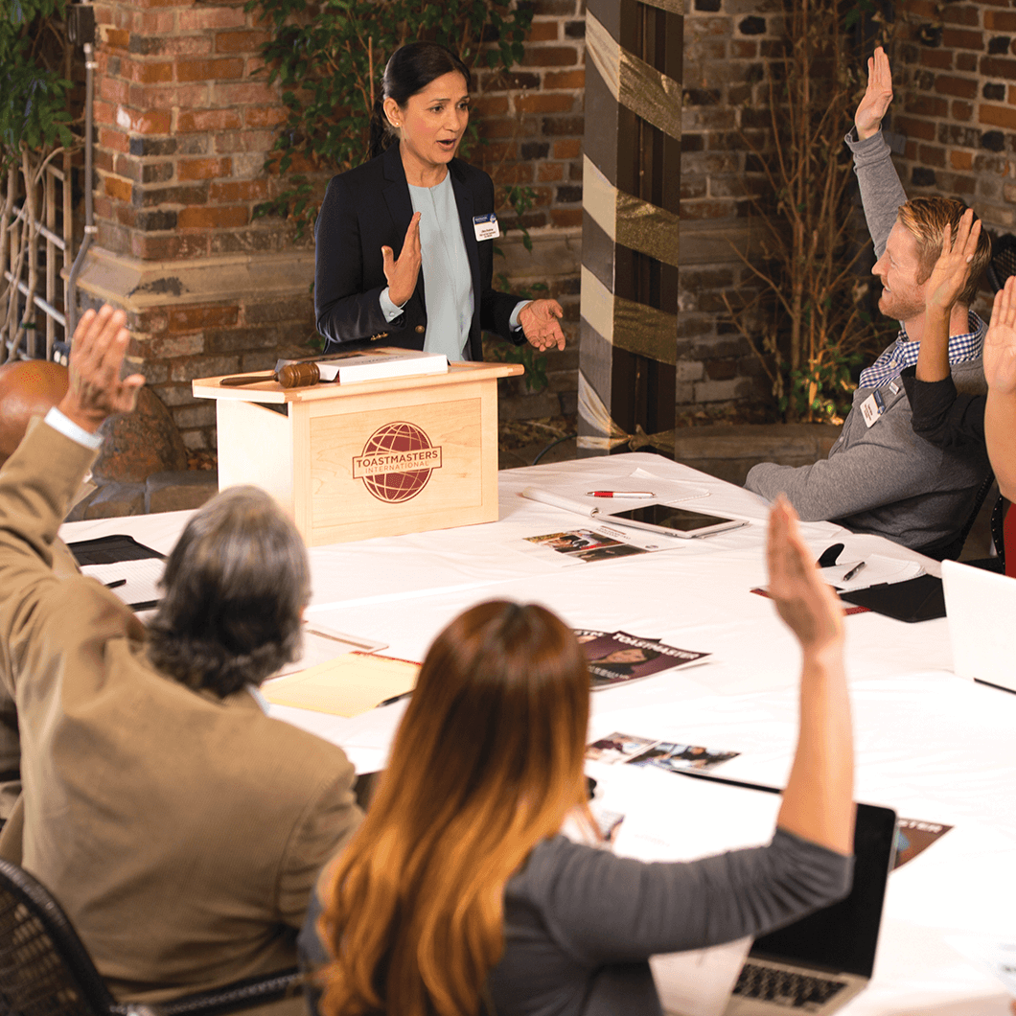
Topics Discussed in Previous VPM / VPPR Session
Strategies for attracting guests to community clubs. (Community)
How can host companies support club membership growth? (Corp)
Following through with guests. (Both)
Helping new members get started on Pathways. (Both)
Having difficulty motivating members to volunteer. (Both)

Slide 6

“Strategies for attracting guests to community clubs.”
“Have to have consistency with social media, especially Meetups.”
“Use different social media for different age groups. Facebook doesn’t work for Gen Z.”
“Make sure to plan ahead and advertise your open house if you want a good turnout.”
“ALWAYS keep the club website up to date. Add the next meeting theme to the homepage.”
“Extend a personal invite to former members. Can also send them a digital copy of TI magazine to remind them of Toastmasters.”
“Email former guests about each club meeting.”
“Advertise your speech contests!!”
“Organize a club sponsored Speechcraft.”
“Wear TI pins, buttons, t-shirts outside of club meetings. People will ask you about it.”
Notes:
How do we get leads? Is it easier to Keep a member or find a new member?
Regarding former members how do reactivate them?
ice President Public Relations
You promote the club to the local community and notify the media about the club’s existence and benefits it provides - newspapers, radio stations, television stations, etc. It’s your job to notify the media whenever your club does something newsworthy.
As vice president public relations, you’ll find yourself writing news releases, creating and distributing fliers, and maintaining the club’s presence at various key places on the Web and in the community.
Update web content and safeguard the Toastmasters brand identity.

Slide 7
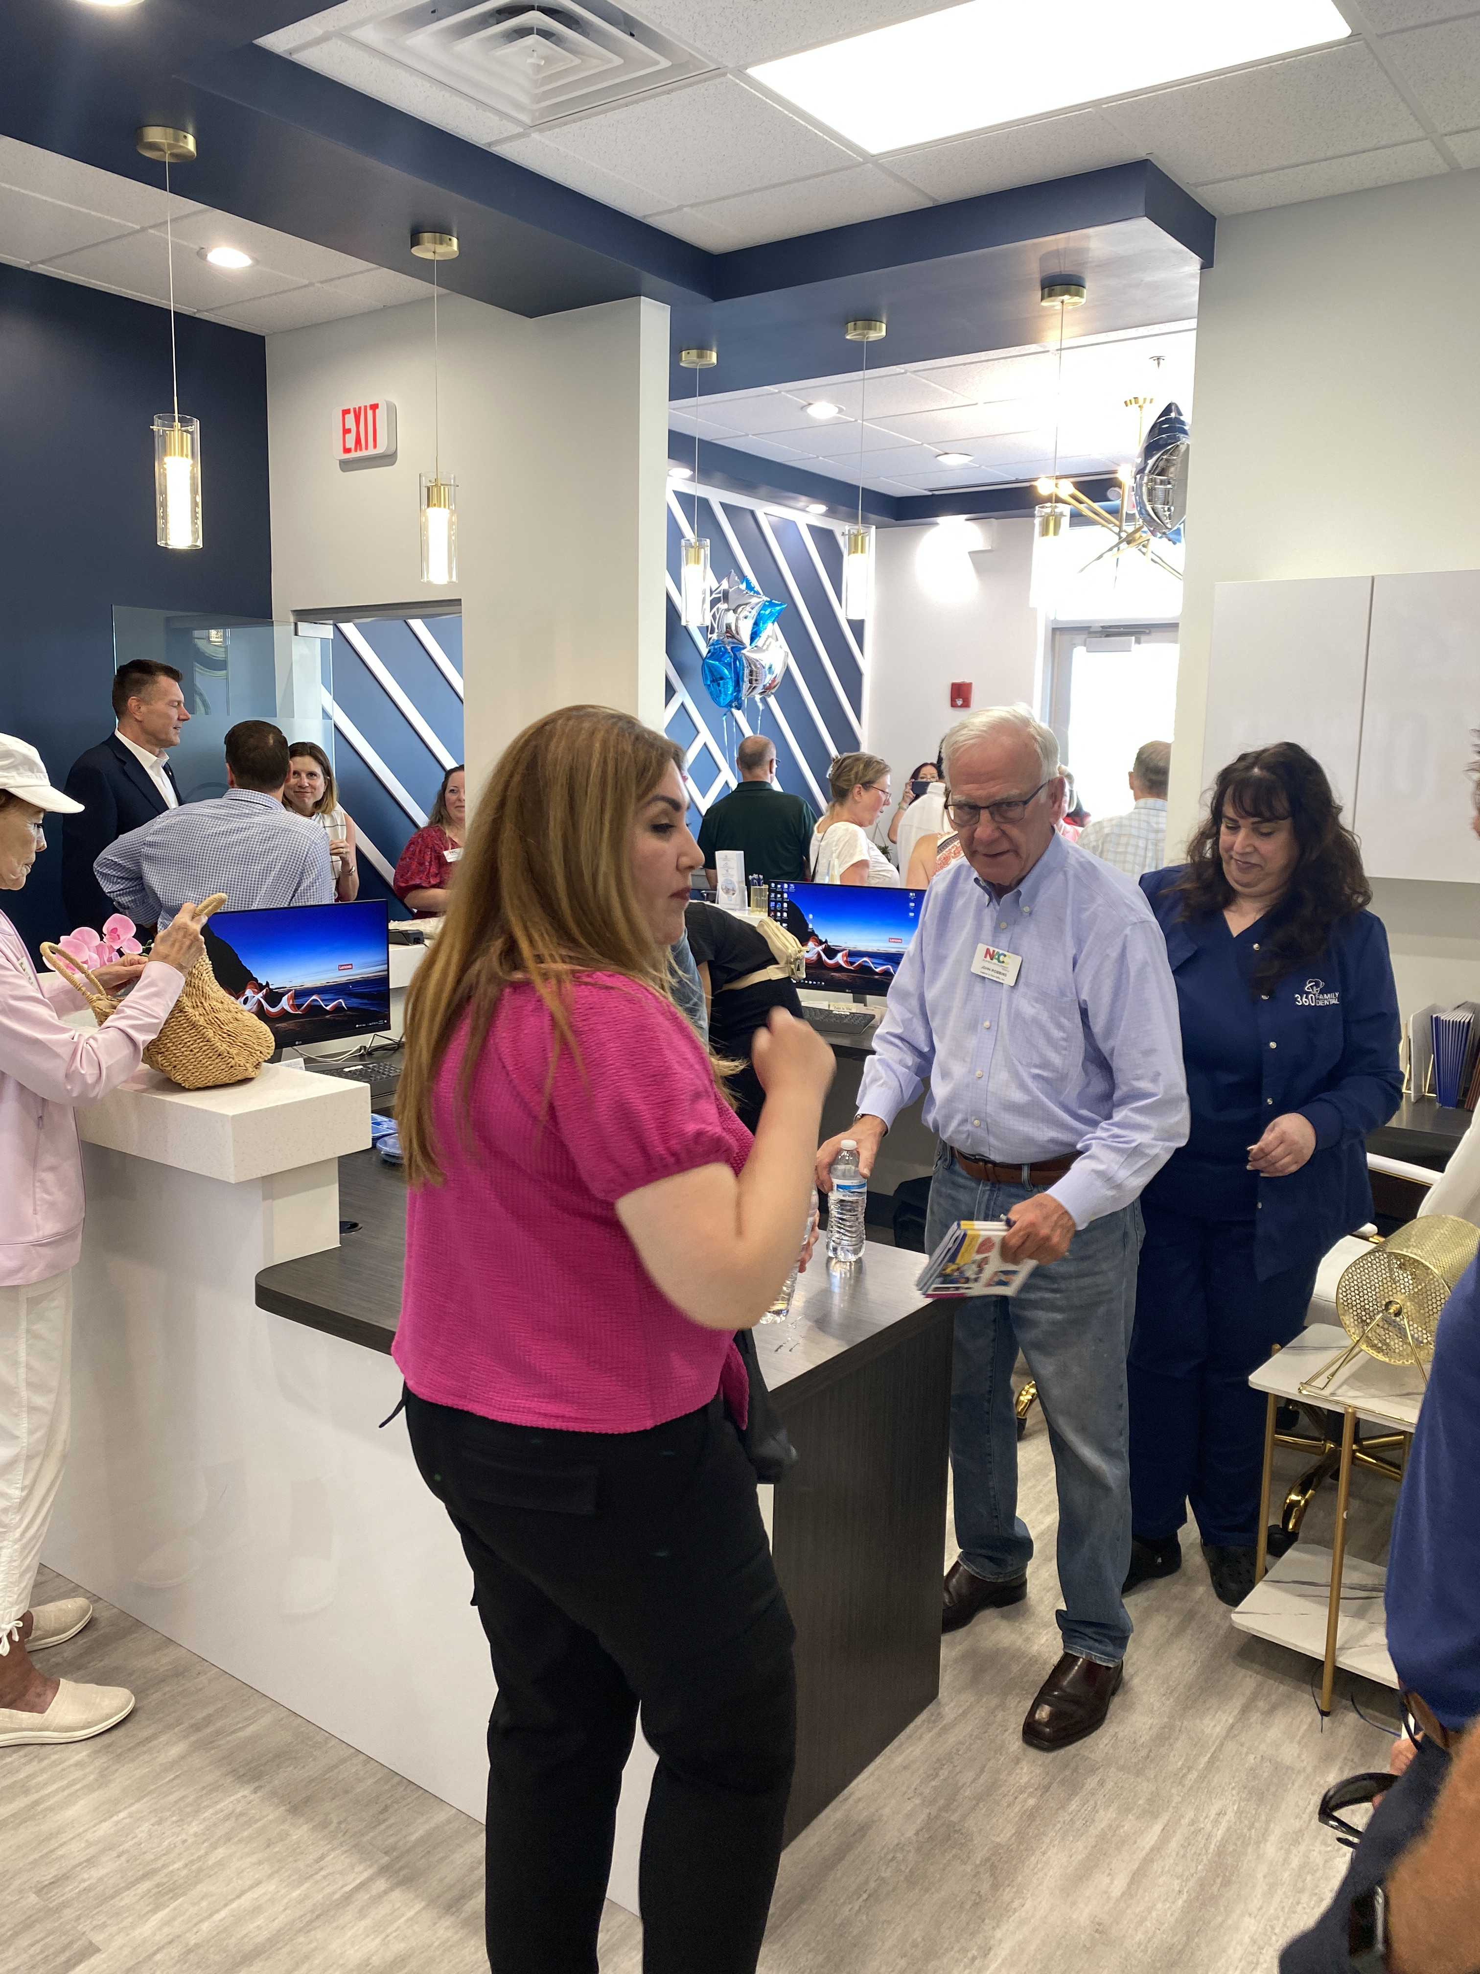
“How can host companies support club membership growth?”
“Publicize your Toastmasters meetings through the company intranet. Ask for your meetings to be put on the company calendar.”
“My company has interns give a presentation about what they learned at the end of their internship. Through HR, we offer mentors to the interns to improve their presentation skills.”
“Have the club president invite high level executives to your meetings. They give a lot of presentations and if they join and like it others will follow.”
”Remember to ask the member if they want a Pathways level completion certificate to be sent to their boss. It will give more exposure to Toastmasters.”
Notes:
In 2024, we’ll see deeper integration with popular tools like Microsoft Teams, Planner, and other third-party applications. ”

Slide 8
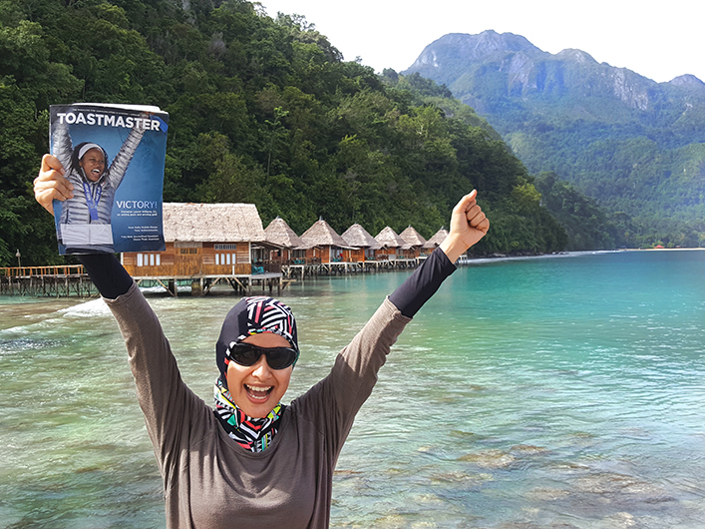
“Following through with guests.”
“Sometimes the VPM can’t be at the meeting. The officers need to work together and decide who will follow up.”
“Have them (guests) put their contact info in the chat if it is an online meeting.”
“The VPM should follow up while the meeting is fresh in their (guest) memory. Don’t be scared to ask them to join the first day if they are really excited.”
“Send them a guest packet before the meeting and get them an application ASAP!”

Slide 9
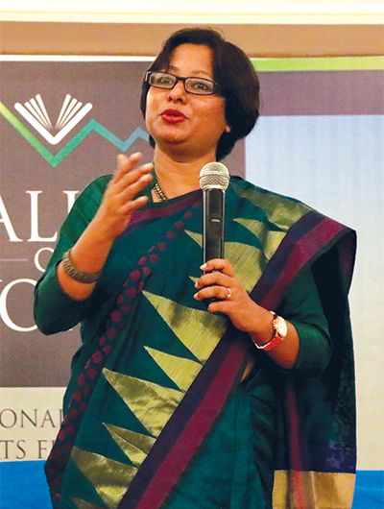
“Helping new members get started on Pathways.”
“Schedule a new member orientation session for them when they join.”
“Show them (new members) how to use both sites (TI site and club site), If you don’t, they can’t sign up for speeches.”
“Email the district for information about the next Pathways seminar. I think Maryann Reichelt is doing it this year.”
“Follow up so you know they (new member) got the link from TI to set up their member account.”

Slide 10
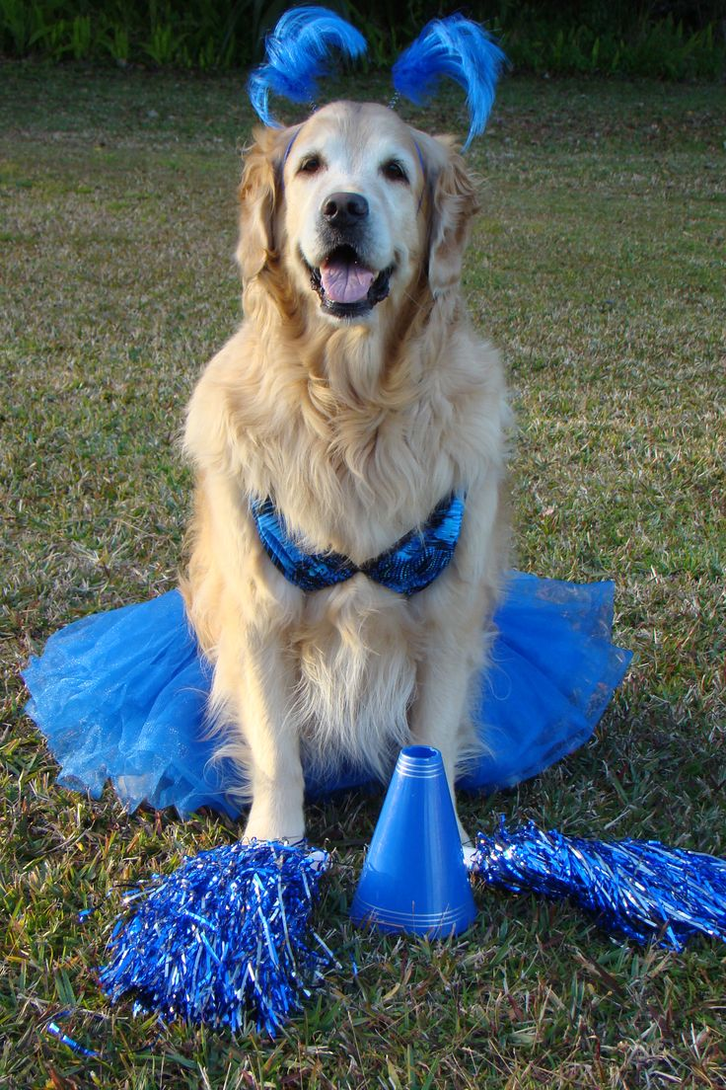
“Having difficulty motivating members to volunteer.”
“You have to take it back to “What’s in it for them (the member)?” If they volunteer, they learn new skills and they get leadership experience. They won’t do it unless they see the benefit.”
“I prefer the “voluntold” method. If you need to fill the agenda and no one volunteers, assign meeting roles.”
“Can’t motivate them (members) if you don’t know what they want out of Toastmasters. Give them the member interest survey.”
“I have noticed that every club has a cheerleader or a golden retriever personality member. Someone needs to generate enthusiasm. No cheerleader equals no enthusiasm.”

Slide 11
Member Engagement
Notes:
Let's start with the mission of Ti, D54, and the club

Slide 12
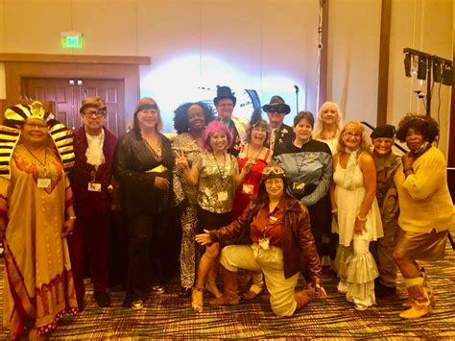
Club Member Engagement
The degree to which a member:
Feels committed to the organization
Identifies with the organization
Feels satisfied with the organization
Feels energized by their participation

Slide 13
Member Engagement
Actively Disengaged
Indifferent Group
Engaged Contributor
Actively Engaged

Slide 14

Actively Disengaged
View the the organization unfavorably
Disparage the organization and its leaders
Blame the organization
Point fingers at others
Will quit, or stay and contribute to a negative environment if no change occurs
Notes:
Nobody joins actively disengaged

Slide 15

Opportunity Group
Members who are ambivalent or indifferent
Fly under the radar
Do not actively contribute to the club
May go, may stay
Best chance to improve engagement

Slide 16

Engaged Contributor
Satisfied with their contribution
Speak well of the organization
Meet expectations
Not likely to take risks
Don’t go above and beyond
Tend to stay in their comfort zone
Committed to the organization

Slide 17

Actively Engaged
Take personal satisfaction in what they do and how they do it
Will contribute in meetings
Stretch themselves to do more
learning and growing
Love to be members

Slide 18
“Are we going to be a group or are we going to be a team?”

Slide 19
Focus on Member Goals
Notes:
All of us are part of our own clubs Executive committee. Who are the members of the executive committee?

Slide 20
New Member Engagement Tools

Slide 22
Focus on Club Improvement
Notes:
All of us are part of our own clubs Executive committee. Who are the members of the executive committee?

Slide 23
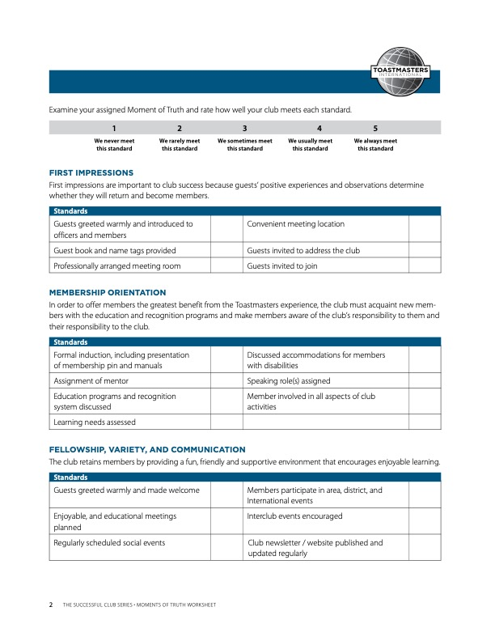
Continuous Club Improvement

Slide 24

The Experts Say…
Volunteers who receive regular recognition are up to 8x more engaged. (Geoforce 2023)
High performing teams receive 6x more positive feedback than less effective teams. (American Behaviorial Journal 2022)
Volunteers who felt respected stayed longer, perceived a better experience, and had a more positive view of the organization. (Gerontological Social Science Magazine 2018)

Slide 25
Year End
Club Executive Committee
Notes:
All of us are part of our own clubs Executive committee. Who are the members of the executive committee?

Slide 26
Year End Executive Committee
Prepare For Transition
Update Club Success Plan
Review DCP Goals
Plan Recognition And Fun

Slide 27
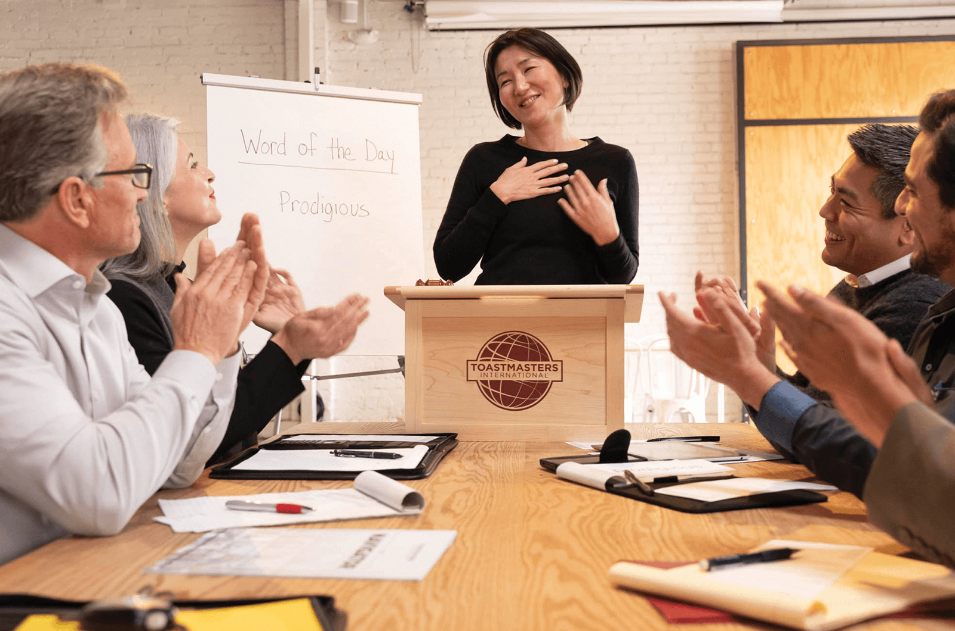
Next Years Executive Committee
Suitable Candidate
Elections
Installation
Mentor
Transition

Slide 28
Update Club Success Plan
Notes:
Let's start with the mission of Ti, D54, and the club

Slide 29
Success Plan

Slide 30
Review DCP Goals
Notes:
Let's start with the mission of Ti, D54, and the club

Slide 31




Monitor Distinguished Club Program (DCP) Goals
Education
Membership
Training
Administration
Four Level 1 awards achieved
Two Level 2 awards achieved
Two more Level 2 awards achieved
Two Level 3 awards achieved
One Level 4, Level 5, or DTM award achieved
One more Level 4, Level 5, or DTM award achieved
Four new members
Four more new members
A minimum of four club officers trained during each of the two training periods
On-time payment of membership dues and on-time submission of one club officer list
10 Goals
Notes:
Together, club officers set attainable goals for club success and develop a plan to achieve them. Focusing your efforts on achieving in the Distinguished Club Program (DCP) is one of the best ways to ensure your club reaches its goals for education, membership, training, and administration.
The DCP is an annual program, running from July 1 through June 30. The program consists of 10 goals your club should strive to achieve during this time.
(CLICK to reveal the list of goals under each area)
Education: Members who have the opportunity to earn education awards are reaching their goals.
Membership: When new, dual, and reinstating members join, everyone’s experience is enhanced because your club has enough members to provide leadership and fill meeting and committee assignments.
Training: Trained club officers are better able to serve and support your club because they know how best to fulfill their roles.
Administration: Submission of the dues renewals and the club officer list on time, which will help your club run more smoothly, benefiting your members

Slide 32
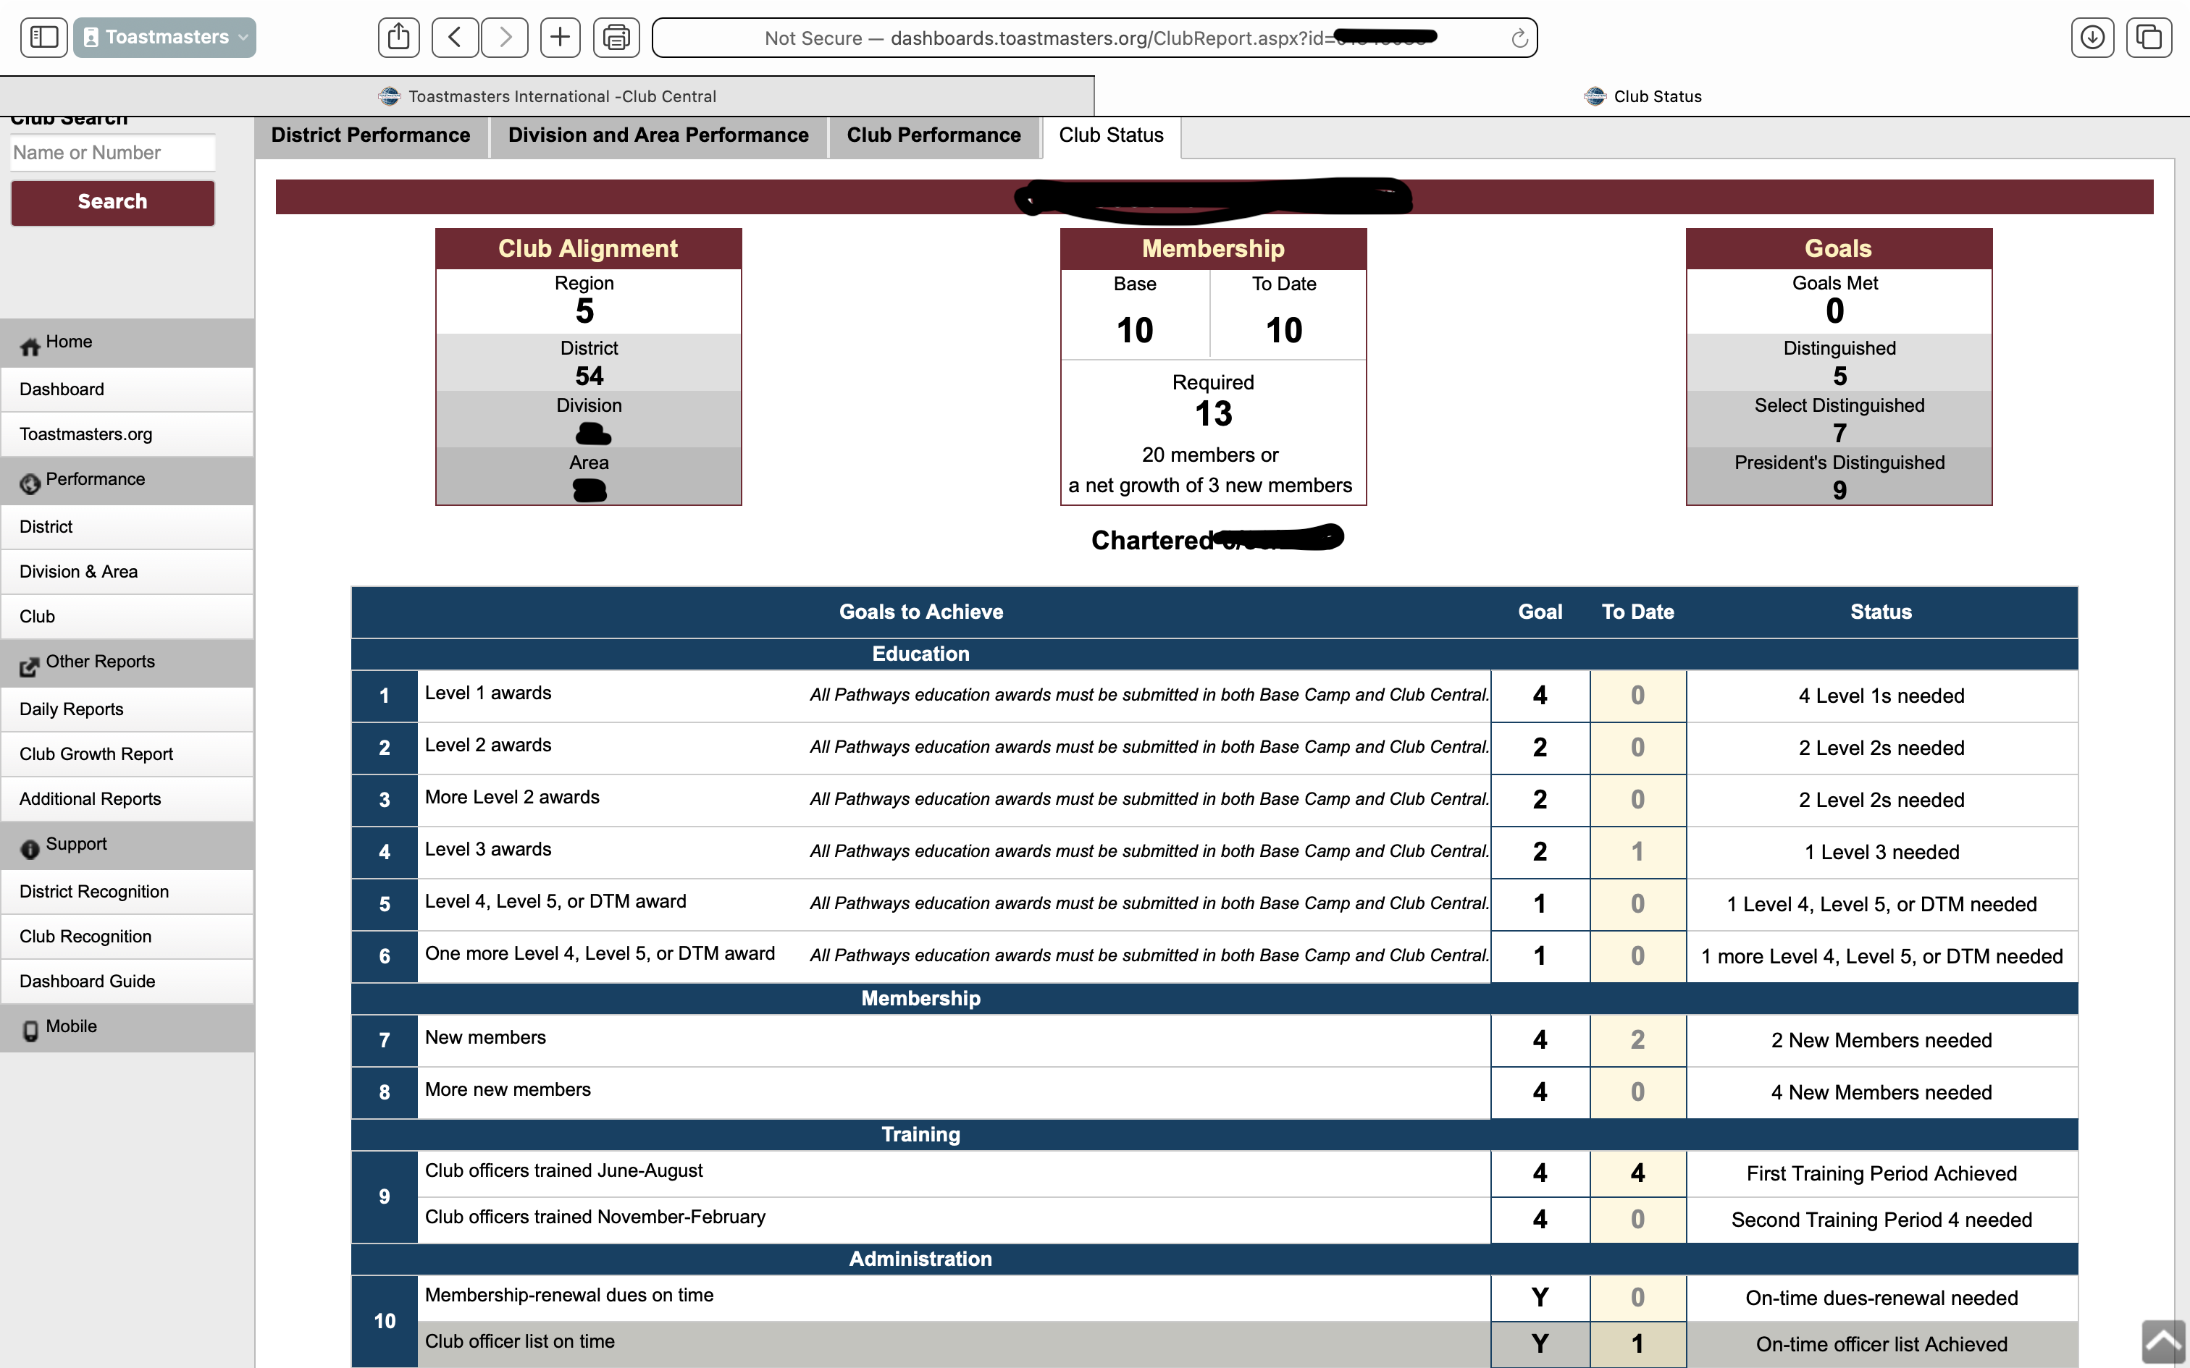
What Areas Of Improvement Can This Club Make?

Slide 33
Wrap-Up

Slide 34
Agenda
Check in
Member Engagement
Executive Committee Tasks

Slide 35
This concludes the session.
Club Officer Training

