Slide 1

District 54

Slide 2

Happy
2024

Slide 3

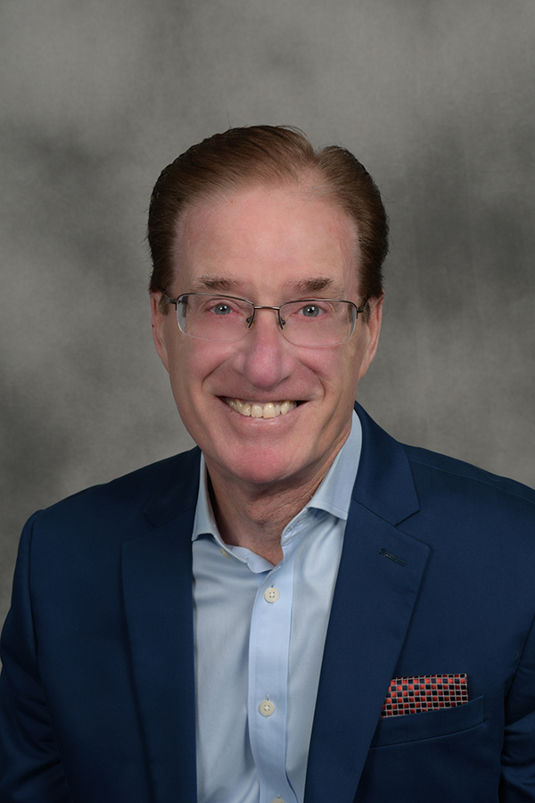
The Power of Crucial Communication
Jerry Evans, DTM

Slide 4

2020

Slide 5


Slide 6


Slide 7

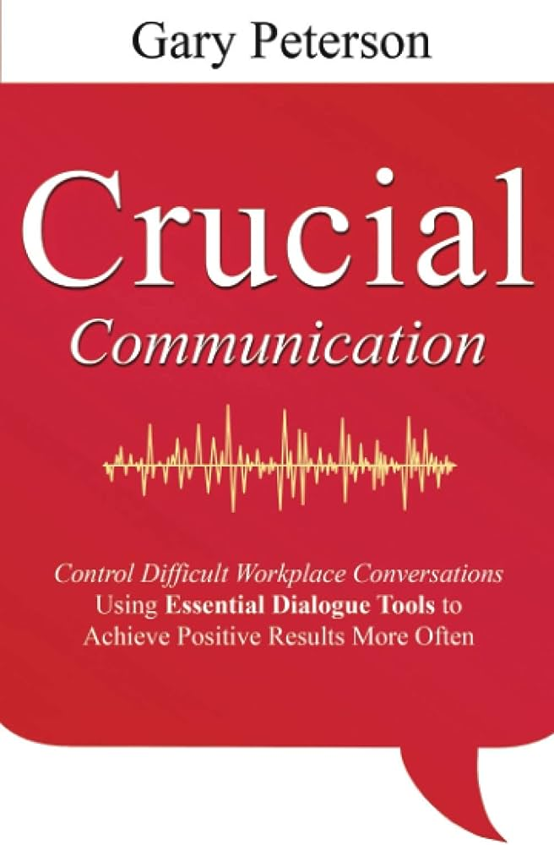

Slide 8
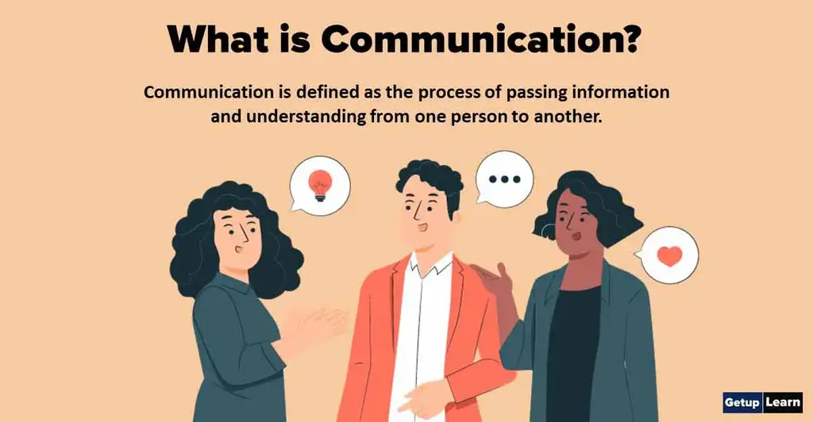


Slide 9

Communication is a learned skill, just like riding a bike. The more you practice the better you become.

Slide 10
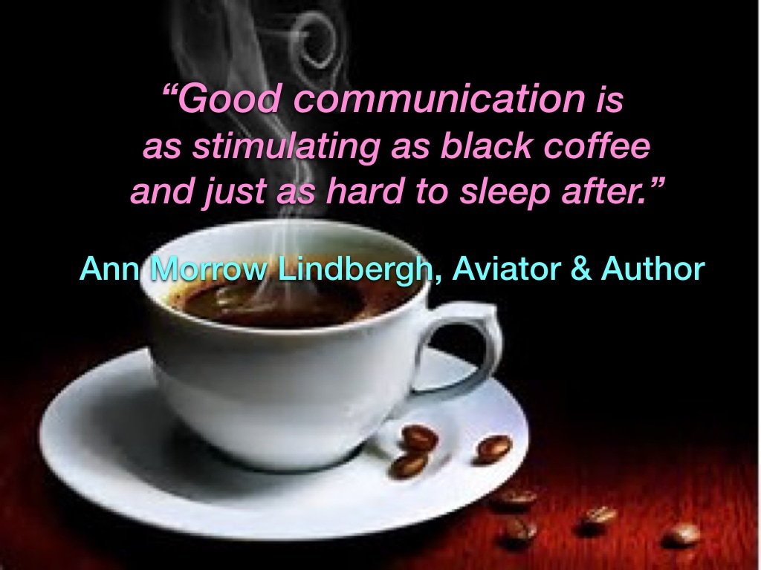
“Bad communication is as
painful as a “kick in the butt.”

Slide 11
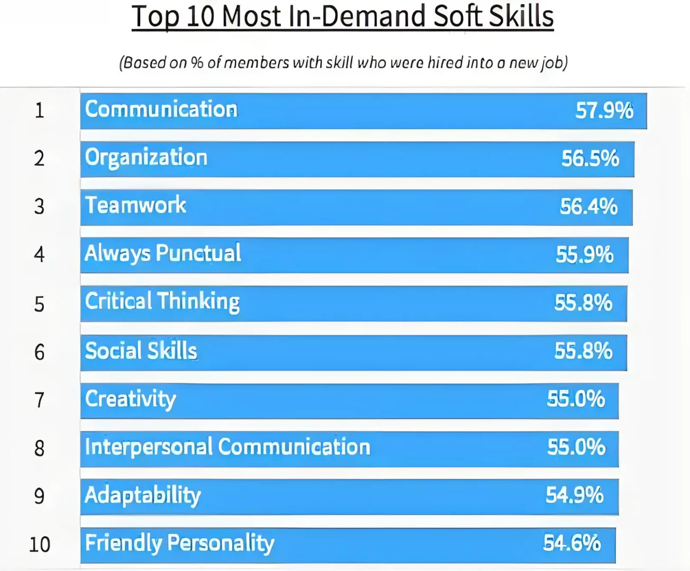

Slide 12
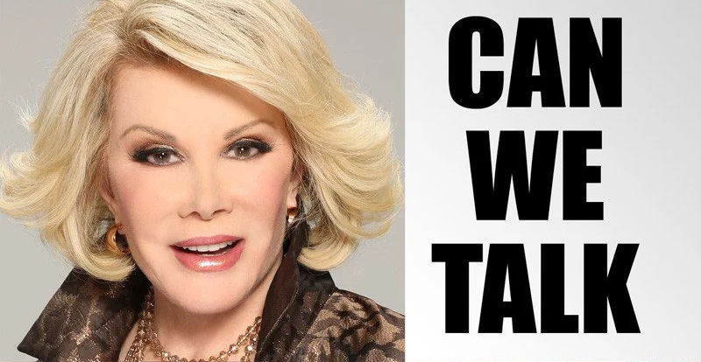

Slide 13
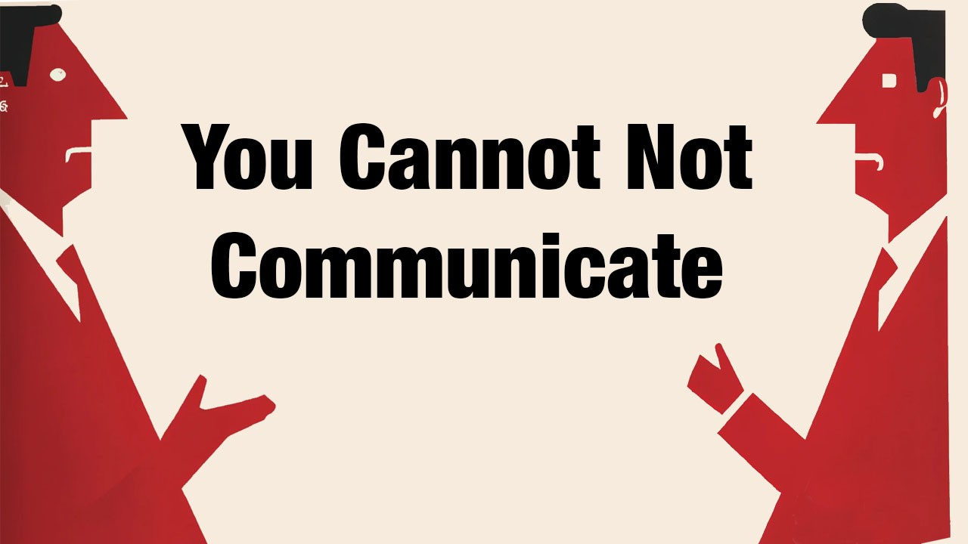

Slide 14
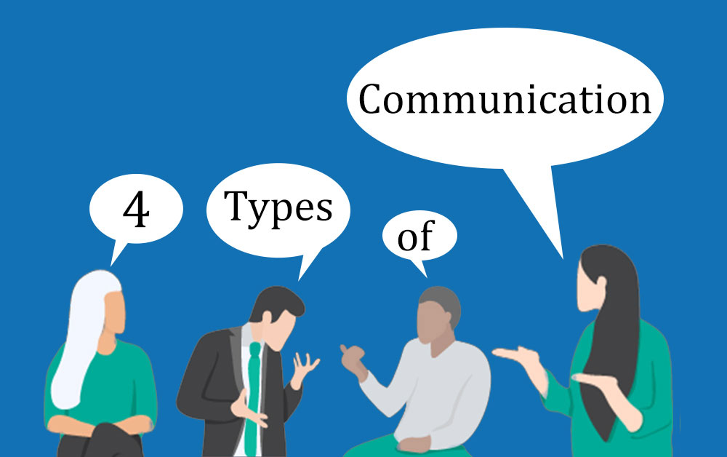

Slide 15
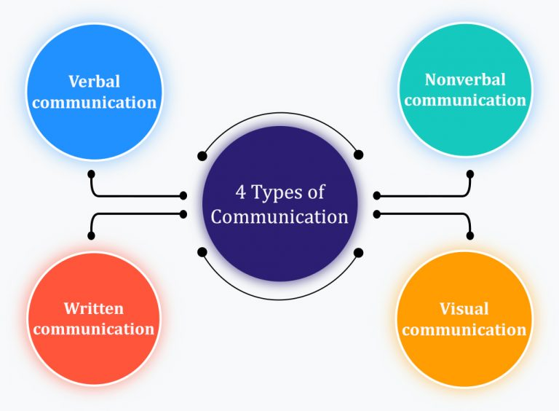

Slide 16
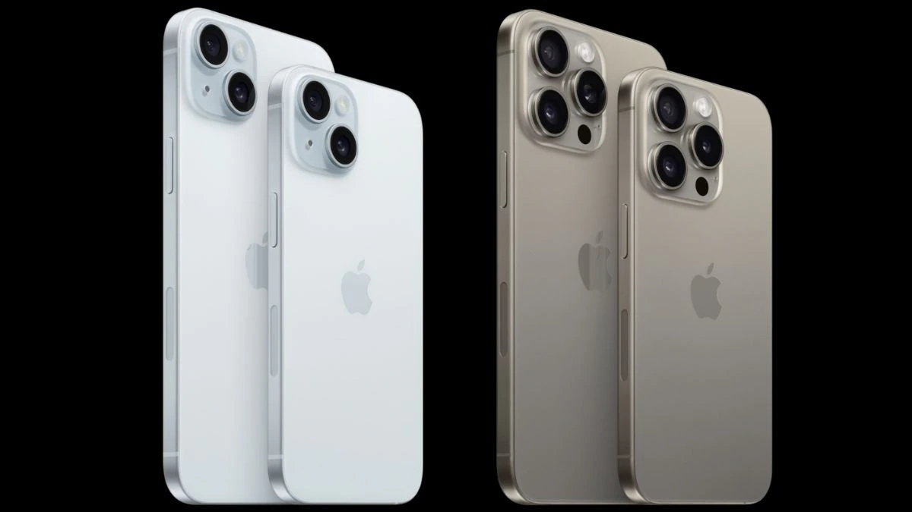
Apple iPhone 15
Apple iPhone 15 Pro

Slide 17
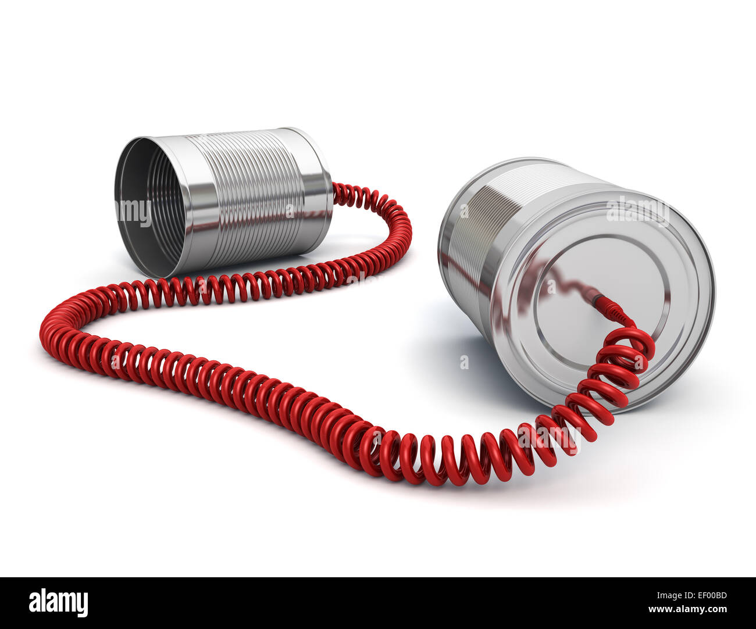

Slide 18

iCan T23

Slide 19
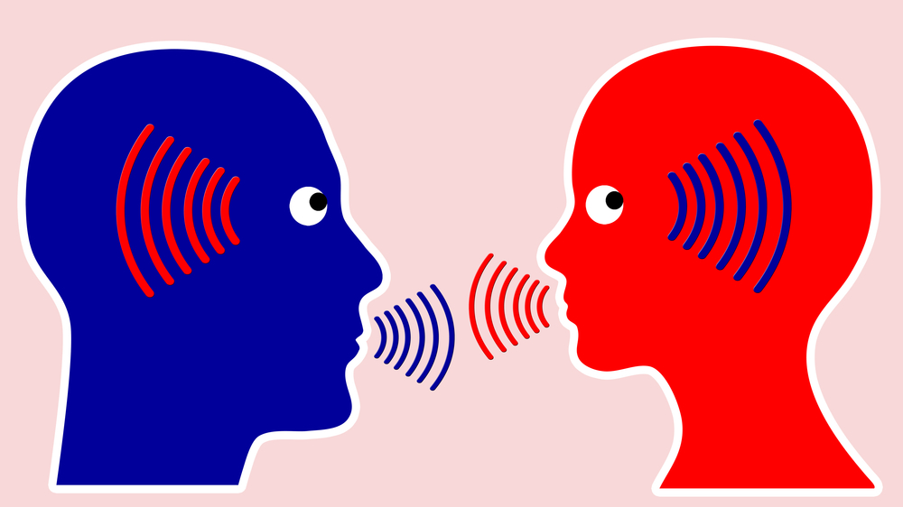
Active Listening

Slide 20
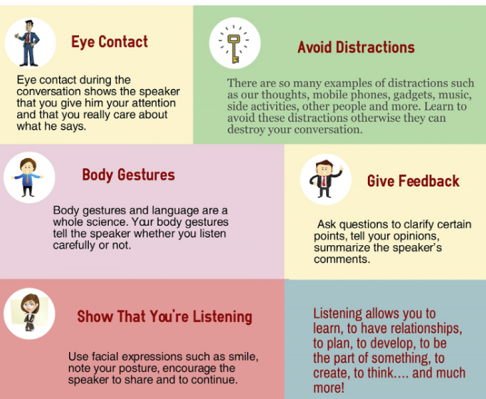
Active Listening Skills

Slide 21

The Gusher – These people keep talking about anything and everything.
The Over-Explainer – Some people have really good intentions, but they want to give way too much detail.
Ms. All About Me – These people talk incessantly about themselves and rarely give someone else the chance to speak. Its always about them.
Mr. Redundant – This man (or woman) is repeating the same lines, in the same conversation, and repeated conversations.
The Know it All – This person has all the answers and is certain that these are the right answers. He is going to tell you whether you asked or not.
Captain Obvious – He or she is saying stuff that everyone already know. Obviously.

Slide 22
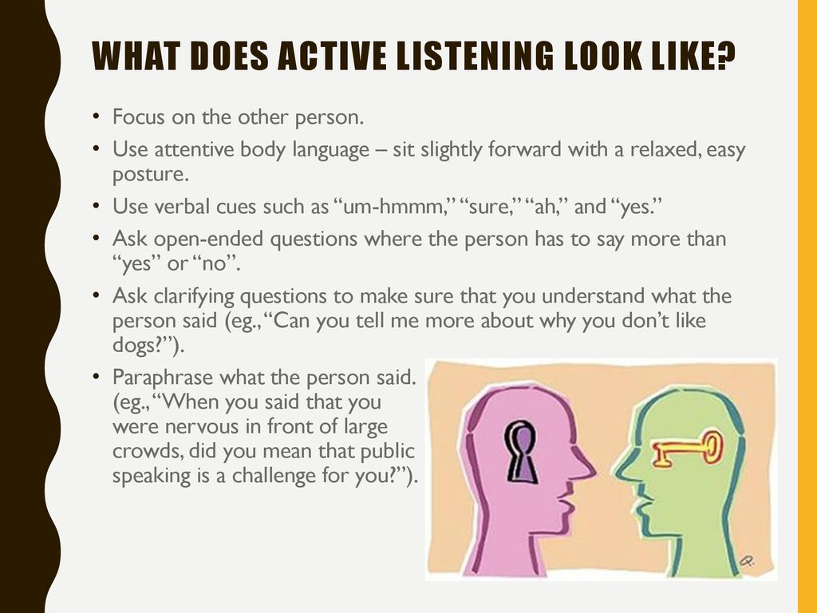

Slide 23


Slide 24

Working From Home

Slide 25

Essential Soft Skills

Slide 26

VERBAL COMMUNICATION
Interaction with people
Face-to-face
Key components are sound, words, speaking and language
Over 3000 languages spoken in the world

Slide 27
SPEECH
Interpersonal speaking
Public Speaking

Slide 28
INTERPERSONAL SPEAKING
First Impressions
Think before you speak
Different styles of speaking
Expressive style
Directive style
Problem-solving style
Meta style

Slide 29
PUBLIC SPEAKING
Topic
Purpose of your speech
Get to know your audience
Organize your speech
Adding an introduction
Conclusion to your speech

Slide 30


Slide 31
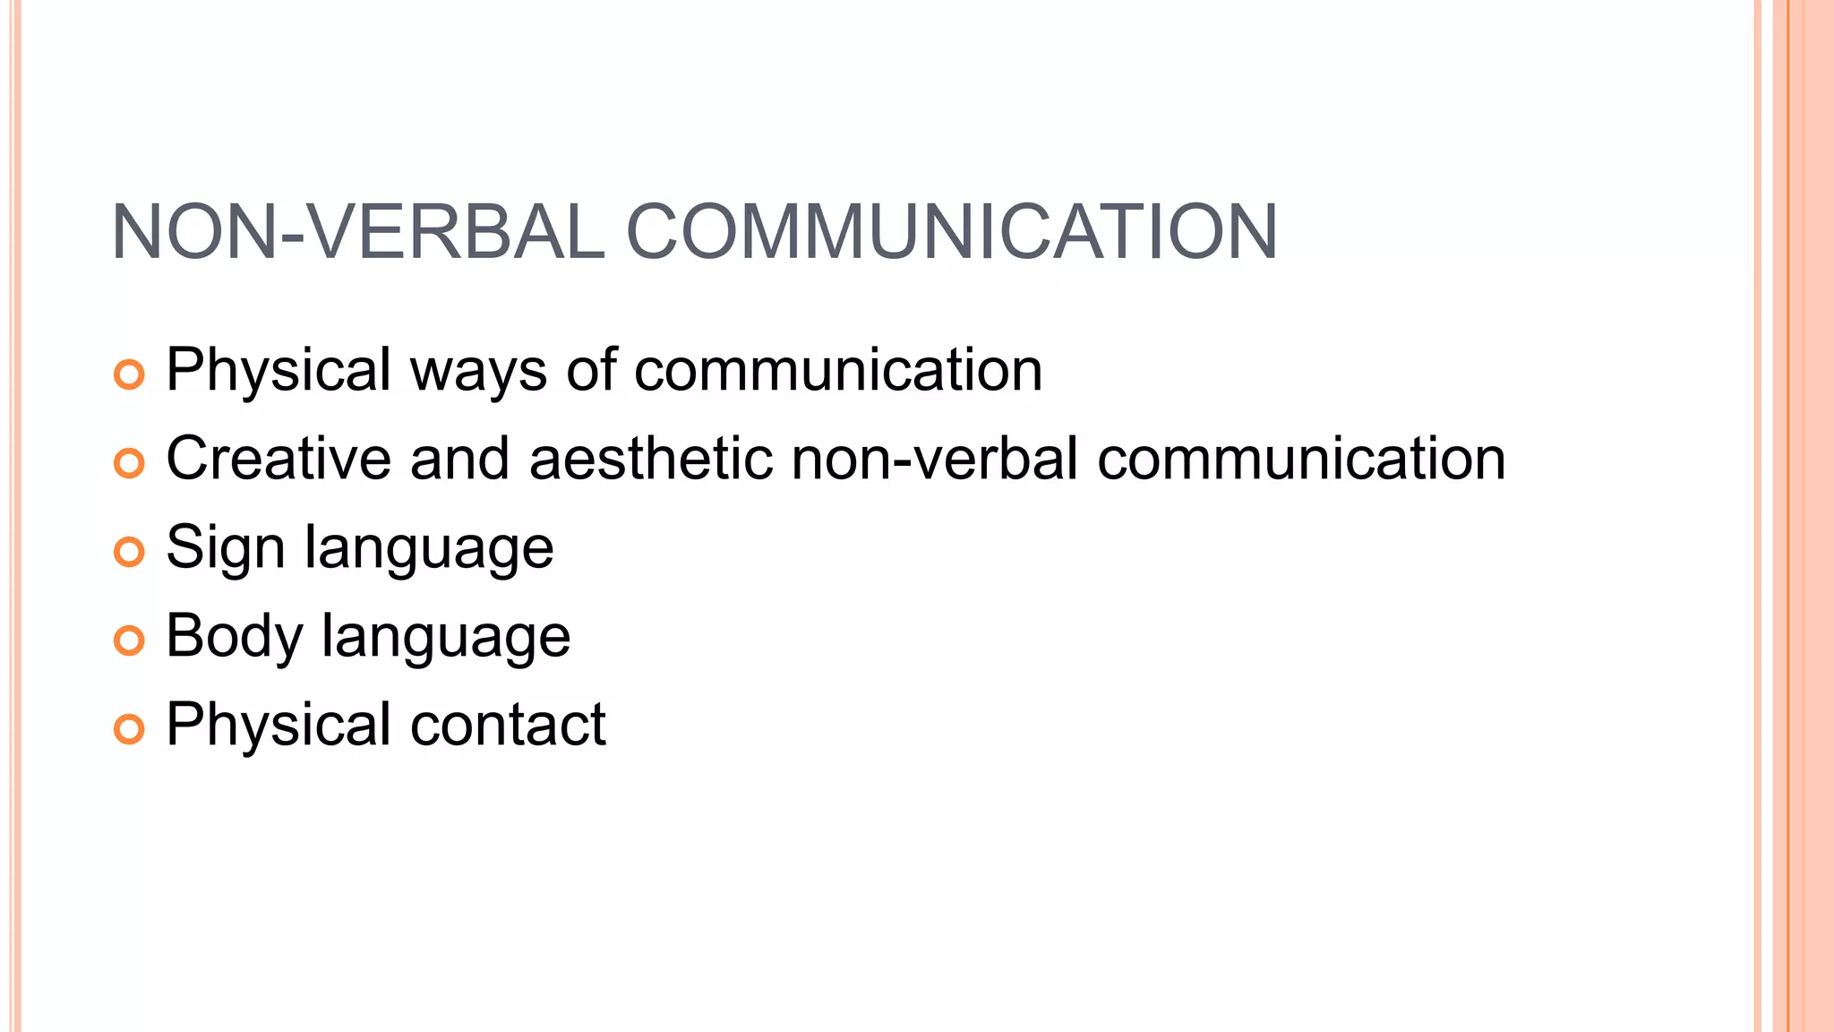

Slide 32
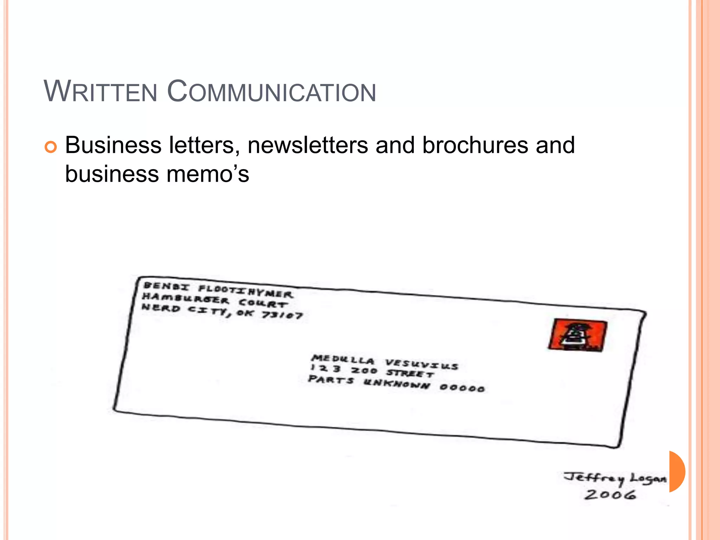

Slide 33
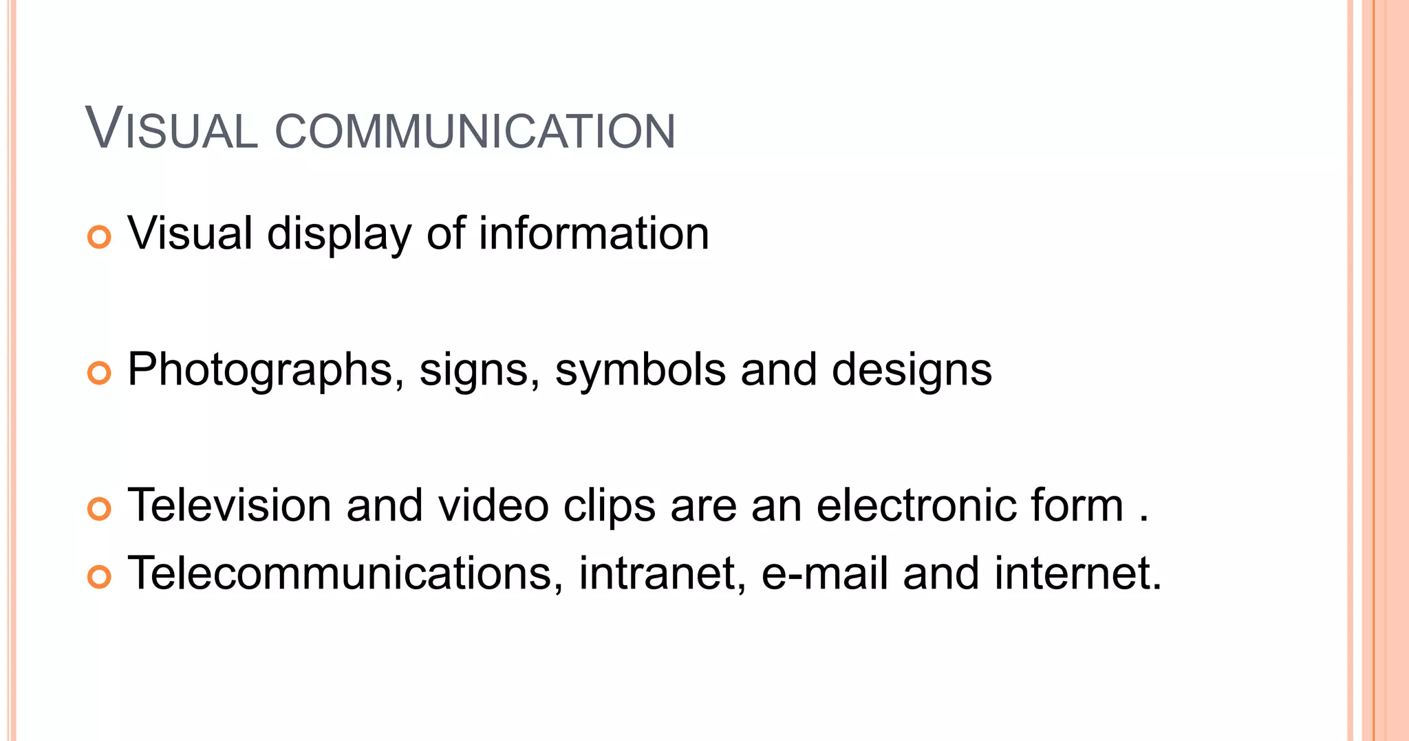

Slide 34
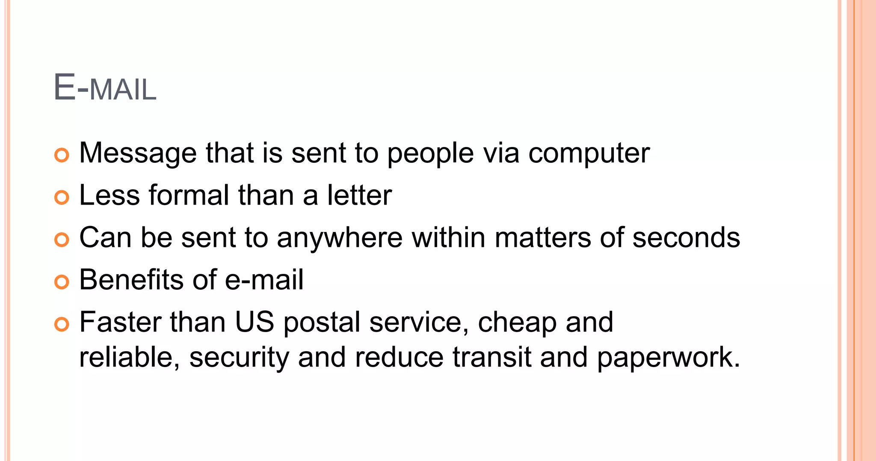

Slide 35
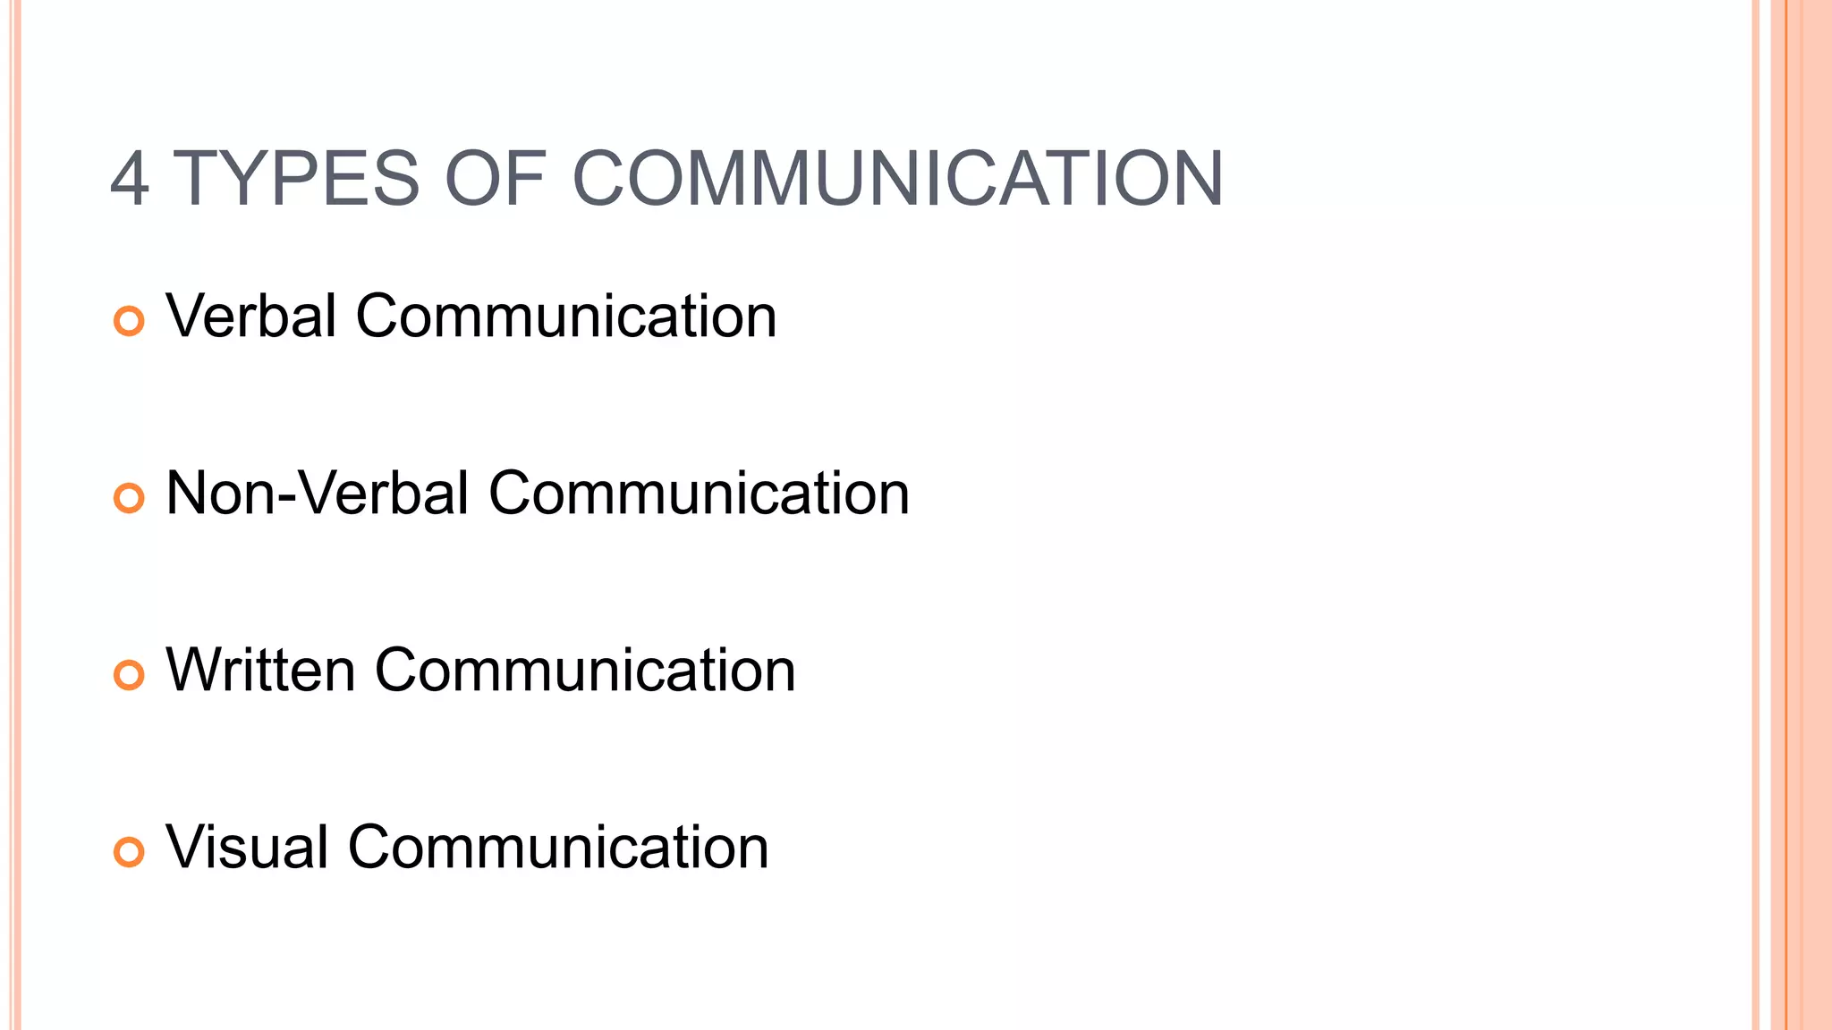
4 Steps Recap

Slide 36
RESOURCES
Crucial Communications - Gary Peterson
Crucial Communication: Control Difficult Workplace Conversations Using Essential Dialogue Tools to Achieve Positive Results More Often: Peterson, Gary: 9798594245280: Amazon.com: Books
Crucial Conversations –Kerry Patterson, Joseph Grenny, Ron McMillian, Al Switzler
Crucial Conversations: Tools for Talking When Stakes are High, Third Edition: Grenny, Joseph, Patterson, Kerry, McMillan, Ron, Switzler, Al, Gregory, Emily: 9781260474213: Amazon.com: Books
Difficult Conversations – Douglas Stone, Bruce Patton, Sheila Heen
Difficult Conversations: How to Discuss... by Stone, Douglas (amazon.com)

Slide 37


G.U.T.S.
Go
Use
This
Stuff

Slide 38

Let's
Have FUN

Slide 39

Contact Information
Jerry Evans, DTM
jerry@theawardscompany.com
Cell: 630-640-9219

