Slide 1
Vice President Education (VPE)
Club Officer Training

Slide 2
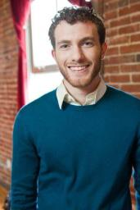
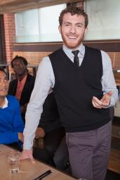

Agenda
VPE
Role
VPE
Responsibilities and Skills Learned
VPE Resources

Slide 3

VPE Role

Slide 4
VPE Role - Definition
Your main tasks are:
  Schedule club members’ speeches
  Verify project completion
  Serve as a Pathways Base Camp resource
  Organize club speech contests
  Lead club mentor program
You are an important source of Toastmasters knowledge for your club members!
It is your job to become familiar with ALL aspects of Pathways!

Slide 5
VPE Responsibilities
Inside the Club Meeting
Outside the Club Meeting
Distinguished Club Program (DCP)

Slide 6

Inside The Club Meeting
Provide positive and impartial evaluation on speeches/projects
Hold yourself and other officers accountable
Encourage member engagement in Pathways
Hand out agendas

Slide 7

Outside the Club Meeting
Set club meeting agendas and assign meeting roles
Manage club schedule and plan meetings
Manage member progress in Pathways and Base Camp
Manage the club’s mentor program
Plan club speech contests
Work with the club President on the Club Success Plan
Attend district events as a voting member

Slide 8
Skills You Will Learn
Strategic planning
Organization
Motivational strategies
Small group collaboration
Critical thinking
Mentoring
Problem Solving

Slide 9
Distinguished Club Program (DCP)
The bulk of the goal requirements in the DCP are educational (6 out of 10 goals)!!
Toastmasters Educational goals in the DCP:
  4 Level 1 Awards (1 goal)
  2 Level 2 Awards (1 goal)
  2 additional Level 2 Awards (1 goal)
  2 Level 3 Awards (1 goal)
  1 Level 4 Award (1 goal)
  1 Level 5 (DTM) Award (1 goal)
Make sure you know the DCP inside and out!

Slide 10
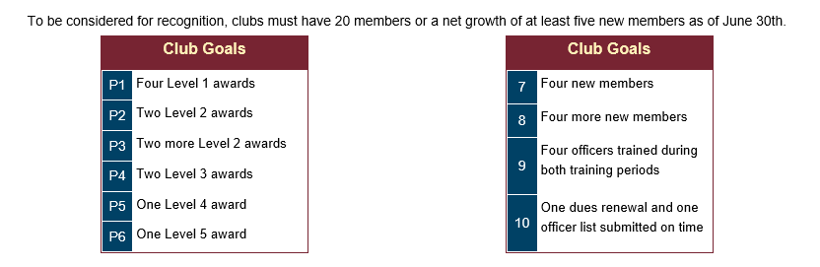
Distinguished Club Program (DCP) con’t.

Slide 11

VPE Resources

Slide 12
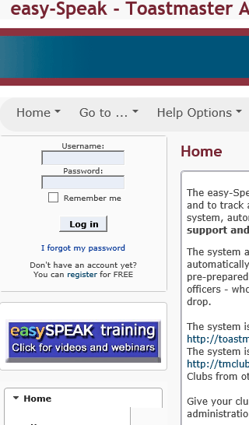
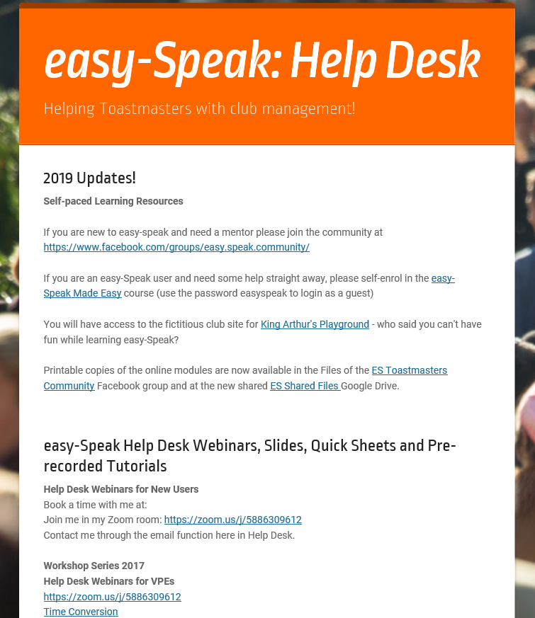
Help - EasySpeak

Slide 13

Support - FreeToastHost

Slide 14
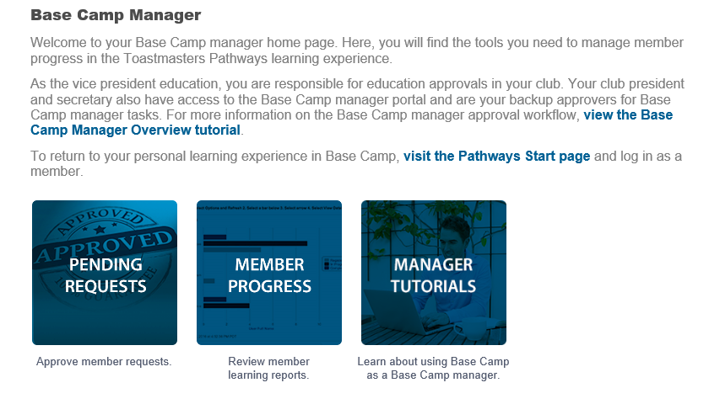
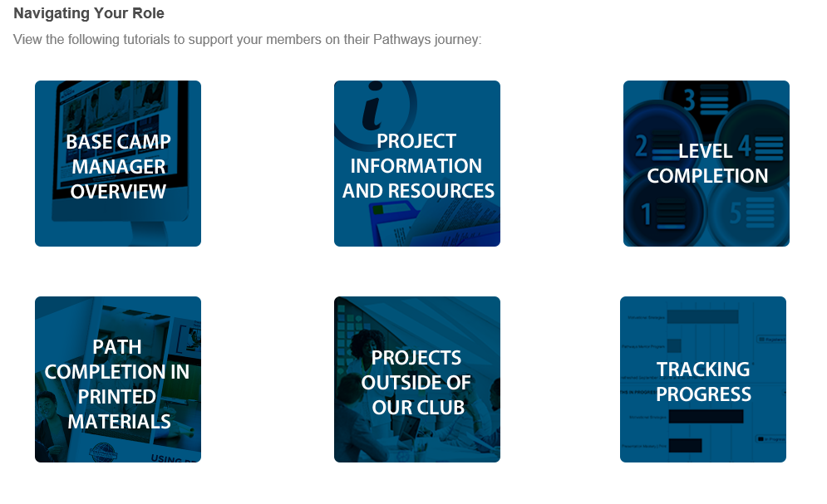
Help - Pathways

Slide 15
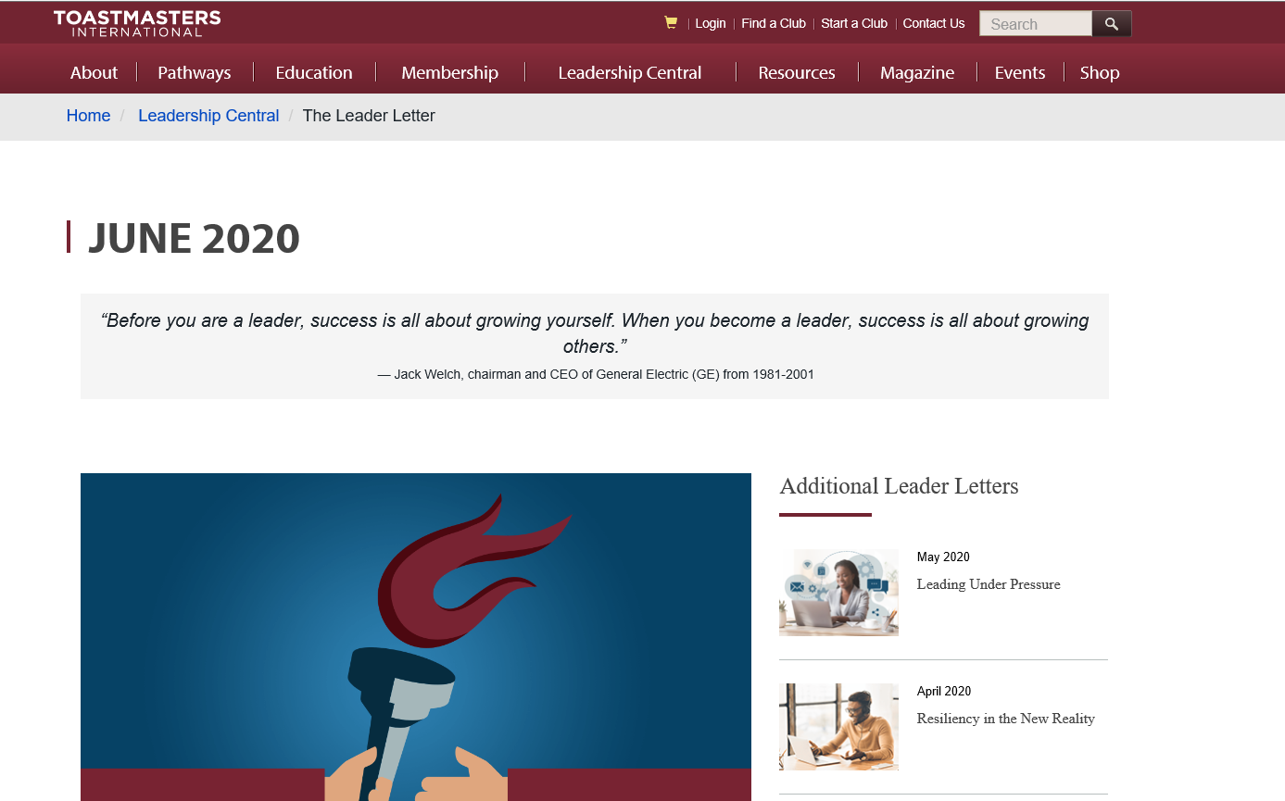
The Leader Letter

Slide 16
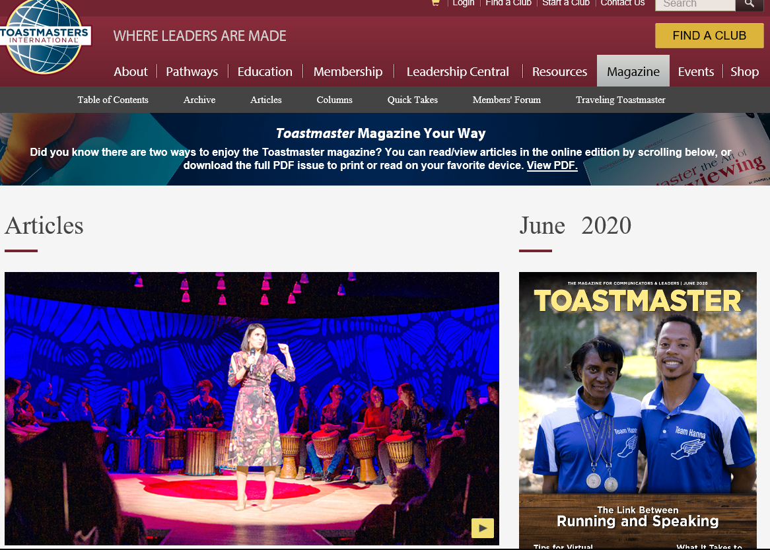
Toastmaster Magazine

Slide 17
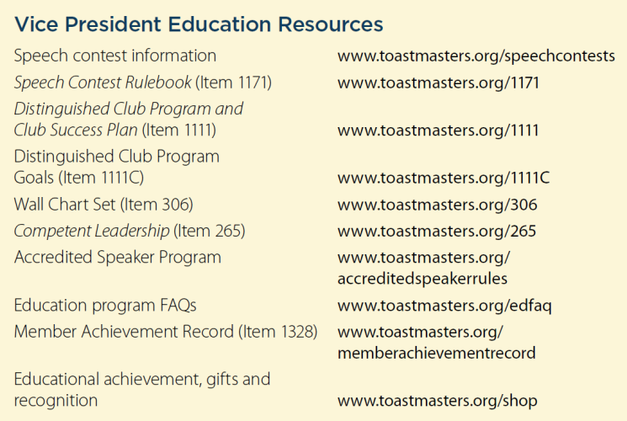
Additional Resources

Slide 18
This concludes the session.
Club Officer Training

