Slide 1
Chief Judge Training
Hints and Tips from the Speech Contest Rulebook
and Experienced Toastmasters
Notes:
Tell about my first Chief Judge experience.
WHY do I think this training is helpful. Quality contests start with knowledgeable leads: Contest Chair, Chief Judge, and Contest Toastmaster.

Slide 2

Topics Covered
Roles in a Contest
Major Responsibilities of Chief Judge
Rulebook (and checklist)
Finding qualified Judges
Briefing Judges, Ballot Counter, and Timers
Counting ballots
Handling Protests
Resources
Q & A
Notes:
With only an hour, I picked the 5 aspects of the Chief Judge’s responsibilities that I think may be the most misunderstood.

Slide 3
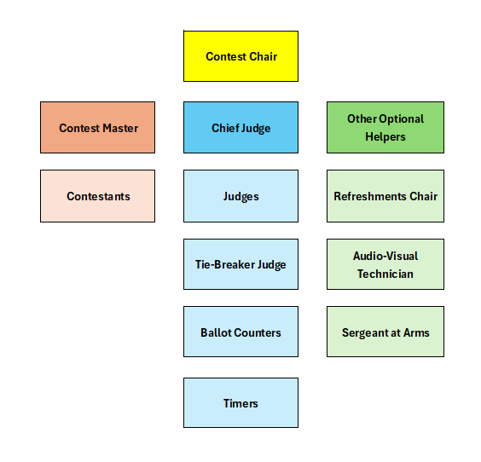
Contest Roles
Notes:
These are the common roles we have in Speech Contests. If you want to fulfill any of these roles, it is helpful to understand all the roles.
Today we are focusing on the Chief Judge. Remember that the Chief Judge is coordinating with the Contest Chair and Contest Master on a regular basis.

Slide 4
Major Responsibilities of Chief Judge
BEFORE | DURING | AFTER
Read the rulebook Find qualified voting Judges Find tiebreaker Judge Find Ballot Counters Find Timers Brief Judges, Ballot Counters and Timers | Affirm that functionaries were briefed Indicate all ballots were collected Double-check counting of ballots Handle any protests Provide results to Contest TM | Provide list of winners to the Contest Chair (and the next level contest chair) Destroy ballots
Notes:
This is HIGH-LEVEL view of the Chief Judge’s responsibilities. For the full list, consult the Chief Judge’s Checklist on p. 27 of the rulebook!

Slide 5
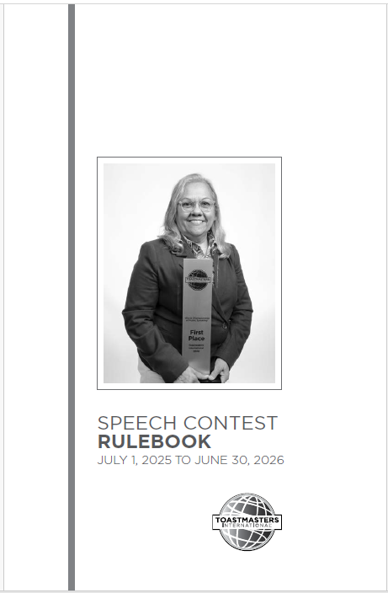
Read the Rulebook
The rulebook is updated every year!
Rulebook contains checklists.
Notes:
Reading the Rulebook is a requirement for all Chief Judges, Contest Chair, and Contest Toastmaster. It is recommended for all contestants, judges and functionaries too.
The rules change EVERY YEAR so make sure you have the latest copy. Note that changes from the prior year are marked in the margin with a diamond.

Slide 6
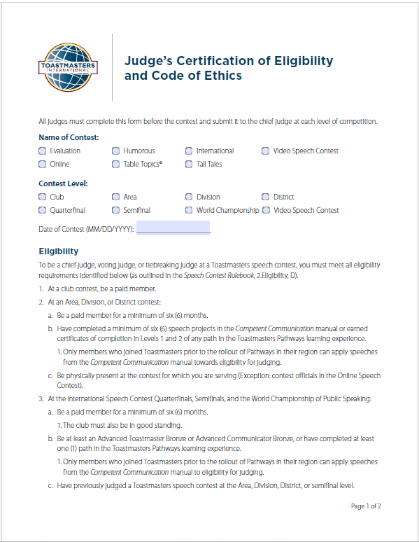
Qualifying Judges
Paid member for minimum 6 months
Completed Lvl 1 and Lvl 2 in any Path
Have no other contest role
Are not candidates for elected District Office
Notes:
These qualification even apply to you – as the Chief Judge!
You are responsible for confirming the eligibility for each judge and tiebreaker judge. All judges must sign and return to you this form.
For club contests, the only requirement is being a Paid Member of the club.
If a judge was a toastmaster prior to the introduction of pathways, they would need to have a minimum of 6 speeches from the legacy education program.
Candidates for elected District Leader Positions for the coming term are INELIGIBLE to service as contest officials.

Slide 7
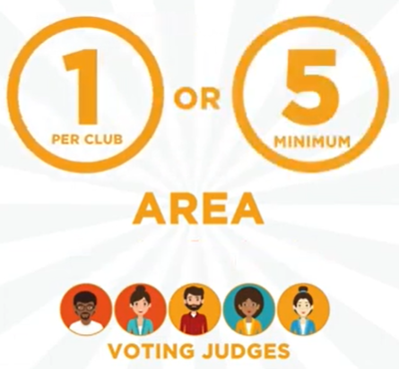
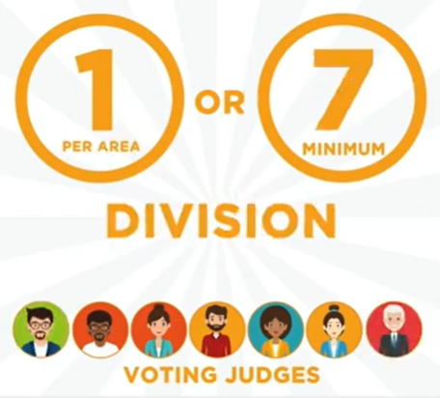
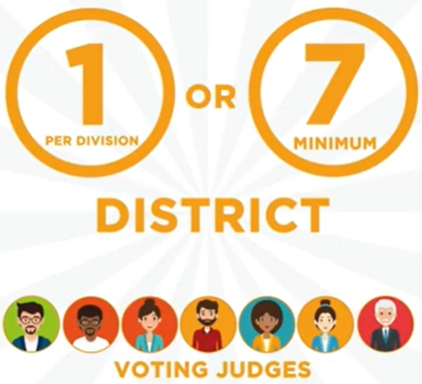
Number of Judges
Notes:
In CLUB contests, there should be a minimum of 5 judges.
At the AREA contests, there should be an equal number of judges per club or a minimum of 5.
At the DIVISION contests, there should be an equal number of judges per area or a minimum of 7.
At the DISTRICT contests, there should be an equal number of judges per area or a minimum of 7.
Toastmasters International understands that sometimes adhering to these counts is not possible. Please do the best you can.
It is ok to have more than the minimum.

Slide 8
Briefing: Judges
Tiebreaker judge is briefed separately (identity only known to you)
Judges briefed on contest rules including possible protests. Remind them of the importance of being unbiased and anonymous.
Review the ballot form and instructions.
Judges MUST sign and print their name on their ballots.
Judges MUST rank the contestants 1st, 2nd, 3rd.
Judges only need to turn in only the bottom portion of the judging form.
Judge Briefing Checklist is in the rulebook. Many briefing scripts exist! Or you can make your own.
Notes:
The tiebreaker judge will only turn their ballot in to the Chief Judge. The tiebreaker judge must follow all the same rules as the other judges except that the tiebreaker judge ranks ALL contestants (not just 1, 2, and 3).
Judge’s briefing checklist is included in the Chief Judge’s checklist in the rulebook p.28. You can use this as a guide for your briefings.

Slide 9
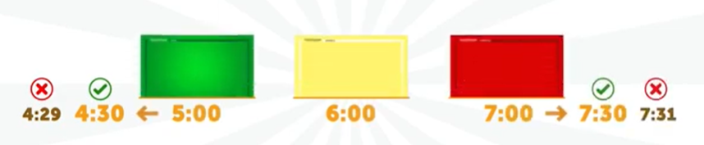
Briefing: Timers
There will be 2 Timers.
Time starts after the sound check, when speaker makes their first verbal or non-verbal communication.
The Official Timer times the speech and records minutes and seconds on the Time Recording Sheet.
The Visual Timer times the speech and shows green at the minimum time, then yellow, finally red at the maximum time. Red stays showing until the speech has ended.
One minute of silence will be timed between each contestant.
Notes:
The times shown in the example are for a 5-7 minutes speech. Obviously, times will be different for different contests. Make sure the Timers understand the timing of each of the types of contest you will be having at this Event.
If we are doing a “sound check” for each contestant, the Timer needs to be aware so that the sound check is NOT included in the recorded time.
One minute of silence should be timed between each contestant to give judges time to make their ballots.

Slide 10
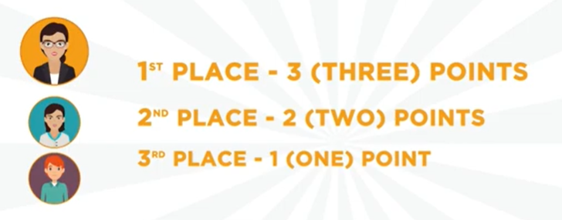
Briefing: Ballot Counters
A minimum of 2 Ballot Counters (3 for District Contest).
After the last contestant has finished speaking, judges complete their ballots and hold them up for the Ballot Counters to collect. (Envelopes recommended).
Chief Judge and Ballot Counters go to a separate, secure area to count the ballots.
Ballots are checked for validity. Then counted twice on the tally sheet. Results are written on the Results Form.
If there is a tie, the Chief Judge consults the tiebreaker ballot.
Notes:
These are the things you are explaining to the Ballot Counters.
Ballots are valid if they have: the winners named in order of first, second, and third and the ballots have the judge’s signature and printed name.
The ballots are counted TWICE for verification.
If there is a tie, the Chief Judge looks at the tiebreaking ballot. The Chief Judge is ONLY looking for the tied contestants and how they were ranked in relationship to each other on the tiebreaker judge’s sheet.

Slide 11
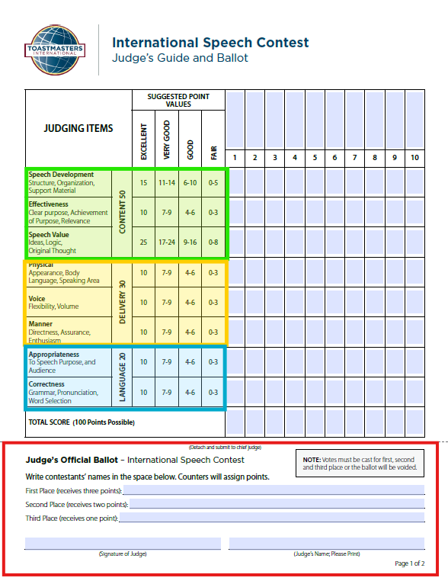
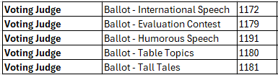
Ballots
Only the bottom portion of the ballot needs to be turned into the Ballot Counters.
Notes:
Important points about the Ballots:
Content and delivery have different weights on the ballot. In other words, the Language used is not as important as the Content of the speech.
There are instructions on the back of the form – very helpful especially for newer judges.
There are different ballots per contest type. In other words, the International Speech and the Tall Tales Speech have different ballots.
ONLY the bottom portion of the ballot should be turned into the Ballot Counters.

Slide 12
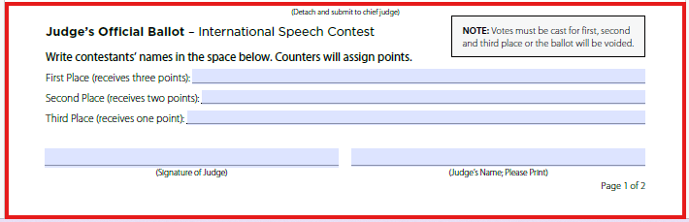
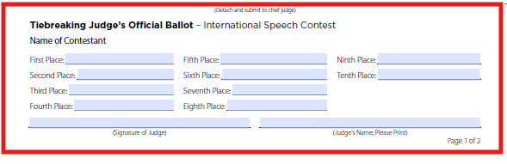
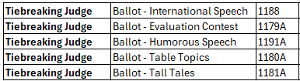
Ballots
Valid ballots have:
Judge’s Signature.
Judge’s Printed Name.
Contestants Ranked first, second, and third.
Notes:
Important points about the Ballots:
ONLY the bottom portion of the ballot should be turned into the Ballot Counters.
Tip: have the judges sign ALL the ballots right away!
The tiebreaker judge has a different ballot than voting judges.
The voting judges turn their ballots into the Ballot Counters; tiebreaker judge turns their ballots into the Chief Judge.

Slide 13
Protests
Protest: Contestant is not eligible
Protest: Speech content ‘substantially’ not original
Protest: Contestant referenced another contestant or speech in the same contest
Protests can ONLY come from judges or contestants.
Chief Judge makes the final determination after input from judges and others including contestant.
Notes:
Protests are uncommon but you must be prepared just in case.
There are 3 kinds of protests that can be raised. Protests can ONLY come from a judge or a contestant.
Contestants should ALWAYS be given an opportunity to respond before the final decision is made.
The Chief Judge may decide that the protest is warranted and disqualify the contestant.

Slide 14
Disqualifications
Speech went over maximum or under minimum time
Contestant is not eligible
Speech content is not ‘substantially’ original
Contestant referenced another contestant or speech in the same contest
Contestant did not arrive at the venue until after the Contest Toastmaster was introduced
Contest Toastmaster will announce if there have been any time disqualifications prior to the winners being announced.
No other disqualifications are announced!
Notes:
Protests (see #2, 3, and 4) may or may not lead to a disqualification.
There are other reasons for disqualification beside protests. Those are over/under time (#1), or contestant was too late to compete (#5).

Slide 15
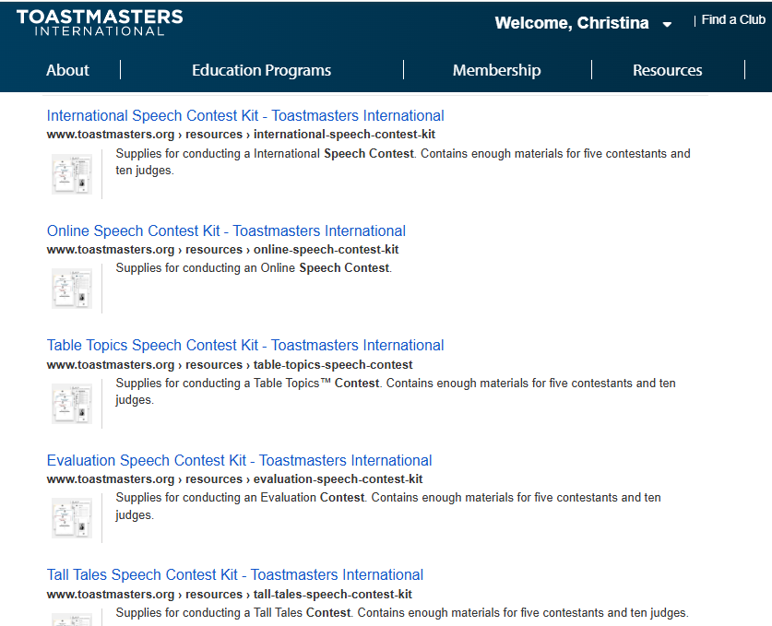
Resources
Notes:
Download the “Contest Kit” from Toastmasters.org for the type(s) of speeches for all the forms you will need.
The Contest Kit comes with all the forms needed for a particular type of contest. Therefore, if you are having 2 contests (e.g. International and Tall Tales) at the same event, you will need to download 2 different kits.
Certificate for each Participating contestant and for the 1st, 2nd, and 3rd place winners are included in the kit but it may not be your job to print them. Work with the Contest Chair to divide up the responsibilities.

Slide 16
Contest Kit Contents
Results Form
Judge’s Eligibility Form
Speech Contest Rulebook
International Speech Ballot
International Speech Ballot for Tiebreaking Judge
Time Record Sheet
Counters’ Tally Sheet
Notification of Contest Winners
Speaker’s Eligibility Form
Speech Contestant Profile
Video Release Form
Certificates (Participant, 3rd, 2nd, 1st Place)
Notes:
Items highlighted in yellow are needed by the Chief Judge. The other forms will likely be needed by the Contest Chair or the Contest Toastmaster.
Certificate for each Participating contestant and for the 1st, 2nd, and 3rd place winners are included in the kit but it may not be your job to print them. Work with the Contest Chair to divide up the responsibilities.
For Area and Division contests Estelle has certificates that were purchased and just need to be distributed.
Area Director & Division Directors need to let Estelle know if they will be at either of the in person TLIs so she can give them to you.

Slide 17
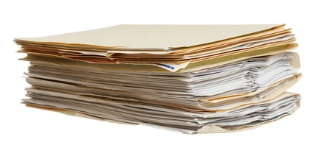
What to Bring Contest Day
Speech Contest Rulebook
Agenda
List of Judges and contact information
Judge’s Eligibility Forms
Speech Ballots (for all judges for all contests)
Speech Ballots for Tiebreaking Judge (for all contests)
Time Record Sheets (per contest)
Counters’ Tally Sheet (per contest)
Results Form (per contest)
Notification of Contest Winners (per contest)
Timing Cards and Stopwatches
Envelopes
Pens
Notes:
If all the Judge’s provide their eligibility forms in advance, you won’t need to bring them.
If you have 6 judges and 1 tiebreaker judge for 2 types of contest, then you will need 14 ballots: 6 International ballots, 1 international tiebreaker ballot, 6 tall tales ballots, and 1 tall tales tiebreaker ballot.
Give pens and envelopes to the judges.
Gives pens to the ballot counters.

Slide 18

Notes:
There is a lot of information I was not able to cover in the time I had. Please feel free to reach out to me if you have any questions: christina1750@gmail.com

Slide 19
DISCUSSION ITEMS
Can someone be a judge if they are from a different District?
Is a ballot valid if the judge forgets to sign it?
When do the Timers start their stopwatches?
Who determines if there has been a time disqualification?
Notes:
Yes, it is possible to have judges from other districts as long as they are eligible!
No, a ballot is only valid if Judge prints their name and provides their signature.
After the sound-check (contestant says ‘Thank you’, contest toastmaster says ‘You’re Welcome’, after that Time starts with contestants next verbal or non-verbal communication.)
The Chief Judge – not the Timer. The Timer just provides the information to the Chief Judge.

Slide 20
DISCUSSION ITEMS
Can an audience member protest a contestant based on eligibility or originality?
If a Judge was deemed eligible in the area contest, do we have to verify the eligibility again at the division and district level?
When should you start looking for Judges?
How can the eligibility of a Judge be verified?
Notes:
5. No, protests can only come from Judges or Contestants.
6. Yes, the eligibility of contestants and judges much be verified at each contest level.
7. Probably right away. We don’t usually have the luxury of long timelines. Guideline: 3 weeks prior to the event.
8. District Leaders can find the information in Toastmaster.Org.

Slide 21
DISCUSSION ITEMS
What is the difference between the Results Form and the Notification of Contest Winners Form?
Do both Timers need stopwatches?
How is the tiebreaker ballot used to break a tie?
If a contestant misses the Contestant Briefing, are they disqualified?
Notes:
9. The Results Form lists top 3 winners of the contest in reverse order. This form is provided to the Contest Chair and Contest Toastmaster so winners can be announced. The Notification of Contest Winners Form is a list of all contestants in order from 1st place to last place. This form is provided to the next level of contest.
10. Yes, it is recommended that both Timers have a stopwatch. Time is recorded from the Official Timer’s timing device. The Visual Timer’s device can be a back-up just in case.
11. If there is a tie when ballots are counted, the Chief Judge reviews the tiebreaker ballot and looks for ONLY the contestants involved in the tie. Then sees how those contestants were ranked in comparison to each other. No need to review any other contestant rankings.
12. A late Contestant may waive their briefing and still participate in the contest… if they arrive BEFORE the Contest Toastmaster is introduced.

