Slide 1
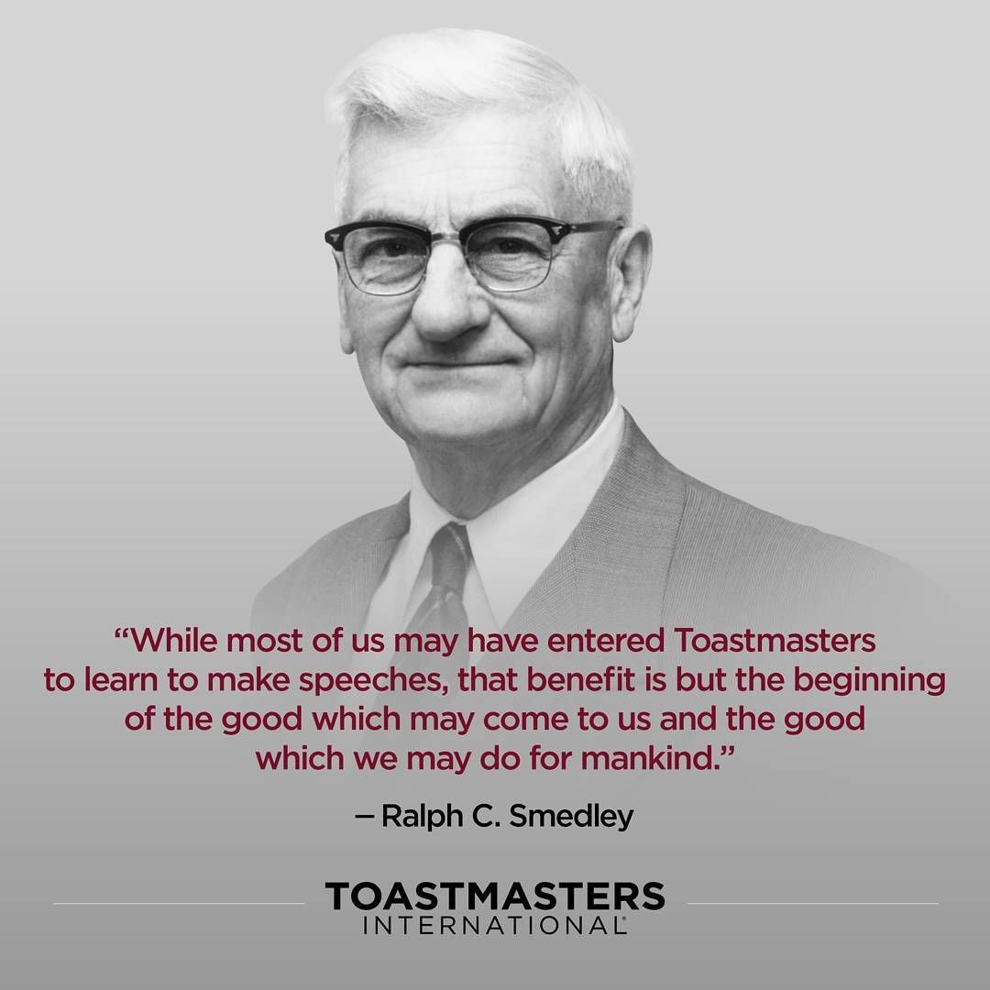
"The destination determines the direction.”
– Ralph Smedley
The ABC’s of the DTM Journey
Wendy Pesavento, DTM
Dekalb Area Toastmasters
11/11/2024
Notes:
The DTM is the highest designation that is awarded by Toastmasters. The journey to becoming a DTM will increase your confidence and expand your skills as a speaker and a leader. It an amazing personal growth journey.

Slide 2
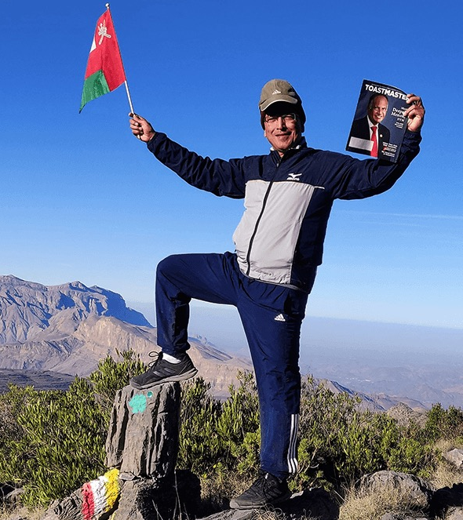
Learning Outcomes
The Process To Earn A DTM
Planning A DTM
Getting Started
The Benefits Of Pursuing A DTM
Notes:
Let’s briefly review our learning outcomes for this session.

Slide 3
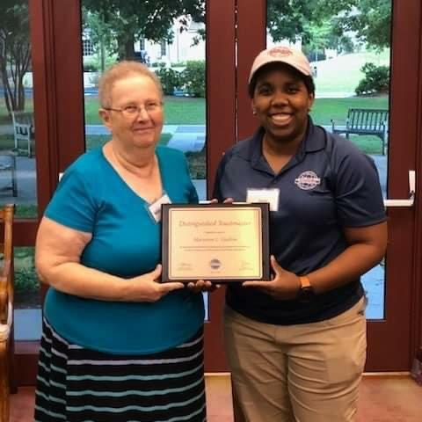
DTM FACTS
902 DTM’s awarded in 2023-2024
Less than half a percent of all toastmasters are DTM’s
The DTM requires both speaking and leadership tasks
The DTM can be completed in 2-3 years
D54 has 134 total DTM’s on record
Notes:
Earning a DTM is a big deal.
902 TI members earned a DTM in 2023-2024
TI membership in 2023-2024 totaled 280,000 members in 150 countries
The DTM can be completed in 2-3 years Some like to take more time to enjoy the journey and may take longer.
Like most things in life that are worthwhile, the DTM requires a plan and persistence.
Let’s begin by discussing the 6 requirements to earn a DTM.

Slide 4
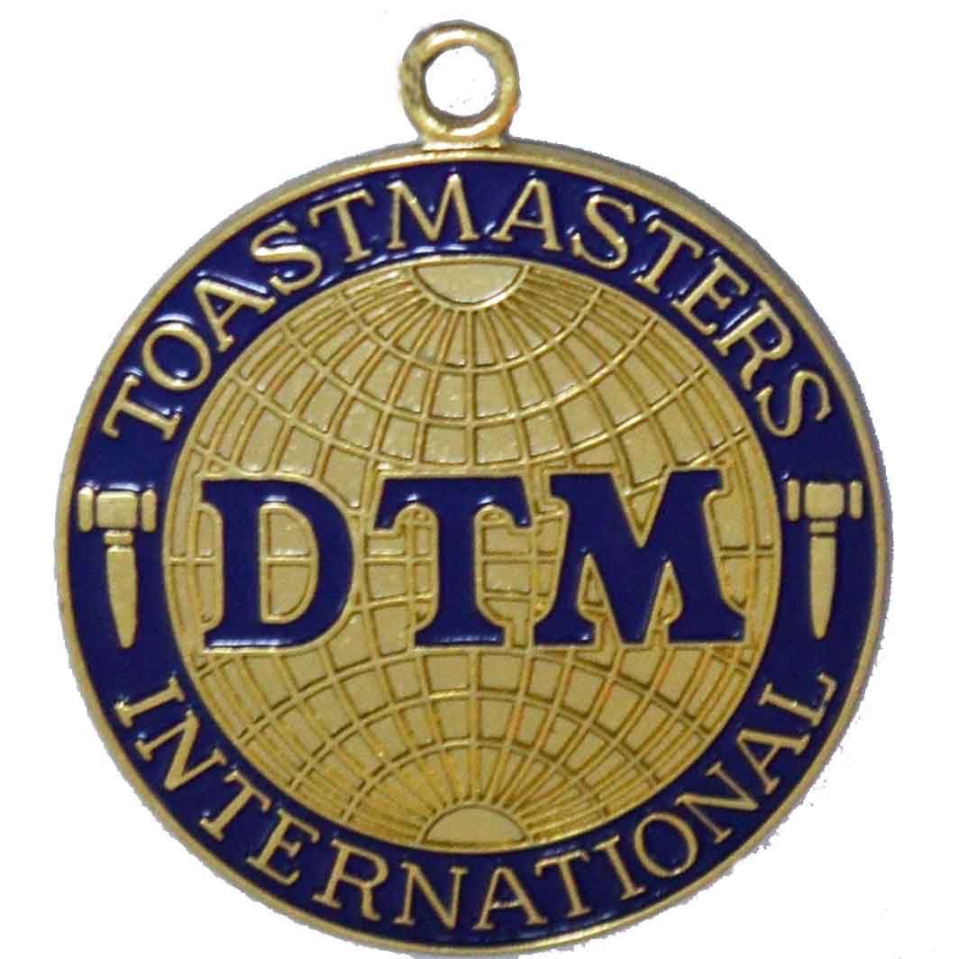
What Are the Requirements of the DTM Designation?
2 Paths (Completed)
Club Officer for 12 months
District Officer 12 months
Club Mentor or Club Coach
Club Sponsor, Speechcraft or Youth Leadership Program (YLP) Coordinator
DTM project
Notes:
Achieving a DTM requires completing 6 tasks. They are...
READ THE SLIDE. (Don’t elaborate yet).
The first requirement is related to education.

Slide 5
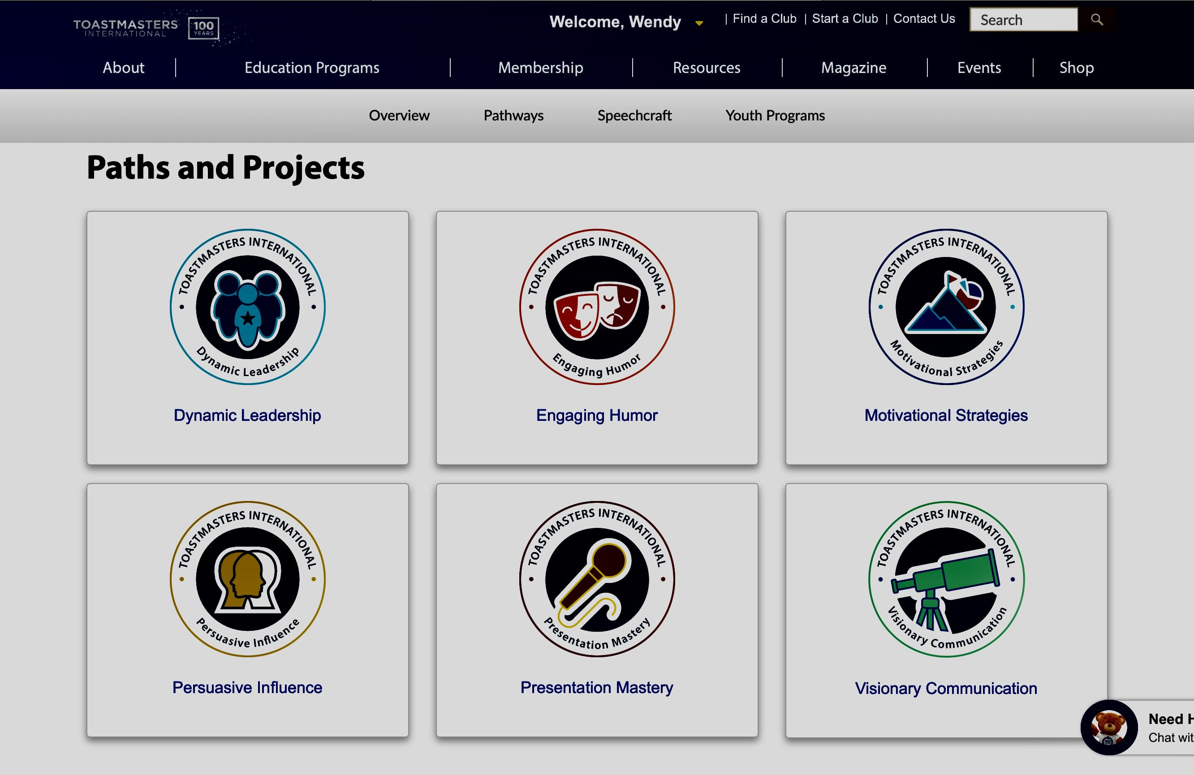
1. Complete 2 Paths
One path and a second path
Can be any path
Can include “legacy paths”
Record evaluations in Base Camp
Speak often, at any club
Request the DTM project after completing path 1 + 3 levels of path 2
Notes:
The first DTM requirement is to complete 2 full Paths in Pathways. It is a good idea to get started on this requirement early and you may have already made progress without knowing it! Pathways speeches that have been delivered previously absolutely count toward the first DTM requirement!. It is necessary to complete 1 full path and 3 levels of a second path before requesting access to the DTM project from TI.
The second requirement is related to club service.

Slide 6
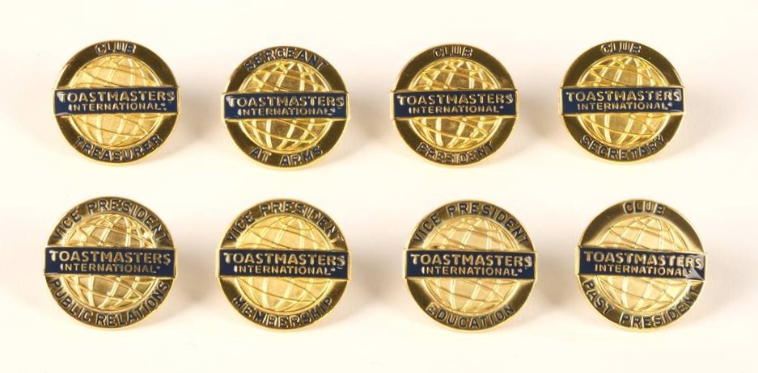
2. Serve 12 Months as a Club Officer
Any elected club officer role including immediate past president
2 terms of 6 months each OR 12 consecutive months
Don’t have to serve both terms at the same club
Name on the club officer list submitted to TI
Club success plan, attend club officer training, attend club and EC meetings
Notes:
The second DTM requirement is to serve as a club officer for 12 consecutive months or to serve two 6-month terms. Previous terms as a club officer can be counted toward this requirement. Club officers are elected by their clubs. It is necessary to fulfill the requirements of the officer role in order to receive DTM credit.
The third DTM requirement relates to serving the District,

Slide 7
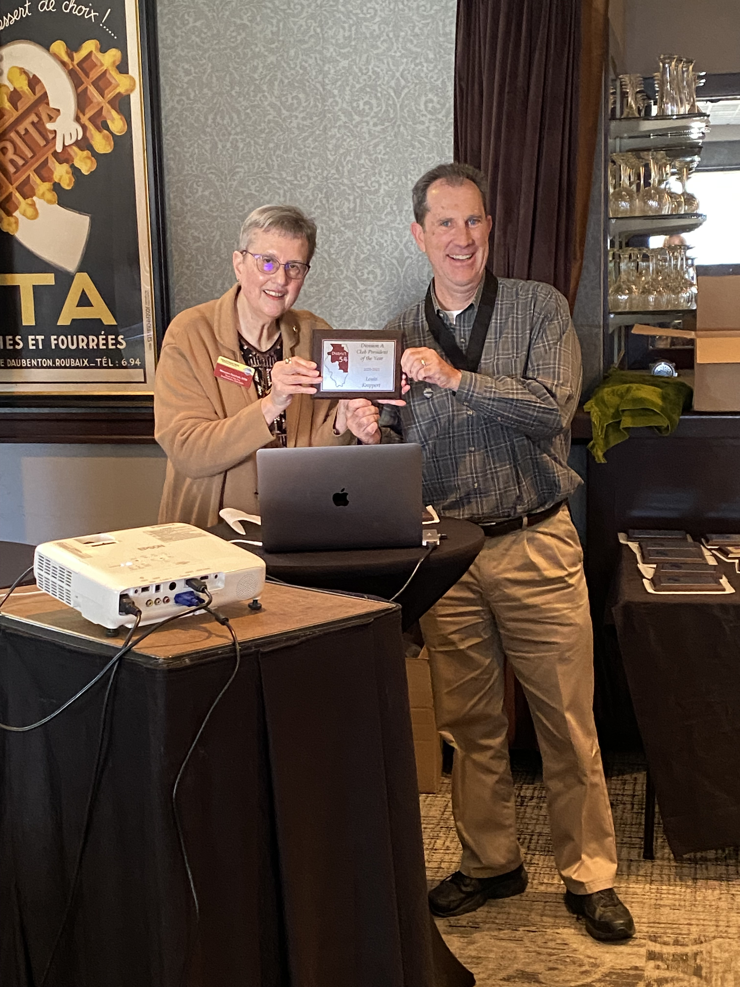
3. 12 Months of Service as a District Officer
  District Director
  Program Quality Director
  Club Growth Director
  Public Relations Manager
  Administrative Manager
  Financial Manager
  Division Director
  Area Director
Notes:
The 3rd requirement of the DTM is to serve 12 consecutive months as a district officer.
Eligible roles are:
District Director: The leader of the district who represents the district in the TI organization. DD’s have many responsibilities to fulfill both as both leaders and administrators.
Program Quality Director: The PQD is 2nd in charge and responsible for the oversight of club quality and district education.
Club Growth Director: The CGD is 3rd in charge. CGD’s charter new clubs, appoint club sponsors, mentors and coaches, and oversee all aspects of club growth.
Public Relations Manager: PRM’s job is to promote Toastmasters events within and outside of the district.
Administrative Manager: The Admin Manager is in-charge of the meeting minutes of district executive council (DEC) and district council.
Financial Manager: The Financial Manager assists in developing the district budget, pays all district expenses and maintains district accounting.
Division Director: DivD’s support multiple Area Directors within their division, hold semi-annual Division Council Meetings, and organize the annual Division speech contest.
Area Director: AD’s support the clubs in their area by working with the clubs EC to ensure clubs are running successfully and to provide help if needed. AD’s also make biannual club visits and oversee Area speech contests.
The fourth and fifth DTM requirements may need some additional explanation.

Slide 8
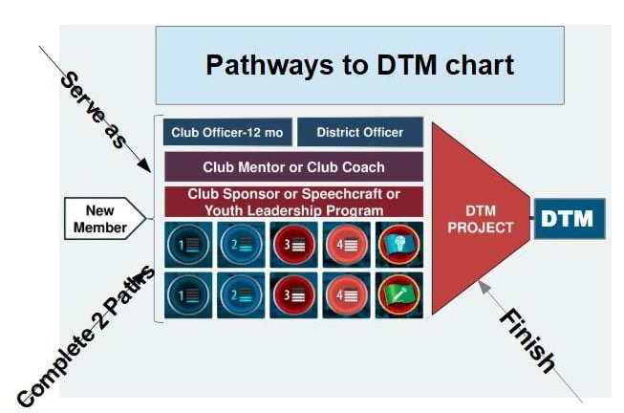

Slide 9
Club Coach, Club Sponsor, Club Mentor? What’s the Difference?
Coach
Mentor
Sponsor
Club Coach
Works to rebuild a club that is in decline and needs new members.
Club Sponsor
Works to get a new club chartered.
Club Mentor
Helps a new club through early period following the chartering process.
Notes:
Before we discuss the 4th and 5th DTM requirements, let’s talk about the difference between 3 similar terms; Club Coach, Club Sponsor, and Club Mentor.
Does anyone know the difference?
READ THE SLIDE.
Let’s discuss how the role of Club Coach and Mentor can fulfill the the 4th DTM requirement.

Slide 10
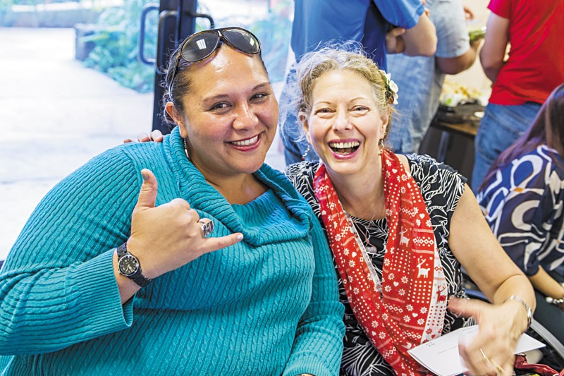
Choose One of Each
4. Choose 1
5. Choose 1
Club Coach
Club Mentor
Club Sponsor
Speechcraft Coordinator
Youth Leadership Coordinator
Notes:
When choosing how to fulfill the 4th DTM requirement, there are two options form which to choose. Option 1 is to serve as a Club Coach and Option 2 is to serve as a Club Mentor.
Let’s discuss each of these roles in more depth and how they benefit struggling clubs and new clubs.

Slide 11

Youth Leadership Program (YLP)
Speechcraft
TI Online Portal
Club driven activity, EC approved
8 hours of class
Attendee pays
Manuals and Workbooks
8 sessions, 2 hours each
14-18 age group
Limited to 25 students
Club often pays
Notes:
A Youth Leadership Program is Toastmasters workshop developed for young people, usually between the ages of 14-18. Youth Leadership Coordinators recruit a group of adult Toastmaster volunteers to conduct 8 educational sessions that are similar to a Toastmasters Club Meeting. Participants gain experience learning to lead and conduct a club meeting, stay on time using an agenda, fill meeting roles, deliver speeches, practice table topics, and deliver evaluations. Many YPL’s result in gavel clubs (TI club for the under 18 age group). The materials for a YPL include a facilitators guide and a participant workbook. These materials can be purchased at the TI shop at Toastmasters.org.
The 6th and final requirement of the DTM is the DTM Project.

Slide 12
6. DTM Project
Capstone project
Request after completing 1 path + 3 levels
District approval
Guidance committee
Project plan
  Build a team
  Coordinate tasks
  Execute plan
360-degree evaluations
2 speeches
Notes:
The DTM Project is a capstone project, encompassing all of the skills necessary to complete DTM requirements 1-5.
A DTM Project requires the Candidate to plan and complete a project that benefits an organization.
A Candidate may choose to revisit any previous Toastmasters Pathways project that contains information to help to complete the project.
Develop a team and design a plan.
Deliver a 5- to 7-minute speech at a club meeting to share the plan.
Organize the project and lead a team to complete it.
Ask members of the team, the organization, and a peer to complete a 360° evaluation of the Candidates leadership skills.
Deliver an 8- to 10-minute speech at a club meeting to review the project, its outcomes, benefits, and the lessons learned.
Common DTM Projects within D54 are to serve as a TLI Dean (club officer training) or a District Conference Co-Chair.
We have discussed the 6 DTM requirements. Now let’s talk about how to get started.

Slide 13
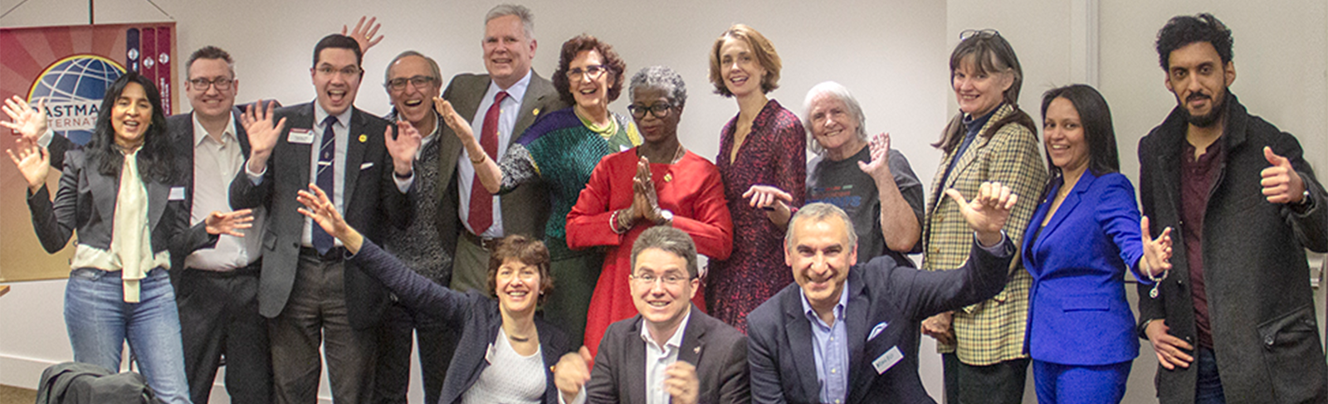
Getting Started
Download and review the DTM application stored on Toastmasters.org
Make a DTM Plan and a DTM calendar
Find a DTM mentor / accountability partner
Tell your club what you are doing and ask for their support
Ask district leaders to help you find opportunities to be a club mentor, sponsor, or coach. They also can help with ideas on Speechcraft, Youth Leadership, or forming new clubs.
Notes:
Many Toastmasters ask, “How do I get Started?” when considering undertaking a DTM journey. Let’s review some steps that will help organize the tasks necessary to earn a DTM.
REVIEW THE SLIDE.
Let’s take a look at a DTM Application found on the Toastmasters.org website.

Slide 14
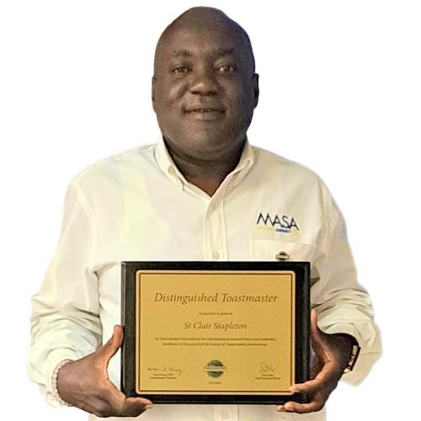
Benefits of Earning A DTM
Individual Toastmaster
Club
District
Notes:
Based on what we have discussed today, can you think of any potential benefits of earning a DTM?

Slide 15
Learning Outcomes
The Process To Earn A DTM
Planning A DTM
Getting Started
The Benefits Of Pursuing A DTM
Notes:
Let’s briefly review our learning outcomes for this session.

Slide 16
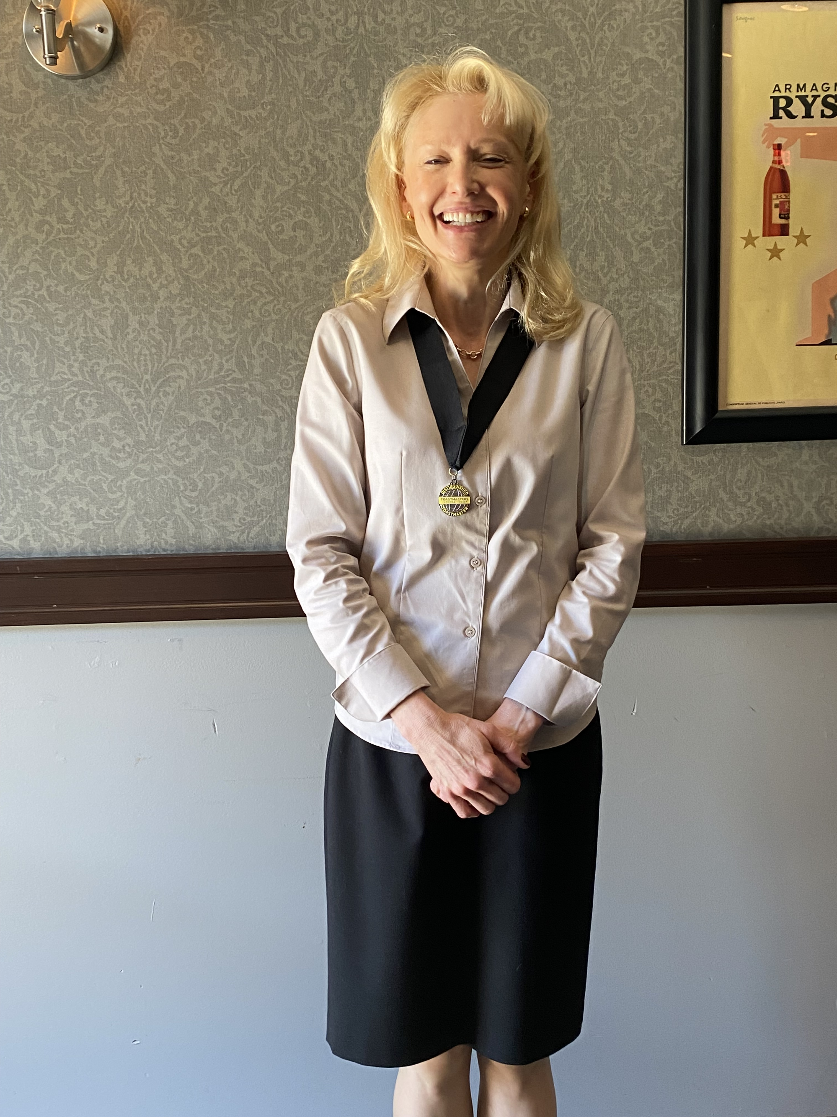
Thank you!
Questions?
Notes:
.

