Slide 1
Overview of October 2025 Pathways Enhancements
Toastmasters International
Enhancing Member Experience and Club Success
Notes:
Original PPT slidedeck developed by Wendy Pesavento, October 2025
Updated PPT slidedeck developed by Maryann Reichelt, October 16, 2025

Slide 2
Introduction
Rollout of Enhancements to the Pathways Education Program
Adding meeting roles and pre-Pathways Education Series presentations.
Designed to grow members Knowledge, Skills, and Abilities (KSA’s).
Supports successful, high quality club meetings.
Effective date October 22, 2025

Slide 3
Overview
Enhanced Pathways Requirements
Enhancements by Level
Affected Paths
Special Notes
What Stays the Same
Next Steps

Slide 4
Enhanced Pathways Requirements
Meeting Roles
Education Series Presentations
Notes:
Enhancements for each Level will appear above that Level’s projects. This shows all meeting roles (including those imbedded in a Level Project, such as, L1-P4-Evaluation and Feedback) AND Legacy Presentation modules.
Meeting Roles will NOT be tracked in Base Camp. Clubs can discern if a member may complete meeting roles out of Level order.
Members can track most meeting roles in their Pathways profile with the date completed. Introductory Mentor, Table Topics Speaker, and Specialized Role will NOT be added to the member’s Pathways profile.
The Board of Directors has determined that members must complete their required meeting roles within the relevant level to receive credit. For example, a role completed in Level 1 cannot count toward Level 3
Education Series Presentations will also have to be tracked by the club.

Slide 5
Meeting Roles
• Members serve in specific meeting roles at each level.
• Roles build from simple (Table Topics Speaker) to more advanced (Toastmaster of the Day).
• Roles entered in member’s Pathways profile.
Notes:
Meeting roles for each level can be downloaded from the Toastmasters International implementation notice e-mail sent October 22. 2025 by clicking on
”how to support these changes in your club”.

Slide 6
Toastmasters Education Series
• The Successful Club Series (Levels 3–5).
• The Better Speaker Series (Level 4).
• The Leadership Excellence Series (Level 5).
• Presentations: 10–15 minutes.
Notes:
Members can be directed to Toastmasters International Resources site via the link in the Toastmasters International implementation notice e-mail sent October 22, 2025 “how to support these changes in your club”.

Slide 7
Level 1 Enhancements
Meeting Roles:
• Table Topics Speaker*
• Evaluator (part of Project 4)
• Timer OR Ah-Counter
No Education Series presentations.
Notes:
While it is suggested that a member respond to a Table Topic thought or question prior to the Ice Breaker, the club can discern if a speech is delivered AND the member also answers a Table Topics thought or question, if the member can get credit for both roles on the same date.

Slide 8
Level 2 Enhancements
Meeting Roles:
• Grammarian
• Table Topics Master
• Evaluator
• Toastmaster, Timer, OR Ah-Counter
No Education Series presentations.

Slide 9
Level 3 Enhancements
Meeting Roles:
• Toastmaster
• Evaluator
• Table Topics Master, Table Topics Speaker, OR Introductory Mentor*
Education Series:
• One Successful Club Series presentation
Notes:
Introductory Mentor is a member that helps a guest navigate the agenda, answers their questions, helps them navigate what each meeting role requires. Is NOT their ‘official’ mentor.
Check if a meeting role is part of a transcript project, such as Table Topics Master (elective - Active Listening). The Club can discern if a member completing an elective that contains a meeting role would qualify as both a project completion AND a meeting role fulfilment.

Slide 10
Successful Club Series Speech Options
Creating the Best Club Climate
Meeting Roles and Responsibilities
Keeping the Commitment
Going Beyond Our Club
Notes:
The other options will appear in Levels 4 and 5

Slide 11
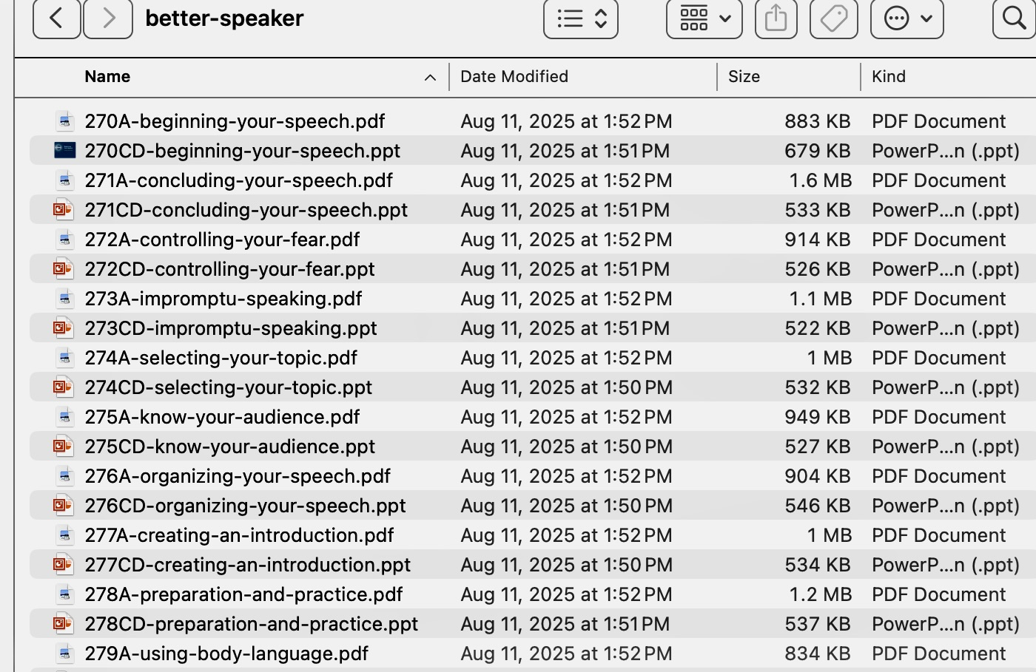
Download Each Series from TI Site
Notes:
A sample of some of the Better Speaker Series of presentations. Click on the ‘how to support these enhancements’ link, scroll towards the bottom of the PDF, and select the Legacy Education Series you wish to download. Refer to ‘how to support these changes in your club’ link in the Toastmasters International implementation e-mail sent October 22, 2025 to be directed to the Toastmasters International Resources page.

Slide 12
Successful Club Series Moments of Truth Materials
Manual
Powerpoint
Notes:
Review the PPT slidedeck for outdated verbiage. Some modification to the current LMS enhanced Pathways may be necessary.

Slide 13
Level 4 Enhancements
Meeting Roles:
• Toastmaster
• General Evaluator
• Evaluator
• Table Topics Speaker, Table Topics Master, Specialized Role*, or repeat role listed above
Education Series:
• One Successful Club Series presentation
• One Better Speaker Series presentation
Notes:
Check if a meeting role is part of a transcript project, such as Table Topics Master (elective - Active Listening). The Club would have to discern if a member completing an elective that contains a meeting role would qualify as both a project completion AND a meeting role fulfilment.

Slide 14
Level 4: Pick 1 from Each Series
Successful Club Series
Better Speaker Series
Finding New Members
Closing the Sale
How to be a Distinguished Club
Toastmasters Education Program
Beginning Your Speech
Concluding Your Speech
Controlling Your Fear
Impromptu Speaking
Selecting Your Topic
Know Your Audience
Organizing Your Speech
Creating an Introduction
Preparation and Practice
Using Body Language

Slide 15
Level 5 Enhancements
Meeting Roles:
• General Evaluator (twice)
• Toastmaster (twice)
• Evaluator (twice)
• Other roles: Table Topics, Table Topics Master, Grammarian, Timer, Ah-Counter, Mentor, or Specialized Role*
Education Series:
• One Successful Club Series presentation
• One Leadership Excellence Series presentation
Notes:
Check if a meeting role is part of a transcript project, such as Table Topics Master (elective - Active Listening). The Club would have to discern if a member completing an elective that contains a meeting role would qualify as both a project completion AND a meeting role fulfilment.

Slide 16
Level 5: Pick 1 from Each Series
Successful Club Series
Leadership Excellence Series
Moments of Truth
Evaluate to Motivate
Mentoring
Visionary Leader
Developing a Mission
Values and Leadership
Goal Setting and Planning
Delegate to Empower
Building a Team
Giving Effective Feedback
The Leader as Coach
Motivating People
Service and Leadership
Resolving Conflict

Slide 17
Affected Paths
Enhancements apply to 6 paths:
• Dynamic Leadership
• Engaging Humor
• Motivational Strategies
• Persuasive Influence
• Presentation Mastery
• Visionary Communication

Slide 18
Special Notes
* Table Topics Speaker must be completed before the Ice Breaker speech.
* Introductory Mentor is a member who unofficially supports new members by answering questions and guiding them based on their experiences.
* Specialized Role is specific to your club or a unique situation.
Notes:
If a member has begun Level 1 projects before giving their response to a Table Topics thought or question, they may get credit for this role.
Specialized Role allows a member to fill a role that is specific to your club or a unique situation. For example, your club may have an Online Moderator role, or there may be a circumstance where they are needed to manage visual aids for another member.

Slide 19
What Stays the Same
• Existing project requirements remain unchanged.
• Completed levels remain completed.
• Members in legacy or translated paths can participate but requirements differ.
Notes:
Legacy and translated Paths will NOT contain the 2025 Pathways enhancements. Legacy (retired) Paths are on a different system than LMS Pathways and will not be updated to include the 2025 enhancements. As Paths get translated, the 2025 enhancements WILL be included in the transcripts.

Slide 20
Important Next Steps
1. Share this information with All Toastmasters.
2. Review Education Series content.
3. Prepare to track new requirements.
4. Ensure club officers understand the new process.

Slide 21
Conclusion
Pathways enhancements begin October 2025.
• Members gain more opportunities to lead and speak.
• Clubs benefit from stronger member engagement.
• Together, we build better communicators and leaders.

