Slide 1
Is Sustainability Dead?
Demand Drivers and the Power of Asking
10/2/2025
Notes:
IRA – GSA, FHWA, EPA, FEMA, HUD
Infrastructure – landed ports of entry concrete and asphalt
SEC GHG/Climate Risk
261 – Financial Risk (over $500 million)
253 – GHG (over $1 billion)
2446 – 40% reduction in GHG emissions from building material by 2035, interim 20% reduction by 2030
Canadian Net Zero Emissions Accountability Act – 5 year national emissions reduction targets along the path to net zero by 2050

Slide 2
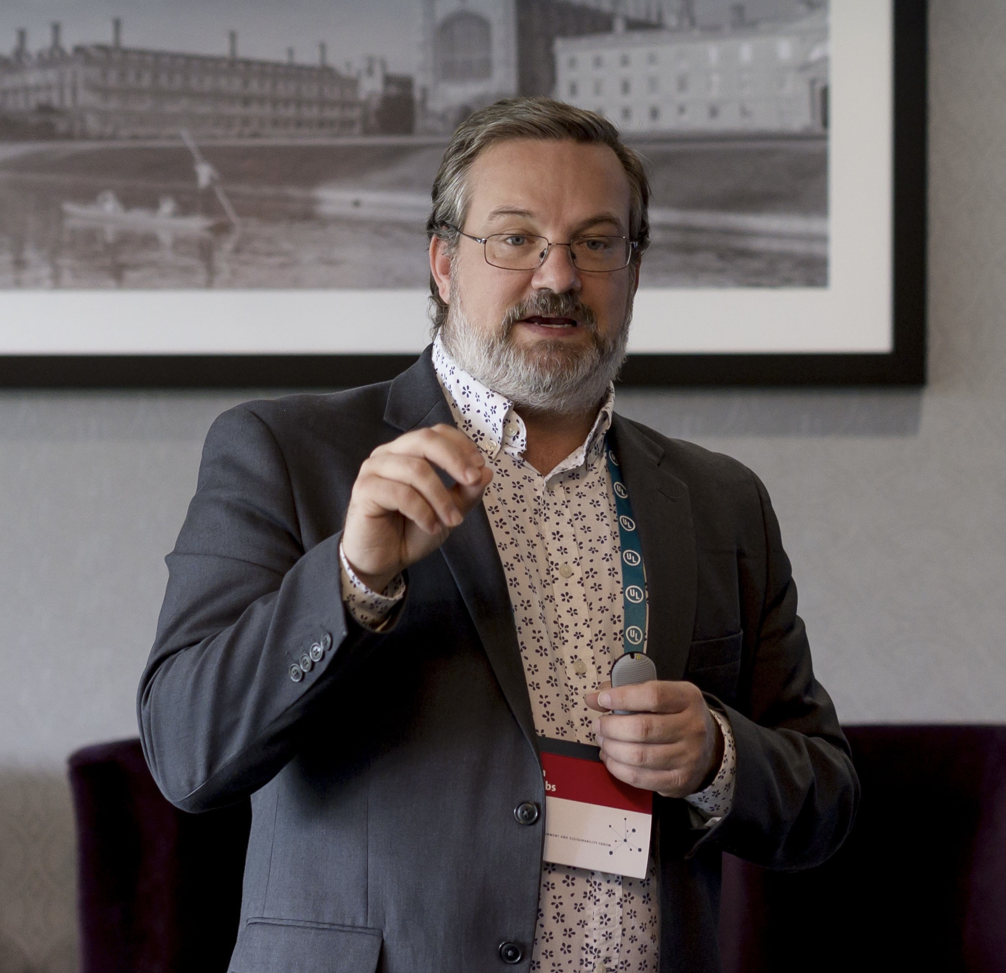
Josh Jacobs
Managing Director of Buildings & Policy
WAP Sustainability
Notes:
IRA – GSA, FHWA, EPA, FEMA, HUD
Infrastructure – landed ports of entry concrete and asphalt
SEC GHG/Climate Risk
261 – Financial Risk (over $500 million)
253 – GHG (over $1 billion)
2446 – 40% reduction in GHG emissions from building material by 2035, interim 20% reduction by 2030
Canadian Net Zero Emissions Accountability Act – 5 year national emissions reduction targets along the path to net zero by 2050

Slide 3
Inflation Reduction Act
Bipartisan Infrastructure Act
SEC GHG
CA SB261 and 253 and AB 2446
NY Climate Superfund Law
Notes:
IRA – GSA, FHWA, EPA, FEMA, HUD
Infrastructure – landed ports of entry concrete and asphalt
SEC GHG/Climate Risk
261 – Financial Risk (over $500 million)
253 – GHG (over $1 billion)
2446 – 40% reduction in GHG emissions from building material by 2035, interim 20% reduction by 2030
Canadian Net Zero Emissions Accountability Act – 5 year national emissions reduction targets along the path to net zero by 2050

Slide 4
Federal Administration Change…….and history
17 states officially aligned with the Paris Climate Agreement
407 US Mayors said they would align with the Paris Climate Agreement
By the end of administration you had 65% of the US population and 68% of the economy was represented by subnational actors who had pledged

Slide 5













CONSUMERS (Demand)
REGULATIONS (Requirements)
Notes:
CDP – companies worth half of global market capitalization, and over 1,100 cities, states and regions
TCFD – Canada, CA/SEC, Singapore, New Zealand, Hong Kong
SFDR - Sustainable Finance Disclosure Regulation
CALGreen – 3 embodied carbon pathways

Slide 6
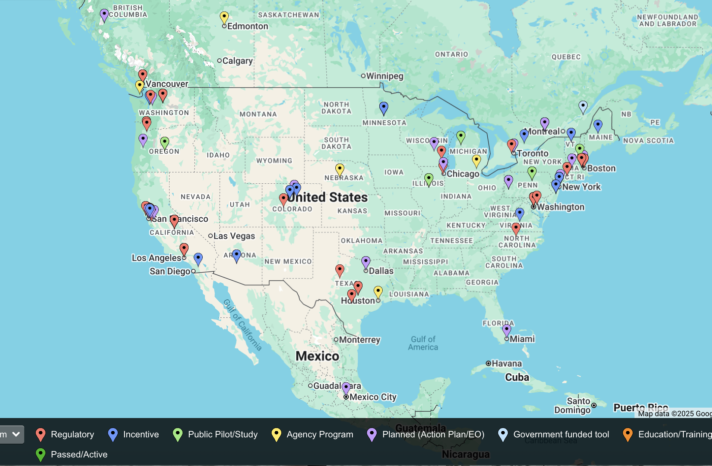
Embodied Carbon

Slide 7
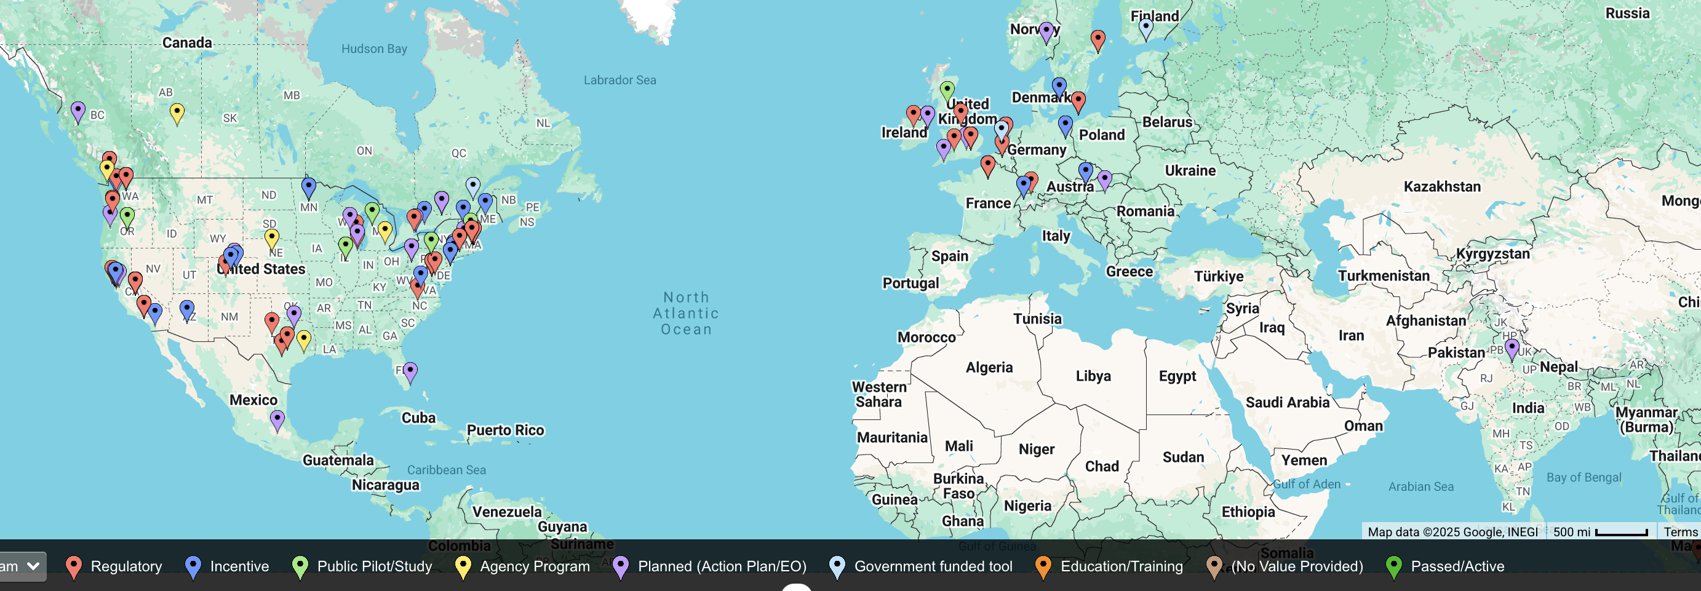
Carbon

Slide 8
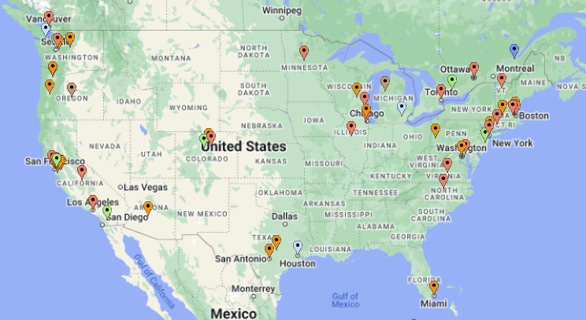
Calgary, ON
Downtown Office Demolition Incentive Program
New York
Low Embodied Carbon Concrete Leadership Act & Steel
State projects to meet GWP limits
Denver, CO
Green Code
GWP limits for concrete and steel.
Toronto, ON
Waterfront Green Building Requirements
Low GWP concrete option.
Portland, OR
Low-Carbon Concrete Initiative
Concrete in city construction projects must meet specific GWP limits.
Marin County
Concrete Code
GWP limits for all concrete.
US GSA - Infrastructure
Low EC Concrete & Environmentally Preferable Asphalt
EPD reporting & GWP limits for concrete and improved asphalt.
Colorado
Reduce Emissions from the Built Environment (SB 22-501)
Low GWP products are exempt from state sales and use tax
Austin, TX
GB Program
Bldg. LCA option.

Slide 9
Buy Clean Minnesota - transportation
Buy Clean Washington
Buy Clean Oregon – transportation coming
Buy Clean California
Buy Clean Illinois – transportation coming
Buy Clean Colorado

Slide 10
Buy Clean
Requirements to Buy Low Carbon Materials
California – structural steel, rebar, flat glass, mineral wool board insulation
Colorado – asphalt, ready mix concrete, flat glass, rebar, structural steel, structural wood
Oregon – DoT to establish program by Dec 31, 2025
Minnesota – concrete used in buildings by Jan 15, 2026 and structural steel and rebar by Jan 15, 2028
New York – concrete and structural steel
Washington – steel, concrete, and wood
New Jersey – concrete (tax incentive…but limits not set)
Maryland – concrete and cement starting July 2026
Minnesota – concrete, steel, asphalt, and glass
Massachusetts - concrete
Notes:
Enforcement notice: “incomplete reporting” and “information the reporting entity already possesses or is already collecting at the time this Notice was issued.”

Slide 11
CA SB 253
SB 253: What are the near-term reporting requirements?
Scope 1 & 2 emissions with limited assurance in 2026.
Scope 3 phase-in during 2027.
What remains to be clarified?
Extent of scope 3 reporting.
Leniency granted by December 5th, 2024 Enforcement Notice.
Notes:
Enforcement notice: “incomplete reporting” and “information the reporting entity already possesses or is already collecting at the time this Notice was issued.”

Slide 12
CA SB 261
SB 261: What are the near-term reporting requirements?
Public Climate-related Financial Risk Report by January 1st, 2026.
  Risk + measures to reduce/adapt
What has CARB clarified?
Framework flexibility (TCFD-aligned).
  TCFD (Starter)
  IFRS S2 (Leader)
Reporting year flexibility.
Reporting mechanism.
Reminder: SB 261 lower revenue threshold for applicability than SB 253.

Slide 13




GHG Reporting
Other states are introducing corporate accountability regulations:
State of Illinois: IL HB 4268 for corporate scope 1, 2, and 3 reporting was in rules committee until session ended 1/7/25.
State of New York: NY SB 3456 for corporate scope 1, 2, and 3 reporting is in Senate committee; NY S 3697 for climate related financial risk is in Senate committee.
State of Colorado: HB 25-1119 in House committee for corporate scope 1 and 2 reporting by 2028 and scope 3 by 2029.
State of New Jersey: NJ SB 4117 introduced on 2/3/2025 and for corporate scope 1 and 2 reporting 4 years after enactment and scope 3 reporting 5 years after enactment.

Slide 14
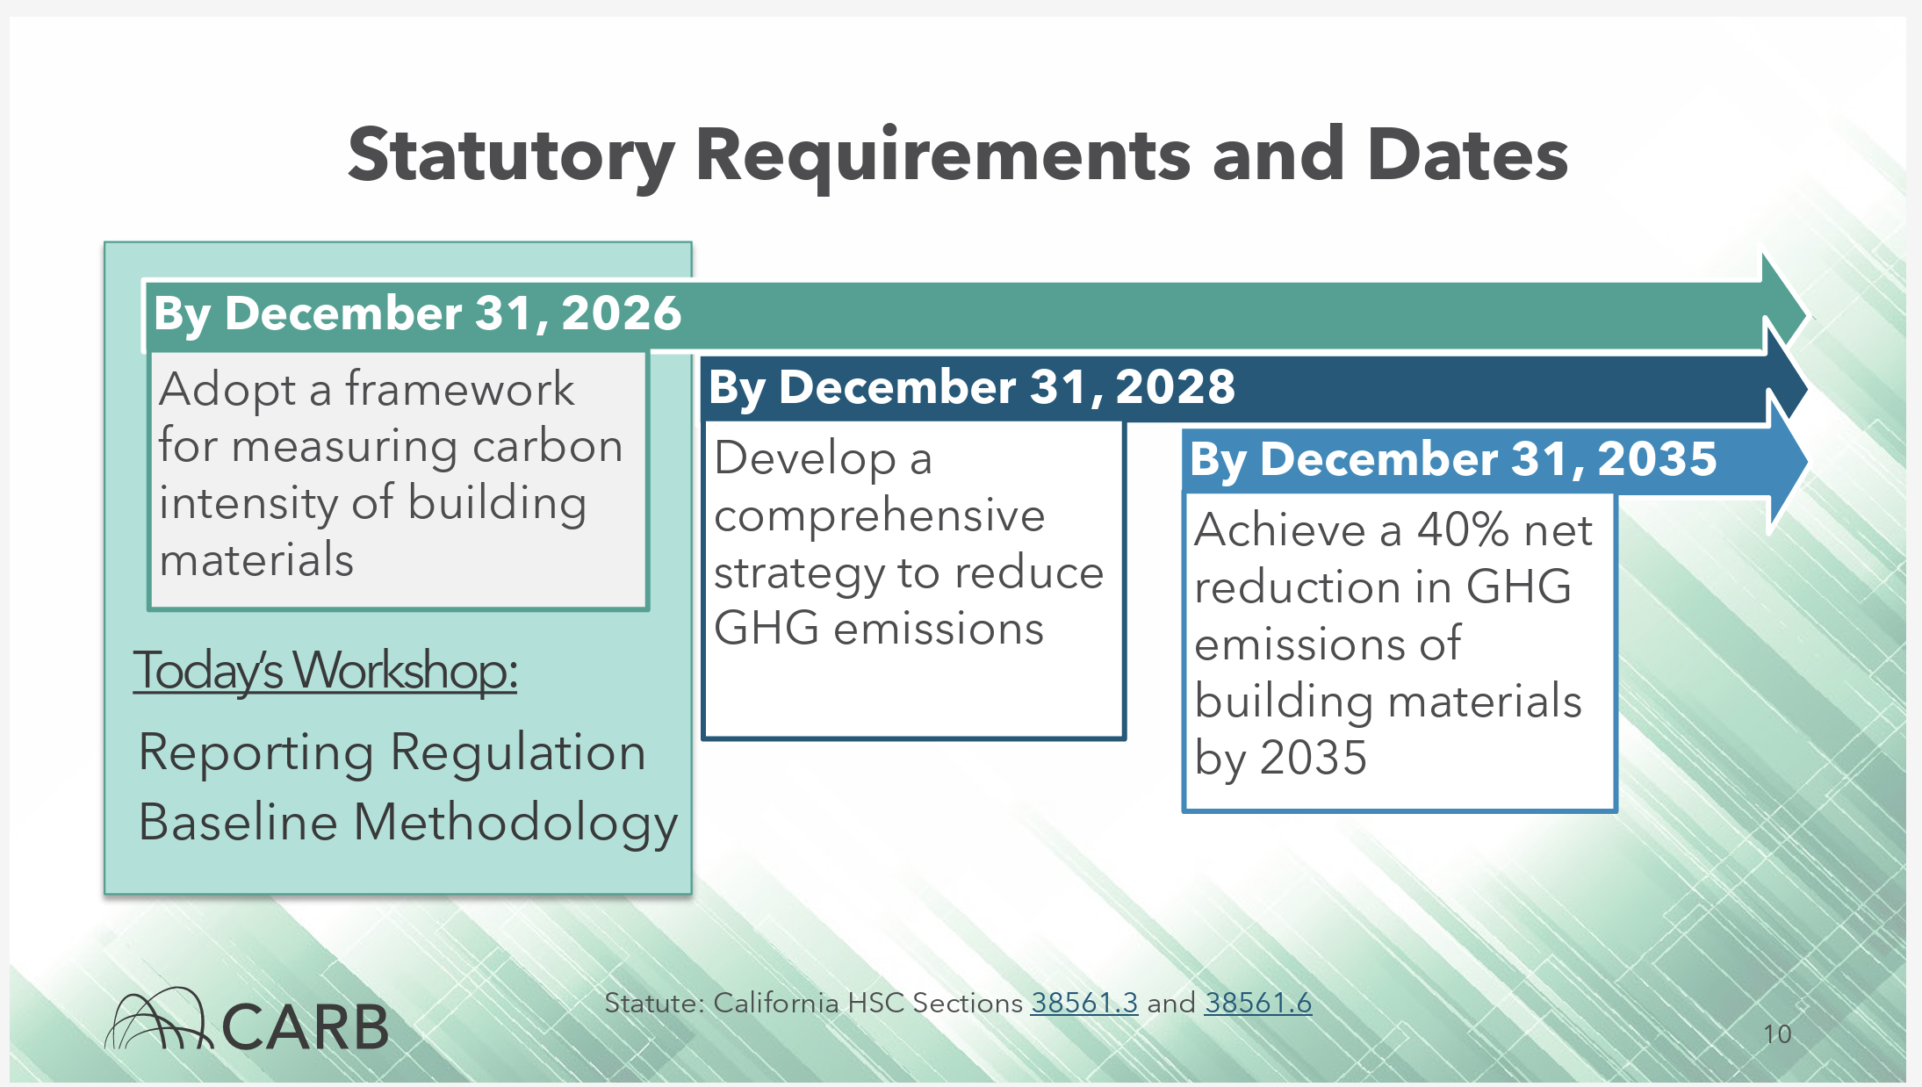
CA AB 2446
AB 2446: Embodied Carbon Emissions: Construction Materials
Set a baseline
and then reduce

Slide 15
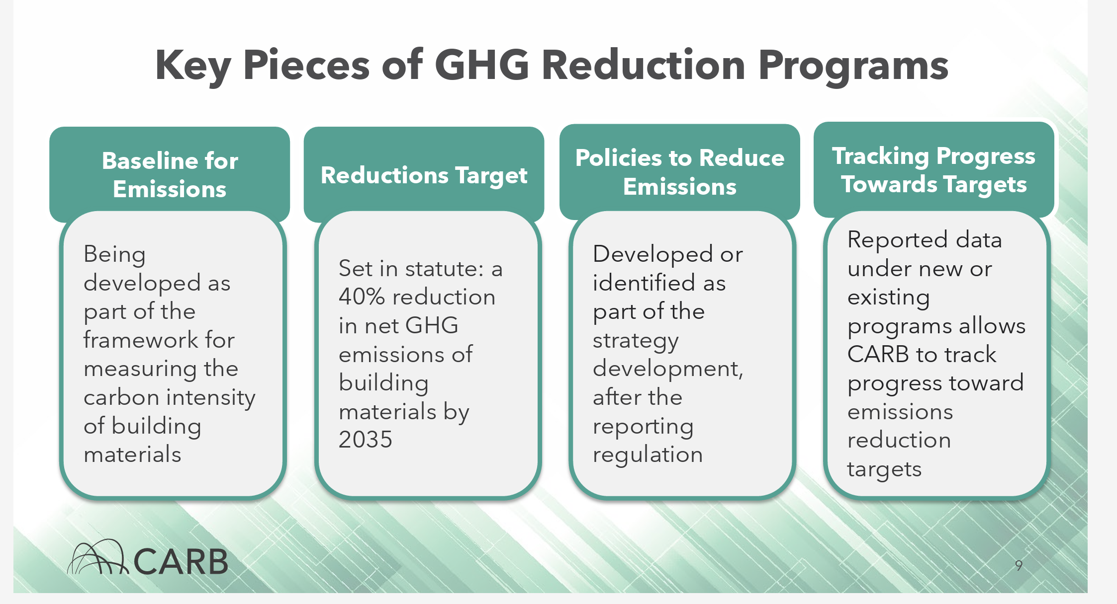
CA AB 2446
AB 2446: Embodied Carbon Emissions: Construction Materials
Set a baseline
and then reduce

Slide 16
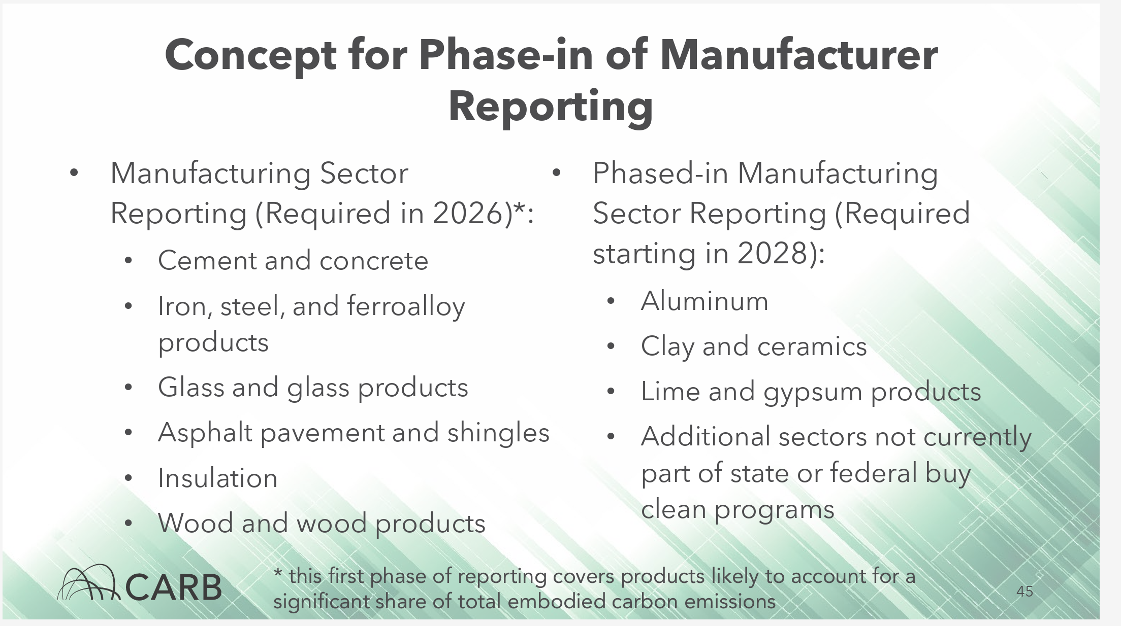
CA AB 2446
AB 2446: Embodied Carbon Emissions: Construction Materials
Set a baseline
and then reduce

Slide 17





Building Certification

Slide 18
Building Certification
LEED by the stats:
195,000+ LEED certified projects in 186 countries
29 billion square feet
Top states per capita sq footage certified in 2024:
  Massachusetts
  Illinois
  New York
  Washington
  Maryland
  California
  Texas
  Nevada
  Colorado
  Virginia
  DC would be well far and away ahead if it was a State

Slide 19
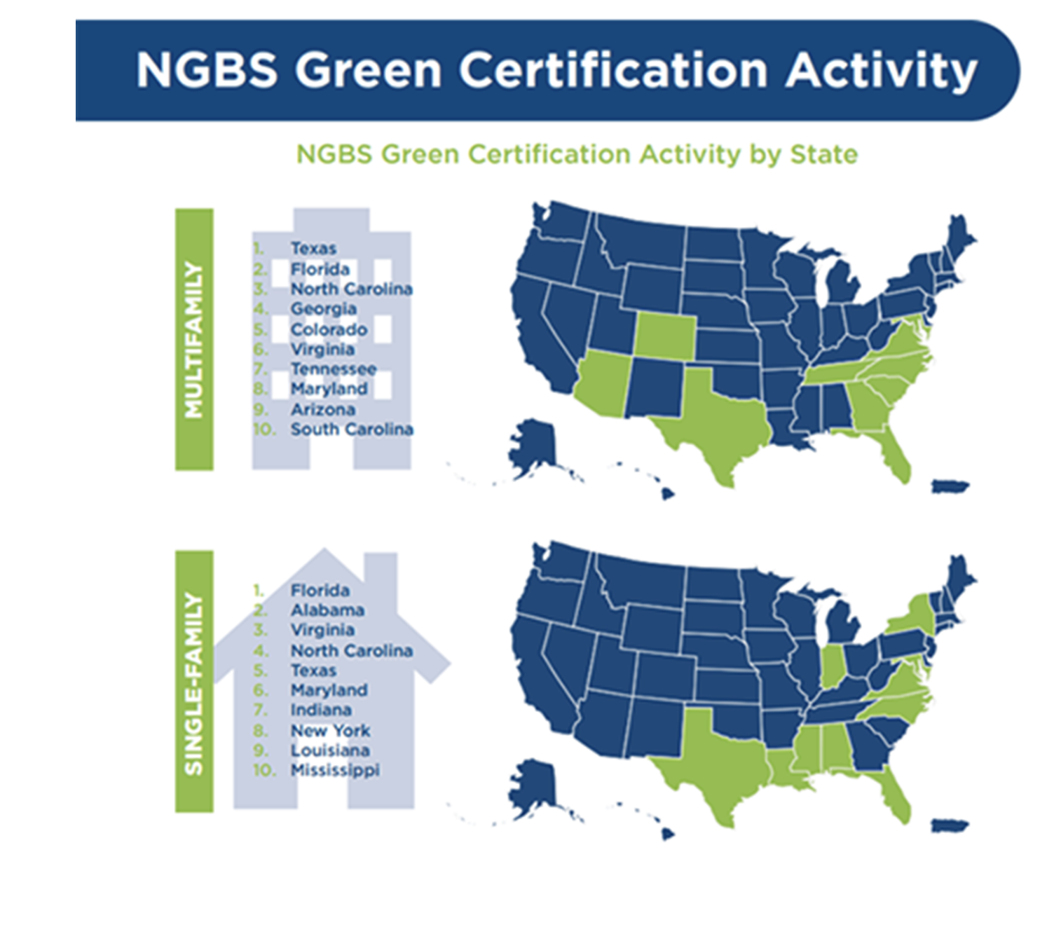
Building Certification
Green Globes = 4,000 certified buildings
BREEAM is up 43%
NAHB = 600,000 homes certified

Slide 20



Building Code

Slide 21
Building Code
States that have some form of IgCC adoption:
Arizona
Colorado
District of Colombia
Florida
Idaho
Illinois
Maryland
Minnesota
Missouri
Montana
New Hampshire
Rhode Island
Tennessee
Texas
Washington

Slide 22
LCAs/EPDs Building Code
Requirements for Compliance
CALGreen – low GWP materials, whole building LCA, or reuse
Washington DC Green Code – material section compliance path
Denver Green Code – concrete and steel limits or project limit
Scottsdale Green Code - industry wide or product specific EPDs
Baltimore Green Code - industry wide or product specific EPDs
Boston Net Zero Carbon – whole building LCA for projects greater than 50,000 sq ft

Slide 23

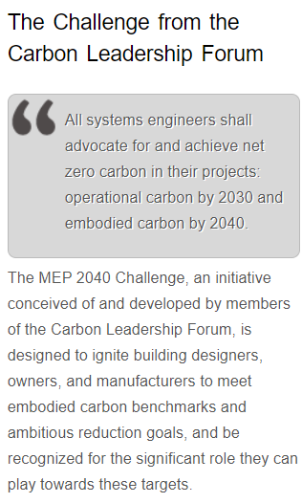
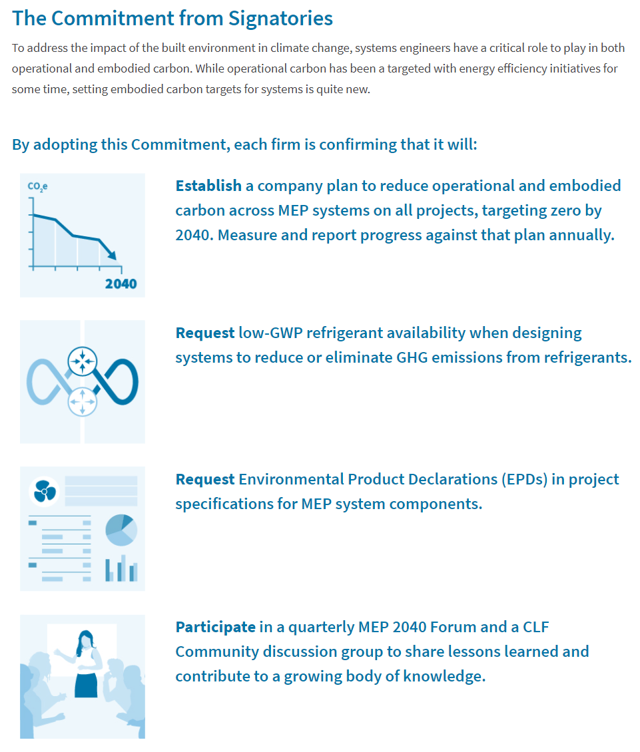
The Challenge from the Carbon Leadership Forum
www.MEP2040.org

Slide 24
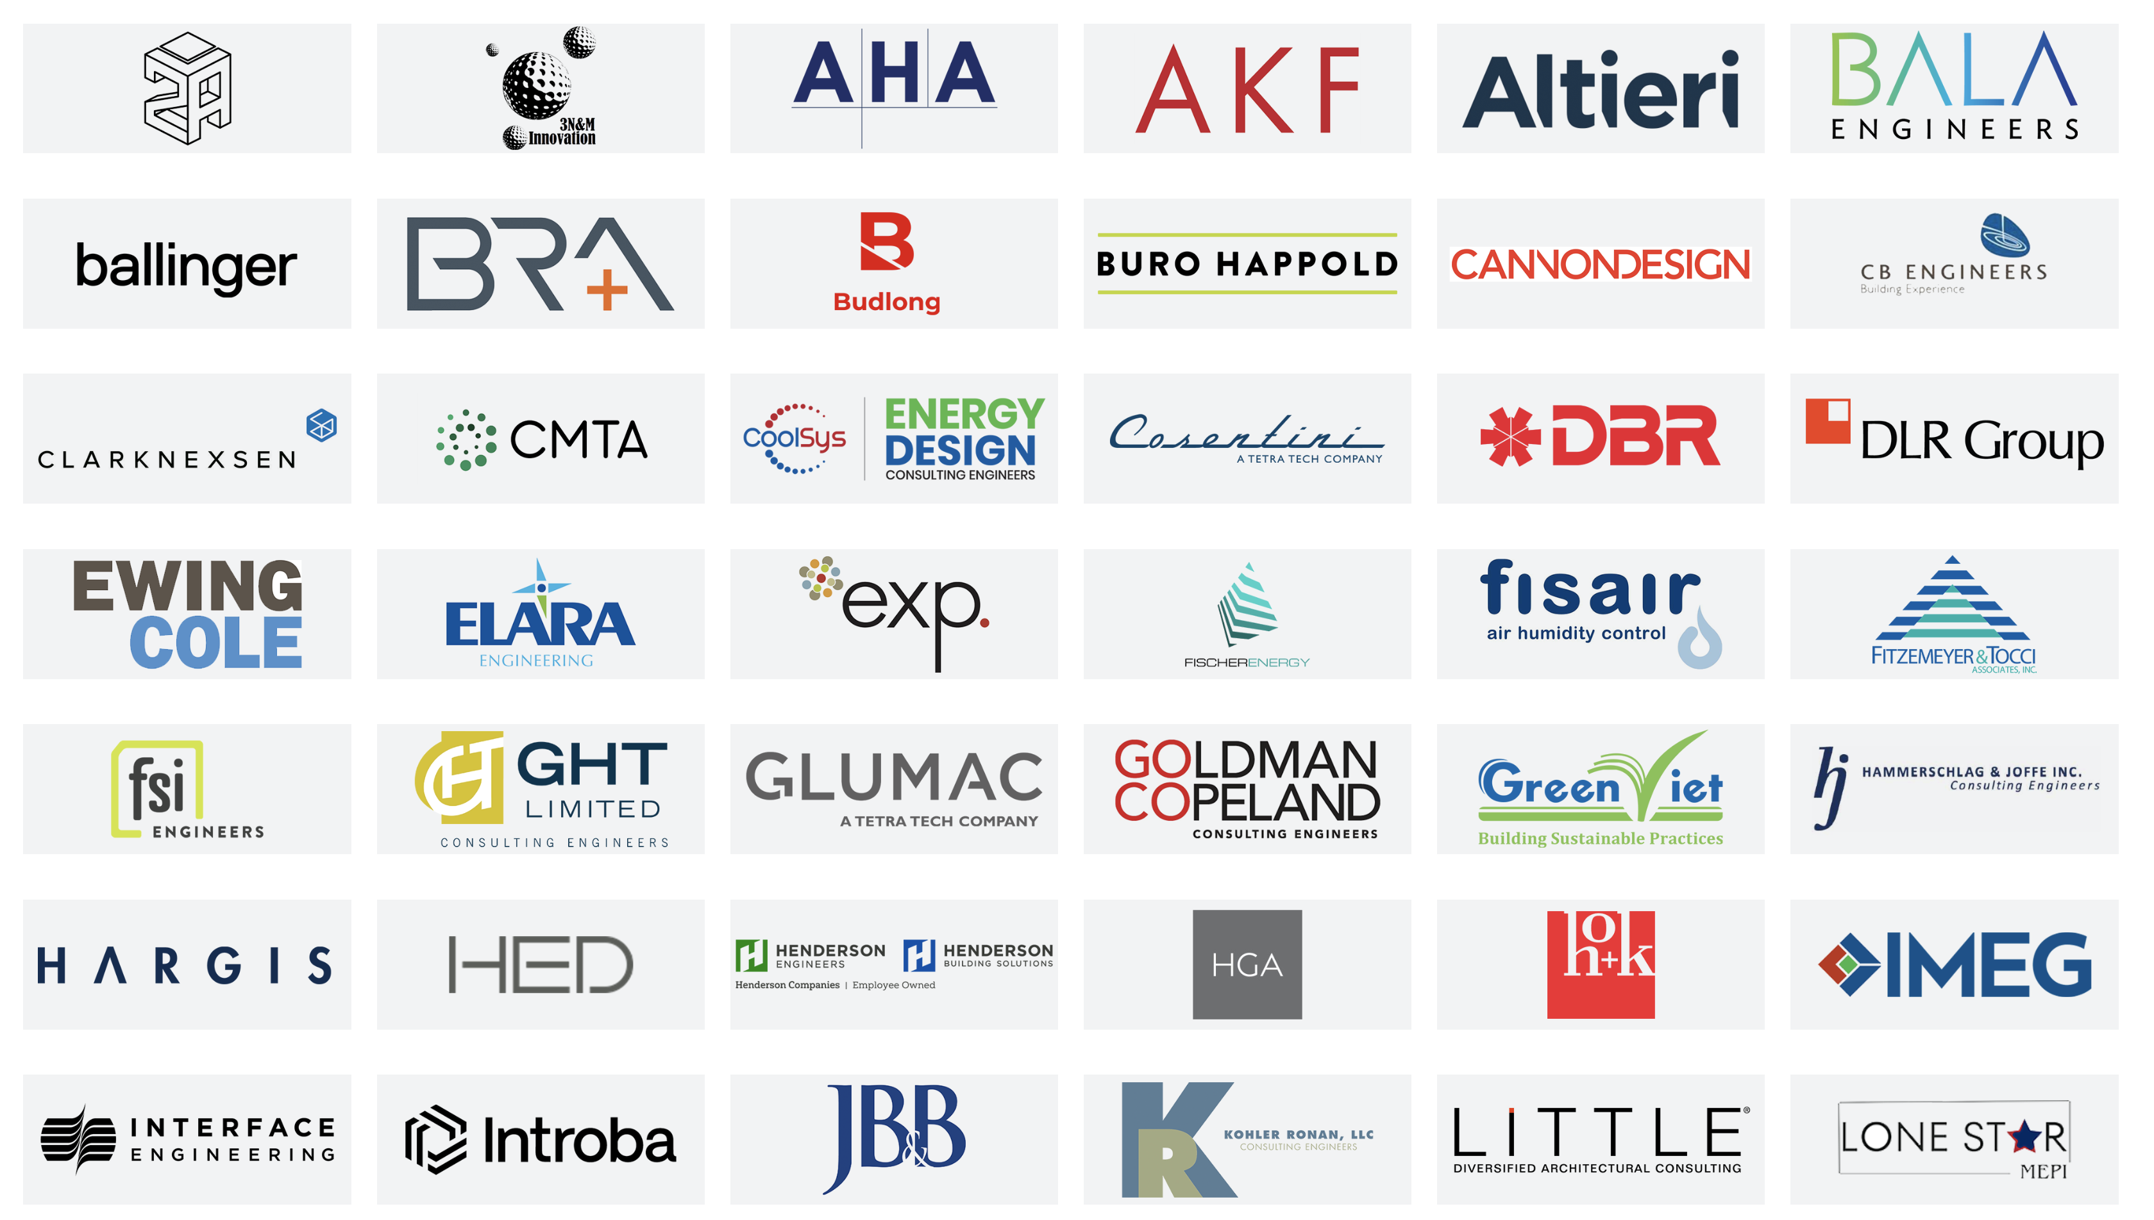
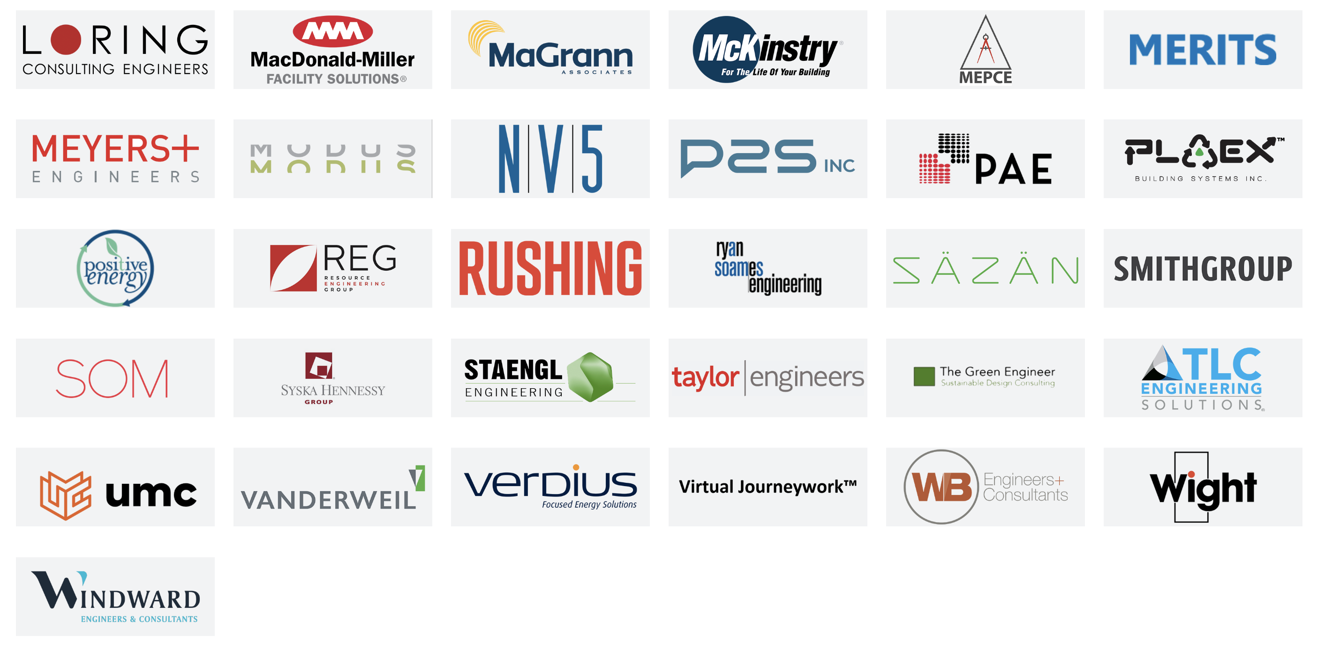
SIGNATORY MEP FIRMS
107!!!

Slide 25
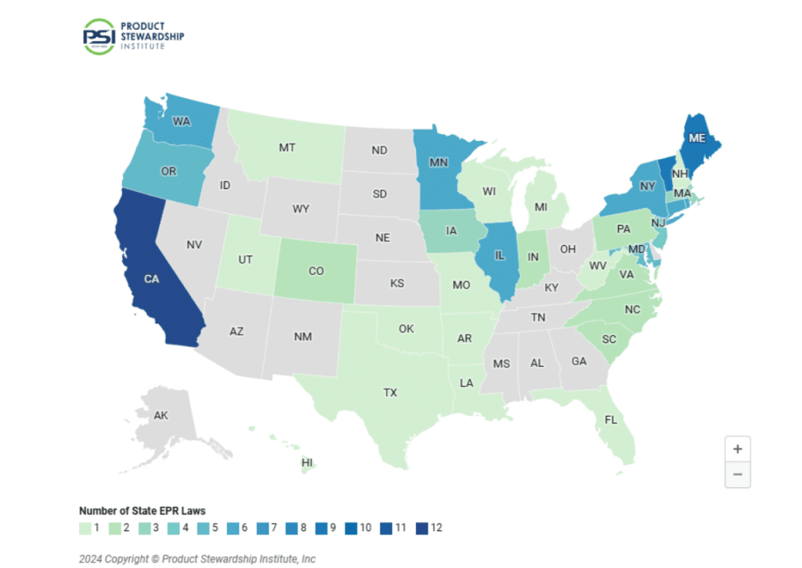

Slide 26
ASK

Slide 27
2013

Slide 28
2013
2015

Slide 29

2013
2017
2015

Slide 30

2013
2017
2015
2019

Slide 31


2021

Slide 32

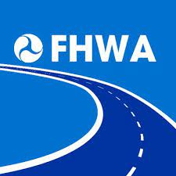
2021
2022

Slide 33

2023
2023

Slide 34


2024

Slide 35
EPDs in North America
90,000 batch level Concrete
8,256 Asphalt mixes
1801 Flooring products
355 Paints and Coatings Products
335 Steel products
264 Insulation products
199 Ceiling products
114 Wall Finishes products
81 Gypsum Board products
65 Cladding products
43 Piping products

Slide 36
ASK

Slide 37
Josh Jacobs
WAP Sustainability
josh@wapsustainability.com

