Slide 1
NETW310 - Course Project
Module 8
Final Project
Student: Santiago (James) Donohue
April 25th, 2026
Prof. Gary Giomi

Slide 2
NETW310
Course Project
Intro
This presentation summarizes the work completed throughout the NETW310 course project, covering key concepts in communications systems and networking. It brings together practical exercises and analysis from multiple modules, including signal modulation, pulse code modulation, structured cabling, antenna performance, and transmission characteristics.
The goal of this project is to demonstrate an understanding of how signals are generated, transmitted, and received, along with the factors that impact performance and reliability in modern communication systems.

Slide 3
NETW310
Module 2
Baseband Signals and AM/FM Signals

Slide 4
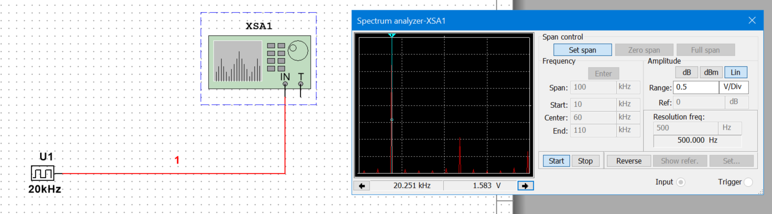
NETW310 - Module 2 - Baseband Signals
The screenshot should show the spectrum analyzer displaying the signal’s harmonic spectrum and its panel settings. Record the signal voltage at each of the frequencies in the table.
Harmonic Frequency | Signal (Volts)
20 kHz | 1.583 V
40 kHz | 0.000 V
60 kHz | 868.765 mV
80 kHz | 0.000 V
100 kHz | 385.663 mV

Slide 5
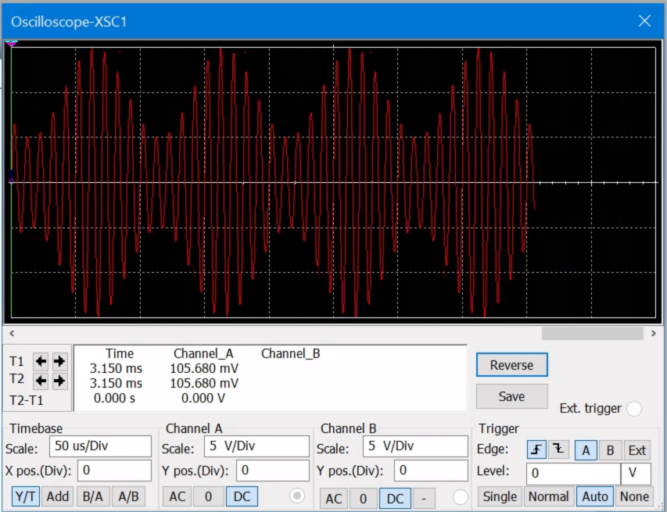
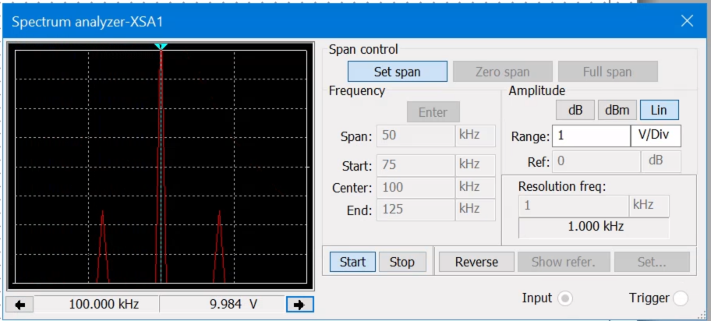
NETW310 - Module 2 - AM Signals
The screenshot of the Oscilloscope should include the signal and the panel settings of the oscilloscope. The screenshot of the Spectrum Analyzer should include the signal and the panel setting of the analyzer.
Oscilloscope screenshot here
Spectrum Analyzer screenshot here
AM Modulation | Frequency (kHz)
Lower side band | 80.000 kHz
Carrier | 100.000 kHz
Upper side band | 110.000 kHz

Slide 6
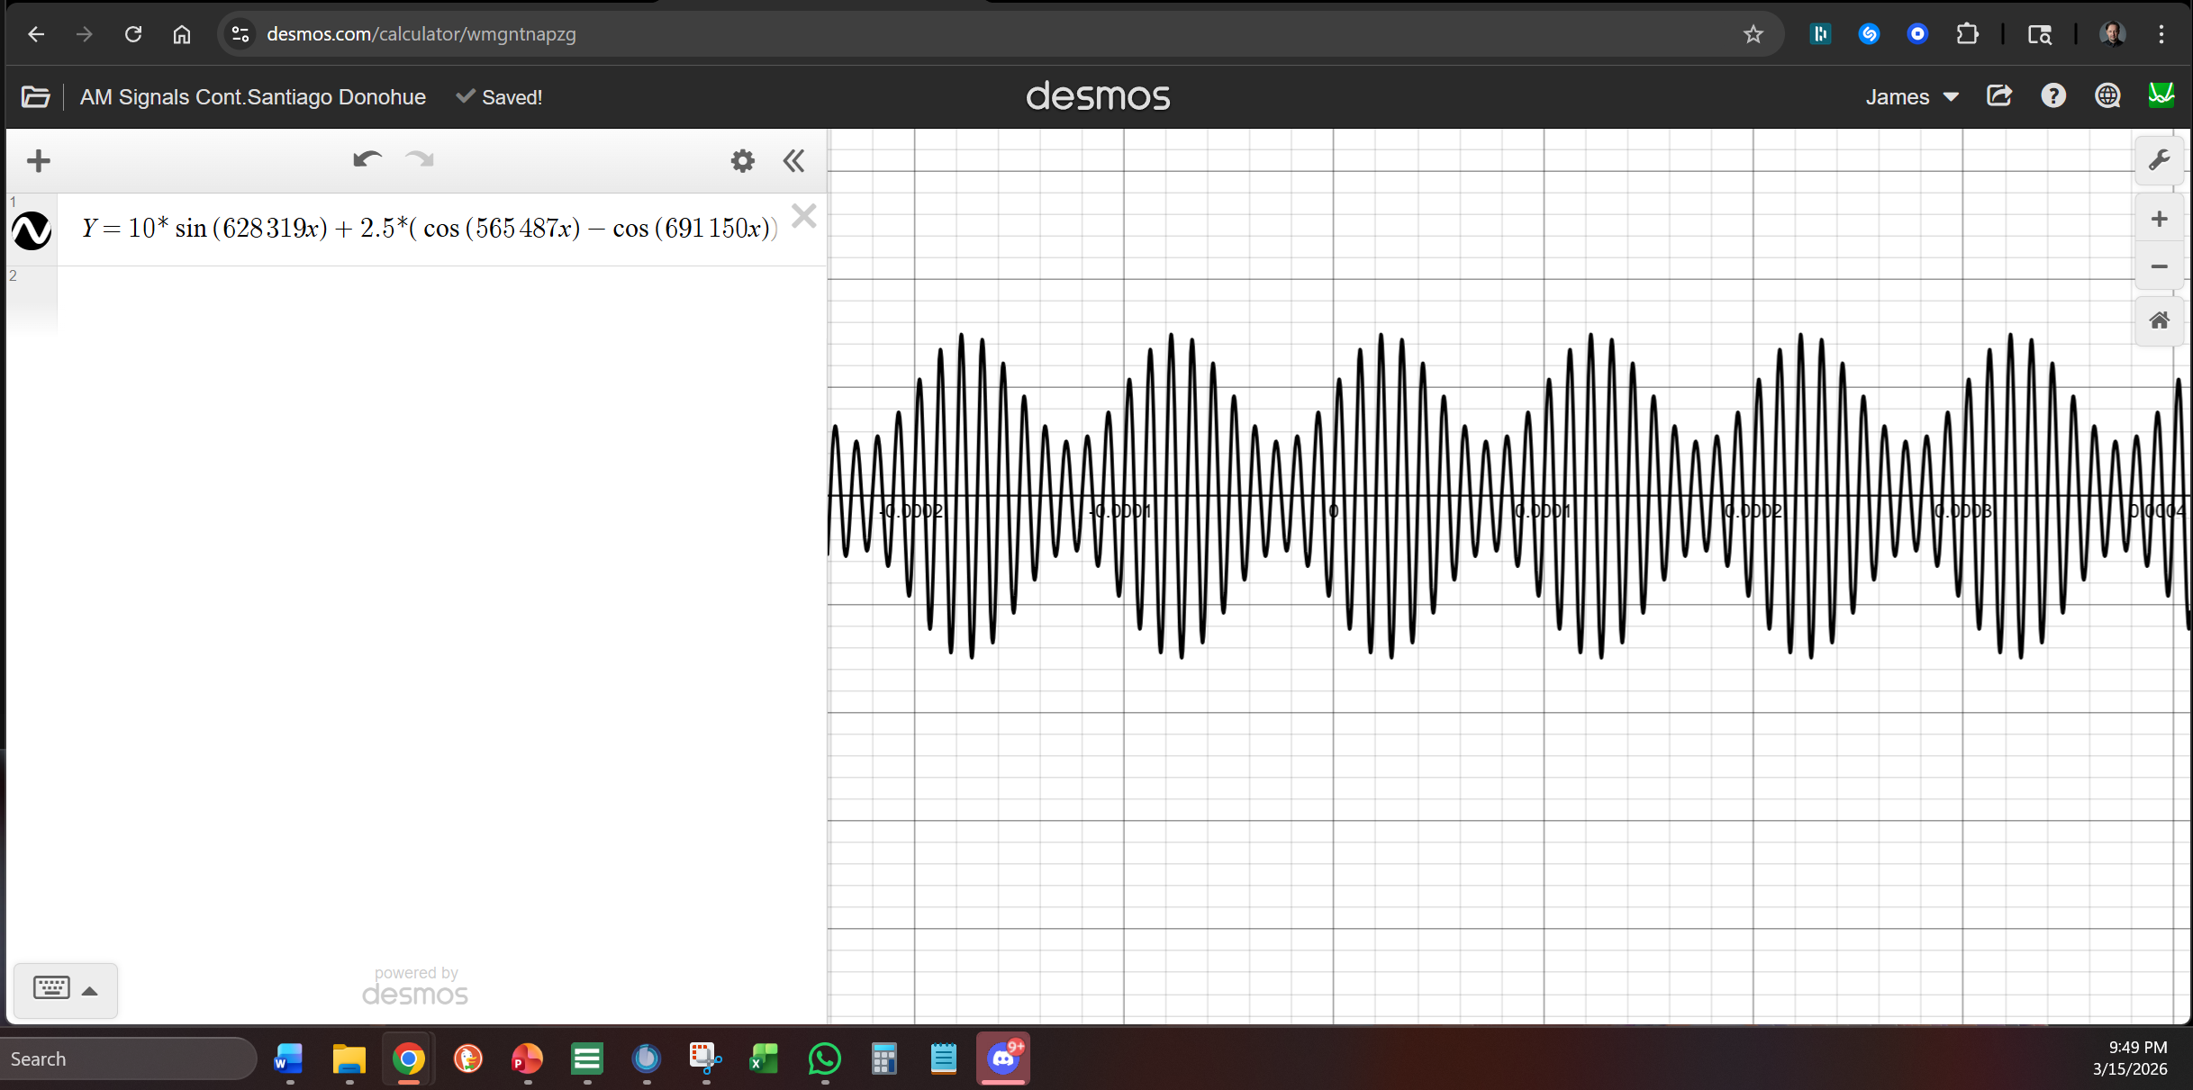
NETW310 - Module 2 - AM Signals Cont.
Develop equations for the carrier and modulating signals and plot the equation for the composite modulated signal V_{AM .}
Equations here:
Carrier signal equation: Vc(t) = 10 sin(2π · 100000 t)
Modulating signal equation: Vm(t) = 5 sin(2π · 10000 t)
Plotted diagram screenshot here:

Slide 7
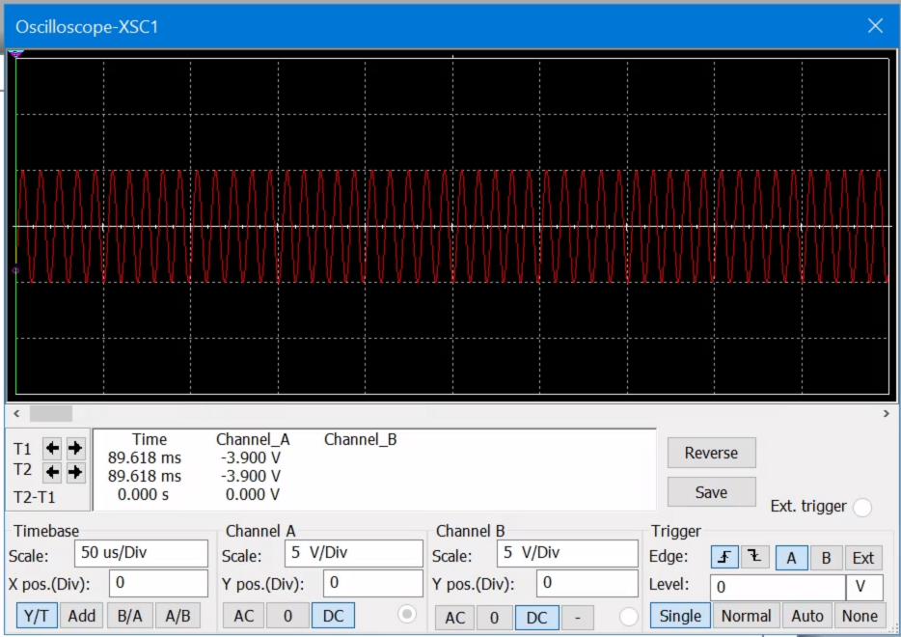
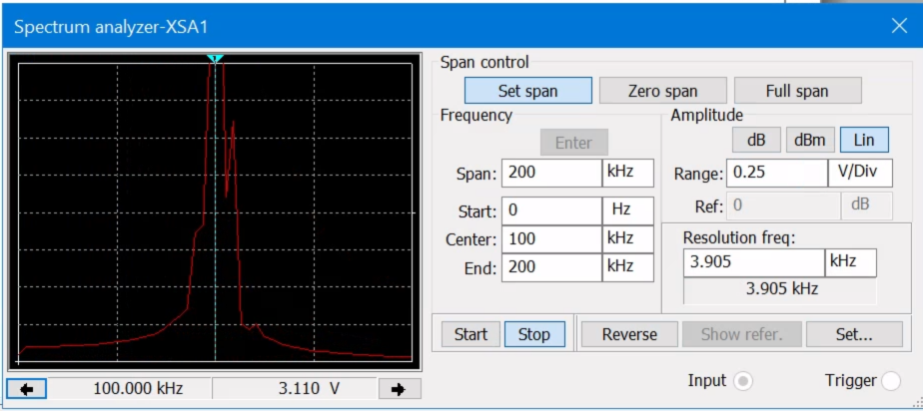
NETW310 - Module 2 - FM Signals
The screenshot of the Oscilloscope should include the signal and the panel settings of the oscilloscope. The screenshot of the Spectrum Analyzer should include the signal and the panel setting of the analyzer.
Oscilloscope screenshot here
Spectrum Analyzer screenshot here
What’s the carrier frequency?
100.000 kHz

Slide 8
NETW310
Module 3
Pulse Code Modulation (PCM) and Line Codes

Slide 9
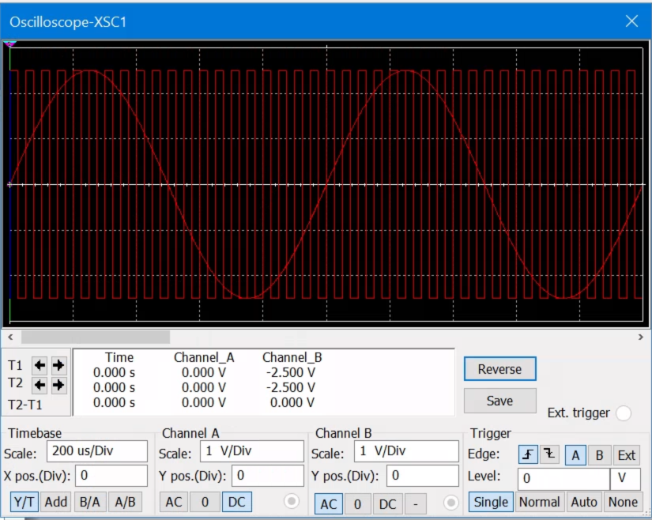
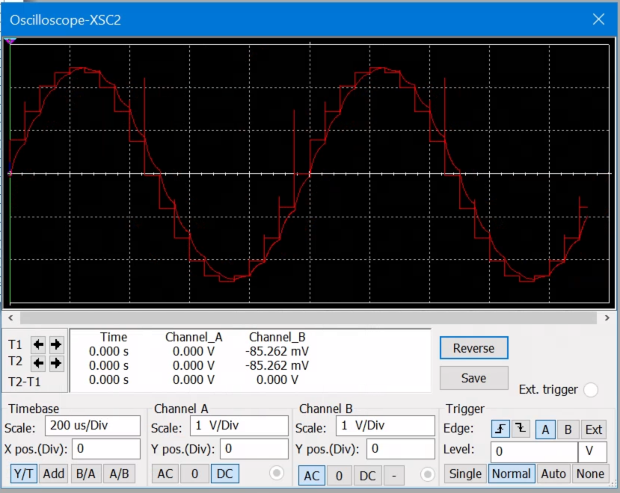
NETW310 - Module 3 - Pulse Code Modulation (PCM)
The first screenshot should show the Oscilloscope-XSC1 display with the analog input signal and sampling clock at the input to the ADC. The second screenshot should show the Oscilloscope-XSC2 display with the output of the DAC.

Slide 10
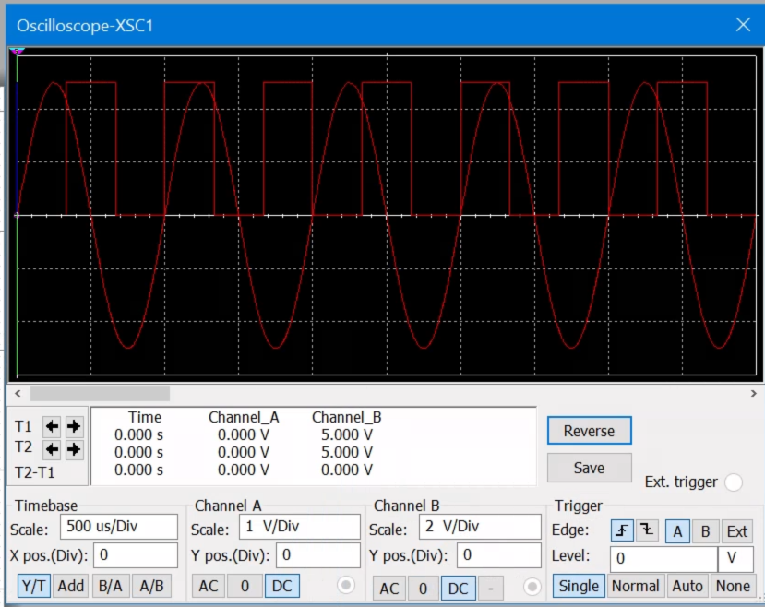
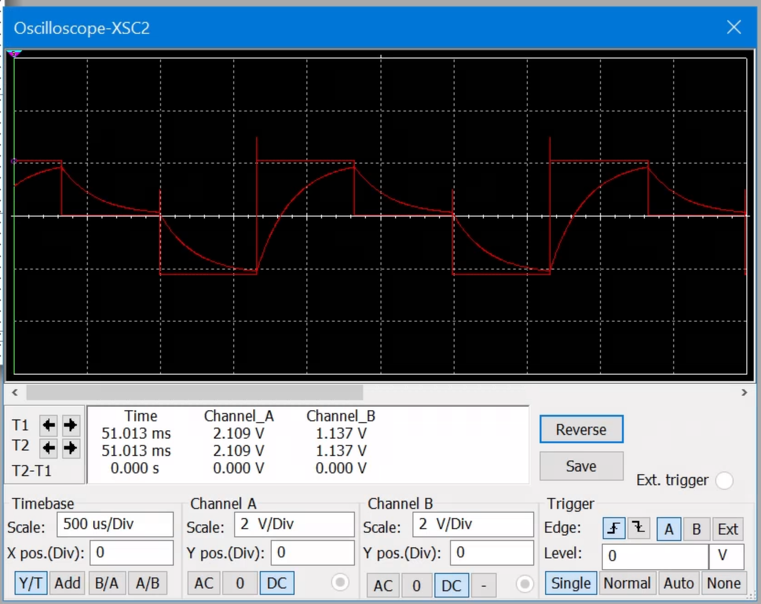
NETW310 - Module 3 - Pulse Code Modulation (PCM)
The first screenshot should show the Oscilloscope-XSC1 display with the analog input signal and sampling clock at the input to the ADC. The second screenshot should show the Oscilloscope-XSC2 display with the output of the DAC.
Q: What are the effects of increasing or decreasing the sampling rate?
A: Increased sampling rates reduces fidelity and increases noise in the sampling clock.

Slide 11
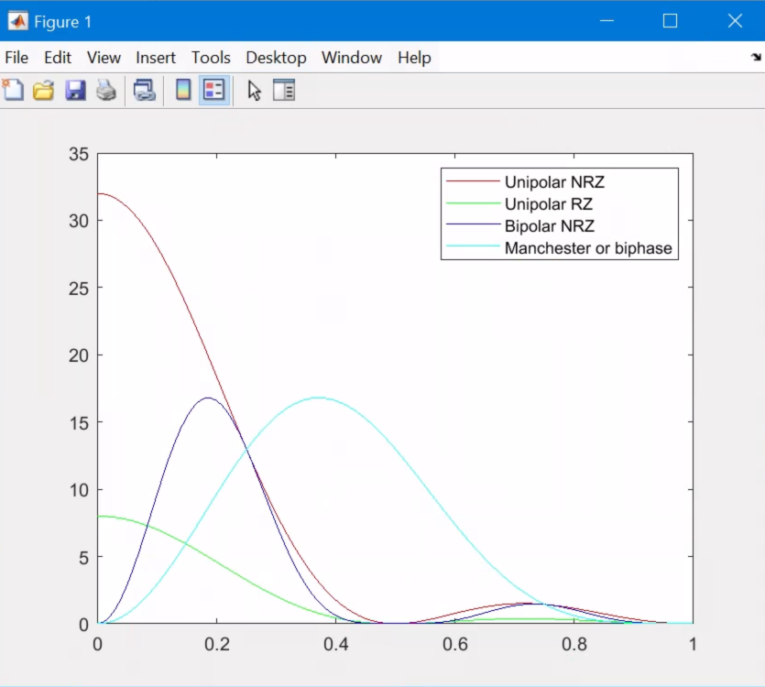
NETW310 - Module 3 – Line Codes
This screenshot should show the power spectral densities of four-line codes: NRZ-Polar, NRZ-Unipolar, NRZ-Bipolar, and Manchester-Polar.
MATLAB Diagram Here
Compare the NRZ-Bipolar and Manchester polar codes in the diagram.
Which one requires more bandwidth?
Answer:
Manchester requires more bandwidth.

Slide 12
NETW310 - Module 3 - References
1. DeVry Desktop > Multism 1.43 > Module 3_PCM_Encoder and Decoder.ms14 > Oscilloscope-XSC 1 & 2 views screenshot.
2. DeVry Desktop > Multism 1.43 > Module 3_PCM_Encoder and Decoder_Undersampled Input.ms14 - ms14 > Oscilloscope-XSC 1 & 2 views screenshot.
3. DeVry Desktop > MATLAB R2024a > Code pasted from DeVry exercise instructions > screenshot of code output plot.

Slide 13
NETW310
Module 4
Cables and Structured Cabling

Slide 14
NETW310 - Module 4 - Questions
1. Why must the twisting in the individual wires be maintained in a UTP cable?
  A: The twisting in a UTP cable needs to be maintained because it helps reduce interference and crosstalk between the wire pairs. From the reading, the twists make sure that any noise picked up along the cable affects both wires in a similar way, which helps cancel it out. If the wires are untwisted too much, especially near the ends, the cable becomes more exposed to interference, and the signal quality can drop. That can lead to errors or slower performance, so keeping the twists intact is important for reliable communication.
2. How many inches should UTP cable be separated from 110 volts electrical cable?
  A: UTP cable should be kept at least about 12 inches away from 110-volt electrical cables. From the reading, this separation helps reduce electromagnetic interference that can affect the signal. If the cables are too close, the electrical wiring can introduce noise into the UTP cable, which can lead to data errors or reduced performance.
3. Horizontal cabling connects what areas to each other?
  A: Horizontal cabling connects the telecommunications room to the work area, like computers and phones. It runs from the telecom room out to user outlets and is designed to support reliable communication over a limited distance.

Slide 15
NETW310 - Module 4 - Questions
1. Why must the twisting in the individual wires be maintained in a UTP cable?
  A: The twisting in a UTP cable needs to be maintained because it helps reduce interference and crosstalk between the wire pairs. From the reading, the twists make sure that any noise picked up along the cable affects both wires in a similar way, which helps cancel it out. If the wires are untwisted too much, especially near the ends, the cable becomes more exposed to interference, and the signal quality can drop. That can lead to errors or slower performance, so keeping the twists intact is important for reliable communication.
2. How many inches should UTP cable be separated from 110 volts electrical cable?
  A: UTP cable should be kept at least about 12 inches away from 110-volt electrical cables. From the reading, this separation helps reduce electromagnetic interference that can affect the signal. If the cables are too close, the electrical wiring can introduce noise into the UTP cable, which can lead to data errors or reduced performance.
3. Horizontal cabling connects what areas to each other?
  A: Horizontal cabling connects the telecommunications room to the work area, like computers and phones. It runs from the telecom room out to user outlets and is designed to support reliable communication over a limited distance.

Slide 16
NETW310 - Module 4 - References
1. ANSI/TIA-568 vs ISO/IEC 11801 vs EN 50173: What Sets These Cabling Standards Apart
https://www.fs.com/blog/network-cable-standards-for-generic-cabling-tia-568-vs-iso-11801-vs-en-50173-6339.html
2. Purpose of the ANSI/TIA/EIA-568-B Standard
https://web.anixter.com/AXECOM/AXEDocLib.nsf/(UnID)/8F2E0839A6190F4986257309005757CC/%24file/ANSI-TIA-EIA-568-B.pdf
3. ANSI/BICSI N1 Standards for ICT Installation
https://www.bicsi.org/standards/available-standards-store/single-purchase/ansi-bicsi-n1-2019-installation-practices-for-telecommunications-and-ict-cabling-and-related-cabling-infrastructure

Slide 17
NETW310
Module 5
Antenna Gain and Free Space Path Loss

Slide 18
NETW310 - Module 5 - Antenna Gain
1. What is the maximum theoretical antenna gain of a common dish antenna at the 2.4 GHz band? [4 points]
Answer: 22.379
2. What is the maximum theoretical antenna gain of a common dish antenna at the 5 GHz band? [4 points]
Answer: 29.079
3. Given the same sized reflector, which signals, high-frequency, or low-frequency, can be more efficiently focused by a common dish antenna (i.e., result in a higher antenna gain)? [5 points]
Answer: High-Frequency
4. What is the maximum theoretical antenna gain of the dish antenna used in the VLA radio telescopes in New Mexico at the 5 GHz band? [4 points]
Answer: 63.059
5. Given the same signal frequency, which dish antennas, large-sized or small-sized, are more efficient at focusing the signal (i.e., result in a higher antenna gain)? [5 points]
Answer: Large-sized Antenna

Slide 19
NETW310 - Module 5 - Free Space Path Loss
1. What is the free space path loss in dB at the 2.4 GHz band? [4 points] Answer: -80.4
2. What is the free space path loss in dB at the 5 GHz band? [4 points] Answer: -87.2
3. How does the free space path loss at a higher frequency (e.g., the 5 GHz band) compare with that at a lower frequency (e.g., the 2.4 GHz band)? [5 points]
Answer: -6db difference; it weakens faster.
4. What is the free space path loss in dB over 20 meters at the 2.4 GHz band? [4 points]
Answer: -66.421
5. What is the free space path loss in dB over 40 meters at the 2.4 GHz band? [4 points]
Answer: -72.441
6. What is the free space path loss in dB over 80 meters at the 2.4 GHz band? [4 points]
Answer: -78.462
7. When the distance doubles, how does free space path loss in dB change approximately? [5 points]
Answer: -6dB

Slide 20

NETW310 - Module 5 - Free Space Path Loss - Cont.
8. Use a scientific calculator to calculate Delta $L_{fS}$ for D1 = 20 meters and D2 = 40 meters. [4 points]
Delta $L_{fS }$= -6.0205999132796239042747778944899
9. Is your calculation approximately the same as the result from Part 1 Step 2? [4 points]
Answer: Yes

Slide 21
NETW310 - Module 5 - References
1. DeVry > NETW310 > Module 5: Antenna Gain and Free Space Path Loss
2. Radio theory and link planning for Wireless LAN (WLAN) http://www.swisswireless.org/wlan_calc_en.html

Slide 22
NETW310
Module 6
Bit Error Rate of Fading Channels

Slide 23
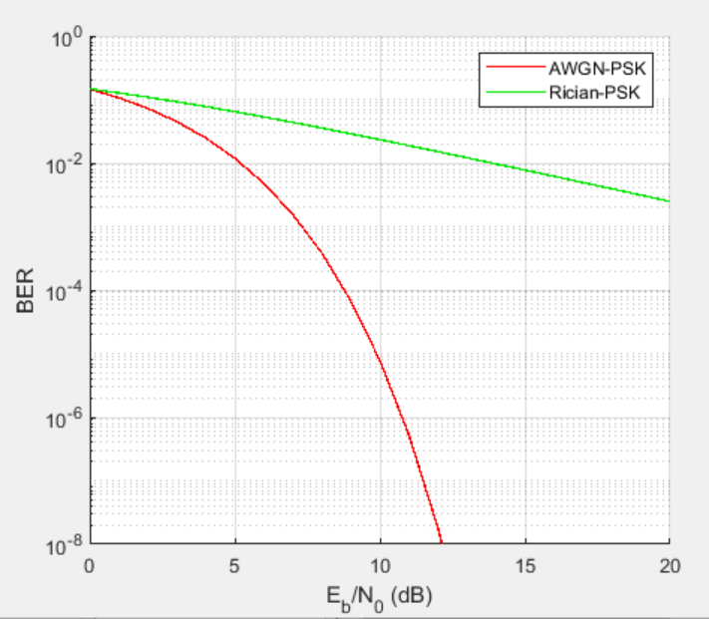
NETW310 - Module 5 - AWGN Channel and Rician Channel
This screenshot should show the bit rate error performance of both AWGN and Rician fading channels.

Slide 24
NETW310 - Module 5 - AWGN Channel and Rician Channel
Compare and contrast the BER performance of PSK over a noise limited (AWGN) transmission channel to the performance of PSK over a Rician channel at 5- and 10-dB Signal to Noise Ratio (E_{b}/N₀), respectively.
Is there a significant difference in BER performance of PSK between the AWGN channel and Rician channel?
Answer: AWGN has a lower bit error rate between 5- and 10-dB Signal to Noise Ratio

Slide 25
NETW310 - Module 6 - References
NETW310 CP Guide Module 6 Dec 8 2024.docx
Prof. Giomi’s live class on 04/09/2026

Slide 26
NETW310
Project Challenges
One of the main challenges in this project was interpreting signals on the oscilloscope and spectrum analyzer and matching them to the expected results. I also had to work through translating formulas into simulations, especially with AM signals and verifying the correct frequencies.
Another challenge was keeping calculations accurate for antenna gain and path loss. Overall, the difficulty was making sure everything stayed consistent from theory to simulation to results.

Slide 27
NETW310
Career Skills Obtained
Signal analysis and interpretation using oscilloscopes and spectrum analyzers
Understanding of AM and FM modulation techniques
Knowledge of pulse code modulation (PCM) and line coding methods
Ability to evaluate antenna gain and free space path loss
Understanding of bit error rate (BER) and channel performance
Structured cabling standards and best practices
Hands-on experience with simulation tools (Multisim and MATLAB)
Ability to connect theoretical concepts to real-world technical scenarios

Slide 28
NETW310
Conclusion
In conclusion, this project allowed me to apply core technical concepts across areas such as signal analysis, AM/FM modulation, pulse code modulation, line coding, structured cabling, antenna gain, free space path loss, and bit error rate.
These exercises helped me connect the material to both academic and real-world technical scenarios. Overall, the project strengthened my understanding of how networking and telecommunications systems are designed, measured, and evaluated.

