Slide 1
Quick guide to loving your body
Key focus: Healing the intestines

Slide 2
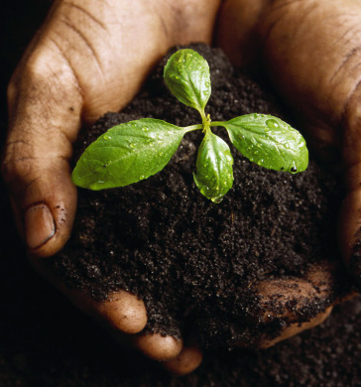
Give your body what it NEEDS
Genesis 2: 7 “And the LORD God formed man of the dust of the ground, and breathed into his nostrils the breath of life; and man became a living soul.”
Genesis 1:28, 29 ”And God blessed them, and God said unto them, Be fruitful, and multiply, and replenish the earth, and subdue it: and have dominion over the fish of the sea, and over the fowl of the air, and over every living thing that moveth upon the earth.
And God said, Behold, I have given you every herb bearing seed, which is upon the face of all the earth, and every tree, in the which is the fruit of a tree yielding seed; to you it shall be for meat.”
Picture of fertile soil

Slide 3
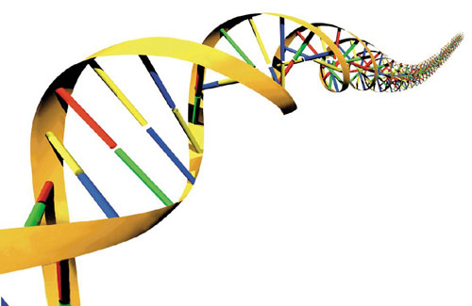
A fertile soil will contain all the major nutrients for basic plant nutrition (e.g., nitrogen, phosphorus, and potassium), as well as other nutrients needed in smaller quantities (e.g., calcium, magnesium, sulfur, iron, zinc, copper, boron, molybdenum, nickel).
https://www.soils4teachers.org/fertility
Our human DNA (the coding for all cells and hormones) requires phosphorous, oxygen, carbon, hydrogen and nitrogen.
Plants produce glucose (storing it as starch; a carbon, hydrogen & oxygen compound) and oxygen during the day through photosynthesis. And the soil (dust) from which the plant grows contains the micronutrients listed above.
Those micronutrients are also VITAL for the functionality of the human body. In the amino acids, the building blocks for our proteins needed for tissue and organ synthesis, elements (such as sulfur) are crucial for the structure of our proteins found in muscles, skin and bones.

Slide 4
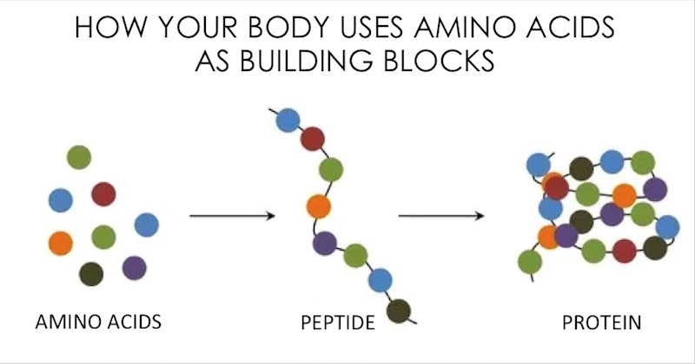
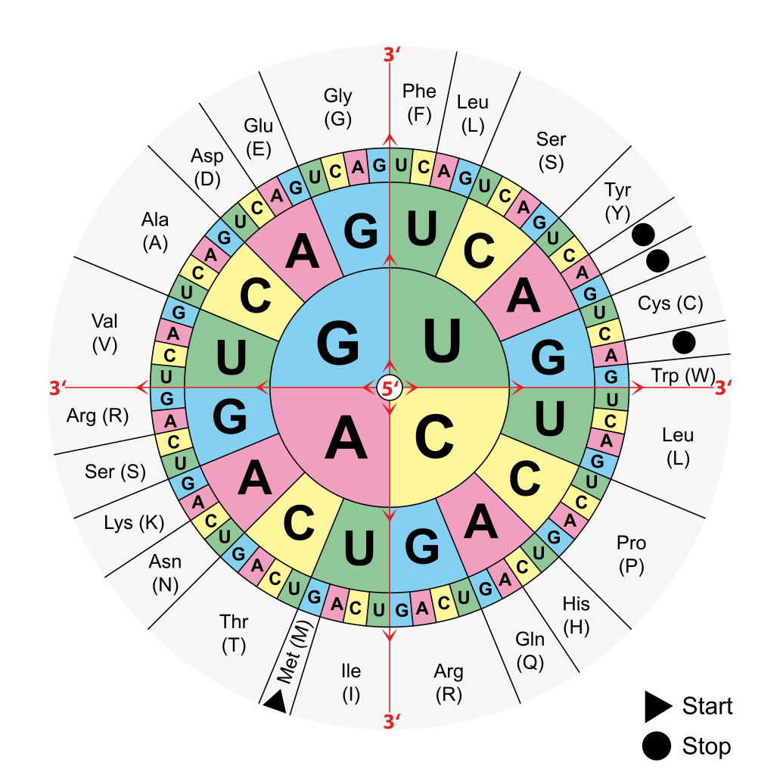
So sequences of DNA code for… amino acids!
…and sequences of amino acids form proteins.
Provided that you maintain a balanced varied nutritional diet containing the required macro and micronutrients, your body should effectively produce its own amino acids (non-essential). However, there are some amino acids you NEED to obtain from your diet that your body cannot make on its own!

Slide 5
Not only are amino acids vital for the synthesis of proteins but also for the body’s natural immunity against oxidative stress (producing anti-oxidants which prevent & heal free radical damage, cancers, and other diseases).
There are about 500 different amino acids that derive from the 20 that are shown next however, without the intake of minerals and vitamins from our diet, our bodies will break down before it even generates.
https://healthifybody.com/l-cysteine-benefits.html

Slide 6
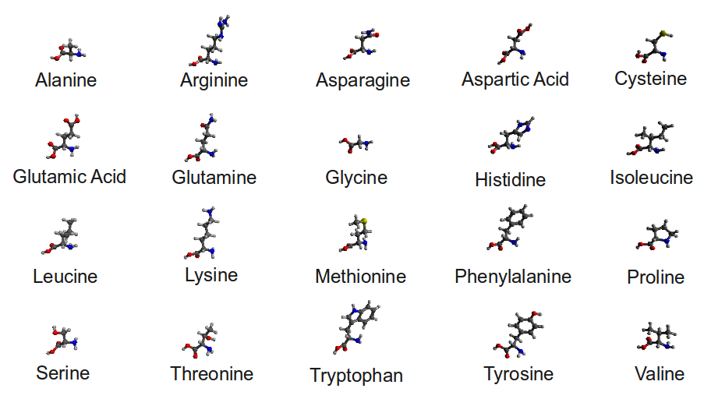
Essential versus non-essential
Alanine (from pyruvic acid)
Arginine (from glutamic acid)
Asparagine (from aspartic acid)
Aspartic Acid (from oxaloacetic acid)
Cysteine
Glutamic Acid (from oxoglutaric acid)
Glutamine (from glutamic acid)
Glycine (from serine and threonine)
Proline (from glutamic acid)
Serine (from glucose)
Tyrosine (from phenylalanine)
Isoleucine
Histidine
Leucine
Methionine
Lysine
Phenylalanine
Tryptophan
Threonine
Valine
List of amino acids
You need to have a daily intake of essential amino acids as your body cannot store nor create them on its own!

Slide 7
Restoring the intestinal wall barrier
The lining of the intestines go through a cycle of regeneration every 4- 5 days and it is important that you obtain enough protein from your diet in order for your body to carry out this important work.

Slide 8
Restoring the intestinal wall barrier
The lining of the intestines is a complex, collagen (protein-rich) organ which secretes digestive enzymes (which are made of protein), absorbs nutrients, secretes mucous for immunity against infections (e.g. E Coli), etc.

Slide 9
Restoring the intestinal wall barrier
Ranging between 10 -16 feet (3- 5 metres) in length, your small intestine plays the pivotal role in absorption of nutrients to sustain your ENTIRE function of the body.

Slide 10
Restoring the intestinal wall barrier
Split up into three parts: duodenum, jejunum and ileum; the ileum (about 3.5 metres/ 11.5 feet) is the final third & largest of the small intestine which absorbs vitamin B12, bile acids (from the liver) and other nutrients which were not absorbed before in the earlier part of the small intestine.

Slide 11
For the health of your small intestines, you need amino acids:
Glutamine for normal cell function
Arginine for maintaining the intestinal mucosal cells for immunity, hormone secretion and wound healing
Tryptophan (an essential amino acid) for stomach peristalsis. Essential in making proteins, neurohormone melatonin (responsible for regulating sleep patterns) which is converted into serotonin and vitamin B3 (niacin).
Cysteine for intestinal bacteria
Along with the minerals and vitamins to help the chemical processes to absorb them

Slide 12
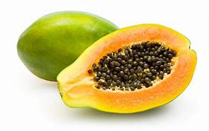
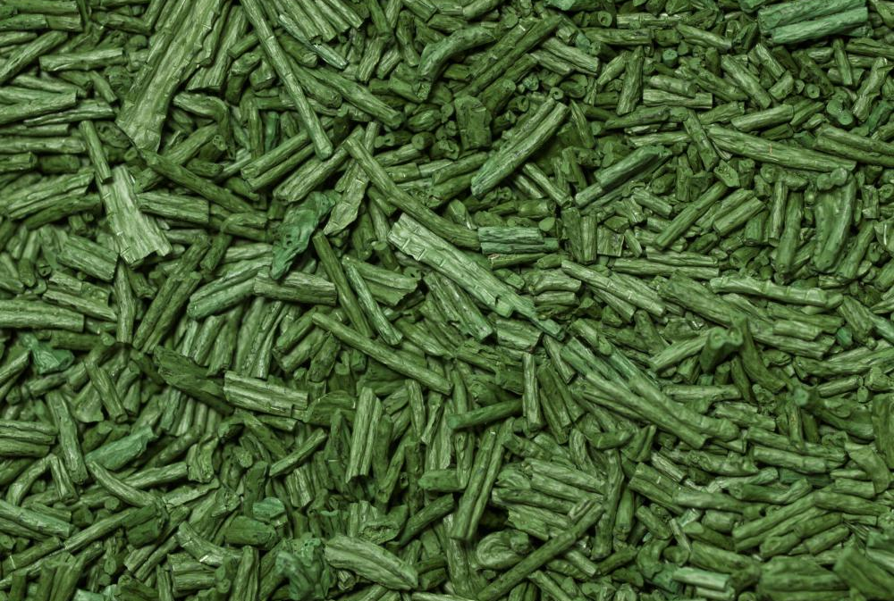
Where do you get those amino acids from?
You can get glutamine from beef, poultry, fish, beans, beets, cabbage, *eggs, spinach, carrots, parsley, wheat, papaya, brussel sprouts, celery, kale and milk.
Arginine from seeds and nuts, meat, legumes such as chickpeas, seaweed
*to be used as a medicine in times of malnutrition/ mineral deficiency
Above: papaya, below: spirulina

Slide 13
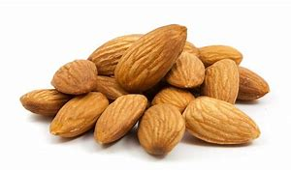
Where do you get those amino acids from?
In order for your body to convert tryptophan into niacin and serotonin, you NEED to have enough iron, vitamin B6 and B2 (riboflavin).
You can get tryptophan from salmon, poultry, eggs, spinach, seeds, milk, garlic, onions, soy products, nuts
Vitamin B2 from eggs, milk, almonds,
Vitamin B6 from meat, bananas, walnuts, brown rice, whole grains, blackstrap molasses, wheatgerm
Iron from spinach, legumes, pumpkin seeds, quinoa

Slide 14
Where do you get those amino acids from?
Your body makes cysteine from the essential amino acid methionine. It is only these two amino acids that contain the element sulfur which is critical for muscle, skin/ hair (collagen) and bone health, insulin production, cellular health and pressure regulation (dysfunction leads to inflammation and pain) and intestinal mucous membrane maintenance.
You can get cysteine from beef, fish, poultry, broccoli, brussel sprouts, cauliflower, kale, watercress, mustard greens, sunlight (vitamin D3 sulfate)
Vitamin D from fish oil, sunlight
Vitamin D also helps you absorb calcium which you can get in abundance from seeds, beans and lentils, almonds and leafy greens.

Slide 15
POWER FOODS for a healthy small intestine
Legumes- provides magnesium, zinc, iron & vitamin B5
Seeds- provides vitamins B1, B9 (known as folate/folic acid) and E, calcium, iron, copper, zinc, magnesium
Spinach- provides vitamins A and K, iron, sodium
Almond- provides vitamins B2, B7 and E, calcium
Beans- provides vitamin B9, calcium, potassium and phosphorous
Eggs- provides vitamins B2 and B12, iodine, sodium, zinc
Fish- provides vitamins A, B3, B12 (and D in the form of fish oil)

Slide 16
Thoughts on consuming meat
Although obtaining dietary nutrients from meat is OK, the small intestines can only absorb small amino acids. By eating meat, the digestive system has to work harder to break complex proteins (chains of 3 or 4 amino acids in length) down into single amino acids before being able to absorb it. This may be a reason why after eating meat, you may feel full for longer and the amount of energy required to do this may be counterproductive for the mineral intake.

Slide 17
Thoughts on consuming meat
Eating plenty of power foods and vegetables however, provides you with a variety of minerals and nutrients in one take. The body requires less energy to break down these foods leaving you feeling full and less sluggish! The only downside is the way that vegetables are processed. Often mineral content decreases during packaging, storage and cooking, so learn the most effective way to prepare meals and where possible, go raw.

Slide 18
The science behind the western diet
What is the western diet?
A modern diet schedule consisting of a high intake of red meat, processed meat, pre-packaged foods, butter, fried foods, high-fat dairy products, eggs, refined grains, potatoes, corn (and high-fructose corn syrup) and high-sugar drinks.
What are the diseases associated with this diet?
Breast cancer, prostate cancer, coronary heart disease and colon cancer

Slide 19
Chemical additives to food
We have moved far from the historic and natural ways of using salt and vinegar to preserve foods and even then, people of old would generally consume foods within a matter of days.
In today’s society, the abundance of food is at our disposal and chemicals have been added to prolong shelf-life by delaying mould growth, enhance taste, aroma, texture and colour. Packaged food may take a week or two in transit from the slaughterhouse to the stockroom of your local supermarket, then by the time it is presented on display for purchase, it may be another week or two before you actually consume it!

Slide 20
What effects do these preservatives have on the body?
“Sodium nitrate and nitrite are food preservatives often used in meat products. They help to prevent oxidation of meats, keeping them red in color and preventing bacterial growth. The U.S. Environmental Protection Agency notes that consumption of nitrates may be linked to an increased risk of cancers, such as leukemia, brain tumors and nasopharyngeal tumors. Nitrates and nitrites may also increase risk for diabetes, diarrhoea and respiratory tract infections in children. Ingesting a large amount of these preservatives at one time may cause you to experiences abdominal pain, muscle weakness, bloody stools and fainting, according to the EPA. You'll find nitrates and nitrites in bacon, lunch meat, hot dogs, sausage, smoked fish, ham and corned beef.”
https://livehealthy.chron.com/effects-food-preservatives-human-body-6876.html

Slide 21
“Sulfites in dried fruit, wine, shrimp and processed potato foods are preservatives that prevent discoloration in food. They also destroy vitamin B-1 content, however, and may cause adverse health impacts. If you are sensitive to sulfites, you may experience skin irritations, hives, flushing, hypotension, abdominal pain, diarrhoea and asthmatic breathing after eating them, according to a study published in November 2009 in the journal "Clinical and Experimental Allergy.””
Vitamin B1 (commonly known as thiamine) is necessary for cell metabolism and deficiency in vitamin B1 leads to BeriBeri disease which either affects the cardiovascular system or the nervous system. Either condition is life-threatening.

Slide 22
“Sodium benzoate, or benzoic acid, is another preservative used to prevent bacterial growth in foods. The Center for Science in the Public Interest notes that people who are sensitive to sodium benzoate may experience hives, asthma or allergic reactions after consuming it. When combined with vitamin C, also known as ascorbic acid, sodium benzoate may pose a small risk of cancer, including leukemia. According to the World Health Organization, animal studies reveal that high doses of the preservative may cause damage to the heart, spleen, liver, kidneys, brain and *adrenal glands.”
*the sex hormones (oestrogen in the ovaries and testosterone in the testes) are mainly produced by the adrenal glands and gonads. They play an essential role in sexual development and reproduction.

Slide 23
“Propyl gallate and tert-butylhydroquinone are antioxidant preservatives that help prevent the spoilage of fats and oils. They're found in processed foods, vegetable oils and meat products.”

Slide 24
This excludes the sugar content and artificial colourings added to soft drinks…
“There is great concern that artificial food coloring may cause increased hyperactivity in children…
3. Blue #1 and Blue #2 (E133)
Banned in Norway, Finland, and France. May cause chromosomal damage.
Found in candy, cereal, soft drinks, sports drinks and pet foods.
4. Red Dye # 3 (also Red #40 – a more current dye) (E124)
Banned in 1990 after 8 years of debate from use in many foods and cosmetics. This dye continues to be on the market until supplies run out! Has been proven to cause thyroid cancer and chromosomal damage in laboratory animals. May also interfere with brain-nerve transmission.
Found in fruit cocktail, maraschino cherries, cherry pie mix, ice cream, candy, bakery products and more! Etc, etc”
https://www.foodmatters.com/article/22-additives-and-preservatives-to-avoid

Slide 25
Why do we need to move away from the western diet?
“A Western-type diet elevates plasma levels of sex hormones and decreases the sex hormone binding globulin concentration, increasing the bioavailability of these steroids. The same diet results in low formation of mammalian lignans and isoflavonic phytoestrogens.”
“Western diet and Western diseases: Some hormonal and biochemical mechanisms and associations” –Herman Adlercruetz
https://www.tandfonline.com/doi/abs/10.1080/00365519009085798
Our bodies cannot function. This diet is affecting our natural ability to develop as a man and woman, to be fertile so that we can carry out TMH’s order to procreate.
This diet is killing us, genetically. The combination of chemicals, bad food types and unhealthy portions (appetite), our bodies are malfunctioning and because it is effecting our neurotransmitters, we can’t do anything about it. We are under mind control, by food.

Slide 26
Mammalian lignans are compounds (phytoestrogens) that support the prevention of breast cancer and coronary heart disease.
“The precursors of these diphenols are to be found in fiber-rich unrefined grain products, various seeds, beans and probably also in pulses, peas and berries.”
TMH has already gave us our medicine, from in the beginning in the Garden of Eden- HalleluYah! In the last days, we need to go back to the diet in Eden.
“Western diet and Western diseases: Some hormonal and biochemical mechanisms and associations” –Herman Adlercruetz
https://www.tandfonline.com/doi/abs/10.1080/00365519009085798

Slide 27
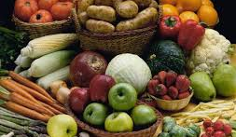
Daniel 1:12-17
¹²Prove thy servants, I beseech thee, ten days; and let them give us pulse to eat, and water to drink. ¹³Then let our countenances be looked upon before thee, and the countenance of the children that eat of the portion of the king's meat: and as thou seest, deal with thy servants. ¹⁴So he consented to them in this matter, and proved them ten days. ¹⁵And at the end of ten days their countenances appeared fairer and fatter in flesh than all the children which did eat the portion of the king's meat. ¹⁶Thus Melzar took away the portion of their meat, and the wine that they should drink; and gave them pulse. ¹⁷As for these four children, God gave them knowledge and skill in all learning and wisdom: and Daniel had understanding in all visions and dreams.
Application of the relationship between diet and understanding

Slide 28
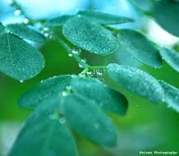
2 Esdras 9:26 So I went my way into the field which is called Ardath, like as he commanded me; and there I sat among the flowers, and did eat of the herbs of the field, and the meat of the same satisfied me.
Esdras 12:51 But I remained still in the field seven days, as the angel commanded me; and did eat only in those days of the flowers of the field, and had my meat of the herbs

Slide 29
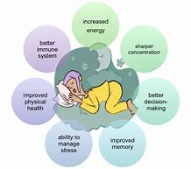
So why is it important to eat right?
Healthy neurological and sexual function
Healthy bones, hair, muscles & skin
Healthy sleeping pattern and mood
Overall immunity to disease and stress

