Slide 1

Chesapeake Lighthouse Foundation
Funding Presentation, October 2025
Yilmaz Zayn Ak, CEO ak@clfmd.org

Slide 2
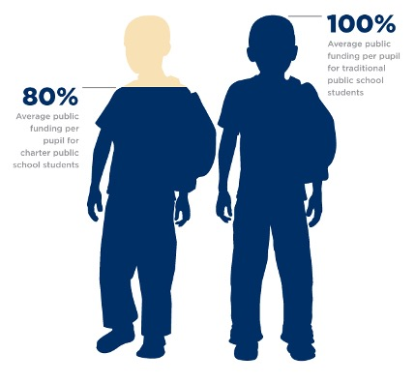
Charter Funding Basics
Charter schools do not receive capital funding, meaning that we have to spend roughly 15% ($1,500 per pupil) of our budgets on facilities.
Blueprint decreased funding by 10%
Salaries have gone up by almost 10% since Blueprint came into effect.

Slide 3

State Board Decision
Historically, Districts withheld 2% from charter schools for administrative fees
The new State Board ruling allows for a 5% Administrative Fee and a 10% Special Education Adjustment. Essentially allowing districts to cut another 13%
Initially it was planned to be 18-20%

Slide 4
Impact: No immediate impact
AACPS has been a good partner and has funded us equitably, keeping fees at 2% and will continue to do so.
PGCPS has been withholding 5-6% this year. The leadership has verbally stated that they would not further cut, but we have not yet seen the numbers.
This could change with future administrations.
Notes:
Advocacy has made a difference in the district’s decision.

Slide 5
Charter School Facilities funding bill
A facilities funding bill will be submitted to the legislature and we will need your support
The bill could potentially add $1,000 per pupil
We are currently running a deficit and this could close that gap.

Slide 6

Our ask: Advocacy
State Board Ruling will be published for public comment: we will ask you to push back on the 15%
Facilities Funding Bill: We will ask you to support the bill by reaching out to your delegates. Mark Chang is sponsoring the bill.
Consider annual donations to the school
Notes:
$100 per month for 10 month per family would also close most of the gap.

Slide 7

Thank you!
CMIT is not just a school; it’s a community dedicated to educational excellence and innovation. Help us keep building this legacy for future generations.
Yilmaz Zayn Ak
CEO
ak@clfmd.org

