Slide 1
INDIVIDUAL COMPREHENSIVE EVALUATION (ICE)
Mentoring – Training – Behavioral Illumination – Education
facebook.com/Lifeexcels

Slide 2
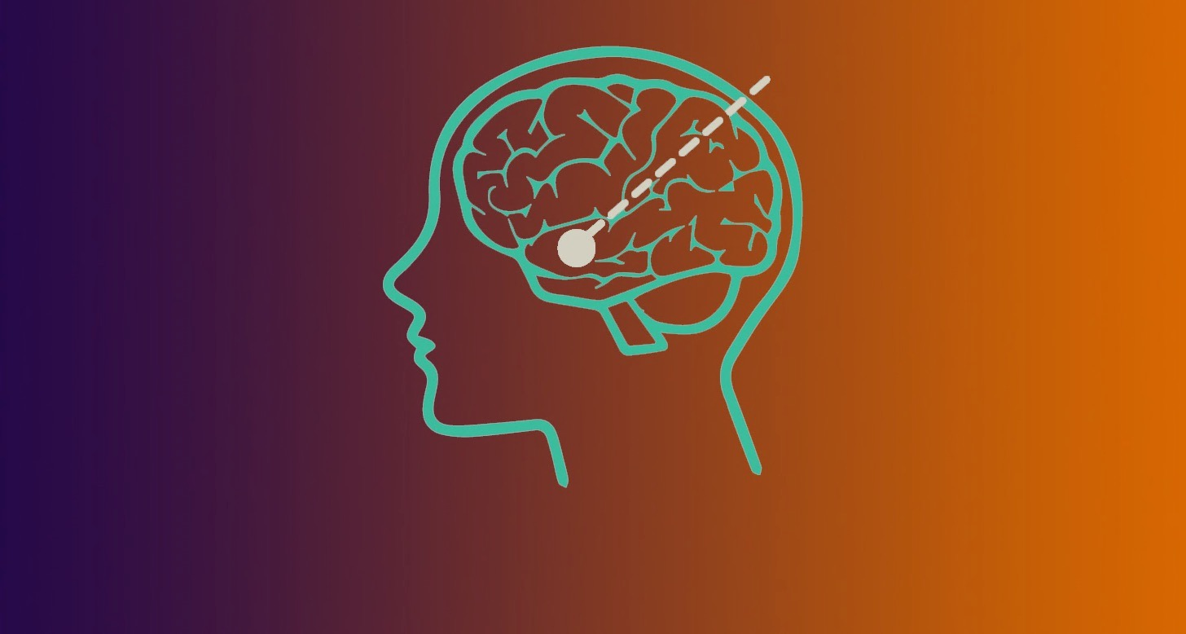
'The question is not what you look at, but what you see.’
Henry David Thoreau

Slide 3
WHAT IS INTELLECT?
Ability of mental faculties with respect to the growth of human brain
Another school of thought calls it “lifespan mental development” or brainpower
Ability of human to think, perceive, analyze, interpret & express
Intellect refers to Cognitive Functions of Human Brain

Slide 4
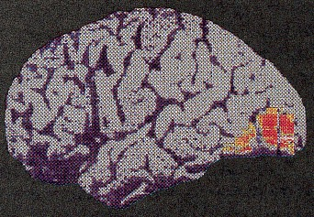
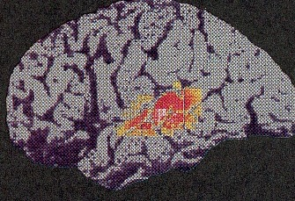
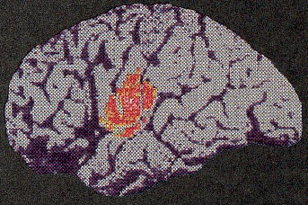
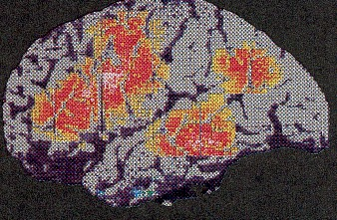
COGNITIVE FUNCTIONS OF BRAIN
listening to words
looking at words
speaking words
thinking about words

Slide 5
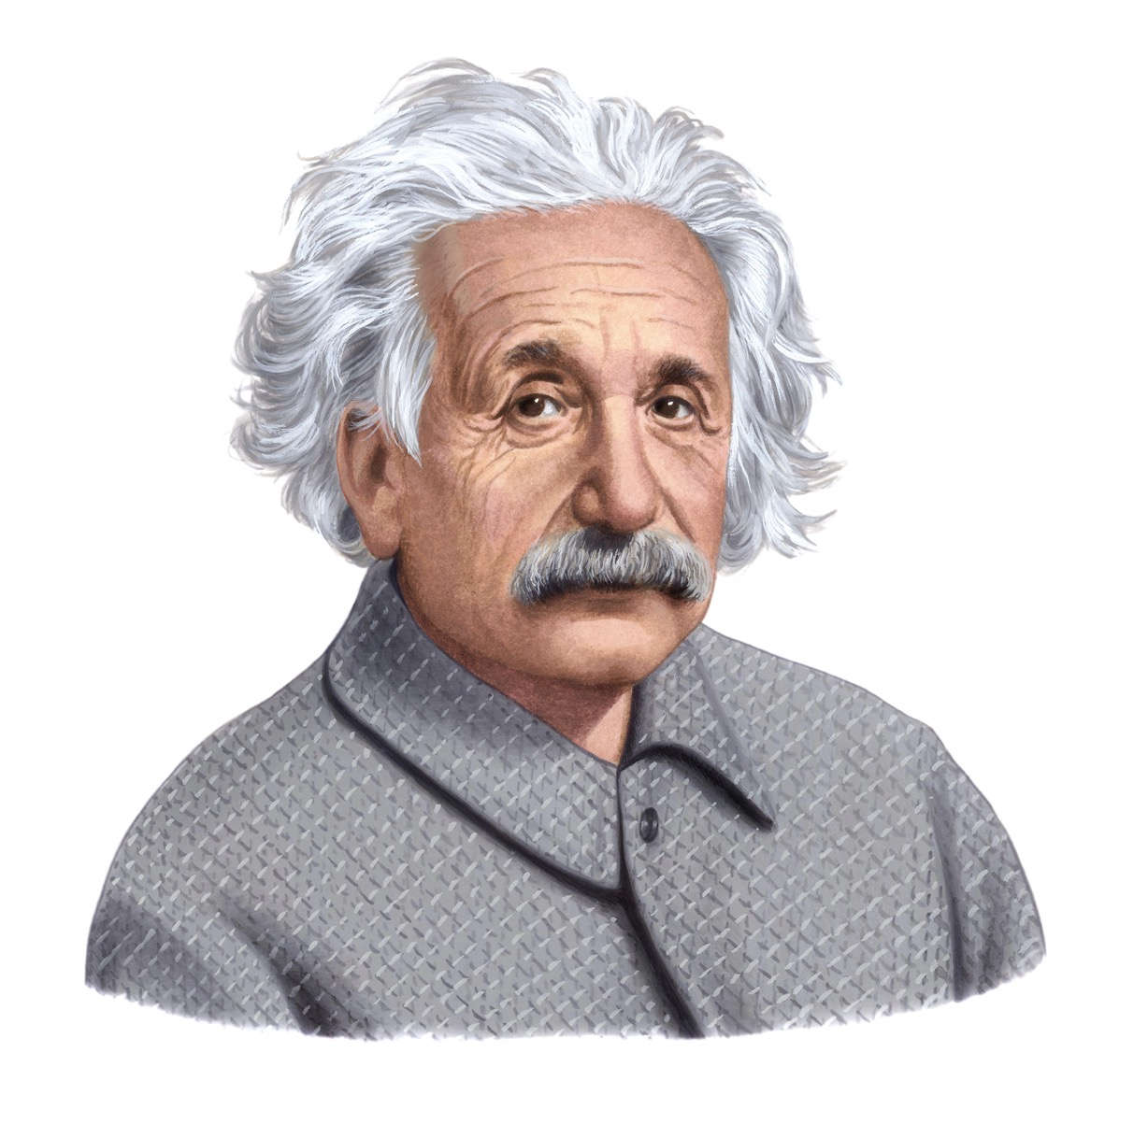
'Education is not the learning of facts, but the training of the mind to think.'

Slide 6
WHY ICE?
Helps STUDENTS know their natural aptitude
Individual Learning Profiles & Career Profiles
Develops & maintains Healthy Cognition
Empowers PARENTS to take “clear” decisions on Child’s Future
Secures their investment & brings Peace of Mind
Helps INSTITUTIONS improve their Academic Quality
Enhances stakeholders contribution to Student’s Wellbeing

Slide 7
OBJECTIVES OF ICE
Neurosensory Liveliness
Scholastic Development
Behavioral Enlightenment
Transformation Through Enlightened Genius

Slide 8
FOCUSED AREAS OF ICE
NEUROCOGNITIVE Info Processing Memory Functions Attentiveness Motor Controls Perception | SCHOLASTIC Intelligence Creativity Confidence Decision Reaching Task Management | BEHAVIORAL Rational Emotive Socio-dynamic Group Chemistry Citizenship Leadership

Slide 9
Guaranteed success to everyone as each individual possesses original ability & talent to become a “professional” in the field of its unique giftedness called “natural tendency” or aptitude.

Slide 10
HOW ICE WORKS?
A simple test to be attempted Online
No Anxiety, Fatigue or Exam phobia
Student
Parents
Teachers
Peers
Institution

Slide 11
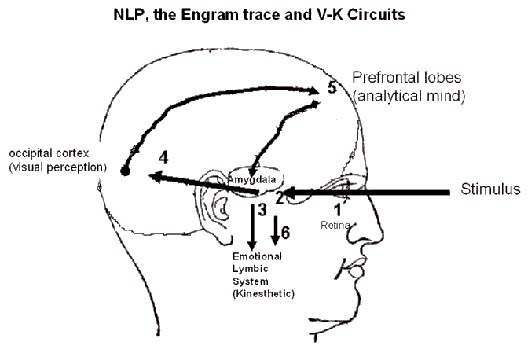
HOW ICE WORKS?
A simple test to be attempted Online
No Anxiety, Fatigue or Exam phobia
Draw functional imagery of EIQ, ESP & Natural Aptitude
Career Development Modules are based on YOUR Career Profiling

Slide 12
WHAT A STUDENT EARNS?
Career Security
Healthy Cognition
Confidence, Motivation & Energy
Enhanced Academic & Co-curricular Performance
Psychosocial Health & Wellbeing

Slide 13
WHAT DO PARENTS GET?
Career Insurance of the child
Security of their investment
Empowerment & Freedom
Socially responsible & mentally grownup children
Stress free life with peace of mind

Slide 14
WHAT DO INSTITUTIONS GET?
First Mover’s Advantage
Brand Value Enhancement
Better Academic Results
Complimentary Academic Staff Orientations on ICE
Cost Reduction on Value Addition

Slide 15
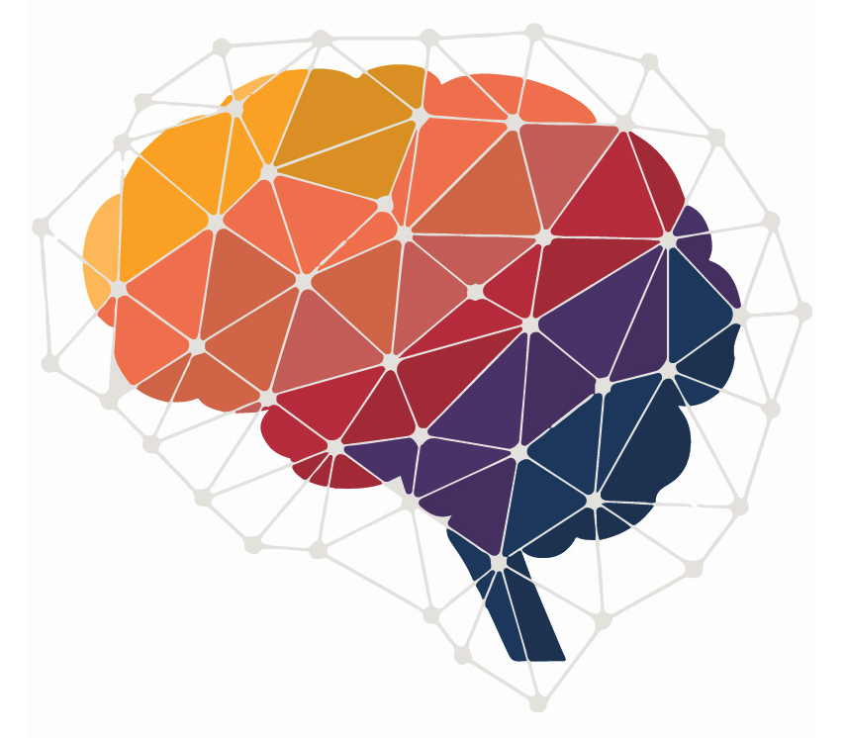
THE GOVERNING SPIRIT
Neurocognitive Development
Intellectual Assessment
Train the Brain Activities
Performance Monitoring

Slide 16
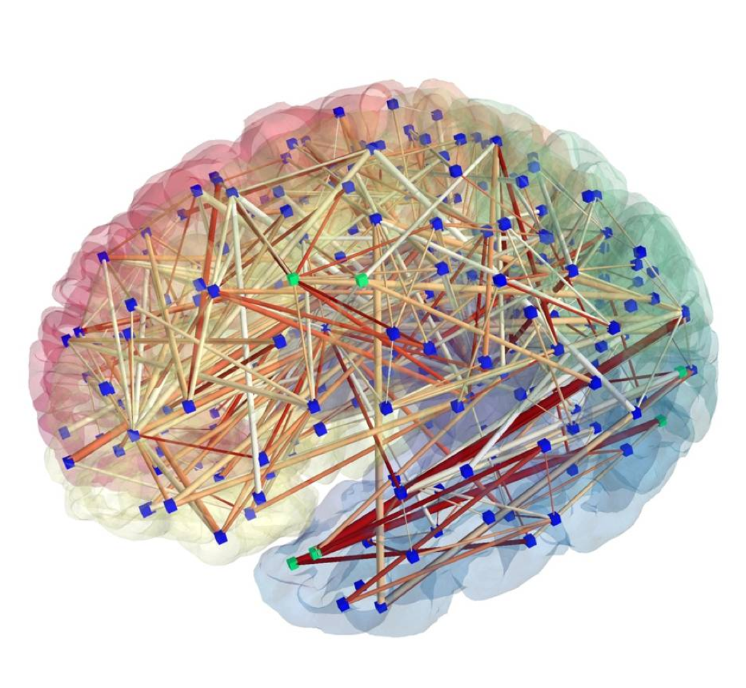
INTELLECTUAL COMPETENCE
Cognitive ability regulates human behavior, i.e. believes, desires & intentions. Human performance can be optimized by enhancing Intellectual competence.
Train the Brain
Specialized trainings for optimization of neurocognitive potential to achieve healthy & stress free lifestyle with optimized performance.

Slide 17
DEVELOPMENT PROCESS & OUTCOMES
Screening
NCD
Peer Support
Strengths based nCBT
Success
Self-regulation
Attitude & Confidence
Efficiency & Output
Bio safety
Enhanced KM Opportunities ,
Trainings, Interactive Sessions,
Expeditions etc.
Notes:
Intro

Slide 18
FOR ALL OF US
Intellectual Assessments
Cognitive Development
Training & Research
Aptitude Sensing
Career Profiling
Relationship Profiling
Personality Profiling
Learning Profiles

Slide 19
Islamic Cultural Center Abu Dhabi

Slide 20
Bulding No:107, 3rd Floor, Commercial Broadway, Phase viii,D.H.A. Lahore
Contact: 0092 334 4634458

