Slide 1

SEVEN LOCKS ELEMENTARY SCHOOL
School year 2019-2020
“FALL” community service activities

Slide 2
Fall 2019 activities
Month(s) | Activity
October/November | Gardening and Park Maintenance (Locust Grove Nature Center)
October/November | Reading to Therapy Dogs (P.A.L. at Potomac Library)
October/November | Collection Drive for Used Sports Equipment (Leveling the Playing Field)
November | Making Placemats for Holiday Dinner (The Children’s Inn at NIH)
December | Presorting Donated Food (Manna Food Center Food Bank)

Slide 3
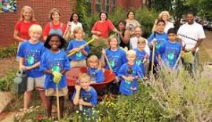
Helping nature
Maintain the grounds
Mulching
Painting plant pots
Gardening
Learn about plants and animals
Locust Grove Nature Center, 7777 Democracy Blvd, Bethesda, MD 20817, tel. 301-765-8660
https://www.montgomeryparks.org/parks-and-trails/cabin-john-regional-park/locust-grove-nature-center/
Four Thursdays this fall, Oct 3, 17 and Nov 7, 21 from 4:30-5:45pm
Children will help the Center in age-appropriate gardening and maintenance activities and will also learn about plants and animals at the Center. Center staff will lead us through the activity each time as well as provide an educational overview. Locust Grove Nature Center is part of the Montgomery County Parks organization. It is located approx. a 5 minute drive, 2 miles from school. Parents or a responsible adult will need to accompany children for this activity. Sign up appreciated (please gdheer@hotmail.com) but not required, you can just come!

Slide 4
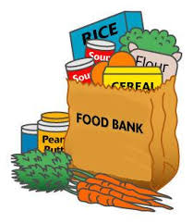
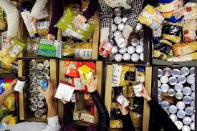

Helping people
Sort food donations into groups
Help feed those who are less fortunate
Manna Food Center, 9311 Gaither Road, Gaithersburg, MD 20877, tel. 301-424-1130
www.mannafood.org
Wednesday, December 11 between 5-9pm, come for a couple of hours or stay for the whole time, up to you.
"Manna stands as the premier food bank of Montgomery County, providing food to 32,000 individuals each year and helping distribute rescued food to soup kitchens, food pantries and emergency shelters county-wide.” Children will help the Center with presorting donated food items into categories and placing them appropriately. Parents or a responsible adult will need to accompany children for this activity. Sign up appreciated (please email gdheer@hotmail.com) but not required, you can just come!

Slide 5
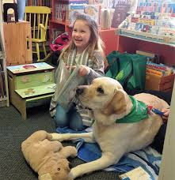
Helping animals
Help therapy dogs
Improve your own reading skills ☺
P.A.L. (People. Animals. Love.) at Potomac Library, 10101 Glenolden Drive, Potomac, MD 20854, 240-777-0690
https://www.montgomerycountymd.gov/Library/branches/potomac.html
https://peopleanimalslove.org
First and Third Tuesdays of each month, Oct 1, 15, Nov 5, 19, Dec 3, 17 from 4:30-5:30pm
"School-age children, especially beginners learning to read and those who want to improve their confidence in reading skills, are invited to practice reading aloud in short (10-15 minute) semi-private sessions with a certified therapy dog,” from P.A.L. Parents or a responsible adult will need to accompany children for this activity. First come first serve. Sign up appreciated (please email orangelace@aol.com) but not required, you can just come!

Slide 6

Helping people
The Children’s Inn at NIH, making placemats for holiday dinner for patient residents and families, exact dates TBD stay tuned
www.childrensinn.org
“The Children’s Inn at NIH is a residential “Place Like Home” for families with children participating in leading-edge research studies at the National Institutes of Health (NIH) in Bethesda, Maryland.” Come spend an afternoon or two at school making placemats to put a smile on the faces of families going through a hard time. Sign up appreciated (please email orangelace@aol.com) but not required, you can just come!
Leveling the Playing Field used sports equipment collection drive at school in October, exact dates TBD stay tuned
http://www.levelingtheplayingfield.org
“Leveling the Playing Field gives underprivileged children the opportunity to enjoy the mental and physical benefits of youth sports participation. We do this through the donation of used and excess sporting equipment to programs and schools serving low-income communities.” We will collect sports equipment at school to donate to Leveling the Playing Field. Details regarding accepted donation items can be found at this link:
https://d3n8a8pro7vhmx.cloudfront.net/levelingtheplayingfield/pages/123/attachments/original/1482447245/Accepted_Equipment_List.pdf?1482447245

Slide 7

Do you have other ideas on how we can serve and help our community?
If you have other ideas or suggestions on how we can help our community together please let us know! We want to hear your ideas ☺! There are so many ways to help so think about some things we can do together!
Contact our 2019-2020 PTA Community Service Co-Chairs
Lisa Najafi
orangelace@aol.com
Geeta De Silva
gdheer@hotmail.com

Slide 8
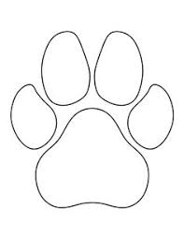
Seven locks elementary school community service 2019-2020
KEEP TRACK OF THE COMMUNITY SERVICE ACTIVITIES YOU PARTICIPATE IN ON THIS FORM! AT THE END OF THE YEAR YOU WILL BE ASKED TO SUBMIT IT AND BE RECOGNIZED FOR YOUR EFFORTS!
Project 2
Project 3
Project 4
Project 1
How I Made A Difference:
Student Name
Grade and Teacher

