Slide 1


Welcome
Proposed LNG Facility on Merritt Island:
What Nearby Residents Need to Know
NO LNG IN MERRITT ISLAND

Slide 2
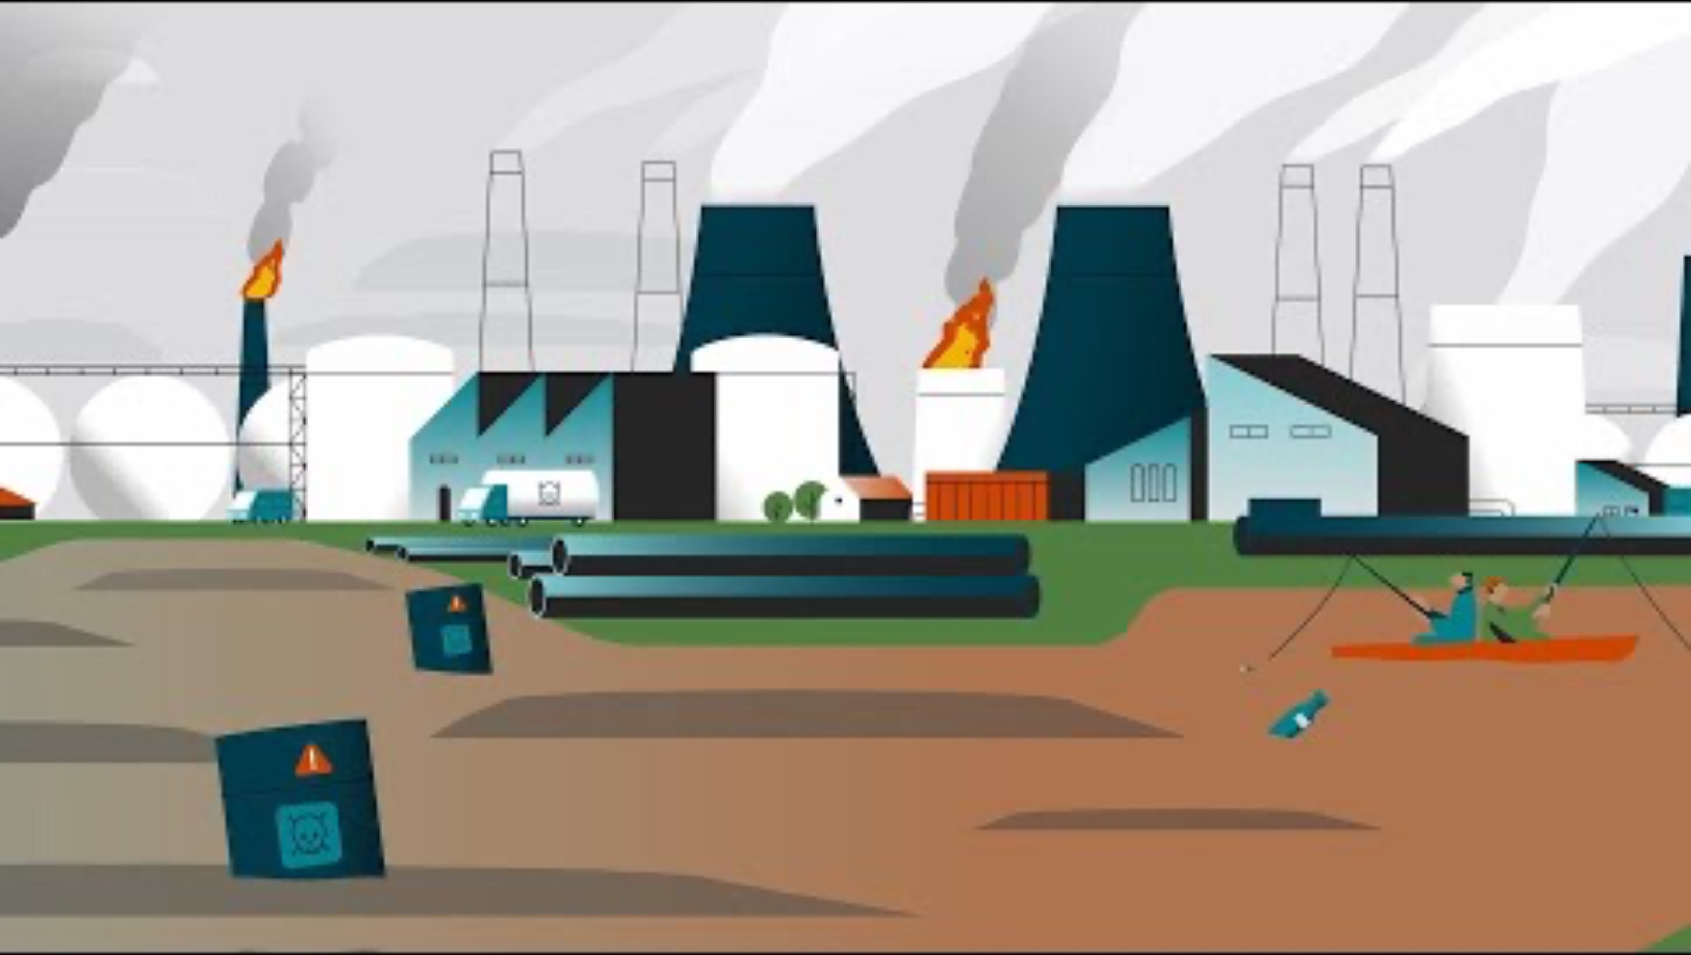
What is LNG?

Slide 3
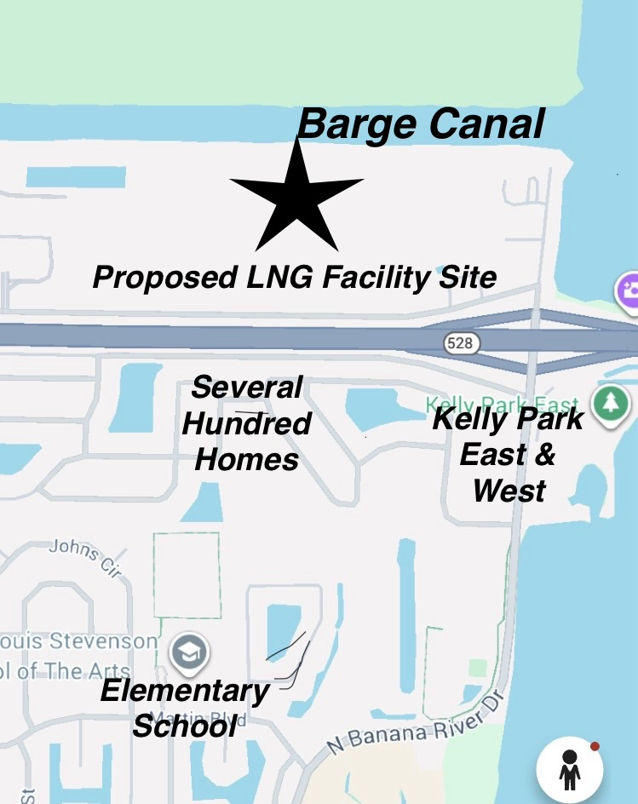
This is NOT Canaveral as the gas company says it is. It’s Merritt Island our home!
There are 930 homes within a 1-mile radius
¼ mile from Island Crossing & Riverwalk subdivision
½ mile from Kelly Park
½ mile from Stevenson Elementary School.

Slide 4
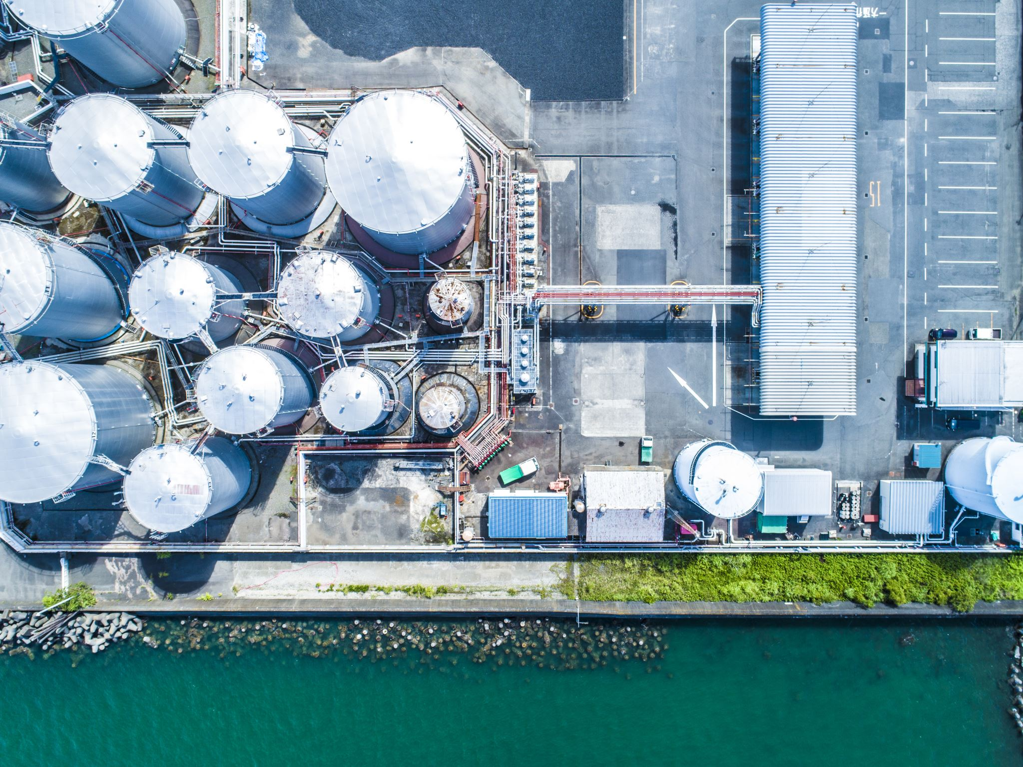
How we got here
Berkshire Hathaway/Chesapeake Energy came to the Port with an UNSOLICITED proposal to purchase their land to build the LNG plant.
The Port Canaveral Board of Commissioners will vote whether to sell this 50 acres of land to the gas companies. *
*Timeline for this vote is still undetermined

Slide 5
Why Proximity Matters for LNG Facilities
Public safety not sufficiently studied guidance says location should be “remote”, not densely populated

Slide 6
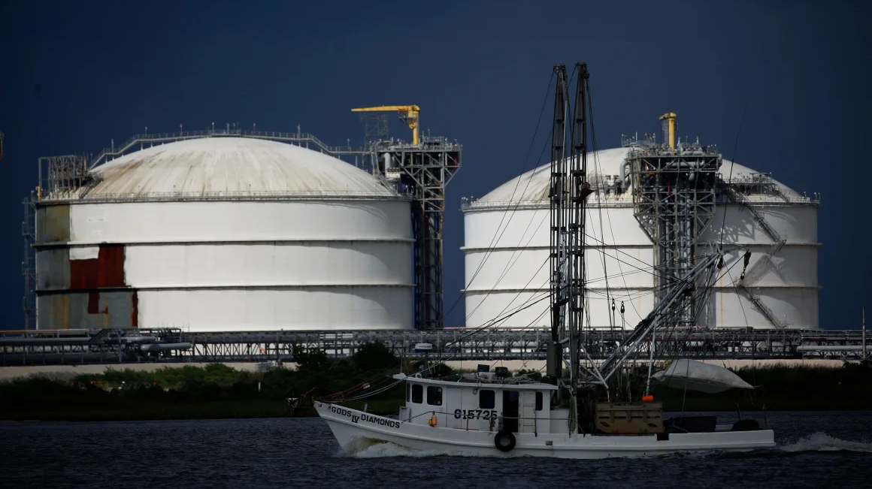
Day-to-Day reality, not just the permit description.
LNG delivery method (truck-based vs pipeline)
Liquefaction, storage, and loading processes
Frequency of truck deliveries and departures
Hours of operation (24/7 implications)
Emergency responders lack equipment and training

Slide 7
Increased Road & Barge Traffic
Estimated number of LNG tanker truck trips per day/week
Class 8 heavy-duty vehicles with a Gross Vehicle Weight (GVW) of up to 80,000 lbs
Congestion
Barge traffic in canal and across river to cruise ship term

Slide 8
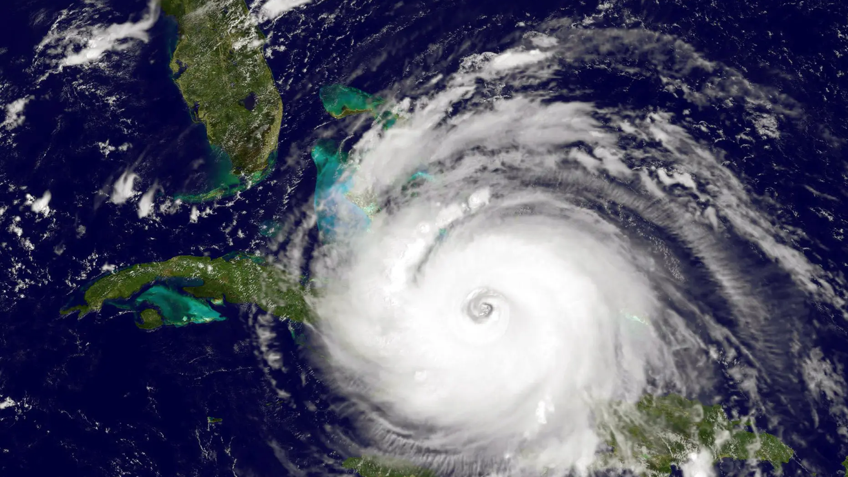
Risks to LNG Plants During Hurricanes
Physical Infrastructure Damage:
High-speed winds and storm surges can severely damage marine infrastructure,, as seen with severe damage to pipelines during past storms.
Power and Utility Outages:
Damage to electricity transmission lines can lead to long-term outages, especially for plants relying on the grid.
Environmental and Safety Hazards:
Leaks or spills of liquefied natural gas (LNG) during a storm are a concern, as the gas can create large, flammable vapor clouds.
Evacuation and Safety:
Emergency procedures What happens if SR-528 is closed
Lack of alternate evacuation routes

Slide 9
Air Pollution from LNG Processing
Particulate matter (PM2.5)
Particulate matter (PM10)
Nitrogen oxides (NOx)
Sulfur dioxide (SO2)
Carbon monoxide (CO)
Volatile organic compounds (VOCs)
Ammonia
“Combined hazardous air pollutants’
Sulfuric acid
Greenhouse gases

Slide 10
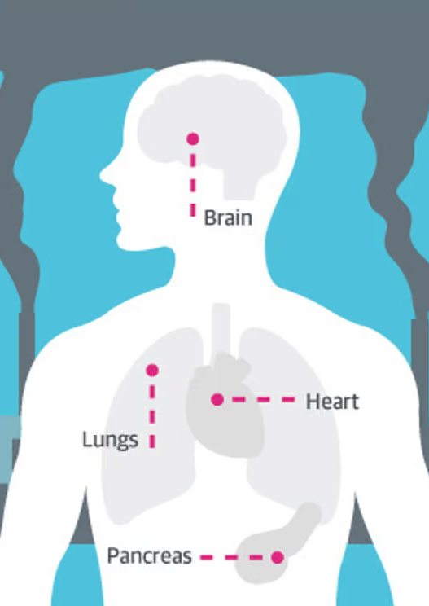
Negative Health Impacts from LNG
In 2024, direct air pollution from LNG export terminals was estimated to cause 60 premature deaths and $957 Million total health costs per year.
Living near LNG facilities has been associated with higher risks of Health Problems such as
Cancer
Birth defects, low birth weight, preterm delivery
Asthma and respiratory issues
Heart and blood pressure problems
Skin irritation and dermal symptoms
Neurological symptoms including fatigue and migraines

Slide 11
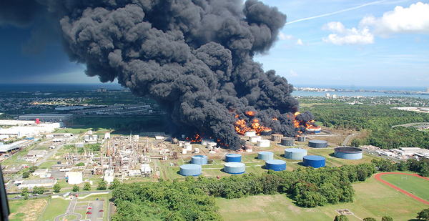
LNG Hazards What Can Go Wrong?
Flammable and hazardous substance
Once released to air, cannot control it
Expands 620 times in volume
Colorless/odorless, so hard to track if released
Cold vapor cloud robs oxygen from the air, can suffocate those close by; can freeze burn skin tissue in seconds
Vapor collects in ditches, basements, sewers, tunnels; can explode with the force of a bomb
A spark or static electricity can ignite a fire or explosion
Fire so hot it cannot be extinguished – “let it burn” (cryogenic, flammable vapor cloud)

Slide 12
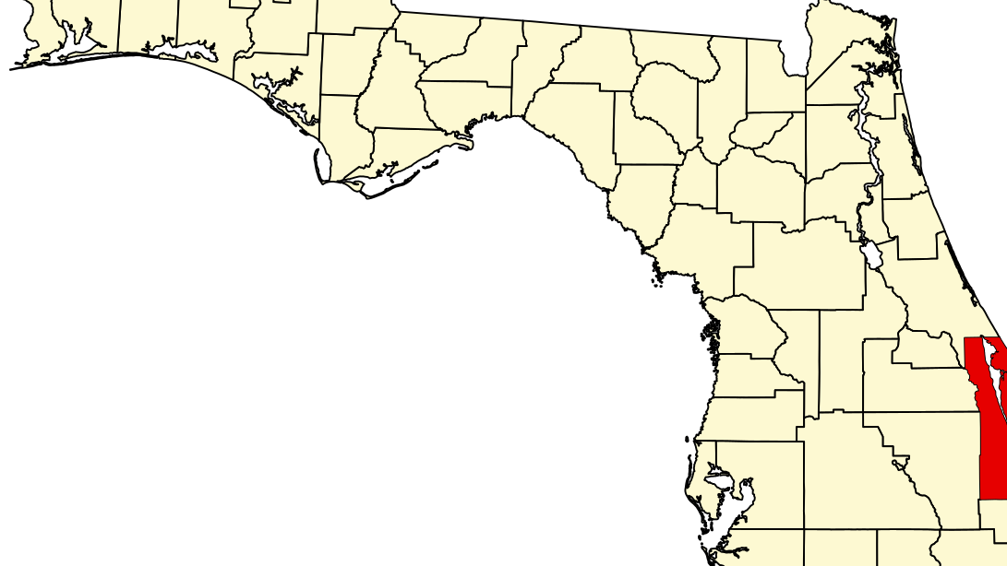
Community Level Impacts
Property values of homes near LNG facilities decrease
Homeowners insurance premiums increase/some companies refuse to insure your home
Quality-of-life impacts (noise, traffic, perception of risk)
Stress and health considerations for nearby residents
This Photo by Unknown Author is licensed under CC BY-SA

Slide 13
What Can you Do
ATTEND
  Port Canaveral Board of Commissioners Meeting on February 25 at 9:00 AM, at 445 Challenger Road, Cape Canaveral.
SPEAK
  Residents wishing to speak during the Public Comments section must complete a comment card upon arrival. Each speaker is allotted three minutes.
CALL
  Port Authority 321-394-3201 & Your local and state elected official. Let them know you do not want an LNG facility in your community.
SCAN / VISIT
  The code to sign the petition and stay informed
  www.nocanaverallng.com

Slide 14
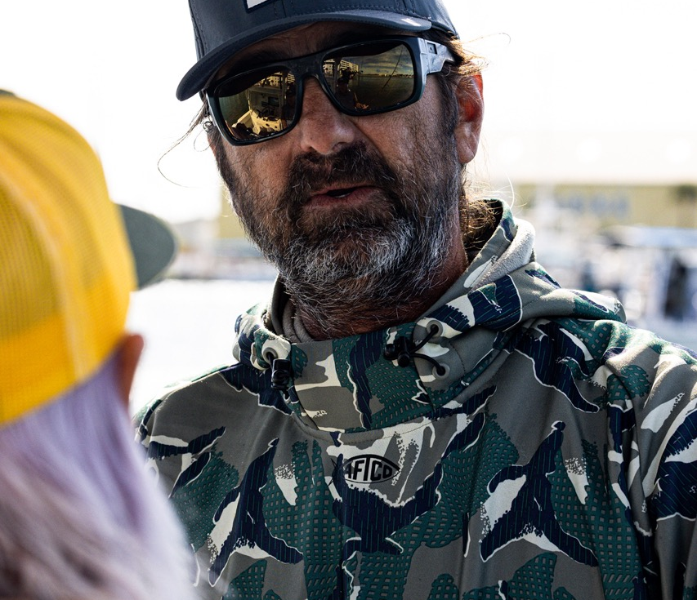
Guest Speaker
Captain Alex Gorichky
Raised on the Space Coast, Captain Alex Gorichky has dedicated his life to Florida’s unique coastal ecosystems. With expertise in offshore and inshore fishing, diving, and ecological restoration, he channels his passion for conservation into protecting the waters that have shaped his journey. Alex’s work focuses on building resilient habitats and engaging communities to safeguard Florida’s natural beauty.

Slide 15
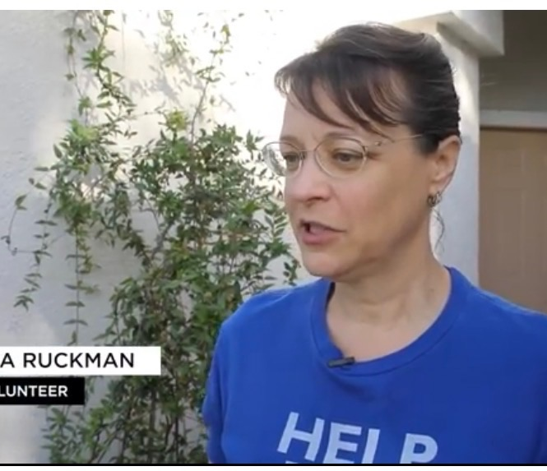
Guest Speaker
Lisa Ruckman
Brevard Indian River Lagoon Coalition, specifically engaging with the East Merritt Island Community Association (EMICA) to promote environmental beautification efforts for the lagoon. Her work focuses on community-driven action to improve the health of the Indian River Lagoon. Role: She has shared initiatives related to the Brevard Indian River Lagoon Coalition's goal of restoring the lagoon.

Slide 16
Q&A

