Slide 1



INVESTOR PACK
BUZZARD PROPERTY INVESTMENTS LTD

Slide 2
Who are we and what is our vision?
After recognising the current housing crisis with the UK being in excess of 300,000 houses short, as property investors we have recently felt the need to use our skills to contribute towards the reduction in this number. We believe with the right investment we can make a difference whilst still operating a profitable business and building for the future.

Slide 3

What makes now a good time to invest in property?
Exit of hobby landlords releasing distressed stock into the market due to Section 24
Huge demand for rental is driving the rise in rental rates
At least 1.8M more households will be looking to rent rather than buy a home by 2025 the RICS claims
Stable growth asset and long term growth
With the UK being on the brink of a recession, now presents a good opportunity to purchase properties at a lower purchase price.

Slide 4

What can we offer you?
With the current housing market, house prices have decreased presenting a good opportunity to purchase.
Buying below Market value allows us to maximise the ROI on your investment up to 12% as opposed to an average 4-5% offered by high street banks.
Choose exactly how much involvement you want in the project, be included in every step of the process or have minimal involvement allowing you to have free time whilst making a return on your investment.
We offer multiple ways to invest to suit. For example we offer: Joint Venture, General Partnerships etc..
Investing in property with Elite will also allow for capital gains relief which we offer full advice via our accountant.

Slide 5


Why us
The Buzzard team have a range of business backgrounds and extensive business knowledge which has allowed us to create and build strong relationships with clients, customers and the support network around us.
Having extensive training and knowledge within the property industry, we are experienced property investors and have fantastic potential.
Having access to quality tradesman we believe and have testimonies to support that the quality of workmanship is to a high standard.
We are a very ethical team that hold core values within our business which we believe leads us to be trusted property investors.

Slide 6

Strategies
HMO – Housing of Multiple Occupancy Creating an HMO is a straightforward conversion of a 3-4 bedroom property housing none related occupants. There is minimal spend on converting the properties into viable HMO’s in most cases and a potential to generate high income from this.
BUY TO LET –
Aquiring properties below market value(BMV), that require a light or full renovation. This enables us to maximise on the valuation. Once the property has been renovated, it will then be put onto the open market to rent. The property will be refinanced and exited as a BTL, enabling our investors to have a healthy and forecasted return on their investment
BUY TO SELL –
Aquiring properties below market value(BMV), that require a light or full renovation. Having high stardards on all of our renovations enables us to maximise on the valuation, generating a healthy return for our investors. Once renovated the exit plan will be to sell on the open market

Slide 7
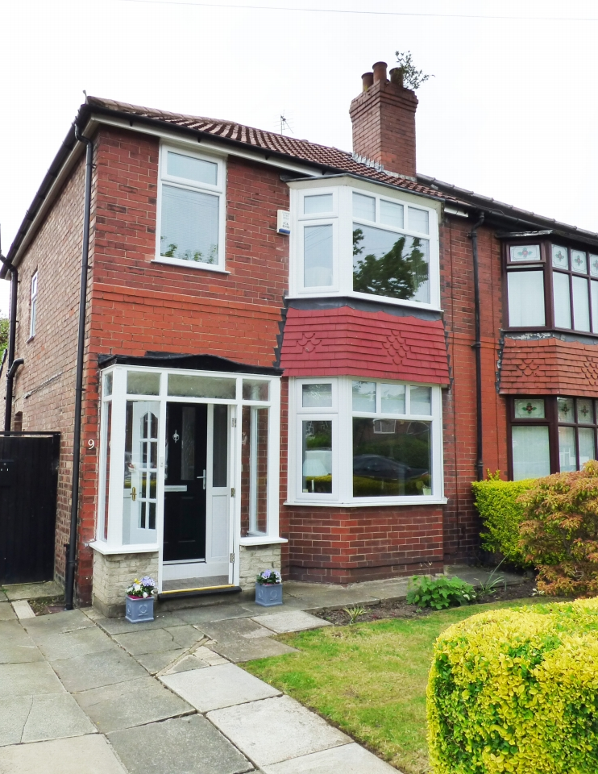
Case Study
Purchase Price: £105,000
Stamp Duty: £3,150
Legals & Fees: £500
Refurb: £30,000
Total Costs: £138,650
Post refurb valuation: £180,000
Profit: £41,350 over 3 months

Slide 8
Contact Details
Email Address: buzzardproperty@gmail.com
Contact Number: 07527488959
Company Details: Gary Catling
Social Media :buzzardpropertyinvestments Facebook/Instagram/Linkedin

