Slide 1

Code Enforcement Update
August 21, 2017

Slide 2
What is Code Enforcement?
The process of preventing, inspecting and mitigating nuisances on public and private premises relating to health, safety and general welfare.
  Defined by federal/state law and local ordinances
Code enforcement does not regulate aesthetics, taste, civil disputes, HOA violations, or noise related to barking dogs and loud music.

Slide 3
Why a Code Enforcement Program?
To help create and maintain a safe and healthy environment
To prevent physical and aesthetic deterioration of the community
To protect property values of residents and businesses
To reduce vandalism and deter crime
To publish standards for compliance that are based on reasonable and consistent enforcement of state and local laws and ordinances
To establish a framework for community involvement to resolve public nuisances

Slide 4
Code Enforcement Program Goal
The goal of this division is to make and maintain the City of Stonecrest as a clean and beautiful place. Code Enforcement is responsible for enforcing codes which address health and safety issues, including regulations related to rubbish, debris, attractive nuisances (vacant properties), removal of vegetation, zoning and inoperable vehicles on private property.

Slide 5
History of Code Enforcement
Building codes have a long history. The earliest known written building code is included in the Code of Hammurabi, which dates from circa 1772 BC.
After the Great Fire of London in 1666, which had been able to spread so rapidly through the densely built timber housing of the city, the Rebuilding of London Act was passed in the same year as the first significant building regulation.

Slide 6

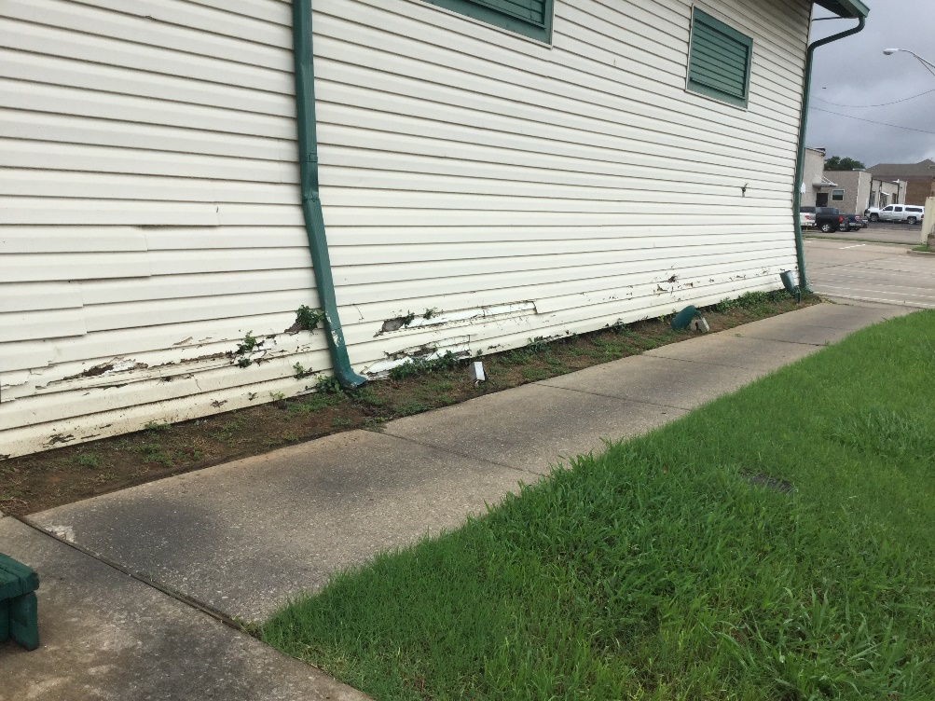
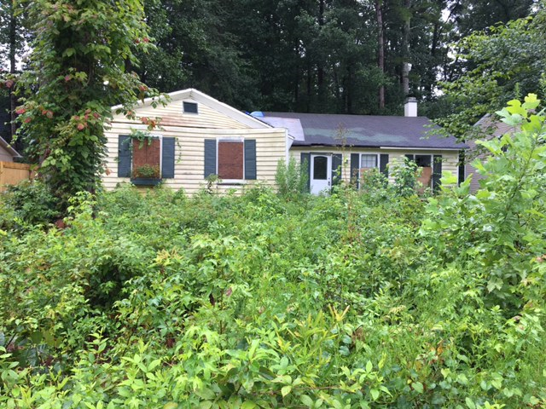
Property Maintenance Issues
Peeling Paint/Protective Treatment(left) and Tall weeds and grass and a vacant property(right)

Slide 7
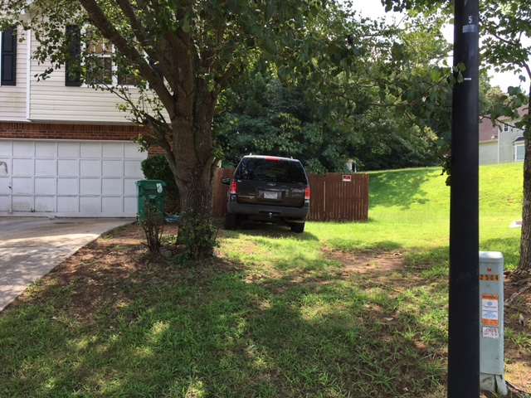
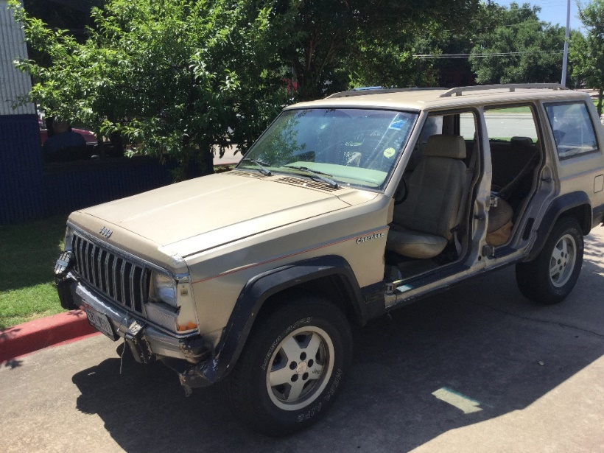
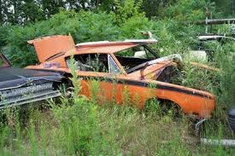
Property Maintenance Issues
Inoperable vehicle(s) ( left) and parking on yard or grass (right)

Slide 8
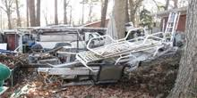
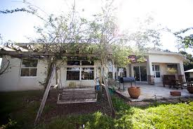
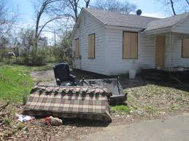
Property Maintenance Issues
Outside storage ( left) and trash and debris (right)

Slide 9
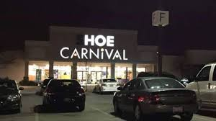
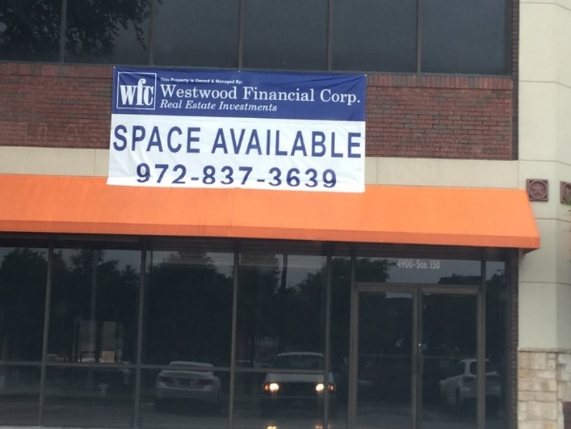
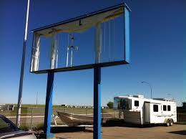
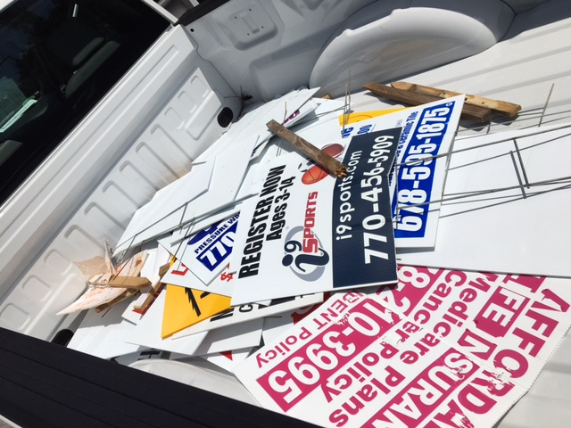
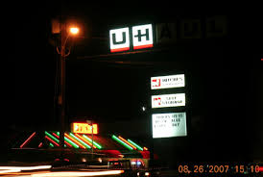
Sign Enforcement
Banners (non-permitted)
Dilapidated/ partially lit signage
Illegal signs in the right of way

Slide 10
Duties of code enforcement officers include:
Abandoned vehicles
Document incidents for possible legal action
Educate the public through personal contacts.
Gain the public's cooperation to make City of Stonecrest a safe environment to raise a family
Health and safety issues
Property maintenance related to overgrown properties, outside storage and trash and debris, junk vehicles and other issues found on all commercial, residential and multifamily properties within the City of Stonecrest.
Recreational vehicle parking
Vehicle parking complaints related parking in the yard or grass or specialized vehicles within residential districts.
Noise complaints related to construction noise beyond scope of work hours
Respond to citizen questions, complaints, and inquires; and explain code requirements
Issue warnings and / or citations for violations
Zoning issues
Business License and Sign Enforcement

Slide 11
The process
Cases are started through complaints received via the call center at (770) 224-0200 or email codeenforcement@stonecrestga.gov (24 hours a day)or proactive enforcement by the assigned officer for the designated council district( once fully staffed-additional staff is planned for Jan 2018)
If issues are found then a Notice of Violation is issued with a 10 day compliance period to resolve by the owner, tenant or individual with control and custody of the location which includes photos for the file.
A follow-up inspection is done after the 10 day period and if issues are resolved then the case is closed. If the violations are not corrected by the compliance deadline, then a citation can be issued for the violator, property owner or designee to appear at a hearing before the Municipal Judge.

Slide 12
Questions ??

