Slide 1
ʻokina
It’s an ʻokina, not an apostrophe.
Easy ways to Insert ʻOkina into
Google Docs,
Microsoft Word, and
PowerPoint

Slide 2
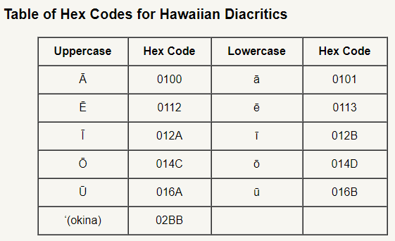
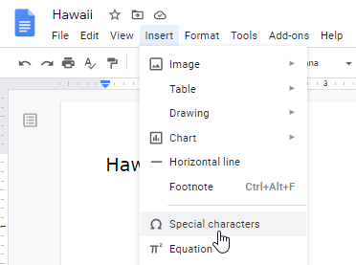
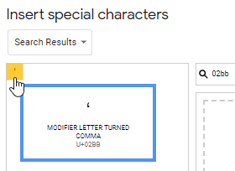
Insert ʻOkina into
Google Docs
1. Click on the “Insert” menu.
2. Select “Special characters”
3. Search for the hex number:
02BB
(not case sensitive)
4. After searching, click on the ʻokina to insert it into the Google Doc.

Slide 3
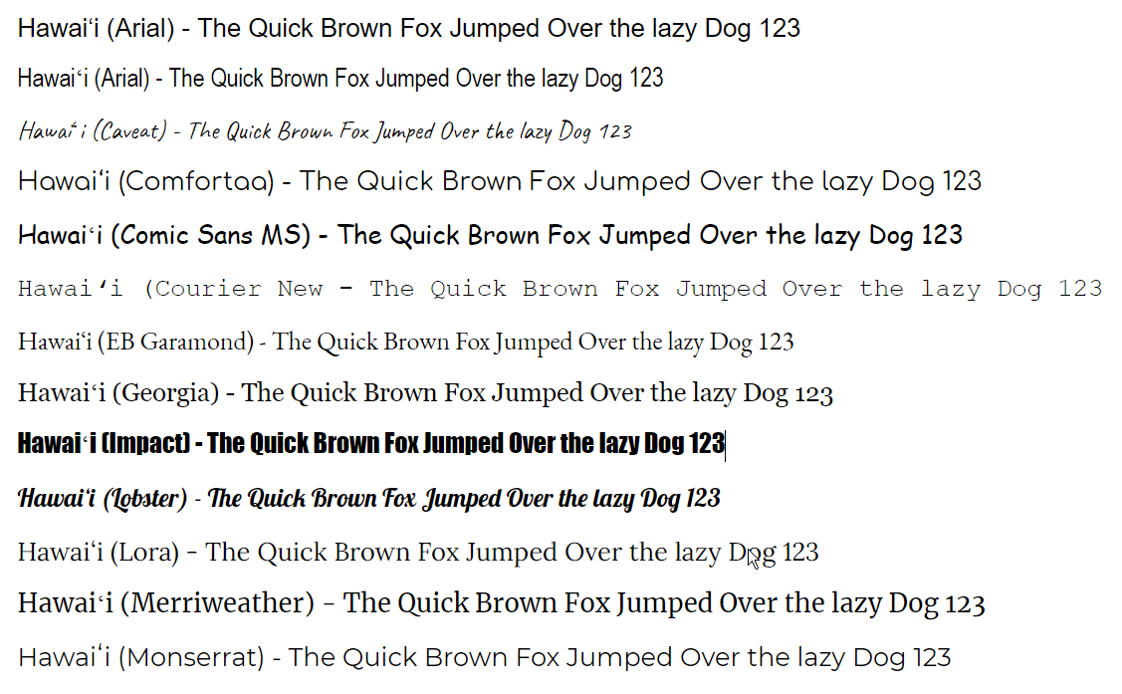
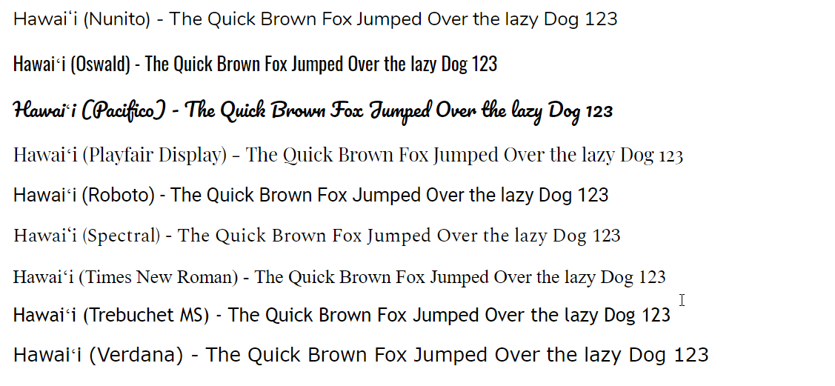
Compare ʻOkina in
Google Docs Fonts

Slide 4
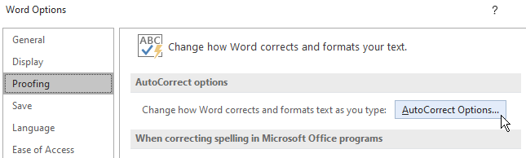
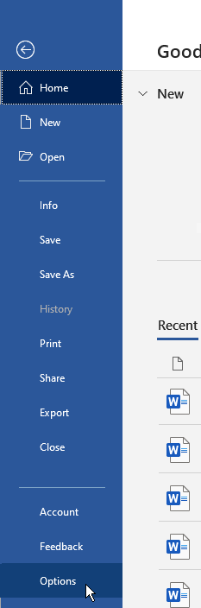
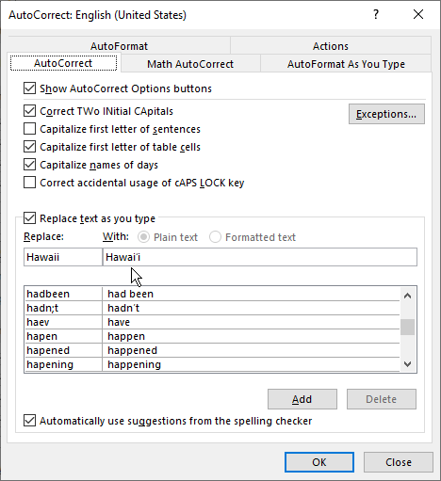
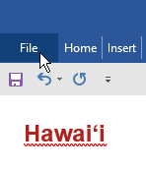
Set Up Microsoft Word to Correct Spellings of Words with ʻOkina
5. In “Word Options” window, select “Proofing” group.
1. Copy an authorized version of the word with the proper ʻokina into your computer copy buffer. (Select the word, then use the shortcut: Ctrl+c)
6. Click “AutoCorrectOptions…” button.
7. On “AutoCorrect” tab, paste the ʻokina-correct spelling in the field “Replace text as you type With:”
2. Paste the word into the document. (Ctrl+v)
3. Click the “File” menu tab.
8. In the field “Replace text as you type Replace:” enter:
Hawaii
4. Select “Options” from the menu.
9. Click the “OK” button.

Slide 5
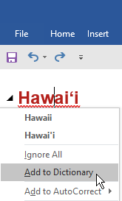
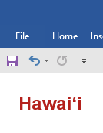
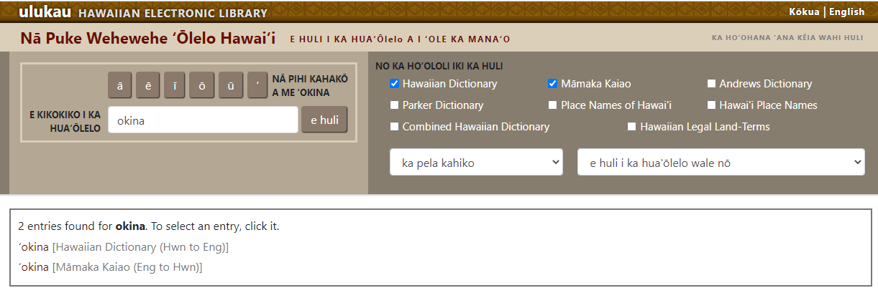
Notes
Techniques described for Microsoft Word also work for PowerPoint.
After typing a word with an ʻokina added to the AutoCorrect options, it will not take effect until you type the next character (space, period, comma, Enter, etc.)
If you just need one ʻokina for a special word, type a word you’ve added to the autocorrect options such as, “Hawaiʻi”, then simply copy and paste the ʻokina as needed.
Best Online Resource for Spellings of Hawaiian Words:
Add Words Spelled with ʻOkina to MS Word Dictionary
1. Right-click on the word.
2. From the menu that appears, select “Add to Dictionary”
wehewehe.org
The word will now appear in your document without the red wavy line indicating a misspelled word.
last update: 27 SEP 2020 freespeech4us.com/okina

