Slide 1
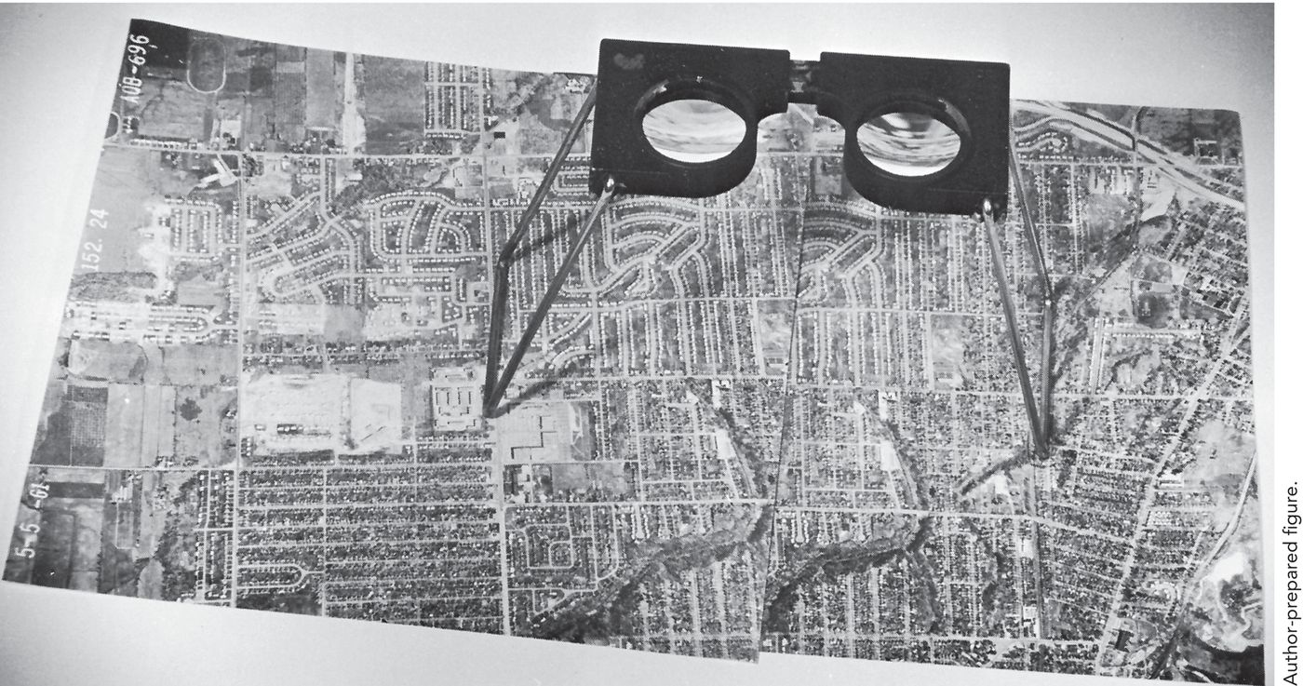
Remote Sensing of the Environment
FW4540
Advanced
Terrestrial Remote Sensing
FW5540
Lecture 05
Visual Image Interpretation

Slide 2
Foundations of Remote Sensing (review)
Energy signals need to be detected and recorded. This can be done by analog means (film photography) or digitally.
Digital imagery can be combined with other data (e.g. DEMs) that has been georeferenced to produce new products

Slide 3
Visual Image Interpretation- the art of an individual applying their perception and experience in the identification of information on an image and communicating that information to others. In this case the image is the raw data (analog) and the interpreter’s brain is the data processor.
Imagery can be from a ground, airborne, or orbital platform and may or may not be photographic in nature.

Slide 4
Basic characteristics that are used to identify objects:
Shape: outline of an object in 2 or 3 dimensions
Size: relative and absolute (scale dependent)
Pattern: spatial arrangement of objects
Tone: relative brightness or color of an object
Texture: frequency of tonal change (smooth or coarse)
Shadows: double edged sword, can help or hinder
Site: Geographical or topographical location
Association: What is nearby, how does it relate
Spatial Resolution: You want to see what from where?
Most important is the integration of all of these factors with the context in which they combine.

Slide 5
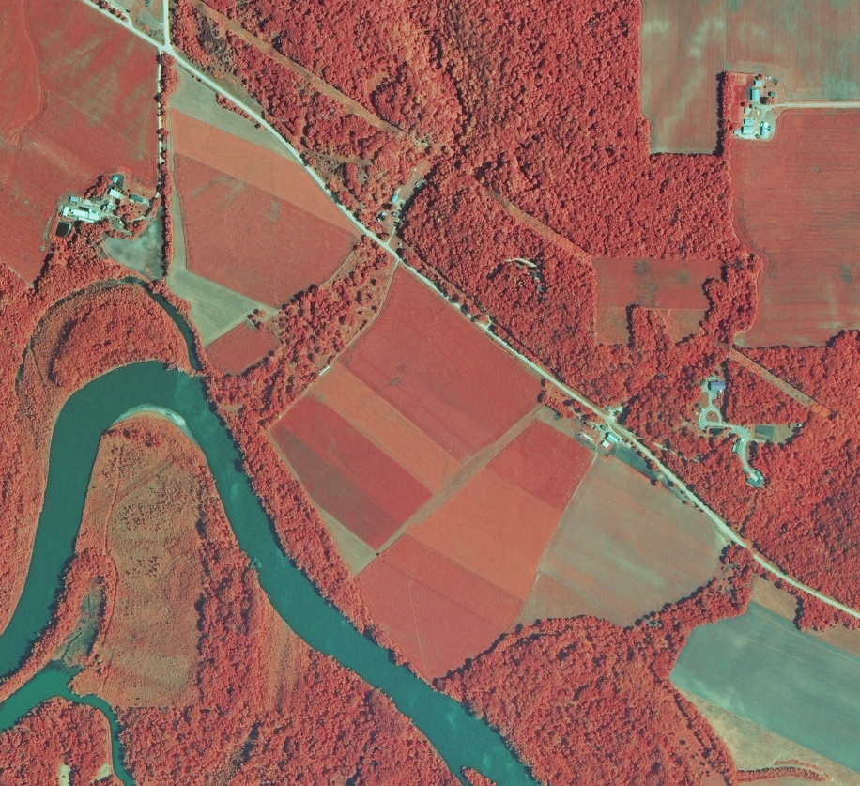
B
?
Apply these characteristics to this image:
B Shape
C Size
D Pattern
E Tone
F Texture
G Shadows
H Site
I Association
J Spatial Resolution
C
F
D
E

Slide 6
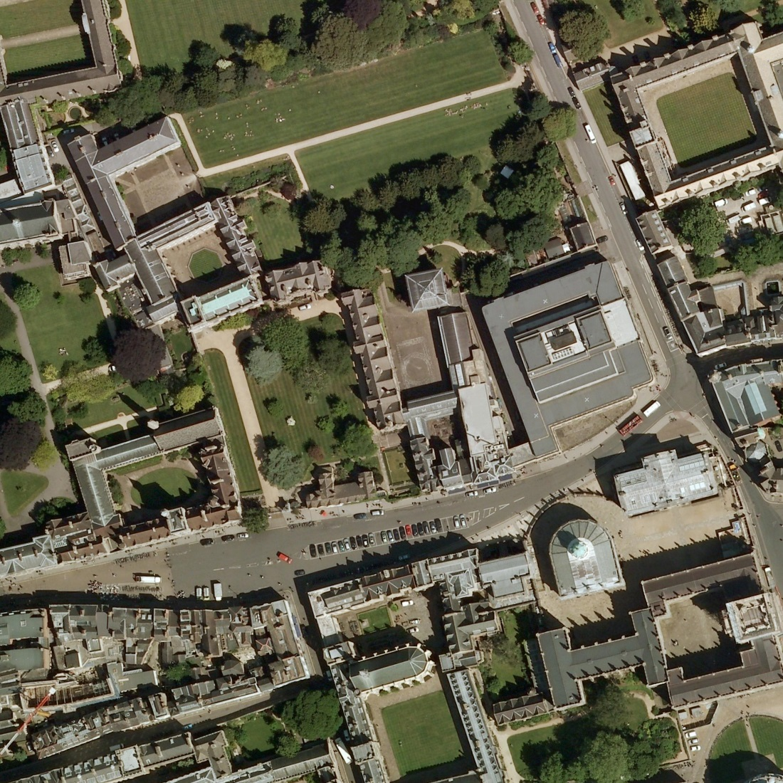
E
F
B
Apply these characteristics to this image:
B Shape
C Size
D Pattern
E Tone
F Texture
G Shadows
H Site
I Association
J Spatial Resolution
G
C
D

Slide 7
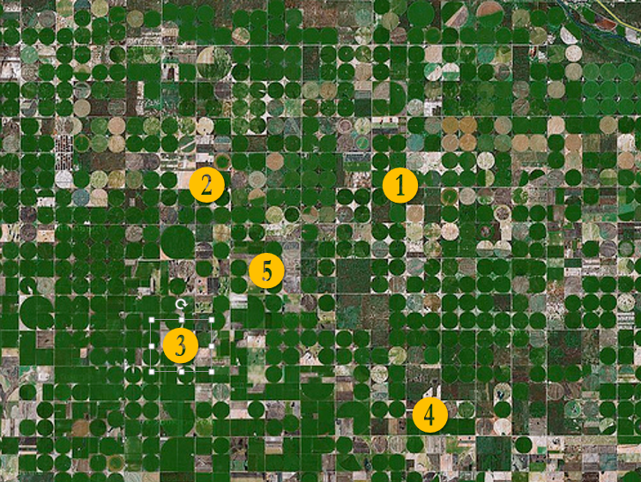
Apply these characteristics to this image:
B Shape
C Size
D Pattern
E Tone
F Texture
G Shadows
H Site
I Association
J Spatial Resolution
G?

Slide 8
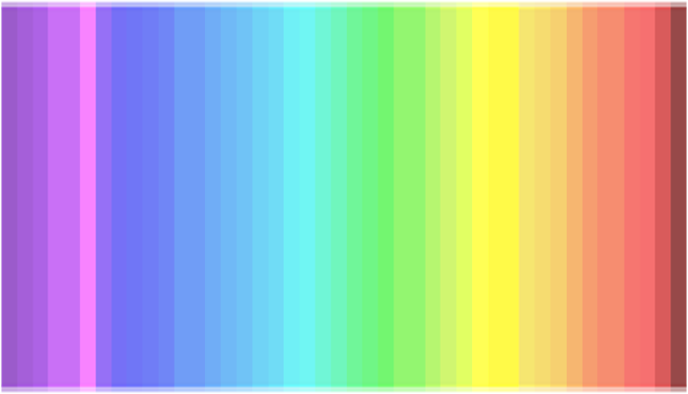
Color Perception
How many colors can you see?
https://www.linkedin.com/pulse/25-people-have-4th-cone-see-colors-p-prof-diana-derval

Slide 9
AUTHOR’S interpretation:
You see less than 20 color nuances: you are a dichromats, like dogs, which means you have 2 types of cones only. You are likely to wear black, beige, and blue. 25% of the population is dichromat.
You see between 20 and 32 color nuances: you are a trichromat, you have 3 types of cones (in the purple/blue, green and red area). You enjoy different colors as you can appreciate them. 50% of the population is trichromat.
You see between 33 and 39 colors: you are a tetrachromat, like bees, and have 4 types of cones (in the purple/blue, green, red plus yellow area). You are irritated by yellow, so this color will be nowhere to be found in your wardrobe. 25% of the population is tetrachromat.
You see more than 39 color nuances: come on, you are making up things! there are only 39 different colors in the test and probably only 35 are properly translated by your computer screen anyway :)

Slide 10
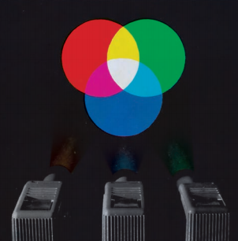
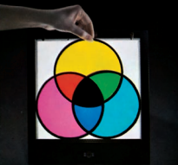
Color Mixing – Trichromatic Theory
Additive- BGR
(Display Monitors)
Subtractive – YMC
(Photographs)
130 million rod cells, peak sensitivity at 550 nm these are 1,000 times more sensitive to light than the color sensing cone cells

Slide 11
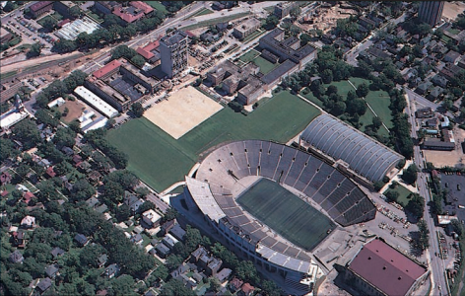
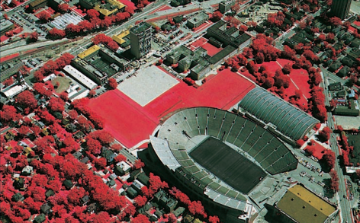
True Color versus False Color
True Color
B = B
G = G
R = R
IR = N/A
False Color
B = N/A
G = B
R = G
IR = R

Slide 12
Temporal Aspects of Interpretation
How an object, especially a vegetative object, presents itself on imagery varies depending on the time of year (growing season). Leaf-on, Leaf-off, budding, senescence.
This relates to “phenology” or the study of cyclic and seasonal natural phenomena, especially in relation to climate and plant and animal life.
Reconsider the objectives of the GLS article you read for recitation.

Slide 13
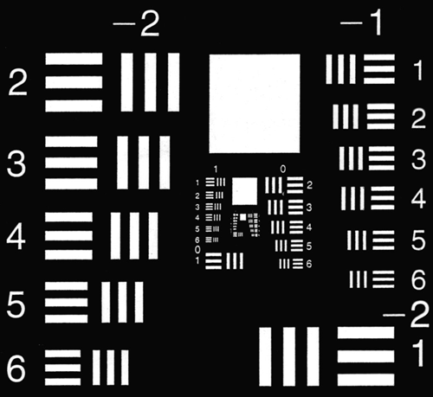
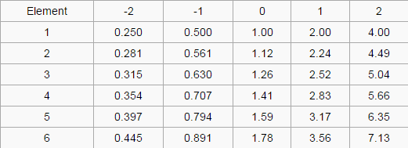
Resolution
Spatial Resolution- the smallest interval measurable by a scientific (especially optical) instrument; the resolving power.
In film products it is defined by the line-pairs per millimeter.
1951 USAF resolution test chart is a resolution test pattern conforming to MIL-STD-150A standard, set by US Air Force in 1951. It is still widely accepted to test the resolution of optical imaging systems such as microscopes, cameras and image scanners.

Slide 14
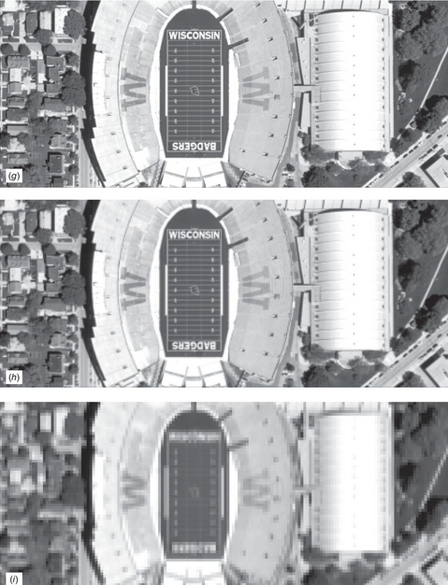
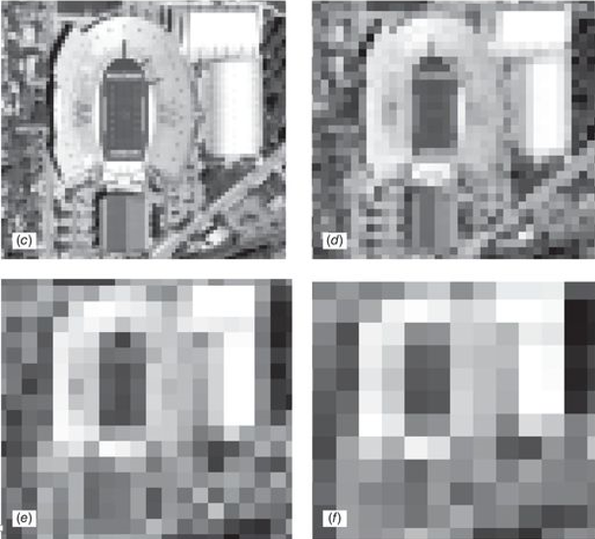
In digital data the equivalent measure is the “ground sample distance” or “pixel size.”
0.5 meters
5 meters
10 meters
1 meters
20 meters
30 meters
2.5 meters

Slide 15
Concept of “Resolution” can be taken beyond just spatial, to other aspects that are important considerations for image interpretation, such as:
Spectral Resolution - to what wavelengths is the sensor sensitive, and if digital, how many bands and the width of those bands
Radiometric Resolution - the limits between the lightest and the darkest objects the sensor can differentiate and if digital the number of bits per pixel the “greys” are recorded.
Temporal Resolution – the time difference between repeated data acquisition (i.e. an orbital based imager could have a 16 day repeat cycle)

Slide 16
Image Scale – the relationship between the distance between two objects as measured on an image versus the distance between the same two objects measure on the ground. In digital data there is no “scale” per se.
Image Scale is usually expressed as a fraction in the form 1:X
Small Scale – usually 1:50,000 or smaller
Medium Scale – 1:12,000 to 1:50,000
Large Scale – 1:12,000 or larger
If that seems counterintuitive, objects are large on large scale images and small on small scale images.

Slide 17
Image Interpretation Process
Takes all of these factors into account and adds the elements of a classification system (or structure), minimum mapping unit (essentially YOUR spatial resolution), and in many cases the ability of the human brain to visualize and analyze objects in stereoscopically (in 3 dimensions).

Slide 18
Wisconsin Wetlands Mapping Program- 1:20,000 Leaf off, BWIR photography, 2 acre MMU, multilayer classification system

