Slide 1
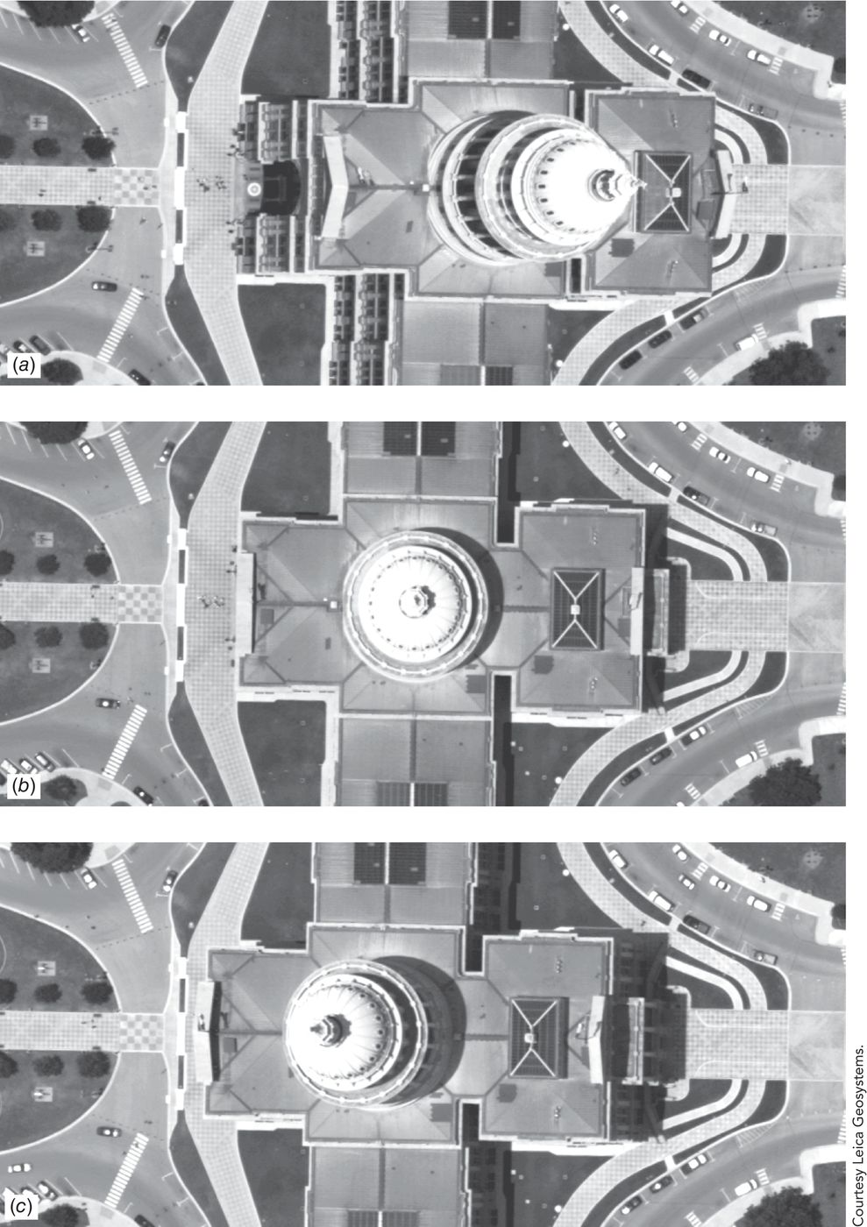
Remote Sensing of the Environment
FW4540
Advanced Terrestrial Remote Sensing
FW5540
Lecture 12
Scanners I

Slide 2
Multispectral Scanner
A remote sensing device that is capable of recording data in multiple discrete areas of the ultraviolet, visible, and infrared portions of the spectrum.
Data is collected in a continuous fashion (rather than by frame as in a photographic system) and can have a wide variety of spatial, spectral and radiometric configurations.
REVIEW- Spatial, spectral, radiometric resolutions.

Slide 3
Many electronic remote sensors acquire data using scanning systems, which employ a sensor with a narrow field of view (i.e. IFOV) that sweeps over the terrain to build up and produce a two-dimensional image of the surface.
Scanning systems are used on both aircraft and satellite platforms and have essentially the same operating principles.
A scanning system used to collect data over a variety of different wavelength ranges is called a multispectral scanner (MSS) and is the most commonly used scanning system.

Slide 4
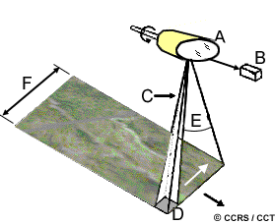
Two Basic types of Scanners
Across Track Scanners (whiskbroom) - The lines are oriented perpendicular to the direction of motion of the sensor platform (i.e. across the swath). Each line is scanned from one side of the sensor to the other, using a rotating mirror
Rotating Mirror
Detectors
IFOV
Ground Resolution Cell
Angular Field of View
Image Swath

Slide 5
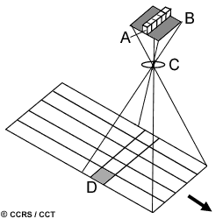
Along Track (pushbroom) –
Use the forward motion of the platform to record successive scan lines and build up a two-dimensional image, perpendicular to the flight direction. However, instead of a scanning mirror, they use a linear array of detectors located at the focal plane of the image formed by lens systems, which are "pushed" along in the flight track direction.
Linear Array of Detectors
Focal Plane
Lens System
Ground Resolution Cell

Slide 6
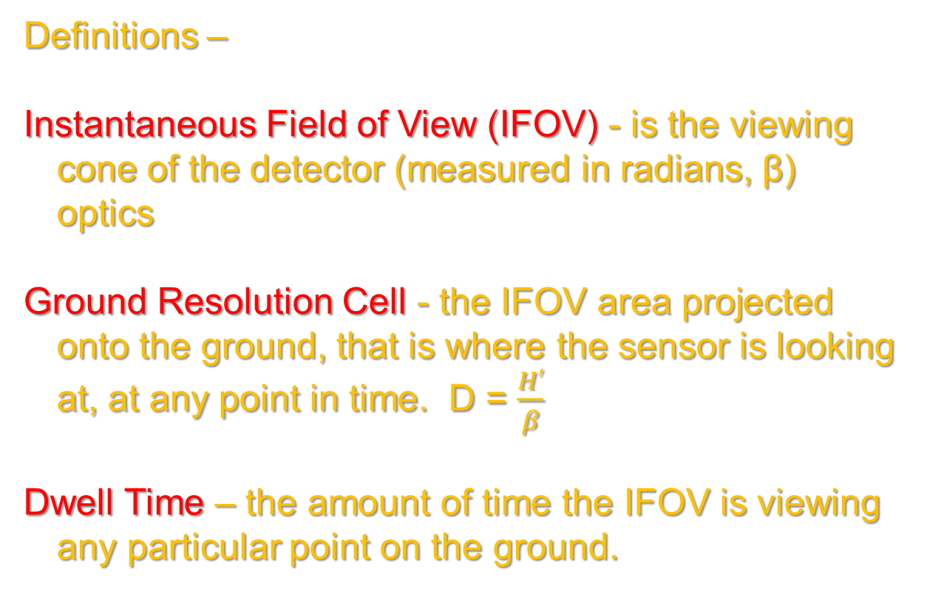
Definitions –
Instantaneous Field of View (IFOV) - is the viewing cone of the detector (measured in radians, β) optics
Ground Resolution Cell - the IFOV area projected onto the ground, that is where the sensor is looking at, at any point in time. D = $\frac{H′}{β}$
Dwell Time – the amount of time the IFOV is viewing any particular point on the ground.

Slide 7
Advantages/Disadvantages
 | Advantages | Disadvantages
Across Track | “Single” Detector | Moving Parts
 | Wider Swath Potential | Short Dwell Time
Along Track | No Moving Parts | “Multiple” Detectors
 | Long Dwell Time | Swath Limited by Detector Array

Slide 8
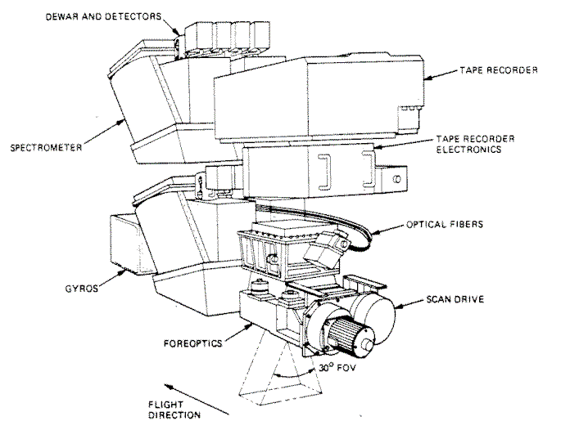
Across Track Scanner

Slide 9

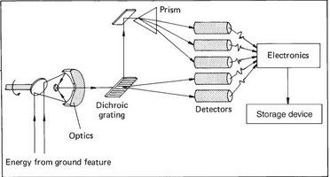
Multispectral Scanners are capable of detecting and measuring EM energy over a wide range of wavelengths from ultraviolet to thermal infrared (300nm to 12,000nm). They need to have a mechanism to separate the reflected (and emitted) energy.
A dichroic filter, thin-film filter, or interference filter is a very accurate color filter used to selectively pass light of a small range of colors while reflecting other colors.

Slide 10
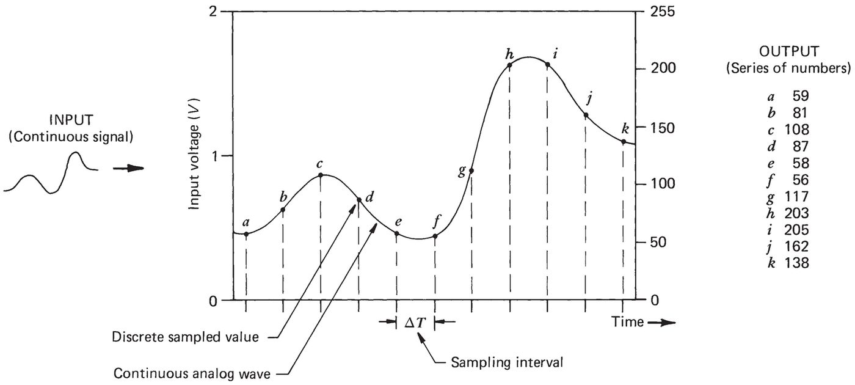
Because the mirror of Across Track Scanners are continuously moving, the system needs to “sample” the detectors periodically. This is the analog to digital conversion.
Trade off between spatial resolution and radiometric resolution due to “signal to noise” ratio.
Noise – unwanted, extraneous system response.
Large IFOV = Large signal, better radiometric resolution
Small IFOV = Small signal, better spatial resolution

Slide 11
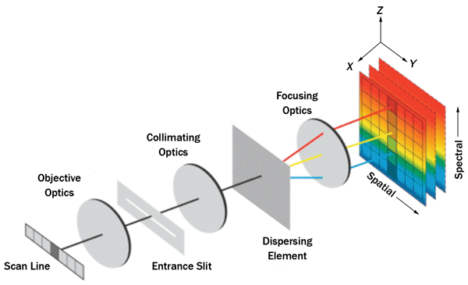
Along Track Scanners
Require an entirely different mechanism to breakup the spectrum because of the linear nature of the spatial array

Slide 12
Scanner Imagery
Different from digital photography in that each “slice” of the spectrum is collected separately.
Essentially the image is a series of panchromatic images that must be compiled if color viewing is needed.
Along Track Scanners have an added advantage of providing “look angles”, forward, vertical, backward, if needed.

Slide 13
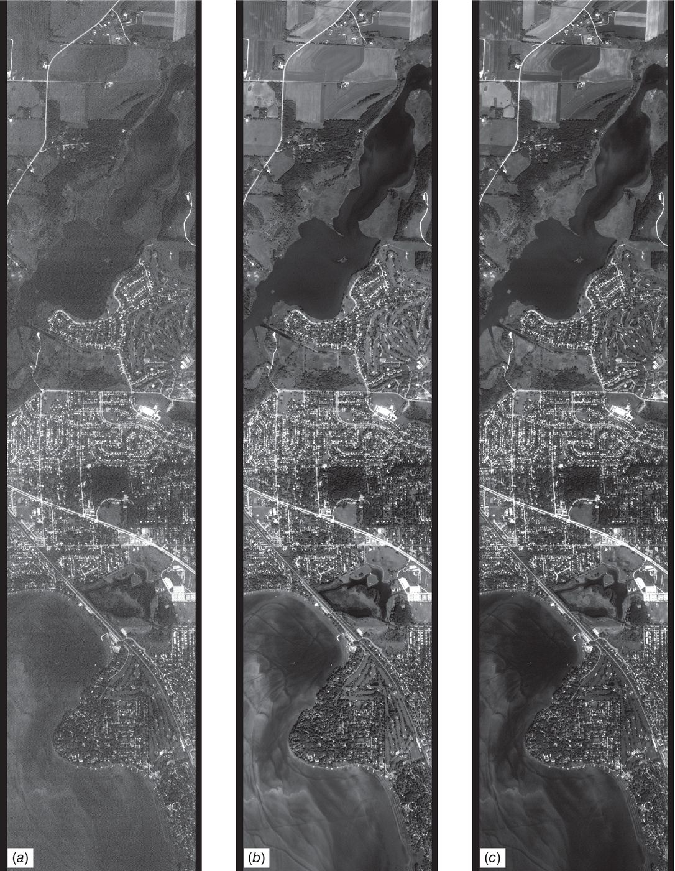
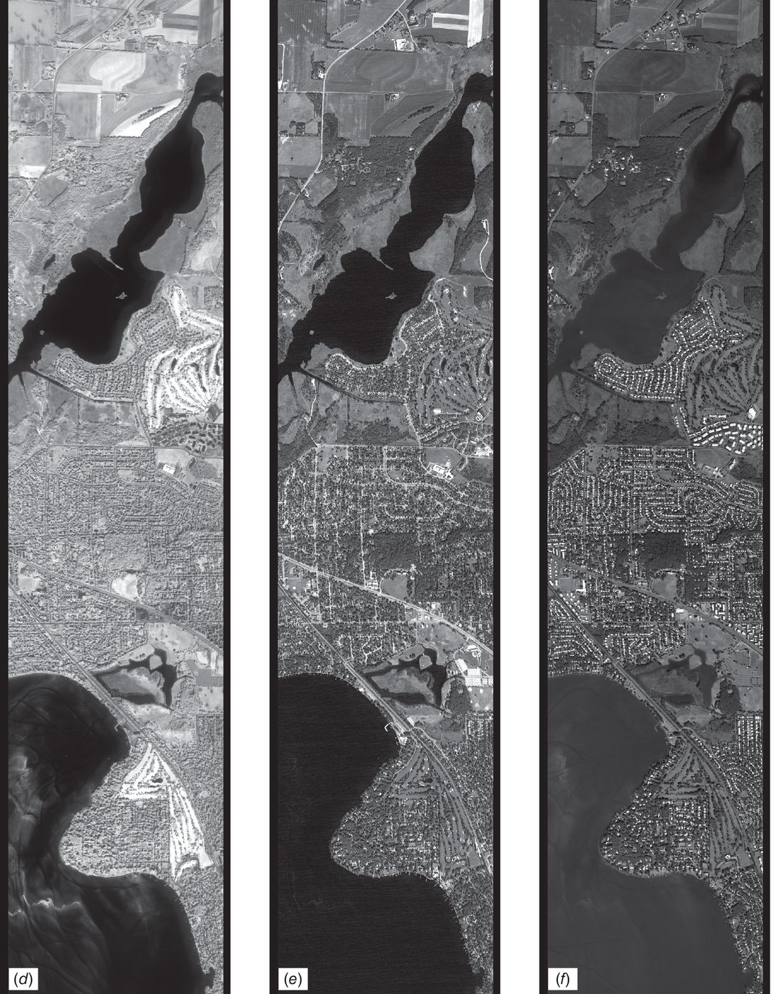
Across Track
450-520nm 520-600nm 630-690nm 760-900nm 2,080-2,350nm 9,000-9,400nm

Slide 14
Along Track
28.4○ forward
Vertical
Application??
14.2○ backward

Slide 15

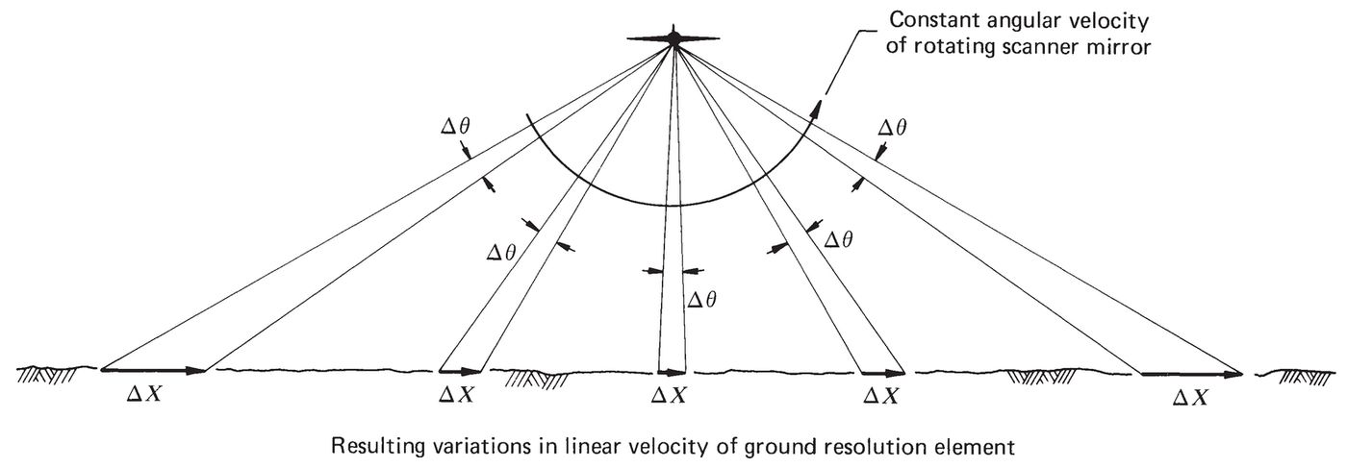
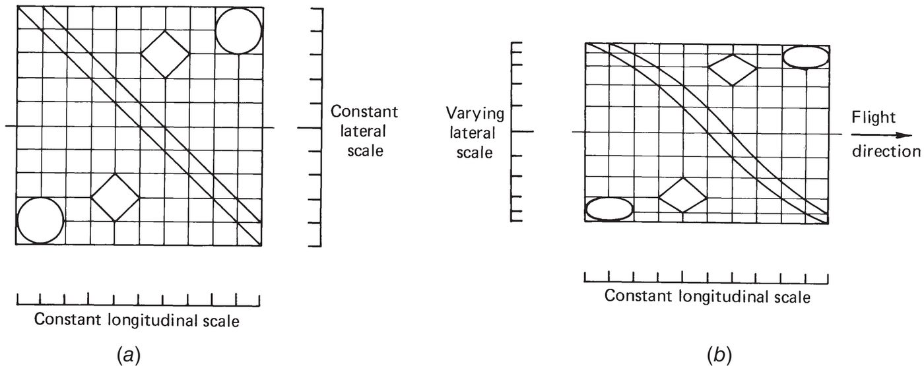
Geometric Characteristics – Across Track
Swath width of across track scanner = 2H´tanθ
Tangential Scale Distortion
Note: Resolution cell size varies with distance from nadir.

Slide 16
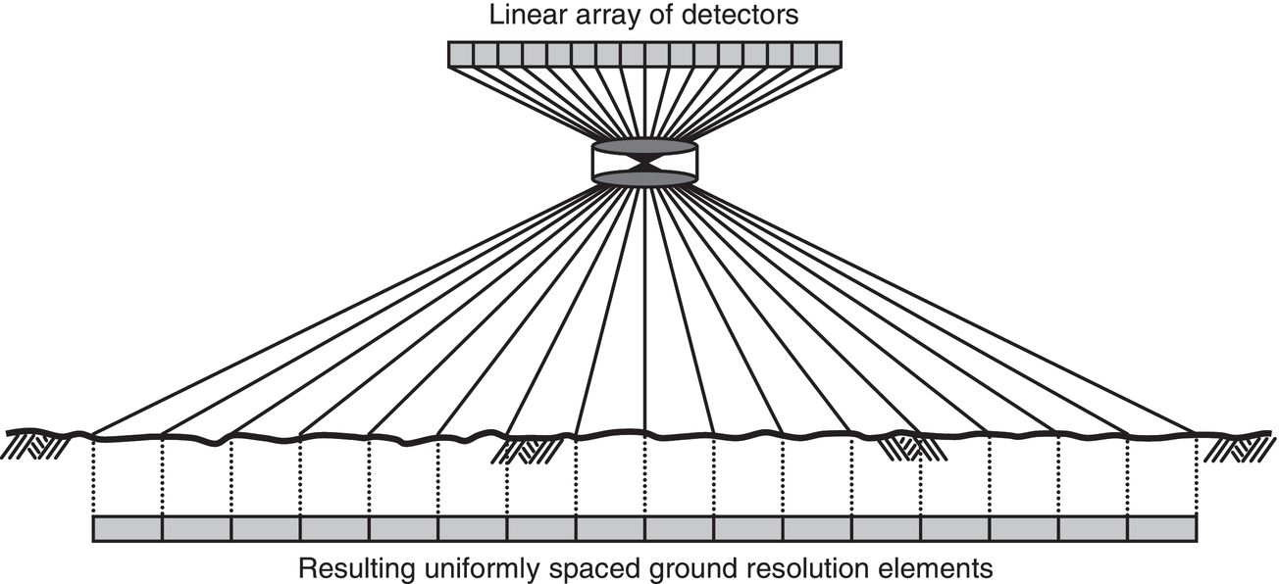
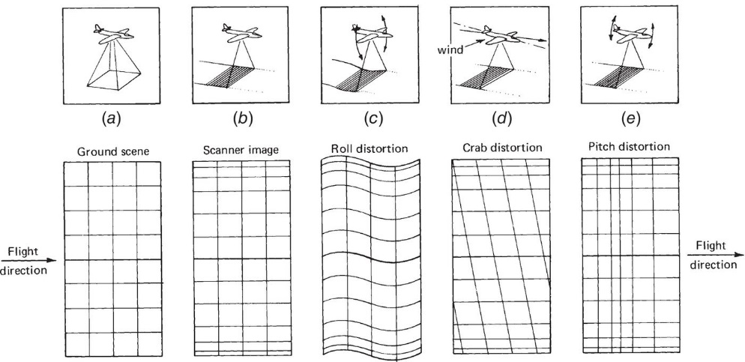
Geometric Characteristics – Along Track
No tangential distortion, because of array characteristics
Aircraft motion distortion in both types of imagery, one dimensional relief displacement, across track example.

