Slide 1
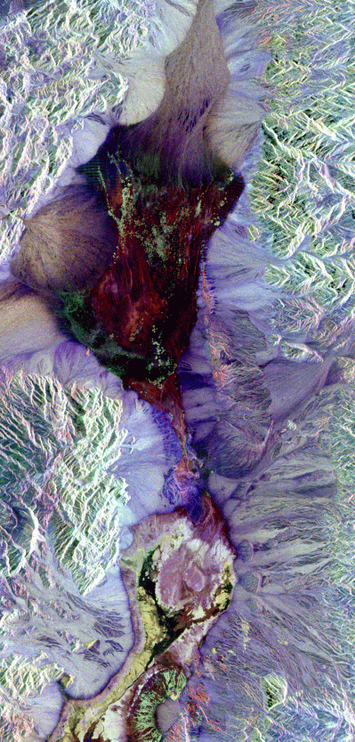
Remote Sensing of the Environment
FW4540
Advanced Terrestrial Remote Sensing
FW5540
Lecture 13
Scanners II
And
Pre-exam Review

Slide 2
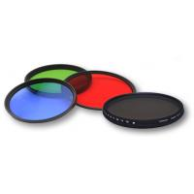
Pre-Exam Review- Questions that didn’t make it
Draw the transmission curves of any of these filters
What is lens falloff and how do you correct for it?
What are the wavelengths usually associated with the visible three primary colors?

Slide 3
Identify the wavelengths usually associated with the following areas of the spectrum.
Ultraviolet
Infrared
Blue
Green
Red
nanometers
What is a D-logE curve? And how does it relate to film contrast?
Define “blackbody”.

Slide 4
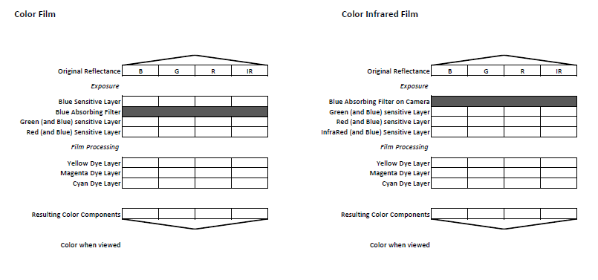
Guaranteed to be on the test…

Slide 5
Thermal Scanner – A scanner that has been designed to detect emitted infrared energy rather than reflected energy. This form of energy cannot be recorded on film or by normal CCD scanners.
Can be used during day or night.
Because of atmospheric transmission windows, these devices are restricted to the 3,000 to 5,000 nm and 8,000 to 14,000nm ranges. (Weins Displacement tells us that equates to objects with peak EM emissions in the 300 to 700 degrees C and -66 to +90 degrees C ranges respectively.)

Slide 6
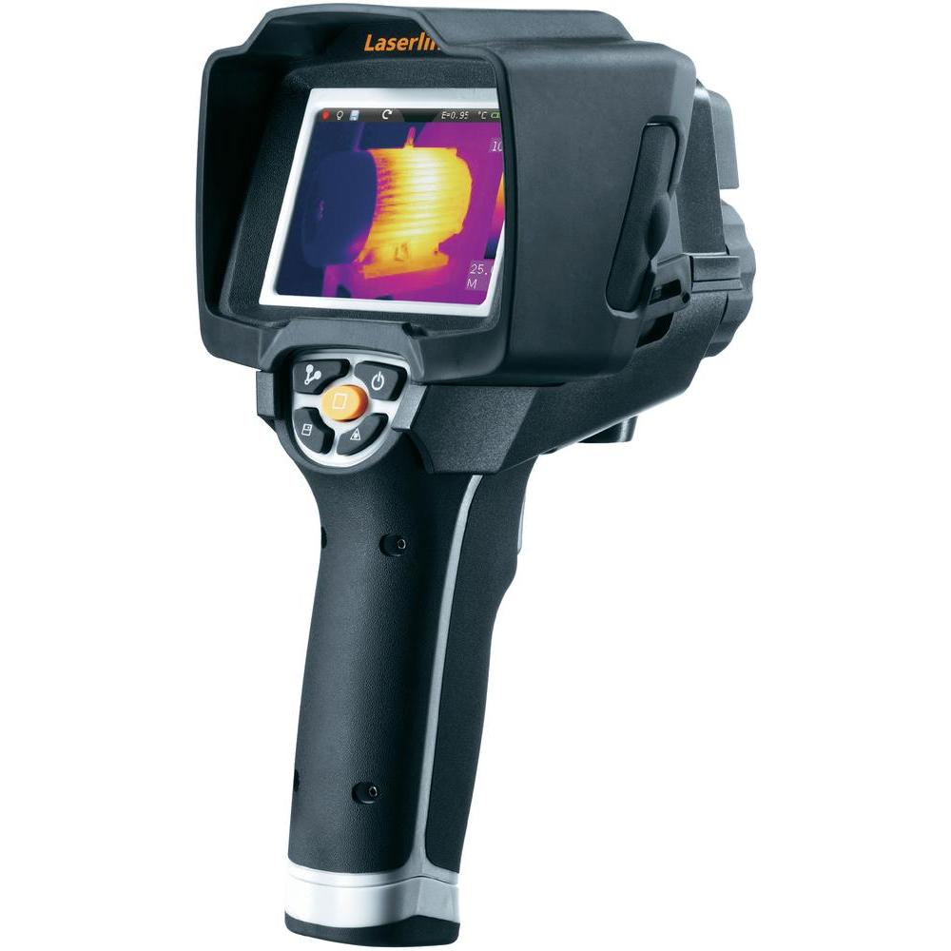
Biggest operational issue with thermal scanners is system “noise” related to ambient temperature of the sensor itself. Sensor must be cooled (usually with liquid nitrogen) to maximize sensor sensitivity.
Most thermal sensing systems are pushbroom scanners.
The exception to sensor cooling requirement is the “bolometer”

Slide 7
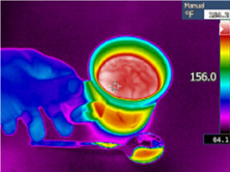
Kinetic versus Radiant Temperature
Thermal Scanners measure RADIANT energy. We want to measure KINETIC energy.
Kinetic Energy is essentially a measure of the average motion of the molecules in any object, measured directly as “temperature”.
Radiant energy measures the APPARENT temperature of an object, no object emits energy perfectly except for the theoretical “blackbody.”

Slide 8
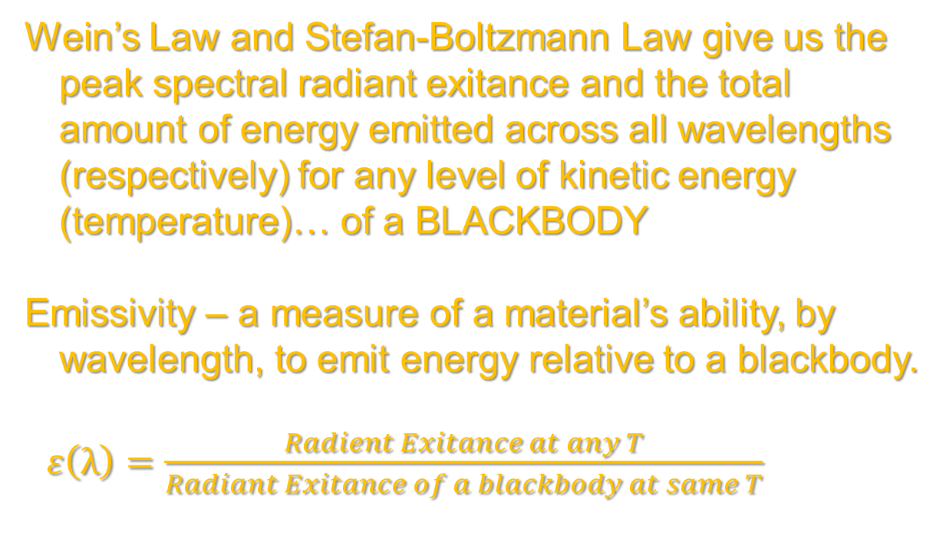
Wein’s Law and Stefan-Boltzmann Law give us the peak spectral radiant exitance and the total amount of energy emitted across all wavelengths (respectively) for any level of kinetic energy (temperature)… of a BLACKBODY
Emissivity – a measure of a material’s ability, by wavelength, to emit energy relative to a blackbody.
$ε\left(λ\right)=\frac{Radient Exitance at any T}{Radiant Exitance of a blackbody at same T}$

Slide 9
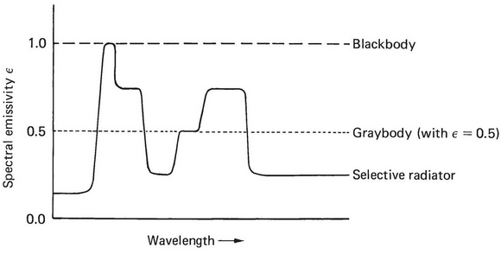
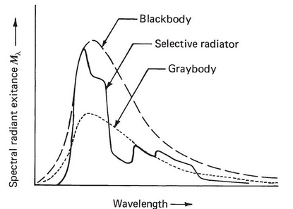
ε can have a value of 0 to 1. A blackbody has an emissivity of 1. A “graybody” is a theoretical object that emits uniformly over all wavelengths at some value greater than 0 and less than 1.
Selective emitter is an object that has different emissivity's at different wavelengths.

Slide 10
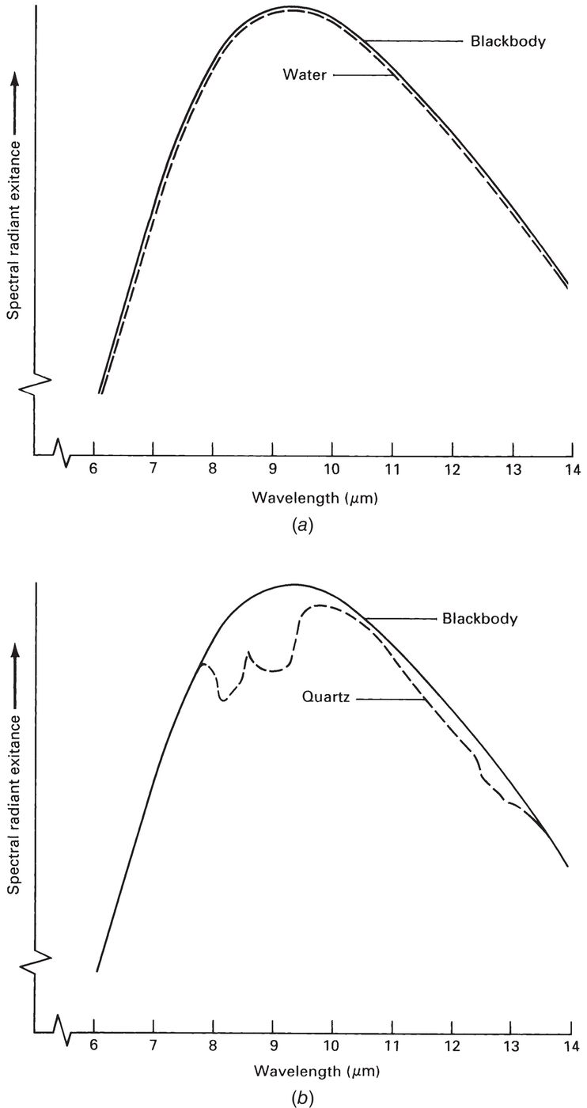
Water is a good example of a “near blackbody” with a an emissivity of 0.98 - 0.99
Quartz is a selective emitter in wavelengths longer than 7,000 nm but almost a blackbody for wavelengths shorter than 7,000 nm
Quartz is preferable to glass for thermal detector lenses in the 3,000 – 5,000 nm band, because glass is a poor emitter in that region of the spectrum.

Slide 11
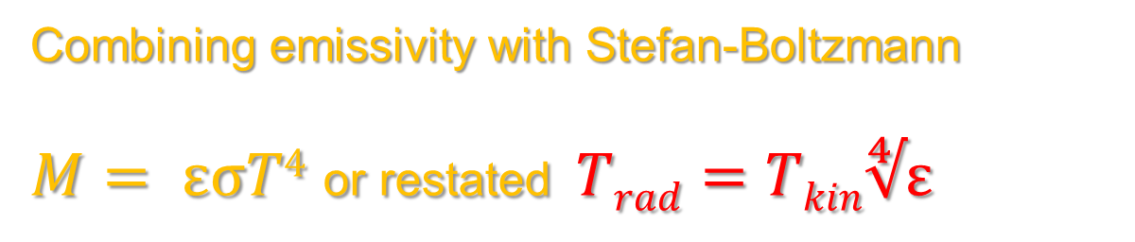
Reworking the energy budget equation from Lecture 02 we get ε(λ) = α(λ)
“Good absorber equals a good emitter”
Combining emissivity with Stefan-Boltzmann
$M= εσT4$ or restated $Trad=Tkin∜ε$

Slide 12
Final important points
Thermal sensors detect radiation ONLY from the surface of objects (typically the first 50 μm). Any measurement of internal temperatures require direct contact.
Thermal data WILL INCLUDE the temperature of the air column between the object and the sensor (important for orbital data).

Slide 13
Multi-, Hyper-, Ultra- spectral scanners
There is no set definition for distinguishing the use of the terms multispectral scanner, hyperspectral scanner or ultraspectral scanner.
In addition to considering how many bands of data are being collected, one must also consider the entire spectral breadth of the scanner data.

Slide 14
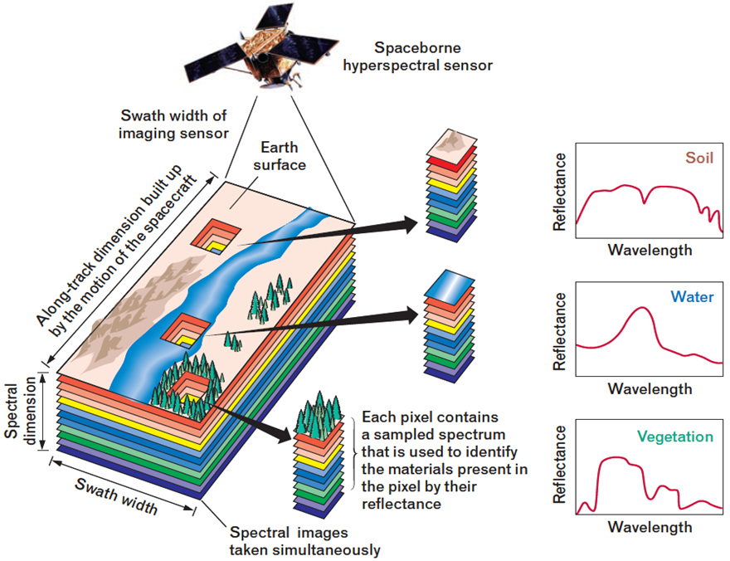
When considering the spectral range of UV through Mid-IR, 10 bands would be considered multispectral by most professionals, while 100 bands would definitely be considered hyperspectral.

Slide 15
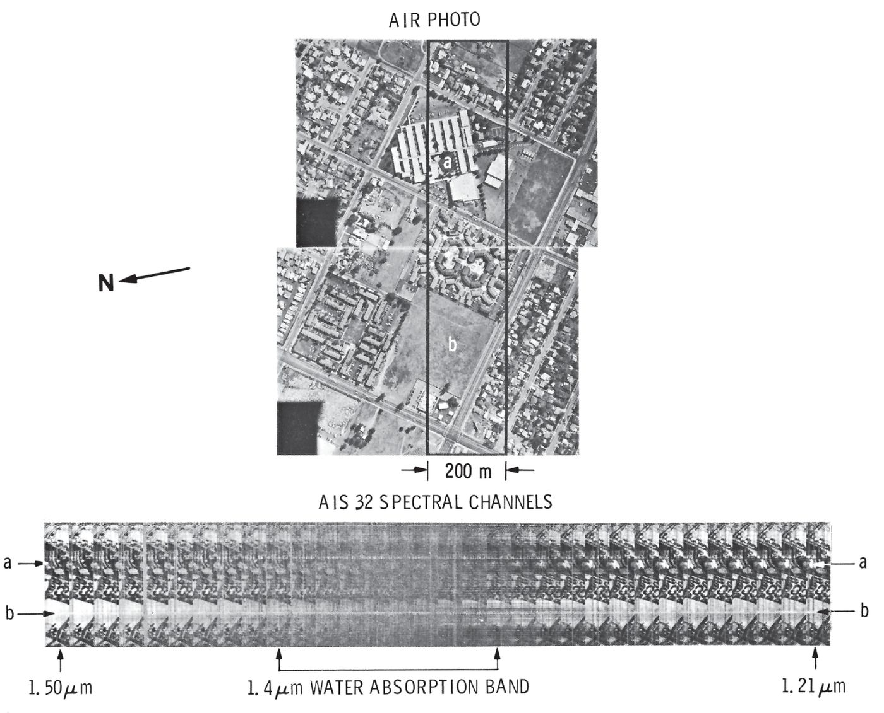
However, if 10 bands were used to slice a small portion of the spectrum, say from 600 nm to 650 nm, it would be difficult to argue that not being hyperspectral.

Slide 16
Ultraspectral scanners literally divide spectral space in many hundreds if not thousands of bands.
Why are so many bands needed? As we learn more about materials on the surface of the earth, we have been able to identify key spectral returns that in many cases span a spectral resolution of just a few wavelengths… OR avoid atmospheric absorption bands of a few wavelengths.
Having the ability to define, very precisely our spectral resolution is no different than doing the same with our spatial resolution (think 60m pixels vs 0.5m pixels)

Slide 17
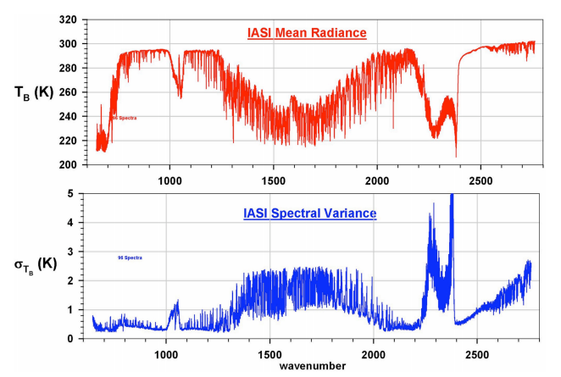
In addition to surface uses such as minerology and agriculture, ultraspectral scanning has the potential to provide valuable information in the fields of aerosol plume monitoring, chemical hazard detection, biomedical applications and manufactured materials quality control.

