Slide 1
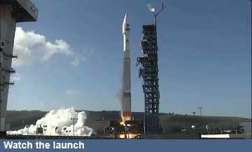
Remote Sensing of the Environment
FW4540
Advanced Terrestrial Remote Sensing
FW5540
Lecture 16
Orbital Platforms
Mission Planning

Slide 2
Why are we discussing this?
These are the types of decisions that are made at the top management level before a project even is considered for funding.
Most likely you will never be in a position to be part of the decision making process for a satellite system, but you may be part of a user group who could influence the decision makers.
These considerations are also used in other project development fields that you may be part of.

Slide 3
Earlier we briefly discussed aspects of aerial photography mission planning. We looked at image requirements such as endlap, sidelap and scale and how they affect the flight planning.
Mission Planning changes dramatically when moving from aerial platforms to orbital.
Orbital platforms are much more difficult because once the mission is launched there is no turning back because a technician put the wrong filter on the lens.
Need to have a clear definition of:
Functional Requirements
Operational Requirements
Constraints

Slide 4
Functional Requirements – define how well the system must perform to meet its objectives
Define who the intended user is
Performance – sensors, payload size, orbit, pointing
Coverage – what are the spatial, spectral, radiometric and temporal resolutions
Responsiveness – data turnaround time
Are there potential Secondary users?

Slide 5
Operational Requirements – determine how the system operates and how users interact with it to achieve the mission objectives.
Mission Duration – is it experimental or operational, will there be hardware redundancy
Availability – what happens if something goes wrong
Survivability – electronics hardening
Data Distribution – communication architecture
Data Content, Form and Format – user needs

Slide 6
Constraints – what limits the system from meeting the objectives?
Cost – one spacecraft or multiple, size, complexity, LIFE CYCLE COST
Schedule – technical readiness, mission size
Regulations – law and policy
Political – sponsored program, international program
Interface – user and operator infrastructure

Slide 7
Hypothetical Example “FireSat”
Primary Mission Objective:
To detect, identify and monitor forest fires throughout the US including Alaska and Hawaii, in near real time
Secondary Objectives:
To demonstrate to the public that positive action is underway to contain forest fires
To collect statistical data on the outbreak and growth of forest fires
To monitor forest fires for other countries
To collect other forest management data

Slide 8
Mission Concept – is the most fundamental statement of how the mission will work
Element | Definition | FireSAT
Data Delivery | How mission and housekeeping data are generated or collected, distributed and used | How is imagery collected, how are forest fires identified, how is info transmitted to firefighters in the field?
Tasking, Scheduling and Control | How the system decides what to do in the long term and short term | What sensors are active and when is data being transmitted and processed? Which forested areas are receiving attention, when.
Communication Architecture | How the various components of the system talk to each other | What communications network is used to transmit forest-fire data to the users in the field?
Mission Timeline | The overall schedule for planning, building, deployment, operations and end-of-mission | When will FireSat 1 become operational? What is the schedule for satellite replacement?

Slide 9
Requirement | FireSAT
Functional – Performance | # temperature levels, spatial resolution, spatial accuracy
Functional – Coverage | Daily coverage of entire US
Functional – Responsiveness | Send data subscribers mission data within 30 minutes
Functional – Secondary Mission | Pest Management personnel
Operational – Duration | At least 10 years
Operational – Availability | 98% excluding weather, 3 day maximum outage
Operational – Data Distribution | 500 fire monitoring offices, 2000 worldwide
Op – Content, Form, Format | Location and extent of fire, map format, spatial resol grid
Constraints – Cost | Less than $20M/year
Constraints – Schedule | Operational within 5 years
Constraints – Interface | Communications compatible with established ground net
Constraints – Development | Contract launch services, no unique R&D or personnel

Slide 10
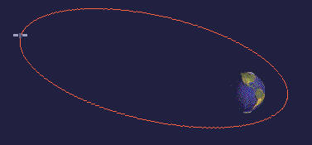
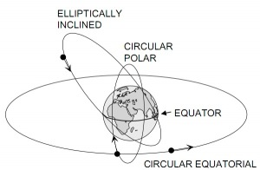
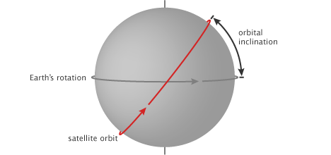
Orbital Considerations
Circular versus Elliptical
Inclination?
Geocentric?

Slide 11
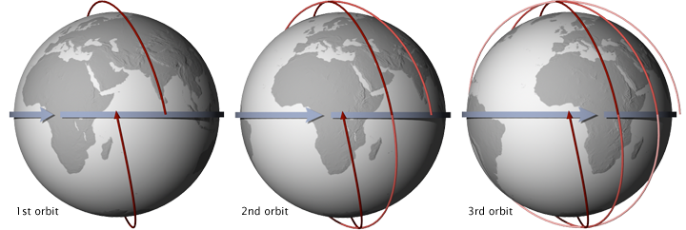
Geosynchronous - is an orbit around the Earth with an orbital period of one sidereal day, intentionally matching the Earth's sidereal rotation period (approximately 23 hours 56 minutes and 4.9 seconds)
Sun-synchronous - A Sun-synchronous orbit (sometimes called a heliosynchronous orbit) is a geocentric orbit which combines altitude and inclination in such a way that an object on that orbit will appear to orbit in the same position, from the perspective of the Sun, during its orbit around the Earth.

Slide 12
Possible Sun-synchronous configurations
Orbits per day | Period (hrs) | Height above Earth's surface (km) | Maximum latitude
16 | = 1 hr 30 min | 282 | 83.4°
15 | = 1 hr 36 min | 574 | 82.3°
14 | ≈ 1 hr 43 min | 901 | 81.0°
13 | ≈ 1 hr 51 min | 1269 | 79.3°
12 | ≈ 2 hr | 1688 | 77.0°
11 | ≈ 2 hrs 11 min | 2169 | 74.0°
10 | = 2 hrs 24 min | 2730 | 69.9°
9 | = 2 hrs 40 min | 3392 | 64.0°
8 |  | 4189 | 54.7°
7 | ≈ 3 hrs 26 min | 5172 | 37.9°

Slide 13
Case study – Mission Planning Failure, Constraints
In 1979, President Jimmy Carter transferred Landsat operations from NASA to NOAA, recommended development of long term operational system with four additional satellites beyond Landsat 3, and recommended transition to private sector operation of Landsat.
This occurred in 1985 when the Earth Observation Satellite Company (EOSAT), a partnership of Hughes Aircraft and RCA, was selected by NOAA to operate the Landsat system under a ten year contract.

Slide 14
EOSAT operated Landsat's 4 and 5, had exclusive rights to market Landsat data, and was to build, launch and maintain Landsat's 6 and 7.
EOSAT raised image prices from $650 to $3700 to $4400 and restricted redistribution. While the U.S. monopoly of Landsat-like data made this 600% increase feasible, the practice priced out many data users. (As a result, many data users migrated to the free low-resolution land data being captured by meteorological satellites.) In 1986, a French Landsat-like satellite SPOT launch broke the U.S. monopoly.

Slide 15
In 1989, this transition had not been fully completed when NOAA's funding for the Landsat program was due to run out (NOAA had not requested any funding, and Congress had appropriated only six months of funding for the fiscal year) and NOAA directed that Landsat's 4 and 5 be shut down.
Again in 1990 and 1991, Congress provided only half of the year's funding to NOAA, requesting that agencies that used Landsat data provide the funding for the other six months of the upcoming year.

Slide 16
In 1992, various efforts were made to procure funding for follow on Landsats and continued operations, but by the end of the year EOSAT ceased processing Landsat data.
Landsat 6 was finally launched on October 5, 1993, but was lost in a launch failure. Processing of Landsat 4 and 5 data was resumed by EOSAT in 1994. NASA finally launched Landsat 7 on April 15, 1999.

Slide 17
The value of the Landsat program was recognized by Congress in October 1992 when it passed the Land Remote Sensing Policy Act (Public Law 102-555) authorizing the procurement of Landsat 7 and assuring the continued availability of Landsat digital data and images, at the lowest possible cost, to traditional and new users of the data.

Slide 18
What about EOSAT? In 1996 it was bought by Space Imaging Corp. Space Imaging/EOSAT launched the first high resolution satellite IKONOS (1 meter spatial resolution).
Space Imaging built the spacecraft and three ground stations (Colorado, Oklahoma, Alaska).
EOSAT distributed the data through a global network of distributors.
Eventually Space Imaging/EOSAT was bought by Orbimage which became GeoEye, which is now part of Digital Globe, who provides imagery to Google Earth.

