Slide 1
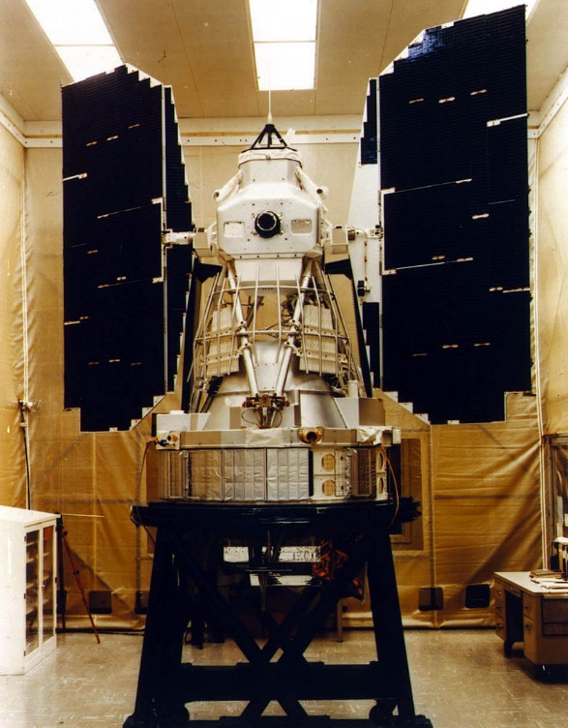
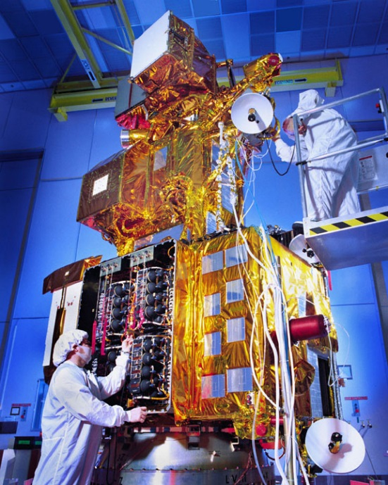
Remote Sensing of the Environment
FW4540
Advanced Terrestrial Remote Sensing
FW5540
Lecture 17
Landsat

Slide 2
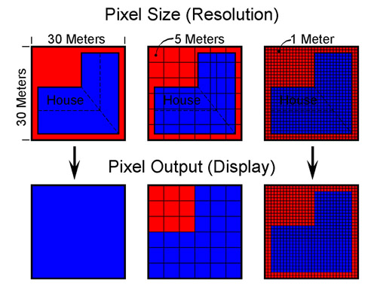
Classes of Satellites
(by Spatial Resolution)
Low Resolution (pixel size > 100m)
Moderate Resolution (10m – 100m)
High Resolution (1m > 10m)

Slide 3
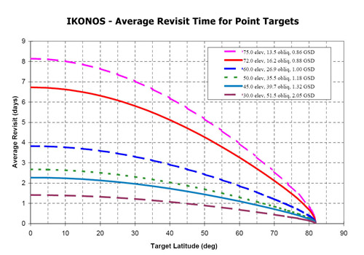
Classes of Satellites
(by Temporal Resolution)
Low Resolution (>16 days)
Moderate Resolution (4 – 16 days)
High Resolution
(< 4 days)

Slide 4
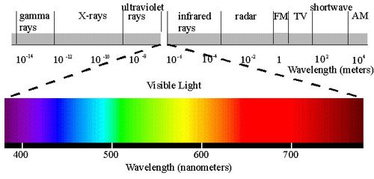
Classes of Satellites
(by Spectral Resolution)
Low Resolution (3 bands/panchromatic)
Moderate Resolution (4 – 15 bands)
High Resolution (>15 bands)

Slide 5
Resolution Trade-Off
The different spatial, temporal and spectral resolutions are the limiting factor for the utilization of the satellite image data for different applications.
Unfortunately, because of technical constraints, satellite remote sensing systems can only offer the following relationship between spatial and spectral resolution: a high spatial resolution is associated with a low spectral resolution and vice versa.
That means that a system with a high spectral resolution can only offer a medium or low spatial resolution.

Slide 6
Therefore, it is either necessary to find compromises between the different resolutions according to the individual application or to utilize alternative methods of data acquisition.
The trade-off may result in two different solutions:
To lay emphasis upon the most important resolution, in direct dependency to the application, with the acceptance of low attendant resolutions at the same time, or
To lay no emphasis on one specific resolution and at the same time the acceptance of a medium spectral, temporal and spatial resolution.

Slide 7
What is Landsat and why is it important?
Landsat is currently a moderate, moderate, moderate (spatial, temporal, spectral) resolution system, in everyday terms, a “generalist”.
This joint NASA/USGS program provides the longest continuous space-based record of Earth’s land in existence. Every day, Landsat satellites provide essential information to help land managers and policy makers make wise decisions about our resources and our environment.

Slide 8
On July 23, 1972 the Earth Resources Technology Satellite was launched. This was eventually renamed Landsat 1.
The most recent, Landsat 8, was launched on February 11, 2013. The instruments on the Landsat satellites have acquired millions of images.
The images, archived in the United States and at Landsat receiving stations around the world, are a unique resource for global change research and applications in agriculture, cartography, geology, forestry, regional planning, surveillance and education, and can be viewed through the USGS 'EarthExplorer' website.

Slide 9
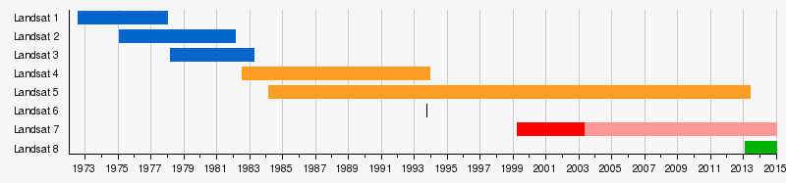
Landsat Timeline
Work has begun on Landsat 9 and that is scheduled for launch in 2023.
In addition, a low-cost thermal infrared (TIR) free-flying satellite will launch in 2019 to reduce the risk of a data gap in this important measurement. The TIR free flyer will ensure data continuity by flying in formation with Landsat 8.

Slide 10
“Because an important part of the land imaging program is to provide consistent long-term observations, this mission will largely replicate its predecessor Landsat 8. The mission will carry two instruments, one that captures views of the planet in visible, near infrared and shortwave-infrared light, and another that measures the thermal infrared radiation, or heat, of Earth’s surfaces. These instruments have sensors with moderate resolution and the ability to detect more variation in intensity than the first seven satellites in the Landsat program.” – John Grunsfeld, NASA
WHAT DOES THIS IMPLY??

Slide 11
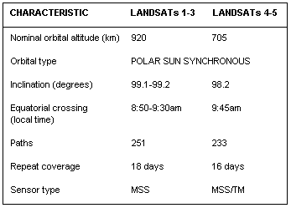
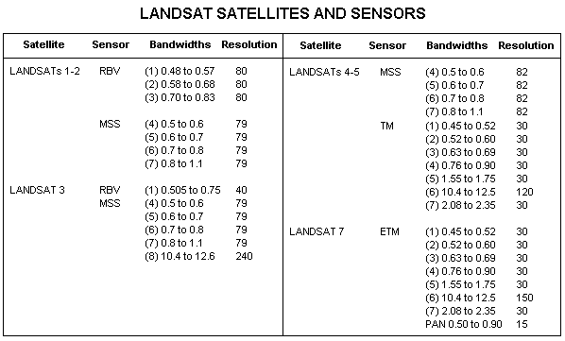
Landsat's 1-5 – A quick summary
Radiometric Resolution
Landsat MSS data – 6 bit (0-63)
Landsat TM data – 8 bit (0-255)

Slide 12
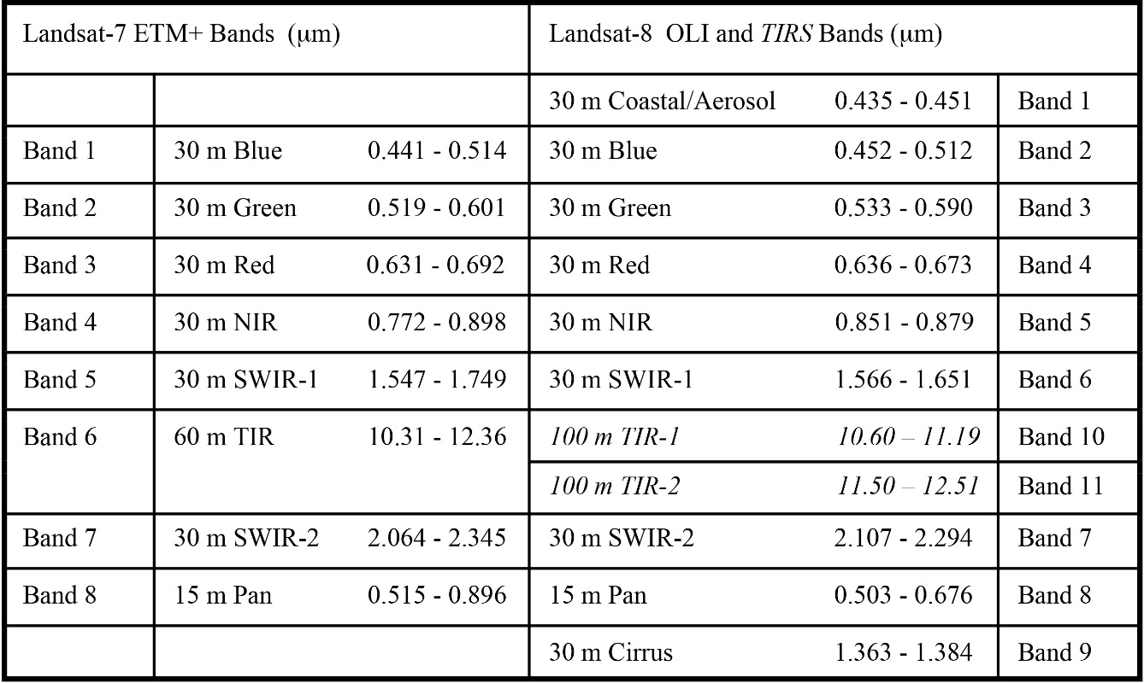
Landsat's 7-8 – A quick summary
Radiometric Resolution:
Landsat 7 TM+ data – 9 bit (8 bits transmitted 0-255)
Landsat 8 – 12 bit (0-4095)
Orbit:
Landsat 7 – 705km, 98.2, sun sync 10:00am, 16 day
Landsat 8 – 705km, 98.2, sun sync 10:11am, 16 day
https://upload.wikimedia.org/wikipedia/commons/f/f9/Florida_Everglades_Landsat_5_Band_Remix_%28high_res%29.ogv

Slide 13
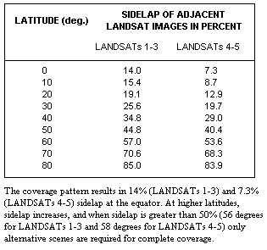
It is possible to view the images stereoscopically in the overlap region and at latitudes greater than 60 degrees there is complete stereoscopic coverage. The quality of the viewing will be dependent on the relief in the overlap area with the angle of the capture varying from zero in the center of the scene to a maximum of 8 degrees at the extreme edges of the scenes.

Slide 14
Landsat 8 – How is it different than Landsat 7?
Landsat 8 carries two push-broom instruments: the Operational Land Imager (OLI), and the Thermal Infrared Sensor (TIRS).
The spectral bands of the OLI sensor, while similar to Landsat 7’s ETM+ sensor, provides enhancement from prior Landsat instruments, with the addition of two new spectral bands: a deep blue visible channel (band 1) specifically designed for water resources and coastal zone investigation, and a new infrared channel (band 9) for the detection of cirrus clouds.
A new Quality Assurance band is also included with each data product. This provides information on the presence of features such as clouds, water, and snow.

Slide 15
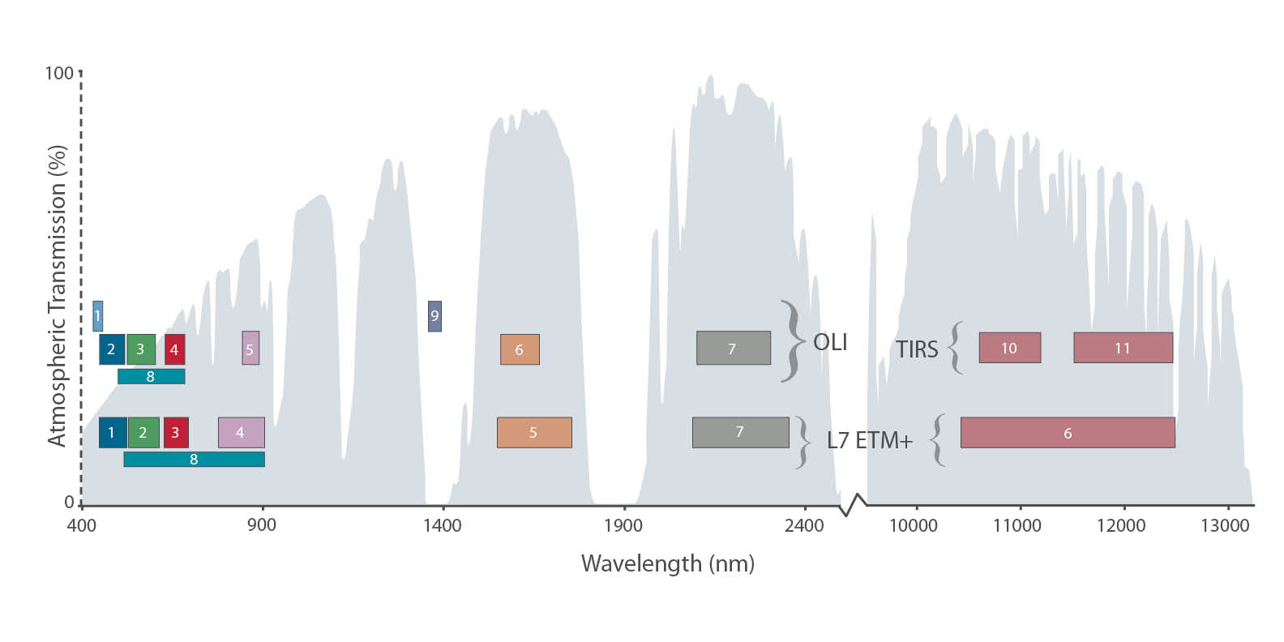
The TIRS instrument collects two spectral bands for the wavelength covered by a single band on the previous TM and ETM+ sensors.

Slide 16
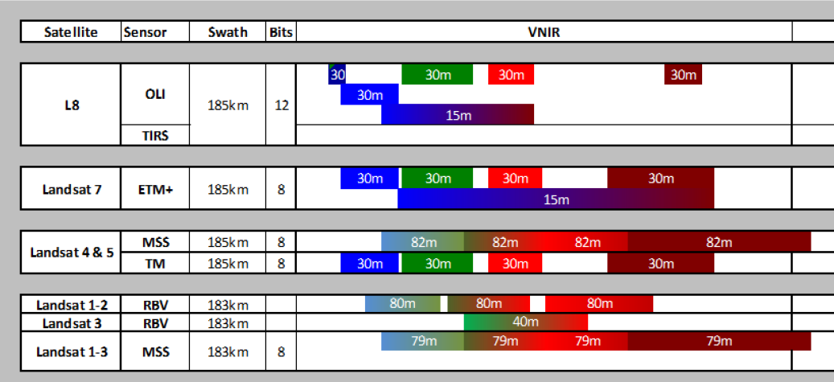
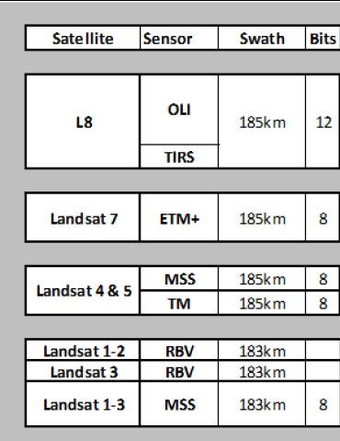
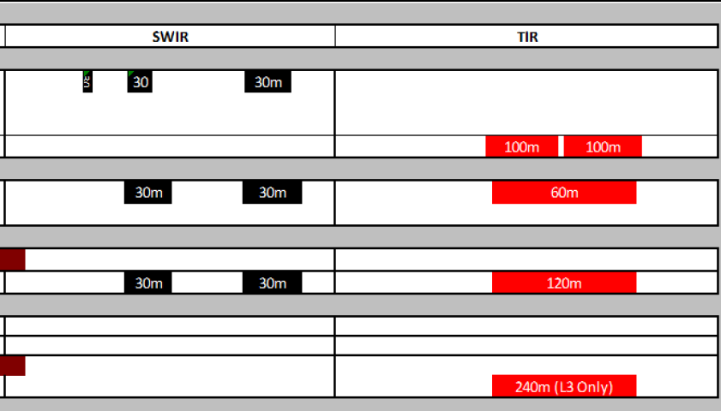

Slide 17
