Slide 1


Remote Sensing of the Environment
FW4540
Advanced Terrestrial Remote Sensing
FW5540
Lecture 18
SPOT

Slide 2
SPOT - (French: Satellite Pour l’Observation de la Terre)
In 1982 the CNES’s (Centre national d'études spatiales, French Space Agency) formed a subsidiary, Spot Image, to develop and operate a commercial land remote sensing satellite system.
Spot 1 was launched in February, 1986 and was the first non-U.S. commercial remote sensing satellite.

Slide 3
In addition to being a competing data source for EOSAT and its Landsat data, SPOT offered some other advantages that were of interest to users.
SPOT 1 had only 3 multispectral bands but those bands had a 20m spatial resolution. It also had a panchromatic band with a 10m resolution.
PUSHBROOM SCANNER and POINTABLE

Slide 4
SPOT 1 was the first direct competition with the U.S. Landsat satellite.
But SPOT 1 carved out its own niche. Spot Image engineers gave it steerable mirrors to be able to view on either side of its ground track, meaning it could revisit a site every 5 days and acquire relief imagery.

Slide 5
“SPOT was very clearly the forerunner of the Helios military surveillance satellites,” says Benoît Boissin, SPOT Program Manager at CNES. (Helios -> joint project between France, Italy, Spain)
“The technologies developed for the SPOT satellite bus also served for the 2 ERS radar satellites, Envisat1 and the 3 MetOp2 weather satellites.”

Slide 6
The SPOT orbit is polar, circular and sun-synchronous. The inclination of the orbital plane combined with the rotation of the Earth around the polar axis allows the satellite to fly over any point on Earth within 26 days.
The orbit has an altitude of 832 kilometers, an inclination of 98.7°.

Slide 7
Don’t forget that we are in the era of Landsat’s 4
and 5 and their TM sensors.
The Thematic Mapper on those satellites covered a much larger portion of the spectrum than SPOT, but only had 30m resolution (except for the 120m thermal band).
Landsat TM Band | λ (nm) | Spatial Resolution (m) | SPOT 1-3,(4) Band | λ (nm) | Spatial Resolution (m)
1 | 450-520 | 30
2 | 520-600 | 30 | 1 | 500-590 | 20
3 | 630-690 | 30 | 2 | 610-680 | 20
4 | 760-900 | 30 | 3 | 790-890 | 20
5 | 1550-1750 | 30 | 4 (SPOT 4) | 1580-1750 | 20
6 | 10400-12500 | 120
7 | 2080-2350 | 30
 |  |  | Pan | 510-730 (1-3) 610-680 (4) | 10

Slide 8
Recall our Resolution Characteristics from last Lecture
Resolution | Spatial (m) | Spectral (bands) | Temporal (days)
Low | >100 | 3 , panchromatic | > 16
Medium | 10-100 | 4 - 15 | 4 - 16
High | 1-10 | > 15 | < 4
We gave Landsat a “Moderate, Moderate, Moderate” generalist designation.
Where did SPOT 1 fit in?
“High, Low, Low (High)”
A hi-res specialist

Slide 9
Spatial resolution came at a cost (besides the limited spectral resolution).
The physical size of the detectors and the data load for downlink from satellite to ground meant that instead of the 183km swath with Landsat, SPOT was limited to 60km (nadir, 80km off-nadir).

Slide 10
This played a part in the system’s 26 day temporal resolution. While the “pointability” of mitigated that somewhat, if the system was pointed off-nadir for one reason, it meant that another area is not even getting 26 day coverage.
RECALL from Last Lecture, the concept…
The trade-off may result in two different solutions:
To lay emphasis upon the most important resolution, in direct dependency to the application, with the acceptance of low attendant resolutions at the same time.

Slide 11
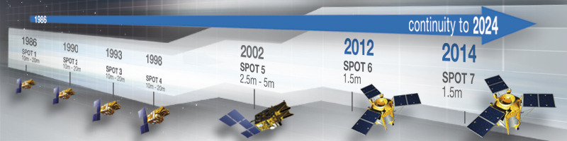
With Landsat it is convenient to talk about 1-3 as being “first” generation, 4-5 “second” generation, 7-9 as “third” generation.
It is the similar for the SPOT satellites: 1-4 are “first” generation, 5 was the “second” generation, 6-7 are the “third” generation.

Slide 12
SPOT 1-4 were essentially identical configurations in all aspects including spectral, special, temporal and radiometric (8 bit, 0-255) resolutions, orbital configurations (inclination, altitude, equatorial crossing times).
SPOT 5 – Launched May 2002 saw a wider panchromatic (480-710nm) and spectral bands similar to 1-4 plus the introduction of the “Vegetation Sensor”, which featured 10 bit (0-1023) radiometric resolution, a 2250km image swath, and a 1165m spatial resolution. The Vegetation Sensor was conceived as a “cover the globe daily” mission.

Slide 13
SPOT 5 Also saw the spatial resolutions reduced to ¼ of the SPOT 1-4 configurations (5m for spectral bands, 2.5m for panchromatic).
This effort was necessitated because by now SPOT’s historical niche as the hi-res leader was being undercut by the myriad of other commercial satellite systems, mostly high spatial resolution specialists.
QuickBird (owned by Digital Globe) was launched in 2001 with a 61cm panchromatic band and 2.5m spectral bands. More later.

Slide 14
With this type of market competition and technological advances, Spot Image could not justify another “second” generation SPOT and quickly reconfigured to the development of its “third” generation SPOT 6 (and 7) system.
SPOT 6 was launched in September 2012, its sensor package had been upgraded from SPOT 5
Band | λ (nm) | Spatial Resolution (m)
Panchromatic | 450-745 | 1.5
Blue | 450-525 | 6
Green | 530-590 | 6
Red | 625-695 | 6
Near IR | 760-890 | 6

Slide 15
While retaining SPOT’s trademark 60-km
wide imaging swath, SPOT 6 and SPOT 7 offer users a number of key improvements:
1.5m resolution natural-color products, orthorectified as standard
Multi-year coverage of entire national territories
Daily revisits to any point on the globe
Ability to accommodate last-minute tasking requests (updated every 6 hours)
Billing per area of interest
Built with a 10-year lifetime warranty, SPOT 6 and SPOT 7 assure continuity of high-resolution data services through to 2024.

Slide 16
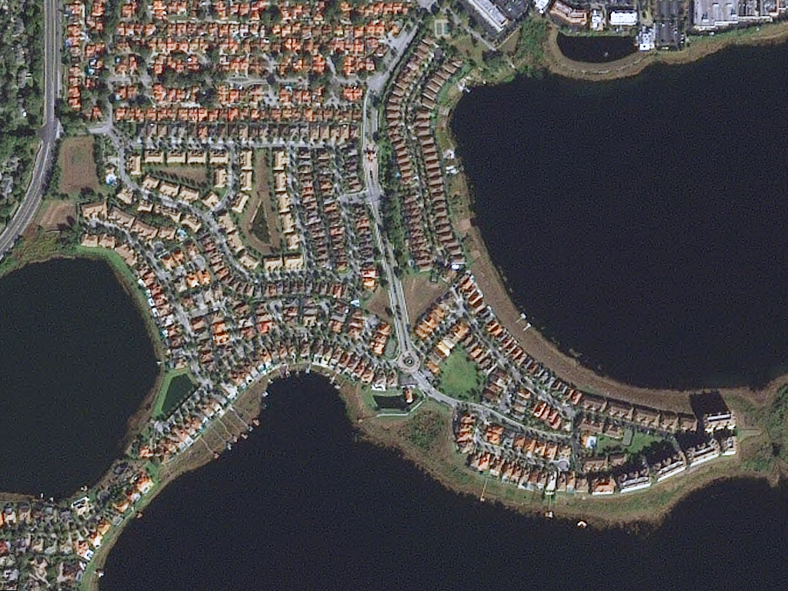
1.5m SPOT 6 data

Slide 17
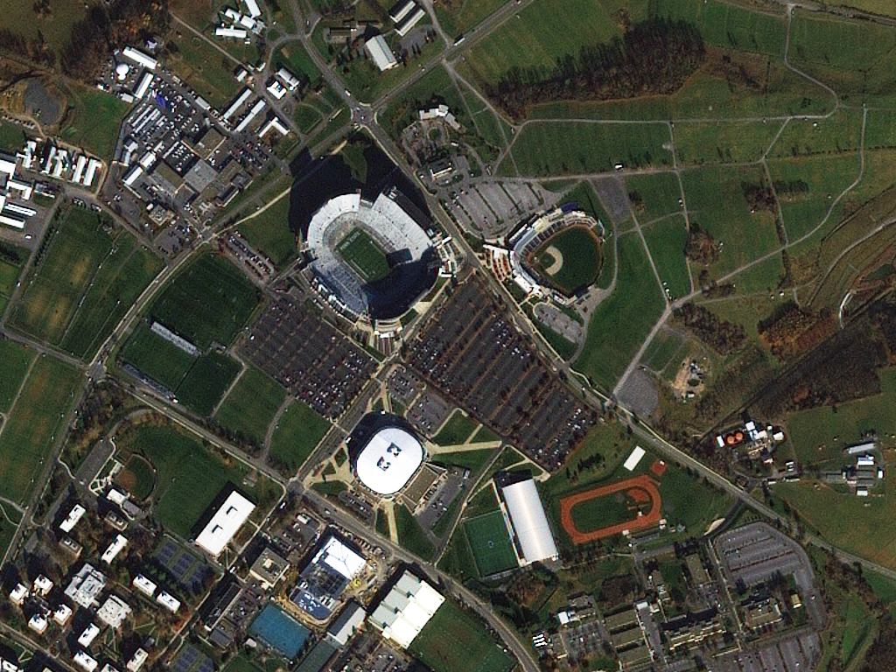
1.5m SPOT 6 data

Slide 18
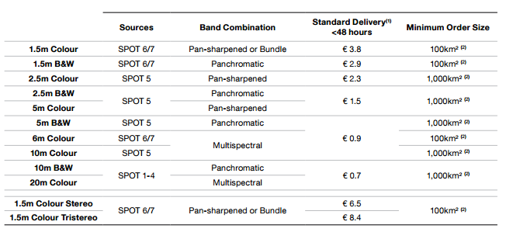

SPOT pricing schedule
Data ordering: http://www.geo-airbusds.com/en/4937-geostore

Slide 19
2014
Airbus Defense and Space took over operation of the SPOT satellite constellation.
SPOT 7 was launched in June.
In December SPOT 7 was sold to Azerbaijan's space agency Azercosmos, who renamed it Azersky.
Azeri engineers are currently training with Airbus, the transition will be completed by January 2016.
Azercosmos to Take Ownership of Airbus’ Spot 7 EO Satellite
[12-02-2014] Azercosmos, the national satellite operator of Azerbaijan, has entered a cooperative agreement with Airbus Defense and Space to operate and commercialize the Spot 7 optical Earth Observation (EO) satellite. As part of the agreement, Spot 7 will be renamed Azersky.
The Azersky satellite was launched on June 30 aboard the Indian Space Research Organization’s (ISRO’s) Polar Satellite Launch Vehicle (PSLV).
The spacecraft has a predicted lifespan of 12 years, and provides 1.5-meter imagery. More than 25 Azerbaijani professionals will train in France on various aspects of EO and Geo-Information services.
The Airbus Defense and Space-Azercosmos agreement also includes joint operation of Airbus Defense and Space’s Spot 6, and a ground segment to access images acquired from Pleiades 1A and 1B, 0.5-meter EO satellites.
Together, Azersky and SPOT 6 cover equal to 6 million square kilometers per day at 1.5-meter resolution, reaching every point on the globe.

