Slide 1
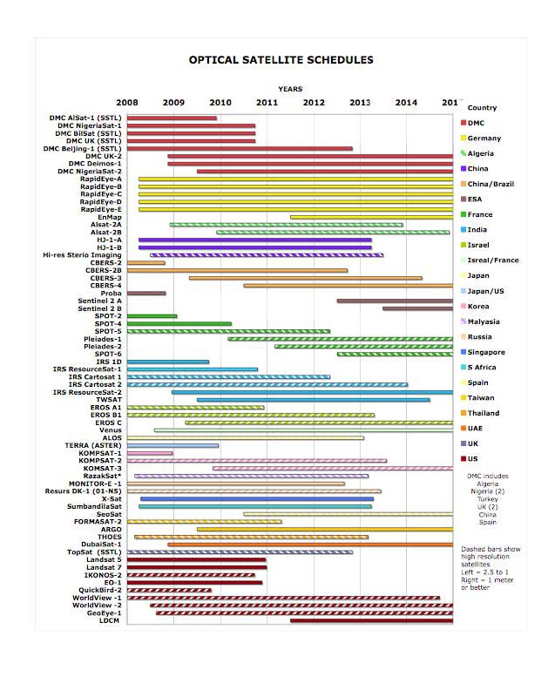
Remote Sensing of the Environment
FW4540
Advanced Terrestrial Remote Sensing
FW5540
Lecture 19
Satellites- All the Rest

Slide 2
Physical Limits of Hi-res
“spy satellites can read newspapers [cigarette packs, license plates] from space
This goes back to the 1960’s and the camera based systems of the day
In addition to the practical limits of extreme spatial resolution systems, there is a physics based limit to deal with.

Slide 3
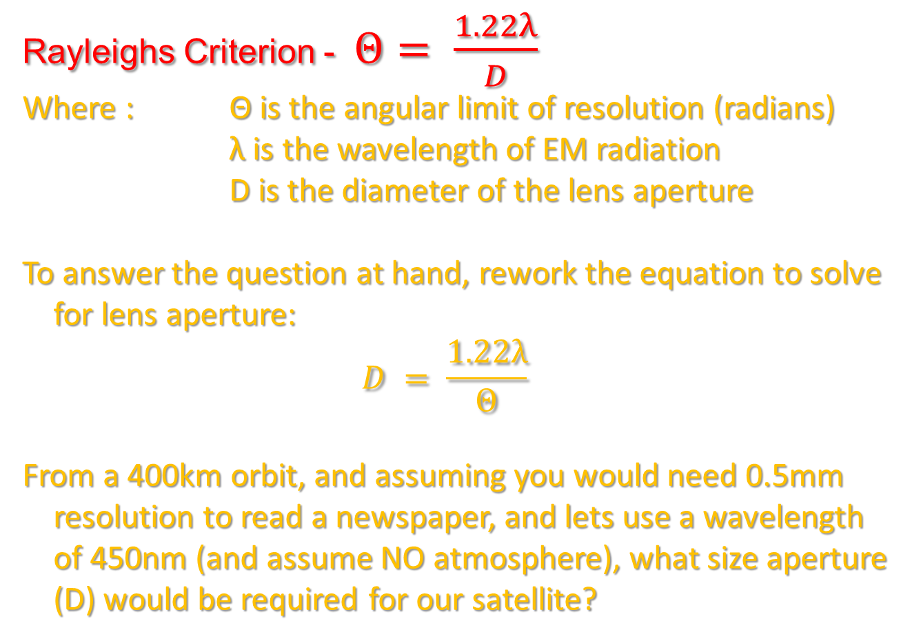
Rayleighs Criterion - $Θ= \frac{1.22λ}{D}$
Where : Θ is the angular limit of resolution (radians)
λ is the wavelength of EM radiation
D is the diameter of the lens aperture
To answer the question at hand, rework the equation to solve for lens aperture:
$$D = \frac{1.22λ}{Θ}$$
From a 400km orbit, and assuming you would need 0.5mm resolution to read a newspaper, and lets use a wavelength of 450nm (and assume NO atmosphere), what size aperture (D) would be required for our satellite?

Slide 4

arctan(.5mm / 400km) = arctan(0.0005m/400,000m)
our angular resolving resolution Θ = 1.25*10⁻⁹ rad
D = (1.22 * 450*10⁻⁹m) / 1.25*10⁻⁹ = 439 meters
So to read a newspaper from orbit we would have to manufacture and launch a satellite 4 times larger than the ISS, and we have not even addressed atmospheric clarity, off nadir angle, and diffraction. BTW- reading a license plate (5mm resolution) would only require a 43.9 meter lens.

Slide 5
What are “spy satellites capable of ?
The code named Kennan "Keyhole-class" (KH) reconnaissance satellites have been orbiting the Earth for more than 30 years. They are typically used to take overhead photos for military missions. The big question for a lot of people is: "What can they see?“
A KH-12 is a $1 billion satellite that resembles the Hubble Space Telescope, except it is looking at our planet. For security reasons, there are no published orbit schedules for the imagery spacecraft. They are supplemented by the 15-ton Lacrosse-class radar-imaging satellites.
Probable suggested resolution ~ 10 cm

Slide 6
In the 1980s, SPOT was successful in the United States because it was technically better than Landsat in terms of performance.
Moreover, SPOT gained initial attention because it was considered a threat to reveal secrets only detectable on classified American satellite imagery.
It spurred policy debates on what to do about high-quality images taken from space. Aggressive marketing and publicity pushed by SPOT Image Corporation further advanced knowledge about the system and its products.

Slide 7
In the 1990s, SPOT was successful because it was the best space-based system that could provide unclassified imagery to the U.S. military and coalition allies prior to and during the Gulf War.
The sale of a direct receipt capability to the U.S. Air Force also enabled SPOT to sell timely imagery to interested commanders.
By 2000, however, SPOT lost traction in the U.S. market because U.S. defense users had new access to commercial imagery from American sensors, specifically Ikonos that was launched in 1999.

Slide 8
The greatest advantage for the newly formed Astrium GEO-Information Services will accrue from a marketing strategy based on the principle that the “sum of the optical and radar space-based and ground processing parts is greater than the whole.”
Promoting Pleiades, for example, in isolation as an optical alternative is not likely to gain traction, unless it guarantees a significant price break from other offerings.

Slide 9
IKONOS (Digital Globe)
The IKONOS Satellite sensor is a high-resolution satellite operated by DigitalGlobe. Its capabilities include capturing a 3.2m multispectral with NIR and 0.82m panchromatic resolution at nadir.
On January 22, 2015 DigitalGlobe announced that during recent maintenance activities, DigitalGlobe attempted to resolve an irregularity in the accuracy of imagery collected by the IKONOS satellite sensor. After extensive testing, DigitalGlobe have determined that the accuracy of IKONOS imagery does not meet DigitalGlobe’s product quality specifications

Slide 10
Pleiades (Airbus Defense and Space)
The Pleiades-1A satellite is capable of providing orthorectified color data at 0.5-meter resolution and revisiting any point on Earth daily.
Perhaps most importantly, Pleiades-1A is capable of acquiring high-resolution stereo imagery in just one pass, and can accommodate large areas (up to 1,000 km x 1,000 km).
The Pleiades-1A satellite features four spectral bands as well as image location accuracy of 3 meters without GCPs. Image location accuracy can be improved up to 1 meter by the use of GCPs.
The satellite has been designed with urgent tasking in mind, images can be requested less than six hours before they are acquired, crisis monitoring.

Slide 11
Other High Spatial Resolution Satellites
GeoEye 1 (Digital Globe) – 41cm panchromatic. Launched 2008.
Sub 50cm data not legal for US licensed commercial satellites when this was launched. Digital Globe had to degrade data to that level except when the data were sold to US military
June 2014 DigitalGlobe received permission from the US Department of Commerce to collect and sell imagery at the best available resolutions. Additionally, six months after WorldView-3 is operational DigitalGlobe will be permitted to sell imagery at up to 25 cm panchromatic and 1.0 m multispectral GSD.

Slide 12
WorldView 3 – The WorldView-3 satellite sensor was licensed by the National Oceanic and Atmospheric Administration (NOAA) to collect in addition to the standard Panchromatic and Multispectral bands, eight-band short-wave infrared (SWIR) and 12 CAVIS imagery. The satellite was successfully launched on August 13, 2014.
Landsat on steroids

Slide 13
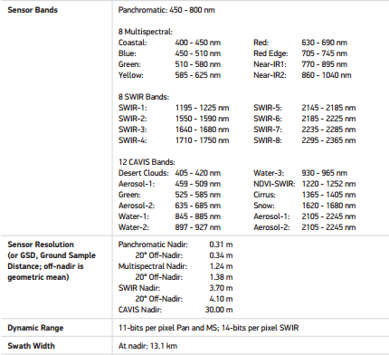
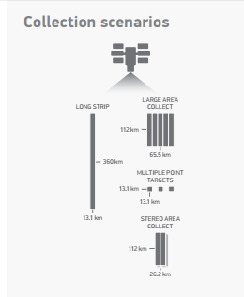
WorldView 3 Specs
Pricing – Available on Request

Slide 14
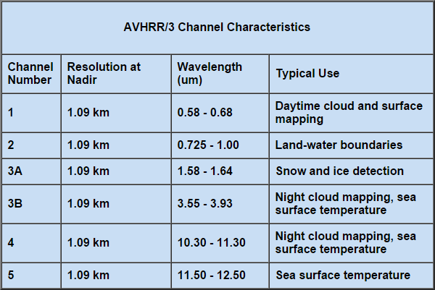
High Spectral Resolution
Landsat, WorldView3
AVHRR – Advanced High Resolution Radiometer (NOAA)
The AVHRR is a radiation-detection imager that can be used for remotely determining cloud cover and the surface temperature.
This scanning radiometer uses 6 detectors that collect different bands of radiation wavelengths. The latest instrument version is AVHRR/3, with 6 channels, carried on NOAA-15 launched in May 1998 thru NOAA-19. 15-19 are all operational.

Slide 15
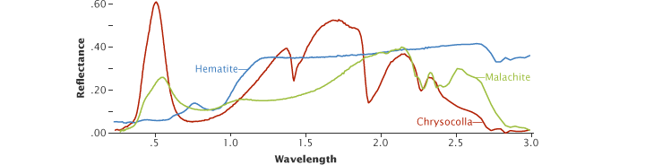

Hyperion (Earth Observing 1 satellite)
Launched November 2000, experimental package designed for 12 month mission.
The Hyperion sensor package provides a high resolution hyperspectral imager capable of resolving 220 spectral bands (from 0.4 to 2.5 µm) with a 30-meter resolution. The instrument can image a 7.5 km by 100 km land area per image, and provide detailed spectral mapping across all 220 channels with high radiometric accuracy.

Slide 16
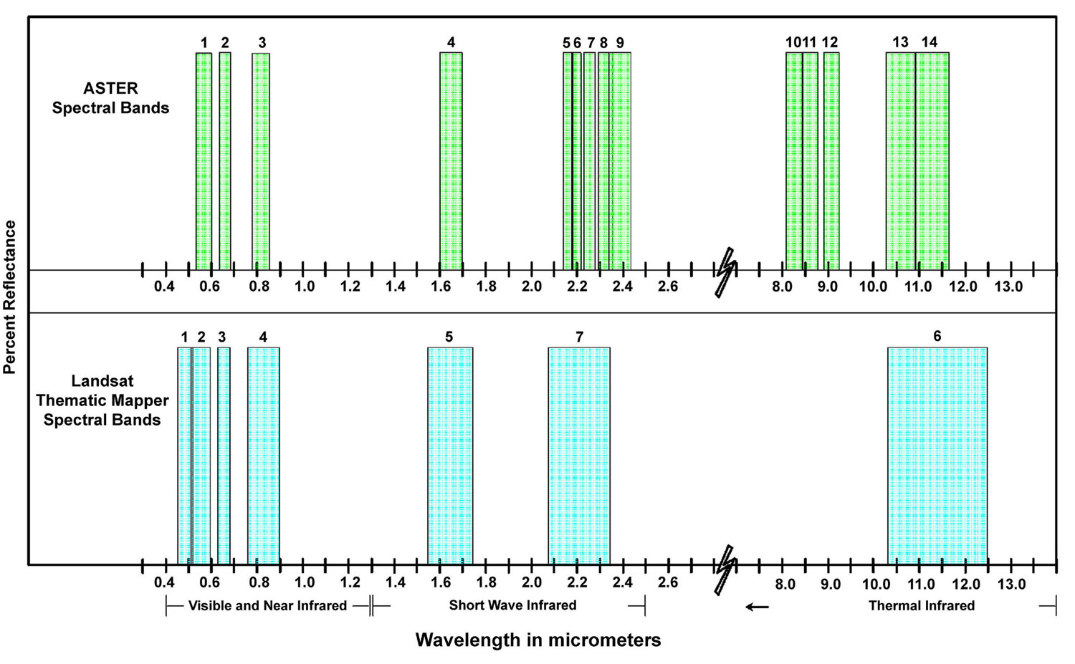
ASTER – Advanced Spaceborne Thermal Emission and Reflection Radiometer (Japan/NASA, 2000-2008)
14 spectral bands: 3 visible and 11 in the infrared region of the electromagnetic spectrum.

Slide 17
HyspIRI – follow up Hyperion mission
The HyspIRI mission includes two instruments mounted on a satellite in Low Earth Orbit. There is an imaging spectrometer measuring from the visible to short wave infrared (VSWIR: 380 nm - 2500 nm) in 10 nm contiguous bands and a multispectral imager measuring from 3 to 12 um in the mid and thermal infrared (TIR).
The VSWIR and TIR instruments both have a spatial resolution of 60 m at nadir. The VSWIR will have a revisit of of 19 days and the TIR will have a revisit of 5 days.

Slide 18
The Hyperspectral Infrared Imager or HyspIRI mission will study the world’s ecosystems and provide critical information on natural disasters such as volcanoes, wildfires and drought.
HyspIRI will be able to identify the type of vegetation that is present and whether the vegetation is healthy. The mission will provide a benchmark on the state of the worlds ecosystems against which future changes can be assessed.
The mission will also assess the pre-eruptive behavior of volcanoes and the likelihood of future eruptions as well as the carbon and other gases released from wildfires.

Slide 19
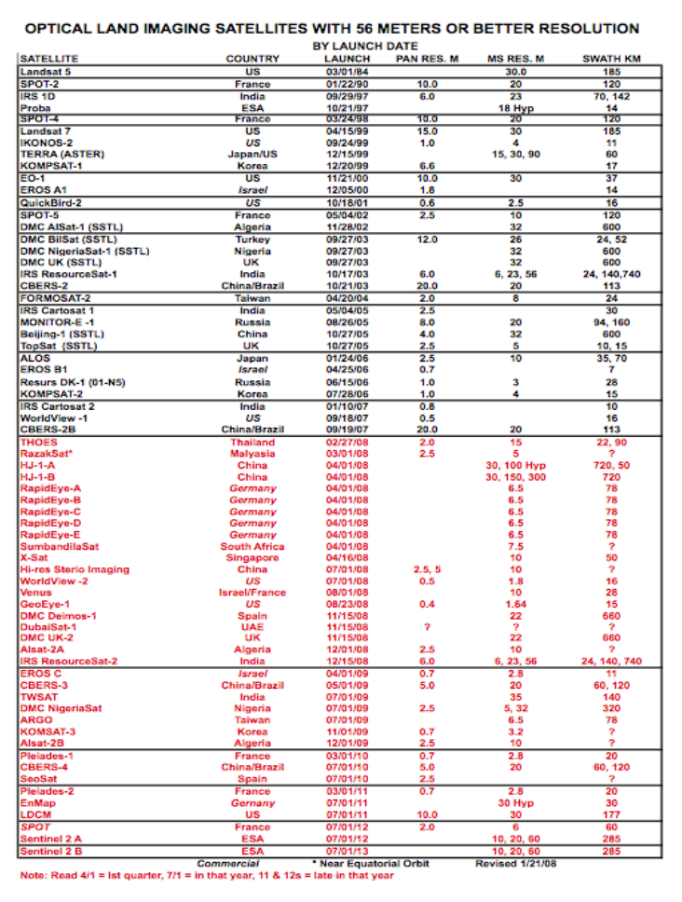
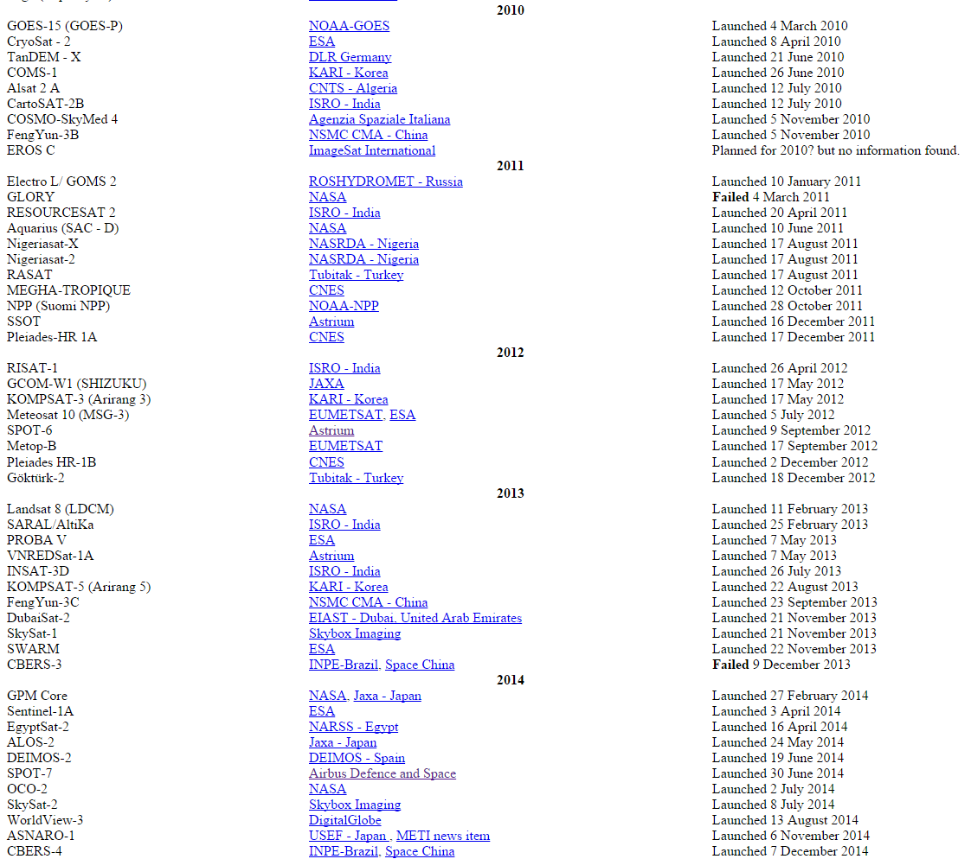
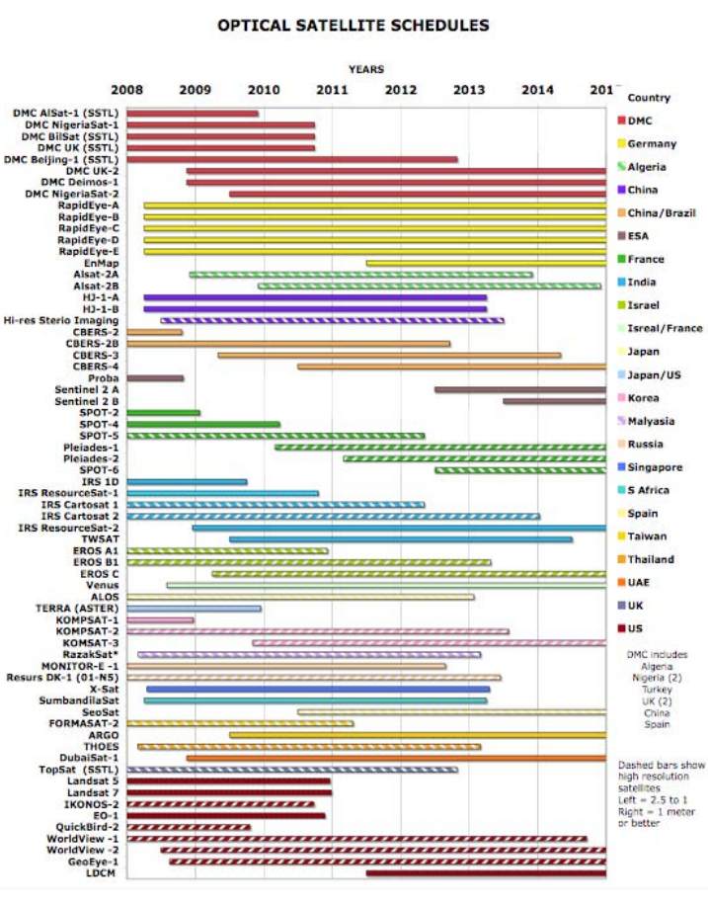
Current constellation- http://www.asprs.org/a/news/satellites/ASPRS_DATABASE_021208.pdf

Slide 20
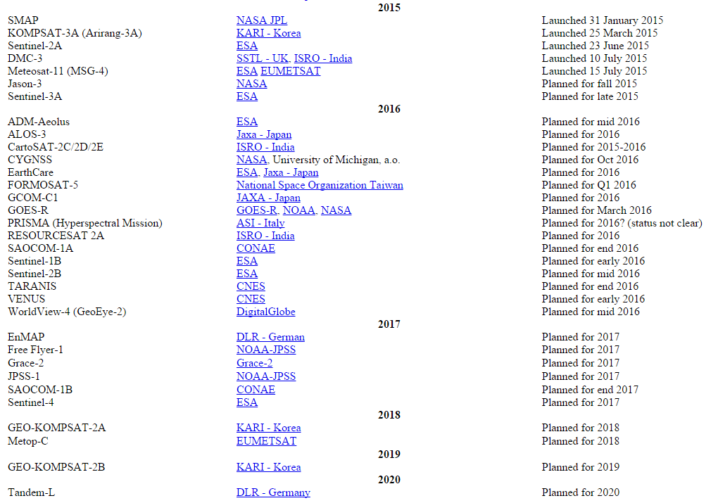
Scheduled launches
https://www.itc.nl/research/products/sensordb/Launch_Schedule.aspx

