Slide 1
Remote Sensing of the Environment
FW4540
Advanced Terrestrial Remote Sensing
FW5540
Lecture 20
Remote Sensing and GIS
UNITED STATES CODE TITLE 15
CHAPTER 82 -
LAND REMOTE SENSING POLICY
Sec. 5601. Findings
The Congress finds and declares the following: …

Slide 2
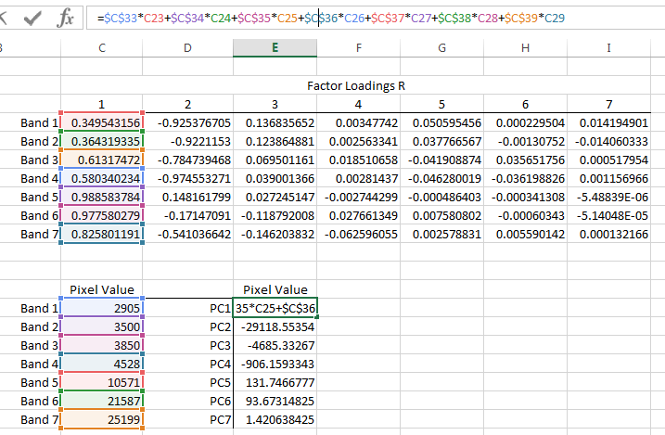
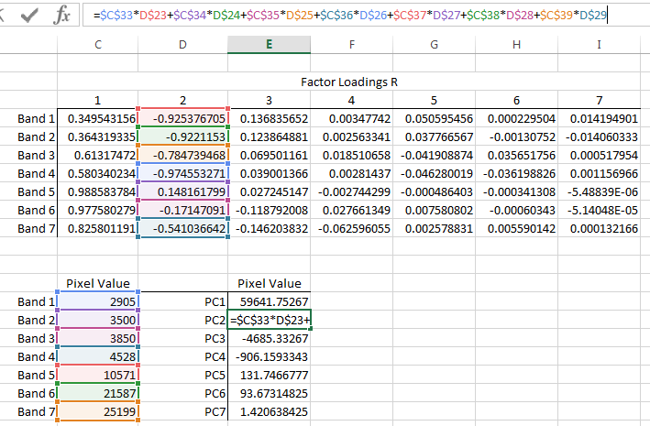

LAB 7 - Compute a new value for pixel 1,1 (it has 7 bands) in principal component number 1 using the following equation:
 | Pixel Value
Band 1 | 2905
Band 2 | 3500
Band 3 | 3850
Band 4 | 4528
Band 5 | 10571
Band 6 | 21587
Band 7 | 25199
$$PC pixel valuei,j,p= \sum_{k=1}^{n}{Rk,p BVi,j,k}$$
Pixel Value_{1,1,1} = (R_{1,1}*2905) + (R_{2,1}*3500) + … + (R_{7,1}*25199)

Slide 3
US Legal and Policy - Land Remote Sensing Policy Act of 1992
Section 2 (3). “The national interest of the United States lies in maintaining international leadership in satellite land remote sensing and in broadly promoting the beneficial use of remote sensing data.”
What it means: U.S. companies can argue that it is a legal requirement to have better system performance than any non-U.S. system.

Slide 4
Section 2 (15): “Development of the remote sensing market and the provision of commercial value-added services based on remote sensing data should remain exclusively the function of the private sector.”
What it means: After the failed 1980s attempt to privatize Landsat, the Congress did not support government help for commercial remote sensing companies.
The text should be revised to cover formal public private partnerships, when it is in the national interest, because absent radical change in the industry it is wrong to presume that this sector could sustain itself without Government funds.

Slide 5
Section 202(b)(6). “Any license issued pursuant to this title shall specify that the licensee shall comply with all requirements of this Act and shall notify the Secretary [of Commerce] of any agreement the licensee intends to enter with a foreign nation, entity, or consortium involving foreign nations or entities.”
What it means: The U.S. Government wants to know how U.S. companies are involved with foreign entities, especially if it involves foreign ownership. The U.S. Government in general does not want to give a foreign entity rights to operate a satellite via a U.S. company’s license.
This should focus exclusively on foreign ownership and potential sales to entities banned from purchasing U.S. goods. Regulating data flows in this highly globalized sector inhibits commerce. (THINK SPOT 7 SITUATION)

Slide 6
Personal Privacy and Remote Sensing
There has long been concern that remote sensing technology is headed in a direction that may “one day” be capable of capturing information that the public perceives as “private space.”
In fact as the technical advances have developed of the past decade, the potential for concern has grown.

Slide 7
US law in this matter is can be ambiguous. Court decisions have upheld the legality what could be considered routine acquisitions of remotely sensed data.
HOWEVER, that does not necessarily apply to data specifically acquired for law enforcement agencies.

Slide 8
In 1986, the Supreme Court ruled that the EPA was within their rights to obtain aerial photography of a Dow Chemical production facility after requests to gain entry on the ground were denied.
However, in 2001, the Supreme Court upheld a lower court decision that held that thermal imagery that was used to detect heat from lamps that were used to grow marijuana constituted a search and therefor required a warrant.

Slide 9
Prior to the rescinding of the 50cm spatial limit on orbital data it is surprising to note that there has never been a US policy or law that limits the spatial resolution or aperture/shutter setting of aerial photography.
With the development of highly accurate GPS and the positioning precision of aerial photo data, it is also surprising that the only restrictions on the aerial system are not imposed on the camera or its data or the areas that can be photographed, but on the aircraft itself to avoid interference with commercial aircraft.

Slide 10
US Military Bases do have some restrictions on overflights, but for the most part, large area air photo projects that cover these bases are routine.
Drones - Only within the last year has there been movement to restrict the use of privately owned Unmanned Aircraft Systems. As of this point in time there are restrictions on UAS operation within five miles of commercial airports, over US military bases and US National Parks. There is a law making its way through Congress that would restrict drone usage over and around active sporting events.
https://www.mapbox.com/drone/no-fly/

Slide 11
What about the “Online” nature of this data availability?
Google Earth makes this data available to everyone with an Internet connection.
Without permission, the backyard of everyone is in public view.

Slide 12
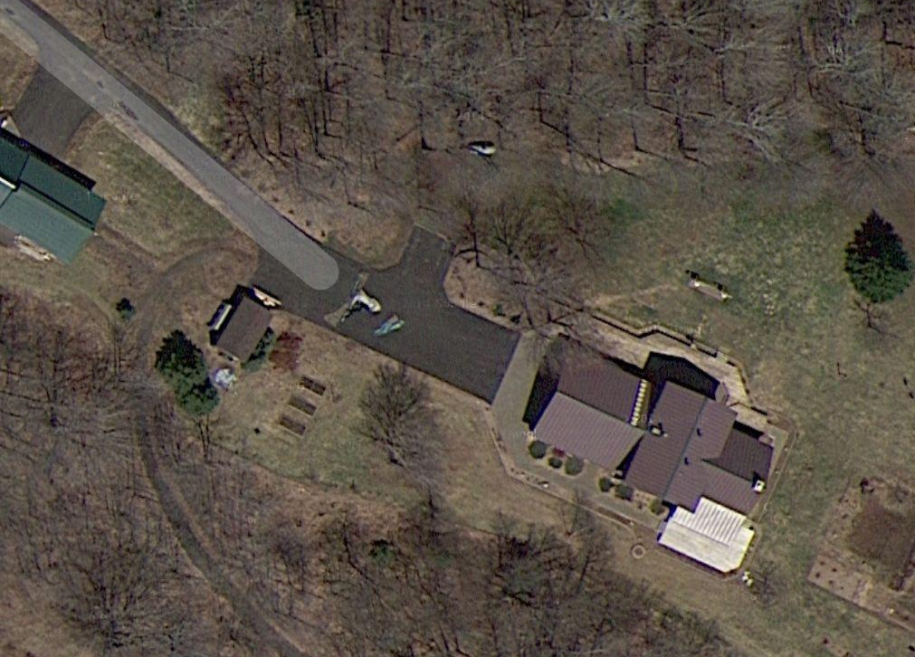

Slide 13
Data Fusion and GIS Integration
GPS
Remotely
Sensed
Data
GIS

Slide 14
Geographic information systems provide tools needed for the storage, retrieval, analysis, management and display of spatial and temporal data.
Remote sensing is an important source for input into GIS. Remote sensing platforms, either airborne or spaceborne have capabilities of acquiring data on a repetitive basis and hence generate large volumes of spatial data

Slide 15
There is a synergism between GPS, remotely sensed data and GIS.
GIS’ capabilities are greatly limited without the new information that RS can provide.
Without GPS it is much more difficult to integrate data into a GIS in a meaningful and accurate way.
Without GIS, RS data are essentially “pretty pictures”

Slide 16
Remote sensing’s strong point is its ability to revisit the same area on the earth on a repetitive basis.
This allows us to build a temporal data structure within our GIS and with ancillary data (site visitation, historical data, non-spatial sources) develop models of observations that can be used to envision what future conditions might result from action or inaction.

Slide 17
Ecosystem modelling has benefitted greatly from the use of GIS over the years. Much of ecosystem modelling relies on the spatial dynamic aspect the ecosystem along with the relational dynamics between the various entities that make up the ecosystem.
The relational dynamics were studied and documented long before GIS allowed for the spatial dynamic to be incorporated into the models.

Slide 18
One of the most important aspects of ecosystem or landscape modelling is the validation process.
Validation is not a procedure for testing scientific theory or for certifying the ‘truth’ of current scientific understanding, nor is it a required activity of every modelling project.
Validation means that a model is acceptable for its intended use because it meets specified performance requirements.

Slide 19
Remotely sensed data, with its long archive of imagery, now allows us to develop and test ecosystem and landscape models.
Using “older” segments of the data archive can be used to aid in the development of the model.
Because of its spatial and temporal consistency it can then be used as independent observations test the model against and to validate the model.

