Slide 1
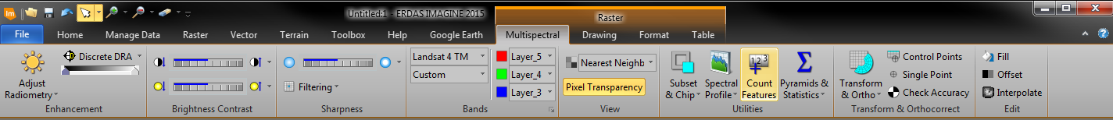
Remote Sensing of the Environment
FW4540
Advanced Terrestrial Remote Sensing
FW5540
Lecture 21
Digital Image Analysis I

Slide 2
Digital Image Analysis
Computer based manipulation of digital images.
Anyone who has used an app that on their cell phone to crop or resize an image has performed the first step digital image analysis, image preprocessing

Slide 3
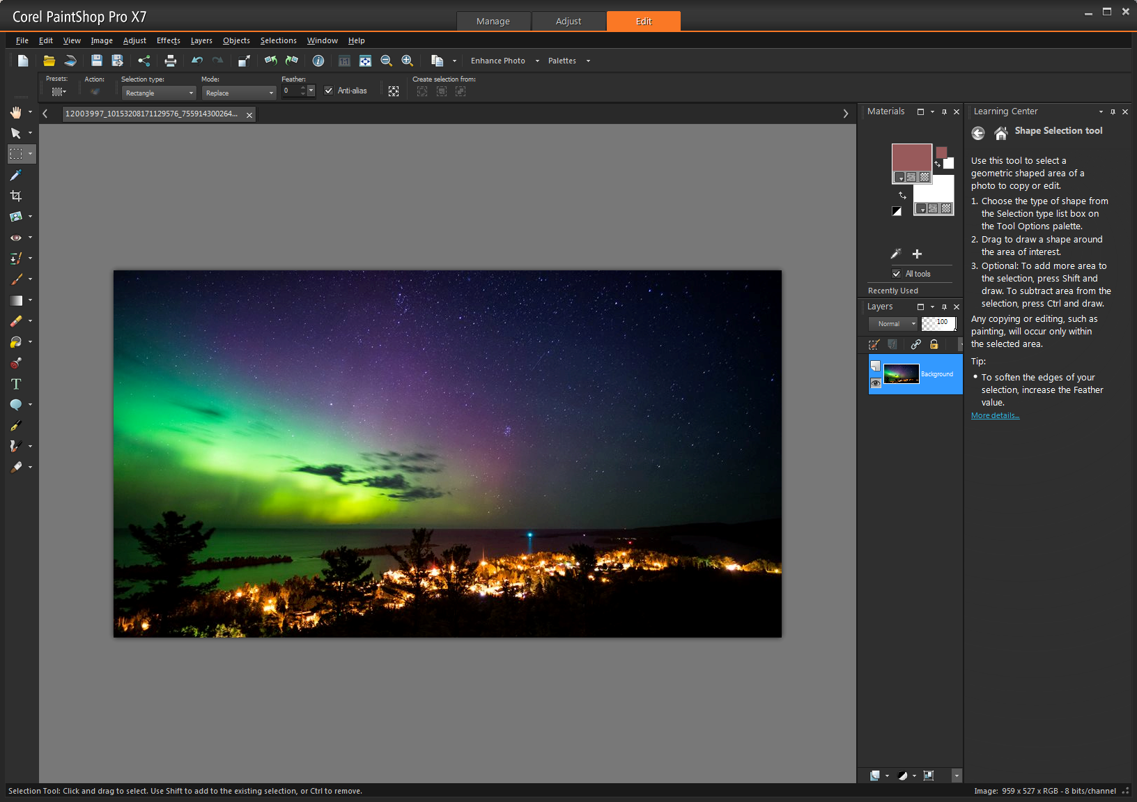
More robust software packages offer a wide array of image enhancements to the amateur photographer.

Slide 4
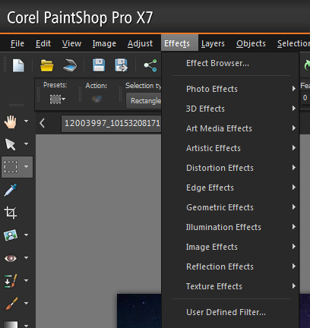
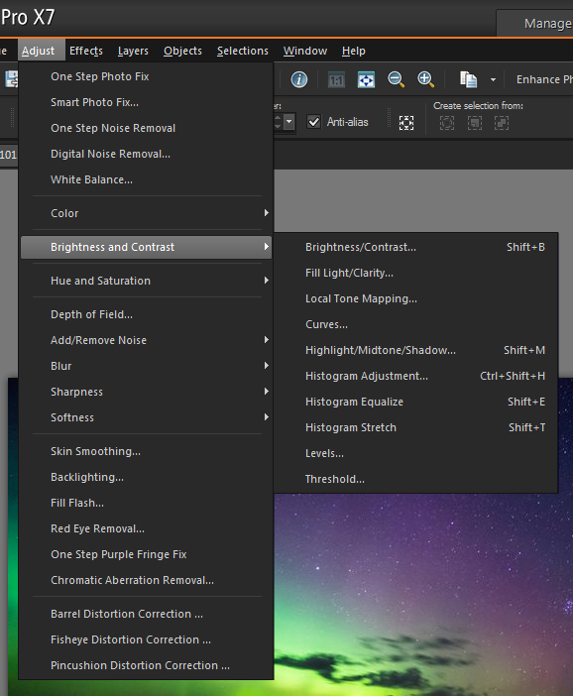
Some of these enhancements cross over into software packages that allow the user to actually “analyze” the image

Slide 5
While these software provide the user with a great deal of image enhancement possibilities, they do not allow the means to extract new information about the content of the imagery.
Digital image analysis allows the use of much more complex algorithms, and hence, can offer both more sophisticated performance at simple tasks, and the implementation of methods which would be impossible by analog means.

Slide 6
In particular, digital image processing is the only practical technology for:
    Classification
    Feature extraction
    Pattern recognition
    Projection

Slide 7
Typically, digital image analysis requires three broad steps. Any of which may require varying degrees of time and expertise to complete:
          Preprocessing
          Enhancement
          Classification

Slide 8
In addition, there are four broad application categories into which analyzed imagery may fall
      Change detection
      Data fusion and GIS Integration
      Hyperspectral Analysis
      Biophysical Modelling

Slide 9
Image Preprocessing
Correct distorted or degraded imagery
Eliminate system noise, radiometric calibration
Eliminate geometric distortions
Image mosaicking or subsetting
Much of this is typically done by the image provider.

Slide 10
Image Enhancement
Procedures to make the imagery better for visual study, exaggerating the visual distinction of the image content.
    Contrast manipulation
    Spatial Filtering
    Edge enhancement
    Ratioing
    Principal Components
    Vegetative Indices
    HIS color space transformation

Slide 11
Image Classification
Quantitative algorithm based techniques for automating the identification of features within an image. These could be spatial features such as roads or other geometric based shapes (spatial pattern recognition) or spectral features such as land cover classes (spectral pattern recognition).
      Supervised Classification
      Unsupervised Classification
      “Hybrid” Classification

Slide 12
Change detection
Change detection involves the application of multi-temporal datasets to quantitatively analyze the changes of land cover classes.
The basic premise in using remotely sensed data is that, changes in land cover must result in differences in radiance values that must be large enough with respect to radiance changes caused by other false factors such as differences in atmospheric conditions, illumination, and viewing angle.

Slide 13
Data Fusion
Several situations in image processing require high spatial and high spectral resolution in a single image.
Image fusion techniques allow the integration of different information sources. The fused image can have complementary spatial and spectral resolution characteristics.
          Multi-sensor
          Multi-date
          Multi-resolution
          2D-3D

