Slide 1
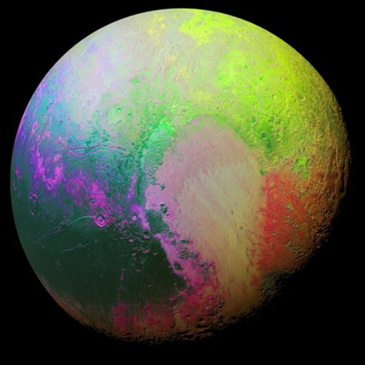
Remote Sensing of the Environment
FW4540
Advanced Terrestrial Remote Sensing
FW5540
Lecture 22
Digital Image Analysis II

Slide 2
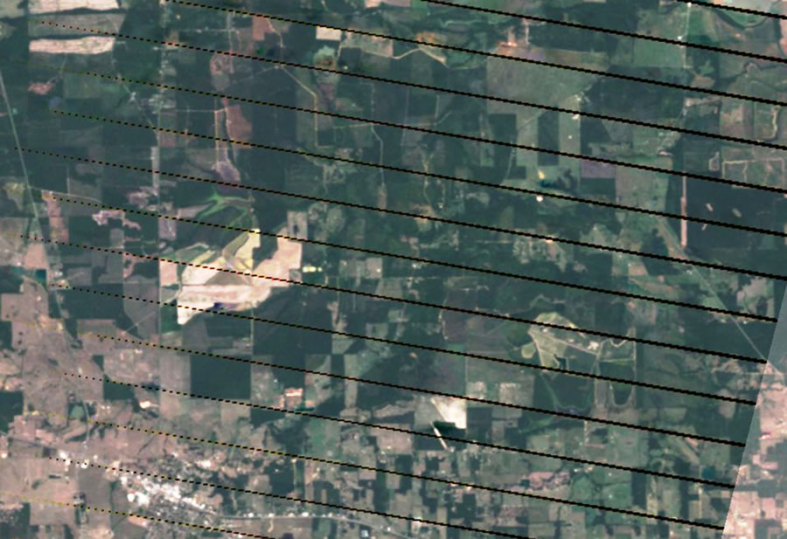
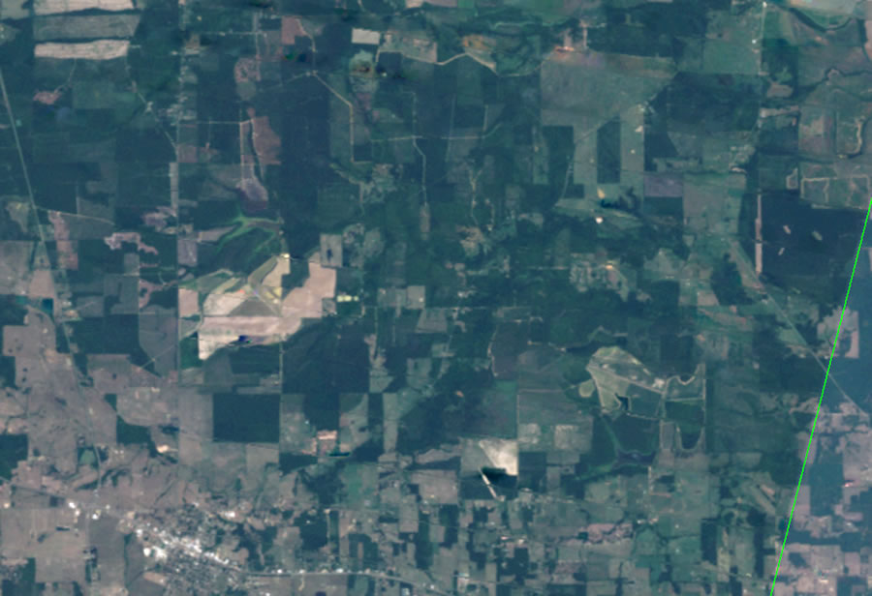
Preprocessing – preparing the data for the user, usually done by the data collection agency
Noise Removal – any unwanted anomaly from the system due to limitations of the sensor, AD conversion, data recording error. Random or systematic.
Radiometric Correction – haze compensation, dark object subtraction, sun angle correction.

Slide 3
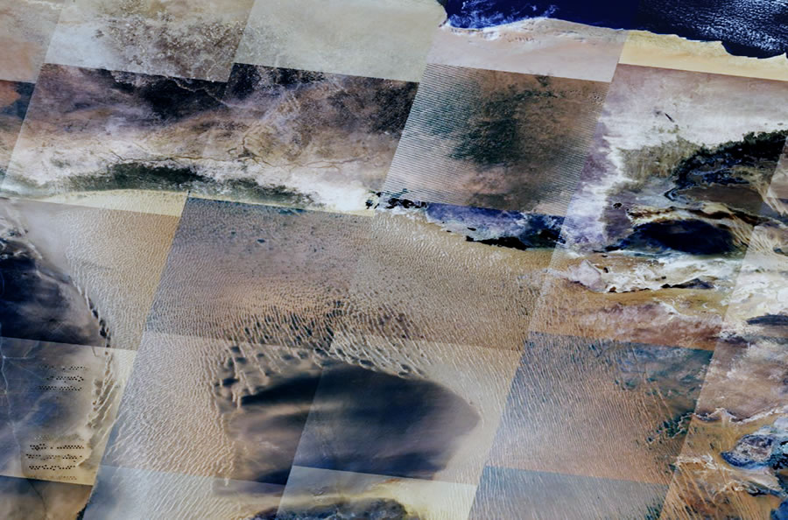
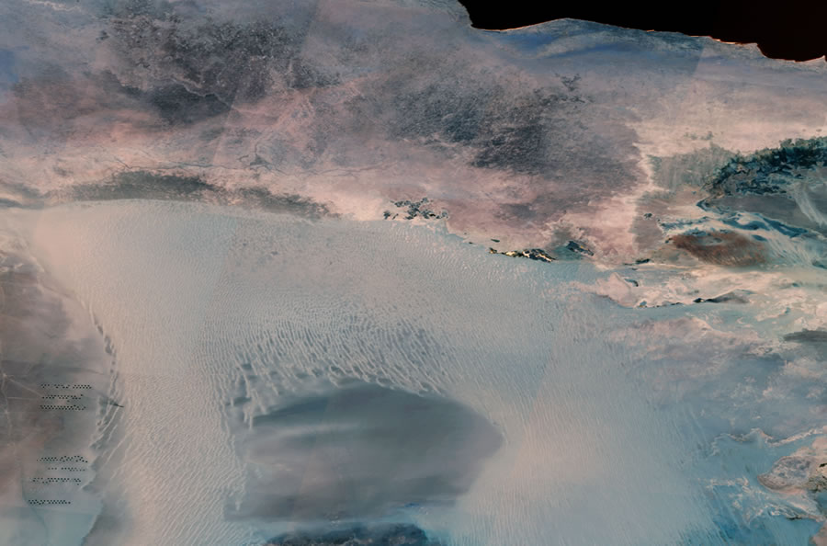
Mosaicking, subsetting – merging several images or taking a piece out of an image, or both in combination.
Mosaicking and radiometric correction for reflectance

Slide 4
Image Enhancement
Contrast Manipulation – Gray-Level Thresholding, Level Slicing, Contrast Stretching
Spatial Filtering – Edge enhancement and detection, Fourier transformation
Multi-image Manipulation – Band ratioing, vegetation indices, Principal Components, canonical components, vegetation components, color space transformations

Slide 5
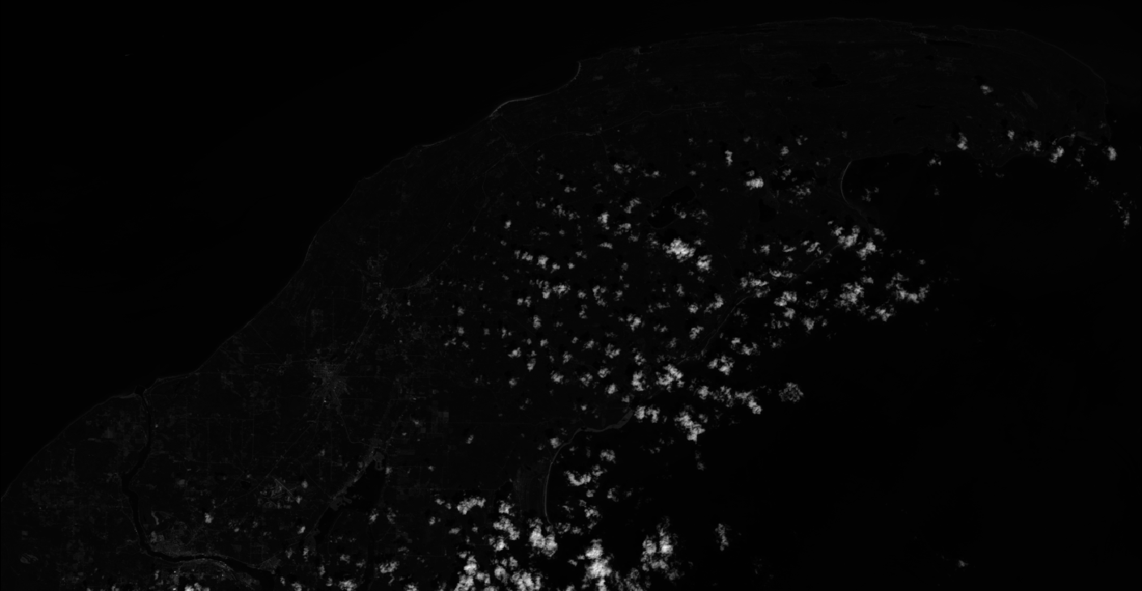
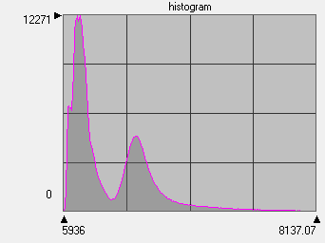
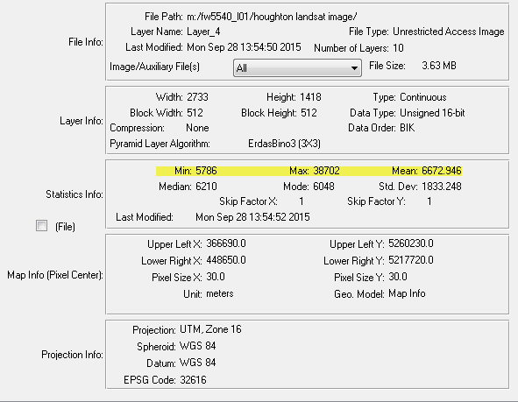
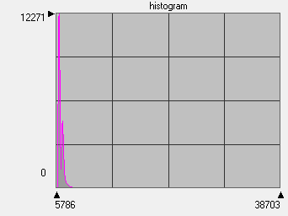
Landsat Image of the Keweenaw August 8, 2013 – Band 4

Slide 6
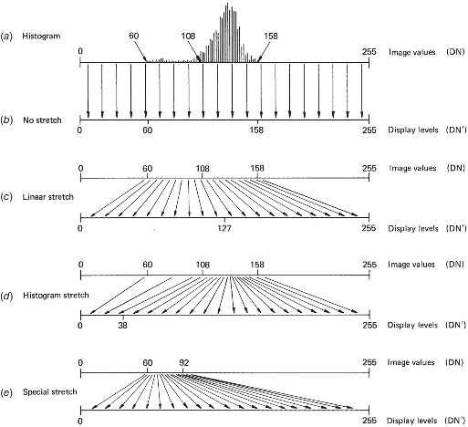
Contrast Stretching

Slide 7
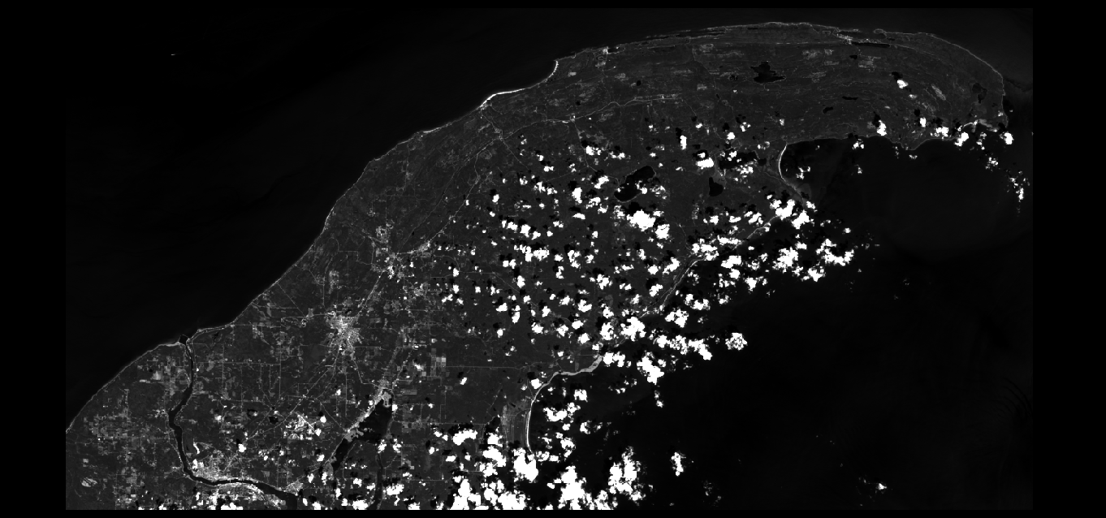
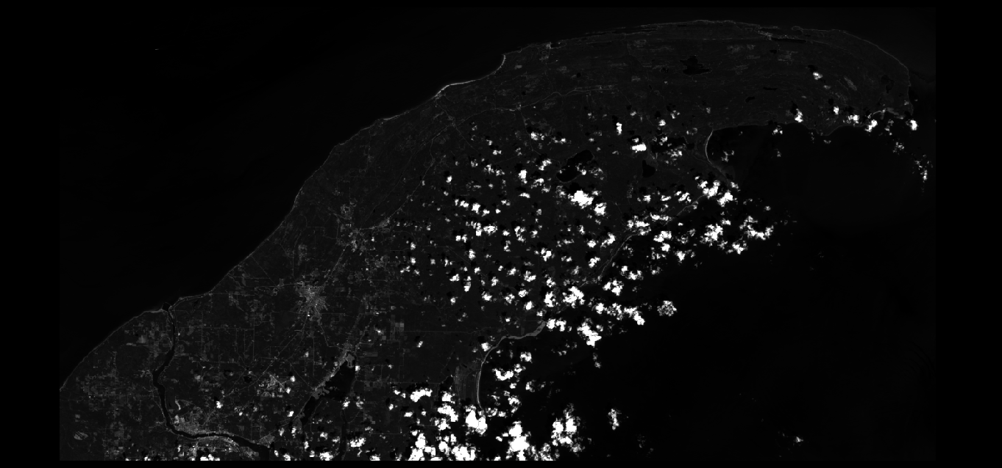
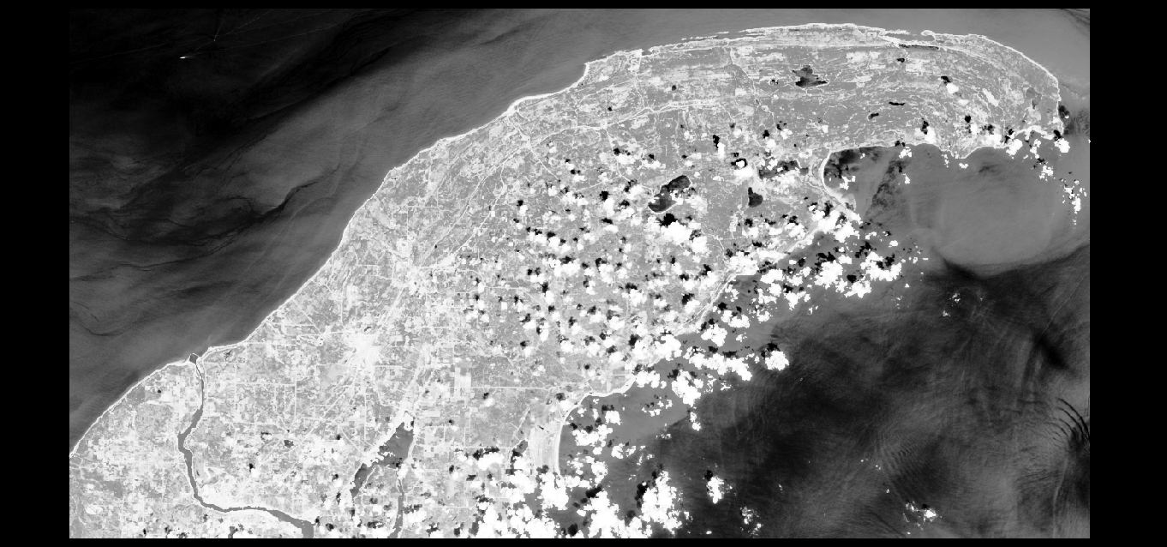
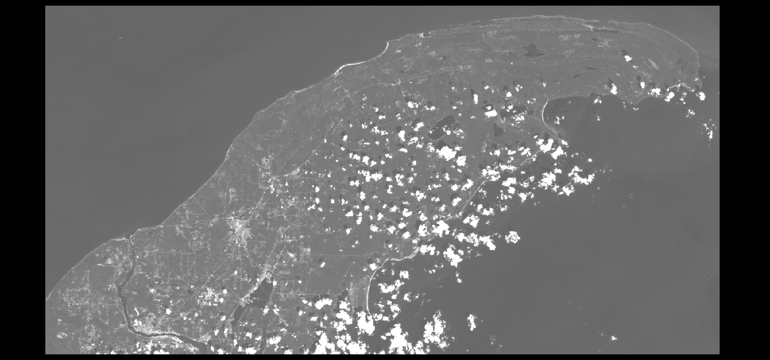
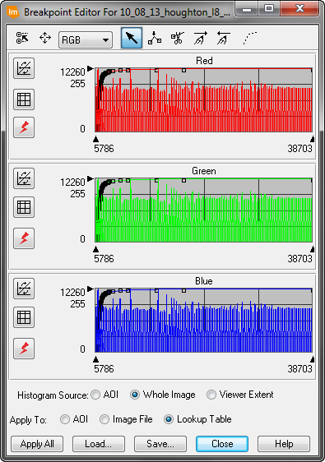
Image Enhancement
Histogram Equalization Stretch
Linear Stretch excluding 2.5% of tails
No Enhancement
Linear Stretch 2 Std Dev about the mean

Slide 8
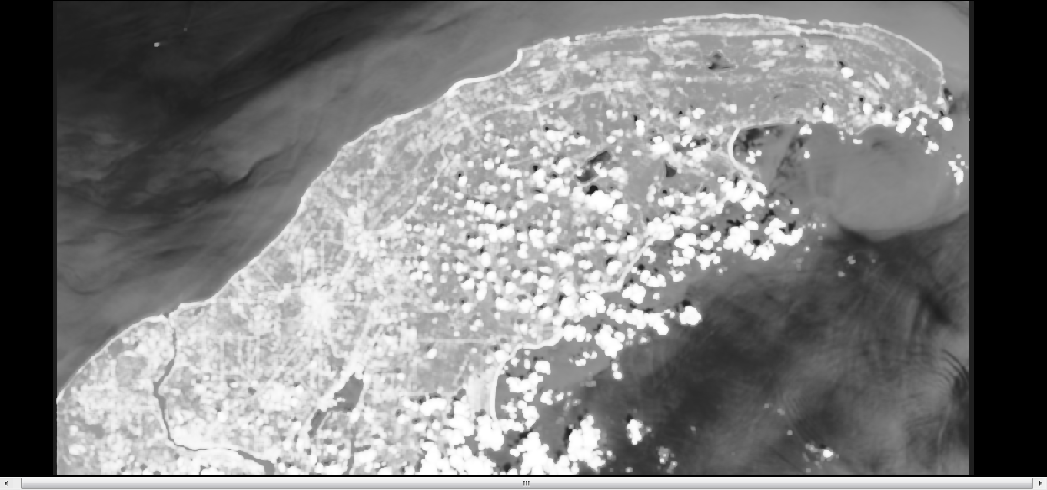
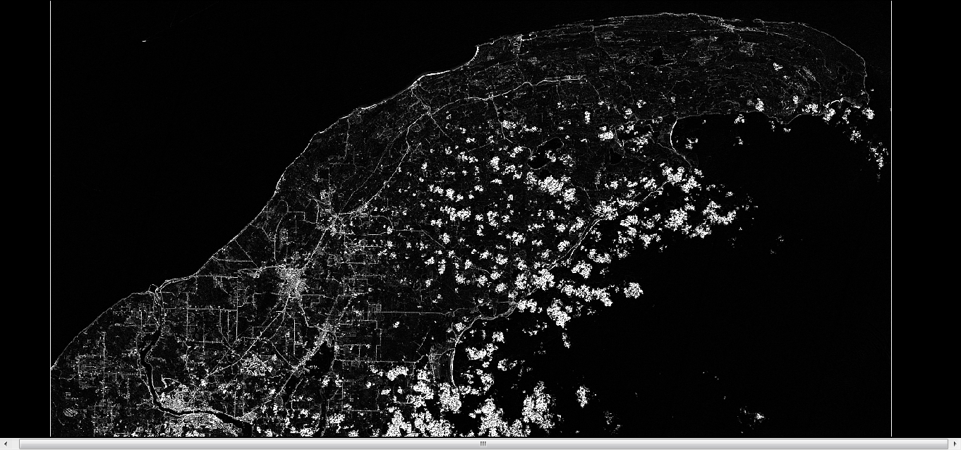
Spatial Filtering – Spectral Space
Edge Detection (High Pass Filter)
Low Pass Filter

Slide 9
Fourier Transform –
Spatial Filtering in “Frequency Space”
Image enhancement techniques can be divided into two basic categories: Point, Neighborhood
Point techniques enhance the pixel based only on its value, with no concern for the values of neighboring pixels. Think image enhancements.
The Fourier transform decomposes a signal (scanner pixel values) into the frequencies that make it up, similar to how a musical chord can be expressed as the amplitude (or loudness) of its constituent notes.

Slide 10
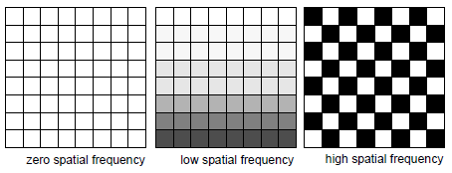
The basic premise behind a Fourier transform is that any one-dimensional function, f(x) (which might be a row of pixels), can be represented by a Fourier series consisting of some combination of sine and cosine terms and their associated coefficients.
Low spatial frequencies represent infrequent gray scale changes that occur gradually over a relatively large number of pixel distances
High spatial frequencies are those that represent frequent gray scale changes in a short pixel distance.

Slide 11
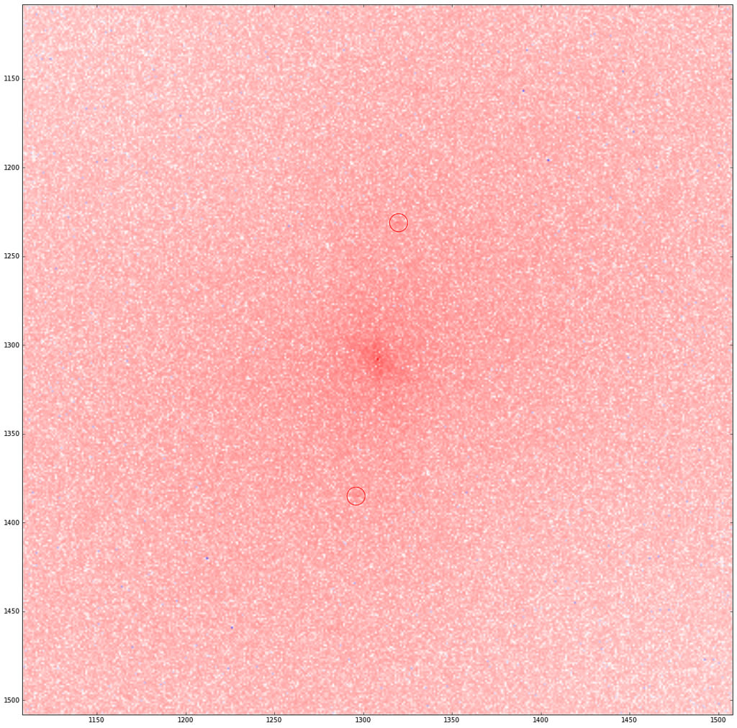
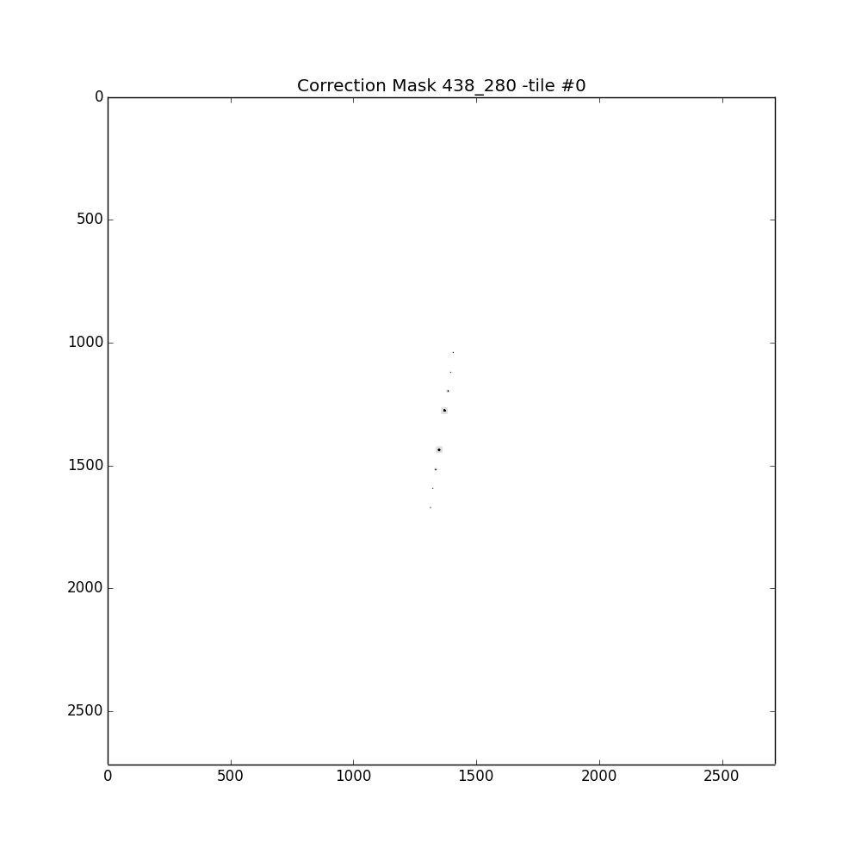
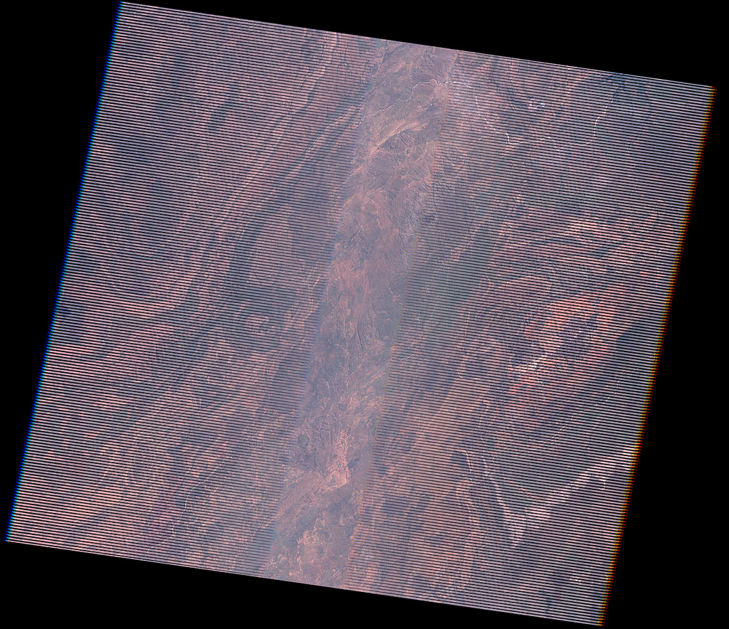
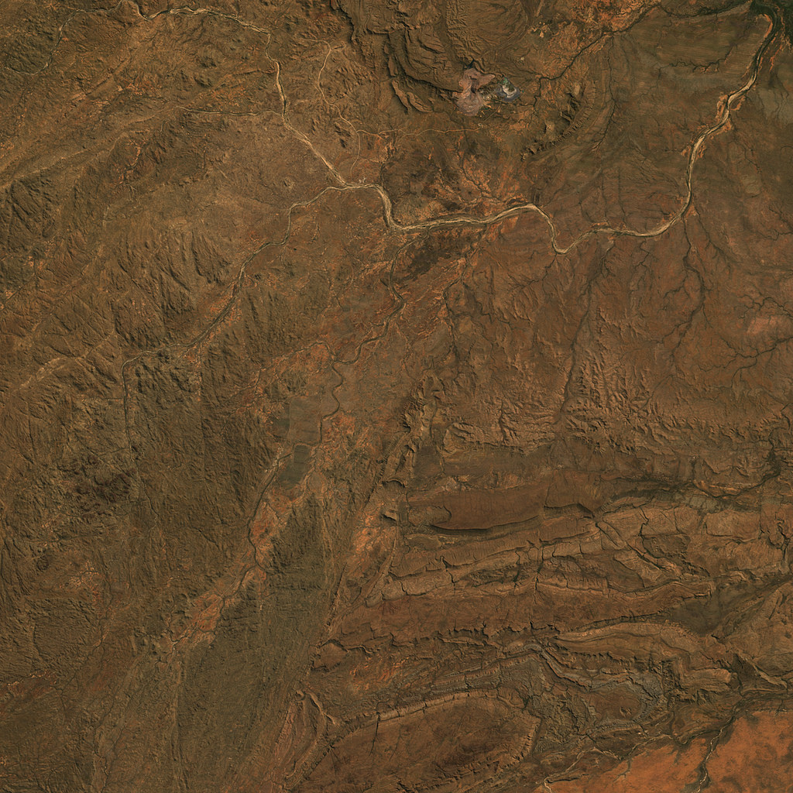
Textbook Example
https://www.mapbox.com/blog/debanding-the-world/

Slide 12
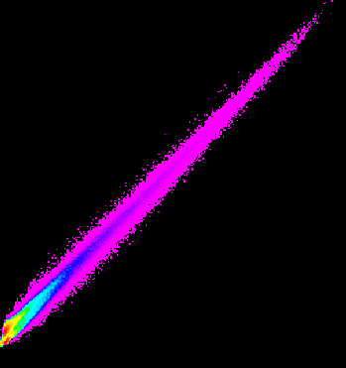
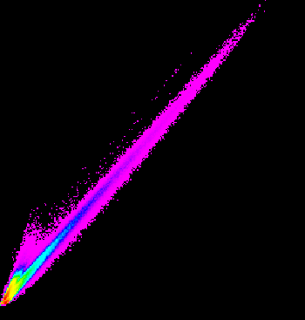
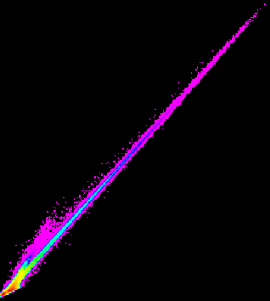
Principal Components
In multispectral (and especially hyperspectral data) there is a high degree of correlation between individual bands (and groups of bands) of data.
Bands 2 vs 3
Bands 2 vs 4
Bands 3 vs 4

Slide 13
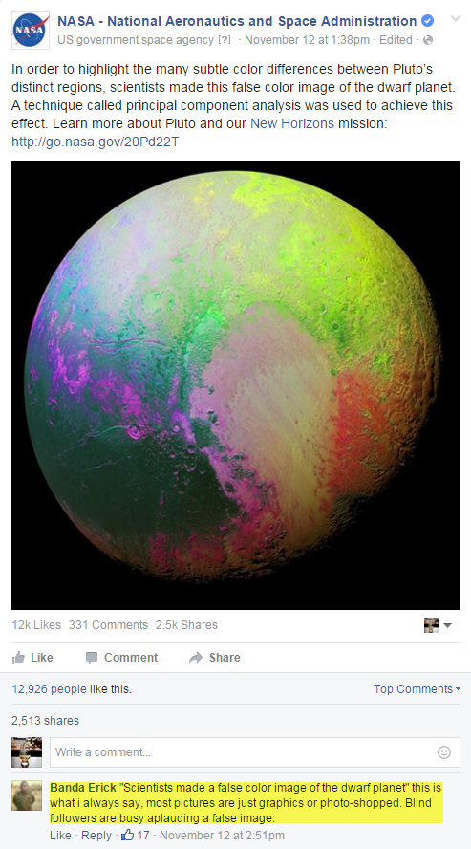

Slide 14
Principal Components is used to:
Minimize correlation between bands
Compress the information content of a number of bands of imagery (e.g., seven OLI bands) into just two or three transformed principal component images.
Reduce dimensionality (i.e., the number of bands in the dataset that must be analyzed to produce usable results) from n to two or three bands.

Slide 15
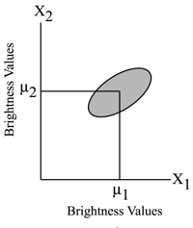
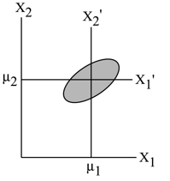
The spatial relationship between the first two principal components:
(a) Scatter-plot of data points collected from two remotely bands labeled X₁ and X₂ with the means of the distribution labeled µ₁ and µ₂.
(b) A new coordinate system is created by shifting the axes to an X′ system. The values for the new data points are found by the relationship X_{1′} = X₁ – µ₁ and X_{2′} = X₂ – µ₂. This is a Translation.

Slide 16
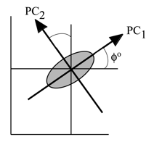
(c) The X′ axis system is then rotated about its origin (µ₁, µ₂) so that PC₁ is projected through the semi-major axis of the distribution of points and the variance of PC₁ is a maximum. PC₂ must be perpendicular to PC₁ or orthogonal. The PC axes are the principal components of this two-dimensional data.

Slide 17
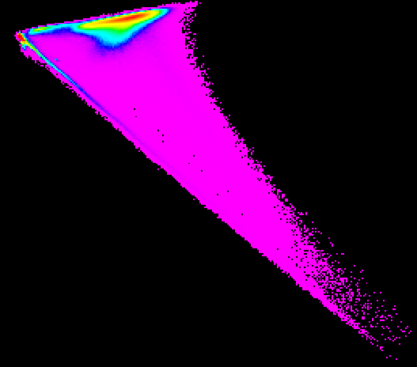
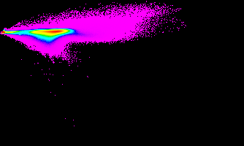
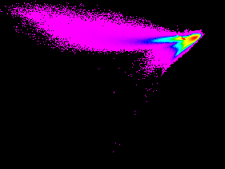
Bands 2 vs 3
Bands 2 vs 4
Bands 3 vs 4
PC 1 vs 2
PC 1 vs 3
PC 2 vs 3

Slide 18
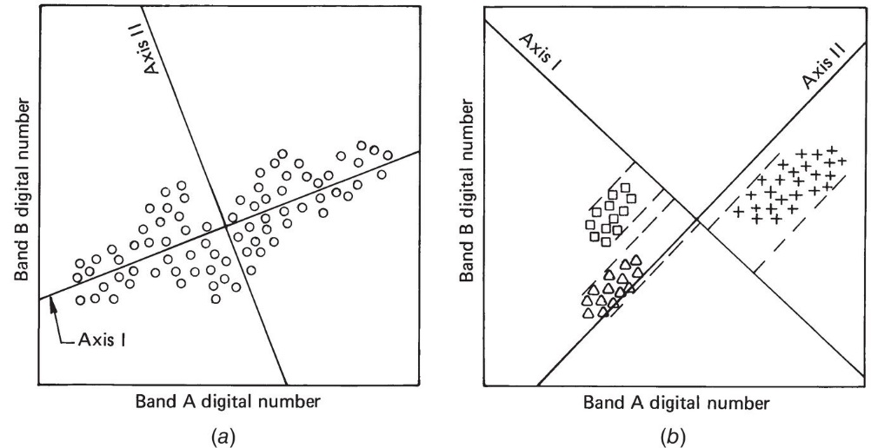
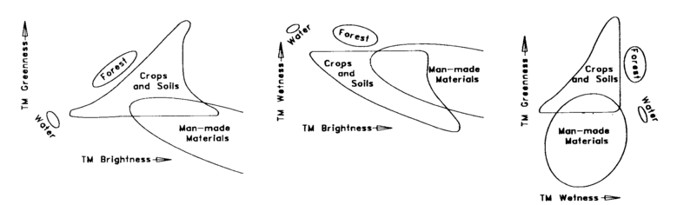
Canonical and Vegetative Components
Canonical Components – Especially useful if you are looking to distinguish between specific feature classes. Maximizes the separation between classes.
Tasseled Cap – Creates three components highly related to vegetative health and vigor, Brightness, Greenness, Wetness

Slide 19
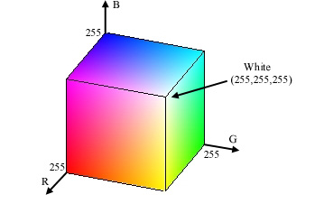
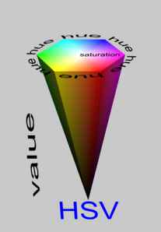
Color Space Transformation
RGB Color Space – Computer monitors, each color displayed as 0-255 (2⁸)
IHS Color Space – Intensity-Hue-Saturation.
Intensity = Total Brightness
Hue = Dominant Wavelength
Saturation = “Purity” of hue relative to gray.

