Slide 1
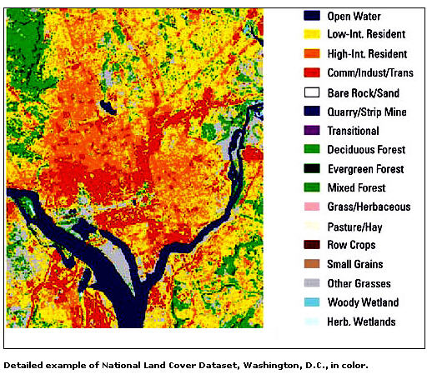
Remote Sensing of the Environment
FW4540
Advanced Terrestrial Remote Sensing
FW5540
Lecture 23
Digital Image Analysis III

Slide 2
Lecture 22 Review
Preprocessing – Mostly prior to receipt of data, Noise removal, radiometric correction, mosaicking and subsetting
Image Enhancement – Contrast manipulation (improve the visual content of the data), Spatial filtering, Multi-band/Multi-image manipulation.

Slide 3
Image Enhancement
Linear Contrast Stretch (several versions)
Histogram Equalization Stretch
Spatial Filtering
High/Low Pass filters
Fourier Transform
Multi-band/Multi-image Manipulations
Principal Component
Canonical Components
Vegetation Indices
Color Space Transformation

Slide 4
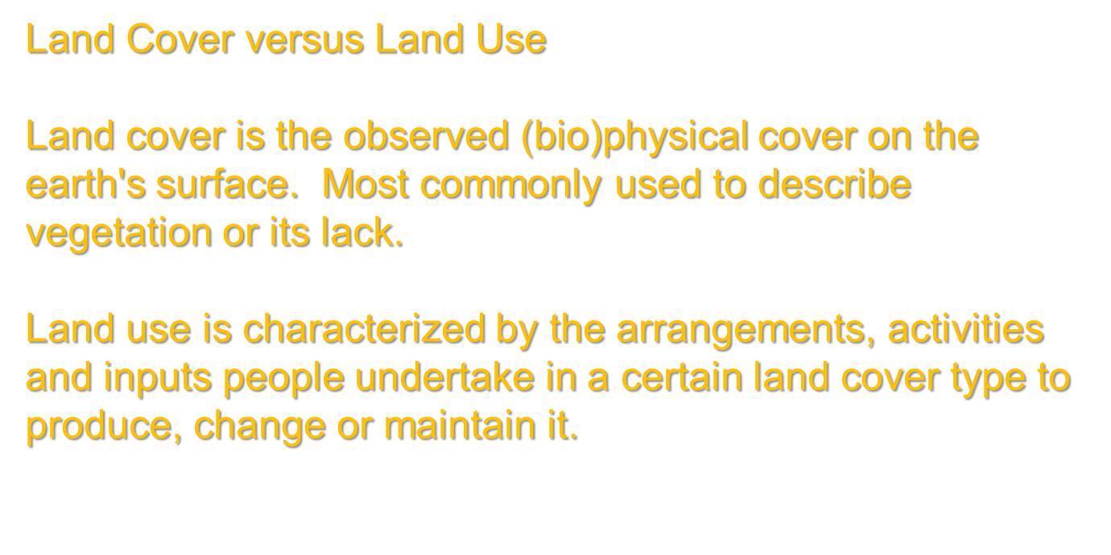

Slide 5
Image Classification
Intent is to categorize all the pixels in an image into land cover classes or themes.
Typically done using spectral patterns, essentially identifying areas of known land cover, determining the spectral characteristics of those areas and applying those spectral characteristics to the entire image (or area of interest.)

Slide 6
In effect we are leveraging a small amount of information that may come at a “high cost” and applying that knowledge to a broader area at a relatively “low cost.”
What does that mean?
It takes a large effort to out into the field and visit areas to identify what is on the ground at any particular spot.
If we can afford to visit a relatively few places, identify the land cover, and can extrapolate to an entire region, we save a lot of time and effort compared to visiting every spot on the ground.

Slide 7
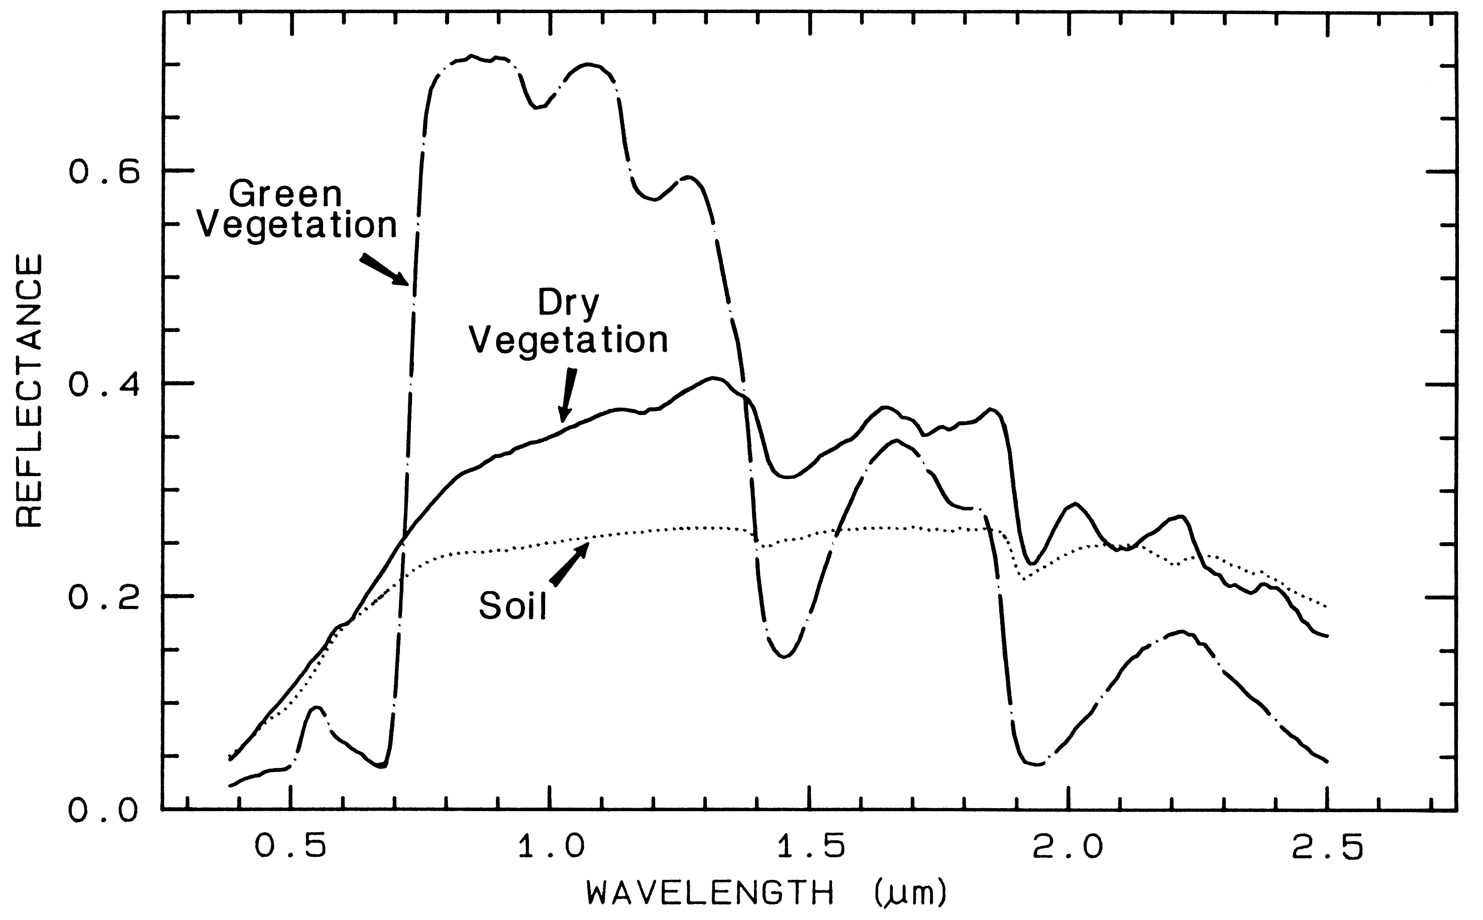
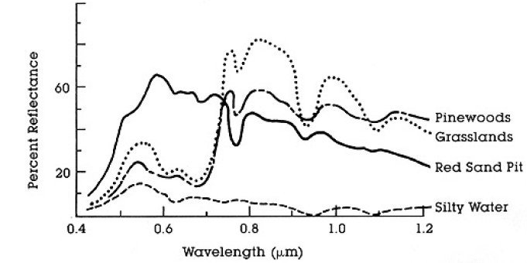
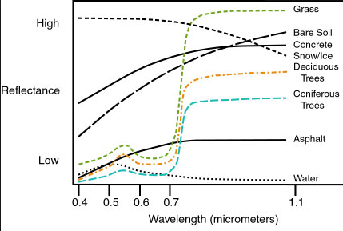
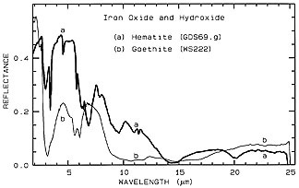
Spectral Pattern Recognition Process
These have popped up all semester, what do they actually mean?
Why have we spent so much time talking about spectral and radiometric resolution?

Slide 8
If we can identify areas of known cover type on a multispectral image, it is possible to develop a “library” of unique spectral signatures for that cover type and for all cover types of interest to us.
These representative sample sites are called “training areas” and are used to numerically describe the multi-spectral characteristics of the cover type

Slide 9
There are two basic approaches to developing these libraries of training areas, supervised and unsupervised.
The supervised approach has the analyst visually identifying the location of the “expensive” areas of known cover type on the imagery that is being used.
The unsupervised approach has the computer analyze the image and compute spectral clusters which the analyst must identify according to the “expensive” known areas.

Slide 10
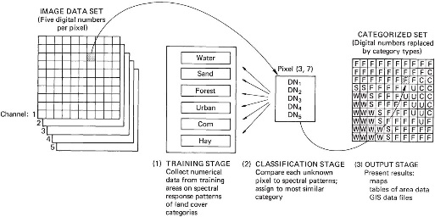
Supervised Classification Procedure

Slide 11
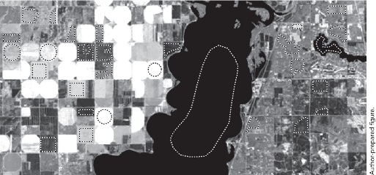
Training Stage
The goal is to get “statistically pure and representative” samples of the spectral signatures for each class

Slide 12
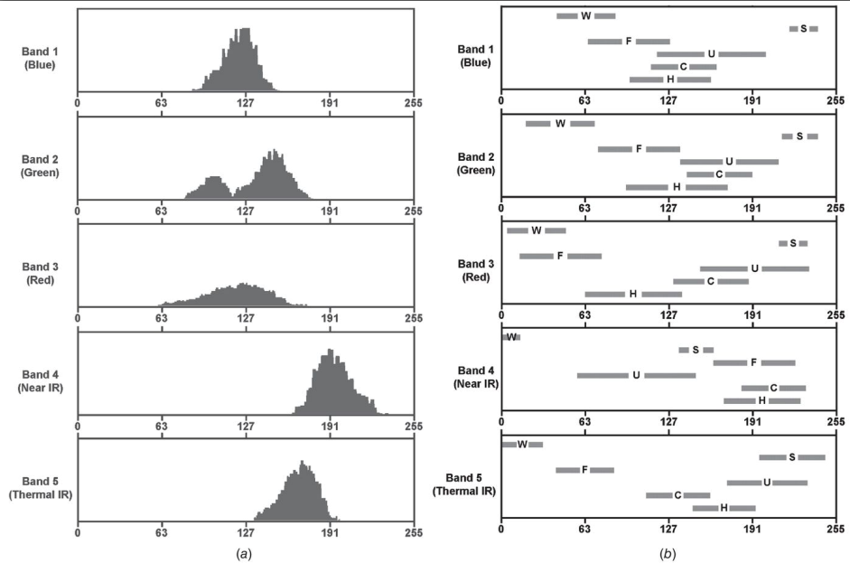

Slide 13
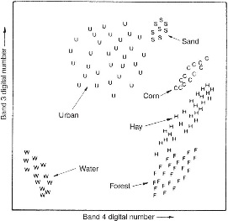
Classification Stage
Visually analyze the data compiled from the training stage

Slide 14
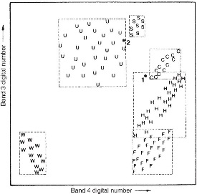
Parallelepiped Classifier
User defines the limits of the “box” based on the minimum and maximum values of each band for each spectral signature… ORDER MATTERS.

Slide 15
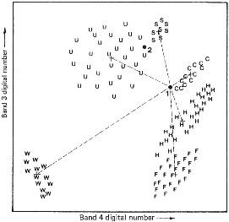
Minimum Distance to Mean Classifier
Computer determines the “n-dimensional distance” from a pixel’s value to the mean value for each signature. Order does not matter.

Slide 16
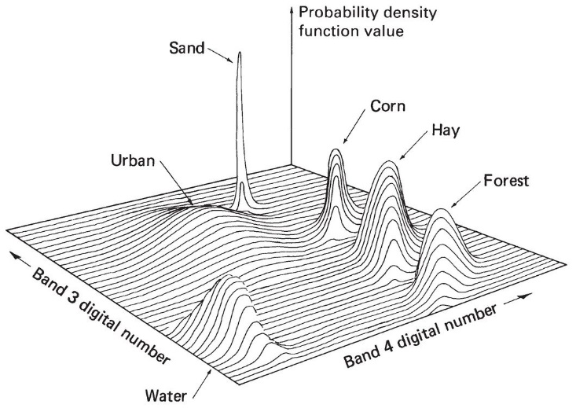
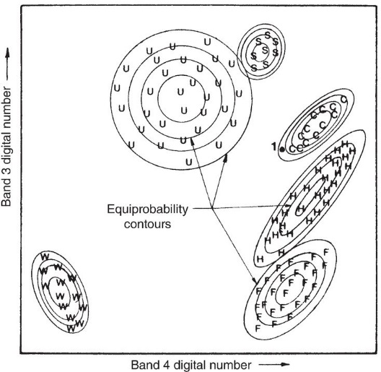
Maximum Likelihood Classifier
Statistically rigorous, probability of a pixel belonging to each class is calculated, the pixel is assigned to the “most probable” signature.

Slide 17
Unsupervised Classification
Relies on clustering algorithms to iteratively group the spectral data into homogeneous collections of spectral classes.
Iterative Self-Organizing Data Analysis Technique (ISODATA) clustering method uses spectral distance as in the sequential method, but iteratively classifies the pixels, redefines the criteria for each class, and classifies again, so that the spectral distance patterns in the data gradually emerge.

Slide 18
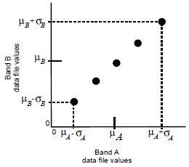
Initial Cluster Means
On the first iteration of the ISODATA algorithm, the means of N clusters can be arbitrarily determined. After each iteration, a new mean for each cluster is calculated, based on the actual spectral locations of the pixels in the cluster, instead of the initial arbitrary calculation. Then, these new means are used for defining clusters in the next iteration. The process continues until there is little change between iterations

Slide 19
Pixels are analyzed beginning with the upper left corner of the image and going left to right, block by block.
The spectral distance between the candidate pixel and each cluster mean is calculated. The pixel is assigned to the cluster whose mean is the closest.

Slide 20
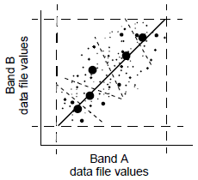
For the second iteration, the means of all clusters are recalculated, causing them to shift in feature space. The entire process is repeated—each candidate pixel is compared to the new cluster means and assigned to the closest cluster mean.

Slide 21
Hybrid Classification
Utilizes a combination of Supervised/Unsupervised techniques.
“Guided Clustering” - Training areas with known “expensive” information are delineated and used to bias the initial spectral clusters, which are then allowed to developed as they would in an unsupervised approach.

Slide 22
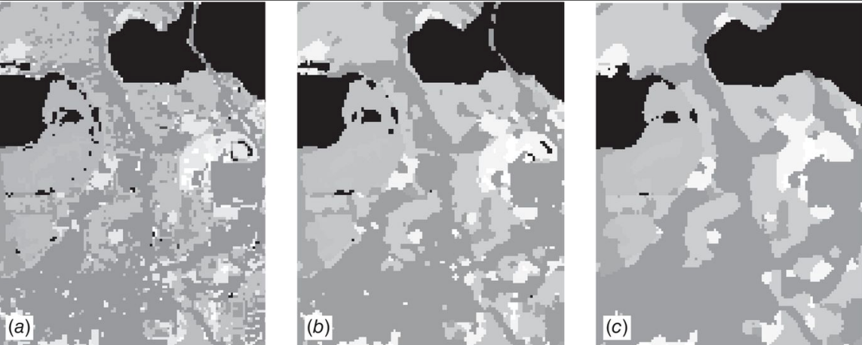
Output Stage
Classification performed
Post Classification Smoothing

Slide 23
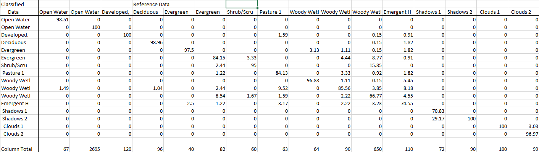
Accuracy Assessment

