Slide 1
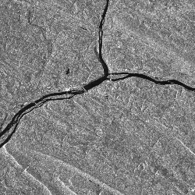
Remote Sensing of the Environment
FW4540
Advanced Terrestrial Remote Sensing
FW5540
Lecture 24
Active Sensor Theory

Slide 2
Passive remote sensing systems record electromagnetic energy that was reflected (blue, green, red, and near-infrared light) or emitted (thermal infrared energy) from the surface of the Earth.
Active remote sensors create their own electromagnetic energy that
is transmitted from the sensor toward the terrain (and is largely unaffected by the atmosphere)
interacts with the terrain producing a backscatter of energy, and
is recorded by the remote sensor’s receiver.

Slide 3
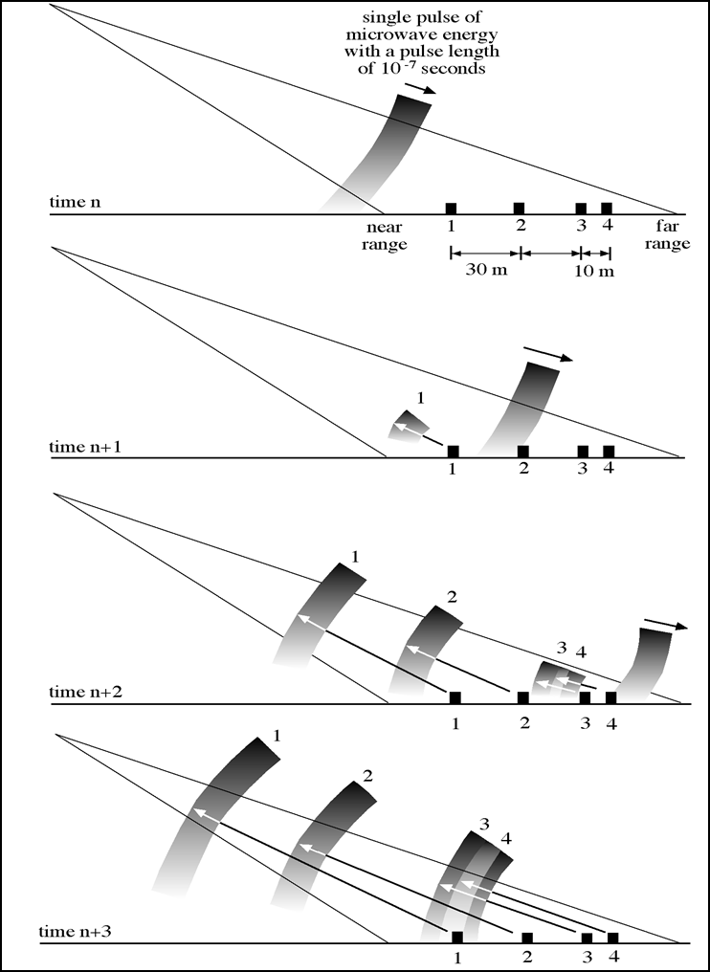
Active systems emit a short burst of energy and record the characteristics of the return “echo” after it has interacted with the reflecting objects on the ground.
This is similar to another system that we have already discussed, LIDAR.

Slide 4
The most widely used active remote sensing systems are LIDAR and active microwave (RADAR).
LIDAR = LIght Detection And Ranging
RADAR = RAdio Detection And Ranging
The only basic difference between the two systems are the wavelengths used and the methods to emit and receive the EM energy.
Radar is based on the transmission of long-wavelength microwaves (.75 – 100 cm) through the atmosphere and then recording the amount of energy back-scattered from the terrain.

Slide 5

There are several types of radar sensing system, which differ only in how the return signal is analyzed.
Doppler radar systems analyze Doppler frequency shifts to determine the relative velocity of objects.
Two objects are approaching each other (closing), the Doppler shift causes a shortening of wavelength.
When the two objects are receding from each other (opening), the Doppler shift causes a lengthening of wavelength.

Slide 6
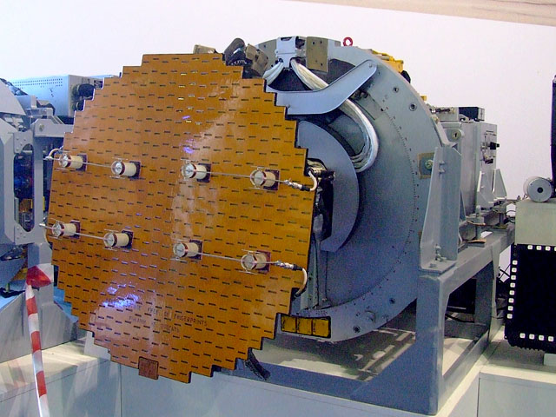
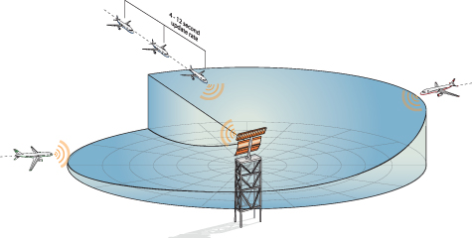
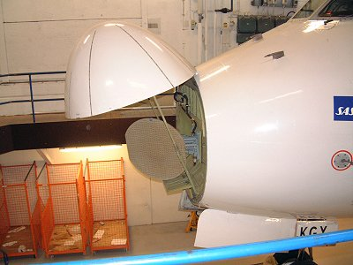
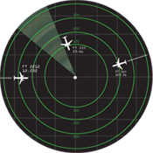
Plan Position indicator (PPI)- system with circular display on which a radial sweep indicates the position of radar “echoes”.

Slide 7

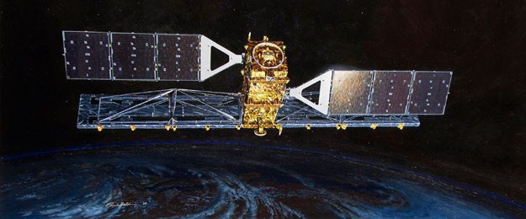
Imaging Radar Systems-Airborne or space borne systems employ systems that use an antennae fixed to the fuselage or platform.
Also referred to side looking radar (SLR) or side looking airborne radar (SLAR)

Slide 8
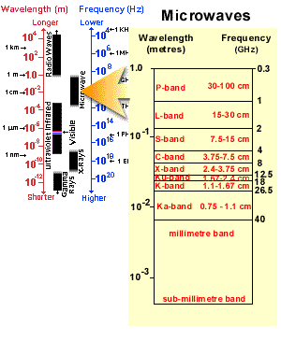
We are going to concern ourselves with the last of these types, the imaging radar systems.
As with passive systems, imaging radar has several arbitrary “bands” available to it.
Hence, like visible and near visible light, active microwave systems can be “multispectral”

Slide 9
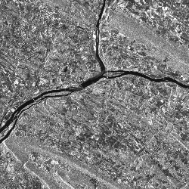
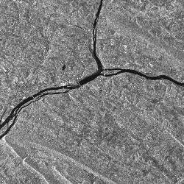
L-Band
C-Band

Slide 10
Since we have several “bands” of microwave data to work with, and because the human eye perceives colors much better than gray scales, why not combine several band of microwave data into a false color composite?

Slide 11
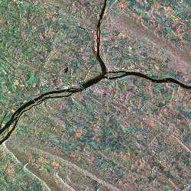
"L-BAND" – red
"C-BAND" – green
"X-BAND”- blue
The tree-covered ridges are redder than the valleys, because we assigned that color to L-band and the trees give a strong backscatter at L-band. Yellow areas are brighter in both the red and green images (L-band and C-band).

Slide 12
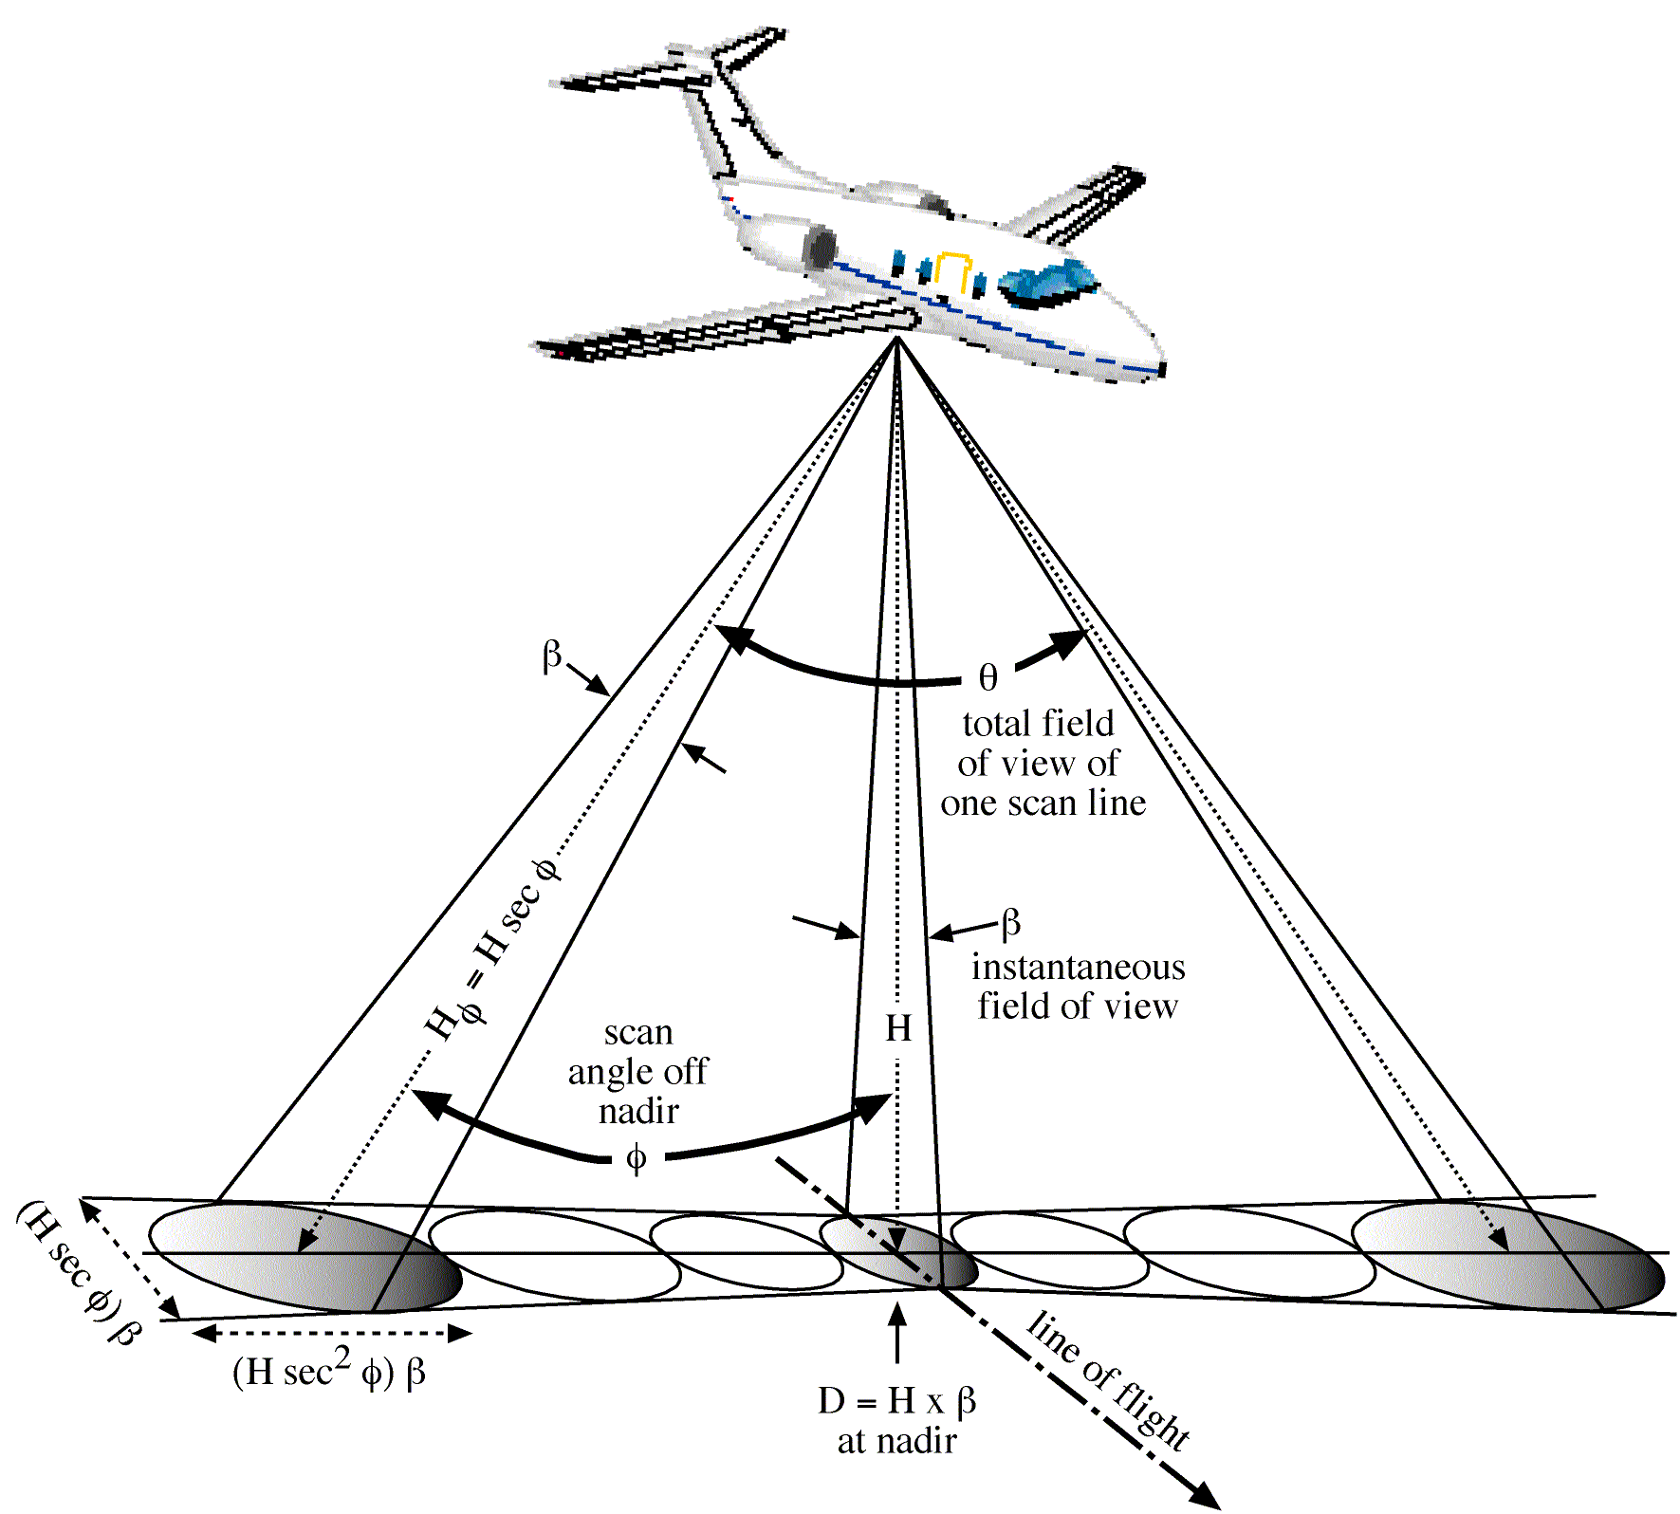
The diameter of the circular ground area viewed by the sensor, D, is a function of the instantaneous-field-of-view, β, of the scanner measured in milliradians (mrad) and the altitude of the scanner above ground level, H, where:
D = H x β
For example, if the IFOV of the scanner is 2.5 mrad, the ground size of the pixel in meters is a product of the IFOV (0.0025) times the altitude above ground level (AGL) in meters.

Slide 13
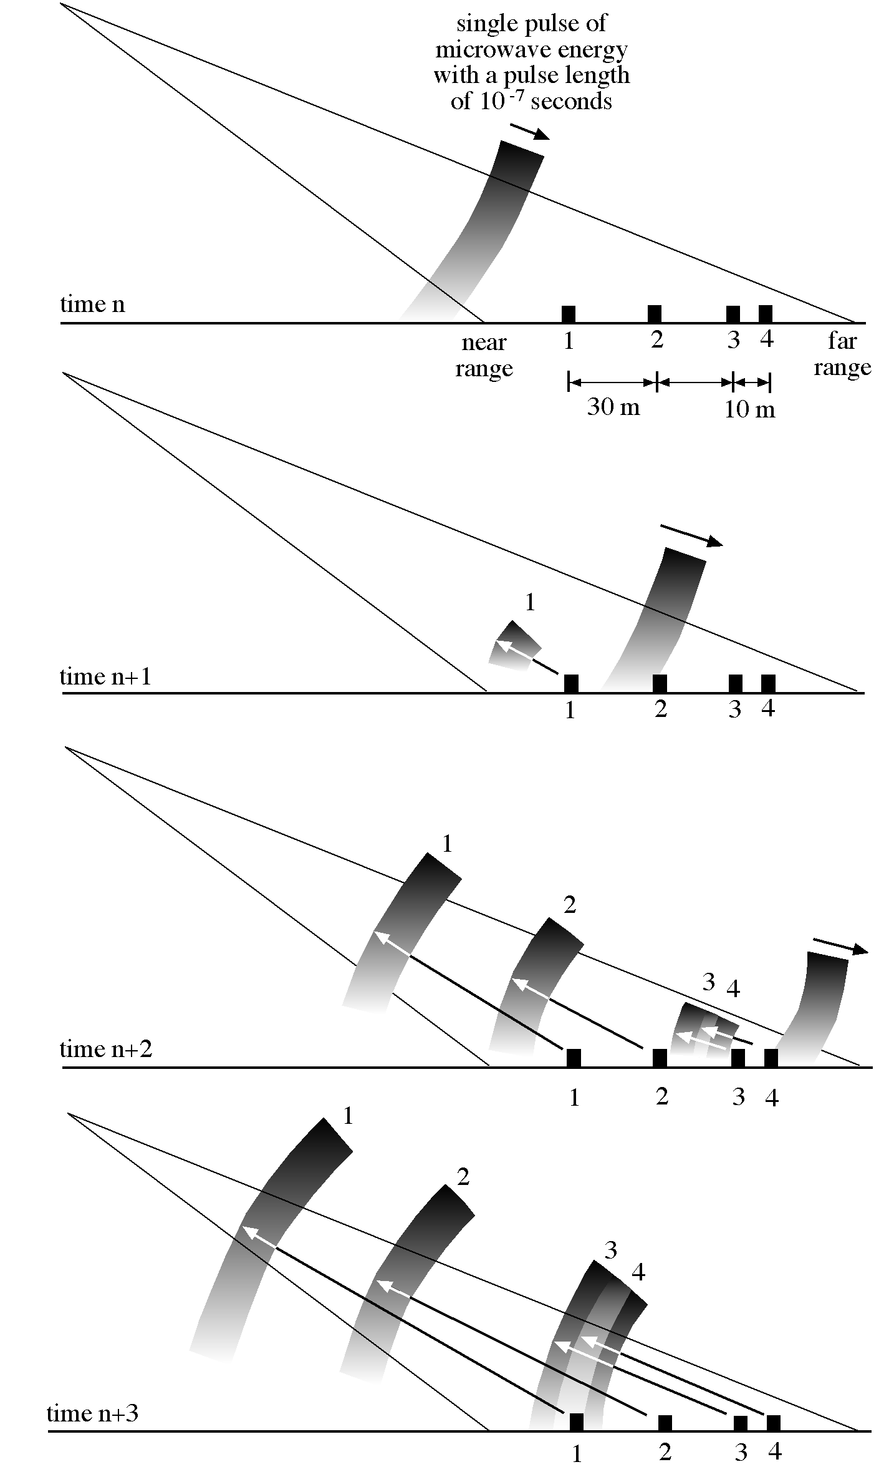
Near Range- terrain illuminated closest to the aircraft in the line of sight
Far Range- farthest point of terrain illuminated by the pulse of energy.
Range or look direction- the direction of the radar illumination that is at right angles to the direction the aircraft or spacecraft is traveling.

Slide 14
To maintain separate imaging of ground features, the reflected signals must be received separately by the antenna.
If signal is overlapped, images are blurred.

Slide 15
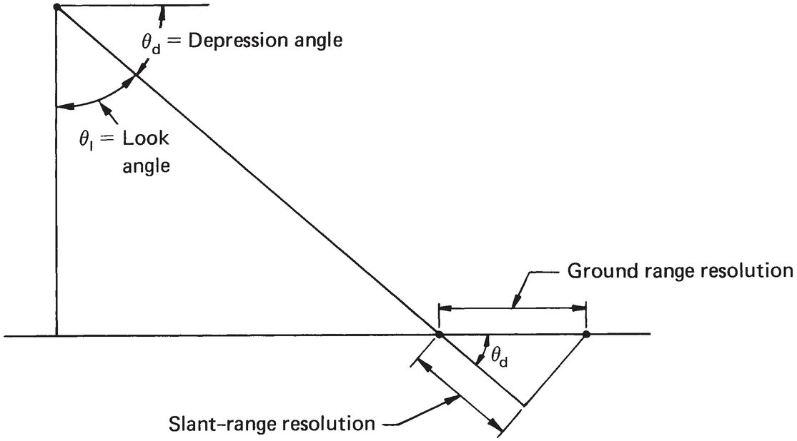
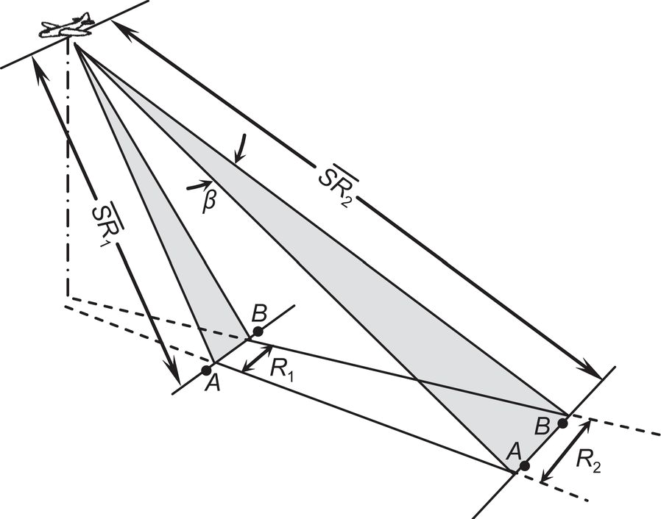
Depression Angle – vertical angle below horizontal
Slant Range – distance from the antenna to the ground at any specific depression angle
Slant Range Resolution – tangential to flight path
R_{r} = cτ/2cosθ_{d}
Azimuth Resolution – along the flight path of the platform
R_{a} = SR * β

Slide 16
The characteristics of a microwave system are dramatically different from optical systems.
There is no microwave equivalent to a shutter and lens, or even a CCD.
Radar uses an antenna to transmit and detect the EM pulse. All aspects to the system spatial spectral and radiometric resolutions are determined by the physical length of the antenna.

Slide 17
β = λ / AL
Where β is the beamwidth of the antenna (mrad)
λ is the wavelength of emitted EM energy
AL is the physical length of the antenna required
λ and AL are in the same units
To obtain a 2 mrad beam for a 5cm radar would require a 25m long antenna.
Synthetic Aperture Radar – uses advanced data recording and processing techniques to mathematically create the required antenna length from a much smaller antenna array.

Slide 18

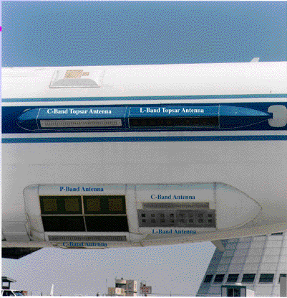
Synthetic aperture radar (SAR)- permits use of shorter antennae length to collect data. L-band is 61”, C-band 53” and P-band 73.6”.

Slide 19
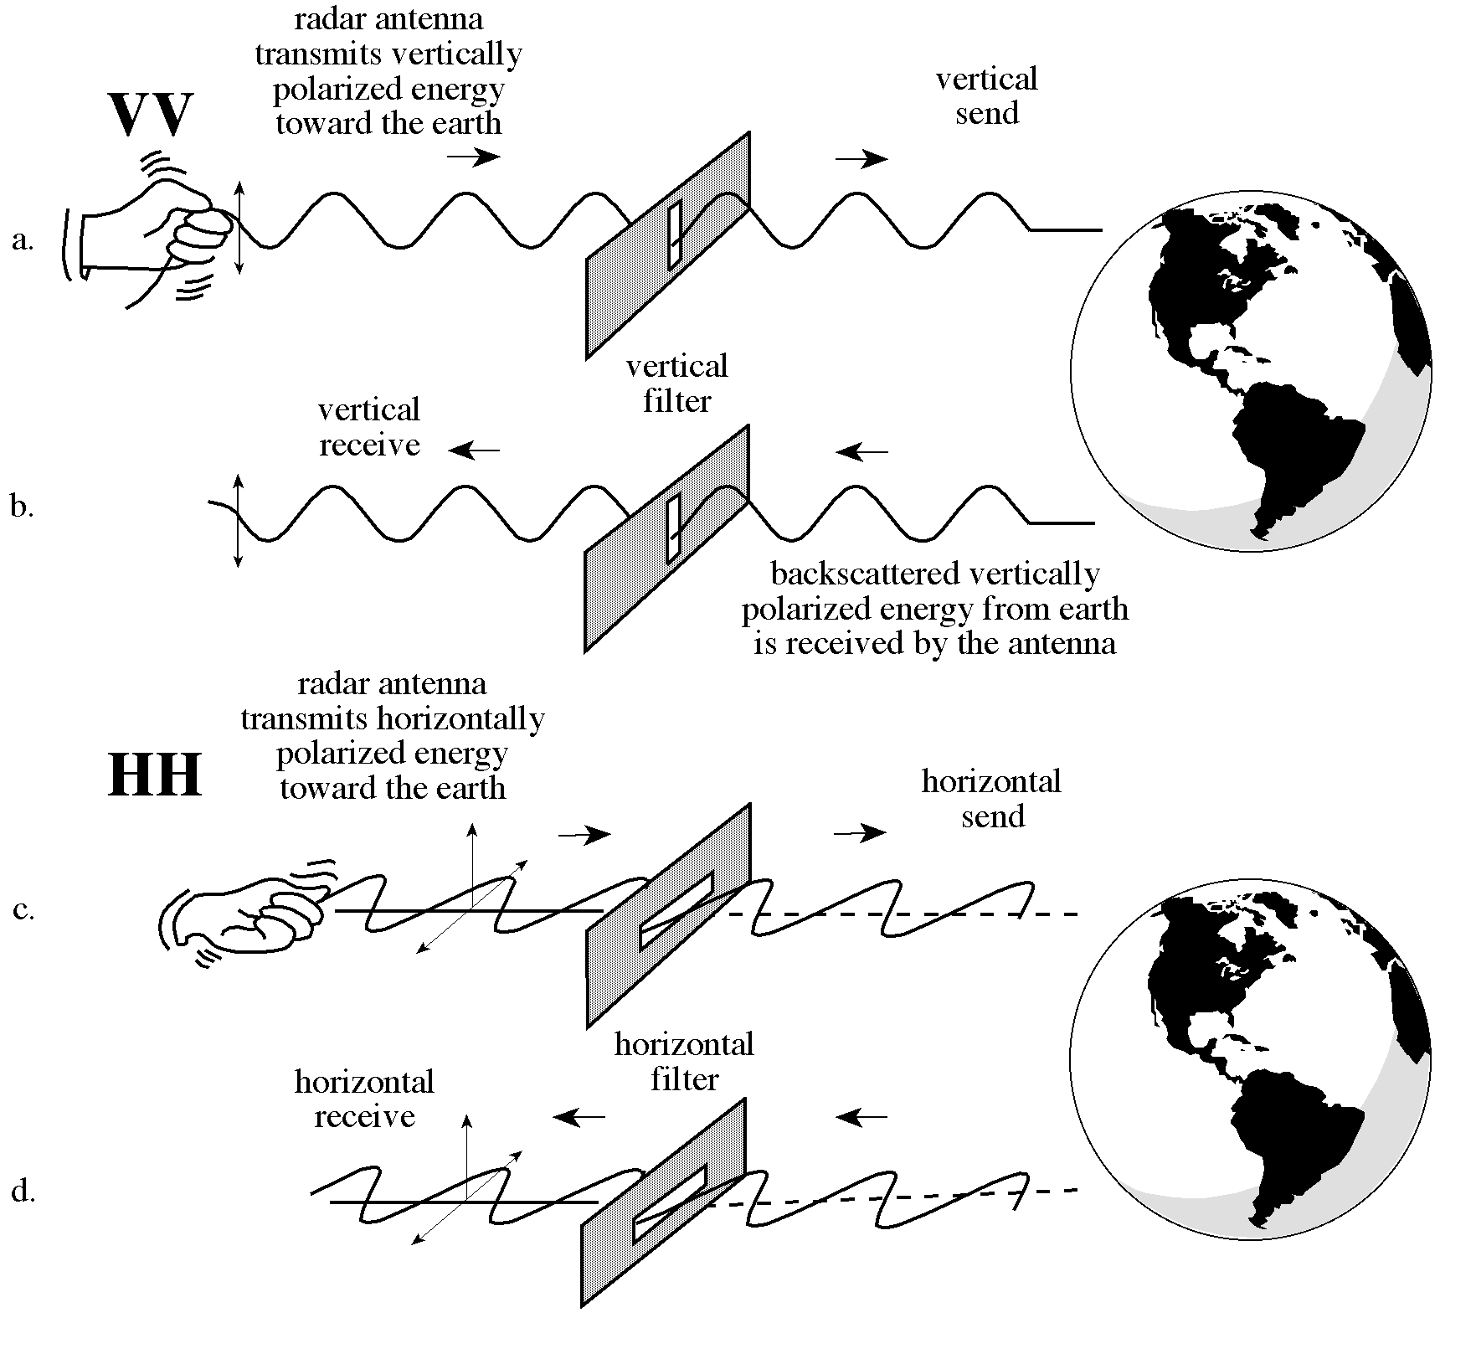
Polarization
Unpolarized energy vibrates in all possible directions perpendicular to the direction of travel.
Radar antennas send and receive polarized energy. This means that the pulse of energy is filtered so that its electrical wave vibrations are only in a single plane that is perpendicular to the direction of travel.
The pulse of electromagnetic energy sent out by the antenna may be vertically or horizontally polarized.

Slide 20
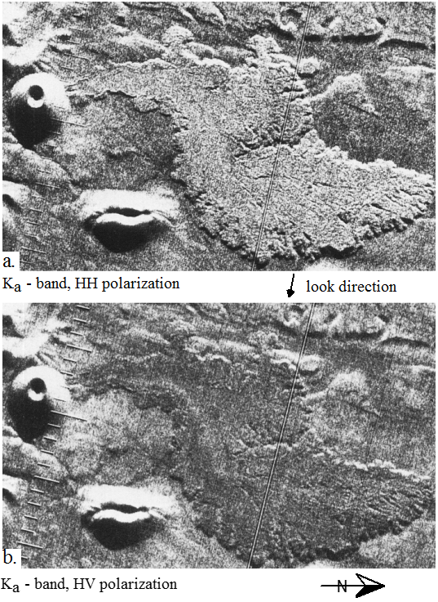
HH and VV configurations produce like-polarized radar imagery.
HV and VH configurations produce cross-polarized imagery.

