Slide 1
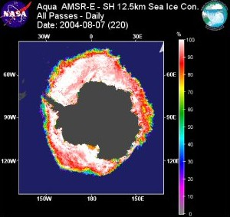
Remote Sensing of the Environment
FW4540
Advanced Terrestrial Remote Sensing
FW5540
Lecture 25
Radar Data Application
and Passive Microwave

Slide 2
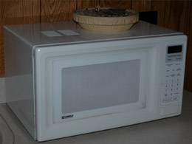
The microwave radiation of microwave ovens and some radar applications is produced by a device called magnetron.
Considering the frequency of 2,450 MHz, the wavelength of microwave oven radiation is about 12 cm.
Every microwave oven produced has a grid with small circles in the door. WHY?

Slide 3
Even though you can see into the microwave oven when your food is cooking, the microwaves are effectively blocked from getting out into the room because the holes in the metal screen on the microwave oven door are about 1 mm in diameter compared to a 120 mm wavelength for the microwaves.
The wavelength of the microwaves is about 120 times the size of the holes, and can't "see" the holes to get out.
This is an application of the fact that you cannot image anything that is smaller than the wavelength of the radiation you use to image it.
You can see through the holes because at 500 nm wavelength, the light wavelength is about 2000 times smaller than the holes.

Slide 4
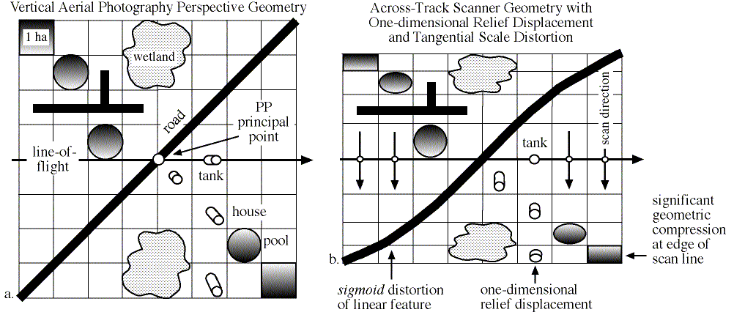
All of the usual warnings about tangential distortion apply in radar imagery

Slide 5
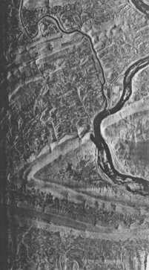
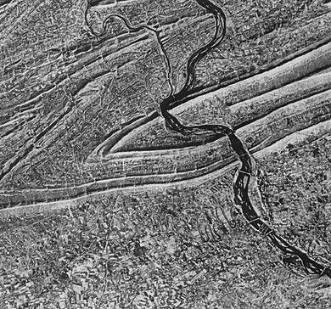
Objects that trend (or strike) in a direction that is orthogonal (perpendicular) to the range or look direction are enhanced much more than those objects in the terrain that lie parallel to the look direction.
Consequently, linear features that appear dark or are imperceptible in a radar image using one look direction may appear bright in another radar image with a different look direction

Slide 6
Primary Advantages of RADAR
Active microwave energy penetrates clouds and can be an all-weather remote sensing system.
Synoptic views of large areas, for mapping at 1:25,000 to 1:400,000; cloud-shrouded countries may be imaged.
Permits imaging at shallow look angles, resulting in different perspectives that cannot always be obtained using imagery.
Senses in wavelengths outside the visible and infrared regions of the electromagnetic spectrum, providing information on surface roughness, dielectric properties, and moisture content.

Slide 7
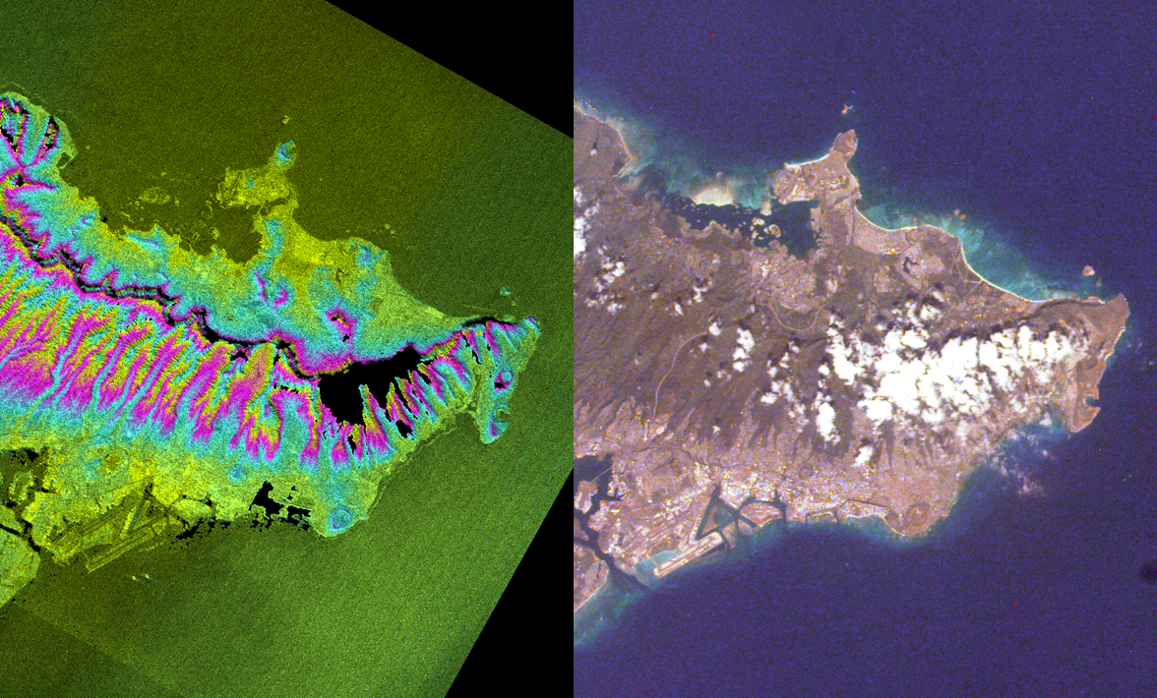

Slide 8
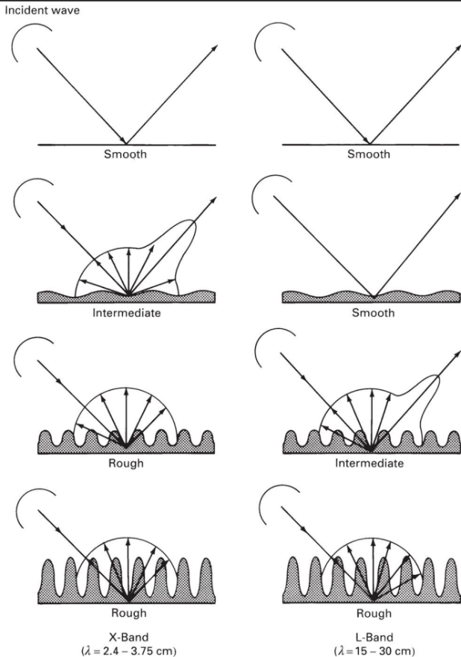
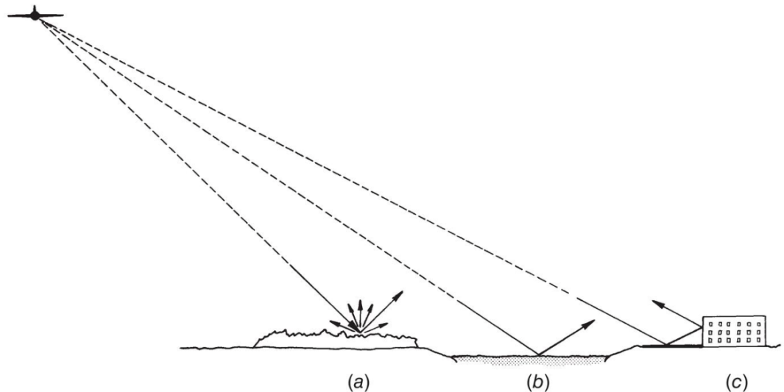
Interpretation of Radar Data – Scatter, Dielectric Properties, Moisture
Scatter – due to the “roughness” of the surface sensed. Similar to the refection characteristics of visible/near visible characteristics that we covered earlier with one exception, the corner reflector. Effects can vary with wavelength.

Slide 9
Interpreting a radar image is not a straightforward task. It very often requires some familiarity with the ground conditions of the areas imaged.
As a useful rule of thumb, the higher the backscattered intensity, the rougher is the surface being imaged.
Flat surfaces such as paved roads, runways or calm water normally appear as dark areas in a radar image since most of the incident radar pulses are specularly reflected away.

Slide 10
Dielectric Characteristics – Dielectric constant is the ratio of the permittivity of a substance to the permittivity of free space (1.000).
It is an expression of the extent to which a material concentrates electric flux, and is the electrical equivalent of relative magnetic permeability.
Most natural objects have a dielectric constant of 3 to 8. Air (at 1 atmosphere) is 1.0006. Water is about 80.
This gives us two capabilities. Ground penetration and vegetative moisture measurements. (Plus the ability to heat food in a microwave oven as the energy induces polar molecules, like water, in the food to rotate and produce thermal energy in a process known as dielectric heating.)

Slide 11
Presence of moisture in vegetation or soil GREATLY increases the surface’s reflectivity to microwave energy.
In fact changes in radar signal strength from one material to the next is much more closely linked to differences in moisture content than to differences in the material itself.

Slide 12
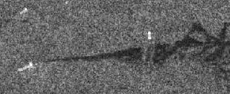
Calm sea surfaces appear dark in SAR images. However, rough sea surfaces may appear bright especially when the incidence angle is small.
The presence of oil films smoothen out the sea surface. Under certain conditions when the sea surface is sufficiently rough, oil films can be detected as dark patches against a bright background.

Slide 13
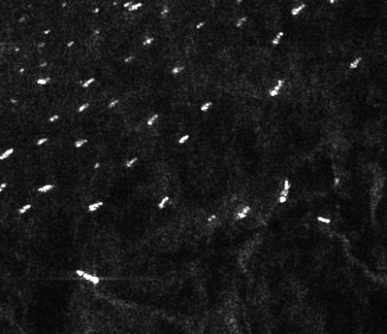
Very bright targets may appear in the image due to the corner-reflector or double-bounce effect where the radar pulse bounces off the horizontal ground (or the sea) towards the target, and then reflected from one vertical surface of the target back to the sensor.
Examples of such targets are ships on the sea, high-rise buildings and regular metallic objects such as cargo containers. Built-up areas and many man-made features usually appear as bright patches in a radar image due to the corner reflector effect.

Slide 14
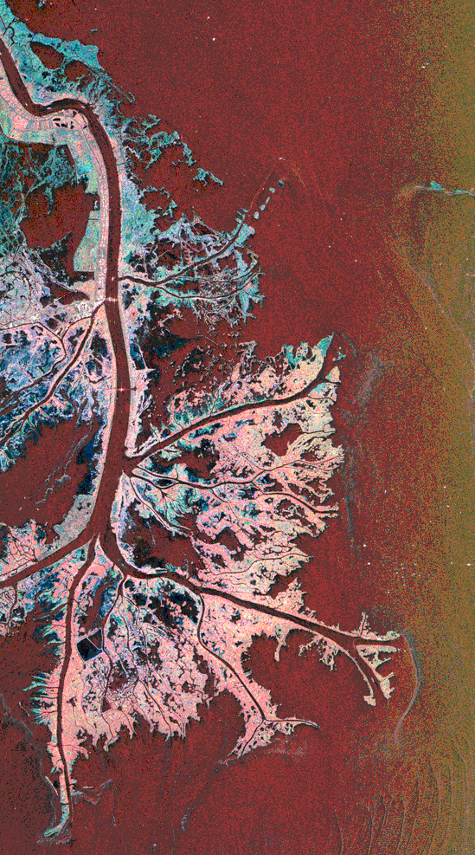
This multi-frequency image demonstrates the capability of the radar to distinguish different types of wetlands surfaces in Mississippi river deltas.
Red is L-band vertically transmitted, vertically received
Green is C-band vertically transmitted, vertically received
Blue is X-band vertically transmitted, vertically received.

Slide 15
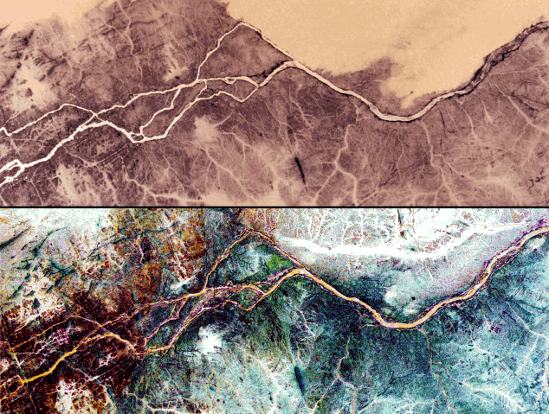
The top image is a photograph taken with color infrared film from Space Shuttle Columbia in November 1995. The radar image at the bottom was acquired by the Spaceborne Imaging Radar C/X-Band Synthetic Aperture Radar (SIR-C/X-SAR) aboard Space Shuttle Endeavour in April 1994. The thick, white band in the top right of the radar image is an ancient channel of the Nile that is now buried under layers of sand. This channel cannot be seen in the photograph and its existence was not known before this radar image was processed.

Slide 16
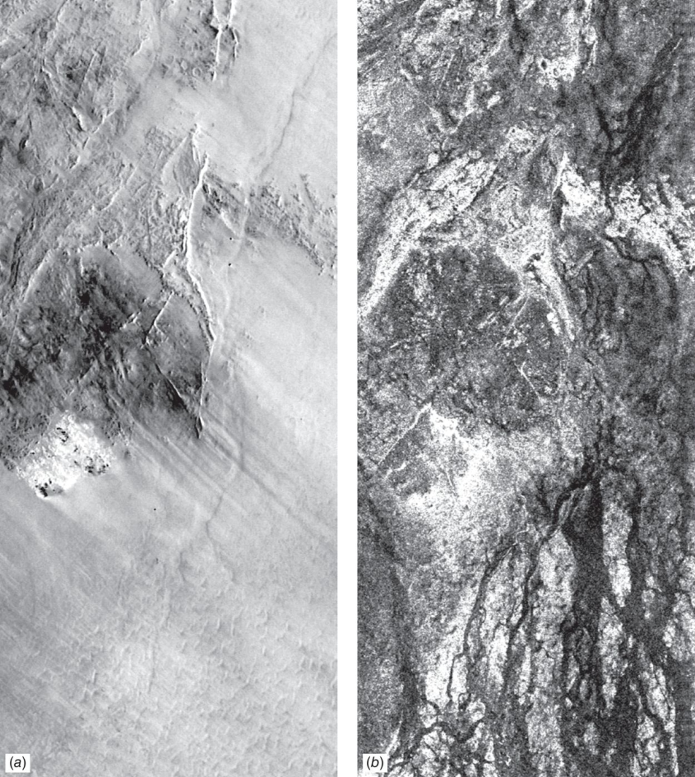
Sahara Desert
Landsat TM
SIR-C image,
L Band, HH

Slide 17
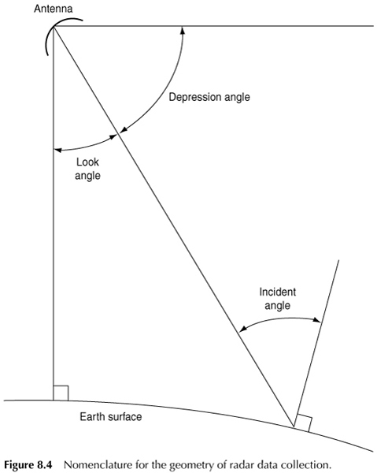
Incident Angle- angle between the radar pulse and a line perpendicular to the Earth’s surface where it makes contact.
Look angle- is the angle between the radar pulse angle and the nadir of the platform.

Slide 18
Space based Imaging Radar Platforms
Seasat 1 – 1 band, 25m resolution, sea ice detection, long period internal waves, current boundaries, eddies and water fronts. Rainfall mapping.
Almaz 1 – First commercial orbiting radar platform. Launched by the Soviet Union in 1991. Operated for 18 months. Follow up satellites were cancelled in the disruptions that followed the break up of the Union.
ERS 1 and 2 – Launched by the European Space Agency, 3 bands, 30m resolution, primarily ocean applications

Slide 19
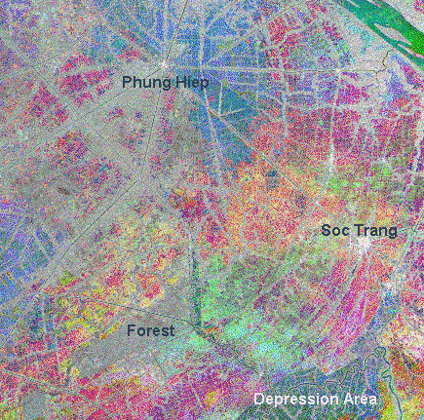
Multi-Temporal Mosaic
This image is an example of a multitemporal color composite SAR image. The area shown is part of the rice growing areas in the Mekong River delta, Vietnam, near the towns of Soc Trang and Phung Hiep.
Three SAR images acquired by the ERS satellite during 5 May, 9 June and 14 July in 1996 are assigned to the red, green and blue channels respectively for display.
The colorful areas are the rice growing areas, where the land covers change rapidly during the rice season.
The greyish linear features are the more permanent trees lining the canals. The grey patch near the bottom of the image is wetland forest.
The two towns appear as bright white spots in this image. An area of depression flooded with water during this season is visible as a dark region.

Slide 20
Shuttle Imaging Radar – SIR-A, SIR-B, SIR-C
An imaging radar system flown on the Space Shuttle three times 1981, 1984 and 1994.
First two flights were 1 band, 40m resolution with near global coverage. SIR-C was a 3 band system that focused on oceans, ecosystems, hydrology, geology, rain and clouds.

Slide 21
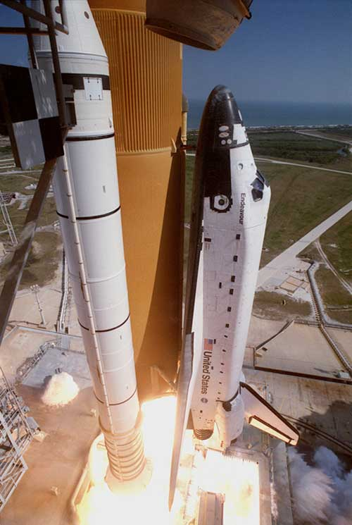
On February 11, 2000, the Shuttle Radar Topography Mission (SRTM) payload onboard Space Shuttle Endeavour launched.
With its radars sweeping most of the Earth's surfaces, SRTM acquired 12 Tb of data during its ten days of operation to obtain the most complete near-global high resolution database of the Earth's topography.

Slide 22
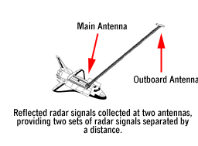
To acquire topographic (elevation) data, the SRTM payload was outfitted with two radar antennas. One antenna was located in the shuttle's payload bay, the other on the end of a 60-meter (200-foot) mast that extended from the payload pay once the Shuttle was in space. In order to gather topographic (elevation) data of Earth's surface, SRTM used the technique of interferometry.
Two images are taken from different vantage points of the same area. The slight difference in the two images allows scientists to determine the height of the surface.

Slide 23
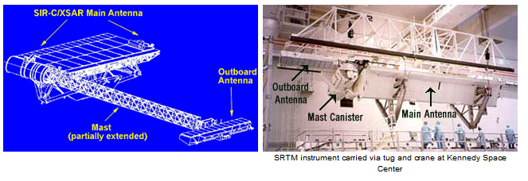
The main radar antenna transmits radar pulse.
The mast was folded up accordion-style inside a canister that was attached to the side of the main antenna. After the shuttle was in space and the payload bay doors opened, the mast emerged from the canister and extended out to 60 meters (200 feet). The SRTM mast is longest rigid structure ever flown in space

Slide 24
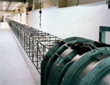
The outboard antenna was attached to the end of the mast. While inside the payload bay, the outboard antenna was folded along the top of the canister and the main antenna.
After the payload bay doors opened but before the mast was extended, the outboard antenna was partially swung down. After the mast fully extended, the outboard antenna was lowered into its operating position. The outboard antenna received the same returned pulse as the main antenna.

Slide 25
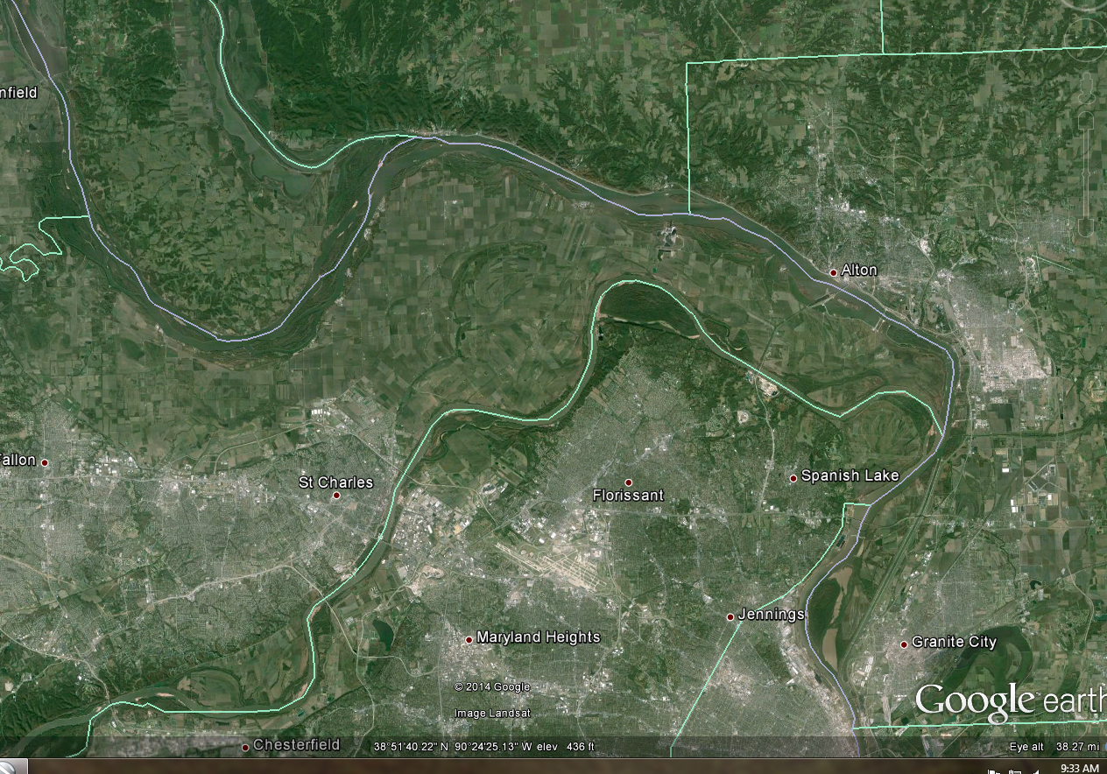

Slide 26
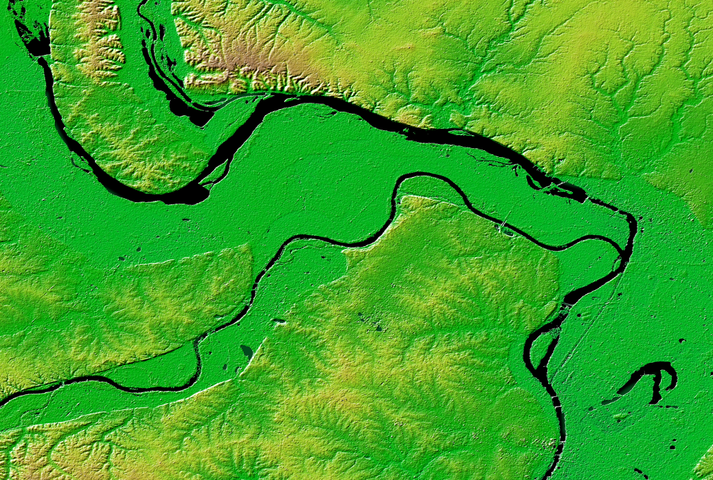

Slide 27
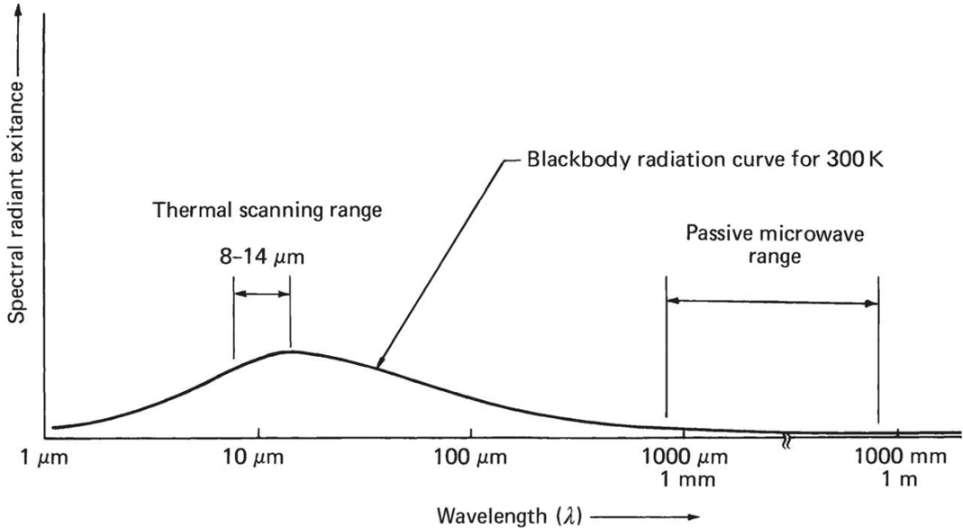
Passive Microwave Sensing
Similar to thermal scanning in concept, extreme noisy due to the very low signal levels emitted from the earth in that part of the spectrum.
Clouds do not emit much microwave radiation, compared to sea ice. Thus, microwaves can penetrate clouds and be used to detect sea ice during the day and night, regardless of cloud cover.

Slide 28
Microwave emission is not as strongly tied to the temperature of an object, compared to infrared. Instead, the object's physical properties, such as atomic composition and crystalline structure, determine the amount of microwave radiation it emits.
The crystalline structure of ice typically emits more microwave energy than the liquid water in the ocean. Thus, sensors that detect passive microwave radiation can easily distinguish sea ice from ocean.

