Slide 1
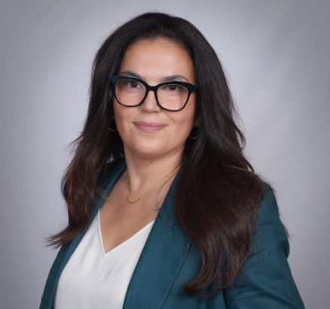
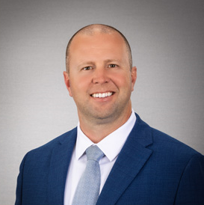
Why Rize CU partnered with MedicareCUSO For Members
Purpose-driven service, member value, and sustainable non‑interest income
Maricela Jauregui,
Director, Member Insurance & Investment Services
Stanton Furness,
CEO, Medicare For Members (CUSO)
Notes:
Brief welcome, one-line framing: today we’ll explain the why, how, and impact.

Slide 2
Agenda
Why we launched this program
Member value: service during a critical life transition
Member value: relationships, and non‑interest income
Program model & partnership with MedicareCU
Deposit Protection
Next steps / call to action
Notes:
Quick run-through so listeners know what to expect

Slide 3
The Why…… It’s simple Member-first + Strategic necessity
Members turning 65 face confusing, high-stakes choices
Rize CU’s mission: remove friction and protect member financial health
Strategic reality: aging members hold significant share of deposits and lifetime value
Fee income is shrinking; non-interest income diversification is needed
Notes:
Connect mission to market forces—this is both the right thing and smart business

Slide 4

The Member Value Proposition
Personalized Medicare education and enrollment support (no sales pressure)
Clear guidance through Part A/B, Advantage, Part D, and supplement choices
Helps avoid costly mistakes, lifetime penalties, and coverage gaps
Builds trust and deepens relationship with members at a vulnerable time
Notes:
Use 1–2 short member stories here if available (anonymized)

Slide 5


Why This Age Group Matters to Credit Unions
Seniors disproportionally hold deposits, investments, and referral potential
Many credit unions were built on the backs of our now seniors this is stewardship
Helping them now preserves deposits, deepens retention, and fuels organic growth
Notes:
Cite any internal numbers if possible (e.g., % of deposits held by 65+
Ages
50-59 15.6% deposits
60-69 26.0% deposits
70-79 23.7% deposits

Slide 6
The Business Case: Measurable Benefits
Non‑interest income stream through Medicare service offerings
Improved deposit stability and increased cross‑selling opportunities
Higher member engagement → longer lifetime value, referrals
Low capital expenditure: leverage partner expertise (MedicareCUSO) and existing channels
Notes:
Mention expected ROI timeframe and low incremental cost model

Slide 7
Program Overview & Roles
Rize CU: member outreach, trust/brand, compliance oversight, referrals
01
MedicareCU: licensed agents, enrollment support, training, regulatory compliance
02
Member experience flow: outreach → education session → enrollment assistance → follow-up
03
Safeguards: opt-in consent, data privacy, conflict‑of‑interest disclosures
04
Notes:
Walk through one member journey step-by-step

Slide 8
Medicare Expertise With a Credit Union Touch
Notes:
Sample Proforma

Slide 9
Members Need a Trusted Source
Significant stress relief for members
01
Medicare & Senior Products is confusing – just ask a senior!
Plan choices are extremely important
Drug are covered, premium cost, doctors are in-networks, dental, vision, hearing…
Members need a trusted and expert resource
A natural extension for the Credit Union
02
Our education focus and expert advice will strengthen the relationship with your members and protect their financial wellbeing against costly expense of healthcare
03
Notes:
End with Stanton briefly describing MedicareCU’s role and readiness to support; then open for questions.

Slide 10
Thank you for your time
Questions?

