Slide 1
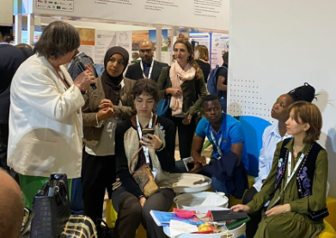
AquaFed
Education and training in water technologies on the African continent
24 May 2022
@AquaFed
www.aquafed.org

Slide 2
Feedback from AquaFed members
Question: What are you seeing in terms of equality of opportunity for women in education and training in water and sanitation in Africa?
Continuously low level of skilled, young women coming through via the education system. Little encouragement for schoolgirls.
Old-fashioned attitudes/cultural issues still apply to recruiting women and is holding them back
Women that do make it through to employment hit the glass ceiling very quickly – chances of management very limited.
@AquaFed

Slide 3
Solutions
Promotion of science and technology to schoolgirls: promotion/inclusion of STEM at an early age – change social bias.
Career Pathways: Improve understanding of young women’s routes into the sector, their skills, their career maps. AquaFed project.
Focus on job types: Accountants/managers vs obession with engineers (Philippines experience)
Networking: Try the Flashmobs that Women4Water and AquaFed launched at the World Water Forum.
@AquaFed

