Slide 1

[E1 PITCH DECK INSTRUCTIONS]
Remove this slide before presenting!
Read the purpose of each slide.
Review the included samples so that you can see
the different ways you can present your information.
Choose the format that works best for your business. Be sure
to include all of the information listed on the instructions slide.
Delete all instructional slides. You only need your completed slides.
Make this plan yours by customizing and including information
that helps you tell your story!

Slide 2
[SLIDE DESIGN TIPS]
Remove this slide before presenting!
Express points clearly and concisely.
  Avoid long sentences
  A good rule is no more than 5 bullets with 5 words each
  Demonstrate numbers with visuals and graphs (Tab: Insert > Chart)
  Use tables to organize information (Tab: Insert > Table)
Use consistent language/verb tense throughout
Keep to a simple, on-brand color scheme
  Too many colors make text hard to read
  Too much animation can be distracting

Slide 3


[TITLE]
Remove this slide before presenting!
This slide is simply a placeholder
to be displayed while you introduce yourself
to the judges and audience members.
Be sure to include:
  Business name
  Logo
  Your name
  Slogan
  Social media pages

Slide 4
TITLE

Slide 5


[PROBLEM / OPPORTUNITY]
Remove this slide before presenting!
Clearly explain how your target market has a problem
that is not being met by other products or services.
Be sure to include:
  A description/image of the target customer​
  A description/image of the target customer’s problem
  Data that shows this problem affects enough people
  to create a business opportunity
Lean Canvas:
Problem, Customer Segments

Slide 6
PROBLEM / OPPORTUNITY

Slide 7
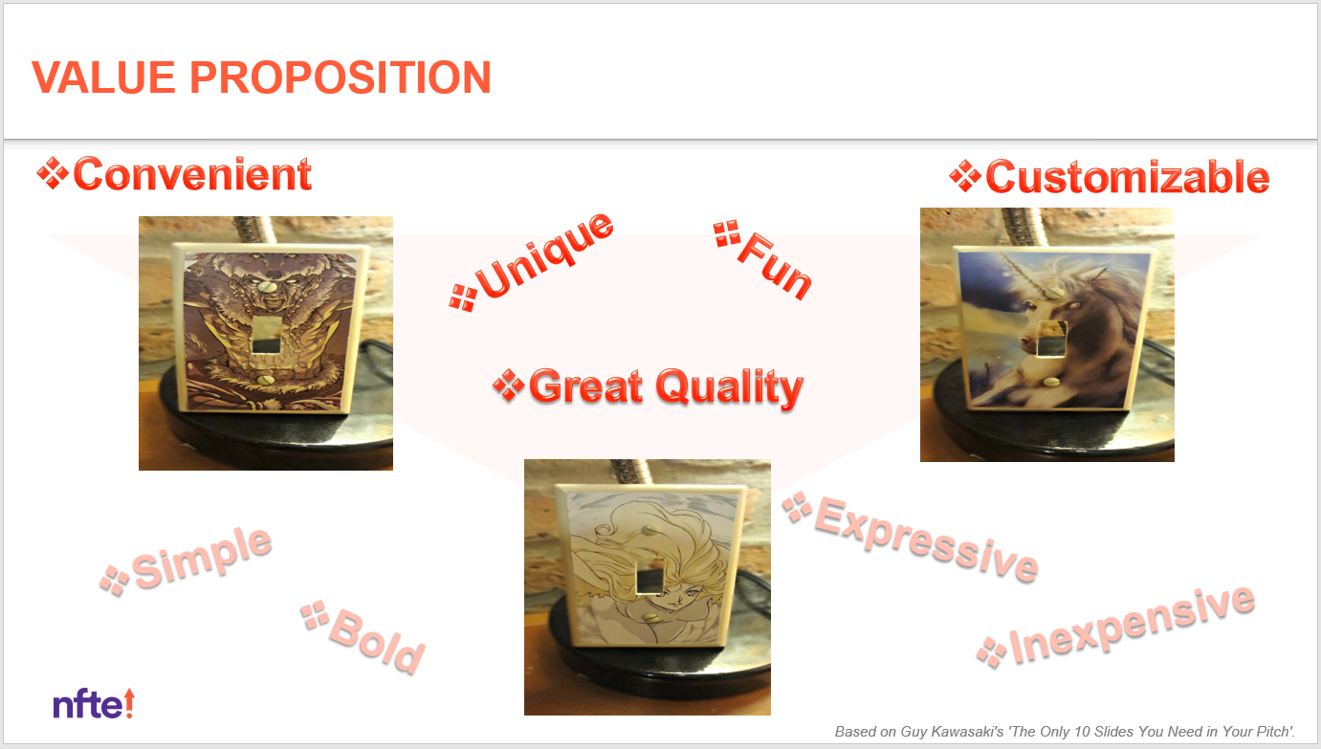

[VALUE PROPOSITION]
Remove this slide before presenting!
Clearly explain how your business will be able
to solve the problem or fulfill the unmet need
described on the previous slide.
Be sure to include:
  A description of how the business solves the problem
  A summary of the features and benefits the business
  provides to its customer segments
  Your value proposition and/or mission statement
Lean Canvas:
Solution, Unique Value Proposition

Slide 8
VALUE PROPOSITION

Slide 9
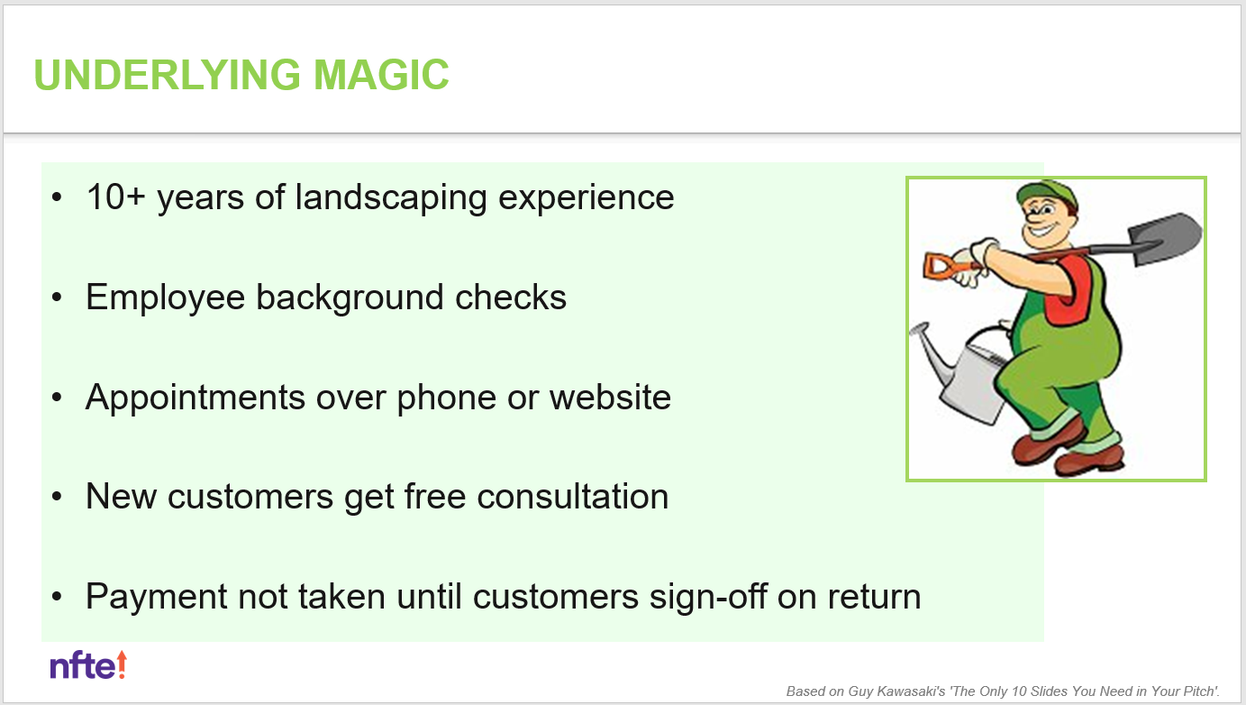
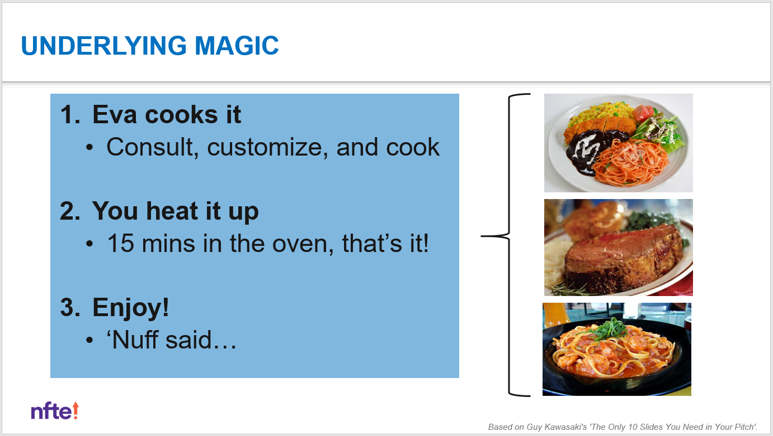
[UNDERLYING MAGIC]
Remove this slide before presenting!
Explain what your product or service is,
what its special features are,
and the special sauce that gives it its edge.
Be sure to include:
  A description or images that show the technology,
  secret sauce, or magic behind the business
  (e.g. how it works, what's under the engine,
  non-tangible benefits)
  Your unique knowledge that contributes to the magic
Lean Canvas:
Unique Value Proposition, Unfair Advantage

Slide 10
UNDERLYING MAGIC

Slide 11
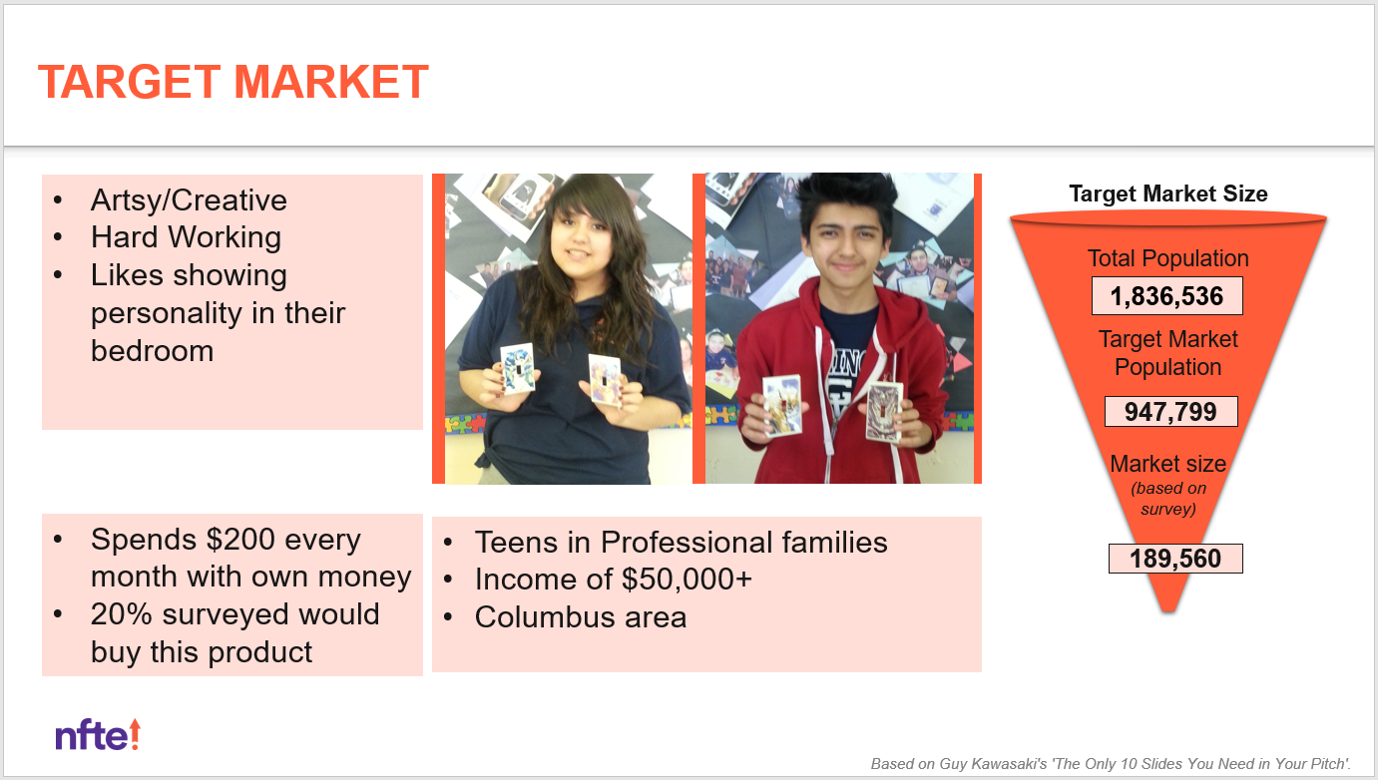
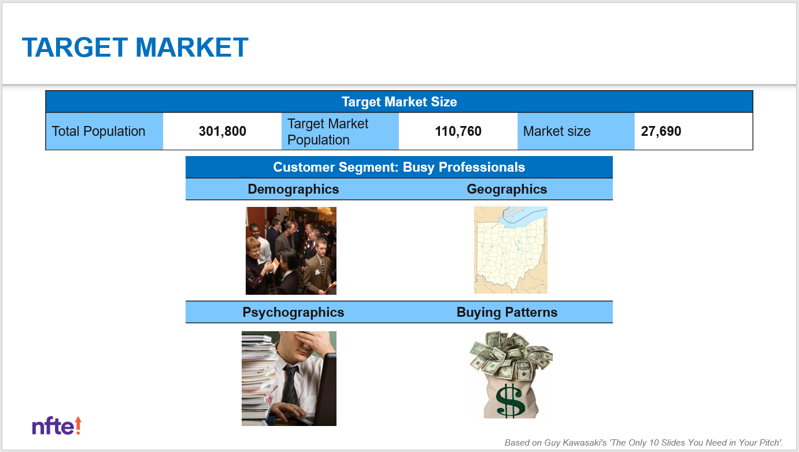
[TARGET MARKET]
Remove this slide before presenting!
Provide a detailed look at the customers in your target market.
Be sure to include:
  Profiles of your target market, organized by customer segment
  Info about your customer segments such as demographics,
  geographics, psychographics, and buying patterns
  Research data that show:
    Your potential customers believe your business can solve
    their problem or unmet need,
    Your potential market size
Lean Canvas:
Problem, Customer Segments

Slide 12
TARGET MARKET

Slide 13
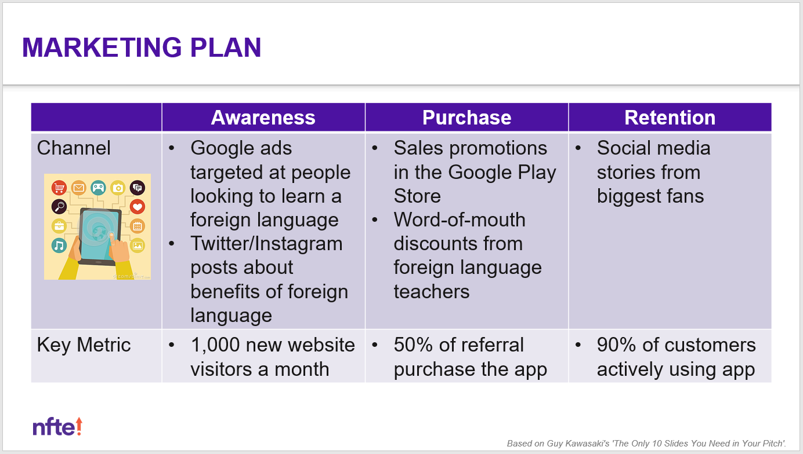
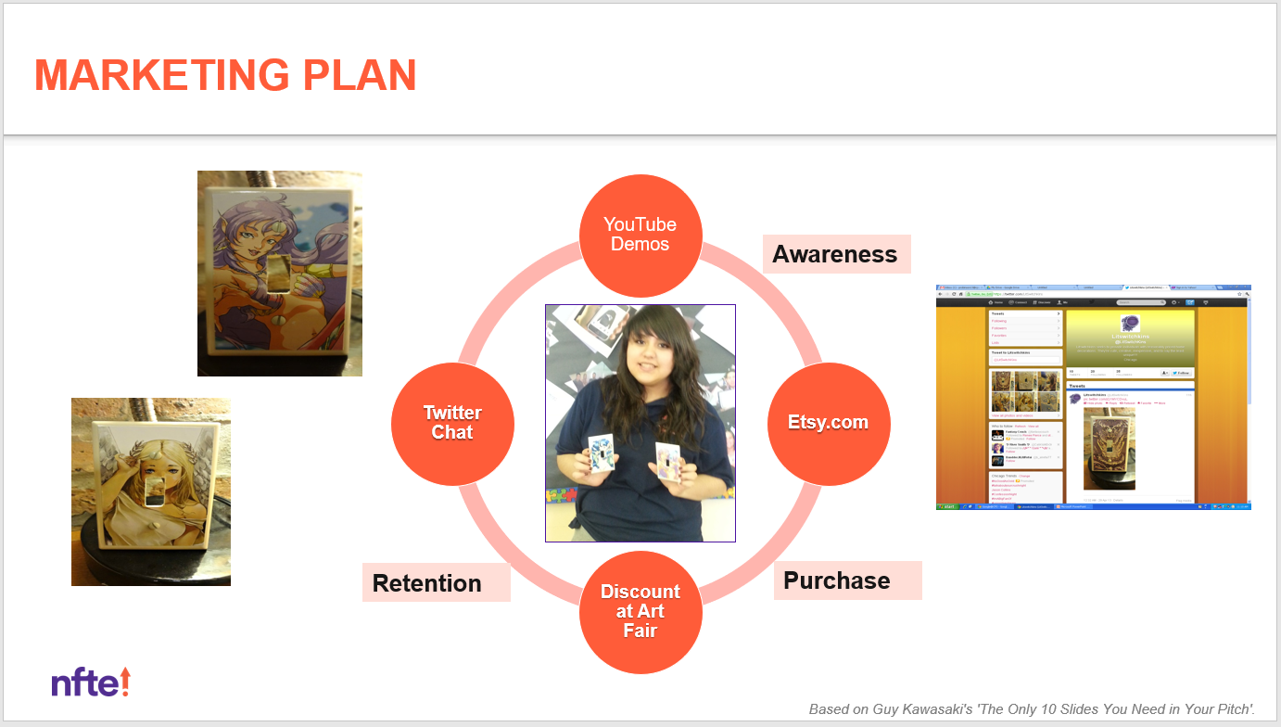
[MARKETING PLAN]
Remove this slide before presenting!
Show how you plan to promote your product or service
to potential customers and engage with your target market.
Be sure to include:
  Marketing goals and the key metrics used to measure
  the effectiveness of your marketing campaign
  A description or images of chosen promotional channels
  and why they were chosen (cost, effectiveness)
  A description or images of chosen retention/engagement
  strategies and why they were chosen (cost, effectiveness)
Lean Canvas:
Channels, Key Metrics, Customer Segments

Slide 14
MARKETING PLAN

Slide 15
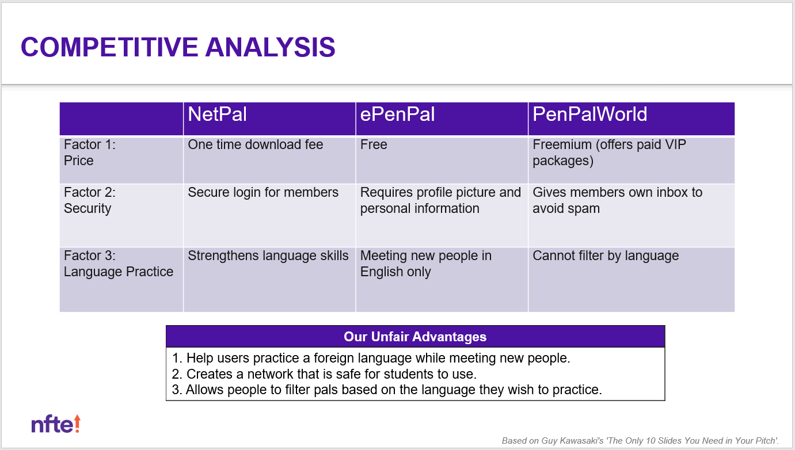
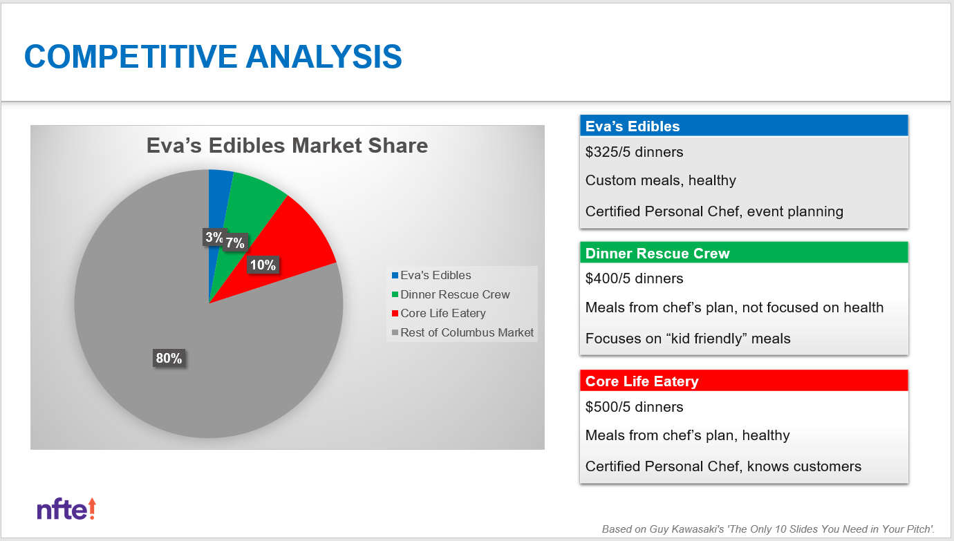
[COMPETITIVE ANALYSIS]
Remove this slide before presenting!
Show you have thoroughly researched your industry
and competitors, and that your business has at least
one feature that makes it unique from your competitors.
Be sure to include:
  Data that show your industry is growing and competitive
  A description or images of your main direct/indirect competition
  An explanation or design of your competitive advantage
  Your estimated market share
Lean Canvas:
Unique Value Proposition, Unfair Advantage

Slide 16
COMPETITIVE ANALYSIS

Slide 17
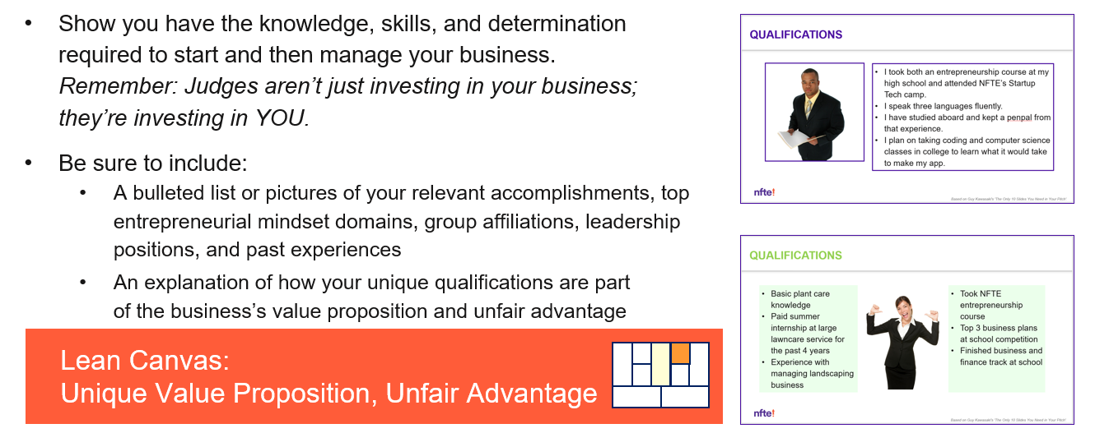


[QUALIFICATIONS]
Remove this slide before presenting!
Show you have the knowledge, skills, and determination
required to start and then manage your business.
Remember: Judges aren’t just investing in your business;
they’re investing in YOU.
Be sure to include:
  A bulleted list or pictures of your relevant accomplishments, top
  entrepreneurial mindset domains, group affiliations, leadership
  positions, and past experiences
  An explanation of how your unique qualifications are part
  of the business’s value proposition and unfair advantage
Lean Canvas:
Unique Value Proposition, Unfair Advantage

Slide 18
QUALIFICATIONS

Slide 19
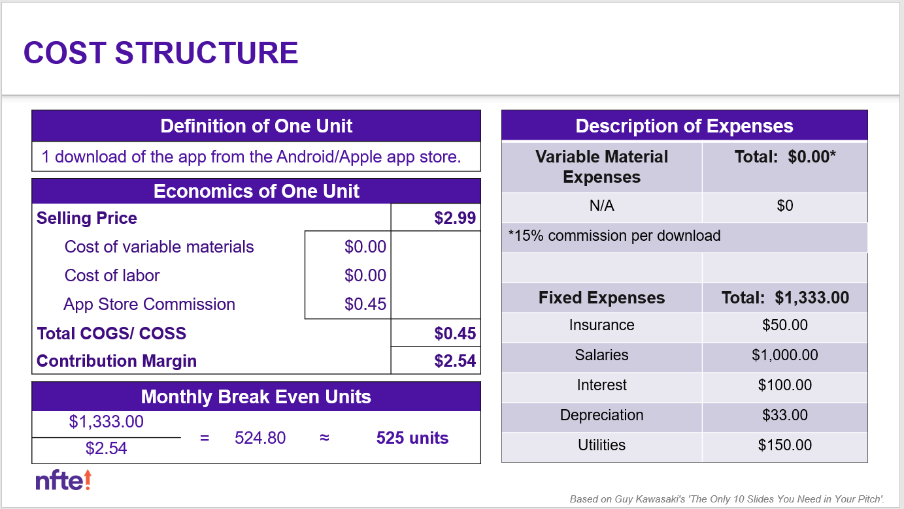
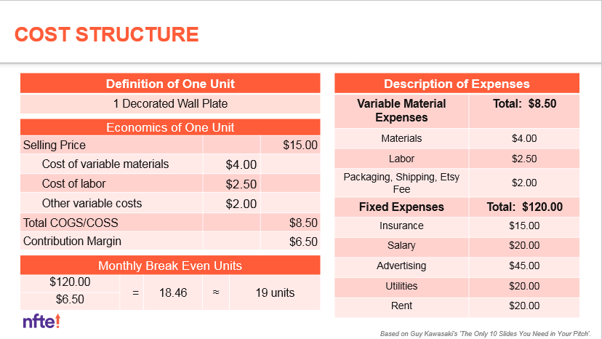
[COST STRUCTURE]
Remove this slide before presenting!
Show you can feasibly produce your product or execute
your service in a cost-effective and time-efficient manner.
Be sure to include:
  Definition of One Unit
  COGS or COSS
  EOU
  Description of Fixed and Variable Expenses
  Break-Even Units
Lean Canvas:
Cost Structure, Revenue Streams

Slide 20
COST STRUCTURE
Definition of One Unit
[text]
Description of Expenses
Variable Material Expenses | Total: $
Item | $
Fixed Expenses | Total: $
Item | $
Economics of One Unit
Selling Price |  | $[value]
Cost of variable materials | $[value]
Cost of labor | [value]
Other variable costs | [value]
Total COGS/ COSS |  | $[value]
Contribution Margin |  | $[value]
Monthly Break Even Units
$[month exp] | = | [value] | ≈ | [value] units
$[con margin]

Slide 21
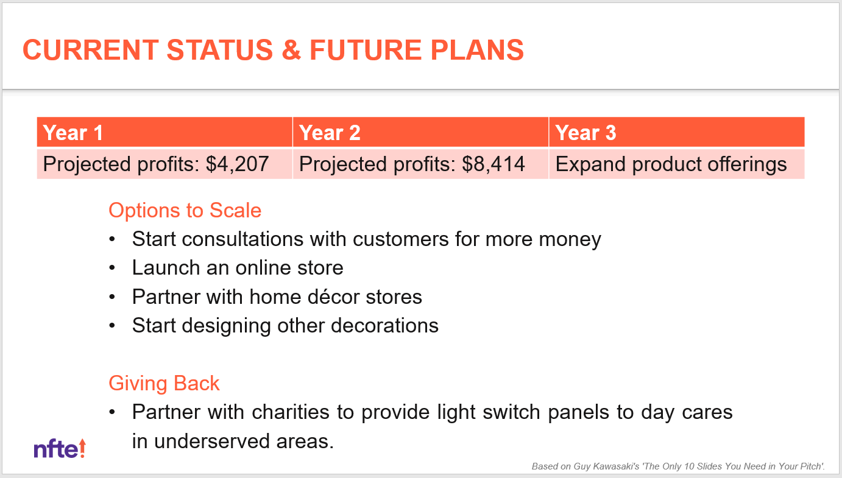
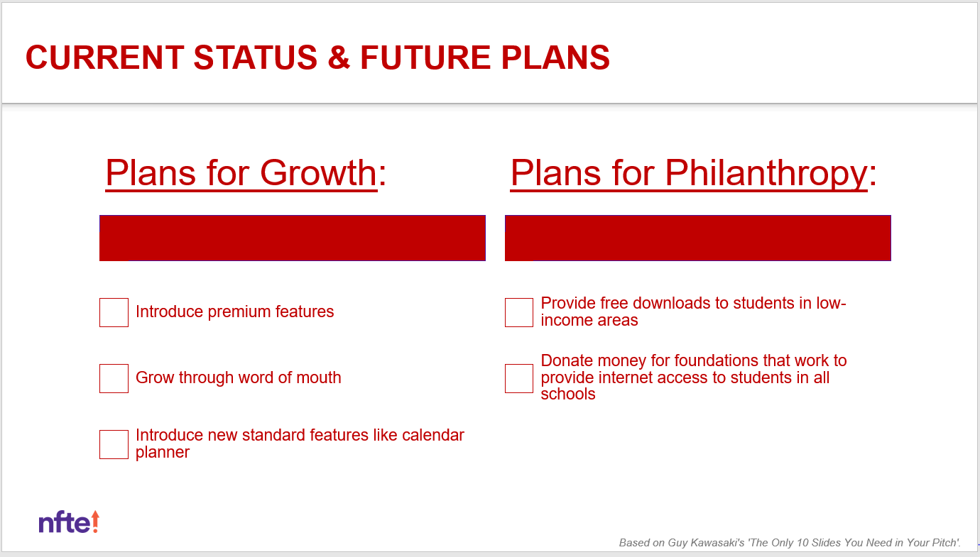
[CURRENT STATUS & FUTURE PLANS]
Remove this slide before presenting!
Explain what you would do at launch and beyond the first year.
Highlight business growth goals and opportunities
for additional education, training, or funding.
Be sure to include:
  An overview of your business’s current status (near future)
  plus next steps, including 2–3 next steps you need to take
  to make your business fully operational
  An overview of what costs are expected / money will be needed
  once the business is up and running
  2–3 education, training, or mentoring opportunities
  to help with your business
  Immediate social responsibility plans and long-term
  philanthropy goals

Slide 22
CURRENT STATUS & FUTURE PLANS

Slide 23
[TITLE]
Remove this slide before presenting!
This slide is simply a placeholder
to let judges know you are finished and to be displayed during judge’s questions.
Be sure to include:
  Business name
  Logo
  Your name
  Slogan
  Social media pages

Slide 24
TITLE

