Slide 1


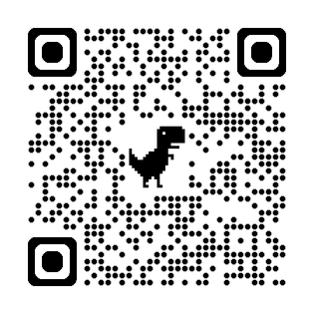
Instruction
Quick Steps: Complete your Lessonup plans and then use the Creative Deck sheets. Once approved, then put it together on Google Slides. HERE IS THE LESSONUP JOIN CODE: woohr
https://lessonup.app/invite/group/woohr
✅ Plan & Design
  Use each page to plan what your final PowerPoint or display will look like.
✅ Keep It Simple
  Use 1–2 words per bullet point.
  Write neatly & clearly.
✅ Be Creative
  Color in a unified theme — pick 2 colors (warm or cool).
  Add borders, doodles, and decorations.
✅ Show Your Process
  Use this as a reference for your final business plan slides.
  Make sure your ideas are clean, creative, and clear.
✅ Approval Ready
  This deck must be neat and fully colored.
  Meet with your teacher for approval before you begin working on your final version.
You must have your parent's signature of Approval ______________________ Date:___________
COPYWRITE 2025 MONEY MOVEZ:COOK OR BE COOKED
Page 0

Slide 2
Money Movez Mindset
Hey Money Mover!
In the Money Movez program, we don’t just play—we invest in ourselves.
When you show strong character, you build a diversified portfolio… just like a smart investor who doesn’t put all their eggs in one basket.
Money Movez Mindset Traits we’re watching for:
  Creativity – You bring new ideas or cool solutions.
  Grit – You keep going, even when it’s hard.
  Curiosity – You ask questions and want to learn more.
  Problem-Solving – You figure stuff out and help fix it.
  Confidence – You speak up and believe in yourself.
  Communication – You listen well and share your ideas clearly.
I agree to invest in myself and grow my value by living out these 6 traits.
Name: ___________________________
Signature: ________________________
Date: ____________________________
Page 1
Write your business name, your name, age, grade, draw your logo, and add your name.
COPYWRITE 2025 MONEY MOVEZ:COOK OR BE COOKED

Slide 3

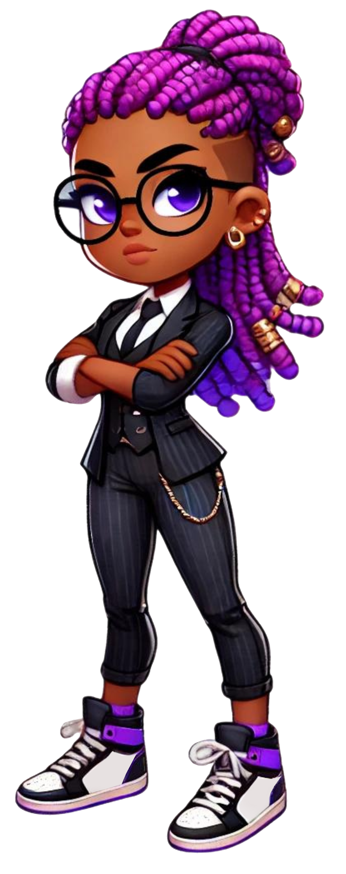
Welcome to My Business
______________________
______________________
Page 1
Write your business name, your name, age, grade, draw your logo, and add your name.

Slide 4
Problem / Opportunity
1.______________
2.______________
3.______________
Describe the problem you're solving. Draw what it looks like.
Page 2

Slide 5
Value Proposition
1.______________
2.______________
3.______________
Explain how your business solves the problem. Draw your idea in action.
Page 3

Slide 6

Draw your Secret Sauce
Underlying Magic
1.______________
2.______________
3.______________
Show what makes your idea unique. Add magic sparkles!
Page 4

Slide 7

Draw Your Customer
Target Market
Geographic
Demographic
1.______________
1.______________
2.______________
2.______________
3.______________
3.______________
Psychographics
Behavior
1.______________
1.______________
2.______________
2.______________
3.______________
3.______________
Who will buy your product? Draw your customers.
Page 5

Slide 8


Marketing Plan
1.______________
Awareness
2.______________
Purchase
3.______________
retention
How will you tell people about your business? Draw flyers, ads, or social media.
Page 6

Slide 9

Competitive Analysis
____________
_____________
____________
____________
1.______________
1.______________
VS
2.______________
2.______________
3.______________
3.______________
My Business
My Competitor
Who else does this? Draw you vs. competitors.
Page 7

Slide 10


Qualifications
1.______________
2.______________
3.______________
4.______________
5.______________
6.______________
What skills do you have? Draw yourself as a superhero!
COPYWRITE 2025 MONEY MOVEZ:COOK OR BE COOKED
Page 8

Slide 11


Cost Structure
Selling Price
COGS
PROFIT
What will you spend money on? Draw dollar signs and coins.
Page 9

Slide 12


Current Status & Future Plans
CURRENT STATUS
FUTURE PLANS
1.______________
1.______________
2.______________
2.______________
3.______________
3.______________
What have you done so far? What's next? Draw a progress bar.
Page 10

Slide 13
Thank You for you consideration
_______________________
_______________________
Page 1
Write your business name, your name, age, grade, draw your logo, and add your name.

