Slide 1

On-Line Analysis and control of Shredded Aluminum
Using gamma-tech cb-rm analyzer

Slide 2
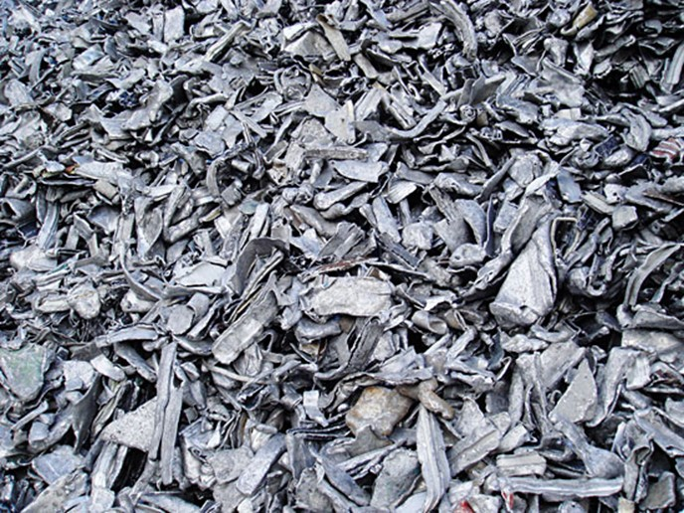
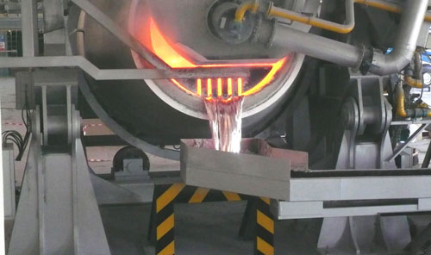
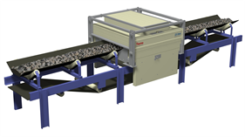
Value of The Analyzer in The Aluminum Industry
The Value
The value of knowing what we are buying &melting – removing the hidden costs
The value as process control instrument to provide means to change the scrap product

Slide 3


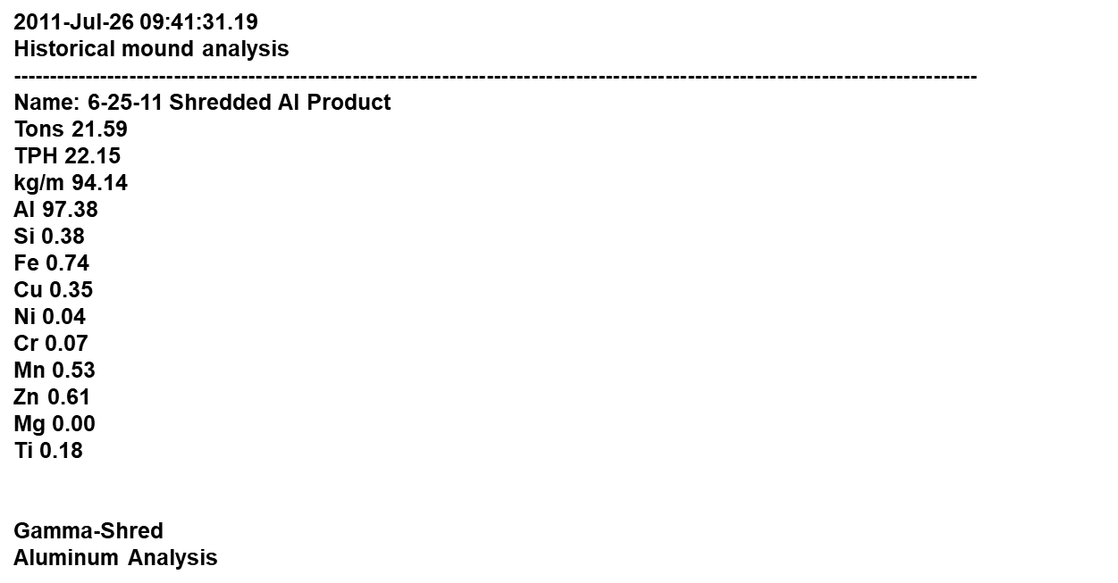

The Value of Knowing
Removing the unknown
Known Analysis
Product Chemistry
Prime
Charge Optimization
RSI
Class
Home
UBCs
Hidden Variability
Product Chemistry
Shred
Problems

Slide 4
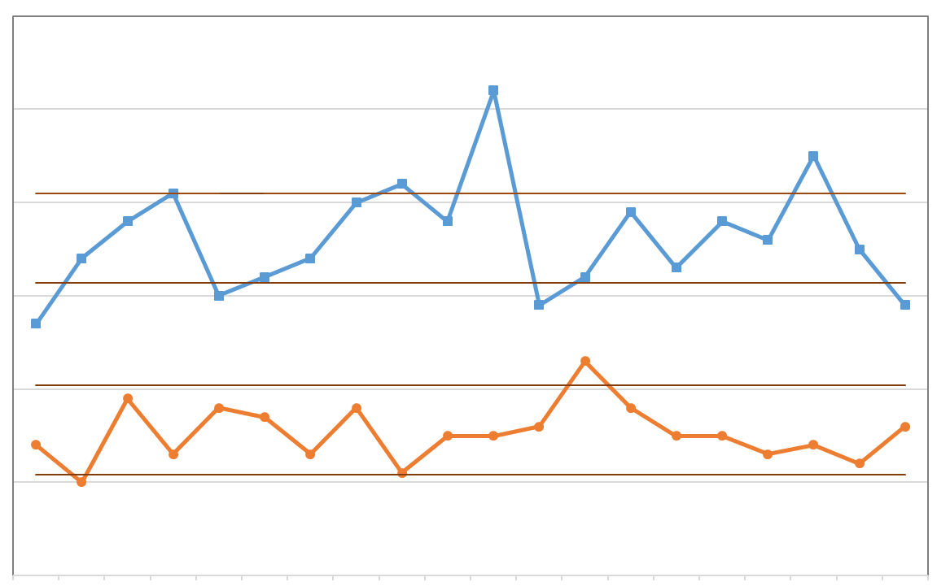
The Value of Improved Process Control
Changing The Scrap Product
Charge Optimization
Product Chemistry
Shredder Before Analyzer
Shredder After Analyzer

Slide 5
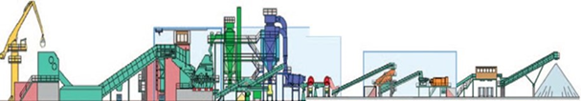
The Value of Analyzed Shredded
Charge Optimization
Diluents
Class
Prime
Home
RSI
The Value - Minimize Diluents
UBCs
Lower Raw Material Cost
Environmental Impact - Lower CO₂
Increase Productivity
GammaShred
Analyzer Installed where Scrap is Processed

Slide 6
Analyzer performance for selected elements
Element | Accuracy† | Range
Si | ±0.05% | 0.44 - 0.65%
Fe | ±0.03% | 0.31 - 0.46%
Cu | ±0.02% | 0.09 - 0.23%
Cr | ±0.01% | 0.02 - 0.05%
Mn | ±0.01% | 0.23 - 0.43%
Zn | ±0.07% | 0.10 - 0.27%
CB-RM Results vs. Furnace
9 - 40,000 lb. loads.
August 2019 – July 2020
† RMSD, 1-hour sample period

Slide 7
accuracy plots

Slide 8
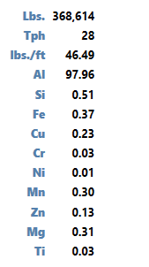
Production
Daily production run
Controlled for Si and Cu limits
Analysis allows for control
Handling and shipping mixes material
Final chemistry meets spec

Slide 9
Value
For the Shred Consumer:
Furnace has experienced no out of spec shipments in more than 1 year.
More than 100 million pounds of analyzed shred has been melted.
Allows for increase in shred usage and decrease of prime grades and RSI.
Shredders ability to analyze and blend increases availability of shred.
For the Shred Processor:
Shredder reduces/eliminates downgrades.
Can blend from more sources to increase to production.
Improves quality
Improved quality translates to increase in demand (in this case shredder has increased shipments by 23%).

Slide 10
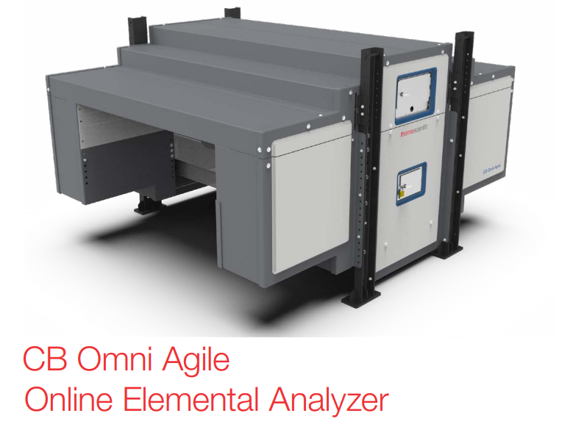
Where we are going
Features:
Isotope OR Neutron Generator for excitation
Modular design
Variable tunnel height based on process
State-of-the-art electronics

Slide 11
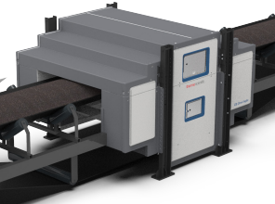
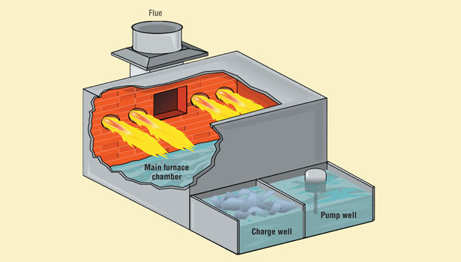
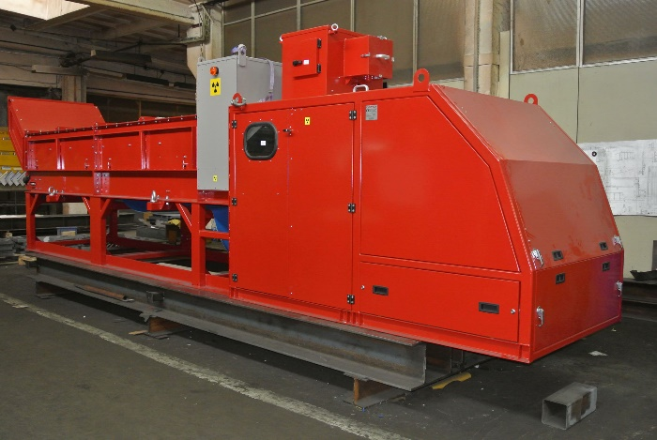


Process and raw materials optimization
Inbound Shred
CB-RM Analyzer
Raw Materials Inventory
Analyzed
In Spec
Furnace
Charge Blending
Raw Materials
RSI
Prime
other
Out of Spec
Re-analyze
Sorter

