Slide 1

Speaking of God
Please organize yourself into groups of about 4 folks
Everyone should be in a group

Slide 2
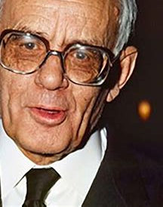
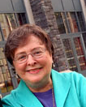
Introducing
Karl Rahner
Profound vision
God as Holy Mystery
Grace
The presence of God in all human experience
Elizabeth Johnson
A Pioneer
Bridges faith and feminism
Rediscovering the Living Mystery of God

Slide 3
From the mouths of babes!

Slide 4
Noah's wife was called Joan of Ark.
Amy, age 9

Slide 5
Lot's wife was
a pillar of salt by day,
but a ball of fire by night.
John, age 10

Slide 6
The seventh Commandment is
Thou shalt not admit adultery.
Hector, age 9

Slide 7
Moses died before he ever reached Canada.
Joshua, age 8

Slide 8
Throughout history,
the Jews have always had trouble
with unruly Genitals.
Brad, age 11

Slide 9
The epistles were the wives
of the apostles.
Dave, age 9

Slide 10
Christians should have only one spouse;
this is called monotony.
Charlene, age 10

Slide 11
Let’s get to work!

Slide 12
Conversations in the Spirit
I will provide you with a prompt
A moment of silence
When I signal you, begin sharing,
One at a time around the circle (it’s okay to pass)
About 1 minute each
Another moment to ponder what we’ve heard
Again, I will signal you
And then a general conversation
Notes to share with us all
Care for anything confidential

Slide 13
A major shift in belief
How we speak of God
Many have given up on the old formula
They don’t know what to believe
What will take the place of these old images of the Holy One?

Slide 14
Wanna see a picture of God?

Slide 15
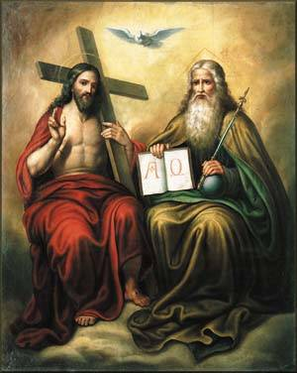
God
is more than
two men
and a bird.
Sandra Schneiders IHM

Slide 16
The vocabulary for God
God is male
…very old
…lives in heaven
He keeps track of offenses against him
We can change God’s mind
& bargain with him
He loves praise
He’s easily offended
He’s the one in charge!

Slide 17
Most importantly
The Father sent his Son to earth
“To die for our sins”
Jesus substituted for us and bore the punishment we deserved
By this death, humanity was reconciled with God
It was a transaction
It’s also only a theory

Slide 18
One woman told me
I just can’t bring myself to praise God for the horrible murder of Jesus

Slide 19
Most of us…
Are beyond these views of God
But many people carry them deep in their hearts
Fear and guilt
Especially for the death of Jesus
Unsure about that Trinity thing
But still praying for favors
Uneasy about God’s apparent silence

Slide 20
A guy at a conference
“I can’t do the God-stuff anymore,” he said.
“I’m done with religion. But...”
(and here’s where it gets interesting)
“...I can’t shake the feeling that something matters,
that there’s more going on.
that beauty and justice and love aren’t just
evolutionary accidents…”

Slide 21
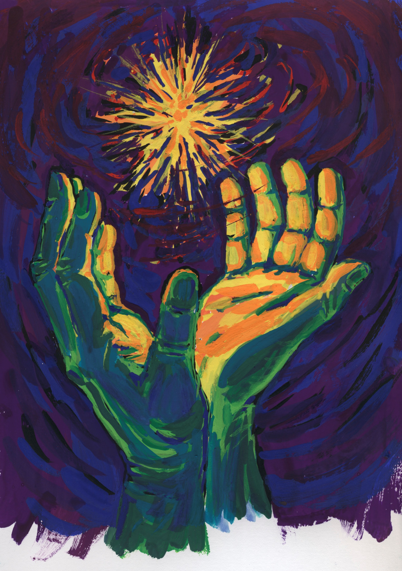
An inner sense
Deep within us
We detect a Presenceㄧ
a summons to love.
We have in our hearts
a truth inscribed by the Holy.
In our hearts we are alone with the Holy One
whose voice echoes
in our depths.

Slide 22
A Conversation
in the Spirit

Slide 23
Conversations in the Spirit
I will provide you with a prompt
A moment of silence
When I signal you, begin sharing,
One at a time around the circle (it’s okay to pass)
About 1 minute each
Another moment to ponder what we’ve heard
Again, I will signal you
And then a general conversation
Notes to share with us all
Care for anything confidential

Slide 24
Conversation
If someone asked you
“Who is God?”
How would you answer?
What is your vocabulary
for The Holy?

Slide 25
Okay, then…
If God isn’t that old guy in the sky
not that angry father,
and not someone to bargain with,
Then how do we describe the Holy?
And how do we pray?

Slide 26
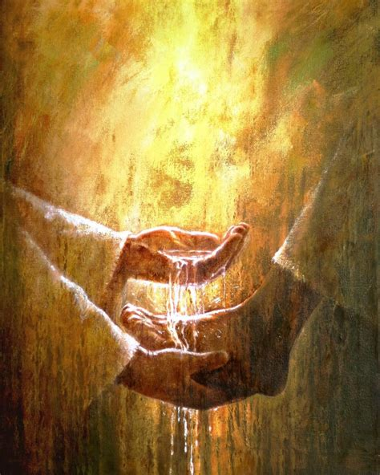
Jesus’ image of God…
from distant
to near at hand
from punishing
to forgiving
from a hidden mystery
to love-made-visible
from seeking praise
to washing feet

Slide 27
How Jesus reveals God to us…
Those parents in Luke 15 waiting at the gate for their son to return
That woman in John 8 who was about to be stoned
Those rambunctious kids in Mark 10
Zacchaeus in Luke 19
Matthew!

Slide 28
These are hints about God
But really,
We don’t know
An epistemology of humility about all things divine and theological
There is a lot of mystery

Slide 29
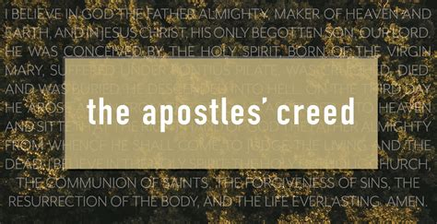

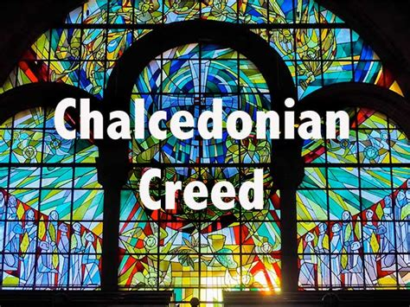
What do we profess about God
in our creeds?

Slide 30
Holy & Gracious Mystery
The Trinity
in Love
Incarnate
& Indwelling

Slide 31
We humbly believe
God is near at hand
The Author of our very being
The Origin and Energy of life
The Anointed and Beloved One
Our Healer, Teacher, & Friend
The Wellspring of Holiness
And Source of all Wisdom

Slide 32
Handout

Slide 33
A Conversation
in the Spirit

Slide 34
Conversation
What is your experience
(not your theological understanding)
of opening your heart
to the Holy One
in sacred conversation (prayer)?

Slide 35
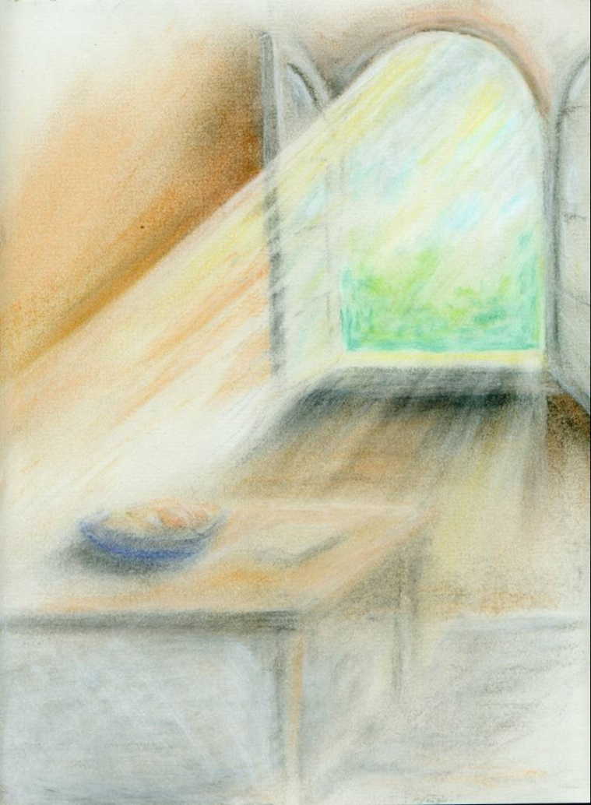
Mystery
A mystery
Not of confusion
Or misunderstanding
But of depth
Holy Mystery
Holy & Gracious Mystery
Mark Hakomaki

Slide 36
Holy Mystery
We can’t express this
We simply don’t have words to describe this great Mystery
But we do have music and poetry
We do have liturgy and worship
We do have that inner voice

Slide 37
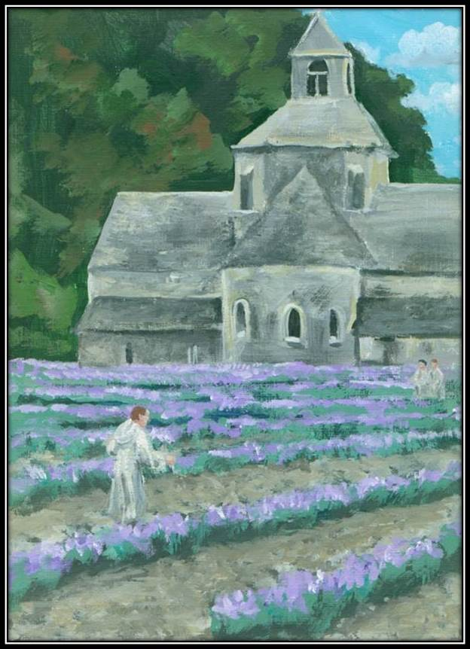
Holy Mystery
O Holy Mystery, vast and deep,
whose secrets endless years do keep,
You breathe through stars, through earth and sea,
and yet you dwell so close to me.
No mind can hold, no words contain,
the boundless love your depths proclaim.
In awe I stand, my heart made new,
lost in the Mystery that is you.
Mark Hakomaki

Slide 38
Holy & Gracious Mystery
In Love
The Author of our very being
The Source of Love
Incarnate
Living among us as friend and teacher
In the faces of the poor
Indwelling
Source of all wisdom and holiness

Slide 39
A Conversation
in the Spirit

Slide 40
Conversation
How does it feel for you to speak of God as Holy Mystery?
Is it too “impersonal?”
Does it make God feel far away
or near at hand?
Can you pray with Holy Mystery?

Slide 41
The $1000 Question
How does God speak to us
in prayer?
How does God answer our prayers?

Slide 42
Prayer
Embedded in the situations of life is a summons,
an inner calling
to respond
and to respond with love
We learn to discern this inner “voice” when it sounds in our hearts

Slide 43
Prayer
Every prayer reveals a vocation
It leads us to see what we must do
And how the Presence of the Holy One
Empowers us to do it!
“We are the ones who are spoken.”
We become a Word for the world.
For example

Slide 44
Prayer
When we’re sick
The weather
War
Immigrants and refugees
The poor
The lonely
Or the fearful

Slide 45
A Conversation
in the Spirit

Slide 46
Conversation
If God is not a person as such
then who’s listening when you pray?
How does God
answer your prayers?

Slide 47
Thank you for these conversations
and for all you do in your ministry

Slide 48

Speaking of God
The new vocabulary with which to speak of the Holy
Rooted in the teachings of Jesus
Leading readers to an encounter with Holy Mystery

Slide 49

Daily Christian Prayer
Morning and Evening
+ Midday Prayer & Compline
In the new vocabulary of Holy Mystery
A blend of
Opening our Hearts daily
Lectio Divina
Ignatian Discernment
Contemplative prayer
& a shortened form of the Breviary

Slide 50

Speaking of Scripture
For the Revised Common & Catholic Lectionaries
In the new vocabulary of Holy Mystery
Easy to present, full homilies for each Sunday and Feast
Original, fresh work
8½ x 11” format
The Word doc is sent with the book to enable editing and printing
Inviting & pastoral with solid theology

